Slide 1


Can photonics & microfluidic cooling save many-core parallel programming from its programming woes?
Uzi Vishkin
Disclaimer: Driven by high impact CS questions. But, neither photonics nor cooling are my fields of expertise.
Notes:
The question mark may be the most informative character in this slide

Slide 2
Many-core computing: state of the art
End of Dennard scaling: while smaller transistors are still possible, they do not necessarily improve performance or energy efficiency
➔* many-core computing with limited bandwidth
Current many-core computers are highly suboptimal*:
  Poor speedups, if any, on communication intensive single-task problems & algorithms, such as typical irregular applications, or large (3D) FFT
  Too difficult to program (code development needs exceptional skill, too much time, and is too costly)
  On every desk; yet, few apps on own dime (unlike smartphones)
Related issues with larger parallel computers: warehouse scale, supercomputers, etc.
Programmer’s productivity is: 1. Important: ~$650M DARPA-HPCS, 2002-11.
2. Challenging: “heroic programmers”…
”… to continue advancing performance .. match parallel hardware with parallel software and ensure .. new software is portable across generations of parallel hardware… Heroic programmers can exploit vast amounts of parallelism... However, none of those developments comes close to the ubiquitous support for programming parallel hardware that is required to ensure that IT’s effect on society over the next two decades will be as stunning as it has been over the last half-century”--Abstract,
* The Future of Computing Performance: Game Over or Next level, NAP 2011
Notes:
The importance of accounting for programming time was recognized by the ~$650M DARPA-HPCS program that ran between 2002 and 2011. However, it did not lead to definite conclusions.

Slide 3
Question How to best exploit for performance the growth in parallelism?
(e.g., from more transistors)
Current bet (all eggs in same basket): SW & architecture alone will do it
Risk: No technology risk, but (large) SW & architecture risk
Jury is still out on how well this bet is working
Proposal: Hedge risk. Invest in technology.
Risk: Technology risk, but minimal SW & architecture risk

Slide 4
What am I after?
Parallel Programming productivity bottlenecks:
  Will present forward looking objective(s) coupled with straw man milestones. Require enabling technologies (photonics, cooling, 3D-VLSI)
  Invite your help in breaking roadmap down to more solid milestones
Case for “pull” from CS algorithms/programming:
  Challenge(s) stand out from CS end. Not otherwise
  Need forward-looking plan with gradual progress. Milestones & investment make sense for CS. Not otherwise
Can “push” by a domain expert suffice? Doubt it:
  One domain expert at a time. But, need integration of several
  Research incentives: intra-discipline
  Scaling ➔ monolithic fabrication. $$$! Harder to justify Investment
In short: crossing the technology “valley of death” with a compass
Notes:
Think about CS as the customer: intellectually, as well as materially
I know what I know and what I don’t. Cannot move forward without domain experts.

Slide 5
State of the art (cont’d)
Following four decades of parallel computing best theory solutions for broad speedups, strong scaling and programming
  require data movement (DM), and
  do not have satisfactory alternatives

Slide 6

State of the art (cont’d 2)
Following four decades of parallel computing best theory solutions for broad speedups, strong scaling and programming
  require data movement, and
  do not have satisfactory alternatives
NAE’2011 Game Over: abandon these solutions!
  Concerns thermal behavior.
  Main limitation data movement
  Conclusion Dump at least some on the
  programmer ➔ suboptimal many-cores
  Even poorer: 1. programmers. 2. speedups.

Slide 7

State of the art (cont’d 3)
Following four decades of parallel computing best theory solutions for broad speedups, strong scaling and programming
  require data movement, and
  do not have satisfactory alternatives
NAE’2011 Game Over: abandon these solutions!
  Concerns thermal behavior.
  Main limitation data movement
  Conclusion Dump at least some on the
  programmer ➔ suboptimal many-cores
  Even poorer: 1. programmers. 2. speedups
  CS researchers can be happy. From left ☺:
  algorithms, programming, compiler, architecture
Example: “Lack of progress in technology scaling will necessarily place more demands on the computer architecture and software layers to deliver capability”, from abstract for Addressing the Computing Technology-Capability Gap: The Coming Golden Age of Design, … , keynote in several 2015 conferences
Easiest to join the party. Never need to embarrass myself talking about areas I have not mastered. Cannot be honest with myself if I do that. I have a hammer, but this is not a nail
Notes:
Even if you have the best hammer in the world, but you need to glue two boards, the hammer cannot do it.

Slide 8
A personal angle
1980 Premise Parallel algorithms technology (yet to be developed in 1980) would be crucial for any effective approach to high end computing systems
  Competing with build-first figure-out-to-program-later, by leading architects
1996 ACM Fellow citation One of the pioneers of parallel algorithms research, Dr. Vishkin's seminal contributions played a leading role in forming and shaping what thinking in parallel has come to mean in the fundamental theory of Computer Science
2007 Commitment to silicon Explicit multi-threading (XMT) stack
  Overcame architects’ claim (1993 LogP paper): parallel algorithms technology too theoretical to ever be implemented in practice
  Since 2007
  2 OoM speedups on apps
  Successes in programmer’s productivity: DARPA HPCS study. UMD/UIUC comparison. 420 TJ-HS students. ~200 grads/undergrads solve otherwise research problems in 6X 2-week class projects
  2011 Game-Over report What I find confusing:
    - Humans-in-the-service-of-technology. Should be the opposite
    - “Against history”: Does it have a future?
    - Isn’t the right goal to alleviate DM so that we can refocus on best solutions?
    - Leave the programmer out of it: a technical problem requires a technical solution
    - Game-Over not even mentioning: microfluidic cooling and photonics
Notes:
OoM – orders of magnitude
IMHO Industry and NAE together cannot compete with “history” in the long term

Slide 9
Serial Abstraction & A Parallel Counterpart
Serial abstraction: any single instruction available for execution in a serial program executes immediately – ”Immediate Serial Execution (ISE)”
Abstraction for making parallel computing simple: indefinitely many instructions, which are available for concurrent execution, execute immediately, dubbed Immediate Concurrent Execution (ICE) – same as ‘parallel algorithmic thinking (PAT)’ for PRAM
See V-CACM-2011
Serial Execution, Based on Serial Abstraction
What could I do in parallel at each step assuming unlimited hardware
➔
Parallel Execution, Based on Parallel Abstraction
#
ops
.
.
#
ops
.
.
.
.
..
..
..
..
time
time
Time = Work
Work = total #ops
Time << Work
Notes:
Serial--Abstracts away: different execution time for operation (memory hierarchy). Made serial programming simple. Programmers: conceptualize. HW and compilers: implement. Program: instruction to execute next (inductively)
Parallel--Step-by-step (inductive) explication of the instructions available next for concurrent execution. # processors not even mentioned. Falls back on the serial abstraction if 1 instruction/step

Slide 10
2015 Proposal
Objective Overcome doom-and-gloom over DM, to the point of being limited by other constraints. Namely, establish that DM is no longer a feasibility constraint even if this comes at some cost
Break down into “evolutionary” premises/stages:
1. Feasible to build 1st generations of (power-inefficient) designs for which data movement is not a restriction. Begin appSW development;
2. Progress in silicon compatible photonics may allow reduction of power by orders of magnitude… but where will the $$$ come from?
3. Successful appSW [speed, demonstrated ease of programming and growing adoption by customers, SW vendors and programmers] ➔ incentivize (HW vendor) investment in generations of more power efficient appSW-compatible designs. New ``software spiral'' (A. Grove, former Intel CEO);
4. microfluidic cooling for: (i) item 1 and (ii) midwifing overall vision
Legend Partial demonstration in CATG, Intel Haifa 2015 paper

Slide 11
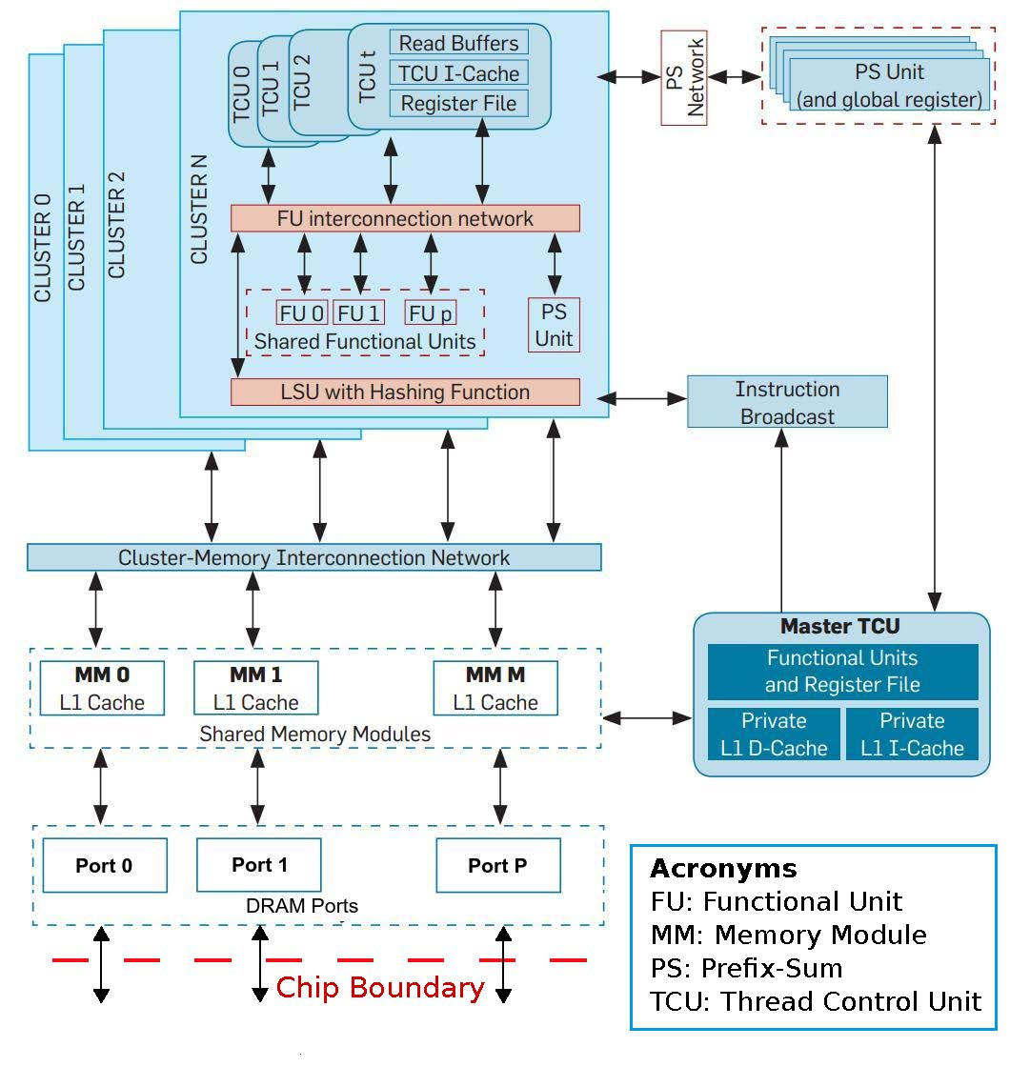
XMT as a test case:
Block diagram of the XMT processor

Slide 12
Remainder of this presentation
Paper Put stake in the ground ➔ publishable results + vision:
3D-VLSI+cooling for scaling silicon area and reducing distances
the ICN part (switching and on-chip DM)
connect the ICN to on-chip processors/memories
2015 proposal (above)
Need to nail down:
How to connect ICN to off-chip memories (and to off-chip processors, if desired)
Scaling/other photonics challenges
Wild card Specs of Intel/Micron 3D Xpoint (solid state) memories: granularity, etc.

Slide 13
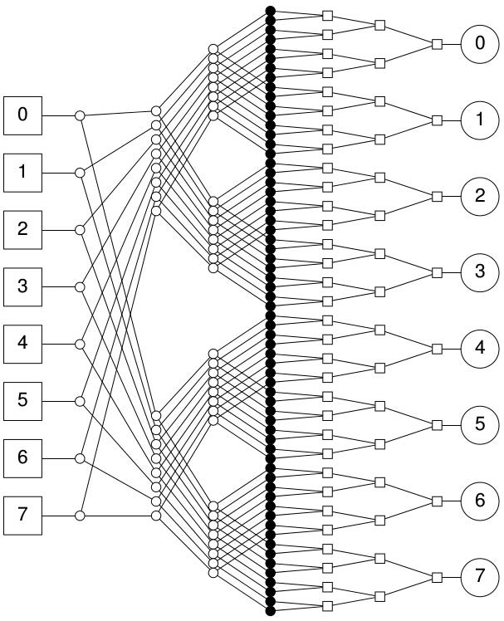
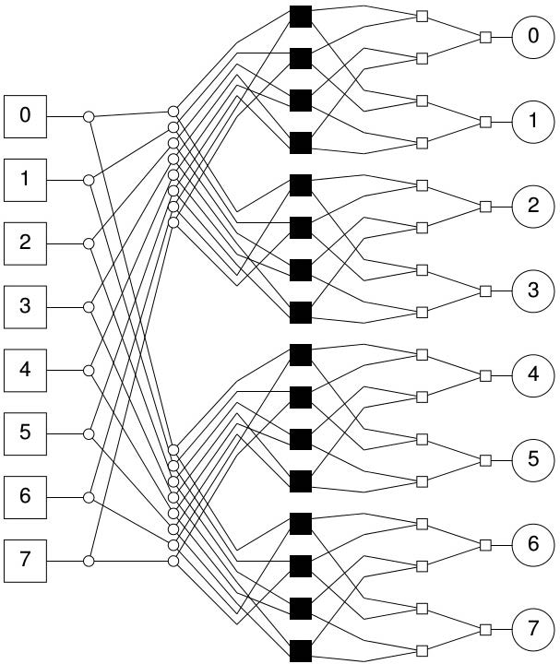
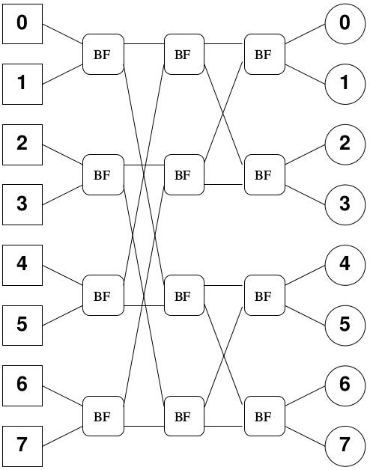
Hybrid ICN: Mesh of trees + Butterfly
Middle layer
n²
versus
~n
+
=

Slide 14
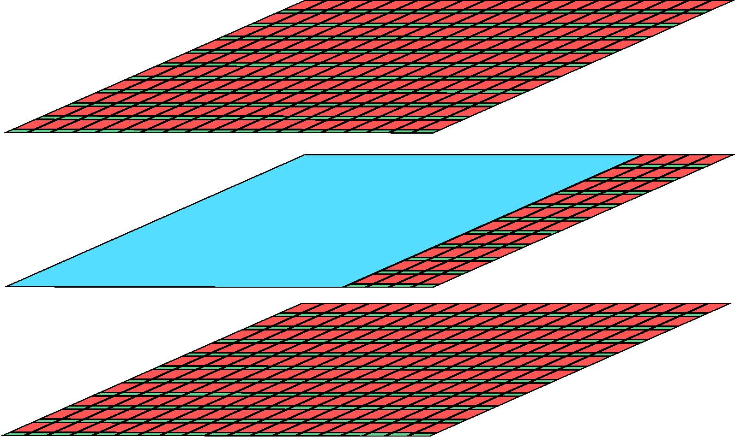
Starting with what we figured out.
Schematic Floorplan for active silicon layers
Red blocks - TCU clusters. Green blocks - memory modules. Blue block - the ICN.
Main points of this slide: ICN is confined to one layer. It is a middle layer. Can share with other functions. Memory ports in external layer.

Slide 15
Cross-section view of uncooled vs cooled 3D IC stack
W/mK – Watt Per meter Kelvin
Thermal conductivity measure
Bigger picture
20 mm wide chip ➔
100 fluid microchannels/layer
100 µm wide, 100 µm apart
For our largest configuration Pump supplying 200 kPa head at 1 L/min. Commercial product*: under 16cm long
*Also: Datasheet for pump meeting specs Drawn ~1.5W. Fits in 3x3x3 inch³ cube. Additional: mounting piece.
*Figure are not to scale
Notes:
Cooling can be filtered open-tap water. Other options : active cooling.

Slide 16
XMT architecture and physical configuration
#TCUS | ~8k | ~16K | ~32k | ~64k
Clusters | 256 | 512 | 1024 | 2048
Mem. Modules | 256 | 512 | 1024 | 2048
MoT levels | 16 | 12 | 10 | 8
Butterfly levels | 0 | 3 | 5 | 7
TCUs/cluster | 32 | 32 | 32 | 32
Physical configuration 22nm
Silicon layers | 2 | 3 | 5 | 8
Microchannel layers | 1 | 2 | 4 | 7
Silicon area per layer (mm²) | 276 | 302 | 328 | 380
Total silicon area (mm²) | 551 | 906 | 1641 | 3046

Slide 17
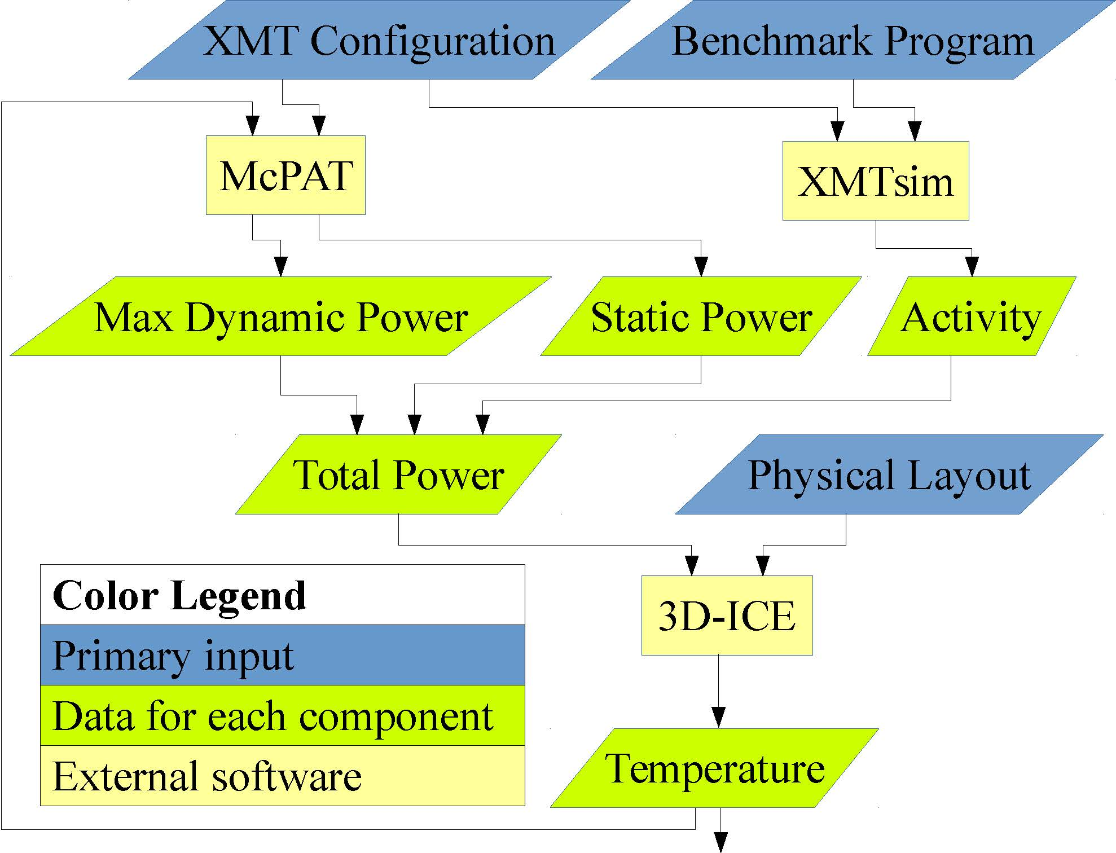
Experimental methodology
XMTsim – Cycle accurate simulator of XMT
McPAT – Used to model power
3D-ICE – Thermal modeling simulator for 3D Ics with micfroluidic channels

Slide 18
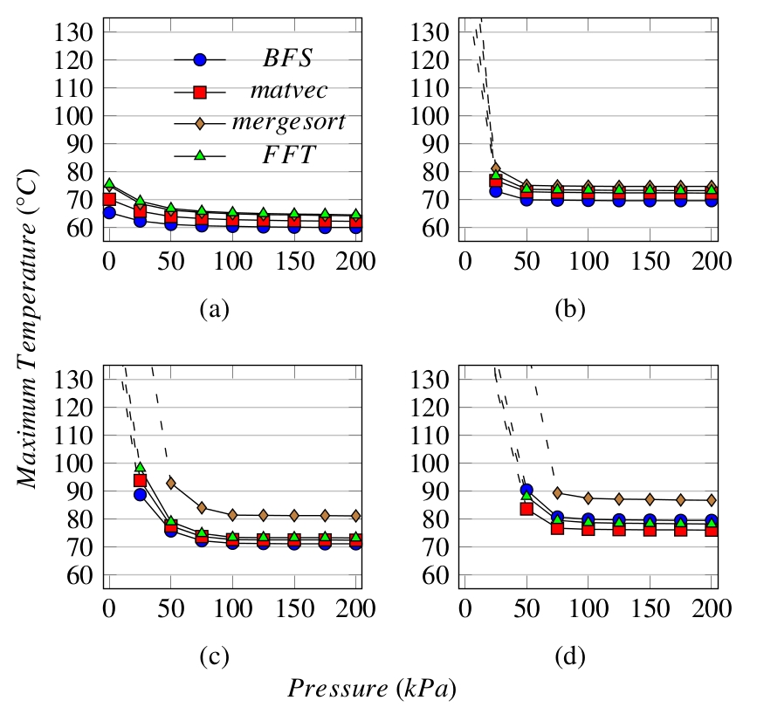
Results: Max temperature/benchmarks
8k TCUs
16k TCUs
- Dotted lines: above 127⁰C
(beyond McPAT modeling)
- Pressure drop of 0 kPa (zero kilo Pascal): air-cooling, but no microfluidic cooling
- 125⁰C is upper limit in military specs
- Air cooling only: ≥16k TCUs are out for all benchmarks
32k TCUs
64k TCUs

Slide 19
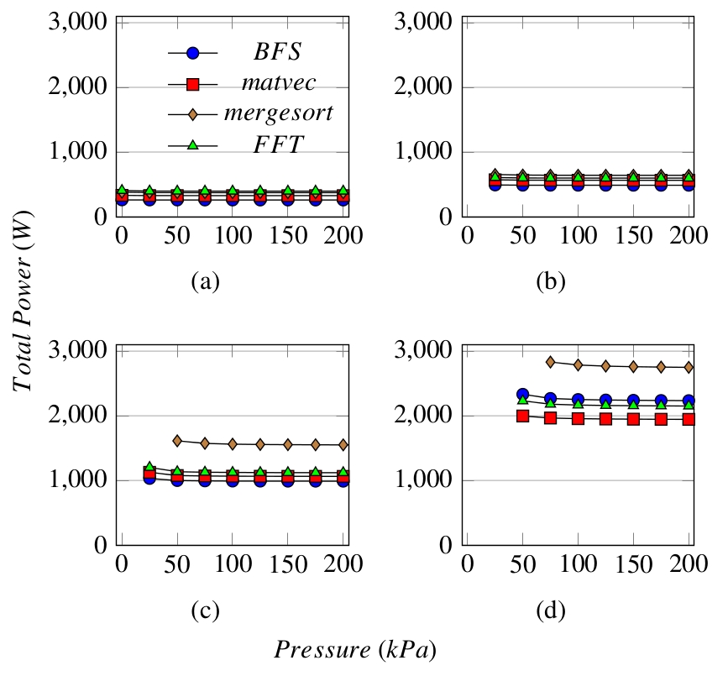
Results: Max power dissipated/benchmark
8k TCUs
16k TCUs
Shown: only when under 127⁰C
32k TCUs
64k TCUs

Slide 20
Other results and discussion
- Win-win on power: Reduction in leakage power exceeds pumping power
- Are these results relevant only for XMT?
Answer No, these are robust results. XMT has only one disproportionate component, its ICN. Now:
Power consumption of XMT ICN is ≤ 18% of total for ≥16k TCUs and decreasing
Area - similar figures and trend

Slide 21
3D Fast Fourier Transform (FFT) on XMT
[Edwards,V, submitted]
3D VLSI, MFC, and photonics enable XMT to outperform a much larger supercomputer (Edison) on 3D FFT
XMT speedups vs. best serial (FFTW):
  With enabling technologies (128k TCUs): 2,494X (19.0 TFLOPS)
  Without enabling technologies (8k TCUs): 31X (0.24 TFLOPS)
Comparison of Edison machine (Cray XC30) to XMT
 | XMT (128k x4) | Edison (Cray XC30) | Factor
# processing elements | 131,072 TCUs | 124,608 cores
# processor groups | 4,096 clusters | 5,192 nodes
Total cache memory | 128 MB | 311,520 MB | 2433
# chips | 1 | 10,384 CPU + 1,298 router | 11682
Total silicon area (process) | 35.4 cm² (14 nm) | 56,177 cm² (22 nm) + 4,072 cm² (40 nm)
Normalized silicon area (22 nm) | 66 cm² | 57,409 cm² | 871
Peak power consumption | 7.0 KW | 2,500 KW | 357
Peak teraFLOPS | 54 | 2,390 | 44
TeraFLOPS for FFT (size) | 19.0 (512³) | 13.6 (1024³) | /1.4
% of peak FLOPS | 35% | 0.57% | /61

Slide 22
More CS context
Flat memory – Ideal abstraction for parallel algorithms/programming
Extra speedups by 1 OoM
Extra scaling by 2 OoM
Per above FFT result: Enable 128K (XMT) cores using flat memory

Slide 23
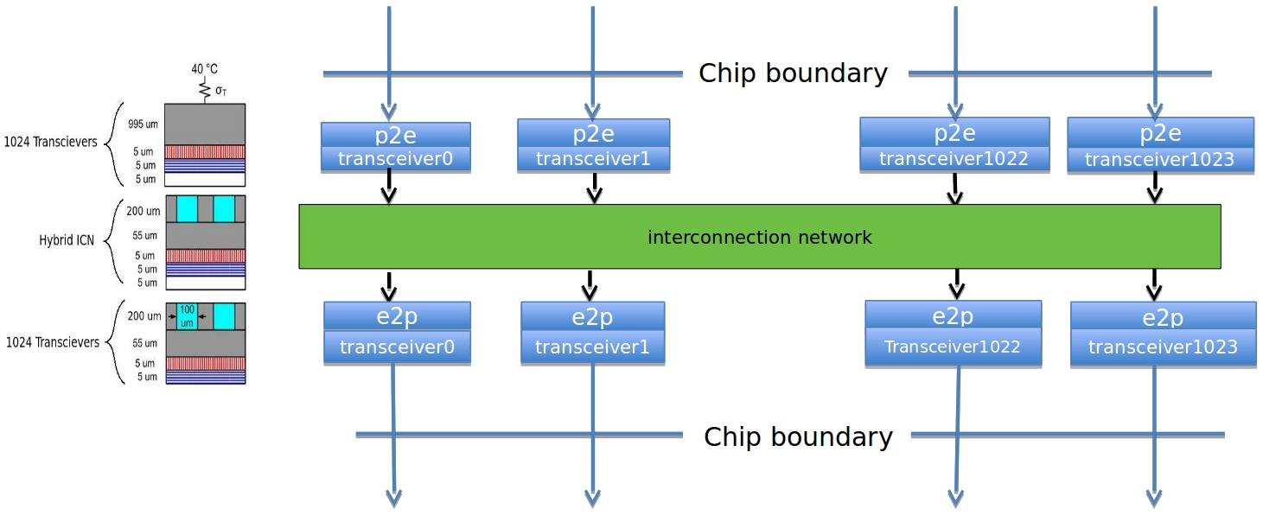
Lead example: Concept of a switch through integration of 3D-VLSI, microfluidic cooling and photonics
Interconnection network: X inputs, X outputs (shown X=1,024). All-to-all switch: source nodes of inputs same as destination nodes of outputs. 3 layers of a 3D stack shown. Each transceiver block either converts electronics to photonics (e2p), or vice versa (p2e). Microfluidic cooling of the two bottom layers is shown. Middle (ICN) layer is particularly challenging to cool otherwise.
Notes:
Simpler application than a parallel computer. Equal exchange with current component(s); hence, easier to adopt by the market. However, similar technical issues.

Slide 24
Experiments with simulators (ANSYS)
Seek partition of the surface of the chip into a grid of as many silicon substrates as possible so that each substrate can transmit 25Gbps. Demonstrated: current/near future pJ/b rates and MFC ➔ a substrate of 50X50X50µm³ can be cooled by MFC, while 30X30X50µm³ will get too hot.
50X50µm² allows 400 substrates per mm² or 160K per area of 20X20mm². This back-of-the envelope calculation suggests potential for off-chip bandwidth of 4Pb/s (=500TB/s) if a monolithic layer (in a 3D-VLSI stack) with these features is built.
Top, or bottom view
Photonic link from every cell
But, what next?...

Slide 25
But, what next?...
Need help to sort out many approaches&tradeoffs to silicon photonics.
Example Dupruis et al 2015, integrate III-V material with CMOS circuits, for a 30-Gb/s optical link. Nice silicon area and pJ/b for Rx and Tx.
Even I can tell: they allow long distance (10km), but we need far less ☺
But, how to navigate among different possibilities and developing them?
Example How "monolithic" can integration be?
To what extent can electronics and photonics (1) share the same wafer improving density and lowering parasitic effects, versus (2) be fabricated on different platforms that favor each better; then brought together, e.g., by short wire bonds and flip chip
Example on-chip modulator: micro-ring resonator. Cooling (+heating) can keep temperature under control

Slide 26
Some comments & comparison(?)
For a 64b(=8B) architecture and 3GHz processors, around 20K words (of 8B each) can be transmitted per clock.
Different objectives (e.g., packet sizes, longer distance), but it appears that top-of-the-line 130Tb/s Mellanox switch would allow transmission of around 650 words per clock. The larger substrate volume option also enables replacing a single 25Gb/s structure by several (e.g., three 8.3Gb/s) structures, which is likely to be cheaper, as these structures are simpler.

Slide 27
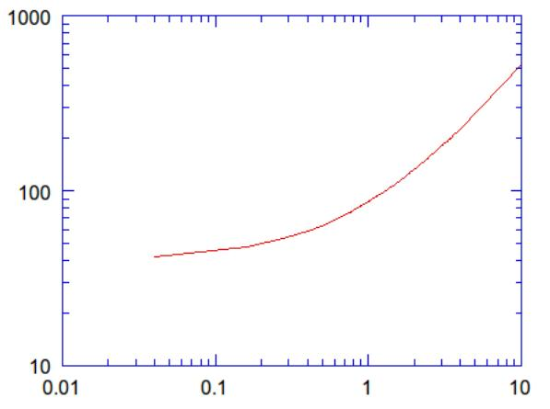
Temperature reached by 25Gbps photonic device. Range: assumed power usage
Celsius
pJpb (at 25Gbps)
Assumption: substrate of 50X50X50µm³ comprises the photonic device. Standard, high thermal conductivity connects transceiver to microfluidic channel. Finding: If transceiver under 1.1 pJ/b, temperature will remain under 100 C

Slide 28
More than one problem domain
For clarity, I chose to leave you with the above simply-stated example.
Surface of chip partitioned into 160K squares, 50X50µm² each. Each supports 25Gb/s photonic-based links.
Domain 1: The links extend 30-100 cm. (already significant: 16K links, 25 Gb/s each)
Domain 2: The switch serves a computer in a room which is 10m by 10m.
Notes:
The all electronic ICN will have ~16K inputs and the same number of outputs since groups of 64+ bits will always travel together.

Slide 29
Proposal from 30,000 feet
Imagine a large city with (the usual) traffic problems
Option 1: Limit investment to roads (and buses)
Option 2: More costly construction of some subway/train system components
One consideration: Impact on labor with subway vs w/o.
  (a) Time at work relative to time away from home
  (b) Pool of workers (how many commute from afar)
Analogy: performance programming problems of today’s computers
Option 1: Limit to architecture and SW layers, or also
Option 2: Invest in technology to allow new capabilities (data movement)
Impact on programmers
  (a) How much time to complete a job for those who can do it?
  (b) How many can do it? And does it make good use of talent?
  How many SW applications/firms can afford?
  Would performance programmers be overqualified?

Slide 30
Why should government care?
Manufacturing
Productivity
Promote U.S. innovation and industrial competitiveness of the IT sector
Note:
Competition lost some steam due to fewer competitors among hardware vendors. But:
If case that the technology is within 3 years from industry-grade switch can be made, couple large (traditionally SW) companies will likely be willing to invest $~100M

Slide 31
Some Random Applications
The fact that at issue is general-purpose computing and programmer’s productivity does not mean that this is less relevant for applications than other approaches
Bio, precision medicine
Machine learning, big data
SW&HW formal verification
Numerical simulations to study instabilities (in liquids, gases and plasmas). Perhaps, could turn around fortune of LLNL ICF $5B fusion facility
Quantum effects defy locality
Scaling graph algorithms
Large FFT (noted before)
DOE on a mission to “reinvent Physics” for communication avoidance. Instead match computing to classic Physics.

Slide 32
Summary
I believe that:
To get (many-core) parallelism to where it should be (in terms of performance, ease of programming and broad applications), we will need to go all the way to “enabling technologies”
This will require a truly multi-disciplinary effort
Government needs to reduce the risks involved to enable commercialization
Horizon of current ideas: ~1M TCUs

Slide 33
References
U. Vishkin. Using simple abstraction to reinvent computing for parallelism. Communications of the ACM 54,1 (2011), 75-85. [Over 15K downloads]
S. O'Brien, U, Vishkin, J. Edwards, E. Waks and B. Yang. Can Cooling Technology Save Many-Core Parallel Programming from Its Programming Woes? In Proc. Compiler, Architecture and Tools Conference (CATC), Intel Development Center, Haifa, Israel, Nov 2015. http://drum.lib.umd.edu/handle/1903/17153
U. Vishkin. Is Multi-Core Hardware for General-Purpose Parallel Processing Broken? Viewpoint article. Communications of the ACM 57,4 (2014), 35-39.

Slide 34
Alt. Summary How to best exploit for performance the growth in parallelism? e.g., from more transistors
Thesis To get (many-core) parallelism to where it should be (performance, ease of programming, apps), we need to go all the way to “enabling technologies”
Current bet: Application and system SW as well as architecture will do it. All eggs have been in this basket. But, jury is still out on how well this bet can work
Proposal: Invest in enabling technologies. Horizon of current ideas: ~1M TCUs
Risk levels | Current bet | Proposal
Enabling Technology | Low | High
SW & Architecture | High | Low
  Presented forward looking objectives. Milestones need: refinement, money & time. Good news: No feasibility problem!
  Upshot Assess $$$: 1. Enabling technologies, versus 2. Gain from improved speedups, productivity, apps, deployment, competitive advantage.
  I expect 2>>1.

Slide 35
Case Studies contrasting poor speedups of multi-core CPUs and GPUs with the UMD XMT
 | XMT | GPU/CPU | factor
Graph Biconnectivity | 33X | 4X random graphs Muuuch parallelism | >>8
Graph Triconnectivity | 129X | Only serial result | 129
Max Flow | 108X | 2.5X | 43
Burrows Wheeler Compression Transform - bzip2 Decompression | 25X 13X | X/2.8 … on GPU 1.1 | 70 11
- On XMT the connectivity and max-flow algorithms did not require algorithmic creativity. But, on other platforms, biconnectivity and max-flow required significant creativity
- BWT is 1st “truly parallel” speedup for lossless data compression. Beats Google Snappy (message passing within warehouse scale computers)
Later: new results on scaling and speedups for 8-64K TCUs; e.g., preliminary results of > 150X over GPU for 2D-FFT
Notes:
Quote from Abstract of the Game over report:
The only foreseeable way to continue advancing performance is to match parallel hardware with parallel software and ensure that the new software is portable across generations of parallel hardware. There has been genuine progress on the software front in specific fields, such as some scientific applications and commercial searching and transactional applications. Heroic programmers can exploit vast amounts of parallelism, domain-specific languages flourish, and powerful abstractions hide complexity. However, none of those developments comes close to the ubiquitous support for programming parallel hardware that is required to ensure that IT’s effect on society over the next two decades will be as stunning as it has been over the last half-century.
Teaching experiment favoring Intel SMP in a joint UIUC/UMD class with 42 students. Codes breadth-first-search (BFS) on graphs using OpenMP on an Intel SMP machine and XMTC. While same effort, no student got any speedups on the SMP machine, while range of XMT speedups was 7X to 25X.
Teaching experiment. Application: MATVEC, by DARPA-HPCS funded Hochstein-Basili. UCSB: MPI. UMD: XMTC. Finding (in journal paper): XMTC needed 50% development time of MPI.

Slide 36
Immediate Concurrent Execution (ICE) Programming
[Ghanim, Barua, V, submitted]
PRAM algorithm and its ICE program
PRAM: main model for theory of parallel algorithm
  Strong speedups for irregular parallel algorithms
ICE: Follows the lock-step execution model
  Parallelism direct from PRAM algorithmic model
  An extension of the C language
    New keyword ‘pardo’ (Parallel Do)
New work: Translate ICE programs into XMTC (& run on XMT)
  Lock-step model → Threaded Model
Motivation: Ease-of-programming of parallel algorithms
Question: but at what performance slowdown?
Perhaps surprising answer: Comparable runtime to XMTC
  average 0.7% speedup(!) on eleven-benchmarks suite
pardo (unsigned i = 0; n – 1; 1) {
 | while (S[i] != S[S[i]]) {
 |  | W[i] = W[i] + W[S[i]];
 |  | S[i] = S[S[i]];
 | }
}
 | Integer Sort | Sample Sort | Merge Sort | Graph Connectivity | Breadth First Search | Maximum Finding | Tree Contraction | Tree Rooting | Jacobi | LU Factorization | Cholesky Factorization
Normalized to XMTC | 100.00% | 98.54% | 102.07% | 98.55% | 108.42% | 104.78% | 100.61% | 97.42% | 100.99% | 98.39% | 98.66%
ICE slowdown | 0.002% | 1.457% | -2.070% | 1.453% | -8.424% | -4.780% | -0.610% | 2.584% | -0.985% | 1.605% | 1.338%

