Slide 1
Slide Sources: CLRS “Intro. To Algorithms” book website
(copyright McGraw Hill)
adapted and supplemented
Ch. 8: Sorting in Linear Time

Slide 2
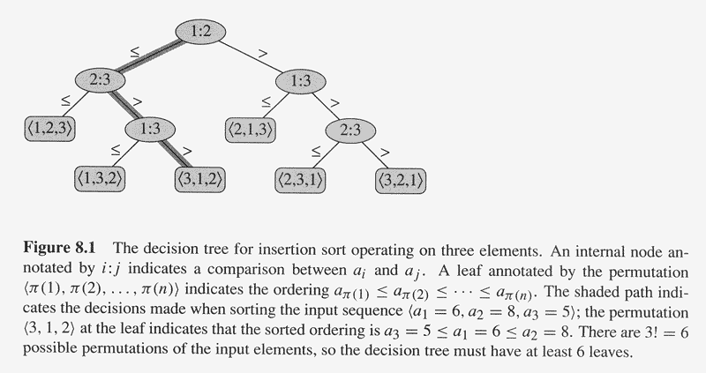
Theorem 8.1: Any comparison sort algorithm requires Ω(nlog n) comparisons in the worst case.
Proof: The decision tree must have n! leaves, one corresponding to each possible output. Moreover, the branching-factor of the tree is two, i.e., the tree is binary, because each comparison gives one of two results.
The height of the decision tree is the number of comparisons made in the worst case.
What then is the minimum possible height of a binary tree with n! leaves?

Slide 3
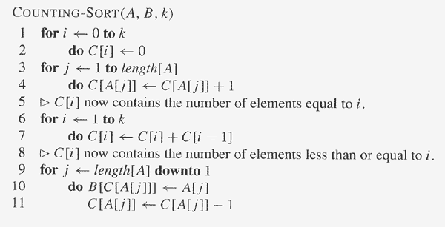
COUNTING-SORT assumes that each of the input elements is an integer in the range 0 to k, inclusive.

Slide 4
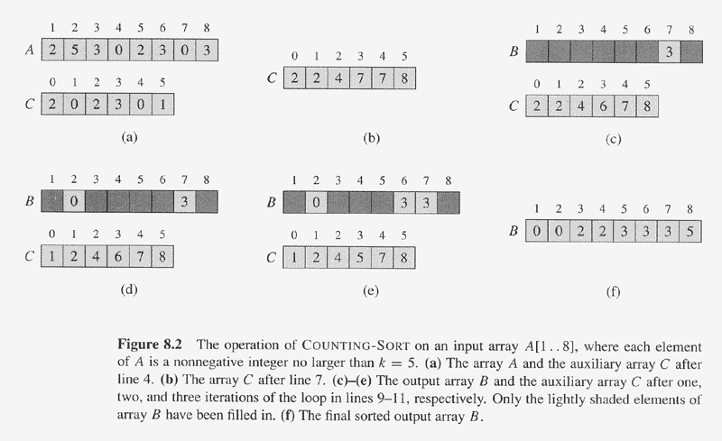
The running time of COUNTING-SORT is Θ(k+n) (why?), which is Θ(n) if k is
of the same order as n.
Intuitively, explain why COUNTING-SORT can beat the lower bound of Ω(nlog n)
for comparison sorts. Doesn’t it do comparisons as well…!?

Slide 5
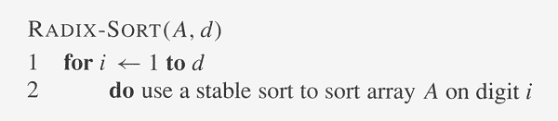
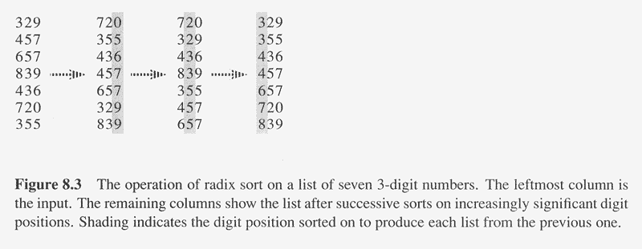
A stable sort is one where items with the same value appear in the
same order in the output as they appear in the input.
Lemma 8.3: Given n d-digit numbers in which each digit can take up to k possible
Values, RADIX-SORT correctly sorts these numbers in Θ(d(n+k)) time.
Proof: COUNTING-SORT on each column * no. of columns (ques: is COUNTING-SORT
stable?!!).

Slide 6
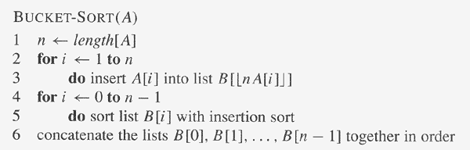
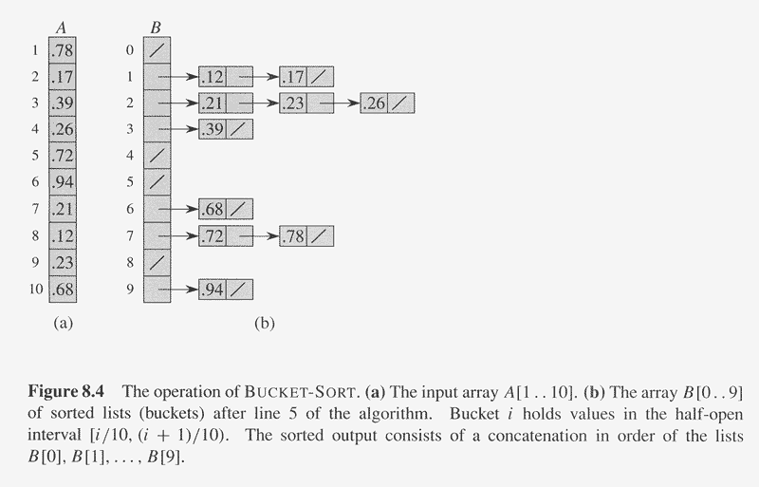
BUCKET-SORT assumes that each of the
input elements is a real number in the
half-open interval [0, 1).

Slide 7
Analysis of BUCKET-SORT
The running time is
T(n) = Θ(n) + ∑_{i=0..n-1} O(n_{i}²)
where n_{i} is the random variable representing the number of
elements in bucket B[i], because insertion sort is quadratic-time.
Therefore,
E[T(n)] = Θ(n) + ∑_{i=0..n-1} O(E[n_{i}²])
Claim:
E[n_{i}²] = 2 – 1/n
If the claim is proved:
E[T(n)] = Θ(n) + ∑_{i=0..n-1} O(2 – 1/n)
= Θ(n) + n * O(2 – 1/n)
= Θ(n)

Slide 8
To prove the claim E[n_{i}²] = 2 – 1/n, let the indicator variable
X_{ij} = I{A[j] falls in bucket i}
for i = 0, …, n-1 and j = 1, 2, …, n.
Therefore, n_{i} = ∑_{j=1..n} X_{ij} and
E[n_{i}²] = E[ (∑_{j=1..n} X_{ij})² ]
= ∑_{j=1..n} E[X_{ij}²] + ∑_{j=1..n} ∑_{k=1..n & k≠j} E[X_{ij} X_{ik}]
Now, X_{ij} is 1 with probability 1/n and 0 with probability 1 – 1/n.
Therefore,
E[X_{ij}²] = 1² * 1/n + 0² * (1 – 1/n) = 1/n
When k ≠ j, X_{ij} and X_{ik} and independent, so
E[X_{ij} X_{ik}] = E[X_{ij}] * E[X_{ik}] = 1/n * 1/n = 1/n²
Substituting:
E[n_{i}²] = ∑_{j=1..n} 1/n + ∑_{j=1..n} ∑_{k=1..n & k≠j} 1/n²
= n * 1/n + n(n-1) 1/n²
= 2 – 1/n

