Slide 1
Ch. 6: Heapsort
Idea: Insertion sort using repeated binary search (to an array)
Does’t work: Following such insertion not an array
Can think about Heapsort as overcoming this problem
n nodes.
Heap -- Nearly binary tree of these n nodes (not just leaves)
Heap property
If max-heap, the max-heap property is that for every node i:
A[parent(i)] >= A[i]

Slide 2
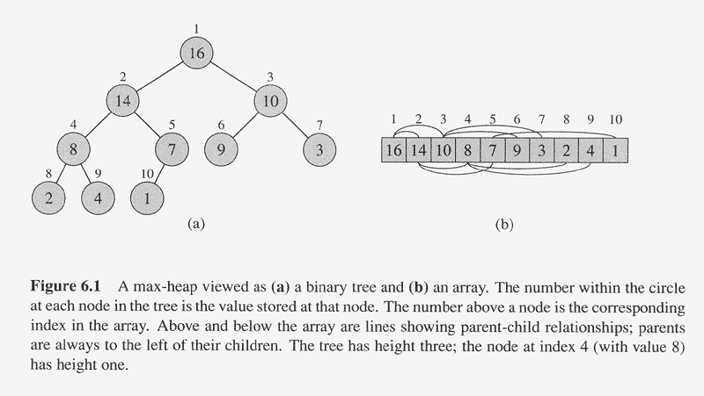
Parent(i)
return floor(i/2)
Left(i)
return 2i
Right(i)
return 2i+1

Slide 3
Maintaining a heap
Assume a max-heap
Suppose the value of one node was modified to a smaller value.
Max-Heapify will update the max-heap to reflect the chage

Slide 4
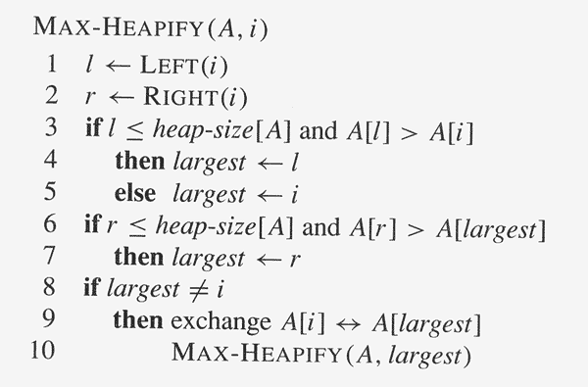

Slide 5
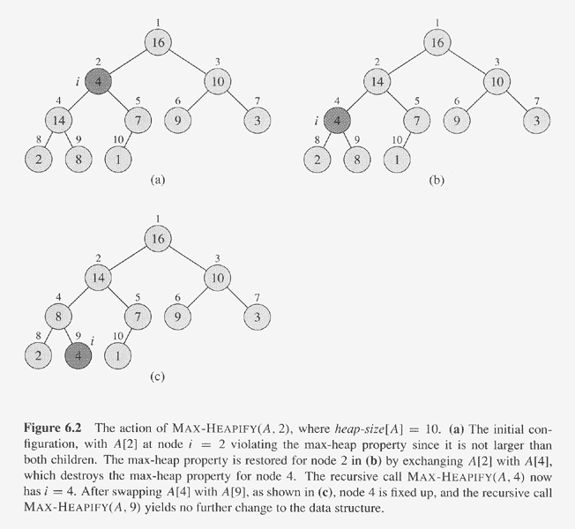
Item percolates down to
its correct position.
Running time of MAX-HEAPIFY on a node at height h is Θ(h).

Slide 6
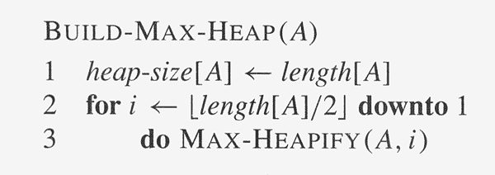
Given any array A, build a max-heap for its values
Converts an unorganized array A into a max-heap.

Slide 7
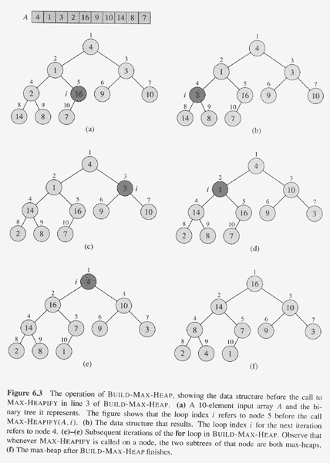
The running time of
BUILD-MAX-HEAP is
linear. Why?
Observe that MAX-HEAPIFY
is called on each node of
height ≥ 1.
How many nodes are there of :
Height 0: n/2 but 0 work
Height 1: n/4, work of 1
height h: n/2^{h+1}, work of h
Total work:
0 n/2 + 1 n/4 + .. h n/2^{h+1} ..
n(1/4 + 2/8 + 3/16 + 4/32)
Formula in text upper bounds by 2. Should be clear how to upper bound by a geometric sum.

Slide 8
Amortized analysis
We show that the total number of operations of BUILD MAX HEAP is O(n).
Each time a call of the Heapify primitive is started we charge the node at which the call is initiated (not the node at which the basic step is applied) $1 (one Dollar). We put initially $2 at each of the <= n/2 non­leaf nodes of the tree.
Inductive step: assume that upon completing a Heapify at a node of height h, a total of $h remains at that node. Its parent will inherit therefore a total of $2h from its two children and add to it its own $2 for a total of $2h + 2. Applying Heapify to the parent requires at most h + 1 basic steps. Therefore, at least $h+1 of the $2h+2 would remain(and could be later forwarded to the parent of that parent).
Why does the proof follow?

Slide 9
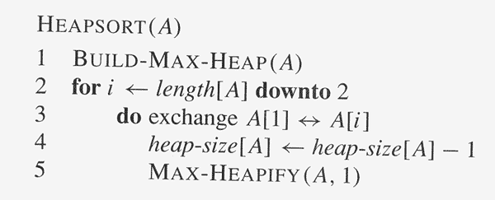
Heap Sort

Slide 10
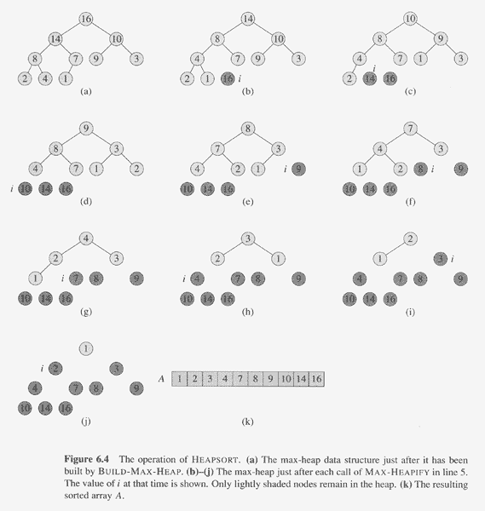
Running HEAPSORT on
an in initial array A =
[9, 1, 3, 14, 10, 2, 8, 16, 7, 4]
Show the array after
BUILD-MAX-HEAP and
successive iterations
of the HEAPSORT
procedure.
The running time of
HEAPSORT is Θ(nlog n).
Why?

Slide 11
Priority Queue Procedures
A priority queue is a data structure for maintaining a set S of elements, each with an associated value called its key. A max-priority queue supports the following operations:
  MAXIMUM(S) returns the element of S with the largest key.
  EXTRACT-MAX(S) removes the element of S with the largest key.
  INCREASE-KEY(S, x, k) increases the value of element x’s key to the new value k, which is assumed to be at least as large as x’s current value.
  INSERT(S, x) inserts the element x in the set S.
  Application Need to schedule the next available job whose priority is the highest:
  Retrieve the job from the priority queue, and possibly remove it.
  Update priorities
  Add job.

Slide 12
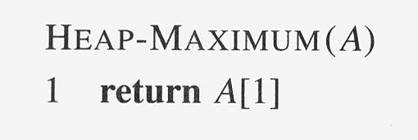
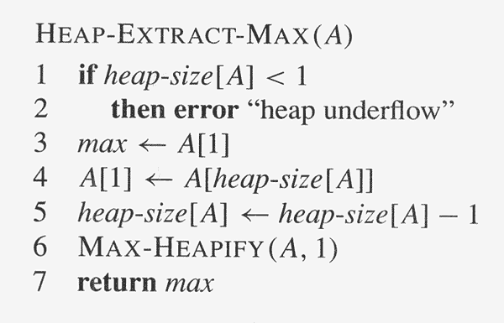

Slide 13
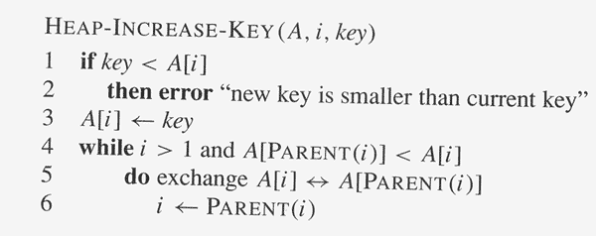

Slide 14
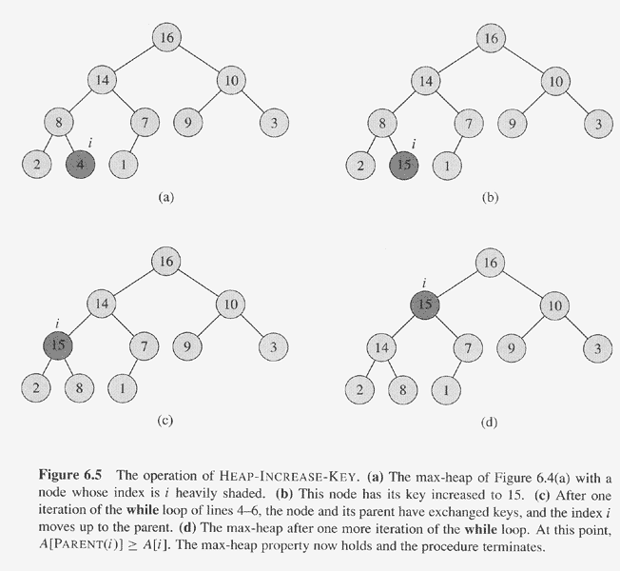

Slide 15
