Slide 1
Introduction to Algorithms Second Edition by
Cormen, Leiserson, Rivest & Stein
Chapter 35: Approximation Algorithms

Slide 2
A problem is NP-complete: what next?
Abandoning it: often not an option.
Textbook notes 3 options.
If input is small, exponential time algorithms may be sufficient.
Sometimes special cases that matter in practice can be solved in polynomial time. Example: Vertex cover on trees.
Sometimes ‘near-optimal’ solutions (in the worst, or average case) that are good enough in practice can be found in polynomial time ➔ ‘approximation algorithms’.
An approximation algorithm A for an optimization problem has approximation ratio RO(n) if for any input of size n, the cost C of the solution of A is within a factor of RO(n) of the cost C* of an optimal solution: Max( C/C*, C*/C) <= RO(n) ➔
A is a RO(n)-approximation algorithm

Slide 3
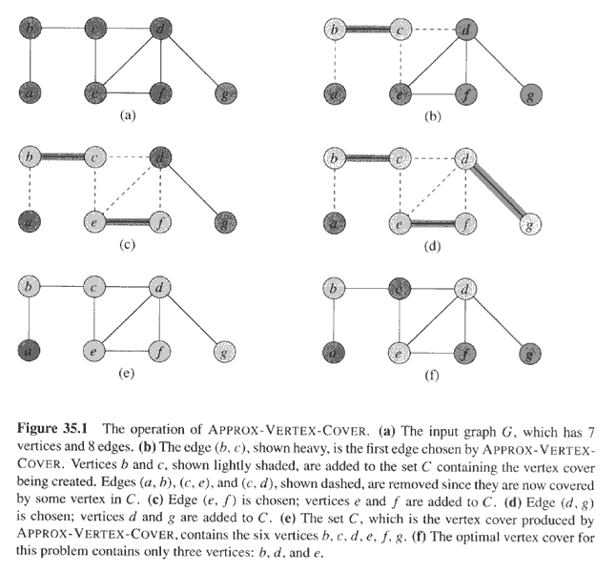
Copyright © The McGraw-Hill Companies, Inc. Permission required for reproduction or display.

Slide 4
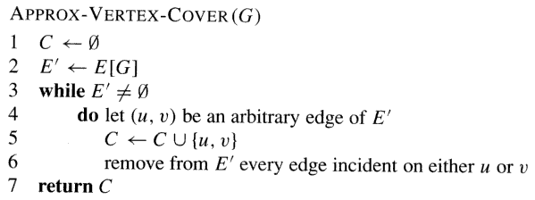
Copyright © The McGraw-Hill Companies, Inc. Permission required for reproduction or display.
Theorem 35.1 APPROX-VERTEX_COVER is a polynomial time 2-appromixation algorithm
Proof Edges form maximal matching. Take both ends of all edges.
Discussion Is this a common-sense algorithm? It ensures 2-approximation in the worst-case. Why not seek better approximation where possible? Perhaps ‘dove tail’ with a heuristics; then pick the best result.

Slide 5
Copyright © The McGraw-Hill Companies, Inc. Permission required for reproduction or display.

Slide 6
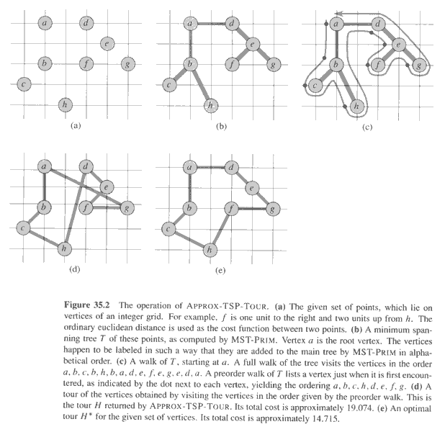
Copyright © The McGraw-Hill Companies, Inc. Permission required for reproduction or display.

Slide 7
Approximation Algorithm for Traveling Salesman with Triangle Inequality
Theorem 35.2 Algorithm is polynomial time and 2-approximation
Proof
c(T) Cost of MST.
c(H*) Cost of optimal tour.
Claim c(T) <= c(H*).
c(“Euler tour of T”) <= 2c(H*).
c(“preorder tour of T” <= c(“Euler tour of T”)

Slide 8
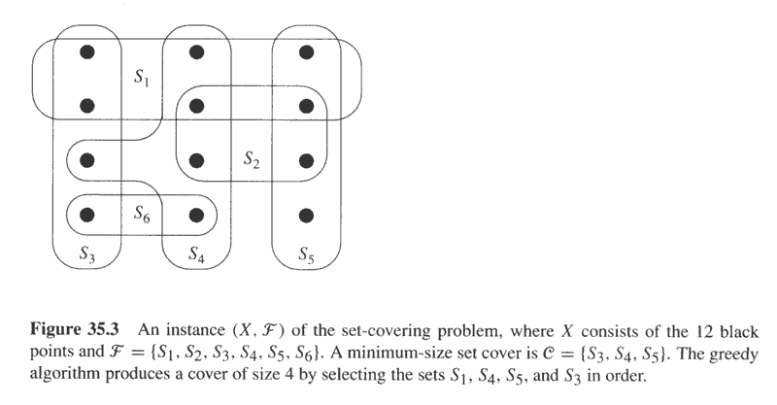
Copyright © The McGraw-Hill Companies, Inc. Permission required for reproduction or display.
The set covering problem
Input: Set of sets. In the example: {S₁ .. S₆}. X is the set of all elements in their union (|X|=12 in the example). Find the smallest number of sets such that their union includes elements in X.

Slide 9
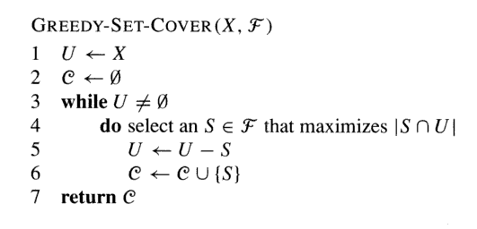
Copyright © The McGraw-Hill Companies, Inc. Permission required for reproduction or display.
**X includes all elements**

Slide 10
Copyright © The McGraw-Hill Companies, Inc. Permission required for reproduction or display.

Slide 11
Approximation scheme
An approximation algorithm whose input is not only the input for the problem, but also a value EPSILON > 0, such that for any fixed EPSILON the scheme is a (1 + EPSILON)-approximation algorithm.
An approximation scheme is polynomial if it runs in polynomial time for any fixed EPSILON > 0.
It is fully polynomial if it runs in polynomial time both in the input size and 1/EPSILON. For example a run-time that is O((1/EPSILON)² n³)

Slide 12
The subset-sum problem
S is a set of positive integers {x₁,x₂,…,x_{n}} and t is a positive integer. The decision problem sought a subset of S that sums up exactly to t.
The subset-sum optimization problem Find a subset of S whose sum is largest but still <= t

Slide 13
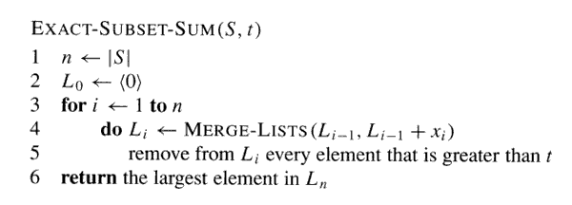
Copyright © The McGraw-Hill Companies, Inc. Permission required for reproduction or display.
Exponential time algorithm

Slide 14
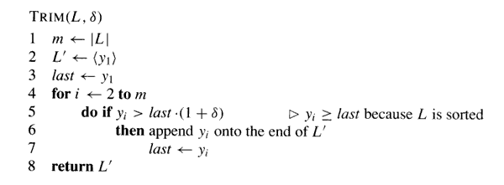
Copyright © The McGraw-Hill Companies, Inc. Permission required for reproduction or display.
Routine for use in a fully polynomial-time approximation scheme
Example
L = {10,11,12,15,20,21,22,23,24,29} and δ = 0.1
➔ L’ = {10,12,15,20,23,29}

Slide 15
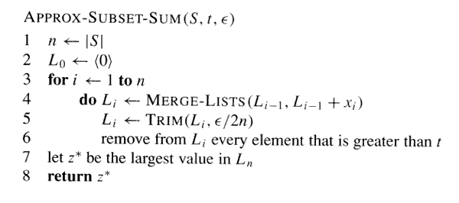
Copyright © The McGraw-Hill Companies, Inc. Permission required for reproduction or display.
The fully polynomial-time approximation scheme
Example S = {104,102,201,101}, t=308, ε=0.4 ➔ δ is ε/8=0.05
Approximation claim Let y* be the optimal solution. Then y*/z* <= 1 + ε.
Fully-polynomial time claim The number of elements in each list L_{i} is
(3n ln t)/ε + 2

