Slide 1
Slide Sources: CLRS “Intro. To Algorithms” book website
(copyright McGraw Hill)
adapted and supplemented
Ch. 25: All Pairs Shortest Paths

Slide 2
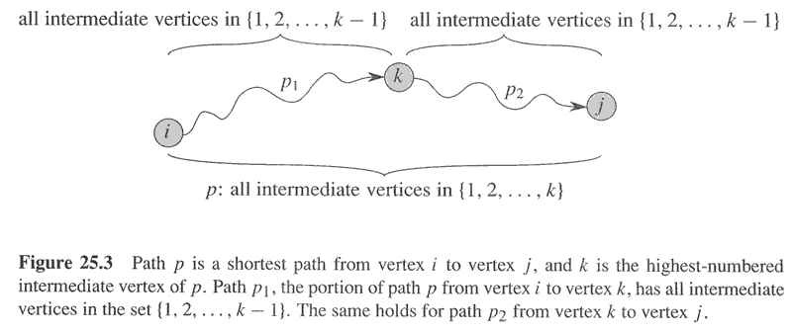
Floyd-Warshall Algorithm
Iteration k

Slide 3
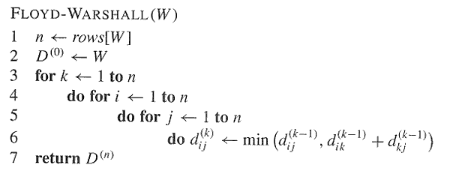

Slide 4
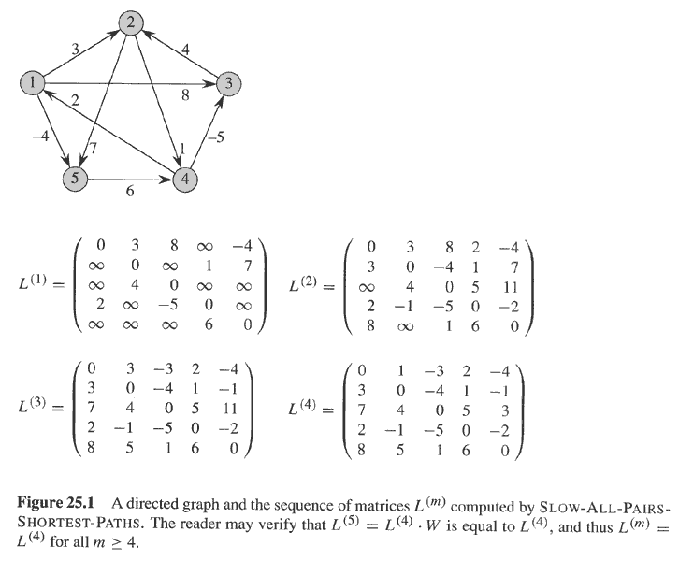
Note input graph. Ignore everything else.

Slide 5
Applying Floyd-Warshall to graph of Fig 25.1. On the right the ‘predecessor matrix’.

Slide 6
Correctness
Assume that graph G does not have any negative cycles.
Following iteration k, d_{i,j} ^{(k)} is the shortest distance of any path from i to j that goes through vertices 1,2,.., k

Slide 7
Complexity
O(n^3) time.
Another algorithm in text for sparse graphs

