Slide 1
Elementary graph algorithms Chapter 22
Slide Sources: CLRS “Intro. To Algorithms” book website
(copyright McGraw Hill)
adapted and supplemented

Slide 2
Representation of graphs
2 representations of an undirected graph
Space Query: is (i,j) in E?
(b) Adjacency-list representation O(n+m) not O(1) time
(c) Adjacency-matrix representation O(n^2) O(1) time

Slide 3
2 representations of a directed graph
(b) Adjacency-list representation
(c) Adjacency-matrix representation

Slide 4
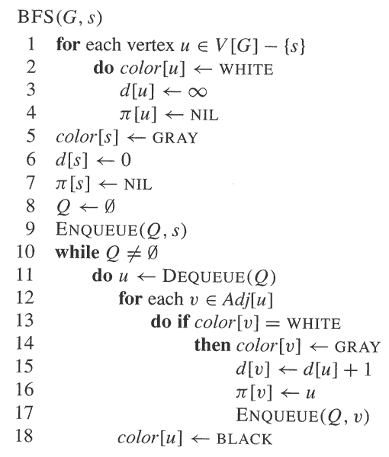
BFS pseudo-code

Slide 5
Breadth-first-search
BFS on an undirected graph. Compute into d(v) distance from source node s. Initially d(v)=‘infinity’. Shawn: queue Q in the beginning of an iteration, tree edges as produced by BFS (shaded), and d(v)
correction

Slide 6
Analysis: shortest-path correctness
delta(s,v) – the shortest distance from node s to node v in graph G(V,E) counting edges
Theorem: At the end of BFS, d(v) = delta(s,v)
[Lemma: If (u,v) is in E then delta(s,v) <= delta(s,u)+1]
[Lemma: At the end of BFS, d(v) >= delta(s,v)
Proof: By induction on the steps of BFS, if following any step of BFS d(v) < ‘inifinity’ then there exists a path from s to v with d(v) edges. ]
Inductive claim on i:
If d(v) <= i, then at the end of BFS, delta(s,v) = d(v)
If delta(s,v) <= i, then at the end of BFS, delta(s,v) = d(v)

Slide 7
Analysis: complexity
Method:
Charging each operation to a vertex or an edge
Upper bound the maximum number of charges per vertex and per edge
Since constant, adjacency-list input ➔ O(n+m) time.
u
u
u
u
s
s
s
s
s
u
u
(u,v)
(u,v)
v
v
v
v
u

Slide 8
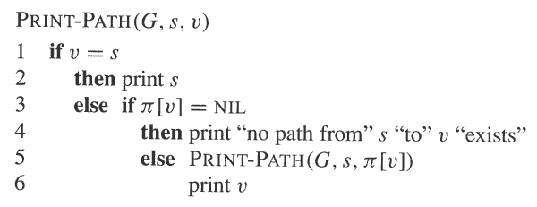
Reconstructing path from s to v: The BFS tree

Slide 9
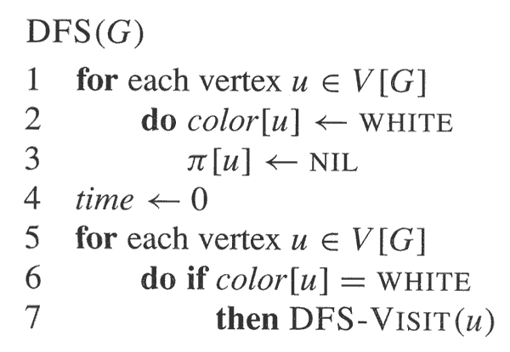
Dept-first search (DFS)
Initialize and initiate DFS

Slide 10
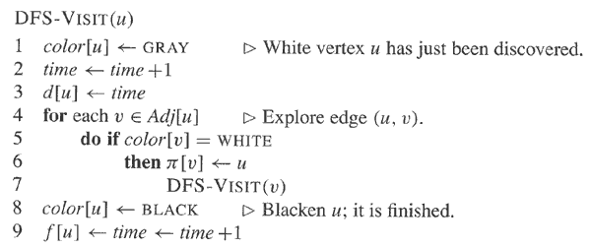
The recursive call
d(v) – discovery time
f(v) – finish time

Slide 12
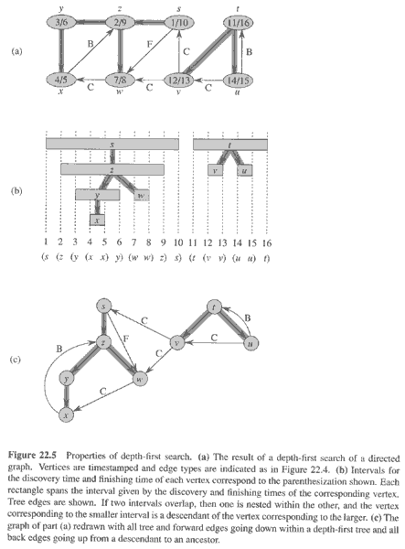
Properties of DFS
Undirected graphs -
2 types of edges:
- Tree edges
- Back edges
Directed graphs –
2 more:
Forward edges
Cross edges

Slide 13
Complexity
Revisit:
- Charging scheme
- Resulting complexity

Slide 14
Topological sort
Input: directed acyclic graph (DAG) representing ‘partial order’. Sort in a way which is compatible with partial order.
Unconvincing example of DFS.
More intuitive algorithm:
Peel in-degree=0 nodes
Repeat

Slide 15
Programming project
Around the “peeling zero-indegree nodes” algorithm
Motivation Attempted definition of computer engineering
Old (obsolete) concept: HW versus CS, which is SW
Proposal: Theory, algorithms, software, architecture, tools, applications and practice in computing that can be methodically validated and their validation, whether analytical, experimental, or a combination thereof.
Underlined: ENEE641
Italics: programming project

Slide 16
DAG for topological sort

Slide 17
Undirected connected graph G(V,E): Articulation points, bridges and biconnected components. Ex 22-2
Root of DFS is an articulation point if and only if it has at least 2 children in the DFS tree
Let v be a non-root of the DFS tree. v is an articulation point if it has a child s such that there is no back edge from s or any of its descendants to an ancestor of v.
low(v) is the minimum of: d(v) and d(w), where (u,w) is a back edge from a descendant u of v. How to compute low(v) for all nodes v in linear time?
The next slides explain why for this class bridges are also biconnected components
4. How to compute all articulation points in linear time?
5. How to compute all bridges in linear time?
6. Define biconnectivity* as a binary relation on edges: e₁Re₂ if they lie on a simple cycle, or e₁=e₂. Prove that R is an equivalence relation.

Slide 18
Clarification to definition of biconnected components
* The prior slide defines biconnectivity as a binary relation on edges, which is an equivalence relation. This extends to biconnected components by including all the vertices that touch on the edges of an equivalence class. This definition implies that a single bridge is an equivalence class of one edge (or a biconnected component of 2 vertices).
In contrast, Problem 22-2 in the textbook defines biconnected component as "a maximal set of edges such that any two edges in the set lie on a common simple cycle"; indeed item g seeks proof that the biconnected components of a graph partition only its non-bridge edges.
In ENEE641 students should follow the definition in the slides, or in Wikipedia http://en.wikipedia.org/wiki/Biconnected_component, but not the one in the text.

Slide 19
Euler tour
An Euler tour of a connected undirected graph G(V,E) is a cycle that traverses each edge of G exactly once.
Show that G has an Euler tour if and only if the degree of every vertex is an even number.
Describe an O(|E|) time algorithm to find the Euler tour of G if one exists.
Comments
1. Important routine for “next generation sequencing.
2. Euler tour for directed graphs is defined in Problem 22-3.

Slide 20
Transition Parallelism of graph /irregular algorithms
Performance implementation is challenging:
http://cacm.acm.org/magazines/2014/4/173217-is-multicore-hardware-for-general-purpose-parallel-processing-broken/fulltext
and desirable:
- (a timely link:) https://developer.nvidia.com/deep-learning-frameworks Look at the link to “Chainer”
- and many others
If interested in this as a research topic (architecture, compiler, programming, algorithms), please talk to me

Slide 21
Some Random Applications just to back up the “many applications” statement in the prior slide
(The fact that at issue is general-purpose computing and programmer’s productivity does not mean that this is less relevant for applications than other approaches)
Bio, precision medicine
Machine learning, big data
SW&HW formal verification
Numerical simulations to study instabilities (in liquids, gases and plasmas). Perhaps, could turn around fortune of LLNL ICF $5B fusion facility
Quantum effects defy locality
Scaling graph algorithms
Large FFT
DOE on a mission to “reinvent Physics” for communication avoidance. Instead match computing to classic Physics.

