Slide 1
2-3 (or B-) Trees, in lieu of Chapter 18
Get material from pages 42-51 in http://www.umiacs.umd.edu/users/vishkin/PUBLICATIONS/classnotes.pdf

Slide 2
2-3 tree
Search takes O(log n) time

Slide 3
Insert(12)
Translate to absorb(12,14)
New “orphan” attached to sibling.

Slide 4
absorb(C-LEFT,C)
Adopted by parent.
Parent split: new parent is orphan whose sibling is the original parent
➔ Defines an inductive step (next slide)
Data for all changes: always available locally

Slide 5
Complete insert(12)

Slide 6
Complexity
Insert takes O(log n) time

Slide 7
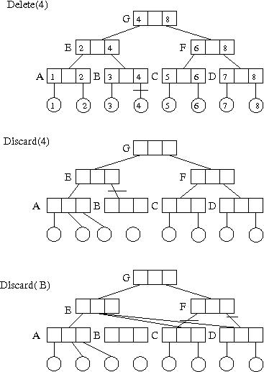
Delete(4): first discard(4), second discard(B)
Parent loses a child
Transfers other child
to siblings
& eliminates
Itself
➔ Inductive step

Slide 8
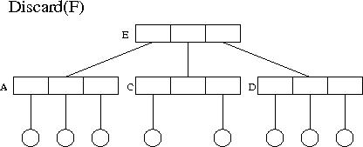
Finally discard(F)
Data for all changes: always available locally
Revisit data with example

Slide 9
Complexity
Delete takes O(log n) time

Slide 10
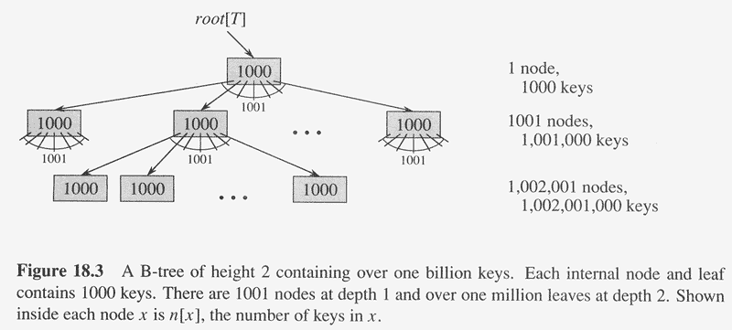

Slide 11
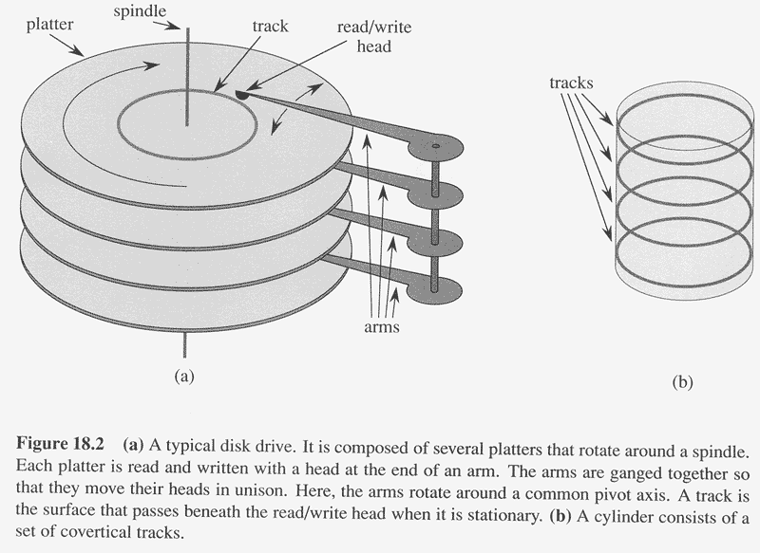
Disc rotation speed: 7200 RPM, typical
Arm movement: few ms.
Total access time for data on disc: 3-9 ms., typical
Versus access time in RAM: < 100 ns.
B-tree objective: to optimize disc access by using the full amount of
information retrieved per disc access, i.e., one page. So:
Size of 1 node of the B-tree = 1 page

