Slide 1
Chapter 16: Greedy Algorithms
Much simpler than dynamic programming: choose what looks best now

Slide 2
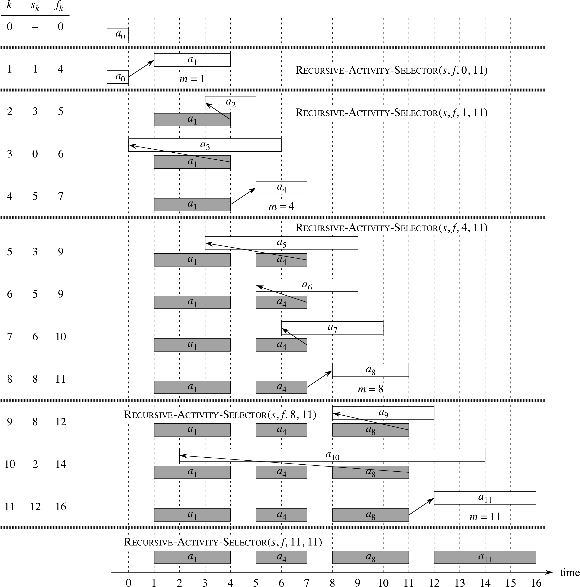
Consider 11 potential lectures all seeking to use the same lecture hall. Lecture i starts at time s_i and ends by time f_i (so that a lecture that starts at time f_i or later can share the lecture with lecture i). Problem How to fit the largest number of lectures into the lecture hall? ..Already sorted by finish time. Pick earliest finish time; repeat.

Slide 3
Proof
Assume: some optimal solution
Show that cannot be better than the outcome of the greedy algorithm

Slide 4
Binary prefix codes
Suppose: A 100,000-character data file we want to store compactly
Each character will be represented by a binary code
Two approaches: fixed length codes or variable length codes
Prefix codes: no code can be the prefix of another code

Slide 5
Tree representation of above codes

Slide 6
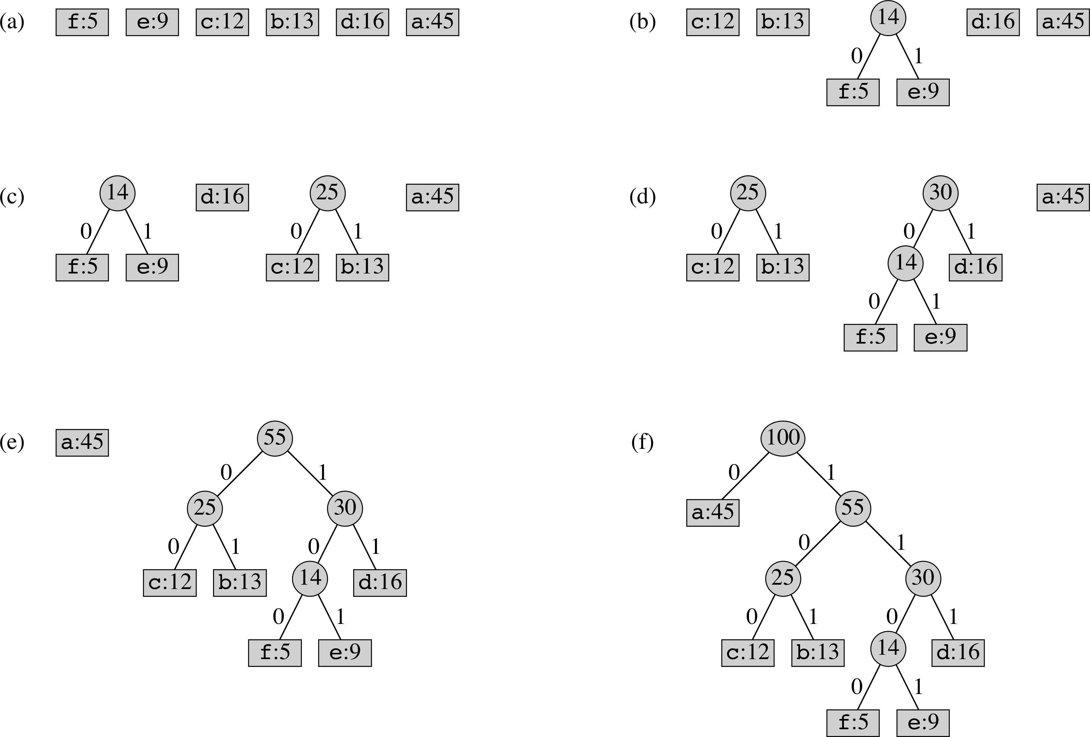
Steps of Huffman’s algorithm

Slide 7
Correctness of Huffman’s algorithm
Lemma 16.2 Let C be an alphabet in which each character c in C has frequency f[c]. Let x and y be two characters in C having the lowest frequencies. Then there exists an optimal prefix code for C in which the code words for x and y have the same length and differ only in the last bit.
Idea of proof:

Slide 8
Theorem 16.4
Huffman’s algorithm minimizes B(S) = sum_{c in C} {f(c)d_S(c)}, where f(c) is the frequency of character c and d_S(c) is the length of its code word over all possible binary prefix codes S.
Proof
By induction on the size of C.
Let x and y be the two characters with minimal frequency. In C’ the characters x and y becomes a new character z whose frequency is f(x) + f (y). Suppose T’ provides optimal binary prefix code for C’. Then the tree T obtained from T’ by replacing the code word for z by longer-by-one code words for x and for y provide optimal such code for C.
B(T) = B(T’) + f(x) + f (y). Suppose that there is a code T’’ for which B(T’’) < B(T). Using Lemma 16.2 derive from T’’, better code than T’ for C’. A contradiction that T’’ is better than T.

