Slide 1
Slide Sources: CLRS “Intro. To Algorithms” book website
(copyright McGraw Hill)
adapted and supplemented
Ch. 13: Red Black Trees

Slide 2
A red-black tree is a binary search tree with one extra bit of storage per node, the color, which can be RED or BLACK.
An RB tree, therefore, contains 5 fields per node: color, key and the left, right and parent pointers. NIL’s represent missing child or parent nodes.
NIL’s are considered leaves, other key-containing nodes are considered internal. Therefore, every internal node has 2 children.
A red-black tree must satisfy the following conditions:
Every node is either red or black.
The root is black.
Every leaf (NIL) is black.
If a node is red, both its children are black.
For each node, all paths from the node to descendant leaves contain the same number of black nodes.
For next slide:
bh(x) – black height of node x is the number of black nodes on any path from node x down to a leaf, not counting x itself.
Sentinel – dummy object that helps simplifying boundary conditions (e.g., NIL).

Slide 3
Sentinel NIL node

Slide 4
Lemma 13.1: An RB tree with n internal nodes has height at most 2log(n+1), in
particular, its height is O(log n).
Proof: We first prove by induction on height the following claim: the subtree
rooted at any node x contains at least 2^{bh(x)} – 1 internal nodes.
To start induction, observe that if ht(x) = 0 then x is a leaf, so bh(x) = 0.
And, indeed, the subtree rooted at x contains 2^{bh(x)} – 1 = 2⁰ – 1 = 0 internal nodes.
For the inductive step, consider a node x with ht(x) > 0. Each child of x has
black-height either bh(x) or bh(x) – 1 (why?). Applying the inductive hypothesis,
the subtree rooted at each child of x has at least 2^{bh(x) – 1} – 1 internal nodes.
Therefore, the subtree rooted at x contains at least
(2^{bh(x) – 1} – 1) + (2^{bh(x) – 1} – 1) + 1 = 2^{bh(x)} – 1
internal nodes, proving the claim.
Next, let h be the height of the tree. According to Prop. 4 at least half the
nodes on a path from the root to the leaf, not including the root, must be black.
Therefore, bh(root) ≥ h/2. Using the claim proved above, the number of
internal nodes of the tree
n ≥ 2^{bh(root)} – 1 ≥ 2^{h/2} – 1 ⇒ h ≤ 2log(n+1)
Therefore, TREE-SEARCH, TREE-MINIMUM, etc., operations that don’t modify the
structure of a binary search tree, take O(log n) time on an RB tree.
How about TREE-INSERT and TREE-DELETE?
We will see later.
Next Slide:
Alternative
lemma &
proof

Slide 5
Lemma 13.1Alternative: An RB tree with height h has at least 2^{ceil h/2 ceil} -1 internal (non-leaf or ‘non-NIL’)) nodes.
Proof: According to Prop. 4 at least half the nodes on a path from the root to the leaf, not including the root, must be black.
Therefore, bh(root) ≥ ceil h/2 ceil. The number of internal nodes of the tree
n ≥ 2^{bh(root)} – 1 ( or per Lemma 13.1 ≥ 2^{h/2} – 1 ⇒ h ≤ 2log(n+1) )
Therefore, TREE-SEARCH, TREE-MINIMUM, etc., operations that don’t modify the
structure of a binary search tree, take O(log n) time on an RB tree.
How about TREE-INSERT and TREE-DELETE?
We will see later.

Slide 6
Rotations

Slide 8
Insertions
Ordinary binary search tree insert
Main
changes!

Slide 9
Uncle (of z) is red
Uncle is black.
Parent on opposite side of grandparent
Uncle is black.
Parent and grandparent on the same side

Slide 10
Complexity of insert
O(log n) since:
height of RB tree with n node is O(log n)
As long as there is infringement (node z), it climbs towards root. One exception: infringement is resolved in one more step

Slide 12
Case 1: z has red uncle.

Slide 13
y δ
y δ
y δ
Case 2: z has black uncle, z is inside child.
Case 3: z has black uncle, z is outside child.
Ques: What is the running time of RB-INSERT?
Ques: What is the maximum number of rotations that RB-INSERT can perform?

Slide 14
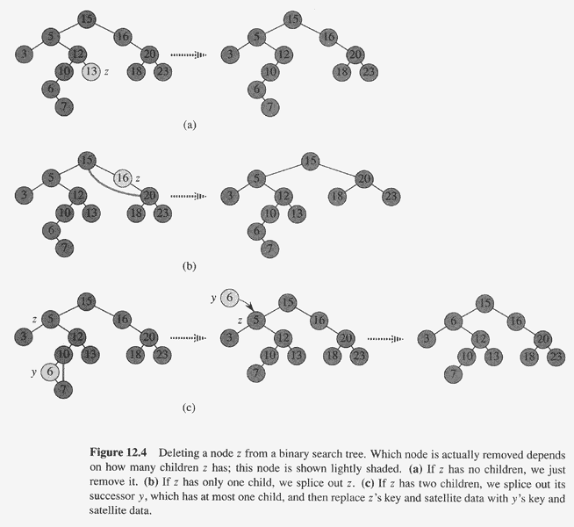
Ordinary binary search
tree delete

Slide 15
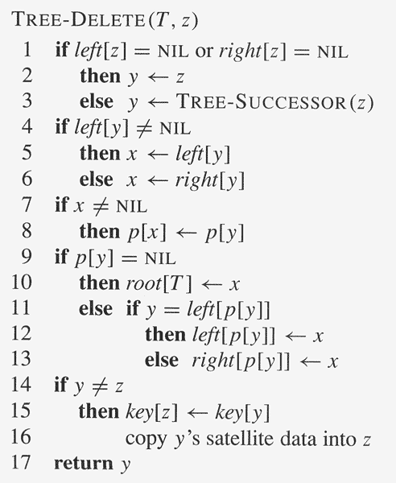
Ordinary binary search tree delete code

Slide 16
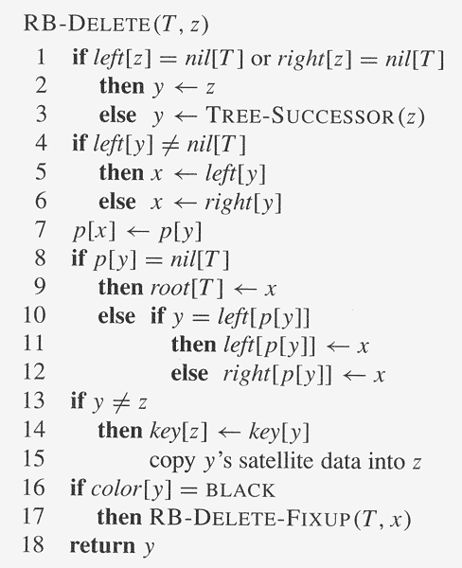
// change: no test if x ≠ nil[T ]!
// change!

Slide 17
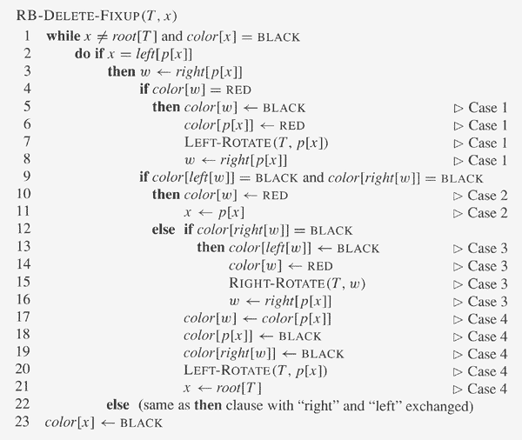

Slide 18
