Slide 1
Slide Sources: CLRS “Intro. To Algorithms” book website
(copyright McGraw Hill)
adapted and supplemented
Ch. 12: Binary Search Trees

Slide 2
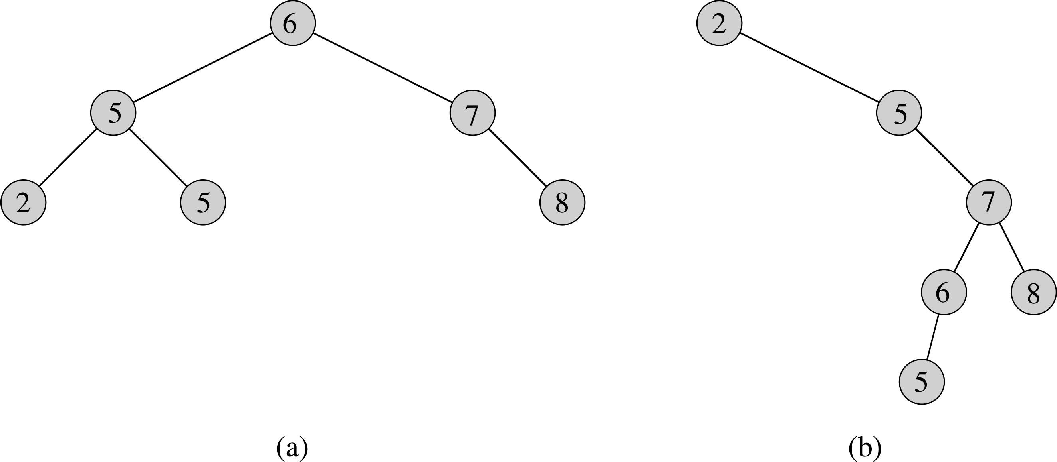
Examples of binary search trees
The binary-search-tree property
For any node x:
the keys in the left subtree of x are at most key[x]
the keys in the right subtree of x are at least key[x]
Different binary search trees can represent the same set of values
Worst-case time is proportional to the height of the tree
A binary search tree with height 2
A less efficient binary search tree of the same set with height 4

Slide 3
INORDER Tree Walk
INORDER-TREE-WALK(x)
if x != NIL \\* != mean NOT EQUAL*\\
then INORDER-TREE-WALK(left[x])
print key[x]
INORDER-TREE-WALK(right[x])
The inorder tree walk above prints 2,3,5,5,6,7,8 for both trees above.
Complexity INORDER-TREE-WALK(x) for a tree of n nodes rooted at x is O(n).
Proof T(n) = T(k) + T(n – k – 1) + d
Assume inductively that T(m) = m d for every m < n.
T(n) = T(k) + T(n-k-1) + d = k d + (n-k-1) d + d = n d

Slide 4
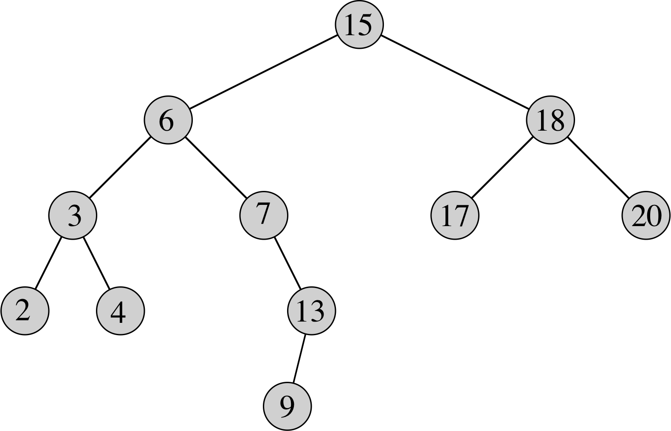
Querying a binary search tree
Search for the key 13. 15→6→7→13.
Search for minimum: Go left till you can’t.
Search for maximum: Go right till you can’t.
Successor(15): 17 since minimum in its right subtree
Successor(13): 15 since 13 has no right subtree, the lowest successor of 13 whose left child is also an ancestor

Slide 5
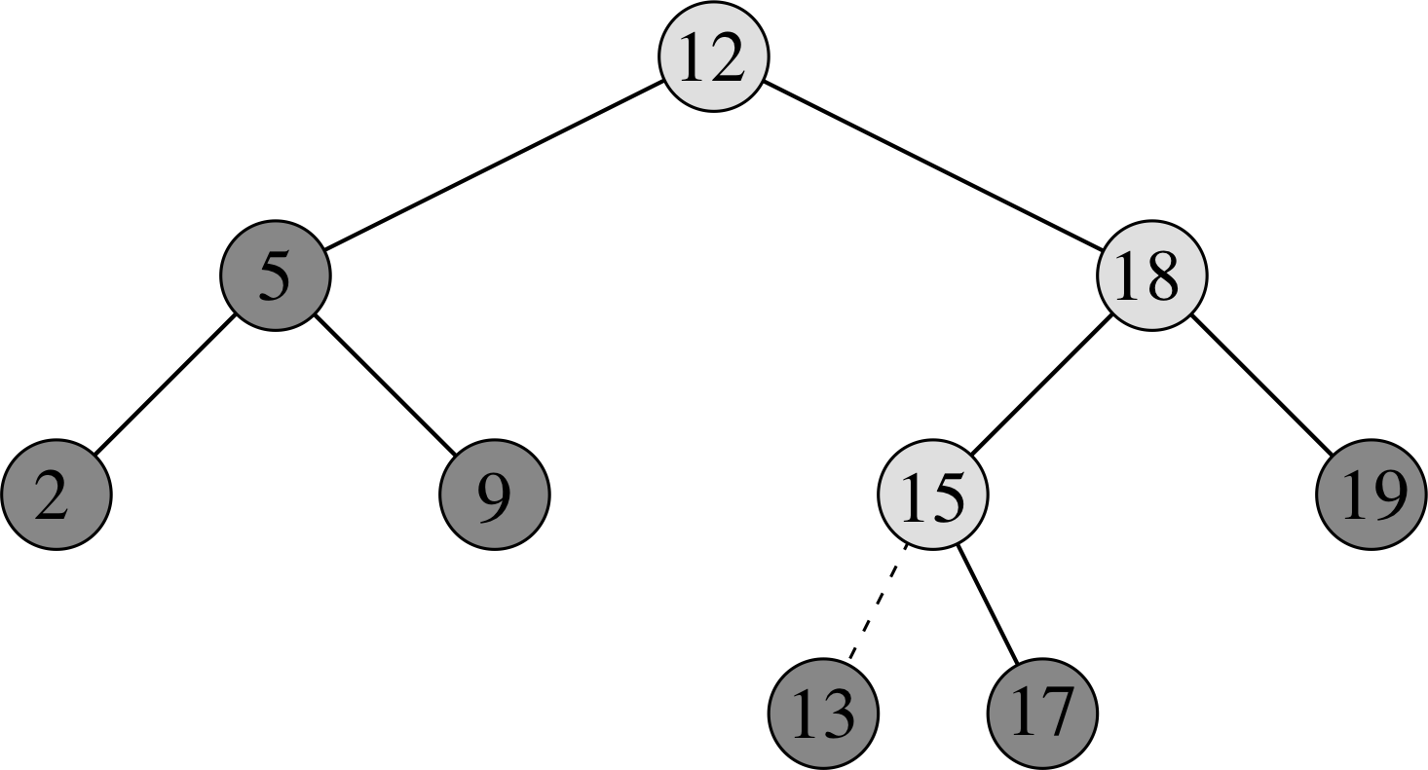
Insertion
Insert(13)
Lightly shaded nodes: path from root

Slide 6
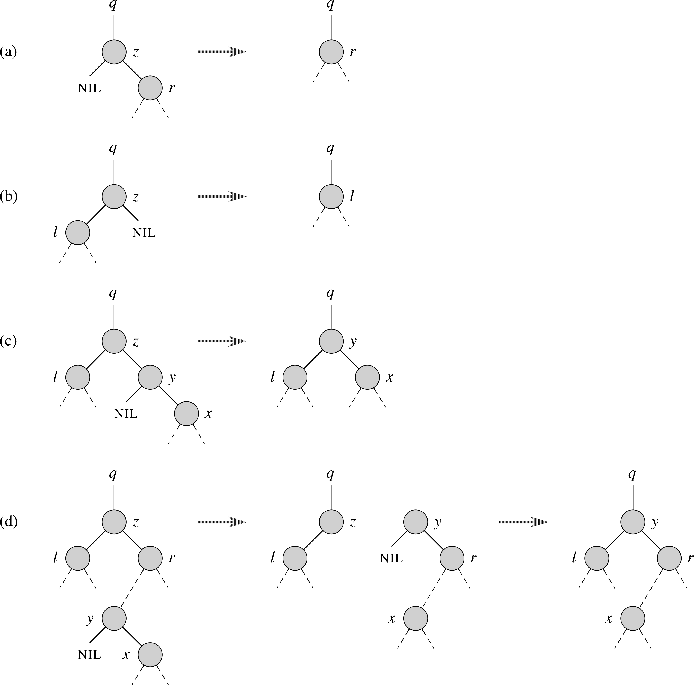
Deletion
Delete(z)
Node z may be the root, left child of q or the right child of q
Case (NOT SHOWN): z has no children. Remove
Cases (a AND b): z has one child. Splice z out
Case (c): z has 2 children. One is its successor y, and y only has a right child. Replace z by y.
Case (d): z has 2 children. Its successor y is not its right child. Splice out y and replace z by y.
(Note: 1. Replacements include satellite data. 2. Case (c) does not appear in 2nd edition.)

Slide 7
Randomly built search tree (Sec. 12.4)
Insert n keys in random order into an initially empty binary search tree
FYI only
Theorem 12.4: The expected height of randomly built search tree is O(log n)

