Slide 1
Slide Sources: CLRS “Intro. To Algorithms” book website
(copyright McGraw Hill)
adapted and supplemented
Ch. 11: Hash Tables

Slide 2
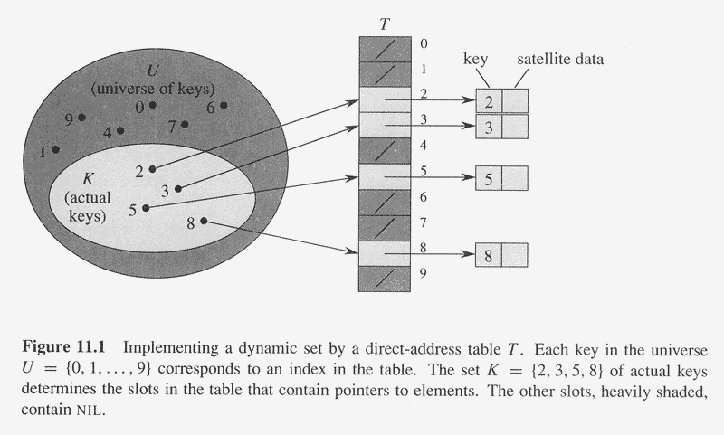
Implementing a dictionary with a direct-address table
Size of table T = size of universe U !!
DIRECT-ADDRESS-SEARCH(T, k) : return T[k]
DIRECT-ADDRESS-INSERT(T, x) : T[ key[x] ] ← x
DIRECT-ADDRESS-DELETE(T, x): T[ key[x] ] ← NIL

Slide 3
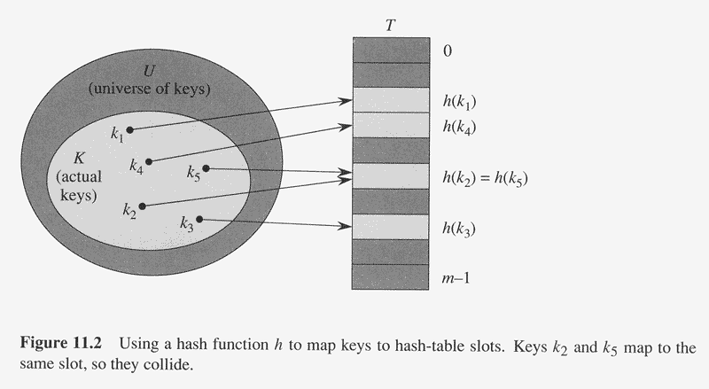
Reducing the size of the table using a hash function to map keys to a hash table
Hash Table
h : U -> [0, …, m-1]

Slide 4
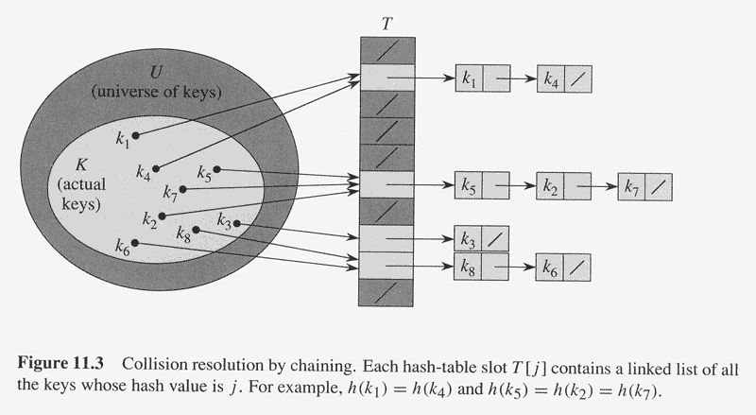
Collision resolution by chaining
Load factor α = # elements in table n / # slots in table m = average # elements in a chain
CHAINED-HASH-INSERT(T, x): insert x at the head of the list T[ h( key[x] ) ]
CHAINED-HASH-SEARCH(T, k): search for an element with key k in list T[ h(k) ]
CHAINED-HASH-DELETE(T, x): delete x from the list T[ h( key[x] ) ]
What are worst-case times?!

Slide 5
Simple uniform hashing means each element is equally likely to hash to any of the
m slots, independently of where any other element has hashed to.
Th. 11.1: In a hash table in which collisions are resolved by chaining, an
unsuccessful search takes expected time Θ(1+α), under the assumption of
simple uniform hashing.
Proof: For j = 0, 1, …, m-1, denote the length of the list T[j] by n_{j}.
Therefore, n = n₀ + n₁ + … + n_{m-1}.
Expected search time = time to compute h(k) + time to search to end of list
of expected length E[ n_{h(k)} ]
= Θ(1) + Θ(α)
= Θ(1+α)

Slide 6
Th. 11.2: In a hash table in which collisions are resolved by chaining a successful
search takes time Θ(1+α), on the average, under the assumption of simple
uniform hashing.
Proof: We assume that the element being search for is equally likely to be any of the n elements stored in the table.
Short argument: without the element ,average number of element mapped to the same value α (n-1). This is the expected number of other elements mapped to the same value as the element. The element is equally likely to any of the elements mapped to the same value. Namely, it will take on average α(n-1)/2 + 1 steps to get to it.
Continue: # of elements examined = 1 + # elements before x in x’s list
= 1 + # elements inserted in x’s list after x
Let x_{i} denote i th element inserted into list, and k_{i} = key[x_{i}].
Define the indicator random variable X_{ij} = I[ h(k_{i}) = h(k_{j}) ].
Therefore, E[X_{ij}] = Pr{ h(k_{i}) = h(k_{j}) } = 1/m, because of simple uniform hashing.
Therefore, expected # elements examined in a successful search is (averaging over
i, the n different orders in which the element could have been inserted):
E[ 1/n ∑_{i=1..n} (1 + ∑_{j=i+1..n} X_{ij})] = 1/n ∑_{i=1..n} ( 1 + ∑_{j=i+1..n} E[X_{ij}] )
= 1/n ∑_{i=1..n} ( 1 + ∑_{j=i+1..n} 1/m )
= 1 + 1/nm ∑_{i=1..n} (n-i)
= 1 + (n-1)/2m (verify!)
= 1 + α/2 – α/2n
Therefore, expected search time = time to compute h(k) + time to find x in x’s list
= Θ(1) + Θ(1 + α/2 – α/2n)
= Θ(1+α)

Slide 7
What make a good hash function?
As close as possible to the assumption of simple uniform hashing: each key equally likely to hash to any of the m slots, independently of other keys.
Typical assumption about Universe:
Natural numbers.
What follows are some practical approaches. They will not satisfy the real paranoid (not a derogatory term), since their hashing is fixed.
For the paranoid, you must rely on ‘real randomness’. Addressed by universal hashing

Slide 8
Developing a Hash Function
Division method:
  Key k goes to slot h(k) = k mod m
  Avoid choosing m as power of 2, otherwise h(k) is just lower order bits of k (in binary representation), which may not be “random”
  A good choice is a prime number not close to a power of 2. E.g., if n = 2000, and a load factor α about 3 is acceptable, then m = 701 is ok.

Slide 9
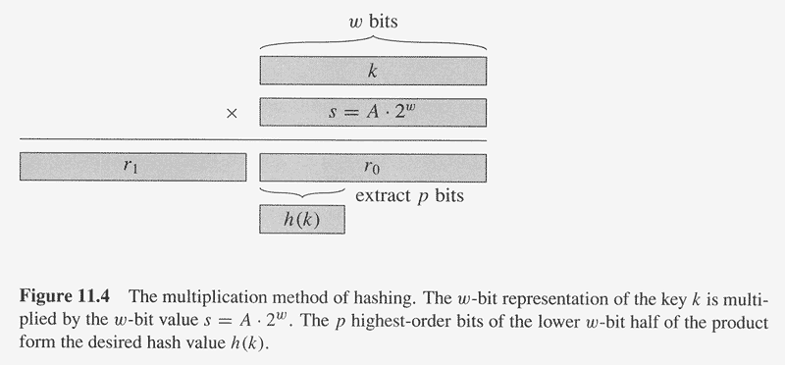
Multiplication method:
  Fix a constant A in 0 < A < 1.
  Then, h(k) = ⎣ m (kA mod 1) ) ⎦, i.e.,
    Multiply k by A, take the fractional part of k*A, then multiply m by this fractional part and take the floor
Fractional part of kA =
kA - ⎣kA⎦
m can be chosen arbitrarily in the division method without randomness being an issue.
Efficient implementation is possible if m is a power of 2, say m = 2^{p}, and A = s/2^{w},
where w is the word size and 0 < s < 2^{w}. See Figure 11.4.
Book example: k = 123456, p =14, m = 2¹⁴ = 16384, w = 32, A = 2654435769/2³²,
(following Knuth’s suggestion of choosing A close to (√5 – 1)/2 = 0.6180339887… )
So, k*s = 327706022297664 = 76300*2 ³² + 17612864, which means r₁ = 76300
and r₀ = 17612864. The 14 most significant bits of r₀ give h(k) = 67.

Slide 10
Universal Hashing
A fixed hash function is vulnerable to malicious distributions (e.g., so that all keys hash to the same slot!)
Universal hashing consists of choosing a hash function randomly from some fixed set of hash functions independent of the keys. Therefore, universal hashing is (probabilistically) immune to bad distributions (just like randomized quicksort is probabilistically immune to a bad input).
Let H be a finite collection of hash functions that map a given universe U of keys into the range {0, 1, …, m-1}. H is said to be a universal collection if for each pair of distinct keys k, l ∈ U, the number of hash functions for which h(k) = h(l) is at most |H|/m, i.e., the chance of collision between k and l is no more than the chance 1/m of collision if h(k) and h(l) were independently and randomly chosen.

Slide 11
Th. 11.3: Suppose that hash function h is chosen randomly from a universal collection and used to hash n keys into a table of size m. If key k is not in the table, then expected length E[ n_{h(k)} ] of the list that k hashes to is at most α; if k is in the table, then it’s at most 1+α.
Proof: Define indicator variable X_{kl} = I{h(k) = h(l)}. [Notation: i then L] Therefore, by universality and the random choice of h, E[X_{kl}] ≤ 1/m. For each key k, define the random variable Y_{k} that equals the number of keys other than k that hash to the same slot as k, so that
Y_{k} = ∑_{l∈T, l≠k} X_{kl}
Therefore, E[ Y_{k} ] = ∑_{l∈T, l≠k} E[ X_{kl} ]
≤ ∑_{l∈T, l≠k} 1/m
If k ∉T, then |{l : l ∈ T, l ≠ k}| = n. Moreover, n_{h(k)} = Y_{k} ⇒ E[n_{h(k)}] = E[Y_{k}] ≤ n/m = α.
If k ∈T, then |{l : l ∈ T, l ≠ k}| = n-1. Moreover, n_{h(k)} = Y_{k} + 1 ⇒ E[n_{h(k)}] = E[Y_{k}] + 1 ≤ (n-1)/m + 1 = 1 + α – 1/m < 1 + α.
Corollary: Using universal hashing and collision resolution, a hash table of m slots
containing n keys where n = O(m), requires Θ(1) expected time per dictionary
operation.

Slide 12
A Universal Class of Hash Functions
Let prime p be large enough so that every possible key k is in the range
0 ≤ k ≤ p-1.
Let Z_{p} denote {0, 1, …, p-1} and Z_{p}* denote {1, 2, …, p-1}.
Because the hash table size is smaller than that of the universe of keys, we
have also m < p.
For any a ∈ Z_{p}* and b ∈ Z_{p} define the hash function h_{a,b} :
h_{a,b}(k) = ( (ak+b) mod p ) mod m.
E.g., if p = 17 and m = 6, we have h_{3,4}(8) = 5.
Ques: If p = 29 and m = 20, what is h_{5,9} (17)?
We shall show that the family of such hash functions h_{a,b} , i.e., the family
H_{p,m}= {h_{a,b} : a ∈ Z_{p}* and b ∈ Z_{p}}
is universal.

Slide 13
Th. 11.3: The class H_{p,m} of hash functions is universal.
Proof: Consider two distinct keys k and l from Z_{p}. For a given hash fn. h_{a,b} let
r = h_{a,b}(k) = (ak + b) mod p
s = h_{a,b}(l) = (al + b) mod p
Now r ≠ s. Why? Because, if r = s, then
ak + b = al + b mod p ⇒ ak = al mod p ⇒ k = l mod p,
contradicting that k ≠ l. Therefore, k and l map to distinct values r and s mod p.
Moreover, each of the p(p-1) choices of the pair (a, b), with a ≠ 0, yields a different
resulting pair (r, s) with r ≠ s. Why? Because, for a given r and s, we can solve the
equations
ak + b = r and al + b = s
uniquely to determine a and b (check this!). Therefore, different pairs (r,s) must give
different pairs (a, b). Since, there are p(p-1) choices of pairs (r, s) with r ≠ s, there is
a one-to-one correspondence between pairs (a, b) with a ≠ 0 and pairs (r, s) with
r ≠ s.
Therefore, if (a, b) is picked randomly from Z_{p}* × Z_{p} the resulting pair (r, s) is
equally likely to be any pair of distinct values mod p.

Slide 14
Now, given r, of the p-1 remaining possible values for s, the number of
values such that r ≡ s (mod m) is at most
⎡p/m⎤ – 1 ≤ (p – 1)/m
Therefore, the number of hash function h_{a,b} in H_{p,m} such that
h_{a,b}(k) = h_{a,b}(l) (which is exactly when r ≡ s (mod m)) is at most
p(p-1)/m = |H_{p,m}|/m, proving that H_{p,m} is indeed universal.

Slide 15
End of Section 11.3

Slide 16
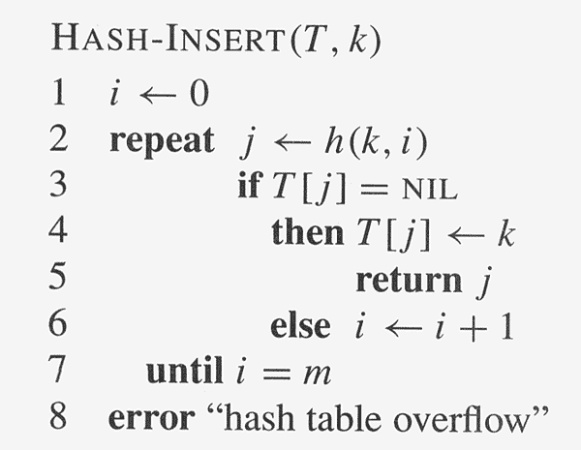
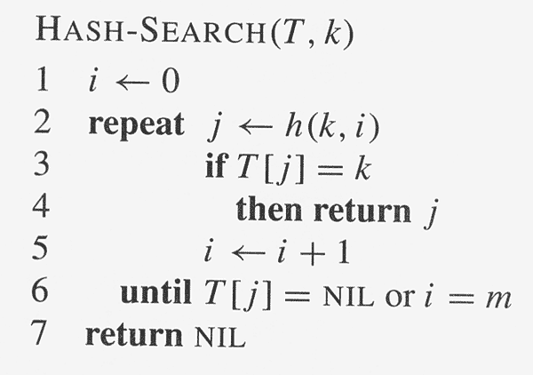
Open Addressing
In hashing with open addressing all elements are stored in the table, not in linked lists.
To probe the table the hash function is extended to be of the form
h: U × [0, 1, …, m-1] → [0, 1, …, m-1]
where, for every key k, the probe sequence
h(k, 0), h(k, 1), …, h(k, m-1)
is a permutation of
0, 1, …, m-1
so that every slot in the table is eventually probed.
Deletion is implemented by marking the slot of the deleted element with the special value
of DELETED instead of NIL (why is this necessary?).
Ques: Do we need to modify HASH-INSERT? How about HASH-SEARCH?

Slide 17
Probing Methods
Linear probing: given an ordinary hash fn. h’: U → [0, 1, …, m-1],
called the auxiliary hash function, define the hash function
h(k, i) = ( h’(k) + i ) mod m
for i = 0, 1, …, m-1.
Therefore, given key k the first slot probed is T[ h(k) ], i.e., the
Slot given by the auxiliary hash fn. Next probed are
T[ h(k)+1 ], T[ h(k)+2 ], …, T[m-1], T[0], T[1], …
Linear probing suffers from the problem of primary clustering
where long runs of occupied slots build up that slow down searching.
Ex: Insert 89, 18, 49, 58, 9 in that order into an open-addressed
hash table of size 10 using the division method for the auxiliary hash
function and using linear probing.

Slide 18
Probing Methods
Quadratic probing: Define the hash function
h(k, i) = ( h’(k) + c₁i + c₂i²) mod m
where h’ is an auxiliary hash function, and c₁ and c₂(≠0) are
auxiliary constants.
Ex: Insert 89, 18, 49, 58, 9 in that order into an open-addressed
hash table of size 10 using the division method for the auxiliary hash
function and using quadratic probing (with c₁ = 0 and c₂ = 1).
Quadratic suffers from a milder form of clustering, called secondary
clustering, which is essentially unavoidable: it is due to runs formed
from actually collisions in the hashed values.

Slide 19
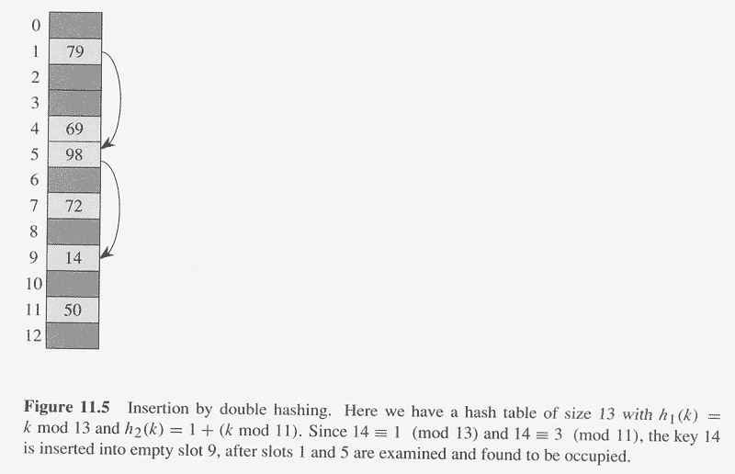
Double hashing: Define the hash function
h(k, i) = ( h₁(k) + ih₂(k)) mod m
where h₁ and h₂ are auxiliary hash functions.
h₂(k)) must be relatively prime to the table size m for all slots to be probed. One way
is to let m be a power of 2 and make sure h₂ is always an odd integer. Another is to
let me be a prime and make sure h₂ is always a positive integer < m. E.g., as in
Figure 11.5.

Slide 20
Perfect Hashing
If the set of keys is static (e.g., a set of reserved words in a
programming language), hashing can be used to obtain excellent
worst-case performance.
A hashing technique is called perfect hashing if the worst-case time for a search is O(1).
A two-level scheme is used to implement perfect hashing with universal hashing used at each level.
  The first level is same as for hashing with chaining: n keys are hashed into m = n slots using a hash fn. h from a universal collection.
  At the next level though, instead of chaining keys that hash to the same slot j, we use a small secondary hash table S_{j} with an associated hash fn. h_{j}. By choosing h_{j} appropriately one can guarantee that there are no collisions at the secondary level and that the total space used for all the hash tables is O(n).

Slide 21
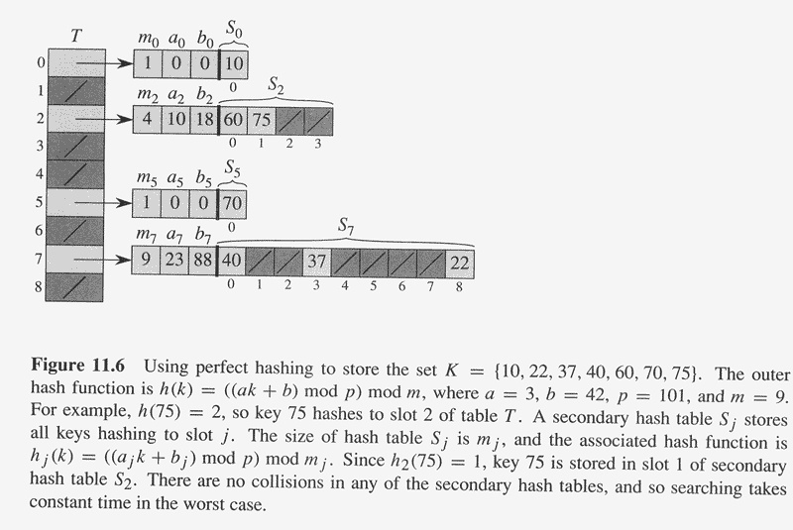
Perfect Hashing Overview
The first-level hash fn. h is chosen from the class H_{p,m}.
Those keys hashing into slot j are re-hashed into a secondary hash table S_{j} of size m_{j} , where m_{j} = n_{j}², the square of the number n_{j} of keys hashing into slot j, using a hash fn. h_{j} chosen from the class H_{p,mj}.

Slide 22
Perfect Hashing Theory
Cor. 11.12:
If we store n keys in a hash table of size m = n using a hash function h randomly chosen from H_{p,m} and we set the size of each secondary hash table to m_{j} = n_{j}², for j = 0, 1, …, m-1, then the probability that the total storage used for secondary hash tables exceeds 4n is less than ½.
Therefore, repeatedly randomly choosing a hash function from H_{p,m} will soon yield an h such that the total storage for the secondary hash tables is ≤ 4n (because the probability of not finding one decreases exponentially).
Th. 11.9:
If we store n_{j} keys in a hash table of size m_{j} = n_{j}² using a hash function h_{j} randomly chosen from H_{p,mj}, then the probability of there being any collision is less than ½.
Therefore, repeatedly randomly choosing a hash function from H_{p,mj} will soon yield an h_{j} that is collision-free.
Summary: The top-level hash function h is chosen by random trial – invoking Cor. 11.12 – to guarantee total space ≤ 4n. Then, by random trials again – invoking Th. 11.0 – collision-free hash functions h_{j} are chosen for each of the secondary tables.

