Slide 1


General-Purpose Many-Core Parallelism –
Broken, But Fixable
Uzi Vishkin
Scope: max speedup from on-chip parallelism
Notes:
Consider the level of application innovation in high-end general-purposes desktop computing over the last decade. I believe that it has been minimal, perhaps with the exception of computer graphics. Consider progress on internet and mobile for comparison where nearly 500,000 work developing mobile apps on their own dime.
Being motivated. Before technology constraints forced Intel to move to multi-cores, it was forced to extend X86 from 32- to 64-bit. Intel invested $4B in the Itanium and then wanted to cancel it. Was put on the right track only because competition from AMD. No correcting competition existed for over a decade. Will better conditions for competition emerge?

Slide 2
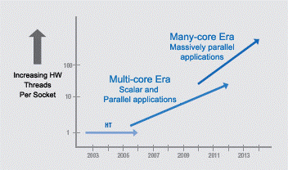
Commodity computer systems
1946➔2003 General-purpose computing: Serial. 5KHz➔4GHz.
2004 Clock frequency growth flat➔General-purpose computing goes parallel. ’If you want your program to run significantly faster … you’re going to have to parallelize it’
1980➔2013
#Transistors/chip: 29K➔10sB
Bandwidth/latency: 300
Intel Platform 2015, March05:
#”cores”: ~d^{y-2003}
~2011: Advance from d₁ to d₂
Did this happen?..
Notes:
Did this happen – have we even stayed on d₁ ?

Slide 3
How is many-core parallel computing doing?
Current-day system architectures allow good speedups on regular dense-matrix type programs, but are basically unable to do much outside that.
In view of the prior slide Are desktop computers doomed to be seen as appliances, where owning one is a necessity, but upgrading for running a new application is not?
Even the exception of PC gaming is threatened by diversifying onto other platforms
Take home Parallelism doing good: used at unprecedented scale. But, can still do much better
Notes:
Students in my recent computer engineering junior class were dismayed to hear that. Nearly all (mostly serial) programs they have learned and written do not fit this mold and they felt that this was too limiting.

Slide 4
My focus: What’s missing
  Irregular problems/program
  Strong scaling, and
  - Cost-effective parallel programming for regular problems
    Sweat-to-gain ratio is (often too) high
    Though some progress with domain-specific languages
Requires revolutionary approach
  Revolutionary: Throw out & replace ➔ ☹ high bar
Notes:
Students in my recent computer engineering junior class were dismayed to hear that. Nearly all (mostly serial) programs they have learned and written do not fit this mold and they felt that this was too limiting.

Slide 5
How else does parallel computing confuse the rest of CS?
Supercomputer/cloud/big-data types: it is all about (programming for) "communication avoidance”
Parallel algorithms types: hopeless for general-purpose programming & apps
Others: why wouldn’t you make up your mind and let us know
Not so confusing: limited scale vs largest scale, e.g.,:
  Intra-node: high communication bandwidth
  A problem: inter-node
New result: The former can greatly help the latter. Perhaps some peace & coherence. Interest in other camp

Slide 6
Example Memory
How did serial architectures deal with locality?
1. Gap opened between improvements in
  - Latency to memory, and
  - Processor speed
2. Locality observation Serial programs tend to reuse data, or nearby addresses ➔
  Increasing role for caches in architecture; yet,
  Same basic programming model
In summary
Starting point: Successful programming model
Found a way to hold on to it

Slide 7
Locality in Parallel Computing
Early on Processors with local memory
➔ Practice of parallel programming meant:
  Program for parallelism, and
  Program for locality
Consistent with: design for peak performance
But, not with: cost-effective programming
In summary
Never: Truly successful parallel programming model
➔ Less to hold on to..

Slide 8
Back-up:
Current systems/revolutionary changes
  Multiprocessors HP-12: Computer consisting of tightly coupled processors whose coordination and usage are controlled by a single OS and that share memory through a shared address space
  GPUs HW handles thread management. But, leave open missing items
  BACKUP:
  Goal Fit as many FUs as you can into silicon. Now, use all of them all the time
  Architecture, including memory, optimized for peak performance on limited workloads, rather than sustained general-purpose performance
  Each thread is SIMD ➔ limit on thread divergence (both sides of a branch)
  HW uses parallelism for FUs and hiding memory latency
    No: shared cache for general data, or truly all-to-all interconnection network to shared memory ➔ Works well for plenty of “structured” parallelism
  Minimal parallelism: just to break even with serial ➔
  Cannot handle serial & low-parallel code. Leave open missing items: strong scaling, irregular, cost-effective regular
  Also: DARPA-HProductivityCS. Still: “Only heroic programmers can exploit the vast parallelism in today’s machines” [“GameOver”, CSTB/NAE’11]

Slide 9
Hardware-first threads
Place holder
Build-first, figure-out-how-to-program later ➔ architecture
Graphics cards
Where to start
Parallel programming: MPI, Open MP
GPUs. CUDA. GPGPU
so that
ν Dense-matrix-type
X Irregular,Cost-effective,Strong scaling
ν
Past
Future?
Heterogeneous ➔ ☺ lowering the bar: Keep what we have, but augment it.
Enabled by: increasing transistor budget, 3D VLSI & design of power
Heterogeneous system

Slide 10
Hardware-first threads
Algorithms-first thread
Build-first, figure-out-how-to-program later ➔ architecture
Graphics cards
How to think about parallelism? PRAM & Parallel algorithms
Parallel programming: MPI, Open MP
GPUs. CUDA. GPGPU
Concepts Theory, MTA, NYU-Ultra SB-PRAM, XMT Many-core. Quantitative validation XMT
ν Dense-matrix-type
X Irregular,Cost-effective,Strong scaling
Fine, but more important:
ν
Past
Future?
Heterogeneous system
Legend: Remainder of this talk

Slide 11
General thought on research/impact
Human knowledge is dynamic. Let’s hope it keeps growing ☺
Seek work where (you believe that) returns are highest today
My own story
Math education led me to … pursue CS➔parallelism
Till ~1990s Algorithms and Architecture
More recently Algorithms And Architecture
IMO, need has become highest in the combination
Applicable to any field of research

Slide 12
Serial Abstraction & A Parallel Counterpart
Serial abstraction: any single instruction available for execution in a serial program executes immediately – ”Immediate Serial Execution (ISE)”
Abstraction for making parallel computing simple: indefinitely many instructions, which are available for concurrent execution, execute immediately, dubbed Immediate Concurrent Execution (ICE) – same as ‘parallel algorithmic thinking (PAT)’ for PRAM
Serial Execution, Based on Serial Abstraction
What could I do in parallel at each step assuming unlimited hardware
➔
Parallel Execution, Based on Parallel Abstraction
#
ops
.
.
#
ops
.
.
.
.
..
..
..
..
time
time
Time = Work
Work = total #ops
Time << Work
Notes:
Serial--Abstracts away: different execution time for operation (memory hierarchy). Made serial programming simple. Programmers: conceptualize. HW and compilers: implement. Program: instruction to execute next (inductively)
Parallel--Step-by-step (inductive) explication of the instructions available next for concurrent execution. # processors not even mentioned. Falls back on the serial abstraction if 1 instruction/step

Slide 13
Example of Parallel algorithm Breadth-First-Search (BFS)

Slide 16
(i) “Concurrently” as in natural BFS: only change to serial algorithm
(ii) Defies “decomposition”/”partition”
Parallel complexity
W = ~(|V| + |E|)
T = ~d, the number of layers
Average parallelism = ~W/T
Mental effort
1. Sometimes easier than serial
2. Within common denominator of other parallel approaches. In fact, much easier

Slide 17
Memory example (cont’d)
XMT Approach
Rationale Consider parallel version of serial algorithm
Premise Similar* locality to serial ➔
  1. Large shared cache on-chip
  2. High-bandwidth, low latency interconnection network
[2011 technical introduction: Using Simple Abstraction to Reinvent Computing for Parallelism, CACM, 1/2011, 75-85 http://www.umiacs.umd.edu/users/vishkin/XMT/]
3D VLSI Bigger shared cache, lower distance (latency & power for data movement) and bandwidth with TSVs (through-silicon vias)
* Parallel transition from time t to t+1: subset of serial transitions

Slide 18
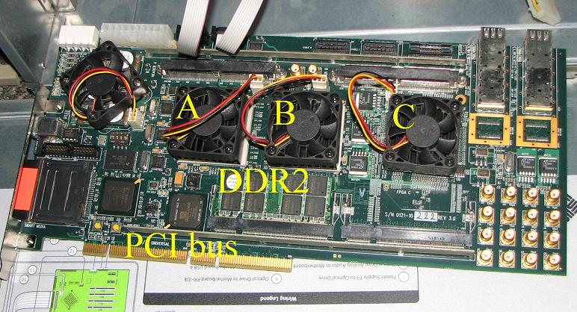
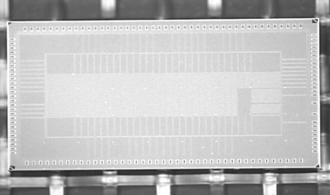
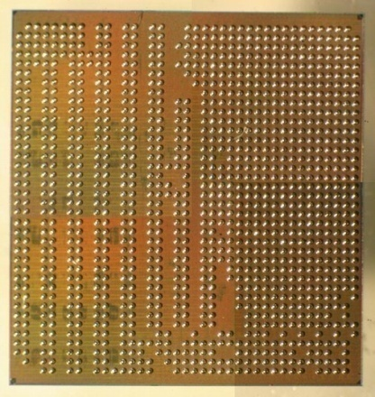
Not just talking
Algorithms&Software
PRAM-On-Chip HW Prototypes
ICE/WorkDepth/PAT
Creativity ends here
PRAM
Programming & workflow
No ‘parallel programming’ course beyond freshmen
Stable compiler
IP for dynamic thread allocation ➔ Intel TBB 4/13
64-core, 75MHz FPGA of XMT
(Explicit Multi-Threaded) architecture
SPAA98..CF08
128-core intercon. network IBM 90nm: 9mmX5mm, 400 MHz [HotI07]➔Fund
work on asynch NOCS’10
FPGA design➔ASIC
IBM 90nm: 10mmX10mm
Scales: 1K+ cores on-chip. Power & Tech updates ➔ cycle accurate simulator
Notes:
Creativity--By nature, algorithms require some level of creativity. Ideally, programming does not.

Slide 19
Orders-of-magnitude speedups & complexity
Next slide: ease-of-programming
non-trivial stress tests
 | XMT | GPU/CPU | factor
Graph Biconnectivity 2012 | 33X | 4X random graphs Muuuch parallelism | >>8
Graph Triconnectivity 2012 | 129X | ? | ?
Max Flow 2011 | 108X | 2.5X | 43
Burrows Wheeler Compression Transform - bzip2 Decompression | 25X 13X | X/2.8 … on GPU ? | 70 ?
- 3 graph algorithms: No algorithmic creativity.
- 1st “truly parallel” speedup for lossless data compression. SPAA 2013. Beats Google Snappy (message passing within warehouse scale computers)
State of project
- 2012: quant validation of (most advanced) PRAM algorithms: ~65 man years
2013 -: 1. Applications 2. Update Memory & VLSI technologies/opportunities

Slide 20
Not alone in building new parallel computer prototypes in academia
At least 3 more US universities in the last 2 decades
Unique(?) daring own course-taking students to program it for performance
  - Graduate students do 6 programming assignments, including biconnectivity, in a theory course
  - Freshmen do parallel programming assignments for problem load competitive with serial course
And we went out for
  HS students: magnet and inner city schools
“XMT is an essential component of our Parallel Computing courses because it is the one place where we are able to strip away industrial accidents from the student's mind, in terms of programming necessity, and actually build creative algorithms to solve problems”—national award winning HS teacher. 6th year of teaching XMT. 81 HS students in 2013.
  HS vs PhD success stories
  And …

Slide 21

Middle School Summer Camp Class, July’09 (20 of 22 students).
Math HS Teacher D. Ellison, U. Indiana
Notes:
7 were rising 6th graders
Summer camp for children from underrepresented groups

Slide 22
What about the missing items ?
Recap
Feasible Orders of magnitude better with different hardware.
Evidence Broad portfolio; e.g., most advanced parallel algorithms; high-school students do PhD-thesis level work
Who should care?
- DARPA Opportunity for competitors to surprise the US military and economy
Vendors
  Confluence of mobile & wall-plugged processor market creates unprecedented competition. Standard: ARM. Quad-cores and architecture techniques reached plateau. No other way to get significantly ahead.
  ➔Smart node in the cloud helped by large local memories of other nodes
  ➔Bring Watson irregular technologies to personal user

Slide 23
But, we may be missing…
- Chicken-and-egg effect Few end-user apps use missing items (since..missing)
- My guess Under water, the “end-user application iceberg” is much larger than today’s parallel end-user applications
Supporting evidence
  Irregular problems: many and rising. Data compression. Computer Vision. Bio-related. Sparse scientific. Sparse sensing & recovery. EDA
  “Educated innocents” Students, last CompEng non-elective class
    Nearly all serial programs we learned/wrote do not fit this regular mold
    Cannot believe that the regular mold is sufficient for more than a small minority of potential applications
    For balance Heard from a colleague: so we teach the wrong things
2013 Embedded processor vendors hear from their customers. New attitude…

Slide 24
What is really missed IMO
Forget apps. Think how problems are posed and programs developed. Irregular programming is all over computer programs for problems whose understanding does not imply clear input or output definitions ➔ big variety on program development and resulting programs. Appealing instance of individuality & creativity in CS: Why robots have not yet replaced us..
Open-ended programming: Prevalent, but not in benchmarks.
Open-ended programming is big deal for:
  the standard curriculum
  practice
  computer science culture as a whole
Students resentful since they came to appreciate it, only see it now crushed it when it comes to parallel programming..
Notes:
VC’s role in IT is great, but we should be aware of the pernicious effect of seeking shortcuts to apps.

Slide 25
Can such ideas gain traction?
Naive answer: “Sure, since they are good”.
So, why not in the past?
  Wall Street companies: risk averse. Too big for startup
  Focus on fighting out GPUs (only competition)
  60 yrs same “computing stack” ➔ lowest common ancestor of company units for change: CEO… who can initiate it? … Turf issues

Slide 26
My conclusion
A time bomb that will explode sooner or later
Huge market: more frequent replacement.
- Will take over domination of a core area of IT. How much more?

Slide 27
Snapshot: XMT High-level language
A
D
Cartoon Spawn creates threads; a
thread progresses at its own speed
and expires at its Join.
Synchronization: only at the Joins. So,
virtual threads avoid busy-waits by
expiring. New: Independence of order
semantics (IOS)
The array compaction (artificial) problem
Input: Array A[1..n] of elements.
Map in some order all A(i) not equal 0 to array D.
1
0
5
0
0
0
4
0
0
e0
1
4
5
e2
e6
For program below:
e$ local to thread $;
x is 3

Slide 28
XMT-C
Single-program multiple-data (SPMD) extension of standard C.
Includes Spawn and PS - a multi-operand instruction.
Essence of an XMT-C program
int x = 0;
Spawn(0, n-1) /* Spawn n threads; $ ranges 0 to n − 1 */
{ int e = 1;
if (A[$] not-equal 0)
{ PS(x,e);
D[e] = A[$] }
}
n = x;
Notes: (i) PS is defined next (think F&A). See results for
e0,e2, e6 and x. (ii) Join instructions are implicit.

Slide 29
XMT Assembly Language
Standard assembly language, plus 3 new instructions: Spawn, Join, and PS.
The PS multi-operand instruction
New kind of instruction: Prefix-sum (PS).
Individual PS, PS Ri Rj, has an inseparable (“atomic”) outcome:
Store Ri + Rj in Ri, and
(ii) Store original value of Ri in Rj.
Several successive PS instructions define a multiple-PS instruction. E.g., the
sequence of k instructions:
PS R1 R2; PS R1 R3; ...; PS R1 R(k + 1)
performs the prefix-sum of base R1 elements R2,R3, ...,R(k + 1) to get:
R2 = R1; R3 = R1 + R2; ...; R(k + 1) = R1 + ... + Rk; R1 = R1 + ... + R(k + 1).
Idea: (i) Several ind. PS’s can be combined into one multi-operand instruction.
(ii) Executed by a new multi-operand PS functional unit. Enhanced Fetch&Add.
Story: 1500 cars enter a gas station with 1000 pumps. Main XMT patent: Direct in unit time a car to a EVERY pump; PS patent: Then, direct in unit time a car to EVERY pump becoming available

Slide 30
Programmer’s Model as Workflow
Arbitrary CRCW Work-depth algorithm.
- Reason about correctness & complexity in synchronous PRAM-like model
SPMD reduced synchrony
  Main construct: spawn-join block. Can start any number of processes at once. Threads advance at own speed, not lockstep
  Prefix-sum (ps). Independence of order semantics (IOS) – matches Arbitrary CW. For locality: assembly language threads are not-too-short
  Establish correctness & complexity by relating to WD analyses
spawn
join
spawn
join
  Circumvents: (i) decomposition-inventive; (ii) “the problem with threads”, e.g., [Lee]. Issue addressed in a PhD thesis nesting of spawns
Tune (compiler or expert programmer): (i) Length of sequence of round trips to memory, (ii) QRQW, (iii) WD. [VCL07]
  - Correctness & complexity by relating to prior analyses
Notes:
Prefix-sum is the well-known fetch-and-add/increment commutative ‘atomic operation’, introduced by the NYU-Ultracomputer project in the early 1980s.
Our only innovation there is in a more efficient direct HW implementation

Slide 31
XMT Architecture Overview
BestInClass serial core – master thread control unit (MTCU)
Parallel cores (TCUs) grouped in clusters
Global memory space evenly partitioned in cache banks using hashing
No local caches at TCU. Avoids expensive cache coherence hardware
HW-supported run-time load-balancing of concurrent threads over processors. Low thread creation overhead. (Extend classic stored-program+program counter; cited by 40 patents; Prefix-sum to registers & to memory. )
MTCU
Hardware Scheduler/Prefix-Sum Unit
Cluster 1
Cluster 2
Cluster C
Parallel Interconnection Network
…
Memory Bank 1
Memory Bank 2
Shared Memory
(L1 Cache)
Memory Bank M
DRAM Channel 1
DRAM Channel D
- Enough interconnection network
bandwidth
Notes:
Back-up slide: XMT Block Diagram –

Slide 32
Backup - Holistic design
Lead question How to build and program general-purpose many-core processors for single task completion time?
Carefully design a highly-parallel platform ~Top-down objectives:
High PRAM-like abstraction level. ‘Synchronous’.
Easy coding Isolate creativity to parallel algorithms
Not falling behind on any type & amount of parallelism
Backwards compatibility on serial
Have HW operate near its full intrinsic capacity
Reduced-synchrony & no busy-waits; to accommodate varied memory response time
Low overhead start & load balancing of fine-grained threads
High all-to-all processors/memory bandwidth. Parallel memories
Notes:
Easy code--
See next slide for my inspiration on how to operate near full intrinsic capacity
Tensions: Synchronous for higher abstraction, reduced synchrony & no-busy-waits for physical reality

Slide 33
Backup- How?
The contractor’s algorithm
1. Many job sites: Place a ladder in every LR ☺
2. Make progress as your capacity allows
System principle 1st/2nd order PoR/LoR
PoR: Predictability of reference
LoR: Locality of reference
Presentation challenge
Vertical platform. Each level: lifetime career
Strategy Snapshots. Limitation Not as satisfactory
Notes:
Place a ladder:
Each processor represents a job site: issues instructions and when the working material arrives can fire-up the functional-units (laborers).
Inspired by a contractor at home. He perfected this so well that we needed to replace him in order get back our life

Slide 34
The classic SW-HW bridge, GvN47
Program-counter & stored program
XMT: upgrade for parallel abstraction
Virtual over physical:
distributed solution
H. Goldstine, J. von Neumann.
Planning and coding problems for an
electronic computing instrument, 1947
Notes:
GvN47

Slide 35
Workflow from parallel algorithms to programming versus trial-and-error
Legend creativity hyper-creativity [More creativity ➔ less productivity]
Option 1
Option 2
Domain decomposition,
or task decomposition
PAT
Parallel algorithmic thinking (say PRAM)
PAT
Prove
correctness
Program
Program
Sisyphean(?)
loop
Insufficient inter-thread bandwidth?
Still correct
Rethink algorithm: Take better advantage of cache
Tune
Compiler
Still correct
Hardware
Hardware
Is Option 1 good enough for the parallel programmer’s model?
Options 1B and 2 start with a PRAM algorithm, but not option 1A.
Options 1A and 2 represent workflow, but not option 1B.
Not possible in the 1990s.
Possible now.
Why settle for less?

Slide 36
Who should produce the parallel code?
Choices [state-of-the-art compiler research perspective]
Programmer only
  Writing parallel code is tedious.
  Good at ‘seeing parallelism’, esp. irregular parallelism.
  But are bad at seeing locality and granularity considerations.
    Have poor intuitions about compiler transformations.
Compiler only
  Can see regular parallelism, but not irregular parallelism.
  Great at doing compiler transformations to improve parallelism, granularity and locality.
⇒ Hybrid solution: Programmer specifies high-level parallelism, but little else. Compiler does the rest.
Goals:
Ease of programming
  Declarative programming
Thanks: Prof. Barua
(My) Broader questions
Where will the algorithms come from?
Is today’s HW good enough?
This course relevant for all 3 questions
Notes:
For question on algorithm: obvious.
For question on compilers: see Prof. Barua’s comments. This course is all about ‘seeing parallelism’.
For HW: stay tuned. Hint: engineering (not computer engineering…) typically goes from specs to building.

Slide 37
Denial Example: BFS [EduPar2011]
2011 NSF/IEEE-TCPP curriculum teach BFS using OpenMP
Teaching experiment Joint F2010 UIUC/UMD class. 42 students
Good news Easy coding (since no meaningful ‘decomposition’)
Bad news None got speedup over serial on 8-proc SMP machine
BFS alg was easy but .. no good: ➔no speedups
Speedups on 64-processor XMT 7x to 25x
Hey, unfair! Hold on: <1/4 of the silicon area of SMP
Symptom of the bigger “denial”
‘Only problem Developers lack parallel programming skills’
Solution Education. False Teach then see that HW is the problem
HotPAR10 performance results include BFS:
XMT/GPU Speed-up same silicon area, highly parallel input: 5.4X
Small HW configuration, large diameter: 109X wrt same GPU
Notes:
Unfair since 64 processors are compared to 8

Slide 38
Discussion of BFS results
Contrast with smartest people: PPoPP’12, Stanford’11 .. BFS on multi-cores, again only if the diameter is small, improving on SC’10 IBM/GaTech & 6 recent papers, all 1st rate conferences
BFS is bread & butter. Call the Marines each time you need
bread? Makes one wonder Is something wrong with the field?
‘Decree’ Random graphs = ‘reality’. In the old days: Expander graphs taught in graph design. Planar graphs were real
Lots of parallelism ➔ more HW design freedom. E.g., GPUs get decent speedup with lots of parallelism, and
But, not enough for general parallel algorithms. BFS (& max-flow): much better speedups on XMT. Same easier programs
Notes:
Contrast – Marines and perhaps parallel computing people are really brave. If you give them a piece of hardware, nothing will stop them. But is it wise?
Decree-- For academia, it has been. For industry, it seems to work, perhaps because competition is so limited. Isn’t it fascinating how we find ourselves in a hole and keep digging?
Lots of parallelism –This is not where the trick is.

Slide 39
Power Efficiency
heterogeneous design ➔ TCUs used only when beneficial
extremely lightweight TCUs. Avoid complex HW overheads: coherent caches, branch prediction, superscalar issue, or speculation. Instead TCUs compensate with much parallelism
distributed design allows easy turned off of unused TCUs
compiler and run-time system hide memory latency with computation as possible ➔ less power in idle stall cycles
HW-supported thread scheduling is both much faster and less energy consuming than traditional software driven scheduling
same for prefix-sum based thread synchronization
custom high-bandwidth network from XMT lightweight cores to memory has been highly tuned for power efficiency
we showed that the power efficiency of the network can be further improved using asynchronous logic

Slide 40
Back-up slide
Possible mindset behind vendors’ HW
“The hidden cost of low bandwidth communication” BMM94:
HW vendors see the cost benefit of lowering performance of interconnects, but grossly underestimate the programming difficulties and the high software development costs implied.
2. Their exclusive focus on runtime benchmarks misses critical costs, including: (i) the time to write the code, and (ii) the time to port the code to different distribution of data or to different machines that require different distribution of data.
Architects ask (e.g., me) what gadget to add?
☹ Sorry: I also don’t know. Most components not new. Still ‘importing airplane parts to a car’ does not yield the same benefits
  ☺ Compatibility of serial code matters more

Slide 41
More On PRAM-On-Chip Programming
10th grader* comparing parallel programming approaches
  “I was motivated to solve all the XMT programming assignments we got, since I had to cope with solving the algorithmic problems themselves, which I enjoy doing. In contrast, I did not see the point of programming other parallel systems available to us at school, since too much of the programming was effort getting around the was the system was engineered, and this was not fun”
*From Montgomery Blair Magnet, Silver Spring, MD

Slide 42
Independent validation by DoD employee
Nathaniel Crowell. Parallel algorithms for graph problems, May 2011. MSc scholarly paper, CS@UMD. Not part of the XMT team
http://www.cs.umd.edu/Grad/scholarlypapers/papers/NCrowell.pdf
Evaluated XMT for public domain problems of interest to DoD
Developed serial then XMT programs
Solved with minimal effort (MSc scholarly paper..) many problems. E.g., 4 SSCA2 kernels, Algebraic connectivity and Fiedler vector (Parallel Davidson Eigensolver)
Good speedups
No way where one could have done that on other parallel platforms so quickly
Reports: extra effort for producing parallel code was minimal
Notes:
More like a couple of PhD theses on other platforms
Reports: NSA people told me that with GPUs, the experience has been 1 week for a working program and then ½ year for performance

Slide 43
Importance of list ranking for tree and graph algorithms
advanced planarity testing
advanced triconnectivity
planarity testing
triconnectivity
st-numbering
k-edge/vertex
connectivity
minimum
spanning forest
Euler
tours
ear decompo-
sition search
bicon-
nectivity
strong
orientation
centroid
decomposition
tree
contraction
lowest common
ancestors
graph
connectivity
tree Euler tour
Point of recent study
Root of OofM speedups:
Speedup on various input sizes
on much simpler problems
list ranking
2-ruling set
prefix-sums
deterministic coin tossing

Slide 44
Software release
Allows to use your own computer for programming on an XMT environment & experimenting with it, including:
a) Cycle-accurate simulator of the XMT machine
b) Compiler from XMTC to that machine
Also provided, extensive material for teaching or self-studying parallelism, including
Tutorial + manual for XMTC (150 pages)
Class notes on parallel algorithms (100 pages)
Video recording of 9/15/07 HS tutorial (300 minutes)
Video recording of Spring’09 grad Parallel Algorithms lectures (30+hours)
www.umiacs.umd.edu/users/vishkin/XMT/sw-release.html,
Or just Google “XMT”
Notes:
44

Slide 45
Helpful (?) Analogy
  Grew on tasty salads: Natural ingredients; No dressing/cheese
  Now salads requiring tones of dressing and cheese. Taste?
  Reminds (only?) me of
  Dressing Huge blue-chip & government investment in system & app software to overcome HW limitations. (limited scope) DSLs.
  Taste Speed-ups only on limited apps.
  Contrasted with:
  Simple ingredients Parallel algorithms theory. Few basic architecture ideas on control & data paths and memory system
    Modest academic project
    Taste Better speedups by orders of magnitude. HS student vs PhDs

Slide 46
Participants
Grad students: James Edwards, Fady Ghanim Recent PhDs: Aydin Balkan, George Caragea, Mike Horak, Fuat Keceli, Alex Tzannes*, Xingzhi Wen
Industry design experts (pro-bono).
Rajeev Barua, Compiler. Co-advisor X2. NSF grant.
Gang Qu, VLSI and Power. Co-advisor.
Steve Nowick, Columbia U., Asynch logic. Co-advisor. NSF team grant.
Ron Tzur, U. Colorado, K12 Education. Co-advisor. NSF seed funding
K12: Montgomery Blair Magnet HS, MD, Thomas Jefferson HS, VA, Baltimore (inner city) Ingenuity Project Middle School 2009 Summer Camp, Montgomery County Public Schools
Marc Olano, UMBC, Computer graphics. Co-advisor.
Tali Moreshet, Swarthmore College, Power. Co-advisor.
Bernie Brooks, NIH. Co-Advisor.
Marty Peckerar, Microelectronics
Igor Smolyaninov, Electro-optics
Funding: NSF, NSA deployed XMT computer, NIH
Transferred IP for Intel/TBB-customized XMT lazy scheduling. 4’2013
Reinvention of Computing for Parallelism. 1st out of 49 for Maryland Research Center of Excellence (MRCE) by USM. None funded. 17 members, including UMBC, UMBI, UMSOM. Mostly applications.
* 1st place, ACM Student Research Competition, PACT’11. Post-doc, UIUC

Slide 47
Mixed bag of incentives
Vendor loyalists
In past decade, diminished competition among vendors. The recent “GPU chase/race” demonstrates power of competition. Now back with a vengeance: 3rd and 4th in mobile dropped out in 2012
What’s in it for researchers who are not generalists? and how many HW/SW/algorithm/app generalists you know?
Zero-sum with other research interests; e.g., spin (?) of Game Over report into supporting power over missing items

Slide 48
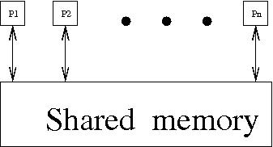
Algorithms dart Parallel Random-Access Machine/Model
PRAM:
n synchronous processors all having unit time access to a shared memory.
Basis for Parallel PRAM algorithmic theory
- 2nd in magnitude only to serial algorithmic theory
- Simpler than above. See later
- Won the “battle of ideas” in the 1980s. Repeatedly:
Challenged without success ➔ no real alternative!
Today: Latent, though not widespread, knowledgebase
Drawing a target?
State-of-the-art 1993 LogP well-cited paper: unrealistic for implementation
Why high bandwidth hard for 1993 technology
Low bandwidth ➔ PRAM lower bounds [VW85,MNV94] ➔ real conflict
Notes:
Mention Arbitrary CRCW PRAM

Slide 49
What else can be done?
The approach I pursued
Start from the abstraction: coming from algorithms, how do I want to think about parallelism?
Co-develop parallel algorithms theory
Learn architecture. Understand constraints & compilers
Start from a clean slate to build a holistic system, by connecting dots developed since 1970s. Preempt need for afterthought. No shame in learning from others
Prototype/validate quantitatively
Notes:
Prototype/validate– switch gear to some bumper sticker philosophy.
Trust, but verify --Ronald Reagan
In theory, there should be no difference between theory and practice, but in practice, there is--(Yogi Berra or William T. Harbaugh). I used to be offended by that, but then took it to heart.
To which James C. Maxwell replied a 100 years earlier:There is nothing more practical than a good theory. What I think that he meant is that practice with its inertia can get you stuck so bad that only theory can save you, especially if you need to get to the ‘next level’

Slide 50
Our explicit multi-threaded (XMT) platform
Contradicting LogP: can do it!
1st thought leading to XMT Sufficient on-chip bandwidth now possible

Slide 51
More Order-of-Magnitude Denial Examples 1
Performance Example Parallel Max-Flow speedups vs best serial
  [HeHo, IPDPS10] <= 2.5x using best of CUDA & CPU hybrid
  [CarageaV, SPAA11] <= 108.3x using XMT (ShiloachV&GoldbergTarjan)
  Big effort beyond published algorithms vs normal theory-to-practice
  Advantage by 43X
Why max-flow example?
As advanced any irregular fine-grained parallel algorithms dared on any parallel architecture
- Horizons of a computer architecture cannot only be studied using elementary algorithms [Performance, efficiency and effectiveness of a car not tested only in low gear or limited road conditions]
Stress test for important architecture capabilities not often discussed:
Strong scaling : Increase #processors, not problem size
Rewarding even little amounts of algorithm parallelism with speedups & not falling behind on serial

Slide 52
More Order-of-Magnitude Denial Examples 2
  Ease of programming Ease of learning. Teachability [SIGCSE’10]
Freshman class. 11 non-CS students. Prog. assignments: merge-sort*, integer-sort* & sample-sort.
TJ Magnet HS. Teacher downloaded simulator, assignments, class notes, from XMT page. Self-taught.
Recommends Teach XMT first. Easiest to set up (simulator), program, analyze - predictable performance (as in serial). Not just embarrassingly parallel. Teaches also OpenMP, MPI, CUDA **
- HS & MS (some 10 yr old) from underrepresented groups by HS Math teacher
Benchmark Can any CS major program your manycore? for hard speedups? Avoiding it ➔ denial. Yet, this is the state-of-the-art
*In Nvidia + UC Berkeley IPDPS09 research paper!
**Also, keynote at CS4HS’09@CMU + interview with teacher
Notes:
Need for creativity and programmer’s productivity are opposites. The more originality/creativity is required the less the productivity. Academics seek originality opportunities for publishing, but they are the only ones who seek that…
The issue of programmers’ productivity has defied so far quantitative studies.
Ease-of-learning is a necessary condition for ease of programming.
Education: good benchmark for ease-of-learning. There is linear order of what is teachable learnable (what can be taught to grad students, can be taught to seniors, then freshmen, then high-school..), which is the next best thing to quantitative

Slide 53
Biconnectivity Speedups [EdwardsV’12]: 9X to 33X relative to up to best result of up to 4X [Cong-Bader] over 12-processor SMP. No GPU results.
Ease-of-programming
Normal algorithm-to-programming (of [TarjanV]) versus creative and complex program
Most advanced algorithm in parallel algorithms textbooks
Spring’12 class: programming HW assignment!
Biconnectivity speedups were particularly challenging since DFS-based serial algorithms is very compact. Indeed:
Triconnectivity speedups [EdwardsV,SPAA’12]: up to 129X! Unaware of prior parallel results.
This completes the work on advanced PRAM algorithms.
Guess what next.

Slide 54
Other speedup results
SPAA’09: XMT gets ~10X vs. state-of-the art Intel Core 2 in experiments guided by senior Intel engineer. Silicon area of 64-processor XMT, same as 1-2 commodity processor-core
Simulation of 1024 processors: 100X on standard benchmark suite for VHDL gate-level simulation. for 1024 processors [Gu-V06]
HotPar’10/ICPP’08 compare with GPUs ➔ XMT+GPU beats all-in-one
Power All results extend to a power envelop not exceeding current GPUs

Slide 55
Reward game is skewed gives (illusion of) job security
You might wonder: why if we have such a great architecture, don’t we have many more single-application papers?
Easier to publish on “hard-to-program” platforms
  Remember STI Cell? ‘Vendor-backed is robust’: remember Itanium?
Application papers for easy-to-program architectures are considered “boring”
  Even when they show good results
Recipe for academic publication and promotions
  Take simple application (e.g. Breadth-First Search in graph)
  Implement it on latest difficult-to-program vendor-backed parallel architecture
  Discuss challenges and workarounds to establish intellectual merit
  Stand out of the crowd for industry impact
Job security Architecture sure to be replaced (difficult to program ..)
Notes:
Illusion because market place is sure to reject parallelism in the mainstream, making everybody a loser
Stand out: deans love the industry brand-name and the citation count among all those doing the same thing

Slide 56
Competition may be back
Steve Jobs 4’10: HTML5 will win on mobile&PCs
Trap Rely on HTML5 to quickly get your app to broad compatibility across the mobile landscape. To succeed Tackle each platform separately. Idea Build apps that only work on the latest/greatest version of a phone, and intentionally not on previous models. Fewer people will be able to use it, but buyers of the new toy will. If your app makes hot new HW look good ➔ promoted by HW/OS vendor giving your app presence it could not otherwise get. Once a product succeeds on brand-new HW, you may adapt it to other platforms --ZDNetAsia
Platform competition High-end app exceeding other platforms
Just a matter of time till mobile will start eating desktop vendor’s lunch
Notes:
High-level standard—You can use your HW and SW for a given function as long as you deliver for example, video.
Strong emphasis on off-line operation will lead to much more powerful mobiles/PCs than many predicted

Slide 57
Summary (1 out of 2)
Industry & academia stuck in exploratory stage
Solutions do not work critical adoption problems
Contrasted creativity, complexity, and demand for overhauling code for high amounts of parallelism with:
  Cost-effective parallel programming, and
  Even feasibility
Reviewed a solution The XMT platform:
  - Accounts for opportunities and constraints understood in exploratory stage & current technology realities
  - Isolates all creativity to parallel algorithms
  - Reduce programming to a skill
  Order-of-magnitude improvement: ease-of-prog, performance

Slide 58
Summary (2 out of 2)
In line with new LANL emphasis strong scaling
Belief propagation/inference applications In part: fast processing of Bayesian networks. Typically modeled as irregular directed acyclic graphs (DAGs). Processing of such DAGs in parallel requires fine-grained irregular parallelism.
Supporting such fast parallel algorithm: goal of 1000-processor on-chip XMT system
Stress test that met in max-flow work & strong speedups over the main many-core commercial platforms: promising indicators for such DAGs algorithms. Other results also offer similar evidence

Slide 59
Conclusion 1
Without an easy-to-program many-core architecture, rejection of parallelism by mainstream programmers is all but certain
  More researchers need to work and seek publications on easy-to-program architectures
CS&E people are welcome to study problems/applications on the platform and/or the architecture, and do research:
  A good research bet. Start with comparisons (performance, ease-of-programming) to convince yourself.
  It is crucial for innovation, the economy (Deloitte’s report), the future of the profession, and is a good research bet
  Need to understand that application people will join only when given wall-clock time reward
Notes:
You can fool some of the people all of the time, and all of the people some of
the time, but you can not fool all of the people all of the time—A. Lincoln
Time to wake up: Affirmative action favoring such architectures should drive many more researchers to work and seek publications on easy-to-program architectures.
Instead, we are telling them that:
Such work will be dismissed as ‘too easy’
- Do not give them wall-clock reward

Slide 60
Conclusion 2
XMT aims at being easy-to-program, general-purpose architecture
  Performance improvement on hard-to-parallelize applications (MaxFlow)
  Ease of programming: by showing order-of-magnitude improvement in ease-of-teaching/learning
    Achieved better speedups and at much earlier developmental stage (10th graders in HS versus graduate students). DARPA-HCPS/UCSB/UMD experiment, Middle-School, 2 Magnet HS, Inner City HS, freshmen course, UIUC/UMD-experiment.
Current stage of XMT project: develop more complex applications beyond benchmarks. Steps in this direction:
  Max-Flow
  Gate-level logic simulations GuV06
  New results on variety of high connectivity problems
Other XMT objectives
  Workhorse for general-purpose parallel computing
  Sustained performance A car that can reach 300 mph but goes at an average of 10 mph is not as good as max 70 mph with an average of 50 mph
  Competitive on any type of parallelism fine/coarse grain, regular/irregular
  Parallel algorithms and architecture are on a collision course; preempt it

Slide 61
General-purpose serial computing
Robust
Example Supported the SW spiral (Andy Grove)
Key stored-program-program-counter (SPPC) apparatus.
Survived 60+yrs of general-purpose serial processors. Allowed:
Import only 1 axiom from Math: induction
[couple induction with simple abstraction]
Algorithms Clean analytic theory: correctness, efficiency
Notes:
SW spiral—contract between programmers and architects
Key – next slide
Couple – slide after that

Slide 62
General-purpose parallel computing for speeding up single task
Current commercial systems not robust
- SW spiral broken
Look like industrial accidents
Did not emerge from a clean-slate design
Order-of-magnitude behind* on ease-of-programming Unnecessary burden on programmers. Possibly inventive:
- decomposition
- assignment
- orchestration
- mapping
- reasoning about concurrency (race conditions)
- (for GPUs) making the whole program highly parallel
OofM behind* on speedups for irregular apps
No compact/rigorous induction-like way to reason
Notes:
SW spiral broken—no current contract between programmers and architects
* Behind what’s feasible. Next slide

Slide 63
Is it feasible to rewrite the serial book for parallel?
XMT: Yes! 1-1 match to serial stack
Clean slate design
Theory of parallel algorithm. Couple induction with simple parallel abstraction.
Parallel SPPC
Validation
- Architecture, compiler, run-time
- OofM ahead on ease-of-programming and speedups. Including: most advanced algorithmic problems

Slide 64
Serial Abstraction & A Parallel Counterpart 2nd visit
Serial abstraction: any single instruction available for execution in a serial program executes immediately – ”Immediate Serial Execution (ISE)”
Abstraction for making parallel computing simple: indefinitely many instructions, which are available for concurrent execution, execute immediately, dubbed Immediate Concurrent Execution (ICE) – same as ‘parallel algorithmic thinking (PAT)’ for PRAM
Conjecture SV82: Full PRAM algorithm just matter of skill. Used as framework in main PRAM algorithms texts: JaJa92, KKT01
Serial Execution, Based on Serial Abstraction
What could I do in parallel at each step assuming unlimited hardware
➔
Parallel Execution, Based on Parallel Abstraction
#
ops
.
.
#
ops
.
.
.
.
..
..
..
..
time
time
Time = Work
Work = total #ops
Time << Work
Notes:
Serial--Abstracts away: different execution time for operation (memory hierarchy). Made serial programming simple. Programmers: conceptualize. HW and compilers: implement. Program: instruction to execute next (inductively)
Parallel--Step-by-step (inductive) explication of the instructions available next for concurrent execution. # processors not even mentioned. Falls back on the serial abstraction if 1 instruction/step

Slide 65
Back-up slide
Objectives for the rest of the presentation
1. Explain the XMT order-of-magnitude advantages on ease-of-programming and performance
  Snapshot of XMT programming
  Present ease-of-programming strategy
By nature, algorithms require some level of creativity. Ideally, programming does not. Our approach:
a. Isolate creativity to parallel algorithms
b. Reduce programming to a skill
Achieved that by careful design of the architecture.
Makes more sense than labor on every program
  New insight Good speedup on limited parallelism crucial for order-of-magnitude speedup advantage on interesting problems
2. Rising business & science competition opportunities
Notes:
Present
b.
Achieved that -- It makes more sense to make such effort in HW, similar to saving every driver from crawling under a car every morning to start it, by having car builders install ignition by key.

Slide 66
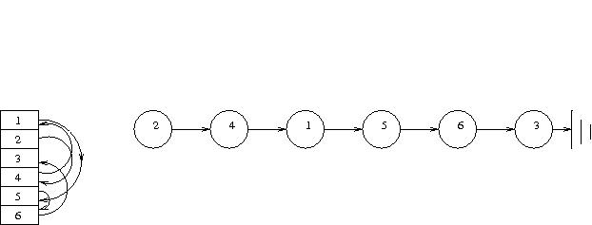
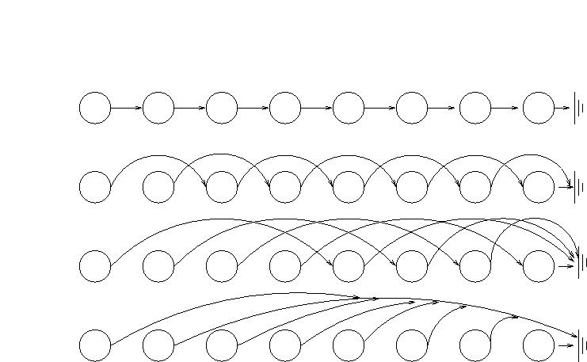
Example: The list ranking problem
Parallel pointer jumping
ICE pseudocode
for 1 <= i <= n pardo
while S(i) != S(S(i)) do
W(i) := W(i) + W(S(i))
S(i) := S(S(i))
end while
end for
Note
- Tight synchrony
- Reads before writes
Complexity O(log n) time, O(n log n) work. Serial: Time = Work = O(n)
Unusual Much (~n) parallelism. Often far less
Notes:
People stand in a very long line to the movies. Everyone sees only the back of the person in front. Where are you in the line? or is the line just going around the block .. and there is no movie?

Slide 67
psBaseReg flag; // number of threads that require another loop iteration
void pointer_jump(int S[n], int W[n], int n) {
int W_temp[n]; int S_temp[n];
do {
spawn(0, n-1) {
if (S[$] != S[S[$]]) {
W_temp[$] = W[$] + W[S[$]]; S_temp[$] = S[S[$]];}
else {W_temp[$] = W[$];S_temp[$] = S[$];}
}
flag = 0;
spawn(0, n-1) {
if (S_temp[$] != S_temp[S_temp[$]]) {
int i = 1;
ps(i, flag);
W[$] = W_temp[$] + W_temp[S_temp[$]];
S[$] = S_temp[S_temp[$]];}
else {W[$] = W_temp[$]; S[$] = S_temp[$];}
}
} while (flag != 0);
}
XMTC program

Slide 68
Speedup for List Ranking (vs. Best Serial)
Focus XMT feature Low overhead initiation of all TCUs
HW (with feature) versus bsplit (without feature). Both within XMT
List size (x 1,000) | jump |  | cointoss |  | hybrid
 | bsplit | HW | bsplit | HW | bsplit | HW
1 | 0.18 | 6.03 | 0.23 | 1.38 | 0.18 | 5.97
3.2 | 0.54 | 7.63 | 0.27 | 2.18 | 0.54 | 7.61
10 | 0.60 | 8.18 | 0.49 | 3.74 | 0.61 | 8.23
32 | 0.75 | 10.72 | 1.17 | 8.83 | 1.43 | 14.31
100 | 1.21 | 17.97 | 3.32 | 27.86 | 3.69 | 36.50
320 | 1.66 | 14.70 | 6.73 | 31.01 | 6.86 | 33.07
1,000 | 3.46 | 8.61 | 16.57 | 40.26 | 16.63 | 40.72
3,200 | 5.63 | 10.44 | 29.37 | 56.53 | 29.64 | 56.68
10,000 | 6.38 | 10.86 | 35.85 | 61.64 | 35.95 | 61.72
➔
Algorithms
cointoss: coin tossing
jump: pointer jumping
hybrid: cointoss until the list size is below some threshold, then jump (accelerating cascades)
Spawn types
bsplit:
binary splitting
HW:
XMT hardware thread initiation
Note (for later)
➔ Compare speedups for input = 1000s
Notes:
Note: best speedups >= 60X vs > 30X without feature (or on GPUs – next slide).
However, for parallelism in the few 1000s, the XMT speedups are ~8X, while all other platforms give none!
Unique: in other systems you will find either ‘low overhead initiation of fine-grained threads’ (GPUs) or support for serial & limited parallelism. Not both.

Slide 69
Comparison with Prior Work on List Ranking
Bader et al. 2005
  Speedups <= 3x on a Sun E4500 SMP (using 8 processors)
  Speedups <= 6x on a Cray MTA-2 (using 8 processors, or 1024 HW streams as in 1024-TCU XMT)
  Speedups are relative to the same parallel algorithm running on a single processor on the same machine (list size = 80 million)
  No comparison with the best sequential algorithm
Rehman et al. 2009
  Speedups <=34x in cycle count (18x wall clock time) on NVIDIA GTX 280 GPU (list size 4M) over best sequential algorithm on Intel Core 2 Quad Q6600 vs <= 62X for 10M (57X for 4M) on XMT
  Pointer jumping for 4K: no speedup on GPU vs 8X for XMT
  MAIN POINT Limited number (e.g., 4K) of very short threads ➔ order-of-magnitude advantage to XMT over all others
D. Bader, G. Cong, and J. Feo. On the architectural requirements for
efficient execution of graph algorithms. In Proc. Int’l Conf. on Parallel Processing (ICPP), pp. 547-556, June 2005.
M. S. Rehman, K. Kothapalli, and P. J. Narayanan. Fast and Scalable List Ranking on the GPU. In Int’l Conf. on Supercomputing (ICS), pp. 235-243, June 2009.
Notes:
Recall comment on GPU productivity problems if whole program is not highly parallel.
I claimed that it affects productivity as upgrading a serial program requires major overhaul for parallelism of the whole program.
You may say: but, list ranking has enough parallelism for interesting input sizes.
Not so! Often, list ranking routines occur with limited input sizes for interesting problems…

Slide 70
Biconnectivity Speedups [EdwardsV]: 9X to 33X relative to up to best result of up to 4X [Cong-Bader] over 12-processor SMP. No GPU results.
Int’l Workshop on Programming Models and Applications for Multicores and Manycores, to appear in Proc. PPoPP’12, Feb 25-29, 2012
Biconnectivity speedups were particularly challenging since DFS-based serial algorithms is very compact; however:
Stronger speedups for triconnectivity: submitted. Unaware of prior parallel results.
Ease-of-programming
Normal algorithm-to-programming (of [TarjanV]) versus creative and complex program
Most advanced algorithm in parallel algorithms textbooks
Spring’12 class: programming HW assignment!

Slide 71
“The U.S. Is Busy Building Supercomputers, but Needs Someone to Run Them”*, 12/2011
‘Low-end’ supercomputers $1-10M/unit
Supercomputing leaders Not enough programmers
Comments 1. Fewer (total) programmers than many-cores
2. Prog. models of many-cores too similar to expect a difference
3. IMO denial. Just a symptom. The problem is the HW
Opportunity Space
<~1TB main memory. If 1000-core HW, order-of-magnitude:
Lower Cost (~$10K/unit),
Easier programming
Greater speedups (performance)
Could LANL be interested?
* http://www.thedailybeast.com/articles/2011/12/28/the-u-s-is-busy-building-supercomputers-but-needs-someone-to-run-them.html
Notes:
Example Story mentions genomics research, as a key application. Does LANL care for this application?

Slide 72
Unchallenged in a Fall’11 DC event ‘what a wonderful dynamic field. 10 yrs ago DEC&Sun were great companies, now gone’; Apple, IBM, Motorola also out of high-end commodity processors.
Oh dear, compare this cheerfulness with:
“The Trouble with Multicore: Chipmakers are busy designing microprocessors that most programmers can't handle”—D. Patterson, IEEE Spectrum 7/2010
Only heroic programmers can exploit the vast parallelism in current machines – The Future of Computing: Game over or Next level, National Research Council, 2011
Ask yourself Dynamic OR consolidation and diminished competition? Satisfied with recent yrs innovation in high-end commodity apps?
Next How did we get to this point, and how to get out?
Notes:
Unchallenged – Vendors appear not to have a clue how to solve the 40 yrs old problem of building easy-to-program parallel machines. Lacking (and despairing of) a technical solution, their business strategy should be torn between preempting: (i) public perception of uncertainty; and (ii) drive researchers to give industry the solution it needs. The former may be fine for a vendor, but it puts the rest of us to sleep, and comes at the expense of the economy and the profession.
IMO, some of the same speakers also implied the opposite elsewhere; e.g., lower on this slide..
Consolidation – ‘winner takes all’ and the implied higher barrier to entry that follows – cited as a problem for getting the US out of today’s recession
How can one establish that many more apps would have been invented with easier to program platforms?

Slide 73
Is it an industrial disease if so many in academia, industry, and Wall Street see black as white?
If yes, consider
Publicity is justly commended as a remedy for social and industrial diseases. Sunlight is said to be the best of disinfectants; electric light the most efficient policeman—Louis D. Brandeis
BTW, IMO vendors will be happy if shown the way. But: 1. people say what they think that vendors want to hear; 2. vendors cannot protest against compliments to their own products
Notes:
BTW – When you get a compliment you typically don’t ask the other party if they forgot to take their pills today…

Slide 74
What if we keep digging (around HW dart)
Example: how to attract students? Starts par prog course with a parallel version of basic matrix multiply or tile-based one? The latter: Deliver 1st par prog trauma ASAP: Shock and awe ☺ Okay to teach later, but .. how many tiles to fit 1000X1000 matrices in cache of modern PC?
A sociology of science angle
Ludwik Fleck, 1935 (the Turing of sociology of science):
Research too esoteric to be reliable ➔ exoteric validation
Exoteric validation: exactly what general programmers could have provided, but … they have not!
Next Why vendors’ approach cannot work (and rejection by programmers is all but certain)
Notes:
Polish Israeli researcher. The most prestigious award in sociology of science named after him. Much of the 1960s book Structure of Scientific Revolutions (Thomas Kuhn’s ‘paradigm shift’ ) was based on this 1935 work.

Slide 75

“Application dreamer” between a rock and a hard place
Permeated the following working assumption
Programming models for larger-scale & mainstream systems – similar ➔ importing ills of parallel computing to mainstream
What if keep digging 2
Programmer’s productivity busters Many-core HW
Decomposition-inventive design **creativity**
☹ Reason about concurrency in threads **complexity**
For some parallel HW: issues if whole program is not highly parallel. Will highlight
Even if it is: **too much work**
Optimized for things you can “truly measure”: (old) benchmarks & power.
What about productivity?
Low priority at best ➔ Denial .. in other words
[Credit: wordpress.com]
Notes:
Will highlight – case of GPUs

Slide 76
Casualties of too-costly SW development
Cost and time-to-market of applications
Business model for innovation (& American ingenuity)
Advantage to lower wage CS job markets
Mission of research enterprises. PhD theses (bioinformatics): program around the engineering of parallel machines. Not robust contributions: new algorithms or modeling app domain.
NSF HS plan: attract best US minds with less programming, 10K CS teachers
.. Only future of the field & U.S. (and ‘US-like’) competitiveness
Still HW vendor ‘11: ‘Okay, you do have a convenient way to do parallel programming; so what’s the big deal?’ or ‘this is SW not HW’
Notes:
Cost -- Example: Suppose that DoD spends $100M/year on developing high-end source code for commodity desktops. Suppose that this cost can be cut by a factor of 10. Imagine: (i) what else you could with the same code development budget and/or (ii) just with the money.
Will it make sense to invest $10M to save $100M/year in this example?
Mission—yet will not support a new architecture, only burn money on architectures that waste time of researchers/programmers

Slide 77
Threats to validity of current power modeling
System 1 5 days correct code +1d performance
System 2 5 days correct code +1/2 year (125d) performance
How would you compare total power?
Power to develop app
Power to use app
Would the applications be the same?
If System 1 promotes more use (more apps, more programmers), is it really bad?
Notes:
If System 2 perhaps we should go to back to farming
If we go to an extreme, is a cemetery (no power consumption) the ideal?
Is this a religious/political/ideological issue, or is it a serious debate?
If the latter, where are the economists/business perspective?

Slide 78
But, what is the performance penalty for easy programming?
Surprise benefit! vs. GPU [HotPar10]
1024-TCU XMT simulations vs. code by others for GTX280. < 1 is slowdown. Sought: similar silicon area & same clock.
Postscript regarding BFS
59X if average parallelism is 20
109X if XMT is … downscaled to 64 TCUs

Slide 79
Problem acronyms
BFS: Breadth-first search on graphs
Bprop: Back propagation machine learning alg.
Conv: Image convolution kernel with separable filter
Msort: Merge-sort algorith
NW: Needleman-Wunsch sequence alignment
Reduct: Parallel reduction (sum)
Spmv: Sparse matrix-vector multiplication

Slide 80
Backup slides
Many forget that the only reason that PRAM algorithms did not become standard CS knowledge is that there was no demonstration of an implementable computer architecture that allowed programmers to look at a computer like a PRAM. XMT changed that, and now we should let Mark Twain complete the job.
We should be careful to get out of an experience only the wisdom that is in it— and stop there; lest we be like the cat that sits down on a hot stove-lid. She will never sit down on a hot stove-lid again— and that is well; but also she will never sit down on a cold one anymore.— Mark Twain

Slide 81
State of the art - approaches
Seek adding arch. support for parallel programming. For ‘Next level’?!..
Holding on to “industrial accidents” – not my term
Contrast with internet/networking: well-engineered core combined with openness-driven accidental design
Off-the-shelf. “What else can I do?”
Notes:
Seek - “new manycore chips can largely still be viewed as arrays of sequential processors” Quote from ISCA’12 workshop call. But look what they do with this understanding.. If adding a gadget would be enough, it would have been done long ago.
Off-the-shelf. What can most researchers/educators do? Each build a new computer? Many in CS shy away from HW. Understandable: not what they chose to do. Also: most are conformists. Call-by-name is low-risk. Often supported.

Slide 82
LPS Conclusion 1
XMT aims at being easy-to-program, general-purpose architecture
  Performance improvements on hard-to-parallelize applications like Max-Flow
  Ease of programming: by showing order-of-magnitude improvement in ease-of-teaching/learning
    Achieved better speedups and at much earlier developmental stage (10th graders in HS versus graduate students). DARPA-HCPS/UCSB/UMD experiment, Middle-School, 2 Magnet HS, Inner City HS, freshmen course, UIUC/UMD-experiment.
Current stage of XMT project: develop more complex applications beyond benchmarks. Steps in this direction:
  Max-Flow
  Gate-level logic simulations GuV06
  New results on variety of high connectivity problems
Without an easy-to-program many-core architecture, rejection of parallelism by mainstream programmers is all but certain
  Affirmative action: drive more researchers to work and seek publications on easy-to-program architectures
  This work should not be dismissed as ‘too easy’
Notes:
Time to wake up: Affirmative action favoring such architectures should drive many more researchers to work and seek publications on easy-to-program architectures.
Instead, we are telling them that:
Such work will be dismissed as ‘too easy’
- Do not give them wall-clock reward

Slide 83
LPS Conclusion 2
Other XMT objectives
  Workhorse for general-purpose parallel computing
  Sustained performance A car that can reach 300 mph but goes at an average of 10 mph is not as good as max 70 mph with an average of 50 mph
  Competitive on any type of parallelism fine/coarse grain, regular/irregular
  Parallel algorithms and architecture are on a collision course; preempt it
What will it take to get researchers & practitioners to experiment with an easy-to-program architectures (e.g., XMT)?
Answer A 1+GHz 1000 XMT prototype
Why Wall-clock reward
Problem funding
IMO, enabling such prototype must be top priority for funding
It is crucial for innovation, the economy (Deloitte’s report), the future of the profession and a good deal for government

Slide 84
Lessons from Invention of Computing
H. Goldstine, J. von Neumann. Planning and coding problems for an electronic computing instrument, 1947: “.. in comparing codes 4 viewpoints must be kept in mind, all of them of comparable importance:
Simplicity and reliability of the engineering solutions required by the code
Simplicity, compactness and completeness of the code
Ease and speed of the human procedure of translating mathematical conceived methods into the code, and also of finding and correcting errors in coding or of applying to it changes that have been decided upon at a later stage
Efficiency of the code in operating the machine near its full intrinsic speed
Take home
Legend features that fail the “truly measure” test
In today’s language programmer’s productivity
Birth (?) of CS: Translation into code of non-specific methods
.. how to match that for parallelism

Slide 85
How does XMT address BSP (bulk-synchronous parallelism) concerns?
XMTC programming incorporates programming for
locality & reduced synchrony
as 2nd order considerations
On-chip interconnection network: high bandwidth
Memory architecture: low latencies
1st comment on ease-of-programming
I was motivated to solve all the XMT programming assignments we got, since I had to cope with solving the algorithmic problems themselves which I enjoy doing. In contrast, I did not see the point of programming other parallel systems available to us at school, since too much of the programming was effort getting around the way the systems were engineered, and this was not fun.
Jacob Hurwitz, 10th grader, Montgomery Blair High School Magnet Program, Silver Spring, Maryland, December 2007.
Among those who did all graduate course programming assignments.

Slide 86
XMT (Explicit Multi-Threading):
A PRAM-On-Chip Vision
IF you could program a current manycore ➔ great speedups. XMT: Fix the IF
XMT was designed from the ground up with the following features:
Allows a programmer’s workflow, whose first step is algorithm design for work-depth. Thereby, harness the whole PRAM theory
No need to program for locality beyond use of local thread variables, post work-depth
Hardware-supported dynamic allocation of “virtual threads” to processors.
Sufficient interconnection network bandwidth
Gracefully moving between serial & parallel execution (no off-loading)
Backwards compatibility on serial code
Support irregular, fine-grained algorithms (unique). Some role for hashing.
Tested HW & SW prototypes
Software release of full XMT environment
SPAA’09: ~10X relative to Intel Core 2 Duo

Slide 87
Movement of data – back of the thermal envelope argument
4X: GPU result over XMT for convolution
Say total data movement as GPU but in ¼ time
Power (Watt) is energy/time ➔ Power_{XMT}~¼ Power_{GPU}
Later slides: 3.7 Power_{XMT}~Power_{GPU}
Finally,
No other XMT algorithms moves data at higher rate
Scope of comment single chip architectures

Slide 88
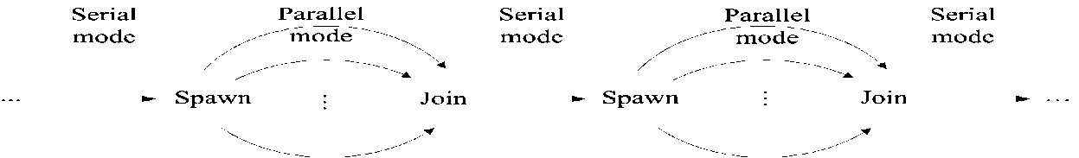
How does it work and what should people know to participate
“Work-depth” Alg Methodology (SV82) State all ops you can do in parallel. Repeat. Minimize: Total #operations, #rounds. Note: 1 The rest is skill. 2. Sets the algorithm
Program single-program multiple-data (SPMD). Short (not OS) threads. Independence of order semantics (IOS). XMTC: C plus 3 commands: Spawn+Join, Prefix-Sum (PS) Unique 1st parallelism then decomposition
Legend: Level of abstraction
Means
Means: Programming methodology Algorithms → effective programs.
Extend the SV82 Work-Depth framework from PRAM-like to XMTC
[Alternative Established APIs (VHDL/Verilog,OpenGL,MATLAB) “win-win proposition”]
Performance-Tuned Program minimize length of sequence of round-trips to memory + QRQW + Depth; take advantage of arch enhancements (e.g., prefetch)
Means: Compiler: [ideally: given XMTC program, compiler provides decomposition: tune-up manually ➔ “teach the compiler”]
Architecture HW-supported run-time load-balancing of concurrent threads over processors. Low thread creation overhead. (Extend classic stored-program program counter; cited by 15 Intel patents; Prefix-sum to registers & to memory. )
All Computer Scientists will need to know >1 levels of abstraction (LoA)
CS programmer’s model: WD+P. CS expert : WD+P+PTP. Systems: +A.

Slide 89
PERFORMANCE PROGRAMMING & ITS PRODUCTIVITY
Basic Algorithm (sometimes informal)
Add data-structures (for serial algorithm)
Add parallel data-structures
(for PRAM-like algorithm)
Serial program (C)
3
Parallel program (XMT-C)
1
Low overheads!
4
Standard Computer
Decomposition
XMT Computer
(or Simulator)
Parallel
Programming
(Culler-Singh)
Assignment
Orchestration
4 easier than 2
Problems with 3
4 competitive with 1: cost-effectiveness; natural
Mapping
2
Parallel computer

Slide 90
APPLICATION PROGRAMMING & ITS PRODUCTIVITY
Application programmer’s interfaces (APIs)
(OpenGL, VHDL/Verilog, Matlab)
compiler
Serial program (C)
Parallel program (XMT-C)
Automatic?
Yes
Maybe
Yes
Standard Computer
Decomposition
XMT architecture
(Simulator)
Parallel
Programming
(Culler-Singh)
Assignment
Orchestration
Mapping
Parallel computer

Slide 91
XMT Block Diagram – Back-up slide

Slide 92
ISA
Any serial (MIPS, X86). MIPS R3000.
Spawn (cannot be nested)
Join
SSpawn (can be nested)
PS
PSM
Instructions for (compiler) optimizations

Slide 93
The Memory Wall
Concerns: 1) latency to main memory, 2) bandwidth to main memory.
Position papers: “the memory wall” (Wulf), “its the memory, stupid!” (Sites)
Note: (i) Larger on chip caches are possible; for serial computing, return on using them: diminishing. (ii) Few cache misses can overlap (in time) in serial computing; so: even the limited bandwidth to memory is underused.
XMT does better on both accounts:
• uses more the high bandwidth to cache.
• hides latency, by overlapping cache misses; uses more bandwidth to main memory, by generating concurrent memory requests; however, use of the cache alleviates penalty from overuse.
Conclusion: using PRAM parallelism coupled with IOS, XMT reduces the effect of cache stalls.

Slide 94
State-of-the-art
Unsatisfactory products
Diminished competition among vendors
No funding for really new architecture
Today’s academics Limited to the best he/she can derive from vendor products (trained and rewarded)
Missing Profound questioning of products
Absurdity Industry expects from its people to: (i) look for guidance to improve products; e.g., from academia (ii) present a brave posture to the world regarding the same products; in turn, lead academia/funding not to develop answers to (i)

Slide 95
Problem: Develop a Technology
Definition Technology: capability given by the practical application of knowledge
how to build and program parallel machines parallel algorithmic thinking
The rest of this talk
Snapshots of the technology
Order of magnitude advantages on ease-of-programming and speedups
Challenges

Slide 96
Somewhere:
Explanation for current reality
Recall Technology: capability given by the practical application of knowledge
XMT: build and program parallel machines parallel algorithmic thinking
VERY few teach both algorithms AND architecture
Theorists stop at creating knowledge
Nearly impossible for young architects to develop a platform (Exception: UT TRIPS. Now: Microsoft, NVidia)
Diminished competition in architecture
(Unintended) Research reward system: conform or perish
No room for questioning vendors’
Every society honors its live conformists and its dead troublemakers—McLaughlin

Slide 97
Are we really trying to ensure that many-cores are not rejected by programmers?
Einstein’s observation A perfection of means, and confusion of aims, seems to be our main problem
Conformity incentives are for perfecting means
Consider a vendor-backed flawed system. Wonderful opportunity for our originality-seeking publications culture:
* The simplest problem requires creativity ➔ More papers
* Cite one another if on similar systems➔ maximize citations
and claim ‘industry impact’
Ultimate job security – By the time the ink dries on these papers, next flawed ‘modern’ ‘state-of-the-art’ system. Culture of short-term impact
Unchallenged in a power DC meeting – ‘what a wonderful dynamic field. 10 yrs ago DEC&Sun were great companies, now gone’; dynamic? or diminished competition?

Slide 98




Parallel Programming Today
Current Parallel Programming
High-friction navigation - by implementation [walk/crawl]
Initial program (1week) begins trial & error tuning (½ year; architecture dependent)
PRAM-On-Chip Programming
Low-friction navigation – mental design and analysis [fly]
Once constant-factors-minded algorithm is set, implementation and tuning is straightforward
Notes:
Quantitative: moves on foot/crawl. Qualitative: obstructions hinder visibility.

Slide 99
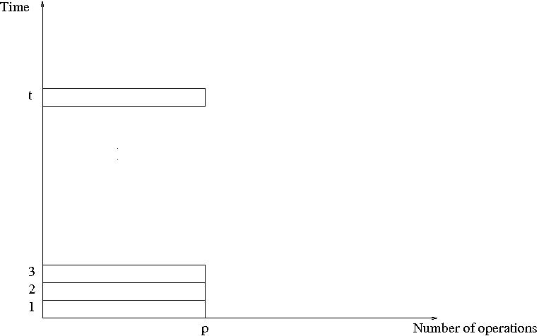
So, an algorithm in the PRAM model
is presented in terms of a sequence of parallel time units (or “rounds”, or “pulses”); we allow p instructions to be performed at each time unit, one per processor; this means that a time unit consists of a sequence of exactly p instructions to be performed concurrently
SV-MaxFlow-82: way too difficult
2 drawbacks to PRAM mode
Does not reveal how the algorithm will
run on PRAMs with different number of
processors; e.g., to what extent will more
processors speed the computation, or fewer
processors slow it?
(ii) Fully specifying the allocation of instructions
to processors requires a level of detail which
might be unnecessary
(e.g., a compiler may be able to extract from
lesser detail)
1st round of discounts ..

Slide 100
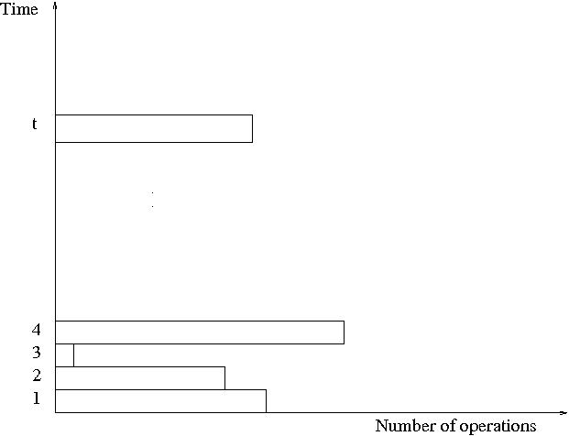
Work-Depth presentation of algorithms
Work-Depth algorithms are also presented as a sequence of parallel time units (or “rounds”, or “pulses”); however, each time unit consists of a sequence of instructions to be performed concurrently; the sequence of instructions may include any number.
Why is this enough? See J-92, KKT01, or my classnotes
SV-MaxFlow-82: still way too difficult
Drawback to WD mode
Fully specifying the serial number of each
instruction requires a level of detail that may
be added later
2nd round of discounts ..

Slide 101
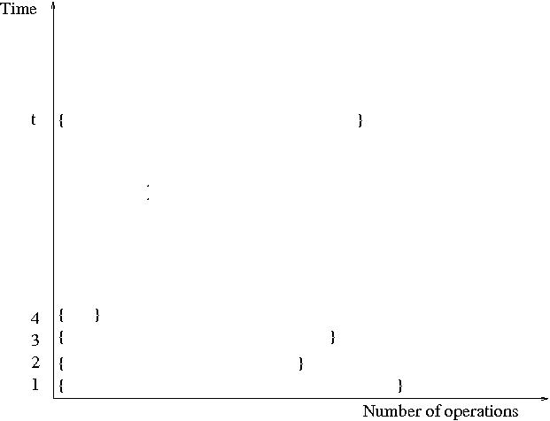
Informal Work-Depth (IWD) description
Similar to Work-Depth, the algorithm is presented in terms of a sequence of parallel time units (or “rounds”); however, at each time unit there is a set containing a number of instructions to be performed concurrently. ‘ICE’
Descriptions of the set of concurrent instructions can come in many flavors.
Even implicit, where the number of instruction is not obvious.
The main methodical issue addressed here is how to train CS&E professionals “to think in parallel”. Here is the informal answer: train yourself to provide IWD description of parallel algorithms. The rest is detail (although important) that can be acquired as a skill, by training (perhaps with tools).
Why is this enough? Answer: “miracle”.
See J-92, KKT01, or my classnotes:
1. w/p + t time on p processors in algebraic, decision tree ‘fluffy’ models
2. V81,SV82 conjectured miracle: use as heuristics for full overhead PRAM model

Slide 102
Example of Parallel ‘PRAM-like’ Algorithm
Gain relative to serial: (first cut) ~T/S!
Decisive also relative to coarse-grained parallelism.
Note: (i) “Concurrently” as in natural BFS: only change to serial algorithm
(ii) No “decomposition”/”partition”
Mental effort of PRAM-like programming
1. sometimes easier than serial
2. considerably easier than for any parallel computer currently sold. Understanding falls within the common denominator of other approaches.
Input: (i) All world airports.
(ii) For each, all its non-stop flights.
Find: smallest number of flights from DCA to every other airport.
Basic (actually parallel) algorithm
Step i:
For all airports requiring i-1flights
For all its outgoing flights
Mark (concurrently!) all “yet unvisited” airports as requiring i flights (note nesting)
Serial: forces ‘eye-of-a-needle’ queue; need to prove that still the same as the parallel version.
O(T) time; T – total # of flights
Parallel: parallel data-structures.
Inherent serialization: S.
Notes:
102

Slide 103
Chronology around fault line
Just right: PRAM model FW77
Too easy
‘Paracomputer’ Schwartz80
BSP Valiant90
LOGP UC-Berkeley93
Map-Reduce. Success; not manycore
CLRS-09, 3rd edition
TCPP curriculum 2010
Nearly all parallel machines to date
“.. machines that most programmers cannot handle"
“Only heroic programmers”
Too difficult
SV-82 and V-Thesis81
PRAM theory (in effect)
CLR-90 1st edition
J-92
NESL
KKT-01
XMT97+ Supports the rich PRAM algorithms literature
V-11
Nested parallelism: issue for both; e.g., Cilk
Current interest new "computing stacks“: programmer's model, programming languages, compilers, architectures, etc.
Merit of fault-line image Two pillars holding a building (the stack) must be on the same side of a fault line ➔ chipmakers cannot expect: wealth of algorithms and high programmer’s productivity with architectures for which PRAM is too easy (e.g., force programming for locality).

Slide 104
Telling a fault line from the surface
PRAM too difficult
PRAM too easy
Surface
Fault line
ICE
WD
PRAM
Sufficient bandwidth
PRAM “simplest model”*
BSP/Cilk *
Insufficient bandwidth
*per TCPP
Old soft claim, e.g., [BMM94]: hidden cost of low bandwidth
New soft claim: the surface (PRAM easy/difficult) reveals side W.R.T. the bandwidth fault line.

Slide 105
Missing Many-Core Understanding
Comparison of many-core platforms for:
Ease-of-programming, and
Achieving hard speedups (over best serial algorithms for the same problem) for strong scaling
strong scaling: solution time ~ 1/#processors for fixed problem size
weak scaling: problem size fixed per processor
Guess what happens to vendors and researchers supported by them once a comparison does not go their way?!
Notes:
----- Meeting Notes (5/29/11 07:01) -----
Fleck 1935. The 'Turing award' of that community is named after him.

Slide 106
New work
Biconnectivity
Not aware of GPU work
12-processor SMP: < 4X speedups. TarjanV log-time PRAM algorithm ➔ practical version ➔ significant modification. Their 1st try: 12-processor below serial
XMT: >9X to <48X speedups. TarjanV ➔ practical version. More robust for all inputs than BFS, DFS etc.
Significance:
log-time PRAM graph algorithms ahead on speedups.
Paper makes a similar case for ShiloachV log-time connectivity. Beats also GPUs on both speed-up and ease (GPU paper versus grad course programming assignment and even couple of 10th graders implemented SV)

Slide 107
Ease of Programming
Benchmark Can any CS major program your manycore?
Cannot really avoid it!
Teachability demonstrated so far for XMT [SIGCSE’10]
- To freshman class with 11 non-CS students. Some prog. assignments: merge-sort*, integer-sort* & sample-sort.
Other teachers:
- Magnet HS teacher. Downloaded simulator, assignments, class notes, from XMT page. Self-taught. Recommends: Teach XMT first. Easiest to set up (simulator), program, analyze: ability to anticipate performance (as in serial). Can do not just for embarrassingly parallel. Teaches also OpenMP, MPI, CUDA. See also, keynote at CS4HS’09@CMU + interview with teacher.
- High school & Middle School (some 10 year olds) students from underrepresented groups by HS Math teacher.
*Also in Nvidia’s Satish, Harris & Garland IPDPS09

Slide 108
Q&A
Question: Why PRAM-type parallel algorithms matter, when we can get by with existing serial algorithms, and parallel programming methods like OpenMP on top of it?
Answer: With the latter you need a strong-willed Comp. Sci. PhD in order to come up with an efficient parallel program at the end. With the former (study of parallel algorithmic thinking and PRAM algorithms) high school kids can write efficient (more efficient if fine-grained & irregular!) parallel programs.

Slide 109
Conclusion
XMT provides viable answer to biggest challenges for the field
  Ease of programming
  Scalability (up&down)
  Facilitates code portability
SPAA’09 good results: XMT vs. state-of-the art Intel Core 2
HotPar’10/ICPP’08 compare with GPUs ➔ XMT+GPU beats all-in-one
Fund impact productivity, prog, SW/HW sys arch, asynch/GALS
Easy to build. 1 student in 2+ yrs: hardware design + FPGA-based XMT computer in slightly more than two years ➔ time to market; implementation cost.
Central issue: how to write code for the future? answer must provide compatibility on current code, competitive performance on any amount of parallelism coming from an application, and allow improvement on revised code ➔ time for agnostic (rather than product-centered) academic research

Slide 110
‘Soft observation’ vs ‘Hard observation’ is a matter of community
In theory, hard things include asymptotic complexity, lower bounds, etc.
In systems, they tend to include concrete numbers
Who is right? Pornography matter of geography
My take: each community does something right. Advantages Theory: reasoning about revolutionary changes. Systems: small incremental changes ‘quantitative approach’; often the case.

Slide 111
Conclusion of Coming Intro Slide(s)
Productivity: code development time + runtime
Vendors’ many-cores are Productivity limited
Vendors: monolithic
Concerns 1. CS in awe of vendors’ HW: “face of practice”; Justified only if accepted/adopted
2. Debate: cluttered and off-point
3. May lead to misplaced despair
Need HW diversity of high productivity solutions. Then “natural selection”.
Will explain why US interests mandate greater role to academia

Slide 112
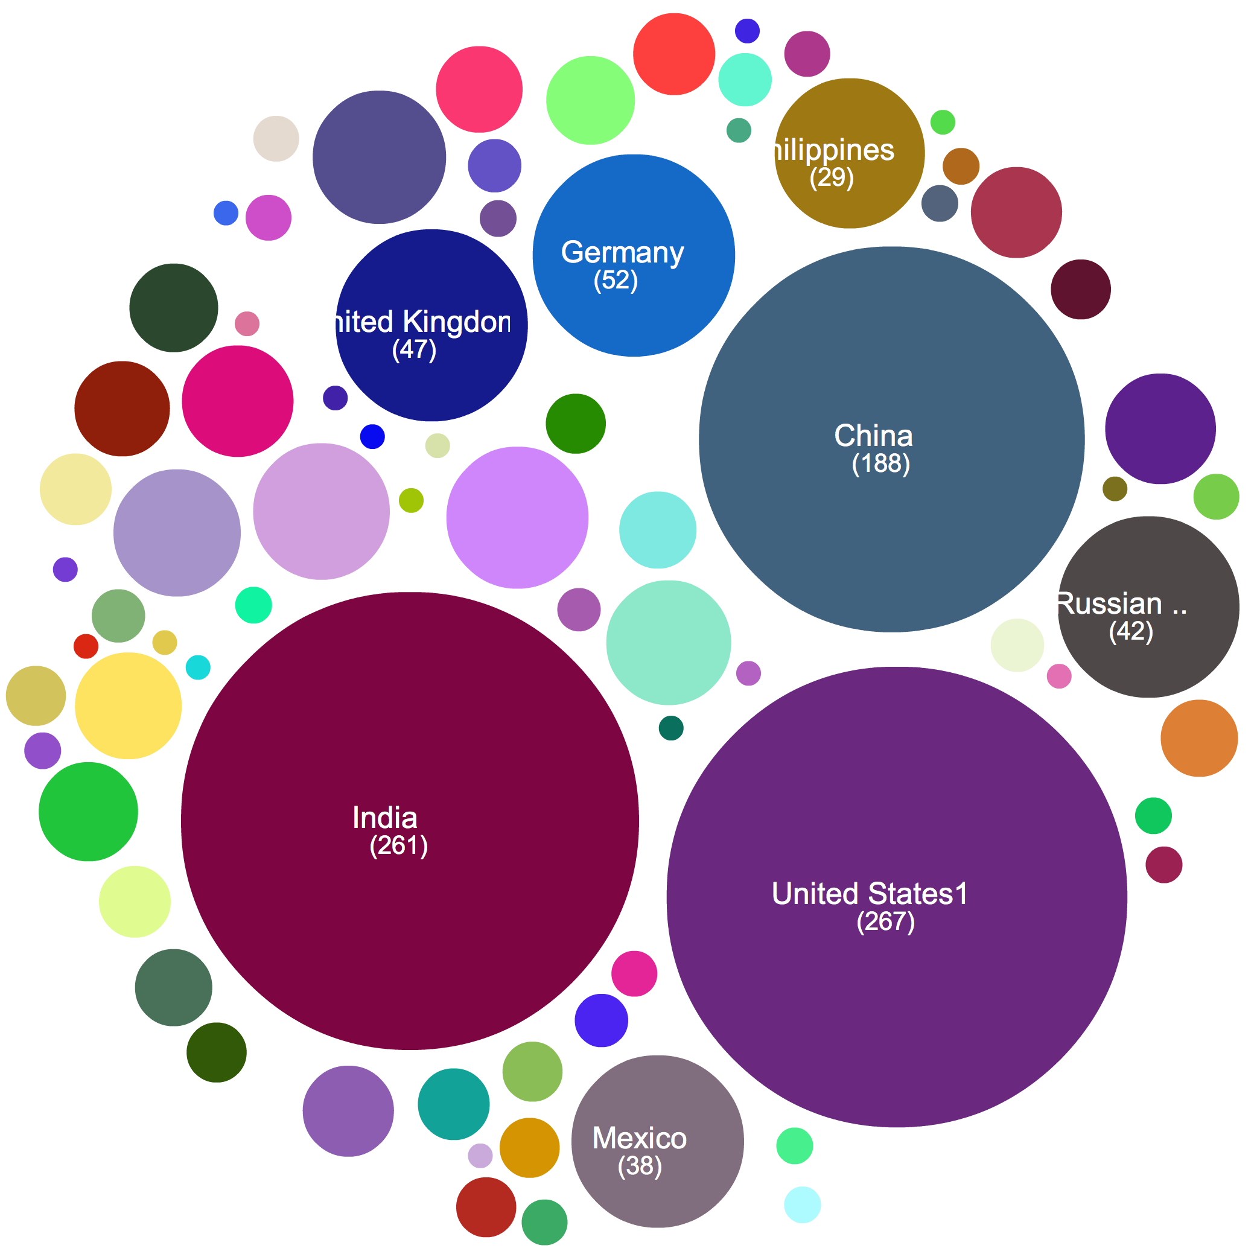
Membership in Intel Academic Community
Implementing parallel computing into CS curriculum
85% outside USA
Source: M. Wrinn, Intel
At SIGCSE’10
Notes:
Slide 8

Slide 113

How was the “non-specificity” addressed?
Answer: GvN47 based coding for whatever future application on math. induction coupled with a simple abstraction
Then came: HW, Algorithms+SW
[Engineering problem. So, why mathematician? Hunch: hard for engineers to relate to .. then and now. A. Ghuloum (Intel), CACM 9/09: “..hardware vendors tend to understand the requirements from the examples that software developers provide… ]
Met desiderata for code and coding. See, e.g.:
- Knuth67, The art of Computer Programming. Vol. 1: Fundamental Algorithms. Chapter 1: Basic concepts 1.1 Algorithms 1.2 Math Prelims 1.2.1 Math Induction
Algorithms: 1. Finiteness 2. Definiteness 3. Input & Output 4. Effectiveness
Gold standards
Definiteness: Helped by Induction
Effectiveness: Helped by “Uniform cost criterion" [AHU74] abstraction
2 comments on induction: 1. 2nd nature for math: proofs & axiom of the natural numbers. 2. need to read into GvN47: “..to make the induction complete..”
Notes:
HW vendors have a hummer for optimizing incremental changes. However, they now need to deal with a paradigm shift, but having a hummer tends to make everything look to us like a nail.

Slide 114
Talk from 30K feet
* Past Math induction plus ISE
Foundation for first 6 decades of CS
Proposed Math induction plus ICE
Foundation for future of CS
* (Great) Parallel system theory work/modeling
Descriptive: How to get the most from what vendors are giving us
This talk Prescriptive

Slide 115
Versus Serial & Other Parallel
1st Example: Exchange Problem
2 Bins A and B. Exchange contents of A and B. Ex. A=2,B=5➔A=5,B=2.
Algorithm (serial or parallel): X:=A;A:=B;B:=X. 3 Ops. 3 Steps. Space 1.
Array Exchange Problem
2n bins A[1..n], B[1..n]. Replace A(i) and B(i), i=1..n.
Serial Alg: For i=1 to n do /*serial exchange through eye-of-a-needle
X:=A(i);A(i):=B(i);B(i):=X
3n Ops. 3n Steps. Space 1
Parallel Alg: For i=1 to n pardo /*2-bin exchange in parallel
X(i):=A(i);A(i):=B(i);B(i):=X(i)
3n Ops. 3 Steps. Space n
Discussion
Parallelism tends to require some extra space
Par Alg clearly faster than Serial Alg.
What is “simpler” and “more natural”: serial or parallel?
Small sample of people: serial, but only if you .. majored in CS
Eye-of-a-needle: metaphor for the von-Neumann mental & operational bottleneck
Reflects extreme scarcity of HW. Less acute now
Notes:
115

Slide 116
In CS, we single-mindedly serialize -- needed or not
Recall the story about a boy/girl-scout helping an old lady cross the street, even if .. she does not want to cross it
All the machinery (think about compilers) that we try later to get the old lady to the right side of the street, where she originally was and wanted to remain, may not rise to challenge
Conclusion: Got to talk to the boy/girl-scout
To clarify:
The business case for supporting in the best possible way existing serial code is clear
The question is how to write programs in the future

Slide 117
What difference do we hope to make? Productivity in Parallel Computing
The large parallel machines story
Funding of productivity: $M650 HProductivityCS, ~2002
Met # Gflops goals: up by 1000X since mid-90’s
Met power goals. Also: groomed eloquent spokespeople
Progress on productivity: No agreed benchmarks. No spokesperson. Elusive! In fact, not much has changed since: “as intimidating and time consuming as programming in assembly language”--NSF Blue Ribbon Committee, 2003 or even “parallel software crisis”, CACM 1991.
Common sense engineering: Untreated bottleneck ➔ diminished returns on improvements➔ bottleneck becomes more critical
Next 10 years: New specific programs on flops and power. What about productivity?!
Reality: economic island. Cleared by marketing: DOE applications
Enter: mainstream many-cores
Every CS major should be able to program many-cores

Slide 118
Many-Cores are Productivity Limited
~2003 Wall Street traded companies gave up the safety of the only paradigm that worked for them for parallel computing ➔ The “software spiral” (the cyclic process of HW improvement leading to SW improvement) is broken
Reality: Never easy-to-program, fast general-purpose parallel computer for single task completion time. Current parallel architectures: never really worked for productivity. Uninviting programmers' models simply turn programmers away
Why drag the whole field to a recognized disaster area?
Keynote, ISCA09: 10 ways to waste a parallel computer. We can do better: repel the programmer; don’t worry about the rest ☺
New ideas needed to reproduce the success of the serial paradigm for many-core computing, where obtaining strong, but not absolutely the best performance is relatively easy.
➔ Must start to benchmark HW+SW for productivity. See CFP for PPoPP2011. Joint video-conferencing course with UIUC.

Slide 119
Key for GvN47 Engineering solution (2nd visit of slide)
Program-counter & stored program
Later: Seek upgrade for parallel abstraction
Virtual over physical:
distributed solution

Slide 120
Few more experimental results
AMD Opteron 2.6 GHz, RedHat Linux Enterprise 3, 64KB+64KB L1 Cache, 1MB L2 Cache (none in XMT), memory bandwidth 6.4 GB/s (X2.67 of XMT)
M_Mult was 2000X2000 QSort was 20M
XMT enhancements: Broadcast, prefetch + buffer, non-blocking store, non-blocking caches.
XMT Wall clock time (in seconds)
App. XMT Basic XMT Opteron
M-Mult 179.14 63.7 113.83
QSort 16.71 6.59 2.61
Assume (arbitrary yet conservative)
ASIC XMT: 800MHz and 6.4GHz/s
Reduced bandwidth to .6GB/s and projected back by 800X/75
XMT Projected time (in seconds)
App. XMT Basic XMT Opteron
M-Mult 23.53 12.46 113.83
QSort 1.97 1.42 2.61
Simulation of 1024 processors: 100X on standard benchmark suite for VHDL gate-level simulation. for 1024 processors [Gu-V06]
Silicon area of 64-processor XMT, same as 1 commodity processor (core) (already noted: ~10X relative to Intel Core 2 Duo)

Slide 121
Recall tile-based matrix multiply
C = A x B. A,B: each 1,000 X 1,000
Tile: must fit in cache
How many tiles needed in today’s high-end PC?

Slide 122
How to cope with limited cache size? Cache oblivious algorithms?
XMT can do what others are doing and remain ahead or at least on par with them.
Use of (enhanced) work-stealing, called lazy binary splitting (LBS). See PPoPP 2010.
Nesting+LBS is currently the preferable XMT first line of defense for coping with limited cache/memory sizes, number of processors etc. However, XMT does a better job for flat parallelism than today's multi-cores. And, as LBS demonstrated, can incorporate work stealing and all other current means harnessed by cache-oblivious approaches. Keeps competitive with resource oblivious approaches.

Slide 123
Some supporting evidence (12/2007)
Large on-chip caches in shared memory.
8-cluster (128 TCU!) XMT has only 8 load/store units, one per cluster. [IBM CELL: bandwidth 25.6GB/s from 2 channels of XDR. Niagara 2: bandwidth 42.7GB/s from 4 FB-DRAM channels.
With reasonable (even relatively high rate of) cache misses, it is really not difficult to see that off-chip bandwidth is not likely to be a show-stopper for say 1GHz 32-bit XMT.

Slide 124
Memory architecture, interconnects
• High bandwidth memory architecture.
- Use hashing to partition the memory and avoid hot spots.
Understood, BUT (needed) departure from mainstream practice.
• High bandwidth on-chip interconnects
• Allow infrequent global synchronization (with IOS).
Attractive: lower power.
• Couple with strong MTCU for serial code.

Slide 125
Naming Contest for New Computer
Paraleap
chosen out of ~6000 submissions
Single (hard working) person (X. Wen) completed synthesizable Verilog description AND the new FPGA-based XMT computer in slightly more than two years. No prior design experience. Attests to: basic simplicity of the XMT architecture ➔ faster time to market, lower implementation cost.

Slide 126


XMT Development – HW Track
  Interconnection network. Led so far to:
  ASAP’06 Best paper award for mesh of trees (MoT) study
  Using IBM+Artisan tech files: 4.6 Tbps average output at max frequency (1.3 - 2.1 Tbps for alt networks)! No way to get such results without such access
  90nm ASIC tapeout
Bare die photo of 8-terminal interconnection
network chip IBM 90nm process, 9mm x 5mm
fabricated (August 2007)
  Synthesizable Verilog of the whole architecture. Led so far to:
  Cycle accurate simulator. Slow. For 11-12K X faster:
  1st commitment to silicon—64-processor, 75MHz computer; uses FPGA: Industry standard for pre-ASIC prototype
  1st ASIC prototype–90nm 10mm x 10mm
  64-processor tapeout 2008: 4 grad students

Slide 127
Bottom Line
Cures a potentially fatal problem for growth of general-purpose processors: How to program them for single task completion time?

Slide 128
Positive record
Proposal Over-Delivering
NSF ‘97-’02 experimental algs. architecture
NSF 2003-8 arch. simulator silicon (FPGA)
DoD 2005-7 FPGA FPGA+2 ASICs

Slide 129
Final thought: Created our own coherent planet
When was the last time that a university project offered a (separate) algorithms class on own language, using own compiler and own computer?
Colleagues could not provide an example since at least the 1950s. Have we missed anything?
For more info:
http://www.umiacs.umd.edu/users/vishkin/XMT/

Slide 130
Merging: Example for Algorithm & Program
Input: Two arrays A[1. . n], B[1. . n]; elements from a totally ordered domain S. Each array is monotonically non-decreasing.
Merging: map each of these elements into a monotonically non-decreasing array C[1..2n]
Serial Merging algorithm
SERIAL − RANK(A[1 . . ];B[1. .])
Starting from A(1) and B(1), in each round:
compare an element from A with an element of B
determine the rank of the smaller among them
Complexity: O(n) time (and O(n) work...)
PRAM Challenge: O(n) work, least time
Also (new): fewest spawn-joins

Slide 131
Merging algorithm (cont’d)
“Surplus-log” parallel algorithm for Merging/Ranking
for 1 ≤ i ≤ n pardo
Compute RANK(i,B) using standard binary search
Compute RANK(i,A) using binary search
Complexity: W=(O(n log n), T=O(log n)
The partitioning paradigm
n: input size for a problem. Design a 2-stage parallel algorithm:
Partition the input into a large number, say p, of independent small jobs AND size of the largest small job is roughly n/p.
Actual work - do the small jobs concurrently, using a separate (possibly serial) algorithm for each.

Slide 132
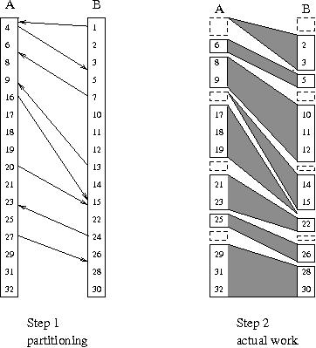
Linear work parallel merging: using a single spawn
Stage 1 of algorithm: Partitioning for 1 ≤ i ≤ n/p pardo [p <= n/log and p | n]
b(i):=RANK(p(i-1) + 1),B) using binary search
a(i):=RANK(p(i-1) + 1),A) using binary search
Stage 2 of algorithm: Actual work
Observe Overall ranking task broken into 2p independent “slices”.
Example of a slice
Start at A(p(i-1) +1) and B(b(i)).
Using serial ranking advance till:
Termination condition
Either some A(pi+1) or some B(jp+1) loses
Parallel program 2p concurrent threads
using a single spawn-join for the whole
algorithm
Example Thread of 20: Binary search B.
Rank as 11 (index of 15 in B) + 9 (index of
20 in A). Then: compare 21 to 22 and rank
21; compare 23 to 22 to rank 22; compare 23
to 24 to rank 23; compare 24 to 25, but terminate
since the Thread of 24 will rank 24.

Slide 133
Linear work parallel merging (cont’d)
Observation 2p slices. None larger than 2n/p.
(not too bad since average is 2n/2p=n/p)
Complexity Partitioning takes W=O(p log n), and T=O(log n) time, or O(n) work and O(log n) time, for p <= n/log n.
Actual work employs 2p serial algorithms, each takes O(n/p) time.
Total W=O(n), and T=O(n/p), for p <= n/log n.
IMPORTANT: Correctness & complexity of parallel program
Same as for algorithm.
This is a big deal. Other parallel programming approaches do not have a simple concurrency model, and need to reason w.r.t. the program.

Slide 134
If solution beats others, will it be adopted by industry?
LATER
Notes:
Some quotes from ISCA’12 workshop call

