Slide 1
The List Ranking Cluster; Techniques: Euler tours; pointer jumping; randomized and deterministic symmetry breaking

Slide 2
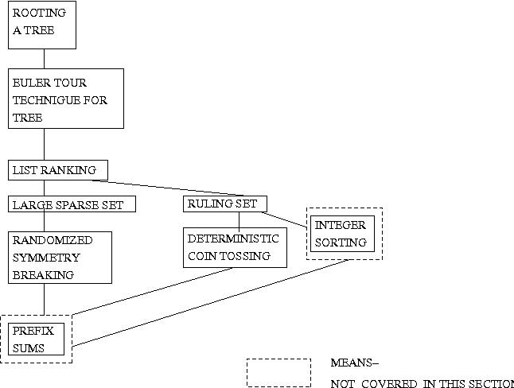
Structural overview of the chapter

Slide 3
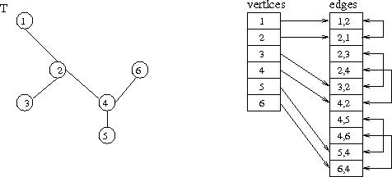
Input representation of a tree

Slide 4
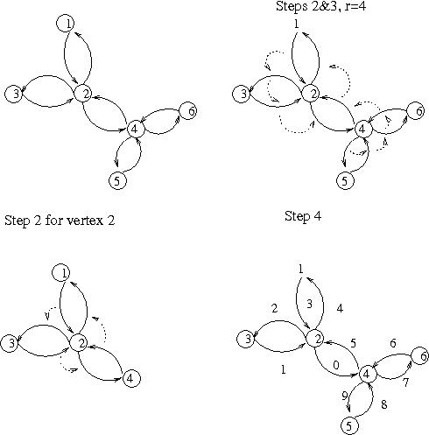
The Euler Tour Technique for Trees

Slide 5
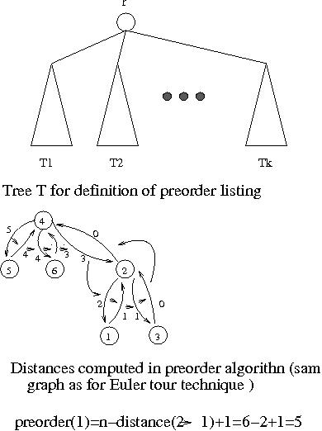
Preorder

Slide 6
Input for list ranking problem

Slide 7
Basic parallel pointer jumping

Slide 8
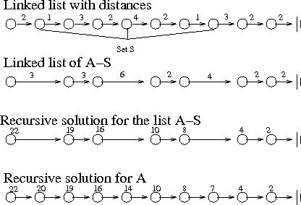
Recursive work-optimal list ranking

Slide 9
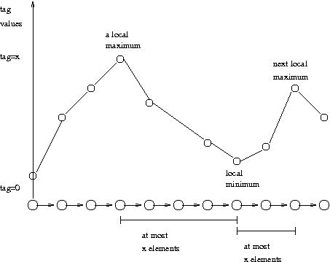
At most 2x-1 elements between two successive local maxima

Slide 10
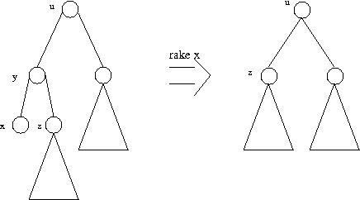
Rake operation

Slide 11
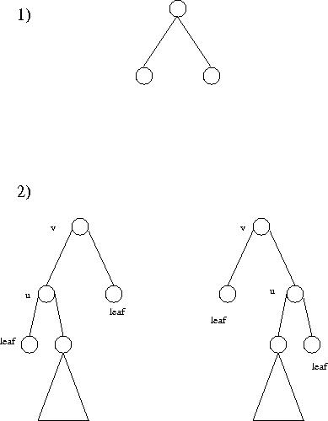
Case analysis for tree contraction

Slide 12
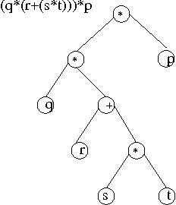
Arithmetic expression and its binary tree

Slide 13
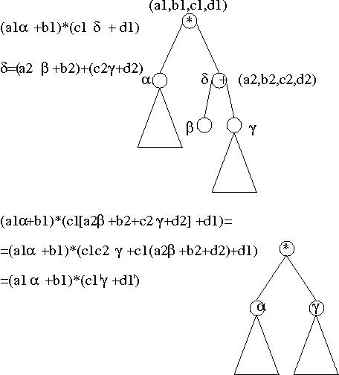
Rake applied to a binary tree of an arithmetic expression

