Slide 1

ENEE699/ENEE459P: Parallel Algorithms
Home page: http://www.umiacs.umd.edu/users/vishkin/TEACHING/enee459p-f10.html
Uzi Vishkin
Electrical and Computer Engineering Dept

Slide 2
4 Reasons for the approach I will present
Reason 1 Thinking in parallel is based on first principles.
The theme:
How to Think Algorithmically in Parallel?
Merits special attention, separate from programming

Slide 3
Reason 2: You can handle algorithms not through programming
Recall how the standard CS curriculum looks:
- 1st year of CS: programming.
- Later: design & analysis of algorithms.
- Rationale: 1st concrete programming experience, so that algorithms & analysis make sense
But, you can understand parallel algorithms. Then:
learn skill of parallel programming by assignments
20 minute review of XMT-C. Rest from tutorial+manual
Test: are assignments on par with other approaches?

Slide 4
The Pain of Parallel Programming
Parallel programming is currently too difficult:
- 40 years of parallel computing→ The world is yet to see a successful general-purpose parallel computer: Easy to program & good speedups
To many users programming existing parallel computers is “as intimidating and time consuming as programming in assembly language” [NSF Blue-Ribbon Panel on Cyberinfrastructure]
AMD/Intel: “Need PhD in CS to program today’s multicores”
“The Trouble with Multicore: Chipmakers are busy designing microprocessors that most programmers can't handle”—D. Patterson, IEEE Spectrum, July 2010.
➔ The software spiral (HW improvements ➔ SW imp ➔ HW imp) – growth engine for IT (A. Grove, Intel); Alas, now broken!
➔ Impasse SW vendors avoid investment in long-term SW development since may bet on the wrong horse.
Parallel programming education: why not same impasse?
Reason 3: Can teach common denominator
Notes:
4

Slide 5
Example and Question
Today’s reality 12MB on-chip caches already available. Likely to increase further ➔ to what extent should programming-for-locality be enforced by many-core vendors?
Example Matrix multiplication
- 12MB on-chip cache can fit 1000X1000 matrices
- In principle*, standard matrix-multiplication can work using high bandwidth on-chip interconnection network coupled with our (static and dynamic) prototyped prefetching mechanisms
Matrix multiplication using tiling still important for large matrices
The Open Question To what extent will we need in the future to drag mainstream programming to the low-productivity pains** experienced by parallel computing?
Not questioned some must know these techniques; may be even all of you eventually. But, should they be part of the intro?
* Reason 4 Done that: XMT. ** Previous slide

Slide 6
Not only us
Parallel algorithms researchers realized decades ago that the main reason that parallel machines are difficult to program is that the bandwidth between processors/memories is so limited.
[BMM94] suggested that: 1. Machine manufacturers see the cost benefit of lowering performance of interconnects (that were much higher in 1994), but grossly underestimate the programming difficulties and the high software development costs implied. 2. Their exclusive focus on runtime benchmarks misses critical costs, including: (i) the time to write the code, and (ii) the time to port the code to different distribution of data or to different machines that require different distribution of data.
G. Blelloch, B. Maggs, and G. Miller. The hidden cost of low bandwidth communication. In Developing a Computer Science Agenda for High-Performance Computing (Editor: U. Vishkin), pp 22–25. ACM Press, 1994.

Slide 7

The eXplicit MultiThreading (XMT)
Easy-To-Program Parallel Computer
www.umiacs.umd.edu/users/vishkin/XMT
Notes:
7

Slide 8
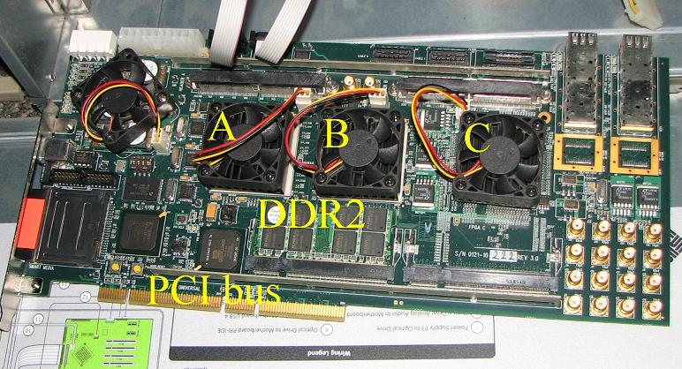
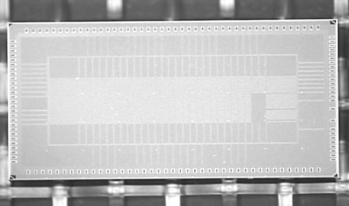
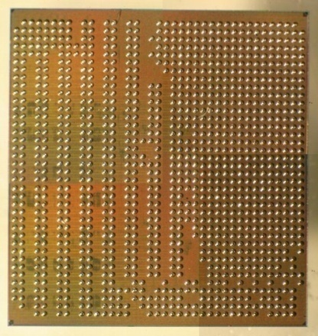
XMT
Algorithms
PRAM-On-Chip HW Prototypes
PRAM parallel algorithmic theory. “Natural selection”. Latent, though not widespread, knowledgebase
Won the battle of ideas on parallel algorithmic thinking. No silver or bronze!
Model of choice in all theory communities. 1988-90: Big chapters in standard algorithms textbooks.
Programming & workflow
Compiler
64-core, 75MHz FPGA of XMT
(Explicit Multi-Threaded) architecture
SPAA98..CF08
128-core intercon. network IBM 90nm: 9mmX5mm, [HotI07];.
Asynch, [NOCS10]
FPGA design➔ASIC
IBM 90nm: 10mmX10mm
Architecture scales to 1000+ cores on-chip

Slide 9
Experience with High School Students, Fall’07
1-day parallel algorithms tutorial to 12 HS students. Some (2 10th graders) managed 8 programming assignments, including 5 of the 6 in the grad course. Only help: 1 office hour/week by undergrad TA. No school credit. Part of a computer club after 8 periods/day.
One of these 10th graders: “I tried to work on parallel machines at school, but it was no fun: I had to program around their engineering. With XMT, I could focus on solving the problem that I had to solve.”
Dec’08-Jan’09: 50 HS students, by self-taught HS teacher, TJ HS, Alexandria, VA. Part of the regular curriculum.
By summer’09: 100+ K-12 students experienced XMT. ‘09 MCPS Middle school camp for children from underepresented groups. Taught at Baltimore Poly HS: 70% African Americans.
Spring’09: Course to Freshmen, UMD (strong enrollment). How will programmers have to think by the time you graduate.
➔ SIGCSE’10 paper and CS4HS’09@CMU Keynote
Notes:
9

Slide 10
NEW: Software release
Allows to use your own computer for programming on an XMT
environment and experimenting with it, including:
Cycle-accurate simulator of the XMT machine
Compiler from XMTC to that machine
Also provided, extensive material for teaching or self-studying parallelism, including
Tutorial + manual for XMTC (150 pages)
Classnotes on parallel algorithms (100 pages)
Video recording of 9/15/07 HS tutorial (300 minutes)
Video recording of Spring’09 grad course (30+ hours)
Notes:
10

Slide 11
Participants
Grad students:, Aydin Balkan, PhD, George Caragea, James Edwards, David Ellison, Mike Horak, MS, Fuat Keceli, Beliz Saybasili, Alex Tzannes, Xingzhi Wen, PhD
Industry design experts (pro-bono).
Rajeev Barua, Compiler. Co-advisor of 2 CS grad students. 2008 NSF grant.
Gang Qu, VLSI and Power. Co-advisor.
Steve Nowick, Columbia U., Asynch computing. Co-advisor. 2008 NSF team grant.
Ron Tzur, Purdue U., K12 Education. Co-advisor. 2008 NSF seed funding
K12: Montgomery Blair Magnet HS, MD, Thomas Jefferson HS, VA, Baltimore (inner city) Ingenuity Project Middle School 2009 Summer Camp, Montgomery County Public Schools
Marc Olano, UMBC, Computer graphics. Co-advisor.
Tali Moreshet, Swarthmore College, Power. Co-advisor.
Marty Peckerar, Microelectronics
Igor Smolyaninov, Electro-optics
Funding: NSF, NSA 2008 deployed XMT computer, NIH
Reinvention of Computing for Parallelism. Selected for Maryland Research Center of Excellence (MRCE) by USM, 12/08. Not yet funded. 17 members, including UMBC, UMBI, UMSOM. Mostly applications.
Notes:
11

Slide 12
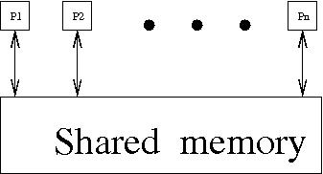
Parallel Random-Access Machine/Model
PRAM:
n synchronous processors all having unit time access to a shared memory.
Each processor has also a local memory.
At each time unit, a processor can:
write into the shared memory (i.e., copy one of its local memory registers into
a shared memory cell),
2. read into shared memory (i.e., copy a shared memory cell into one of its local
memory registers ), or
3. do some computation with respect to its local memory.

Slide 13
pardo programming construct
- for Pi , 1 ≤ i ≤ n pardo
- A(i) := B(i)
This means
The following n operations are performed concurrently: processor P1 assigns B(1) into A(1), processor P2 assigns B(2) into A(2), ….
Modeling read&write conflicts to the same shared memory location
Most common are:
- exclusive-read exclusive-write (EREW) PRAM: no simultaneous access by more than one processor to the same memory location for read or write purposes
concurrent-read exclusive-write (CREW) PRAM: concurrent access for reads but not for writes
concurrent-read concurrent-write (CRCW allows concurrent access for both reads and writes. We shall assume that in a concurrent-write model, an arbitrary processor among the processors attempting to write into a common memory location, succeeds. This is called the Arbitrary CRCW rule.
There are two alternative CRCW rules: (i) Priority CRCW: the smallest numbered, among the processors attempting to write into a common memory location, actually succeeds. (ii) Common CRCW: allows concurrent writes only when all the processors attempting to write into a common memory location are trying to write the same value.

Slide 14
Example of a PRAM algorithm: The summation problem
Input An array A = A(1) . . .A(n) of n numbers.
The problem is to compute A(1) + . . . + A(n).
The summation algorithm works in rounds.
Each round: add, in parallel, pairs of elements: add each odd-numbered element and its successive even-numbered element.
If n = 8, outcome of 1st round is:
A(1) + A(2), A(3) + A(4), A(5) + A(6), A(7) + A(8)
Outcome of 2nd round:
A(1) + A(2) + A(3) + A(4), A(5) + A(6) + A(7) + A(8)
and the outcome of 3rd (and last) round:
A(1) + A(2) + A(3) + A(4) + A(5) + A(6) + A(7) + A(8)
B – 2-dimensional array (whose entries are B(h,i), 0 ≤ h ≤ log n and 1 ≤ i ≤ n/2^{h}) used to store all intermediate steps of the computation (base of logarithm: 2).
For simplicity, assume n = 2^{k} for some integer k.
ALGORITHM 1 (Summation)
1. for Pi , 1 ≤ i ≤ n pardo
2. B(0, i) := A(i)
3. for h := 1 to log n do
4. if i ≤ n/2^{h}
5. then B(h, i) := B(h − 1, 2i − 1) + B(h − 1, 2i)
6. else stay idle
7. for i = 1: output B(log n, 1); for i > 1: stay idle
Algorithm 1 uses p = n processors.
Line 2 takes one round,
Line 3 defines a loop taking
log n rounds
Line 7 takes one round.

Slide 15
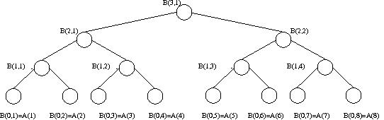
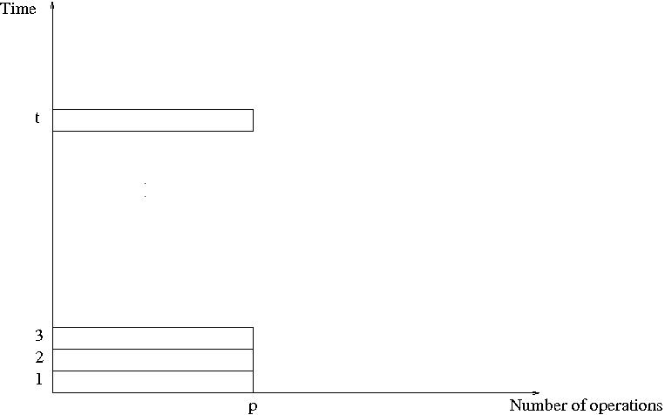
Summation on an n = 8 processor PRAM
Again Algorithm 1 uses p = n processors. Line 2 takes one round, line 3 defines a loop
taking log n rounds, and line 7 takes one round. Since each round takes constant time,
Algorithm 1 runs in O(log n) time. [When you see O (“big Oh”), think “proportional to”.]
So, an algorithm in the PRAM model
is presented in terms of a sequence of parallel time units (or “rounds”, or “pulses”); we
allow p instructions to be performed at each time unit, one per processor; this means
that a time unit consists of a sequence of exactly p instructions to be performed
concurrently.

Slide 16
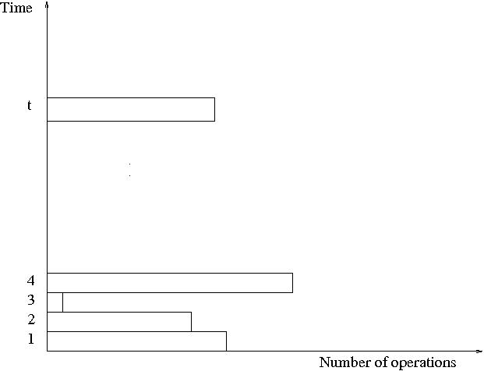
Work-Depth presentation of algorithms
2 drawbacks to PRAM mode: (i) Does not reveal how the algorithm will run on PRAMs with different number of processors; e.g., to what extent will more processors speed the computation, or fewer processors slow it? (ii) Fully specifying the allocation of instructions to processors requires a level of detail which might be unnecessary (a compiler may be able to extract from lesser detail)
Alternative model and presentation mode.
Work-Depth algorithms are also presented as a sequence of parallel time units (or “rounds”, or “pulses”); however, each time unit consists of a sequence of instructions to be performed concurrently; the sequence of instructions may include any number.

Slide 17
WD presentation of the summation example
“Greedy-parallelism”: At each point in time, the (WD) summation algorithm seeks to break the problem into as many pairwise additions as possible, or, in other words, into the largest possible number of independent tasks that can performed concurrently.
ALGORITHM 2 (WD-Summation)
1. for i , 1 ≤ i ≤ n pardo
2. B(0, i) := A(i)
3. for h := 1 to log n
4. for i , 1 ≤ i ≤ n/2^{h} pardo
5. B(h, i) := B(h − 1, 2i − 1) + B(h − 1, 2i)
6. for i = 1 pardo output B(log n, 1)
The 1st round of the algorithm (lines 1&2) has n operations. The 2nd round (lines 4&5 for h = 1) has n/2 operations. The 3rd round (lines 4&5 for h = 2) has n/4 operations. In general, the k-th round of the algorithm, 1 ≤ k ≤ log n + 1, has n/2^{k-1} operations and round log n +2 (line 6) has one more operation (use of a pardo instruction in line 6 is somewhat artificial). The total number of operations is 2n and the time is log n + 2. We will use this information in the corollary below.
The next theorem demonstrates that the WD presentation mode does not suffer from the same drawbacks as the standard PRAM mode, and that every algorithm in the WD mode can be automatically translated into a PRAM algorithm.

Slide 18
O-notation (pronounced ‘big-Oh’)
O-notation is the most frequently used notation in algorithm courses

Slide 19
The WD-presentation sufficiency Theorem
Consider an algorithm in the WD mode that takes a total of x = x(n) elementary operations and d = d(n) time. The algorithm can be implemented by any p = p(n)-processor PRAM within O(x/p + d) time, using the same concurrent-write convention as in the WD presentation.
[i.e., 5 theorems: EREW, CREW, Common/Arbitrary/Priority CRCW]
Proof
x_{i} - # instructions at round i. [x₁+x₂+..+x_{d} = x]
p processors can simulate x_{i} instructions in ⌈x_{i}/p⌉ ≤ x_{i}/p + 1 time units. See next slide. Demonstration in Algorithm 2’ shows why you don’t want to leave this to a programmer.
Formally: first reads, then writes. Theorem follows, since
⌈x₁/p⌉+⌈x₂/p⌉+..+⌈x_{d}/p⌉ ≤ (x₁/p +1)+..+(x_{d}/p +1) ≤ x/p + d

Slide 20
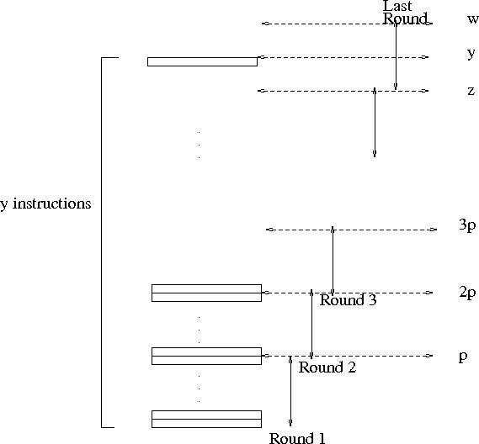
Round-robin emulation of y concurrent instructions
by p processors in ⌈y/p⌉ rounds. In each of the first ⌈y/p⌉ −1 rounds, p instructions are emulated for a total of z = p(⌈y/p⌉ − 1) instructions. In round ⌈y/p⌉, the remaining y − z instructions are emulated, each by a processor, while the remaining w − y processor stay idle, where w = p⌈y/p⌉

Slide 21
Corollary for summation example
Algorithm 2 would run in O(n/p + log n) time on a p-processor PRAM.
For p ≤ n/ log n, this implies O(n/p) time. Later called both optimal speedup & linear speedup
For p ≥ n/ log n: O(log n) time.
Since no concurrent reads or writes ➔ p-processor EREW PRAM algorithm.

Slide 22
ALGORITHM 2’ (Summation on a p-processor PRAM)
1. for P_{i} , 1 ≤ i ≤ p pardo
2. for j := 1 to ⌈n/p⌉ − 1 do
- B(0, i + (j − 1)p) := A(i + (j − 1)p)
3. for i , 1 ≤ i ≤ n − (⌈n/p⌉ − 1)p
- B(0, i + (⌈n/p⌉ − 1)p) := A(i + (⌈n/p⌉ − 1)p)
- for i , n − (⌈n/p⌉ − 1)p ≤ i ≤ p
- stay idle
4. for h := 1 to log n
5. for j := 1 to ⌈n/(2^{h}p)⌉ − 1 do (*an instruction j := 1 to 0 do means:
- “do nothing”*)
B(h, i+(j −1)p) := B(h−1, 2(i+(j −1)p)−1) + B(h−1, 2(i+(j −1)p))
6. for i , 1 ≤ i ≤ n − (⌈n/(2^{h}p)⌉ − 1)p
- B(h, i + (⌈n/(2^{h}p)⌉ − 1)p) := B(h − 1, 2(i + (⌈n/(2^{h}p)⌉ − 1)p) − 1) +
- B(h − 1, 2(i + (⌈n/(2^{h}p)⌉ − 1)p))
- for i , n − (⌈n/(2^{h}p)⌉ − 1)p ≤ i ≤ p
- stay idle
for i = 1 output B(log n, 1); for i > 1 stay idle
Nothing more than plugging in the above proof.
Main point of this slide: compare to Algorithm 2 and decide, which one you like better
But is WD mode as easy as it gets? Hold on…Key question for this presentation

Slide 23
Measuring the performance of parallel algorithms
A problem. Input size: n. A parallel algorithm in WD mode. Worst case time: T(n); work: W(n).
4 alternative ways to measure performance:
1. W(n) operations and T(n) time.
2. P(n) = W(n)/T(n) processors and T(n) time (on a PRAM).
3. W(n)/p time using any number of p ≤ W(n)/T(n) processors (on a PRAM).
4. W(n)/p + T(n) time using any number of p processors (on a PRAM).
Exercise 1: The above four ways for measuring performance of a parallel algorithms form six pairs. Prove that the pairs are all ‘asymptotically equivalent’.
Note: 1➔3 is the WD-presentation sufficiency theorem

Slide 24
Goals for Designers of Parallel Algorithms
Suppose 2 parallel algorithms for same problem:
1. W₁(n) operations in T₁(n) time. 2. W₂(n) operations, T₂(n) time.
General guideline: algorithm 1 more efficient than algorithm 2 if W₁(n) = o(W₂(n)), regardless of T₁(n) and T₂(n); if W₁(n) and W₂(n) grow asymptotically the same, then algorithm 1 is considered more efficient if T₁(n) = o(T₂(n)).
Good reasons for avoiding strict formal definition—only guidelines
Example W₁(n)=O(n),T₁(n)=O(n); W₂(n)=O(n log n),T₂(n)=O(log n) Which algorithm is more efficient?
Algorithm 1: less work. Algorithm 2: much faster.
In this case, both algorithms are probably interesting. Imagine two users, each interested in different input sizes and in different target machines (different # processors). For one user Algorithm 1 faster. For second user Algorithm 2 faster.
Known unresolved issues with asymptotic worst-case analysis.

Slide 25
Nicknaming speedups
Suppose T(n) best possible worst case time upper bound on serial algorithm for an input of length n for some problem. (T(n) is serial time complexity for problem.)
Let W(n) and T_{par}(n) be work and time bounds of a parallel algorithm for same problem.
The parallel algorithm is work-optimal, if W(n) grows asymptotically the same as T(n). A work-optimal parallel algorithm is work-time-optimal if its running time T_{par}(n) cannot be improved by another work-optimal algorithm.
What if serial complexity of a problem is unknown?
Still an accomplishment if T(n) is best known and W(n) matches it. Called linear speedup. Note: can change if serial improves.
Recall main reasons for existence of parallel computing:
- Can perform better than serial
- (it is just a matter of time till) Serial cannot improve anymore

Slide 26
Default assumption regarding shared memory access resolution
Since all conventions represent virtual models of real machines: strongest model whose implementation cost is “still not very high”, would be practical.
Simulations results + UMD PRAM-On-Chip architecture
Arbitrary CRCW
NC Theory
Good serial algorithms: poly time.
Good parallel algorithm: poly-log time, poly processors.
Was much more dominant than what’s covered here in early 1980s. Fundamental insights. Limited practicality.
In choosing abstractions: fine line between helpful and “defying gravity”

Slide 27
Technique: Balanced Binary Trees;
Problem: Prefix-Sums
Input: Array A[1..n] of elements. Associative binary operation, denoted ∗, defined on the set: a ∗ (b ∗ c) = (a ∗ b) ∗ c.
(∗ pronounced “star”; often “sum”: addition, a common example.)
The n prefix-sums of array A are:
A(1)
A(1) ∗ A(2)
..
A(1) ∗ A(2) ∗ .. ∗ A(i)
..
A(1) ∗ A(2) ∗ .. ∗ A(n)
Prefix-sums is perhaps the most heavily used routine in parallel algorithms.

Slide 28
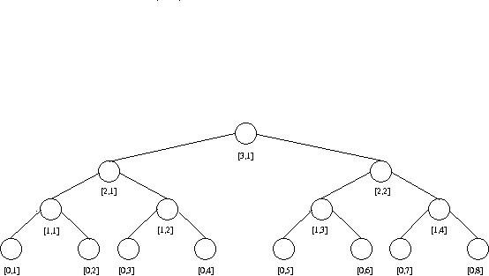
ALGORITHM 1 (Prefix-sums)
1. for i , 1 ≤ i ≤ n pardo
- B(0, i) := A(i)
2. for h := 1 to log n
3. for i , 1 ≤ i ≤ n/2^{h} pardo
- B(h, i) := B(h − 1, 2i − 1) ∗ B(h − 1, 2i)
4. for h := log n to 0
5. for i even, 1 ≤ i ≤ n/2^{h} pardo
- C(h, i) := C(h + 1, i/2)
6. for i = 1 pardo
- C(h, 1) := B(h, 1)
7. for i odd, 3 ≤ i ≤ n/2^{h} pardo
- C(h, i) := C(h + 1, (i − 1)/2) ∗ B(h, i)
8. for i , 1 ≤ i ≤ n pardo
- Output C(0, i)
}
Summation (as before)
}
C(h,i) – prefix-sum of
rightmost leaf of [h,i]

Slide 29
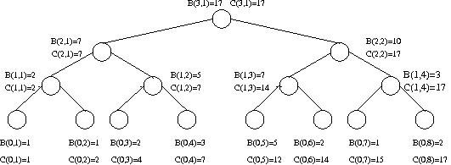
Prefix-sums algorithm
Example
Complexity Charge operations to nodes. Tree has 2n-1 nodes.
No node is charged with more than O(1) operations.
W(n) = O(n). Also T(n) = O(log n)
Theorem: The prefix-sums algorithm runs in O(n) work and O(log n) time.

Slide 30
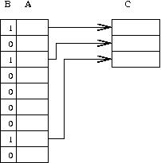
Application - the Compaction Problem
The Prefix-sums routine is heavily used in parallel algorithms. A trivial application follows:
Input Array A = A[1. . N] of elements, and binary array B = B[1 . . n].
Map each value i, 1 ≤ i ≤ n, where B(i) = 1, to the sequence (1, 2, . . . , s); s is the (a priori unknown) numbers of ones in B. Copy the elements of A accordingly.
The solution is order preserving. But, quite a few applications of compaction do not require that.
For computing the mapping, simply find prefix sums with respect to array B.
Consider an entry B(i) = 1. If the prefix sum of i is j then map A(i) into C(j).
Theorem The compaction algorithm runs in O(n) work and O(log n) time.

Slide 31
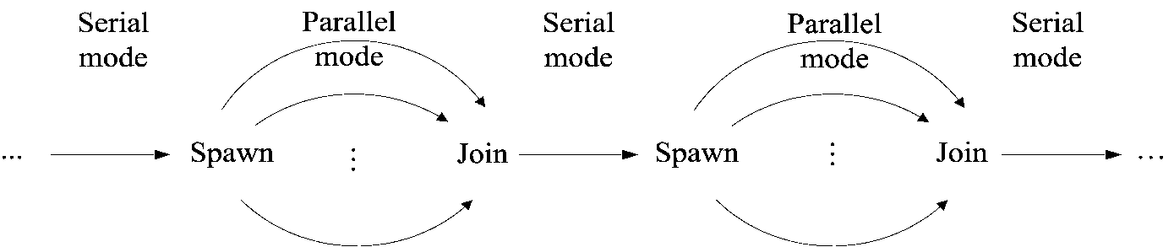
Snapshot: XMT High-level language
XMTC: Single-program multiple-data (SPMD) extension of standard C.
Includes Spawn and PS - a multi-operand instruction.
Short (not OS) threads.
Cartoon Spawn creates threads; a thread progresses at its own speed and expires at its Join.
Synchronization: only at the Joins.
So, virtual threads avoid busy-waits by expiring.
New: Independence of order semantics (IOS).

Slide 32
XMT High-level language (cont’d)
A
D
The array compaction problem
Input: A[1..n]. Map in some order all A(i) not equal 0 to array D.
Essence of an XMT-C program
int x = 0; /*formally: psBaseReg x=0*/
spawn(0, n-1) /* Spawn n threads; $ ranges 0 to n − 1 */
{ int e = 1;
if (A[$] not-equal 0)
{ ps(e,x);
D[e] = A[$] }
}
n = x;
Notes: (i) PS is defined next (think F&A). See results for e0,e2, e6 and x. (ii) Join instructions are implicit.
1
0
5
0
0
0
4
0
0
e0
1
4
5
e2
e6
e$ local to thread $;
x is 3

Slide 33
XMT Assembly Language
Standard assembly language, plus 3 new instructions: Spawn, Join, and PS.
The PS multi-operand instruction
New kind of instruction: Prefix-sum (PS).
Individual PS, PS Ri Rj, has an inseparable (“atomic”) outcome:
Store Ri + Rj in Ri, and
(ii) store original value of Ri in Rj.
Several successive PS instructions define a multiple-PS instruction. E.g., the
sequence of k instructions:
PS R1 R2; PS R1 R3; ...; PS R1 R(k + 1)
performs the prefix-sum of base R1 elements R2,R3, ...,R(k + 1) to get:
R2 = R1; R3 = R1 + R2; ...; R(k + 1) = R1 + ... + Rk; R1 = R1 + ... + R(k + 1).
Idea: (i) Several ind. PS’s can be combined into one multi-operand instruction.
(ii) Executed by a new multi-operand PS functional unit.

Slide 34
Mapping PRAM Algorithms onto XMT
(1st visit of this slide)
(1) PRAM parallelism maps into a thread structure
(2) Assembly language threads are not-too-short (to increase locality of reference)
(3) the threads satisfy IOS
How (summary):
Use work-depth methodology [SV-82] for “thinking in parallel”. The rest is skill.
Go through PRAM or not.
For performance-tuning, in order to later teach the compiler. (To be suppressed as it is ideally done by compiler):
Produce XMTC program accounting also for:
(1) Length of sequence of round trips to memory,
(2) QRQW.
Issue: nesting of spawns.

Slide 35
Workflow from parallel algorithms to programming versus trial-and-error
Option 1
Option 2
Domain decomposition,
or task decomposition
PAT
Parallel algorithmic thinking (ICE/WD/PRAM)
PAT
Prove
correctness
Program
Program
Insufficient inter-thread bandwidth?
Still correct
Rethink algorithm: Take better advantage of cache
Tune
Compiler
Still correct
Hardware
Hardware
Is Option 1 good enough for the parallel programmer’s model?
Options 1B and 2 start with a PRAM algorithm, but not option 1A.
Options 1A and 2 represent workflow, but not option 1B.
Not possible in the 1990s.
Possible now: XMT@UMD
Why settle for less?

Slide 36
Exercise 2 Let A be a memory address in the shared memory of a PRAM. Suppose
all p processors of the PRAM need to “know” the value stored in A. Give a fast EREW
algorithm for broadcasting A to all p processors. How much time will this take?
Exercise 3 Input: An array A of n elements drawn from some totally ordered set. The
minimum problem is to find the smallest element in array A.
(1) Give an EREW PRAM algorithm that runs in O(n) work and O(log n) time.
(2) Suppose we are given only p ≤ n/ log n processors numbered from 1 to p. For the
algorithm of (1) above, describe the algorithm to be executed by processor i, 1 ≤ i ≤ p.
The prefix-min problem has the same input as for the minimum problem and we need to
find for each i, 1 ≤ i ≤ n, the smallest element among A(1),A(2), . . . ,A(i).
(3) Give an EREW PRAM algorithm that runs in O(n) work and O(log n) time for the
prefix-min problem.
Exercise 4 The nearest-one problem is defined as follows. Input: An array A of size n
of bits; namely, the value of each entry of A is either 0 or 1. The nearest-one problem is
to find for each i, 1 ≤ i ≤ n, the largest index j ≤ i, such that A(j) = 1.
(1) Give an EREW PRAM algorithm that runs in O(n) work and O(log n) time.
The input for the segmented prefix-sums problem includes the same binary array A as
above, and in addition an array B of size n of numbers. The segmented prefix-sums
problem is to find for each i, 1 ≤ i ≤ n, the sum B(j) + B(j + 1) + . . . + B(i), where j
is the nearest-one for i (if i has no nearest-one we define its nearest-one to be 1).
(2) Give an EREWPRAM algorithm for the problem that runs in O(n) work and O(log n)
time.

Slide 37
Recursive Presentation of the Prefix-Sums Algorithm
Recursive presentations are useful for describing both serial and parallel algorithms.
Sometimes they shed new light on a technique being used.
PREFIX-SUMS(x₁, x₂, . . . , x_{m}; u₁, u₂, . . . , u_{m})
1. if m = 1 then u₁ := x₁; exit
2. for i, 1 ≤ i ≤ m/2 pardo
- y_{i} := x_{2i−1} ∗ x_{2i}
3. PREFIX-SUMS(y₁, y₂, . . . , y_{m/2}; v₁, v₂, . . . , v_{m/2})
4. for i even, 1 ≤ i ≤ m pardo
- u_{i} := v_{i/2}
5. for i = 1 pardo
- u₁ := x₁
6. for i odd, 3 ≤ i ≤ m pardo
- ui := v_{(i−1)/2} ∗ x_{i}
To start, call: PREFIX-SUMS(A(1),A(2), . . . ,A(n);C(0, 1),C(0, 2), . . . ,C(0, n)).
Complexity Recursive presentation can give concise and elegant complexity analysis.
Excluding the recursive call in instruction 3, routine PREFIX-SUMS, requires: ≤ α time,
and ≤ βm operations for some positive constants α and β. The recursive call is for a
problem of size m/2. Therefore,
T(n) ≤ T(n/2) + α
W(n) ≤ W(n/2) + βn
Their solutions are T(n) = O(log n), and W(n) = O(n).

Slide 38
Exercise 5: Multiplying two n × n matrices A and B results in another n × n matrix
C, whose elements c_{i,j} satisfy c_{i,j} = a_{i,1}b_{1,j} + ..+ a_{i,k}b_{k,j} + ..+ a_{i,n}b_{n,j}.
(1) Given two such matrices A and B, show how to compute matrix C in O(log n) time
using n³ processors.
(2) Suppose we are given only p ≤ n³ processors, which are numbered from 1 to p.
Describe the algorithm of item (1) above to be executed by processor i, 1 ≤ i ≤ p.
(3) In case your algorithm for item (1) above required more than O(n³) work, show how
to improve its work complexity to get matrix C in O(n³) work and O(log n) time.
(4) Suppose we are given only p ≤ n³/ log n processors numbered from 1 to p.
Describe the algorithm for item (3) above to be executed by processor i, 1 ≤ i ≤ p.

Slide 39
Merge-Sort
Input: Two arrays A[1. . n], B[1. . m]; elements from a totally ordered domain S. Each array is monotonically non-decreasing.
Merging: map each of these elements into a monotonically non-decreasing array C[1..n+m]
The partitioning paradigm
n: input size for a problem. Design a 2-stage parallel algorithm:
Partition the input into a large number, say p, of independent small jobs AND size of the largest small job is roughly n/p.
Actual work - do the small jobs concurrently, using a separate (possibly serial) algorithm for each.
Ranking Problem
Input: Same as for merging.
For every 1<=i<= n, RANK(i,B), and 1<=j<=m, RANK(j,A)
Example: A=[1,3,5,7,9],B[2,4,6,8]. RANK(3,B)=2;RANK(1,A)=1

Slide 40
Merging algorithm (cnt’d)
Observe Merging & Ranking: really same problem.
Show M➔R in W=O(n),T=O(1) (say n=m):
C(k)=A(i) ➔ RANK(i,B)=k-i
Show R➔M in W=O(n),T=O(1):
RANK(i,B)=j➔C(i+j)=A(i)
“Surplus-log” parallel algorithm for the Ranking
for 1 ≤ i ≤ n pardo
Compute RANK(i,B) using standard binary search
Compute RANK(i,A) using binary search
Complexity: W=(O(n log n), T=O(log n)

Slide 41
Serial ‘zipper’ algorithm for ranking
SERIAL − RANK(A[1 . . ];B[1. .])
i := 0 and j := 0; add two auxiliary elements A(n+1) and B(n+1), each larger than both A(n) and B(n)
while i ≤ n or j ≤ n do
if A(i + 1) < B(j + 1)
then RANK(i+1,B) := j; i := i + 1
else RANK(j+1),A) := i; j := j + 1
In words Starting from A(1) and B(1), in each round:
compare an element from A with an element of B
determine the rank of the smaller among them
Complexity: O(n) time (and O(n) work...)

Slide 42
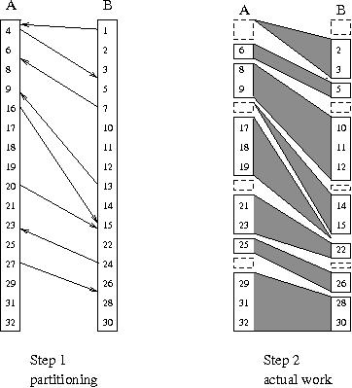
Linear work parallel merging
Partitioning for 1 ≤ i ≤ n/p pardo [p <= n/log and p | n]
b(i):=RANK(p(i-1) + 1),B) using binary search
a(i):=RANK(p(i-1) + 1),A) using binary search
Actual work
Observe Ranking task can be
broken into 2p independent “slices”.
Example of a slice
Start at A(p(i-1) +1) and B(b(i)).
Using serial ranking advance till:
Termination condition
Either A(pi+1) or some B(jp+1) loses
Parallel algorithm
2p concurrent threads

Slide 43
Linear work parallel merging (cont’d)
Observation 2p slices. None larger than 2n/p.
(not too bad since average is 2n/2p=n/p)
Complexity Partitioning takes O(p log n) work and O(log n) time, or O(n) work and O(log n) time. Actual work employs 2p serial algorithms, each takes O(n/p) time. Total work is O(n) and time is O(log n), for p=n/log n.

Slide 44
Exercise 6: Consider the merging problem as above. Consider a variant of the above
merging algorithm where instead of fixing x (p above) to be n/ log n, x could be any positive integer between 1 and n.
Describe the resulting merging algorithm and analyze its time and work complexity as a function of both x and n.
Exercise 7: Consider the merging problem as above, and assume that the values of the
input elements are not pair wise distinct. Adapt the merging algorithm for this problem,
so that it will take the same work and the same running time.
Exercise 8: Consider the merging problem as above, and assume that the values of n
and m are not equal. Adapt the merging algorithm for this problem. What are the new
work and time complexities?
Exercise 9: Consider the merging algorithm as above. Suppose that the algorithm
needs to be programmed using the smallest number of Spawn commands in an XMT-C
single-program multiple-data (SPMD) program. What is the smallest number of Spawn
commands possible? Justify your answer.
(Note: This exercise should be given only after XMT-C programming has been intro-
duced.)

Slide 45
Technique: Divide and Conquer Problem: Sort (by-merge)
Input: Array A[1 .. n], drawn from a totally ordered domain.
Sorting: reorder (permute) the elements of A into array B, such that B(1) ≤ B(2) ≤ . . . ≤ B(n).
Sort-by-merge: classic serial algorithm. This known algorithm translates directly into a reasonably efficient parallel algorithm.
Recursive description (assume n = 2^{l} for some integer l ≥ 0):
MERGE − SORT(A[1 .. n];B[1 .. n])
if n = 1
then return B(1) := A(1)
else call, in parallel,
- MERGE − SORT(A[1 .. n/2];C[1 .. n/2]) and
- MERGE − SORT(A[n/2 +1 .. n);C[n/2 + 1 .. n])
Merge C[1 .. n/2] and C[n/2 +1) .. N] into B[1 .. N]

Slide 46
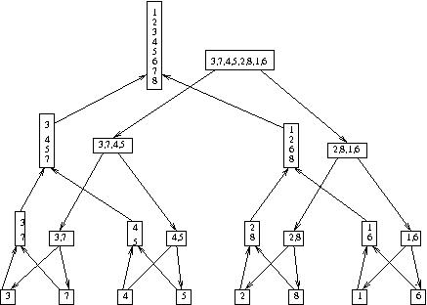
Merge-Sort
Example:
Complexity The linear work merging algorithm runs in O(log n) time.
Hence, time and work for merge-sort satisfy:
T(n) ≤ T(n/2) + α log n; W(n) ≤ 2W(n/2) + βn where α, β > 0 are constants.
Solutions: T(n) = O(log² n) and W(n) = O(n log n).
Merge-sort algorithm is a “balanced binary tree” algorithm. See above figure and try to give a non-recursive description of merge-sort.

Slide 47
PLAN
1. Present 2 general techniques:
Accelerating cascades
Informal Work-Depth—what “thinking in parallel” means in this presentation
2. Illustrate using 2 approaches for the selection problem: deterministic (clearer?) and randomized (more practical)
3. Program (if you wish) the latter
Problem: Selection
Input: Array A[1..n] from a totally ordered domain; integer k, 1 ≤ k ≤ n. A(j) is k-th smallest in A if ≤k−1 elements are smaller and ≤ n−k elements are larger.
Selection problem: find a k-th smallest element.
Example. A=[9,7,2,3,8,5,7,4,2,3,5,6]; n=12;k=4. Either A(4) or A(10) (=3) is 4-th smallest. For k=5, A(8)=4 is the only 5-th smallest element.
Instances of selection problem: (i) for k=1, the minimum element, (ii) for k=n, the maximum (iii) for k = ⌈n/2⌉, the median.

Slide 48
Accelerating Cascades - Example
Get a fast O(n)-work selection algorithm from 2 “pure” selection algorithms:
Algorithm 1 has O(log n) iterations. Each reduces a size m instance of selection in O(log m) time and O(m) work to an instance whose size is ≤ 3m/4. Why is the complexity of Algorithm 1 O(log²n) time and O(n) work?
Algorithm 2 runs in O(log n) time and O(n log n) work.
Pros: Algorithm 1: only O(n) work. Algorithm 2: less time.
Accelerating cascades technique way for deriving a single algorithm that is both: fast and needs O(n) work.
Main idea start with Algorithm 1, but not run it to completion. Instead, switch to Algorithm 2, as follows:
Step 1 Use Algorithm 1 to reduce selection from n to ≤ n/ log n. Note: O(log log n) rounds are enough, since for (3/4)^{r}n ≤ n/ log n, we need (4/3)^{r} ≥ log n, implying r = log_{4/3}log n.
Step 2 Apply Algorithm 2.
Complexity Step 1 takes O(log n log log n) time. The number of operations is n+(3/4)n+.. which is O(n). Step 2 takes additional O(log n) time and O(n) work. In total: O(log n log log n) time, and O(n) work.
Accelerating cascades is a practical technique.
Algorithm 2 is actually a sorting algorithm.

Slide 49
Accelerating Cascades
Consider the following situation: for problem of size n, there are two parallel algorithms.
Algorithm A: W₁(n) and T₁(n). Algorithm B: W₂(n) and T₂(n) time. Suppose: Algorithm A is more efficient (W₁(n) < W₂(n)), while Algorithm B is faster (T₂(n) < T₁(n) ). Assume also: Algorithm A is a “reducing algorithm”: Given a problem of size n, Algorithm A operates in phases. Output of each successive phase is a smaller instance of the problem. The accelerating cascades technique composes a new algorithm as follows:
Start by applying Algorithm A. Once the output size of a phase of this algorithm is below some threshold, finish by switching to Algorithm B.

Slide 50
Algorithm 1, and IWD Example
Note: not just a selection algorithm. Interest is broader, as the informal work-depth (IWD) presentation technique is illustrated. In line with the IWD presentation technique, some missing details for the current high-level description of Algorithm 1 are filled in later.
Input Array A[1..n]; integer k, 1 ≤ k ≤ n.
Algorithm 1 works in “reducing” ITERATIONS:
Input: Array B[1..m]; 1≤ k₀≤m. Find k₀-th element in B.
Main idea behind a reducing iteration is: find an element α of B which is guaranteed to be not too small (≤ m/4 elements of B are smaller), and not too large (≤ m/4 elements of B are larger). Exact ranking of α in B enables to conclude that at least m/4 elements of B do not contain the k₀-th smallest element. Therefore, they can be discarded. The other alternative: the k₀-th smallest element (which is also the k-th smallest element with respect to the original input) has been found.

Slide 51
ALGORITHM 1 - High-level description (Assume: log m and m/ log m are integers.)
1. for i, 1 ≤ i ≤ n pardo
B(i) := A(i)
2. k₀ := k; m := n
3. while m > 1 do
3.1. Partition B into m/log m blocks, each of size log m as follows. Denote
the blocks B₁,..,B_{m/log m}, where B₁=B[1..logm],..,B_{m/log m}=B[m+1−log m..m].
3.2. for block Bi, 1 ≤ i ≤ m/log m pardo
compute the median α_{i} of Bi, using a linear time serial selection algorithm
3.3. Apply a sorting algorithm to find α the median of medians (α₁, . . . , α_{m/log m}).
3.4. Compute s₁, s₂ and s₃. s₁: # elements in B smaller than α, s₂: # elements equal
to α, and s₃: # elements larger than α.
3.5. There are three possibilities:
3.5.1 (i) k₀≤s₁: the new subset B (the input for the next iteration) consists of the
elements in B, which are smaller than α (m:=s₁; k₀ remains the same)
3.5.2 (ii) s₁<k₀≤s₁+s₂: α is the k₀-th smallest element in B; algorithm terminates
3.5.3 (iii) k₀>s₁+s₂: the new subset B consists of the elements in B, which
are larger than α (m := s₃; k₀:=k₀−(s₁+s₂) )
4. (we can reach this instruction only with m = 1 and k₀ = 1)
B(1) is the k₀-th element in B.

Slide 52
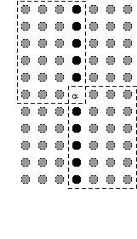
Reducing Lemma At least m/4 elements of B are smaller than α, and at least m/4 are larger.
Proof
Corollary 1 Following an iteration of Algorithm 1 the value of m decreases so that the new value of m is at most (3/4)m.

Slide 53
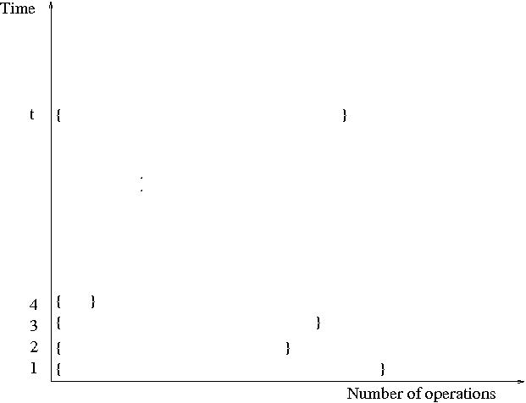
Informal Work-Depth (IWD) description
Similar to Work-Depth, the algorithm is presented in terms of a sequence of parallel time units (or “rounds”); however, at each time unit there is a set containing a number of instructions to be performed concurrently
Descriptions of the set of concurrent instructions can come in many flavors. Even implicit, where the number of instruction is not obvious.
Example Algorithm 1 above: The input (and output) for each reducing iteration is given as a set. We were also not specific on how to compute s₁, s₂ and s₃.
The main methodical issue addressed here is how to train CS&E professionals “to think in parallel”. Here is the informal answer: train yourself to provide IWD description of parallel algorithms. The rest is detail (although important) that can be acquired as a skill (also a matter of training).

Slide 54
The Selection Algorithm (wrap-up)
To derive the lower level description of Algorithm 1, simply apply the prefix-sums algorithm several times.
Theorem 5.1 Algorithm 1 solves the selection problem in O(log²n) time and O(n) work. The main selection algorithm, composed of algorithms 1 and 2, runs in O(n) work and O(log n log log n) time.
Exercise 10 Consider the following sorting algorithm. Find the median element and then continue by sorting separately the elements larger than the median and the ones smaller than the median. Explain why this is indeed a sorting algorithm. What will be the time and work complexities of such algorithm?
Recap: (i) Accelerating cascades framework was presented and illustrated by selection algorithm. (ii) A top-down methodology for describing parallel algorithms was presented. Its upper level, called Informal Work-Depth (IWD), is proposed as the essence of thinking in parallel.

Slide 55
Randomized Selection
Parallel version of serial randomized selection from CLRS, Ch. 9.2
Input Array A[p...r]
RANDOMIZED_PARTITION(A,p,r)
i := RANDOM (p,r)
/*Rearrange A[p...r]: elements <= A(i) followed by those > A(i)*/
exchange A(r) ⬅➔A(i)
return PARTITION(A,p,r)
PARTITION(A,p,r)
x := A(r)
i := p-1
for j := p to r-1
if A(j) <= x
then i := i+1
exchange A(i) ⬅➔A(j)
exchange A(i+1) ⬅➔A(r)
Return i+1
Input Array A[p...r], i. Find i-th smallest
RANDOMIZED_SELECT(A,p,r,i)
if p=r
Then return A(p)
q := RANDOMIZED_PARTITION(A,p,r)
k := q-p+1
if i=k
then return A(q)
else if i < k
then return RANDOMIZED_SELECT(A,p,q-1,i)
else return RANDOMIZED_SELECT(A,q+1,r,i-k)
Basis for proposed programming project

Slide 56
Integer Sorting
Input Array A[1..n], integers from range [0..r−1]; n and r are positive integers.
Sorting: rank from smallest to largest.
Assume n is divisible by r. Typical value for r might be n^{1/2}; other values possible.
Two comments about the parallel integer sorting algorithm:
Its performance depends on the value of r, and unlike other parallel algorithms we have seen, its running time may not be bounded by O(log^{k}n) for any constant k (“poly-logarithmic”). It is a remarkable coincidence that the literature includes only very few work-efficient non ploy-log parallel algorithms.
It already lent itself to efficient implementation on a few parallel machines in the early 1990s. (Remark later.)
The algorithm work as follows:

Slide 57
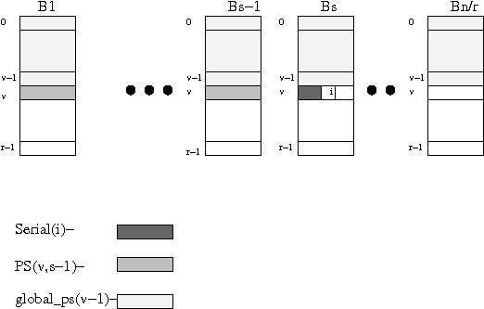
1. Partition A into n/r subarrays: B₁=A[1..r]..B_{n/r}=A[n−r+1..n]. Using serial bucket sort (see Exercise 12 below), sort each subarray separately (and in parallel for all subarrays). Also compute: (1) number(v,s) - the number of elements whose value is v in subarray B_{s}, for 0≤v≤ r−1, and 1≤s≤n/r; and (2) serial(i) - the number of elements A(j) such that A(j)=A(i) and precede element i in its subarray B_{s} (i.e., serial(i) counts only j < i, where ⌈j/r⌉ = ⌈i/r⌉ = s), for 1 ≤ i ≤ n.
Example B₁=(2,3,2,2) (r=4). Then, number(2,1) = 3, and serial(3)=1.
2. Separately (and in parallel) for each value 0 ≤ v ≤ r−1 compute the prefix-sums of number(v,1), number(v,2) .. number(v,n/r) into ps(v,1), ps(v,2) .. ps(v,n/r), and their sum (the number of elements whose value is v) into cardinality(v).
3. Compute the prefix sums of cardinality(0), cardinality(1) .. cardinality(r−1)
into global−ps(0), global−ps(1) .. global−ps(r−1).
4. In parallel for every element i, 1≤i≤n [Let v = A(i) and B_{s} the subarray of element i (s = ⌈i/r⌉]: The rank of element i is 1+serial(i)+ps(v,s−1)+global−ps(v−1)
[where ps(0,s)=0 and global−ps(0)=0]
Exercise 11: Describe the integer sorting algorithm in a “parallel program”, similar to
the pseudo-code that we usually give.
Complexity
1: T=O(r), W=O(r) per subarray; total: T=O(r), W=O(n).
2: r computations; each T=O(log(n/r)),W=O(n/r); total T=O(log n), W=O(n) work.
3: T=O(log r), W=O(r).
4: T=O(1), W=O(n) work.
Total: T=O(r + log n), W=O(n).

Slide 58
Theorem 6.1: (1) The integer sorting algorithm runs in O(r+log n) time and O(n) work. (2) The integer sorting algorithm can be applied to run in time O(k(r^{1/k}+log n)) and O(kn) work for any positive integer k.
Showed (1). For (2): radix sort using the basic integer sort (BIS) algorithm:
A sorting algorithm is stable if for every pair of two equal input elements A(i) = A(j) where 1 ≤ i < j ≤ n, it ranks element i lower than element j.
Observe: BIS is stable.
Only outline the case k = 2.
2-step algorithm for an integer sort problem with r=n in T=O(√n) W=O(n)
Note: the big Oh notation suppresses the factor k=2.
Assume that √n is an integer.
Step 1 Apply BIS to keys A(1) (mod √n), A(2) (mod √n) .. A(n) (mod √n). If the computed rank of an element i is j then set B(j) := A(i).
Step 2 Apply again BIS this time to key ⌊B(1)/√n⌋, ⌊B(2)/√n⌋ .. ⌊B(n)/√n⌋.
Example 1. Suppose UMD has 35,000 students with social security number as IDs. Sort by IDs. The value of k will be 4 since √1B ≤ 35,000 and 4 steps are used.
2. Let A=10,12,9,2,3,11,10,12,4,5,9,4,3,7,15,1 with n=16 and r=16. Keys for Step 1 are values modulo 4: 2,0,1,2,3,3,2,0,0,1,1,0,3,3,3,1. Sorting & assignment to array B: 12,12,4,4,9,5,9,1,10,2,10,3,11,3,15. Keys for Step 2 are ⌊v/4⌋, where v is the value of an element of B (i.e., ⌊9/4⌋=2). The keys are 3,3,1,1,2,1,2,0,2,0,2,0,2,0,3. The result relative to the original values of A is 1,2,3,3,4,5,7,9,9,10,10,11,12,12,15.

Slide 59
Remarks 1. This simple integer sorting algorithm has led to efficient implementation
on parallel machines such as some Cray machines and the Connection Machine (CM-2). [BLM+91] and [ZB91] report giving competitive performance on the machines that they examined. Given a parallel computer architecture where the local memories of different (physical) processors are distant from one another, the algorithm enables partitioning of the input into these local memories without any inter-processor
communication. In steps 2 and 3, communication is used for applying the prefix-sums
routine. Over the years, several machines had special constructs that enable very fast
implementation of such a routine.
2. Since the theory community looked favorably at the time only on poly-log time algorithm, this practical sorting algorithm was originally presented in [CV-86] for a routine for sorting integers in the range 1 to log n as was needed for another algorithm.
Exercise 12: (Redundant if you remember the serial bucket-sort algorithm).
The serial bucket-sort (called also bin-sort) algorithm works as follows. Input: An array
A = A(1), . . . ,A(n) of integers from the range [0, . . . , n−1]. For each value v, 0 ≤ v ≤ n−1, the algorithm forms a linked list of all elements A(i) = v, 0 ≤ i ≤ n−1. Initially,
all lists are empty. Then, at step i, 0 ≤ i ≤ n − 1, element A(i) is inserted to the linked
list of value v, where v = A(i). Finally, the linked list are traversed from value 0 to
value n − 1, and all the input elements are ranked. (1) Describe this serial bucket-sort
algorithm in pseudo-code using a “structured programming style”. Make sure that the
version you describe provides stable sorting. (2) Show that the time complexity is O(n).

Slide 60
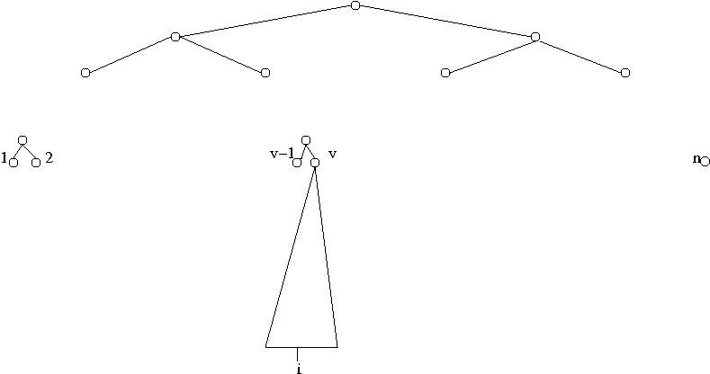
The orthogonal-tree algorithm
Integer sorting problem Range of integers: [1 .. n]. In a nutshell: the algorithm is a big prefix-sum computation with respect to the data structure below. For each integer value v, 1 ≤ v ≤ n, it has an n-leaf balanced binary tree.

Slide 61
1 (i) In parallel, assign processor i, 1 ≤ i ≤ n to each input element A(i). Focus
on one element A(i). Suppose A(i) = v.
(ii) Advance in log n rounds from leaf i in tree v to its root. In the process, compute the number of elements whose value is v. When 2 processors “meet” at an internal node of the tree one of them proceeds up the tree; the 2nd “sleep-waits” at that node.
The plurality of value v is now available at leaf v of the top (single) binary tree that will guide steps 2 and 3 below..
2 Using a similar log n-round process, processors continue to add up these pluralities;
in case 2 processors meet, one proceeds and the other is left to sleep-wait.
The total number of all pluralities (namely n) is now at the root of the upper tree. Step 3 computes the prefix-sums of the pluralities of the values into leaves of the top tree.
3 A log n-round “playback” of Step 2 from the root of the top tree its leaves follows. [Exercise: figure out how to obtain prefix-sums of the pluralities of values at leaves of the top tree.] Only interesting case: internal node where a processor was left sleep-waiting in Step 2. Idea: wake this processor up, send the waking processor and the just awaken one with prefix-sum values in the direction of its original lower tree.
The objective of Step 4 is to compute the prefix-sums of the pluralities of the values at
every leaf of the lower trees that holds an input element-- the leaves active in Step 1(i). 4 A log n-round “playback” of Step 1, starting in parallel at the roots of the lower trees. Each of the processors ends at the original leaf in which it started Step 1. [Exercise: Same as Step 3]. Waking processors and computing prefix-sums: Step 3.
Exercise 13: (i) Show how to complete the above description into a sorting algorithm
that runs in T=O(log n), W=O(n log n) and O(n²) space. (ii) Explain why your
algorithm indeed achieves this complexity result.

Slide 62
2-3 (or B-) Trees
Get material from pages 42-51 in http://www.umiacs.umd.edu/users/vishkin/PUBLICATIONS/classnotes.pdf

Slide 63
2-3 tree
Search takes O(log n) time

Slide 64
Begin with insert(12)
Translate to absorb(12,14)

Slide 65
absorb(C-LEFT,C)

Slide 66
Complete insert(12)

Slide 67
Complexity
Insert takes O(log n) time
Can we insert k elements in parallel?
Yes, but if not too many need to be inserted at the same place (between 2 leaves).
Idea let us restrict our attention to a ‘restricted parallel problem’: only one element can be inserted between 2 leaves (one largest element, or one smallest can be handled separately)
Observation as we climb in synchronous steps the situation is not getting worse: no more than one new node for every old node

Slide 68
Complexity
Restricted problem with k elements to insert: k processors, O(log n) time
What if the problem is not restricted?
Any k elements need to be inserted
Step 1 Sort them [O(log k) time, O(k log k) work]
Step 2 How can the restricted problem help?
Idea?

Slide 69
Unrestricted insert
Insert middle element
Recur
Complexity O(log n log k) time, O(k log n) work
Can this be improved?
Idea?
Complexity O(log n + log k) = O(log n) time, O(k log n) work

Slide 70
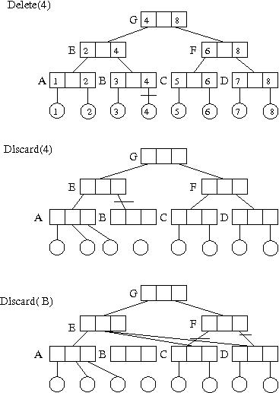
Delete(4): first discard(4), second discard(B)

Slide 71
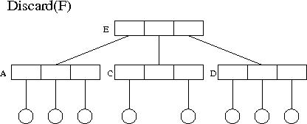
Finally discard(F)

Slide 72
Complexity
Delete takes O(log n) time

Slide 73
Can we delete k elements in parallel?
Yes, but if not too many need to be deleted near one another (e.g., 2 adjacent leaves).
Idea let us restrict our attention to a ‘restricted parallel problem’: if a leaf is deleted its predecessor leaf is not.
Observation as we climb in synchronous steps the situation is not getting worse: no more than one deleted node for every remaining node

Slide 74
Complexity
Restricted problem with k elements to delete: k processors, O(log n) time
What if the problem is not restricted?
Any k elements need to be deleted
Step 1 Remove all nonleaves and sort the leaves [O(log k) time, O(k log k) work]
Step 2 How can the restricted problem help?
Idea?

Slide 75
Unrestricted delete
Delete every second element
Recur
Complexity O(log n log k) time, O(k log n) work
Can this be improved?
Idea?
Complexity O(log n + log k) = O(log n) time, O(k log n) work

Slide 76
Mapping PRAM Algorithms onto XMT
(revisit of this slide)
(1) PRAM parallelism maps into a thread structure
(2) Assembly language threads are not-too-short (to increase locality of reference)
(3) the threads satisfy IOS
How (summary):
Use work-depth methodology [SV-82] for “thinking in parallel”. The rest is skill.
Go through PRAM or not.
Produce XMTC program accounting also for:
(1) Length of sequence of round trips to memory,
(2) QRQW.
Issue: nesting of spawns.
Compiler roadmap:
➔ Produce performance-tuned examples➔ “teach the compiler”➔ Programmer: produce simple XMTC programs

Slide 77
My reading of the state of the art
Ongoing transition of mainstream computing to parallelism.
Traditional CS R&D communities good at keeping intra-community coherence.
But, problems with platforms inter-community coherence
2 Examples noted in course
1. Parallel HW not engineered for ease-of-programming and to connect to the main parallel algorithmic theory of CS
Stay tuned Can HW be out of synch with others? Will the reality check of too few programmers make difference?
2. Parallel Algorithms of yore – just theory. XMT: vertical integration/coherence require a lot of work, but are worth it

Slide 78
Back-up slides

Slide 79
But coming up with a whole theory of parallel algorithms is a complex mental problem
How to address that?
Address first the easiest problem(s) you don’t know to solve.
Provided a surprising structure, as illustrated next.
2. Do what computer scientists do best: develop/identify/fit the correct level of abstraction to each problem
Has been a key point of this presentation

Slide 80
List Ranking Cluster: Euler tours; pointer jumping; randomized and deterministic symmetry breaking
Tree rooting: a “toy problem” that will motivate the presentation.
Input T(V,E), and some specified vertex r in V . V – vertices. E – undirected edges, contains unordered pairs of vertices.
Tree rooting problem For each edge, select a direction, so that the resulting directed graph T’(V,E’) is a (directed) rooted tree whose root is vertex r; e.g., if (u, v) is in E and vertex v is closer to the root r than vertex u then u → v is in E.
Euler tour technique: constant-time optimal-work reduction of tree rooting, and other tree problems, to the list ranking problem.
This section can be viewed as an extensive top-down description of an algorithm for any
of these tree problems, since the list ranking algorithms that follow are also described in
a top-down manner. Top-down structures of problems and techniques from the involved
to the elementary have become a “trade mark” of the theory of parallel algorithms, as
reviewed in [Vis91]. Such fine structures highlight the elegance of this theory and are
modest, yet noteworthy, of fine structures that exist in some classical fields of Mathe-
matics. However, they are rather unique for Combinatorics-related theories. Figure to
illustrate this structure:

Slide 81
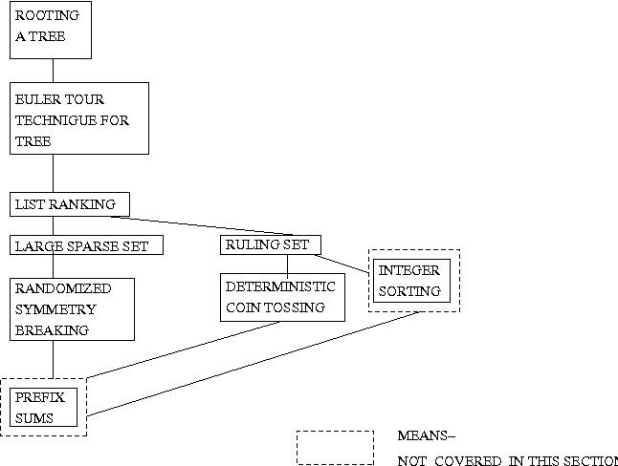

Slide 82
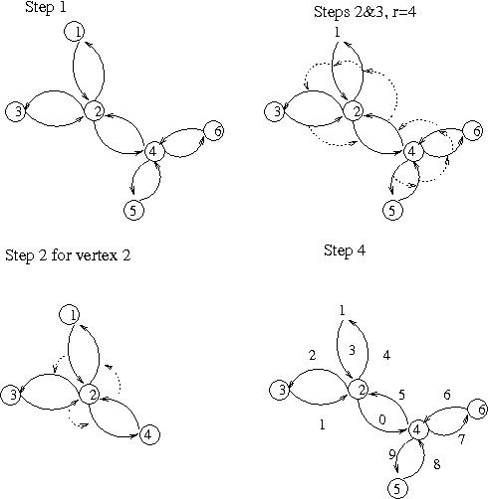
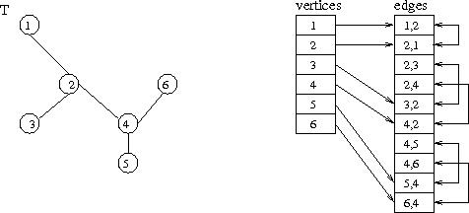
Tree T and its input representation
The Euler-tour technique

