Slide 1


Single-Threaded Parallel Programming
Parallel algorithms/programming dominated by Math induction, like serial a/p for Multi-Threaded Many-Core Design scalable parallel systems
Uzi Vishkin
Notes:
Or, why an old colleague said: you can retire now

Slide 2
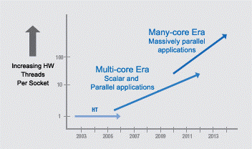
Commodity computer systems
Chapter 1 1946➔2003: Serial. 5KHz➔4GHz.
Chapter 2 2004--: Parallel.
Projection, Intel 2005: #”cores”: ~d^{y-2003}, d>1. Expected a different design to take over somewhere in the range of 16-32 cores.
Not exactly…
Intel Platform 2015, March05
Notes:
2

Slide 3
Commodity computer systems
[Hennessy Patterson-19]:
- Clock frequency growth: ~flat. If you want your program to run significantly faster … you’re going to have to parallelize it ➔ Parallelism: only game in town
- Since 1980:
#Transistors/chip 29K➔~10sB!
Bandwidth/Latency +300X
Great but… Programmer’s IQ? Flat..
Glass half full or half empty?
Products
Market success of:
  dedicated GPUs (e.g., NVIDIA)
  integrated GPUs (Intel)
  Deprecated:
      2005–2018 ☹ Many-Integrated-Core (Intel, Xeon Phi Knights Landing)
Notes:
3
Yet, today’s hot research: Power is important; indeed! Conclusion: build slightly more power efficient machines that are even more difficult to program, and for this reason typical programs will end up being suboptimal possibly requiring more power. Also, few program will be developed, saving even more power..

Slide 4
Comments on operations/programming
(of commodity computers)
Parallel programming: Programmer-generated concurrent threads. Some issues: locality, race conditions, no thread too long relative to others. Too hard
Vendors change designs often➔map & tune performance programs for each generation. Sisyphean
Forced shift to heterogeneous platforms: “it seems unlikely that some form of simple multicore scaling will provide a cost-effective path to growing performance”, HP19.
First comment on this quote:
  Babel-Tower ➔ Hard: Sisyphean & Babel-Tower
Qualifier The glass is only half empty
Salient math primitive supported by GPUs: matrix multiplication (MM)
Deep learning (DL) exuberance: MM➔SGD➔Back propagration➔DL
Explanation (HP19): for dense MM, arithmetic intensity [#FLOPs per <bytes read from main memory>] increases with input size ➔ GPUs
Notes:
For opinion on the limitations of such programming: Is Multi-Core Hardware for General-Purpose Parallel Processing Broken? V-CACM-14

Slide 5
Recall: “unlikely that simple multicore scaling will provide cost-effective path to growing performance”
XMT@UMD: simple multicore scaling and cost-effective path to growing performance
Validated with extensive prototyping: algorithms, compilers, architecture and commitment to silicon
Contradicts the above quote (&common wisdom)

Slide 6
Lead insight: Every Serial Algorithm is a Parallel One
(Semester-long course on theory of parallel algorithms in 30s)
Serial abstraction: a single instruction ready for execution in a serial program executes immediately – ”Immediate Serial Execution (ISE)”
Abstraction for making parallel computing simple: indefinitely many instructions ready for concurrent execution execute immediately - Immediate Concurrent Execution (ICE): ‘parallel algorithmic thinking’
Note: Math induction drives both ISE and ICE. Compare, e,g., with MM.
If more parallelism is desired, algorithm design effort may be needed
New: Programmer’s job is done with ICE algorithm specification
Cilk, etc.: Limited overlap; e.g., some work-depth reasoning.
Serial Execution, Based on Serial Abstraction
What could I do in parallel at each step assuming unlimited hardware
➔
Concurrent writes? Arbitrary…
Parallel Execution, Based on Parallel Abstraction
#
ops
.
.
#
ops
.
.
.
.
..
..
..
..
time
time
Time = Work
Work = total #ops
Time (“depth”) << Work
Notes:
Serial--Abstracts away: different execution time for operation (memory hierarchy). Made serial programming simple. Programmers: conceptualize. HW and compilers: implement. Program: instruction to execute next (inductively)
Parallel--Step-by-step (inductive) explication of the instructions available next for concurrent execution. # processors not even mentioned. Falls back on the serial abstraction if 1 instruction/step

Slide 7
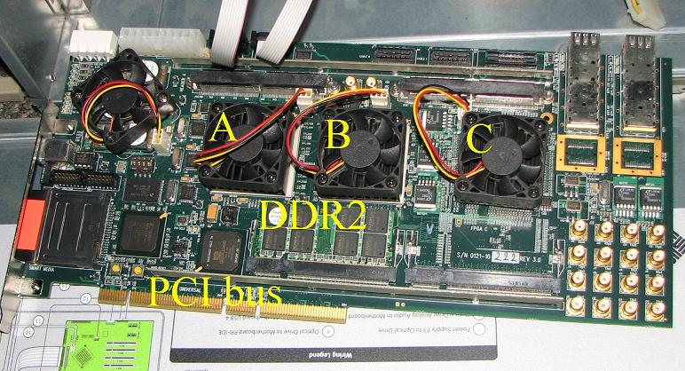
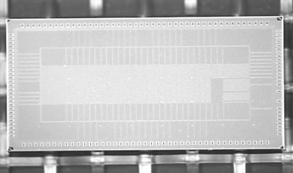
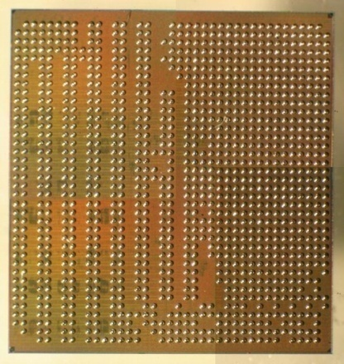
Not just talking
Algorithms&Software
PRAM-On-Chip HW Prototypes
2018: ICE
WorkDepth/PAT/PRAM
Creativity ends here
Programming & workflow
Pre 2018: explicit multi threading
Still: No ‘parallel programming’ course beyond freshmen
Stable compiler
64-core, 75MHz FPGA of XMT
(Explicit Multi-Threaded) architecture
128-core intercon. network IBM 90nm: 9mmX5mm, 400 MHz
FPGA design➔ASIC
IBM 90nm: 10mmX10mm
Architecture scales to 1000+ (100K+?) cores on-chip (off-chip?)
Notes:
Creativity--By nature, algorithms require some level of creativity. Ideally, programming does not.
Current ideas for 100K+ cores require going off-chip

Slide 8
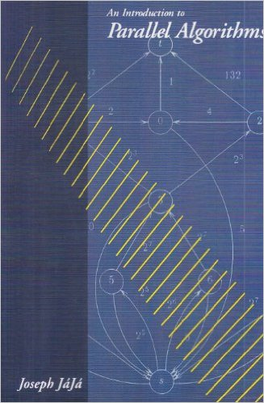

PRAM: main theory of parallel algorithms
Also: surveys, class notes and chapters in algorithms textbooks.
First my focus. Then my compass. since 1979

Slide 9
Immediate Concurrent Execution (ICE) Programming
[Easy PRAM-based high-performance parallel programming with ICE, Ghanim, V,B, IEEE TPDC 2018]
PRAM algorithm and its ICE program
PRAM: main model for theory of parallel algorithm
  Strong speedups for irregular parallel algorithms
ICE: Follows the lock-step execution model
  Parallelism as-is from PRAM algorithms textbook:
  An extension of the C language
    New keyword ‘pardo’ (Parallel Do)
New work: Translate ICE programs into XMTC (& run on XMT)
  Lock-step model → Threaded Model
Motivation: Ease-of-programming of parallel algorithms
Question: but at what performance slowdown?
Perhaps surprising answer: Comparable runtime to XMTC
  average 0.7% speedup(!) on eleven-benchmarks suite
pardo (unsigned i = 0; n – 1; 1) {
 | while (S[i] != S[S[i]]) {
 |  | W[i] = W[i] + W[S[i]];
 |  | S[i] = S[S[i]];
 | }
}
Anecdote Older colleague commented “you can retire now”
 | Integer Sort | Sample Sort | Merge Sort | Graph Connectivity | Breadth First Search | Maximum Finding | Tree Contraction | Tree Rooting | Jacobi | LU Factorization | Cholesky Factorization
Normalized to XMTC | 100.00% | 98.54% | 102.07% | 98.55% | 108.42% | 104.78% | 100.61% | 97.42% | 100.99% | 98.39% | 98.66%
ICE slowdown | 0.002% | 1.457% | -2.070% | 1.453% | -8.424% | -4.780% | -0.610% | 2.584% | -0.985% | 1.605% | 1.338%
Notes:
Proof-of-concept
While XMTC compiler has been stable for human programming, some issues regarding code which is (ICE) compiler output

Slide 10
The appliance that took over the world
Critical feature of serial computing
Math (mankind?) invented (only?) one way for rigorous reasoning:
Mathematical induction (MI) ➔ Serial von-Neumann:
Intuition: An MI appliance?
MI-Enabled for programming, machinery and reasoning.
(Alleged) Aspiration: enabling efficient MI-based algorithms; i.e., constructive step-by-step descriptions
(Beyond scope: “best” model & architecture. Elaborate literature 1940s to 1970; e.g., [AHU74])
To bypass debate: MIA-appliance (MI Aspiring)
In retrospect: engineering for serendipity. An appliance that roared.
The CS miracle: apps unimagined by originators …taken for granted

Slide 11
Parallel computing
Concurrent threads ➔ mandated whole new: 1. algorithms, 2. programming and 3. reasoning. Alas, no 100s yrs of Math to lean on
HW vendor design origins: “build-first figure-out-how-to-program-later” ➔ “threw the programmers under the bus” ☹. Yet: Nice MM appliance ☺
Our aspiration: MI-based parallel algorithms first: Lock-step parallelism for algorithms & programming ➔
Parallel MIA appliance!
Pun intended, since… missing in action
Henceforth: MI-appliance
Contrast with: multi-threaded programming, SIMT (Nvidia), multi-threaded algorithms [CLRS,3rd edition], MIT/Intel Cilk, Intel TBB.

Slide 12
Where we should go from here
Future: CPU +
  GPU
  Other excelerators
Algorithms is a technology. For some this is hard to recognize, since … abstract
Parallel algorithms technology is critical for (at least) the CPU ➔ lead HW/SW specifications, subject to understanding of:
  technology constraints, and
  applications
Contrast with the industry mode of “build-first-figure-out-how-to-program-later”. A related mistake in a leading company:
  1st rate HW and system software people
  No technical representation of parallel algorithmicists
My quest: reproduce for parallelism the biggest (?) technology success story of the 20th century: von-Neumann’s general-purpose serial computer

Slide 13
Takes home: 1 result & 2 questions
Main result A parallel MI appliance is: Desirable, effective and feasible for properly designed many-core systems
  Validated by extensive prototyping
Question 1. Is MI a hidden pull for computing platforms seeking ubiquity? (Example of a hidden pull: Gravity)
  Will compare MI-driven designs choices with afterthought (?) choices in some vendor products
Deep Learning➔stochastic gradient descent➔MM➔ killer app for GPUs … serendipity
Question 2. Find a killer app for many-core parallelism You are unlikely to appreciate the challenge till you try
(Yes to Q2 ➔ likely a killer app for an MI-based one)

Slide 14
Example serial & parallel(!) algorithm: Breadth-First-Search (BFS)

Slide 17
(i) “Concurrent&writes”. Only changes to serial algorithm; involves implementation… natural BFS
(ii) Defies “decomposition”/”partition”
Parallel complexity
W = ~(|V| + |E|)
T = ~d, the number of layers
Average parallelism = ~W/T
Mental effort
1. Sometimes easier than serial
2. Within common denominator of other parallel approaches. In fact, much easier

Slide 18
Prior Case Studies Limited speedups of multi-core CPUs & GPUs vs. “same-size” UMD XMT
 | XMT | GPU/CPU | factor
Graph Biconnectivity | 33X | 4X random graphs Muuuch parallelism | >>8
Graph Triconnectivity | 129X | Only serial result | 129
Max Flow | 108X | 2.5X | 43
Burrows Wheeler Compression Transform - bzip2 Decompression | 25X 13X | X/2.8 … on GPU 1.1 | 70 11
- On XMT the connectivity and max-flow algorithms did not require algorithmic creativity. But, on other platforms, biconnectivity and max-flow required significant creativity
- BWT is 1st “truly parallel” speedup for lossless data compression. Beats Google Snappy (message passing within warehouse scale computers)
Validated PRAM theory Above most advanced problem. Many more results.
Horizons of computer architecture cannot be studied by only using elementary algorithms [Performance, efficiency and effectiveness of a car not tested only in low gear or limited road conditions]
Stress test for important architecture capabilities not often discussed:
Strong scaling : Increase #processors, not problem size
Speedups even with little amounts of algorithm parallelism & not falling behind on serial
Notes:
Quote from Abstract of the Game over report:
The only foreseeable way to continue advancing performance is to match parallel hardware with parallel software and ensure that the new software is portable across generations of parallel hardware. There has been genuine progress on the software front in specific fields, such as some scientific applications and commercial searching and transactional applications. Heroic programmers can exploit vast amounts of parallelism, domain-specific languages flourish, and powerful abstractions hide complexity. However, none of those developments comes close to the ubiquitous support for programming parallel hardware that is required to ensure that IT’s effect on society over the next two decades will be as stunning as it has been over the last half-century.
Teaching experiment favoring Intel SMP in a joint UIUC/UMD class with 42 students. Codes breadth-first-search (BFS) on graphs using OpenMP on an Intel SMP machine and XMTC. While same effort, no student got any speedups on the SMP machine, while range of XMT speedups was 7X to 25X.
Teaching experiment. Application: MATVEC, by DARPA-HPCS funded Hochstein-Basili. UCSB: MPI. UMD: XMTC. Finding (in journal paper): XMTC needed 50% development time of MPI.

Slide 19
Structure of PRAM algorithms for tree and graph problems
advanced planarity testing
advanced triconnectivity
planarity testing
triconnectivity
st-numbering
k-edge/vertex
connectivity
minimum
spanning forest
Euler
tours
ear decompo-
sition search
bicon-
nectivity
strong
orientation
centroid
decomposition
tree
contraction
lowest common
ancestors
graph
connectivity
tree Euler tour
Root of OoM speedups on tree and graph algorithms
Speedup on various input sizes
on much simpler problems; e.g., list ranking
list ranking
2-ruling set
prefix-sums
deterministic coin tossing

Slide 20
From now on:
2018 publications

Slide 21
Machine Learning App: XGBoost
XGBoost = Efficient implementation of gradient boosted decision trees
  Optimized for serial and parallel CPUs
  Recently extended to GPUs
  For market-place apps
  (i) Top-10 winners of KDDCup 2015;
  (ii) Many top winners on Kaggle
  (ML competition website, acquired by Google, 2017)
Important to reduce XGBoost train time:
  Published speedups: GPUs
  Target of Intel Data Analytics Acceleration Library (DAAL)

Slide 22
XGBoost (cont’d)
Conjecture: much greater speedups are possible
  GPUs tuned for regular computation (e.g., deep learning). However,
  XGBoost is highly irregular: sorting, compaction, prefix-sums with indirect addressing
  GPU improves irregular algorithms support; still far behind regular algs support
New speedups
3.3X over NVIDIA's Volta - most powerful GPU to date [Edwards-V 2018]

Slide 23
XMT Architecture
For memory architectures: tightly coupling serial and parallel computation But, tension:
  Serial code: more sensitive to memory latency. Less to bandwidth. Parallel code: can issue multiple requests in parallel to hide latency; often requires sharing data among processors
The hybrid memory architecture underlying the XMT framework features:
  “Heavy” master CPU with a traditional cache (“serial mode”)
  “Light” CPUs with shared caches (“parallel mode”); no local write-caches
  Low-overhead (~10s cycles) transition between the two
  High-bandwidth, on-chip, all-to-all interconnection network
➔ Competitive up- and down- scalable performance
GRF
prefix-sum unit
MTCU
spawn-join
cluster 0
cluster 1
cluster 63
•••
cache
interconnection network
cache 0
•••
cache 7
cache 56
•••
cache 63
•••
MC 0
MC 7

Slide 24
XMT Architecture (cont’d)
How come?
1. Many programs consist of both serial sections of code and parallel sections, potentially with varying degrees of parallelism. Need: Strong serial support
2. Many programs with fine-grained threaded parallelism need to “rethread”. Switch to serial mode and back to parallel mode can be effective
But, what are the prospects that architecture insights and, in particular, memory architecture ones reach commercial implementation?

Slide 25
Preview
While their original principles guided them in the opposite direction, new evidence that:
  both multi-core and GPU design have been getting much closer to this hybrid memory architecture, and
  reasoning that their current quest for more effective support of fine-grained irregular parallelism drew them closer to such memory architecture

Slide 26
Goal for architecture
Fastest implementation from whatever parallelism programmer/application provide
Point of next slides
Much to be desired for limited parallelism
Conditions where CPU doing better than GPU
Can CPU/GPU do better if they get closer to XMT?

Slide 27
GPU memory architectures: something changed…
Compared run-times cycle-accurate simulations of programs on FusionSim (based on GPGPU-Sim) versus recent NVIDIA GPU:
  1. Matched NVIDIA GTX 480 GPU (Fermi architecture). Then,
  2. Sought to develop a cycle-accurate simulation of the Tesla M40 GPU (Maxwell architecture, 2 generations later) for further research
Ran a list ranking (highly irregular parallel pointer jumping) benchmark of three NVIDIA GPUs as well as FusionSim
However, we had to abandon our plans since we could not get FusionSim to match the actual performance of modern GPUs
Anecdotal conclusion: something must have changed

Slide 28
GPU memory architectures: something changed (cont.)
1. For small input sizes (< 8000 elements), FusionSim underestimates benchmark run time relative to all three GPUs.
  Suggests: some kernel launch overheads are not reflected in FusionSim
2. The more recent Tesla K20 and M40 GPUs exhibit a steeper increase in runtime at around 250,000 elements than at any other point, but FusionSim does not reflect this
  FusionSim more closely follows the older GTX 260 in this respect
  This observation led us to suspect that NVIDIA made some improvements between the release of the GTX 260 in 2008 and the Tesla K20 in 2012

Slide 29
Finally a clue…
We could not make sense of this improvement based on published papers. Unexpected given keynote talk [Dally’09] and its well-cited claim: “locality equals efficiency”: How can parallel architectures equating locality with efficiency (and minimizing reliance on non-local memories) provide such strong support for massive data movement?
So, we dug further.
Biggest surprise: unnoticed(?) patent [Dally’15] filed in 2010 which seems near opposite of [D’09]: much better support for shared memory at the expense of local memories for GPUs
Indeed, information on the streaming multiprocessor in the NVIDIA P100 Volta revealed that even the register file is shared
Interestingly…
1. [D’15] claims improved energy consumption. Similar motivation to …[D’09]
2. However, we have not been able to find direct support in the literature for improved energy consumption as a result of trading local memories for shared ones…Our XMT work appears closest: articulating the appeal of shared memory over local memories for both performance and energy
3. In fact, much of the architecture literature seems to continue being influenced by [’09] and its call for limiting data movement
Next: 1. Why XMT-type support for low-overhead transition between serial and parallel execution may be a good idea for GPUs. 2. Some growth in this direction.

Slide 30
Evaluation: Sensitivity to serial-parallel transition overhead
Here, we examine the effect of spawn latency (= hardware portion of transition overhead) on the XGBoost speedup
  Original value = 23 cycles (leftmost point)
Performance falls off when latency exceeds 1,000 cycles
  Typical GPU kernel launch latency ≈ 10,000 cycles.
If the overhead for serial-to-parallel transition on XMT were as high as it is for the GPU, then XMT would perform no better than the GPU.
  Shows the importance of low-overhead transition from serial to parallel in a complete application

Slide 31
Evaluation: Serial-parallel transition overhead (OpenGL)
For ≤ 2048 pixels, the Intel i5 processor with HD Graphics 4600 is faster than the discrete NVIDIA GTX 1060 GPU
(Support for OpenGL both on Nvidia and Intel GPUs. No access to OpenGL in later NVidia GPUs. Other apps did not optimize down-scaling on Intel. See also paper)
This may be because the Intel GPU uses a unified memory architecture
  “Zero-copy” sharing of data between serial and parallel code
  Support for memory coherency and consistency for fine-grained “pointer-based” sharing between CPU cores and GPU
Combined with physical proximity of GPU on the same chip, this may enable tighter coupling of GPU control with the CPU
Does this suggest that CPUs are moving in the direction of XMT?

Slide 32
Buildable, effective and scalable
Buildable: Explicit multi-threading (XMT) architecture
Lock-step➔XMTC➔Tuned threaded code➔HW
For underlined: V-CACM-2011 (~19K download), best introduction; plus updates
Lock-step➔ (threaded) XMTC: IEEE-TPDC-2018
Effective: Unmatched latent algorithm knowledge base; speedups; ease of programming and learning
Scalable: CMOS compatible [will not reach today]

Slide 33
A personal angle
1980 Premise Parallel algorithms technology (yet to be developed in 1980) would be crucial for any effective approach to high end computing systems
  Programmer’s mental model vs build-first figure-out-to-program-later
ACM Fellow’96 citation One of the pioneers of parallel algorithms research, Dr. Vishkin's seminal contributions played a leading role in forming and shaping what thinking in parallel has come to mean in the fundamental theory of Computer Science
2007 Commitment to silicon Explicit multi-threading (XMT) stack
  Overcame notable architects’ claim (1993 LogP paper): parallel algorithms technology too theoretical to ever be implemented in practice
  Last decade
  Rest of the stack; e.g., loop: manual optimizations ➔ teaching the compiler
  2018: ICE threading-free, lock-step programming. Same performance
  2 OoM speedups on non-trivial apps. 2018: 3.3X for XGBoost.
  Successes in programmer’s productivity: Comparison: DARPA HPCS UCSB/UMD, UIUC/UMD. 700 TJ-HS students (75 in Spring2019). >250 grads/undergrads solve otherwise research problems in 6X 2-week class projects
  Scaling
XMT alone: over 60 papers…this talk & prior stuff
Notes:
OoM – orders of magnitude

Slide 34
Summary
Takes home: 1 result & 2 questions
Main result A parallel MI appliance is: Desirable, effective and feasible for properly designed many-core systems
  Validated by extensive prototyping
Question 1. Is MI a hidden pull for computing platforms seeking ubiquity? (Example of a hidden pull: Gravity)
  Compared MI-driven designs choices with afterthought (?) choices in some vendor products
Deep Learning/MM ➔ serendipity killer app for GPUs
Question 2. Find killer app for many-core parallelism.
(Yes to Q2 ➔ likely a killer app for an MI-based one)

Slide 35

Saving power cannot be the lead consideration
“More electricity, less labor” – historic slogan of Israel Electric Company.
Arguably, the gist of the industrial revolution…
However, vendors, architects and NAE expect more labor, less electricity/power from performance programmers since 2003.
Irony: NAE seeks to reverse the industrial revolution…

Slide 36
First: A domain-specific track
Where a GPCPU will operate as an accelerator for a domain
Conjecture (and invitation to grad students/colleagues):
the “machine learning plus GPCPU” space provides ample opportunities for both originality (for many PhD dissertations) and impact

Slide 37
Thoughts on machine learning (ML) and GPCPUs (1 of 2)
Goal for computer systems: support current and future workflows & platforms for both performance and productivity (time to solution and its cost in man hours and skill)
Kaggle* competitions favor XGboost, a random forest boosting platform:
  Doesn’t use GPUs
  Learner compete for an edge over one another by employing many heuristics with varying, often limited parallelism
  Represents significant current marketplace
  Practical; but not so sexy since not deep learning
Key approach to reduce complexity before getting to deep learning optimization: unsupervised clustering. Tends to involve mix of heuristics/parallelism where learner navigates between them. Clustering--Min cut/max flow, k-means
*Acquired 3-8-2017 by Google
Red font is where CPGPUs can make a difference in performance and productivity

Slide 38
Thoughts on machine learning (ML) and GPCPUs (2 of 2)
One current hammer for deep learning: SGD (stochastic gradient descent) for deep learning➔ can use (GPU?) accelerator**. But, what if: matrix is sparse/evolving***)? SGD calls are serial; Partition, learn then combine (Hogwild!) has issues: more sharing may do better
What if: topology is flexible (e.g., information extraction, deep parsing, NLP)? Which vector to learn from (Google translate)?
Python is a favorite among learners. Parallel Python is almost as difficult as parallel variants of the burdensome languages they seek to shortcut for productivity. Python+pardo is much easier and will work on XMT. Ease and speed.
With GPCPU:
- No critical code fractions left unsped (Amdahl’s law)
Productivity of learners will improve. “ML more art than …”
New (Intel) article correlates. Only GPCPU (SW…) in lieu of just FPGA http://systemdesign.altera.com/inferring-the-future-of-machine-learning
** Google TPU (ISCA’17) views matrix-mult as FPU
*** e.g., proposed conjugate gradients alternative or mixing it with SGD

Slide 39
Second: The “megalomanic” track
Where I really mean ubiquitous GPCPU

Slide 40
What it means that current many-cores are suboptimal
  [Already noted: Poor speedups & poor strong scaling on representative single-task problems, algorithms, & workload; e.g., some typical irregular applications ]
  Too difficult to program (code development needs exceptional skill, too much time, and is too costly). For app vendors & developers “glass ceiling” on cost-effectiveness of partition-centered parallel algs/programming. Deep-pocket SW firms hire overqualified CS grads. Little room for “garage startups”
  On every desk; yet, few apps on own dime (unlike smartphones)
Notes:
It is only human to prefer the answers we want to hear

Slide 41
Marketplace opportunities & challenges
Era of improvements through parallelization and heterogeneous accelerators. Wait...but accelerators are also parallel processors
Must separate GPCPU parallelism from the rest
Without a GPCPU, core CS (& key vendors) have lost their edge. Vendors play 2nd fiddle to domain specific accelerator leaders (machine learning SGD)
My proposal for a general-purpose computing stack is yet to gain traction
A GPCPU ecosystem ➔ restore “technical leader/master of its own destiny”. Proposed strategy:
  Reclaim GPCPU turf
  Fight for accelerators from position of power
Vendor party line (based on past reaction): show us how to do your cool algorithms/programming on our hardware as-is
Evidence to the contrary. Please be open. Quote whose only purpose is help you remember my request to be open (not to offend):
  It is difficult to get a man to understand something, when his salary depends upon his not understanding it!—Upton Sinclair
Good news: Necessary upgrade is limited
Last chance before losing edge forever? But, how to sell to finance majors engineering for serendipity?
  Little competition, but high bar to entry
Notes:
Feels like a broken record to say to Intel the n^{th} time: if you do not get your act together somebody else will not only continue eating your lunch. It will become their lunch

Slide 42
Elevator pitch How to cost-effectively exploit for performance growth in parallelism/#transistors?
  Serial days lesson $$$ technology/arch for cost-effective programming. Never put the onus on the programmer …GPCPU vendors
Current manycore bet: Let the programmer/SW cope. Minimize investment in architecture and enabling technologies. All eggs in this basket. But, does it work?
Proposal: Support the easiest programmer’s mental model. Invest in HW, SW and technology. Prototyped performance and ease of learning. Do: further validation
Risk/cost levels | Current bet | Proposal | Serial
Architecture & Technology | Save | Higher: match needs | Match needs
Cost-effective programming | Doesn’t generally work | Prototype. Assess: Gain versus Cost | Primary
  Upshot Assess $: 1. Arch and technology vs. 2. Gain from improved speedups, productivity, apps, deployment, competitive advantage, profit margins
  Start with assessing 2. I expect 2>>1.

Slide 43
Case for infrastructure-type funding
GPCPUs underserved by current HW vendors
Public funding: currently limited to support vendor’s HW
A public good for economic productivity and growth. Consider all the apps that that remained unimagined…

Slide 44
Some references
U. Vishkin. Using simple abstraction to reinvent computing for parallelism. Communications of the ACM 54,1 (2011), 75-85. [~17K downloads]
U. Vishkin. Is Multi-Core Hardware for General-Purpose Parallel Processing Broken? Viewpoint article. Communications of the ACM 57,4 (2014), 35-39.

Slide 45
Conclusion
Invitation to grad students & colleagues:
The “machine learning plus GPCPU” space provides ample opportunities for both originality and impact
Proposal Import minimal XMT elements to make many-core CPUs general-purpose parallel ones
Notes:
Minimalistic proposal. Intel Israel people I spoke with hoped you would be interested at least this first step

Slide 46
Basic threaded programmer’s model as Workflow
Arbitrary CRCW Work-depth algorithm.
- Reason about correctness & complexity in synchronous PRAM-like model
SPMD reduced synchrony
  Main construct: spawn-join block. Can start any number of processes at once. Threads advance at own speed, not lockstep
  Prefix-sum (ps). Independence of order semantics (IOS) – matches Arbitrary CW. For locality: assembly language threads are not-too-short
  Establish correctness & complexity by relating to WD analyses
spawn
join
spawn
join
  Circumvents: (i) decomposition-inventive; (ii) “the problem with threads”, e.g., [Lee]. Issue addressed in a PhD thesis nesting of spawns
Tune (compiler or expert programmer): (i) Length of sequence of round trips to memory, (ii) QRQW, (iii) WD. [VCL07]
  - Correctness & complexity by relating to prior analyses
Notes:
Prefix-sum is the well-known fetch-and-add/increment commutative ‘atomic operation’, introduced by the NYU-Ultracomputer project in the early 1980s.
Our only innovation there is in a more efficient direct HW implementation

Slide 47
Snapshot: XMT High-level language
A
D
The array compaction (artificial) problem
Input: Array A[1..n] of elements.
Map in some order all A(i) not equal 0 to array D.
1
0
5
0
0
0
4
0
0
e0
1
4
5
e2
e6
For program below:
e$ local to thread $;
x is 3

Slide 48
XMT-C
Single-program multiple-data (SPMD) extension of standard C.
Includes Spawn and PS - a multi-operand instruction.
Essence of an XMT-C program
int x = 0;
Spawn(0, n-1) /* Spawn n threads; $ ranges 0 to n − 1 */
{ int e = 1;
if (A[$] not-equal 0)
{ PS(x,e);
D[e] = A[$] }
}
n = x;
Notes: (i) PS is defined next (think F&A). See results for
e0,e2, e6 and x. (ii) Join instructions are implicit.

Slide 49
XMT Assembly Language
Standard assembly language, plus 3 new instructions: Spawn, Join, and PS.
The PS multi-operand instruction
New kind of instruction: Prefix-sum (PS).
Individual PS, PS Ri Rj, has an inseparable (“atomic”) outcome:
Store Ri + Rj in Ri, and
(ii) Store original value of Ri in Rj.
Several successive PS instructions define a multiple-PS instruction. E.g., the
sequence of k instructions:
PS R1 R2; PS R1 R3; ...; PS R1 R(k + 1)
performs the prefix-sum of base R1 elements R2,R3, ...,R(k + 1) to get:
R2 = R1; R3 = R1 + R2; ...; R(k + 1) = R1 + ... + Rk; R1 = R1 + ... + R(k + 1).
Idea: (i) Several ind. PS’s can be combined into one multi-operand instruction.
(ii) Executed by a new multi-operand PS functional unit. Enhanced Fetch&Add.
Story: 1500 cars enter a gas station with 1000 pumps. Direct in unit time a car to a EVERY pump. Then, direct in unit time a car to EVERY pump becoming available

Slide 50
Workflow from parallel algorithms to programming versus trial-and-error
Legend creativity hyper-creativity [More creativity ➔ less productivity]
for first hardware prototype 3-stage compiler development
Option 1
Option 2
Domain decomposition,
or task decomposition
PAT
Parallel algorithmic thinking (say PRAM)
PAT
Prove
correctness
Compiler3
Program
Program
Sisyphean(?)
loop
Insufficient inter-thread bandwidth?
Still correct
Compiler 1
Rethink algorithm: Take better advantage of cache
Tune
Compiler
Still correct
Compiler 2
Hardware
Hardware
Is Option 1 good enough for the parallel programmer’s model?
Options 1B and 2 start with a PRAM algorithm, but not option 1A.
Options 1A and 2 represent workflow, but not option 1B.
Not possible in the 1990s.
Possible now.
Why settle for less?

Slide 51
The classic SW-HW control bridge, GvN47
Program-counter & stored program
XMT: upgrade for parallel abstraction
Virtual over physical:
distributed solution
H. Goldstine, J. von Neumann.
Planning and coding problems for an
electronic computing instrument, 1947

Slide 52
XMT Architecture Overview
Some design choices
BestInClass serial core – master thread control unit (MTCU). Handles both serial&parallel: ‘Heterogeneous’
Cluster of parallel cores (TCUs) looks like standard multi-threaded core
Global memory space evenly partitioned in cache banks using hashing
No local write caches at TCU. Avoids expensive cache coherence hardware
HW-supported run-time load-balancing of concurrent threads over processors. Low thread creation and synchronization overhead. (Extend classic stored-program+program counter; cited by 55 patents; Prefix-sum to registers & to memory. )
Relies on-chip global prefix-sum network
Enough all-to-all interconnection network (ICN) bandwidth
MTCU
Hardware Scheduler/Prefix-Sum Unit
Cluster 1
Cluster 2
Cluster C
Parallel Interconnection Network
…
Memory Bank 1
Memory Bank 2
Shared Memory
(L1 Cache)
Memory Bank M
DRAM Channel 1
DRAM Channel D
Notes:
Back-up slide: XMT Block Diagram –

Slide 53
Ways in which XMT incorporates locality
(i) The MTCU has a standard cache.
(ii) TCUs have prefetch buffers and read-only caches
Recall Every Serial Algorithm is a Parallel One ➔
(iii)The shared memory is composed of memory modules, each is a hierarchy. First level of this hierarchy is analogous to L1 of a serial architecture running the serial algorithm
Namely, when the application provides locality, XMT benefits from it similar to serial computing.
    But, what if the application does not provide enough locality?
    Maxim Putting humans in the service of technology is doomed to fail ➔ Demanding locality from programmers can be problematic; feels like throwing under the bus ➔ Leave the programmer out of it. A technical problem requires a technical solution ➔ Let’s engineer that!

Slide 54
BFS example revisited [EduPar2011] old slide
201x NSF/IEEE-TCPP curriculum teach BFS using OpenMP
Teaching experiment Joint F2010 UIUC/UMD class. 42 students
Good news Easy coding (since no meaningful ‘decomposition’)
Bad news None got speedup over serial on 8-proc SMP machine
BFS alg was easy but .. no good: ➔no speedups
Speedups on 64-processor XMT 7x to 25x
Hey, unfair! Hold on: <1/4 of the silicon area of SMP
Symptom of the bigger denial
‘Only problem Developers lack parallel programming skills’
Solution Education
False Teach then see that HW is the problem
HotPAR10 performance results include BFS:
XMT/GPU Speed-up same silicon area, highly parallel input: 5.4X
Small HW configuration, large diameter: 109X w.r.t. same GPU
One of quite a few benchmarks
What followed since 2011 is indicative of the state of the art…
Notes:
Appearance of “unfair” since 64 processors are compared to 8

Slide 55
BFS was lionized
Many papers devoted to special cases of BFS
But, BFS is bread & butter. Call the Marines each time you need
bread? Makes one wonder Is something wrong with the field?
Examples
  1. ‘Decree’ Random graphs = ‘reality’. In the old days: Expander graphs taught in graph design. Planar graphs were real
  Lots of parallelism ➔ more HW design freedom. E.g., GPUs/CPUs get decent speedup with lots of parallelism.
But, not enough for general parallel algorithms. BFS (& max-flow): much better speedups on XMT.
Same for easier programs. Will explain the impact of this on tree and graph algorithms in a few slides. More recently:
2. Case: visiting every edge on “frontier” may not be needed---parallel DFS folklore... Limited help for some inputs. Bandwidth (scalability!) still big issue. How to apply to topological sort (dependence graphs)?
Notes:
Contrast – Marines and perhaps parallel computing people are really brave. If you give them a piece of hardware, nothing will stop them. But is it wise?
Decree-- For academia, it has been. For industry, it seems to work, perhaps because competition is so limited. Isn’t it fascinating how we find ourselves in a hole and keep digging?
Lots of parallelism –This is not where the trick is.
Other copy of edge not visited on frontier still visited.

Slide 56
More On PRAM-On-Chip Programming
10th grader* comparing parallel programming approaches
  “I was motivated to solve all the XMT programming assignments we got, since I had to cope with solving the algorithmic problems themselves, which I enjoy doing. In contrast, I did not see the point of programming other parallel systems available to us at school, since too much of the programming was effort getting around the way the system was engineered, and this was not fun”
*From Montgomery Blair Magnet, Silver Spring, MD

Slide 57
Independent validation by DoD employee
Nathaniel Crowell. Parallel algorithms for graph problems. MSc scholarly paper, CS@UMD. Not part of the XMT team
http://www.cs.umd.edu/Grad/scholarlypapers/papers/NCrowell.pdf
Evaluated XMT for public domain problems of interest to DoD
Developed serial then XMT programs
Solved with minimal effort (MSc scholarly paper..) many problems. E.g., 4 SSCA2 kernels, Algebraic connectivity and Fiedler vector (Parallel Davidson Eigensolver)
Good speedups
No way where one could have done that on other parallel platforms so quickly
Reports: extra effort for producing parallel code was minimal
Notes:
More like a couple of PhD theses on other platforms
Reports: NSA people told me that with GPUs, the experience has been 1 week for a working program and then ½ year for performance

Slide 58
Example: Another Order-of-Magnitude Improvement
  Ease of programming Ease of learning. Teachability [SIGCSE’10]
Freshman class. 11 non-CS students. Prog. assignments: merge-sort*, integer-sort* & sample-sort.
TJ Magnet HS. Teacher downloaded simulator, assignments, class notes, from XMT page. Self-taught. 700 students, 75 enrolled in 2019.
Recommends Teach XMT first. Easiest to set up (simulator), program, analyze - predictable performance (as in serial). Not just embarrassingly parallel. Teaches also OpenMP, MPI, CUDA **
- HS & MS (some 10 yr old) from underrepresented groups by HS Math teacher
Benchmark Can any CS major program your manycore? for hard speedups? Avoiding it ➔ denial. Yet, this is the state-of-the-art
2-week programming HW assignment Parallel biconnectivity!
*In Nvidia + UC Berkeley IPDPS09 research paper!
**Also, keynote at CS4HS@CMU + interview with teacher
Notes:
Need for creativity and programmer’s productivity are opposites. The more originality/creativity is required the less the productivity. Academics seek originality opportunities for publishing, but they are the only ones who seek that…
The issue of programmers’ productivity has defied so far quantitative studies.
Ease-of-learning is a necessary condition for ease of programming.
Education: good benchmark for ease-of-learning. There is linear order of what is teachable learnable (what can be taught to grad students, can be taught to seniors, then freshmen, then high-school..), which is the next best thing to quantitative

Slide 59

Middle School Summer Camp Class, July’09 (20 of 22 students).
Math HS Teacher D. Ellison, U. Indiana
Notes:
The rising 6th graders are already in 8th grade now..

Slide 60
Some other speedup results
SPAA’09: XMT gets ~10X vs. state-of-the art Intel Core 2 in experiments guided by senior Intel engineer. Silicon area of 64-processor XMT, same as 1-2 commodity processor-core
Simulation of 1024 processors: 100X on standard benchmark suite for VHDL gate-level simulation. for 1024 processors [Gu-V06]
HotPar’10/ICPP’08 compare with GPUs ➔ XMT+GPU beats all-in-one
Power All results extend to a power envelop not exceeding current GPUs

Slide 61
Holistic design
Lead question How to build and program general-purpose many-core processors for single task completion time?
Carefully design a highly-parallel platform Top-down objectives:
High level lock-step algorithms and coding
Isolate creativity to parallel algorithms
Not falling behind on any type & amount of parallelism
Backwards compatibility on serial
Have HW operate near its full intrinsic capacity
Reduced-synchrony & no busy-waits; to accommodate varied memory response time
Low overhead start & load balancing of fine-grained threads
High all-to-all processors/memory bandwidth. Parallel memories

Slide 62
Power Efficiency
heterogeneous design ➔ TCUs used only when beneficial
extremely lightweight TCUs. Avoid complex HW overheads: coherent caches, branch prediction, superscalar issue, or speculation. Instead TCUs compensate with much parallelism
distributed design allows easy turned off of unused TCUs
compiler and run-time system hide memory latency with computation as possible ➔ less power in idle stall cycles
HW-supported thread scheduling is both much faster and less energy consuming than traditional software driven scheduling
same for prefix-sum based thread synchronization
custom high-bandwidth ICN from XMT lightweight cores to memory has been highly tuned for power efficiency
2015 work: ICN not the power bottleneck. ≤18% of power consumption for ≥16K TCUs, where microfluidic cooling needs to augment air cooling
In past work, we showed that the power efficiency of the network can be further improved using asynchronous logic

Slide 63
Software release
Allows to use your own computer for programming on an XMT environment & experimenting with it, including:
a) Cycle-accurate simulator of the XMT machine
b) Compiler from XMTC to that machine
Also provided, extensive material for teaching or self-studying parallelism, including
Tutorial + manual for XMTC (150 pages)
Class notes on parallel algorithms (100 pages)
Video recording of HS tutorial (300 minutes)
Video recording of Spring’09 grad Parallel Algorithms lectures (30+hours)
www.umiacs.umd.edu/users/vishkin/XMT/sw-release.html,
Or just Google “XMT”
Notes:
63

Slide 64
The stock market for whatever it may worth
 | Peak 2017 | Bottom 2015/2012 | From lowest | CPU | GPU
AMD/ATI | 15.20 | 1.66/1.86 | 916% | + | +
Intel | 37.98 | 25.87/19.57 | 194% | +
NVidia | 119.13 | 19.42/11.97 | 995% |  | +
Do you think that the stock market sees CPUs or GPUs as a growth market?

Slide 65
Commodity computer systems
Chapter 1 1946➔2003: Serial. 5KHz➔4GHz.
Chapter 2 2004--: Parallel.
Projection, Intel 2005:
#”cores”: ~d^{y-2003}, d>1
Reality
Not really a many-core “era”
IMO: systems not good enough
Clock frequency growth: ~flat
If you want your program to run significantly faster … you’re going to have to parallelize it ➔ Parallelism: only game in town
Since 1980:
#Transistors/chip 29K➔~10sB!
Bandwidth/Latency 300X [HP12]
Programmer’s IQ? Flat..
Intel Platform 2015, March05
Notes:
65
Yet, today’s hot research: Power is important; indeed! Conclusion: build slightly more power efficient machines that are even more difficult to program, and for this reason typical programs will end up being suboptimal possibly requiring more power. Also, few program will be developed, saving even more power..

Slide 66
Back-up slides

Slide 67
Log axis
For small lists, Intel outperforms the GPU by 4-5 orders of magnitude. The advantage gradually disappears as the list becomes larger.
XMT outperforms the GPU for small lists by 5 orders of magnitude. The advantage is >5x for larger lists.
XMT is ~10-20x faster than the CPU for moderately-sized lists and ~5x faster for large lists.
CPU: 2x Intel Xeon CPU E5-2690 @ 2.90GHz: 2x 8 cores w/hyperthreading (total: 16 cores, 32 HW threads)
GPU NVIDIA Tesla M40: 24 multiprocessors (MPs), 128 cores/MP (3072 cores), core clock = 1.114 GHz
XMT 4096 TCUs (256 clusters, 16 TCUs/cluster): calibrated to match M40 in silicon area and off-chip bandwidth, core clock = 1.114 GHz

Slide 68
Parallel pointer jumping: speedup (regular list)
This shows the same results as the prior figure, but the y-axis here is speedup relative to serial on the CPU (instead of absolute time).
The y-axis of this figure has the same scale as that of the following speedup figure to facilitate comparison.

Slide 69
Log axis
The results are similar, but the crossover point where the GPU beats the CPU is a bit earlier.

Slide 70
Parallel pointer jumping: speedups (irregular list)
The dip in speedup for XMT at 1,048,576 elements is due to XMT having a smaller cache (8 MB) than the CPU (40 MB)

Slide 71
What got us into these problems?
- In practice, exploiting eight cores means that a problem has to be broken down into eight pieces – which for many algorithms is difficult to impossible. The piece that can’t be parallelized will limit your improvement– Paolo Gargini, Intel, same Nature, 2/2016
- From programming/algorithms: pieces mean threads
- Still: difficult to impossible. Is Multi-Core Hardware for General-Purpose Parallel Processing Broken? V-CACM-14
A perfection of means, and confusion of aims, seems to be our main problem – Albert Einstein
Aim Acceptance of many-cores by programmers
Short-term incentives are for perfecting means
Vicious cycle Partition-centered systems ➔ Vendor perfect hardware, but still pain-to-program ➔ Research perfect algs/programs for them:
* Even simple problems hard ➔ many “deep&original” papers
* Mutual admiration society ➔ maximize citations & “industry impact”
Ponzi schemes: 1. Company board finance majors: Maximized next quarter income but: lost general-purpose edge, limited adoption by market ➔ cuts/layoffs
2. Academic job security – Ink dries ➔ new constraints; no more trendy in academia
I will present a programmer’s mental model. I will argue that it is: desirable, feasible for many-core systems and effective, through an array of results…time permitting

Slide 72
Reward game is skewed gives (illusion of) job security
You might wonder: why if we have such a great architecture, don’t we have many more single-application papers?
Easier to publish on “hard-to-program” platforms
  Remember STI Cell? ‘Vendor-backed is robust’: remember Itanium?
Application papers for easy-to-program architectures are considered “boring”
  Even when they show good results
Recipe for academic publication and promotions
  Take simple application (e.g. Breadth-First Search in graph)
  Implement it on latest difficult-to-program vendor-backed parallel architecture
  Discuss challenges and workarounds to establish intellectual merit
  Stand out of the crowd for industry impact
Job security Architecture sure to be replaced (difficult to program ..)
This slide including notes was presented at the Illinois-Intel Parallelism Center in 2012
Notes:
Illusion because market place is sure to reject parallelism in the mainstream, making everybody a loser
Stand out: deans love the industry brand-name and the citation count among all those doing the same thing

Slide 73
Many-core computing: state of the art
Integrated CMOS: while smaller transistors are still possible, they do not necessarily improve performance or energy efficiency. “End of Dennard scaling”
➔* many-core computing with limited bandwidth
Current many-core computers are highly suboptimal*:
  Poor speedups, if any, on communication intensive single-task problems & algorithms, such as typical irregular applications, or large (3D) FFT
  Too difficult to program (code development needs exceptional skill, too much time, and is too costly)
  On every desk; yet, few apps on own dime (unlike smartphones)
Related issues with larger parallel computers: warehouse scale, supercomputers, etc.
Programmer’s productivity is: 1. Important: ~$650M DARPA-HPCS, 2002-11.
2. Challenging: “heroic programmers”…
”… to continue advancing performance .. match parallel hardware with parallel software and ensure .. new software is portable across generations of parallel hardware… Heroic programmers can exploit vast amounts of parallelism... However, none of those developments comes close to the ubiquitous support for programming parallel hardware that is required to ensure that IT’s effect on society over the next two decades will be as stunning as it has been over the last half-century”--Abstract,
Section The End Programming As Know It: “future growth in computing performance will have to come from software parallelism... expressed by dividing work into multiple computation that execute on separate processors and that communicate infrequently, or, better yet, not at all”
*The Future of Computing Performance: Game Over or Next level, NAP 2011
Notes:
The importance of accounting for programming time was recognized by the ~$650M DARPA-HPCS program that ran between 2002 and 2011. However, it did not lead to definite conclusions.

Slide 74
State of the art (cont’d)
Following four decades of parallel computing best theory solutions for broad speedups, strong scaling and programming
  require data movement (DM), and
  do not have satisfactory alternatives

Slide 75

State of the art (cont’d 2)
Following four decades of parallel computing best theory solutions for broad speedups, strong scaling and programming
  require data movement, and
  do not have satisfactory alternatives
NAE’2011 Game Over: abandon these solutions!
  Concerns thermal behavior.
  Main limitation data movement
  Conclusion Dump at least some on the
  programmer ➔ suboptimal many-cores
  Even poorer: 1. programmers. 2. speedups.

Slide 76

State of the art (cont’d 3)
Following four decades of parallel computing best theory solutions for broad speedups, strong scaling and programming
  require data movement, and
  do not have satisfactory alternatives
NAE’2011 Game Over: abandon these solutions!
  Concerns thermal behavior.
  Main limitation data movement
  Conclusion Dump at least some on the
  programmer ➔ suboptimal many-cores
  Even poorer: 1. programmers. 2. speedups
  CS researchers can be happy. From left ☺:
  algorithms, programming, compiler, architecture
Example: “Lack of progress in technology scaling will necessarily place more demands on the computer architecture and software layers to deliver capability”, from abstract for Addressing the Computing Technology-Capability Gap: The Coming Golden Age of Design, … , keynote in several 2015 conferences
Easiest to join the party. Never need to embarrass myself talking about areas I have not mastered. Cannot be honest with myself if I do that. I have a hammer, but this is not a nail
Notes:
Even if you have the best hammer in the world, but you need to glue two boards, the hammer cannot do it

Slide 77
Scalability

Slide 78
Can (photonics&) microfluidic cooling save many-core parallel programming from its programming woes?
S. O'Brien, U. Vishkin, J. Edwards, E. Waks and B. Yang
Disclaimer: Driven by high impact CS questions. But, neither photonics nor cooling are my fields of expertise.
Notes:
The question mark may be the most informative character in this slide

Slide 79
Current Proposal
Objective Overcome doom-and-gloom over DM, to the point of being limited by other constraints. Namely, establish that DM is no longer a feasibility constraint even if this comes at some cost
Break down into “evolutionary” premises/stages:
1. Feasible to build 1st generations of (power-inefficient) designs for which data movement is not a restriction. Begin appSW development;
2. Progress in silicon compatible photonics may allow reduction of power by orders of magnitude… but where will the $$$ come from?
3. Successful appSW [speed, demonstrated ease of programming and growing adoption by customers, SW vendors and programmers] ➔ incentivize (HW vendor) investment in generations of more power efficient appSW-compatible designs. New ``software spiral'' (A. Grove, former Intel CEO);
4. microfluidic cooling for: (i) item 1 and (ii) midwifing overall vision
Legend Partial demonstration in CATG, Intel Haifa 2015 current paper

Slide 80
Why not leave this to enabling technology guys?
Case for “pull” from CS algorithms/programming:
  Challenges such as the mental model of the programmer stand out from CS end. Not otherwise
  Need forward-looking plan with gradual progress. Milestones & investment make sense for CS. Not otherwise
Can “push” by a domain expert suffice? Doubt it:
  One domain expert at a time. But, need integration of several
  Research incentives: intra-discipline
  Scaling ➔ monolithic fabrication. $$$! Harder to justify Investment
In short: crossing the technology “valley of death” with a compass.
Notes:
Think about CS as the customer: intellectually, as well as materially
I know what I know and what I don’t. Cannot move forward without domain experts.

Slide 81
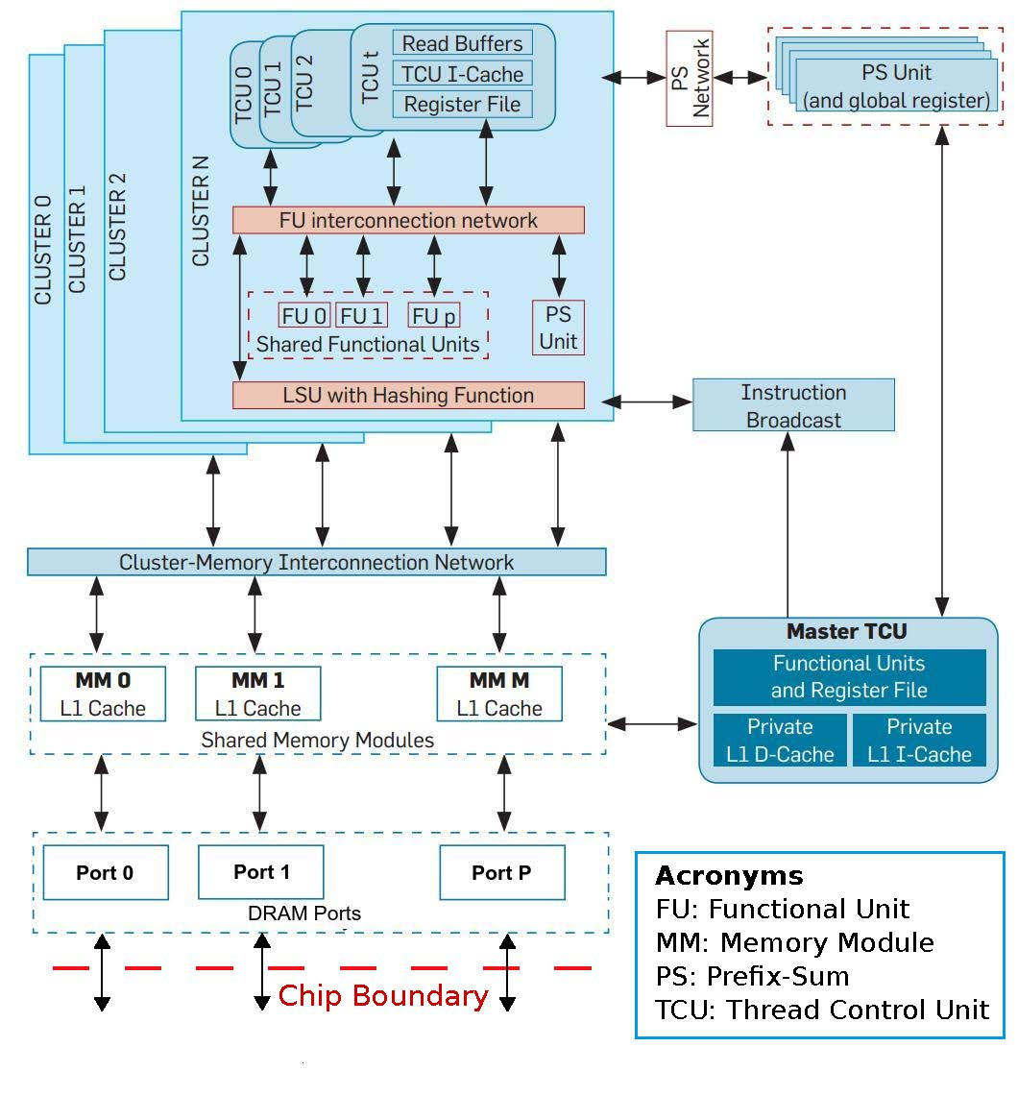
XMT as a test case:
Block diagram of the XMT processor

Slide 82
Remainder of scalability presentation
Paper Put stake in the ground ➔ publishable results + vision:
3D-VLSI+cooling for scaling silicon area and reducing distances
the ICN part (switching and on-chip DM)
connect the ICN to on-chip processors/memories
Current proposal (above)
Need to nail down:
How to connect ICN to off-chip memories (and to off-chip processors, if desired)
Scaling/other photonics challenges
Wild card Specs of Intel/Micron 3D Xpoint (solid state) memories: granularity, etc.

Slide 83
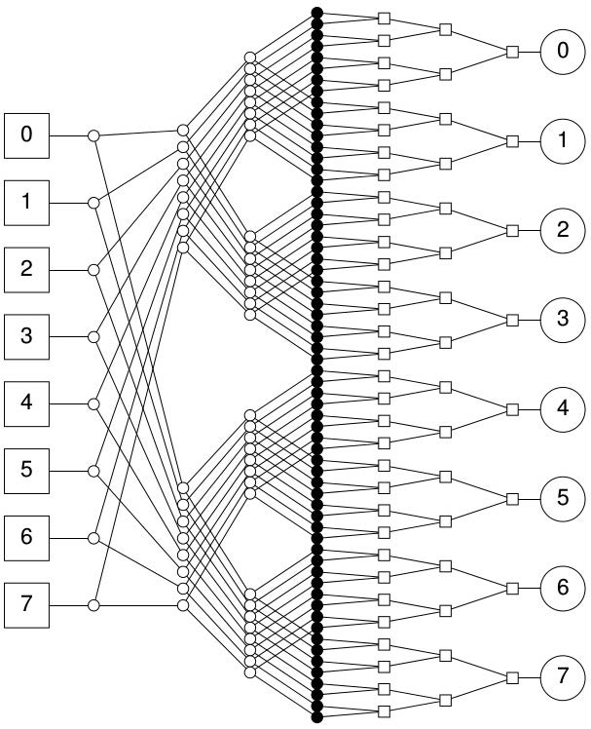
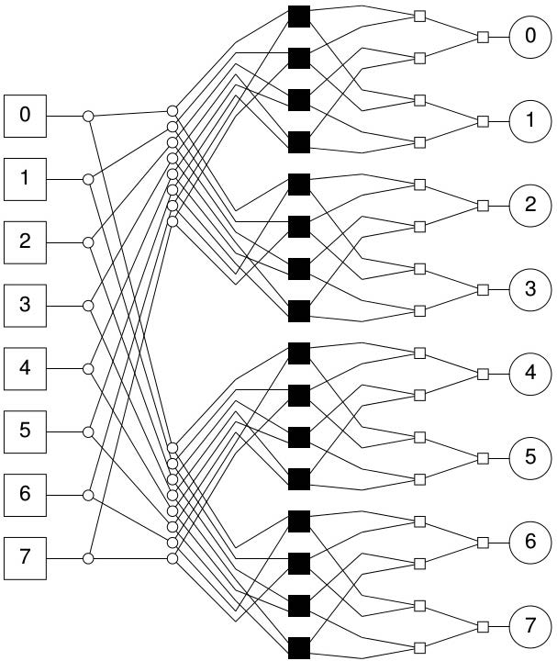
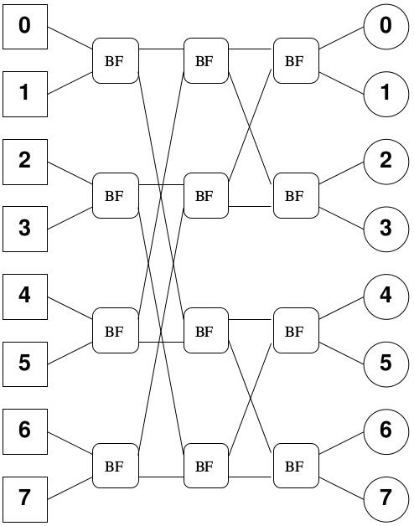
Hybrid ICN: Mesh of trees + Butterfly
Middle layer
n²
versus
~n
+
=

Slide 84

Starting with what we figured out.
Schematic Floorplan for active silicon layers
Red blocks - TCU clusters. Green blocks - memory modules. Blue block - the ICN.
Main points of this slide: ICN is confined to one layer. It is a middle layer. Can share with other functions. Memory ports in external layer.

Slide 85
Cross-section view of uncooled vs cooled 3D IC stack
W/mK – Watt Per meter Kelvin
Thermal conductivity measure
Bigger picture
20 mm wide chip ➔
100 fluid microchannels/layer
100 µm wide, 100 µm apart
For our largest configuration Pump supplying 200 kPa head at 1 L/min. Commercial product*: under 16cm long
*Also: Datasheet for pump meeting specs Drawn ~1.5W. Fits in 3x3x3 inch³ cube. Additional: mounting piece.
*Figure are not to scale
Notes:
Cooling can be filtered open-tap water. Other options : active cooling.

Slide 86
XMT architecture and physical configuration
#TCUS | ~8k | ~16K | ~32k | ~64k
Clusters | 256 | 512 | 1024 | 2048
Mem. Modules | 256 | 512 | 1024 | 2048
MoT levels | 16 | 12 | 10 | 8
Butterfly levels | 0 | 3 | 5 | 7
TCUs/cluster | 32 | 32 | 32 | 32
Physical configuration 22nm
Silicon layers | 2 | 3 | 5 | 8
Microchannel layers | 1 | 2 | 4 | 7
Silicon area per layer (mm²) | 276 | 302 | 328 | 380
Total silicon area (mm²) | 551 | 906 | 1641 | 3046

Slide 87
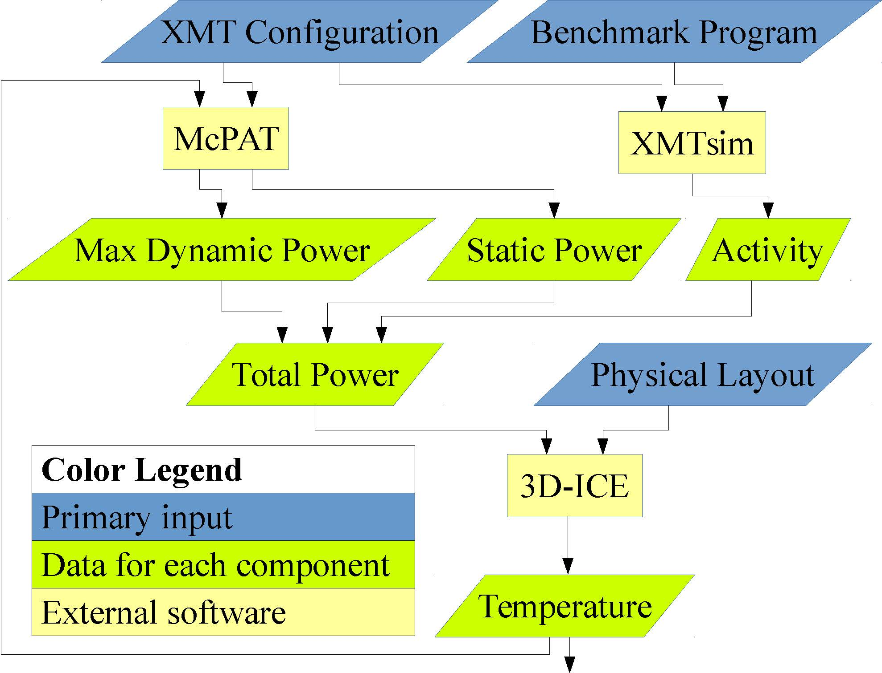
Experimental methodology
XMTsim – Cycle accurate simulator of XMT
McPAT – Used to model power
3D-ICE – Thermal modeling simulator for 3D ICs with microfluidic channels

Slide 88
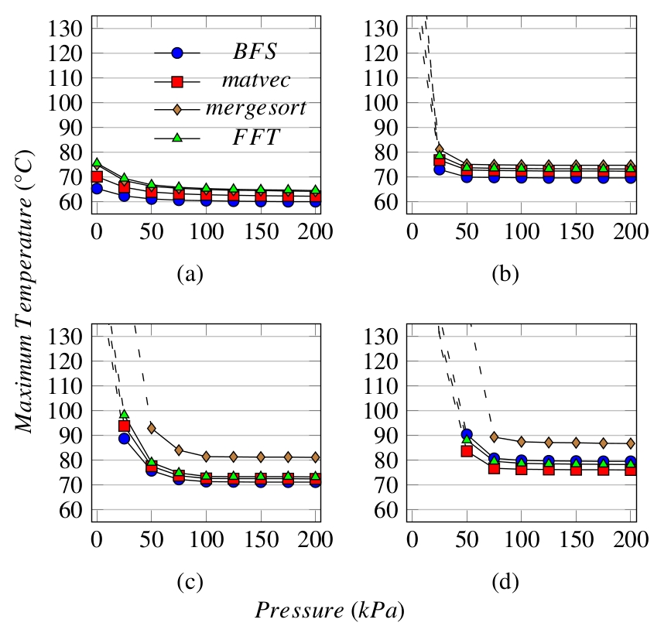
Results: Max temperature/benchmarks
8k TCUs
16k TCUs
- Dotted lines: above 127⁰C
(beyond McPAT modeling)
- Pressure drop of 0 kPa (zero kilo Pascal): air-cooling, but no microfluidic cooling
- 125⁰C is upper limit in military specs
- Air cooling only: ≥16k TCUs are out for all benchmarks
32k TCUs
64k TCUs

Slide 89
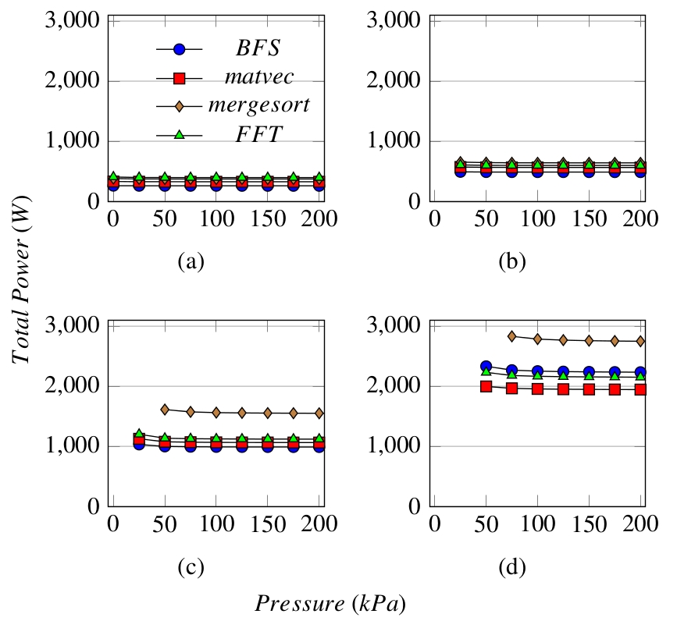
Results: Max power dissipated/benchmark
8k TCUs
16k TCUs
Shown: only when under 127⁰C
32k TCUs
64k TCUs

Slide 90
Other results and discussion
- Win-win on power: Reduction in leakage power exceeds pumping power
- Are these results relevant only for XMT?
Answer No, these are robust results. XMT has only one disproportionate component, its ICN. Now:
Power consumption of XMT ICN is ≤ 18% of total for ≥16k TCUs and decreasing
Area - similar figures and trend

Slide 91
3D Fast Fourier Transform (FFT) on XMT
[Edwards,V, IPDPS’16 workshop Advances in Parallel and Distributed Computing Models]
3D VLSI, MFC, and photonics enable XMT to outperform a much larger supercomputer (Edison) on 3D FFT
XMT speedups vs. best serial (FFTW):
  With enabling technologies (128k TCUs): 2,494X (19.0 TFLOPS)
  Without enabling technologies (8k TCUs): 31X (0.24 TFLOPS)
Comparison of Edison machine (Cray XC30) to XMT
 | XMT (128k x4) | Edison (Cray XC30) | Factor
# processing elements | 131,072 TCUs | 124,608 cores
# processor groups | 4,096 clusters | 5,192 nodes
Total cache memory | 128 MB | 311,520 MB | 2433
# chips | 1 | 10,384 CPU + 1,298 router | 11682
Total silicon area (process) | 35.4 cm² (14 nm) | 56,177 cm² (22 nm) + 4,072 cm² (40 nm)
Normalized silicon area (22 nm) | 66 cm² | 57,409 cm² | 871
Peak power consumption | 7.0 KW | 2,500 KW | 357
Peak teraFLOPS | 54 | 2,390 | 44
TeraFLOPS for FFT (size) | 19.0 (512³) | 13.6 (1024³) | /1.4
% of peak FLOPS | 35% | 0.57% | /61

Slide 92
More CS context
Flat memory – Ideal abstraction for parallel algorithms/programming
Extra speedups by 1 OoM
Extra scaling by 2 OoM
Per above FFT result: Enable 128K (XMT) cores using flat memory

Slide 93
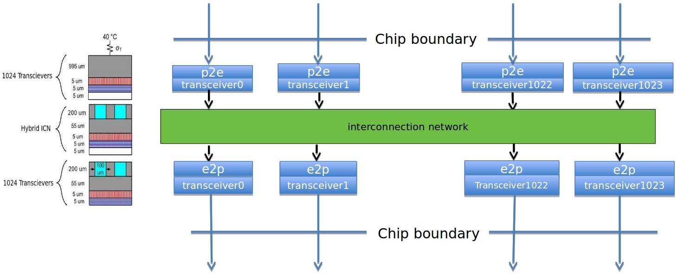
Lead example: Concept of a switch through integration of 3D-VLSI, microfluidic cooling and photonics
Interconnection network: X inputs, X outputs (shown X=1,024). All-to-all switch: source nodes of inputs same as destination nodes of outputs. 3 layers of a 3D stack shown. Each transceiver block either converts electronics to photonics (e2p), or vice versa (p2e). Microfluidic cooling of the two bottom layers is shown. Middle (ICN) layer is particularly challenging to cool otherwise.
Notes:
Simpler application than a parallel computer. Equal exchange with current component(s); hence, easier to adopt by the market. However, similar technical issues.

Slide 94
Experiments with simulators (ANSYS)
Seek partition of the surface of the chip into a grid of as many silicon substrates as possible so that each substrate can transmit 25Gbps. Demonstrated: current/near future pJ/b rates and MFC ➔ a substrate of 50X50X50µm³ can be cooled by MFC, while 30X30X50µm³ will get too hot.
50X50µm² allows 400 substrates per mm² or 160K per area of 20X20mm². This back-of-the envelope calculation suggests potential for off-chip bandwidth of 4Pb/s (=500TB/s) if a monolithic layer (in a 3D-VLSI stack) with these features is built.
Top, or bottom view
Photonic link from every cell
But, what next?...

Slide 95
But, what next?...
Need help to sort out many approaches&tradeoffs to silicon photonics.
Example 1 Dupruis et al 2015, integrate III-V material with CMOS circuits, for a 30-Gb/s optical link. Nice silicon area and pJ/b for Rx and Tx.
Even I can tell: they allow long distance (10km), but we need far less ☺
But, how to navigate among different possibilities and developing them?
Example questions How "monolithic" can integration be?
To what extent can electronics and photonics (1) share the same wafer improving density and lowering parasitic effects, versus (2) be fabricated on different platforms that favor each better; then brought together, e.g., by short wire bonds and flip chip

Slide 96
Example 2: on-chip modulator
Consider micro-ring resonator (low energy). But : (i) vulnerable to temperature fluctuation; (ii) challenging to scale reliably to 100K high-bandwidth devices on chip using automatic fabrication.
C. Sun+ (22 authors), Single-chip microprocessor that communicates directly using light, Nature, 24 Dec 2015. Exciting:
minimal changes to CMOS!
tuning circuitry to overcome λ₀ variations
micro-heaters and temperature controllers
Though:
small dual core
limited thermal range and bandwidth
Will microfluidic cooling (and 3D-VLSI) provide the key for the scale we seek? Not only above issues. Also: greater flexibility with the remaining pieces since intermediate steps may be power inefficient
λ₀ wavelength in vacuum

Slide 97
Some comments & comparison(?)
For a 64b(=8B) architecture and 3GHz processors, around 20K words (of 8B each) can be transmitted per clock.
Different objectives (e.g., packet sizes, longer distance), but it appears that top-of-the-line 130Tb/s Mellanox switch would allow transmission of around 650 words per clock. The larger substrate volume option also enables replacing a single 25Gb/s structure by several (e.g., three 8.3Gb/s) structures, which is likely to be cheaper, as these structures are simpler.
Lower adoption bar for a switch: “equal exchange” of current component. However, lower scaling demands for many-cores…

Slide 98
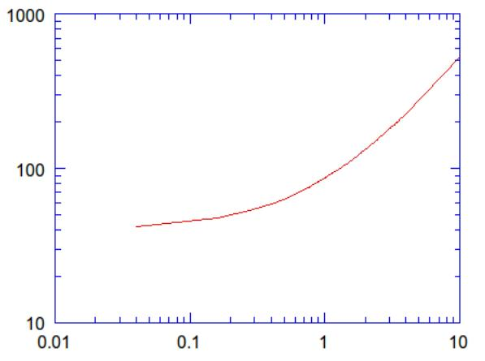
Temperature reached by 25Gbps photonic device. Range: assumed power usage
Celsius
pJpb (at 25Gbps)
Assumption: substrate of 50X50X50µm³ comprises the photonic device. Standard, high thermal conductivity connects transceiver to microfluidic channel. Finding: If transceiver under 1.1 pJ/b, temperature will remain under 100 C

Slide 99
More than one problem domain
For clarity, I chose to leave you with the above simply-stated example.
Surface of chip partitioned into 160K squares, 50X50µm² each. Each supports 25Gb/s photonic-based links.
Domain 1: The links extend 30-100 cm. (already significant: 16K links, 25 Gb/s each)
Domain 2: The switch serves a computer in a room which is 10m by 10m.
Notes:
The all electronic ICN will have ~16K inputs and the same number of outputs since groups of 64+ bits will always travel together.

Slide 100
Proposal from 30,000 feet
Imagine a large city with (the usual) traffic problems
Option 1: Limit investment to roads (and buses)
Option 2: More costly construction of some subway/train system components
One consideration: Impact on labor with subway vs w/o.
  (a) Time at work relative to time away from home
  (b) Pool of workers (how many commute from afar)
Analogy: performance programming problems of today’s computers
Option 1: Limit to architecture and SW layers, or also
Option 2: Invest in technology to allow new capabilities (data movement)
Impact on programmers
  (a) How much time to complete a job for those who can do it?
  (b) How many can do it? And does it make good use of talent?
  How many SW applications/firms can afford?
  Would performance programmers be overqualified?

Slide 101
Why should Intel care?
The SW spiral business model worked once…
Can do it
Improve productivity of 1st line customers: SW vendors, SW developers. Thereby, to end customers
Why now?
Just time & timing till customers lose patience with state of parallelism
If the technology can be brought to within 3 years from industry-grade switch, some large (traditionally SW) companies will likely be willing to invest $~100M

Slide 102
Some Random Applications
The fact that at issue is general-purpose computing and programmer’s productivity does not mean that this is less relevant for applications than other approaches
Bio, precision medicine
Machine learning, big data
SW&HW formal verification
Numerical simulations to study instabilities (in liquids, gases and plasmas). Perhaps, could turn around fortune of LLNL ICF $5B fusion facility
Quantum effects defy locality
Scaling graph algorithms
Large FFT (noted before)
DOE on a mission to “reinvent Physics” for communication avoidance. Instead match computing to classic Physics.

Slide 103
Summary How to best exploit for performance the growth in parallelism? e.g., from more transistors
Thesis To get (many-core) parallelism to where it should be (performance, ease of programming, apps), we need to go all the way to “enabling technologies”
Current bet: Application and system SW as well as architecture will do it. All eggs have been in this basket. But, jury is still out on how well this bet can work
Proposal: Invest in enabling technologies. Horizon of current ideas: ~1M TCUs
Risk levels | Current bet | Proposal
Enabling Technology | Low | High
SW & Architecture | High | Low
  Presented forward looking objectives. Milestones need: refinement, money & time. Good news: No feasibility problem!
  Upshot Assess $$$: 1. Enabling technologies, versus 2. Gain from improved speedups, productivity, apps, deployment, competitive advantage.
  I expect 2>>1.

Slide 104
References
U. Vishkin. Using simple abstraction to reinvent computing for parallelism. Communications of the ACM 54,1 (2011), 75-85. [Over 15K downloads]
S. O'Brien, U. Vishkin, J. Edwards, E. Waks and B. Yang. Can Cooling Technology Save Many-Core Parallel Programming from Its Programming Woes? In Proc. Compiler, Architecture and Tools Conference (CATC), Intel Development Center, Haifa, Israel, Nov 2015. Full paper: http://drum.lib.umd.edu/handle/1903/17153
U. Vishkin. Is Multi-Core Hardware for General-Purpose Parallel Processing Broken? Viewpoint article. Communications of the ACM 57,4 (2014), 35-39.

Slide 105
Commodity computer systems
Chapter 1 1946➔2003: Serial. 5KHz➔4GHz.
Chapter 2 2004--: Parallel.
Projection, Intel 2005:
#”cores”: ~d^{y-2003}, d>1
Reality
Not really a many-core “era”
IMO: systems not good enough
Clock frequency growth: ~flat
If you want your program to run significantly faster … you’re going to have to parallelize it ➔ Parallelism: only game in town
Since 1980:
#Transistors/chip 29K➔~10sB!
Bandwidth/Latency 300X [HP12]
Programmer’s IQ? Flat..
Intel Platform 2015, March05
Notes:
105
Yet, today’s hot research: Power is important; indeed! Conclusion: build slightly more power efficient machines that are even more difficult to program, and for this reason typical programs will end up being suboptimal possibly requiring more power. Also, few program will be developed, saving even more power..

Slide 106
Support Vector Machines (SVM) on XMT
[Edwards, V, work in progress]
Input: 12,000 vectors (54-dimensional), 24% density
XMT (1,024 TCUs) speedup vs. best serial (LIBSVM)
  vs. Xeon (baseline used in [1]): 170X; vs. Core i3: 76X
Speedup vs. Kepler: 4.5X
Comparison of SVM speedups across platforms
 | Serial (Xeon) | Serial (Core i3) | MIC | Fermi | 2x Xeon (24 cores) | Kepler | XMT (1024 TCUs)
Library | LIBSVM | LIBSVM | HPC-SVM | GPUSVM | HPC-SVM | GPUSVM | ours
Si process | - | - | 22 nm | 40 nm | 22 nm | 28 nm | 65 nm
Si area | - | - | ~675 mm² | 520 mm² | 320 mm² | 551 mm² | 576 mm²
@ 22 nm* | - | - | ~675 mm² | 231 mm² | 320 mm² | 397 mm² | 132 mm²
Time | 77.2 s ¹ | 34.7 s | 17.6 s ¹ | 5.1 s ¹ | 2.1 s ¹ | 2.0 s ¹ | 0.45 s
X vs. Xeon | - | 2.2X | 4.4X | 15X | 36X | 38X | 170X
vs. Core i3 | 0.4X | - | 2.0X | 6.8X | 16X | 17X | 76X
* Extrapolated from a scaling factor of 0.54 for scaling from 22 nm to 14 nm (Source: Intel)
¹ Y. You et al., “Scaling Support Vector Machines on modern HPC platforms,” J. Parallel Distrib. Comput., vol. 76, pp. 16–31, 2015.
Notes:
Platforms
Xeon: 2x Intel Xeon E5-2692v2 (12 cores per chip) @ 2.20 GHz
Core i3: Intel Core i3-3220 @ 3.30 GHz
MIC: Intel Xeon Phi 7110P @ 1.09 GHz
Kepler: NVIDIA Tesla GK110 @ 0.73 GHz
Fermi: NVIDIA Tesla M2090 @ 1.5 GHz
XMT: 1024 TCUs @ 3.3 GHz

