Slide 1
Computer Architecture
A Quantitative Approach, Sixth Edition
Chapter 5
Thread-Level Parallelism
We are dedicating all of our future product development to multicore designs. We believe this is a key inflection point for the industry--Paul Otellini, President, Intel, 2005

Slide 2
Introduction
Introduction
Thread-Level parallelism
Have multiple program counters
Uses MIMD model
Targeted for tightly-coupled shared-memory multiprocessors
For n processors, need n threads
Amount of computation assigned to each thread = grain size
Threads can be used for data-level parallelism, but the overheads may outweigh the benefit

Slide 3
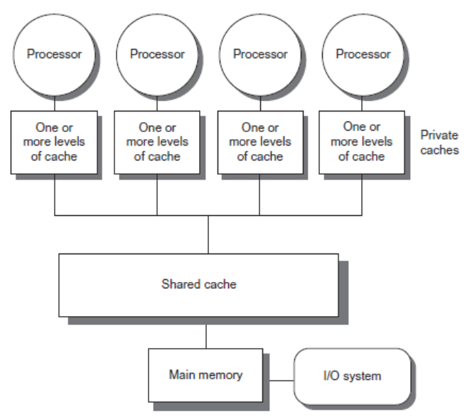
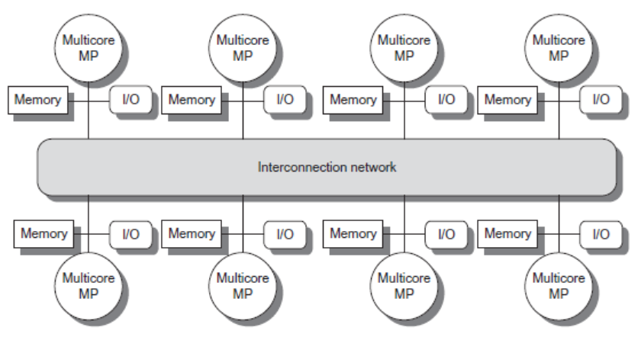
Types
Introduction
Symmetric multiprocessors (SMP)
Small number of cores
Share single memory with uniform memory latency
Distributed shared memory (DSM)
Memory distributed among processors
Non-uniform memory access/latency (NUMA)
Processors connected via direct (switched) and non-direct (multi-hop) interconnection networks

Slide 4
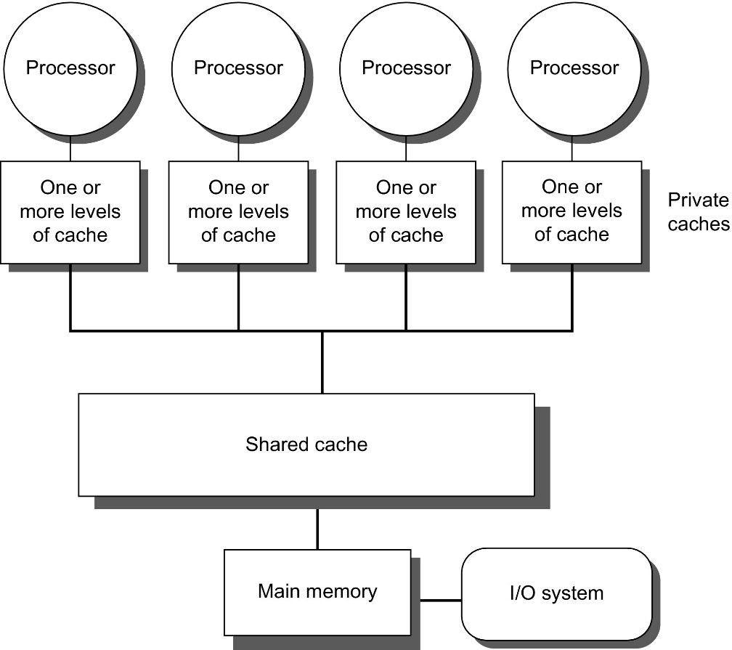
Figure 5.1 Basic structure of a centralized shared-memory multiprocessor based on a multicore chip.
Multiple processor-cache subsystems share the same physical memory, typically with one level of shared cache on the multicore, and one or more levels of private per-core cache. The key architectural property is the uniform access time to all of the memory from all of the processors. In a multichip design, an interconnection network links the processors and the memory, which may be one or more banks. In a single-chip multicore, the interconnection network is simply the memory bus.

Slide 5
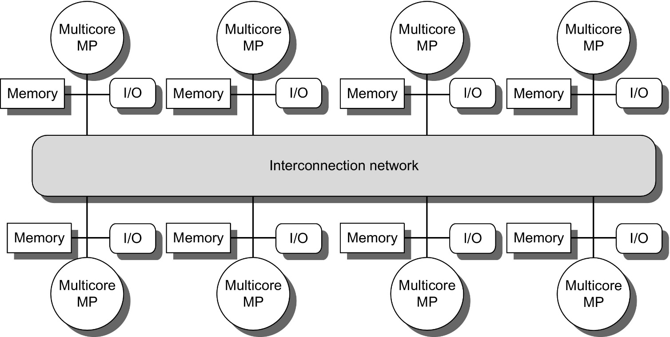
Figure 5.2 The basic architecture of a distributed-memory multiprocessor in 2017 typically consists of a multicore multiprocessor chip with memory and possibly I/O attached and an interface to an interconnection network that connects all the nodes. Each processor core shares the entire memory, although the access time to the local memory attached to the core's chip will be much faster than the access time to remote memories.

Slide 6
Cache Coherence
Processors may see different values through their caches:
Centralized Shared-Memory Architectures

Slide 7
Cache Coherence
Coherence
All reads by any processor must return the most recently written value
Writes to the same location by any two processors are seen in the same order by all processors
Consistency
When a written value will be returned by a read
If a processor writes location A followed by location B, any processor that sees the new value of B must also see the new value of A
Centralized Shared-Memory Architectures

Slide 8
Enforcing Coherence
Coherent caches provide:
Migration: movement of data
Replication: multiple copies of data
Cache coherence protocols
Directory based
Sharing status of each block kept in one location
Snooping
Each core tracks sharing status of each block
Centralized Shared-Memory Architectures

Slide 9
Snoopy Coherence Protocols
Write invalidate
On write, invalidate all other copies
Use bus itself to serialize
Write cannot complete until bus access is obtained
Write update
On write, update all copies
Centralized Shared-Memory Architectures

Slide 10
Figure 5.4 An example of an invalidation protocol working on a snooping bus for a single cache block (X) with write-back caches. We assume that neither cache initially holds X and that the value of X in memory is 0. The processor and memory contents show the value after the processor and bus activity have both completed. A blank indicates no activity or no copy cached. When the second miss by B occurs, processor A responds with the value canceling the response from memory. In addition, both the contents of B's cache and the memory contents of X are updated. This update of memory, which occurs when a block becomes shared, simplifies the protocol, but it is possible to track the ownership and force the write-back only if the block is replaced. This requires the introduction of an additional status bit indicating ownership of a block. The ownership bit indicates that a block may be shared for reads, but only the owning processor can write the block, and that processor is responsible for updating any other processors and memory when it changes the block or replaces it. If a multicore uses a shared cache (e.g., L3), then all memory is seen through the shared cache; L3 acts like the memory in this example, and coherency must be handled for the private L1 and L2 caches for each core. It is this observation that led some designers to opt for a directory protocol within the multicore. To make this work, the L3 cache must be inclusive; recall from Chapter 2, that a cache is inclusive if any location in a higher level cache (L1 and L2 in this case) is also in L3. We return to the topic of inclusion on page 423.

Slide 11
Snoopy Coherence Protocols
Locating an item when a read miss occurs
In write-back cache, the updated value must be sent to the requesting processor
Cache lines marked as shared or exclusive/modified
Only writes to shared lines need an invalidate broadcast
After this, the line is marked as exclusive
Centralized Shared-Memory Architectures

Slide 12
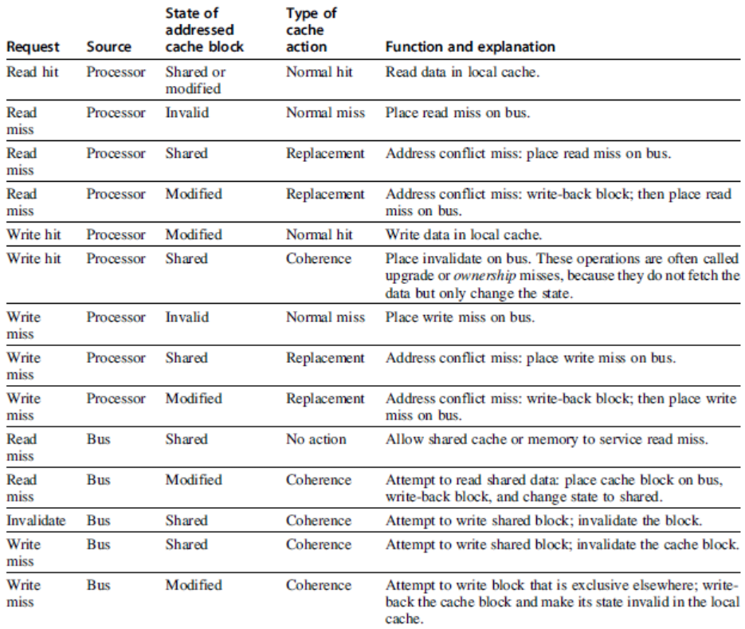
Snoopy Coherence Protocols
Centralized Shared-Memory Architectures

Slide 13
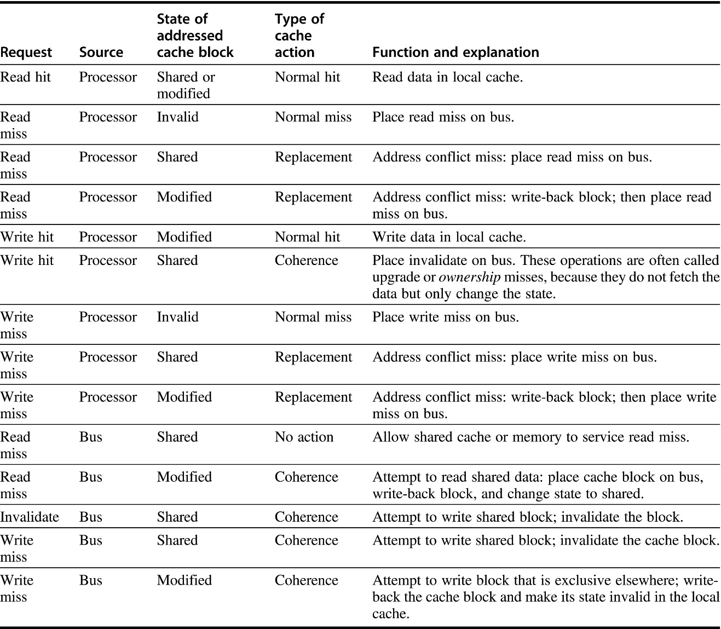
Figure 5.5 The cache coherence mechanism receives requests from both the core's processor and the shared bus and responds to these based on the type of request, whether it hits or misses in the local cache, and the state of the local cache block specified in the request. The fourth column describes the type of cache action as normal hit or miss (the same as a uniprocessor cache would see), replacement (a uniprocessor cache replacement miss), or coherence (required to maintain cache coherence); a normal or replacement action may cause a coherence action depending on the state of the block in other caches. For read, misses, write misses, or invalidates snooped from the bus, an action is required only if the read or write addresses match a block in the local cache and the block is valid.

Slide 14
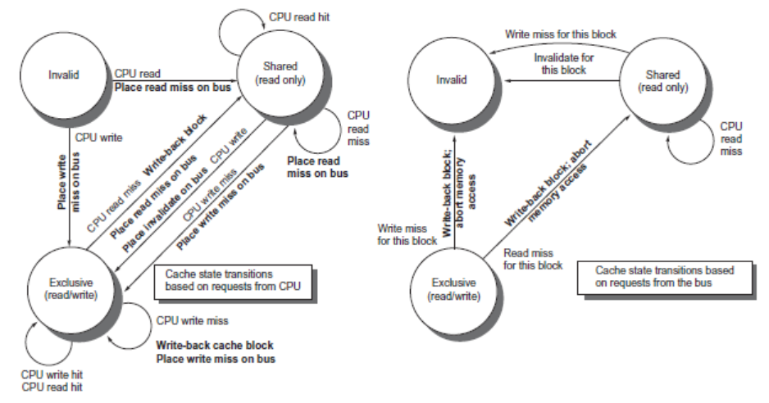
Snoopy Coherence Protocols
Centralized Shared-Memory Architectures

Slide 15
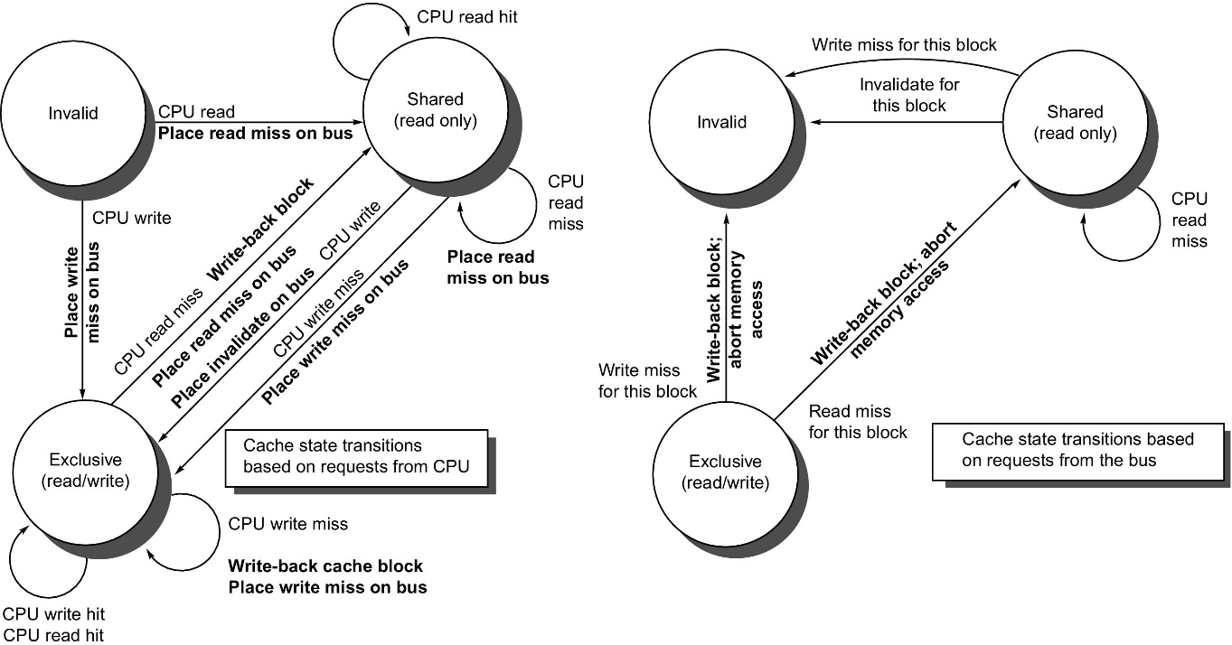
Figure 5.6 A write invalidate, cache coherence protocol for a private write-back cache showing the states and state transitions for each block in the cache. The cache states are shown in circles, with any access permitted by the local processor without a state transition shown in parentheses under the name of the state. The stimulus causing a state change is shown on the transition arcs in regular type, and any bus actions generated as part of the state transition are shown on the transition arc in bold. The stimulus actions apply to a block in the private cache, not to a specific address in the cache. Thus a read miss to a block in the shared state is a miss for that cache block but for a different address. The left side of the diagram shows state transitions based on actions of the processor associated with this cache; the right side shows transitions based on operations on the bus. A read miss in the exclusive or shared state and a write miss in the exclusive state occur when the address requested by the processor does not match the address in the local cache block. Such a miss is a standard cache replacement miss. An attempt to write a block in the shared state generates an invalidate. Whenever a bus transaction occurs, all private caches that contain the cache block specified in the bus transaction take the action dictated by the right half of the diagram. The protocol assumes that memory (or a shared cache) provides data on a read miss for a block that is clean in all local caches. In actual implementations, these two sets of state diagrams are combined. In practice, there are many subtle variations on invalidate protocols, including the introduction of the exclusive unmodified state, as to whether a processor or memory provides data on a miss. In a multicore chip, the shared cache (usually L3, but sometimes L2) acts as the equivalent of memory, and the bus is the bus between the private caches of each core and the shared cache, which in turn interfaces to the memory.

Slide 16
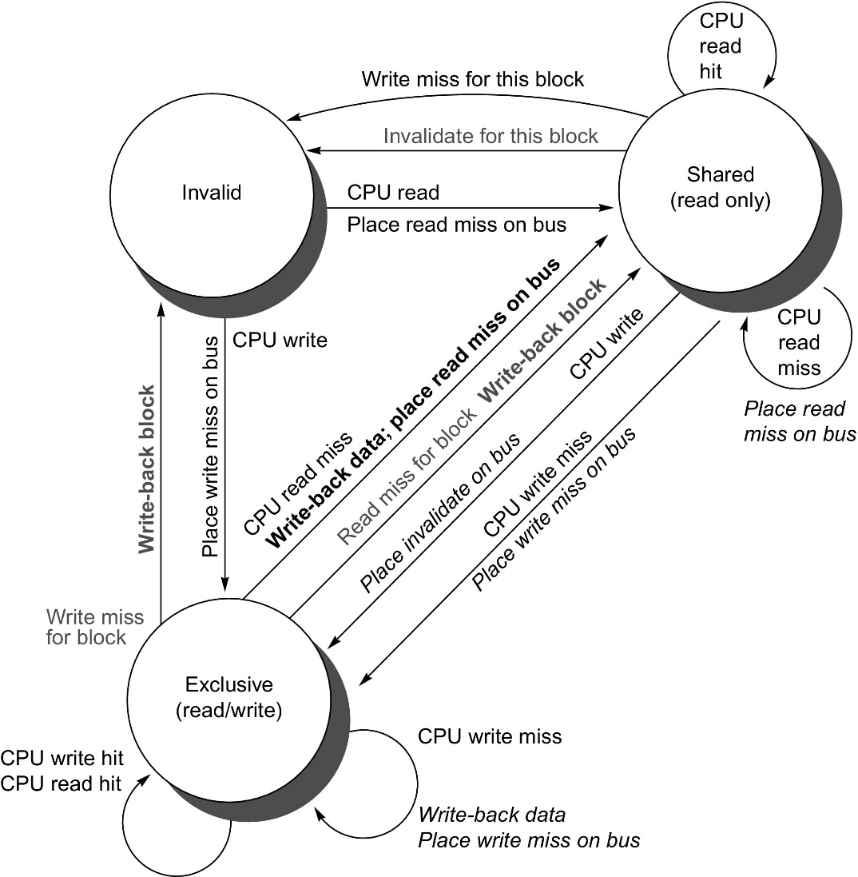
Figure 5.7 Cache coherence state diagram with the state transitions induced by the local processor shown in black and by the bus activities shown in gray. As in Figure 5.6, the activities on a transition are shown in bold.

Slide 17
Snoopy Coherence Protocols
Complications for the basic MSI ModifiedSharedInvalid protocol:
Operations are not atomic
E.g. detect miss, acquire bus, receive a response
Creates possibility of deadlock and races
One solution: processor that sends invalidate can hold bus until other processors receive the invalidate
Extensions:
Add exclusive state to indicate clean block in only one cache (MESI protocol) Adds Exclusive state (reduce traffic if block is needed by only one cache) – One of several refinements.
Prevents needing to write invalidate on a write
Owned state
Centralized Shared-Memory Architectures

Slide 18
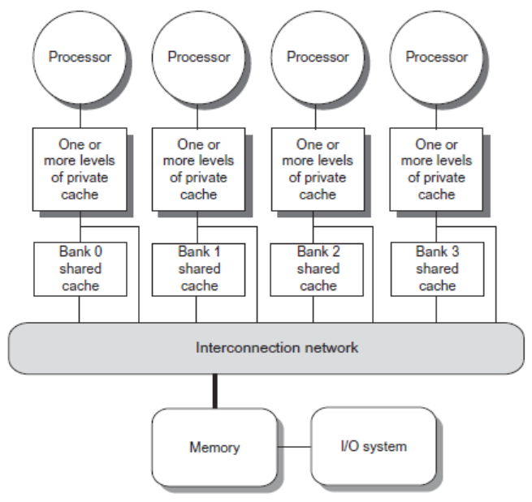
Coherence Protocols: Extensions
Shared memory bus and snooping bandwidth is bottleneck for scaling symmetric multiprocessors
Duplicating tags
Place directory in outermost cache
Use crossbars or point-to-point networks with banked memory
Centralized Shared-Memory Architectures

Slide 19
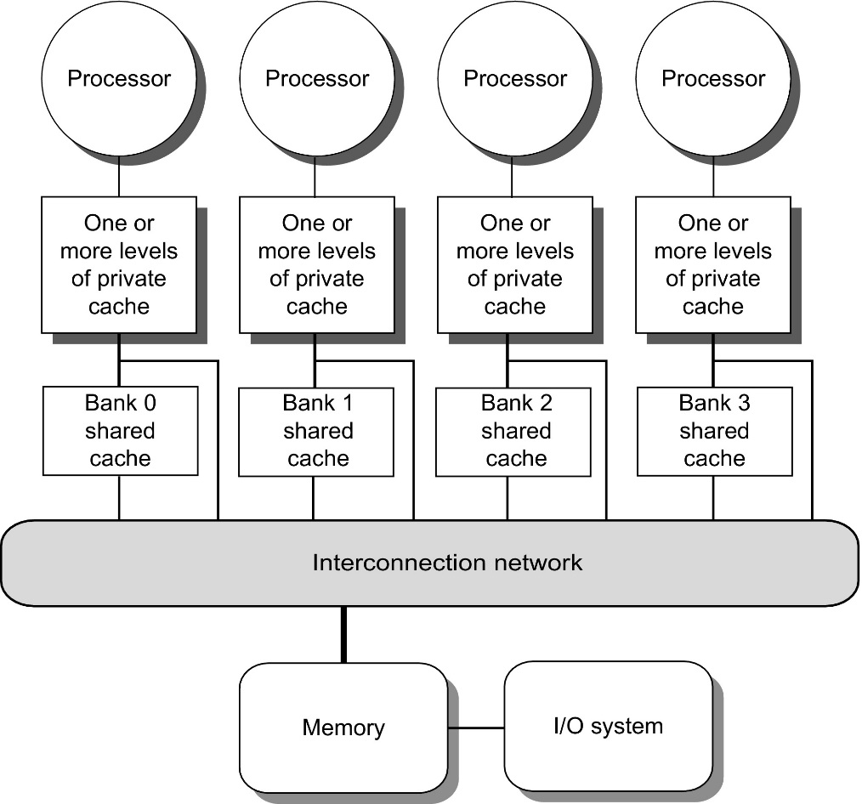
Figure 5.8 A single-chip multicore with a distributed cache. In current designs, the distributed shared cache is usually L3, and levels L1 and L2 are private. There are typically multiple memory channels (2–8 in today's designs). This design is NUCacheA, since the access time to L3 portions varies with faster access time for the directly attached core. Because it is NUCA, it is also NUMA.

Slide 20
Coherence Protocols
Every multicore with >8 processors uses an interconnect other than bus
Makes it difficult to serialize events
Write and upgrade misses are not atomic
How can the processor know when all invalidates are complete?
How can we resolve races when two processors write at the same time?
Solution: associate each block with a single bus
Centralized Shared-Memory Architectures

Slide 21
Performance
Coherence influences cache miss rate
Coherence misses
True sharing misses
Write to shared block (transmission of invalidation)
Read an invalidated block
False sharing misses
Read an unmodified word in an invalidated block
Performance of Symmetric Shared-Memory Multiprocessors

Slide 22
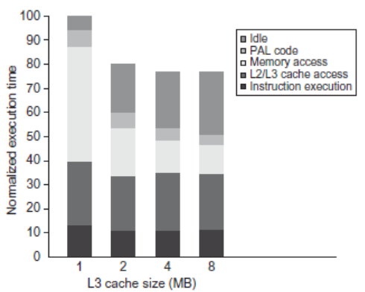
Performance Study: Commercial Workload
Performance of Symmetric Shared-Memory Multiprocessors

Slide 23
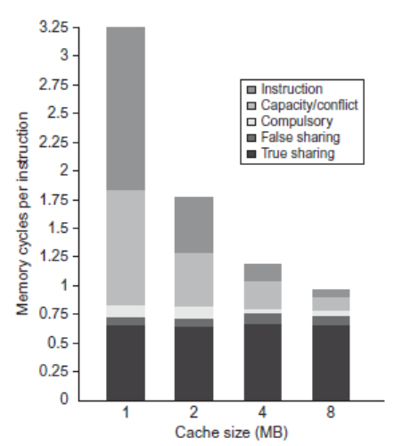
Performance Study: Commercial Workload
Performance of Symmetric Shared-Memory Multiprocessors

Slide 24
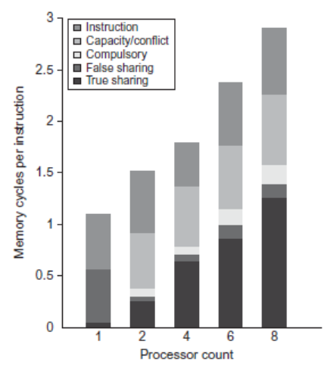
Performance Study: Commercial Workload
Performance of Symmetric Shared-Memory Multiprocessors

Slide 25
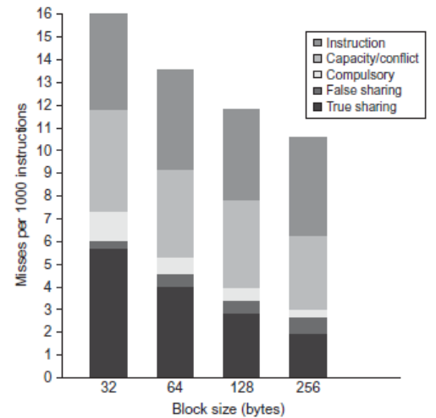
Performance Study: Commercial Workload
Performance of Symmetric Shared-Memory Multiprocessors

Slide 26
Directory Protocols
Snooping schemes require communication among all caches on every cache miss
Limits scalability
Another approach: Use centralized directory to keep track of every block
Which caches have each block
Dirty status of each block
Implement in shared L3 cache
Keep bit vector of size = # cores for each block in L3
Not scalable beyond shared L3
Distributed Shared Memory and Directory-Based Coherence

Slide 27
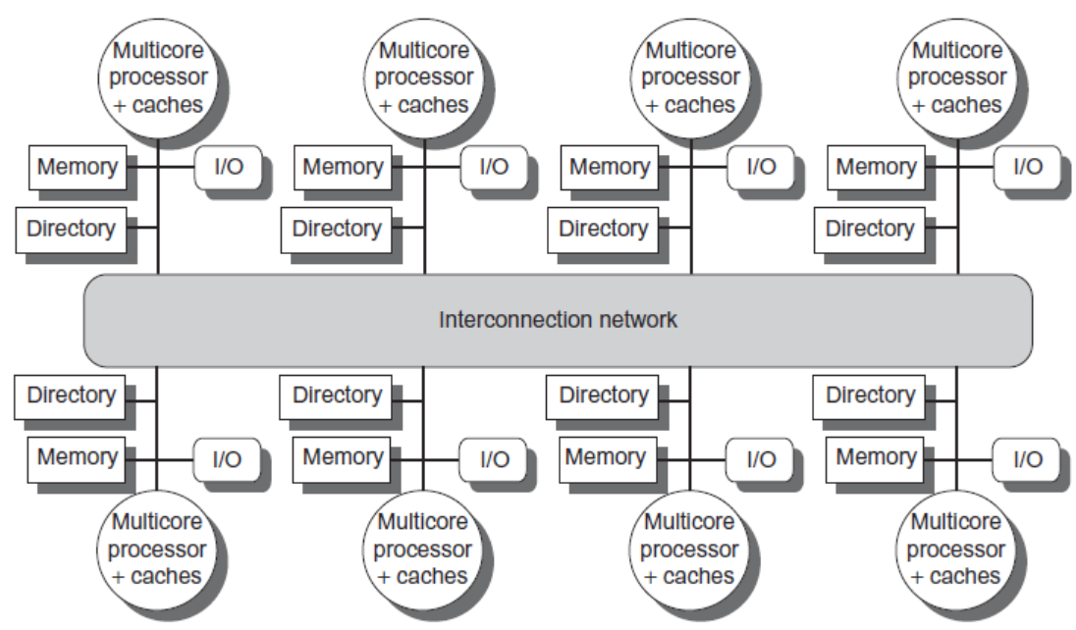
Directory Protocols
Alternative approach:
Distribute memory
Distributed Shared Memory and Directory-Based Coherence

Slide 28
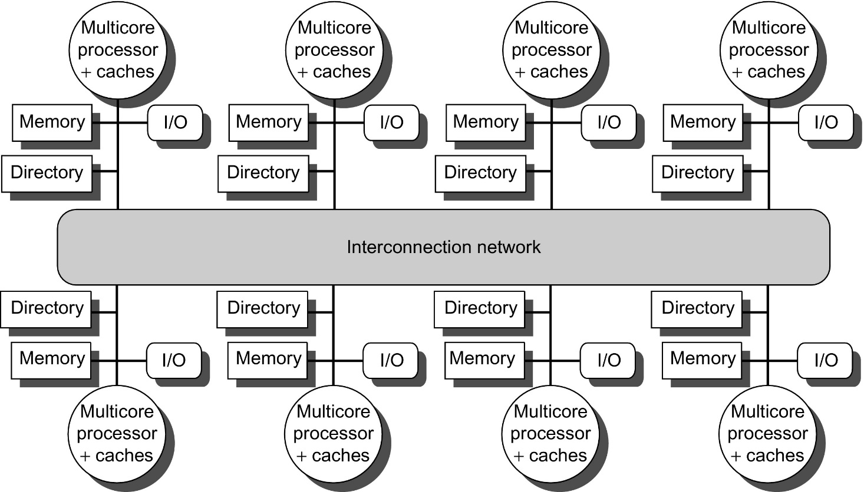
Figure 5.18 A directory is added to each node to implement cache coherence in a distributed-memory multiprocessor. In this case, a node is shown as a single multicore chip, and the directory information for the associated memory may reside either on or off the multicore. Each directory is responsible for tracking the caches that share the memory addresses of the portion of memory in the node. The coherence mechanism will handle both the maintenance of the directory information and any coherence actions needed within the multicore node.

Slide 29
Directory Protocols
For each block, maintain state:
Shared
One or more nodes have the block cached, value in memory is up-to-date
Set of node IDs
Uncached
Modified
Exactly one node has a copy of the cache block, value in memory is out-of-date
Owner node ID
Directory maintains block states and sends invalidation messages
Go to text slides following Fig. 5.21
Distributed Shared Memory and Directory-Based Coherence

Slide 30
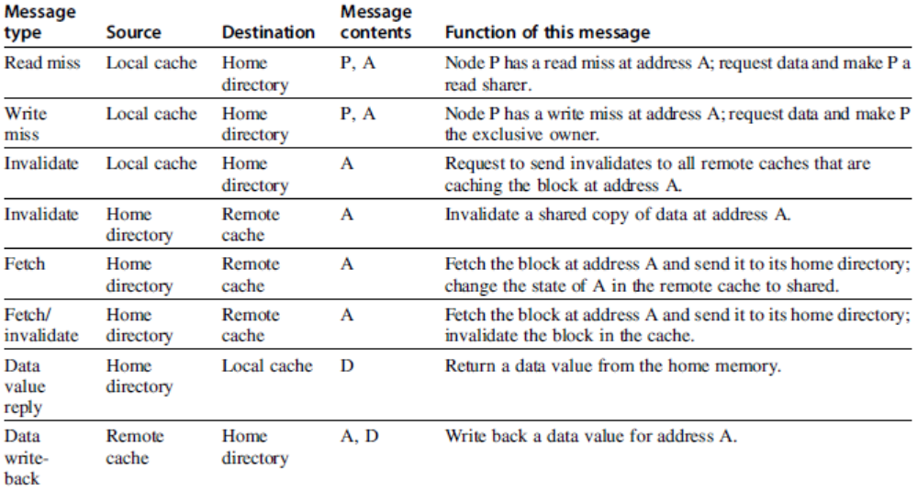
Messages
Distributed Shared Memory and Directory-Based Coherence

Slide 31
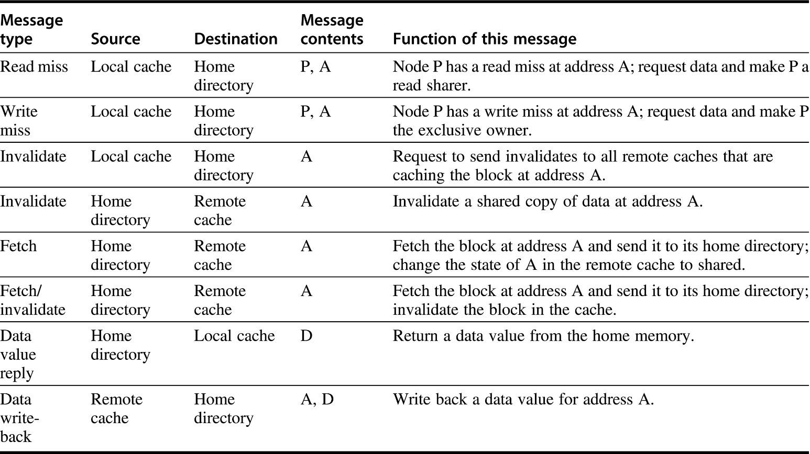
Figure 5.19 The possible messages sent among nodes to maintain coherence, along with the source and destination node, the contents (where P = requesting node number, A = requested address, and D = data contents), and the function of the message. The first three messages are requests sent by the local node to the home. The fourth through sixth messages are messages sent to a remote node by the home when the home needs the data to satisfy a read or write miss request. Data value replies are used to send a value from the home node back to the requesting node. Data value write-backs occur for two reasons: when a block is replaced in a cache and must be written back to its home memory, and also in reply to fetch or fetch/invalidate messages from the home. Writing back the data value whenever the block becomes shared simplifies the number of states in the protocol because any dirty block must be exclusive and any shared block is always available in the home memory.

Slide 32
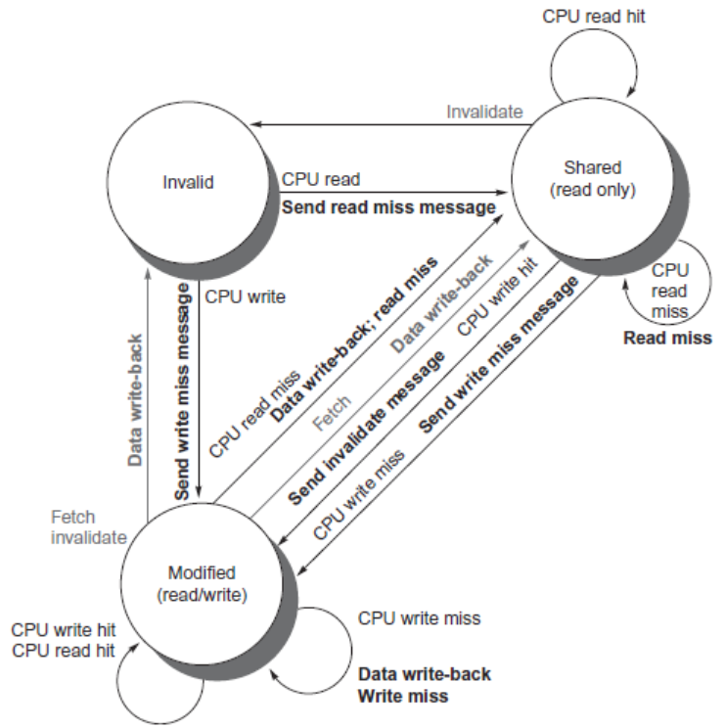
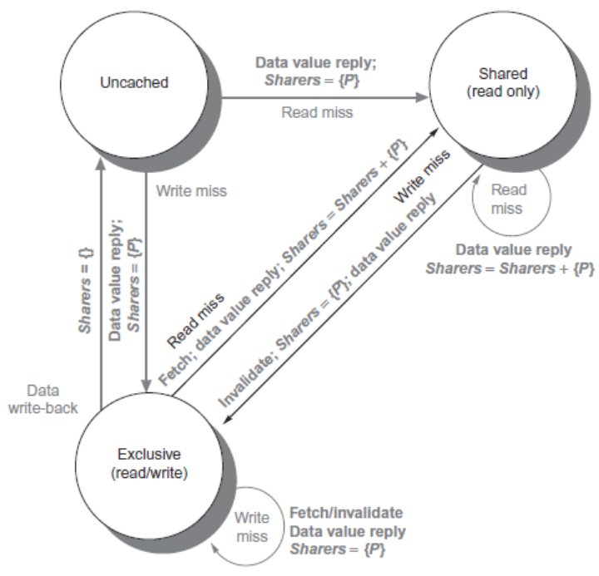
Directory Protocols
Distributed Shared Memory and Directory-Based Coherence

Slide 33
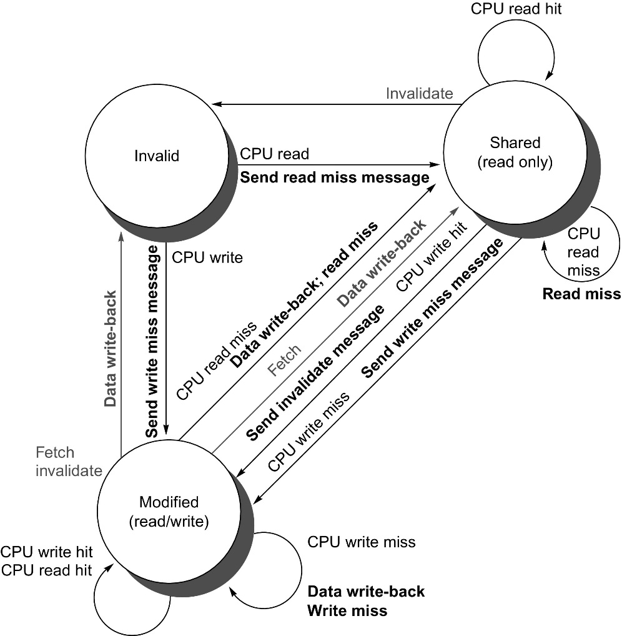
Figure 5.20 State transition diagram for an individual cache block in a directory-based system. Requests by the local processor are shown in black, and those from the home directory are shown in gray. Only in the reference to Figure 5.20 in the text: [Requests coming from outside the node in gray] and actions in black. The states are identical to those in the snooping case, and the transactions are very similar, with explicit invalidate and write-back requests replacing the write misses that were formerly broadcast on the bus. As we did for the snooping controller, we assume that an attempt to write a shared cache block is treated as a miss; in practice, such a transaction can be treated as an ownership request or upgrade request and can deliver ownership without requiring that the cache block be fetched.

Slide 34
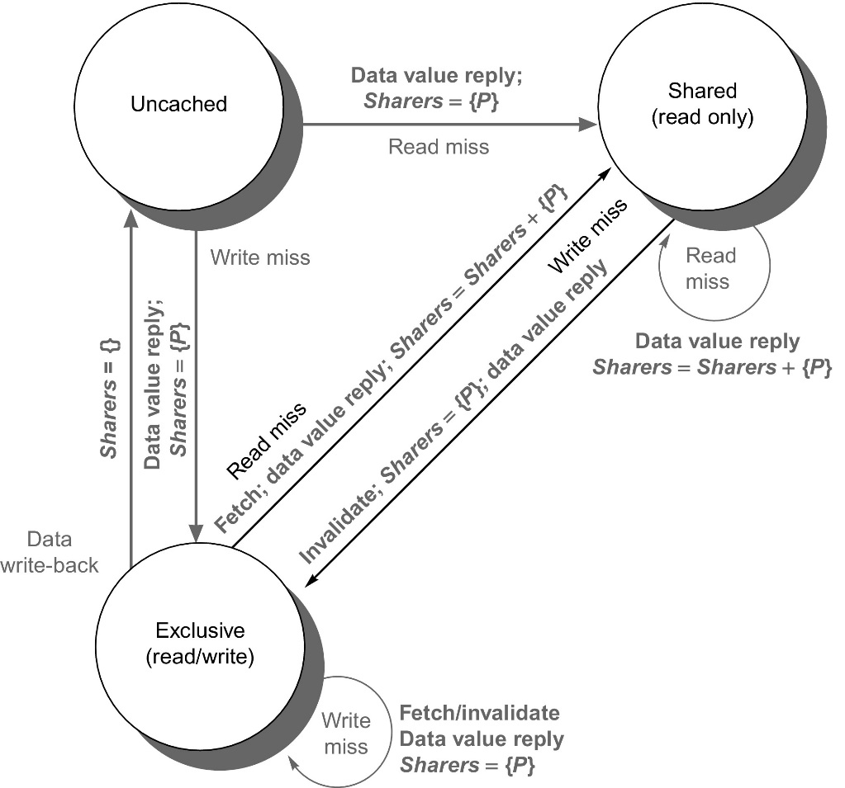
Figure 5.21 The state transition diagram for the directory has the same states and structure as the transition diagram for an individual cache. All actions are in gray because they are all externally caused. Bold indicates the action taken by the directory in response to the request. If there is anything in bold it is not as distinguishable as in Fig 5.20

Slide 35
Directory Protocols
For uncached block:
Read miss
Requesting node is sent the requested data and is made the only sharing node, block is now shared
Write miss
The requesting node is sent the requested data and becomes the sharing node, block is now exclusive
For shared block:
Read miss
The requesting node is sent the requested data from memory, node is added to sharing set
Write miss
The requesting node is sent the value, all nodes in the sharing set are sent invalidate messages, sharing set only contains requesting node, block is now exclusive
Distributed Shared Memory and Directory-Based Coherence

Slide 36
Directory Protocols
For exclusive block:
Read miss
The owner is sent a data fetch message, block becomes shared, owner sends data to the directory, data written back to memory, sharers set contains old owner and requestor
Data write back
Block becomes uncached, sharer set is empty
Write miss
Message is sent to old owner to invalidate and send the value to the directory, requestor becomes new owner, block remains exclusive
Distributed Shared Memory and Directory-Based Coherence

Slide 37
Synchronization
Basic building blocks:
Atomic exchange
Swaps register with memory location
Test-and-set
Sets under condition
Fetch-and-increment
Reads original value from memory and increments it in memory
Requires memory read and write in uninterruptable “atomic” instruction
RISC-V: load reserved/store conditional
If the contents of the memory location specified by the load linked are changed before the store conditional to the same address, the store conditional fails
My understanding: RISC-V replaces a simple failure of acquiring a lock by one of two possible failures (top of p. 417 in textbook) for minimizing bus traffic.
Synchronization

Slide 38
Fetch&Increment example
F&I (x1,x2):
Atomically: x1:=x1+x2; x2:=x1 [right side: old values]
Suppose: threads executing concurrently comprise the following commands
- Thread(/Processor) 1: F&I(x1,x2
- Thread(/Processor) 2: F&I(x1,x3)
- there are no other write commands into x1,x2,x3
What are the their possible value when done?
Assuming associativity of “increment”: x1=x1+x2+x3
Two possibilities: (i) x2=x1 and x3=x1+x2, or (ii) x3=x1 and x2=x1+x3
Now, if x1=0 and x2=x3=1, then exactly one of x2,x3 will be 1 and exactly one will be 2.
Can be used for: (i) “mutual exclusion”: one thread of execution never enters its critical section at the same time that another concurrent thread of execution enters its own critical section; (ii) locks.

Slide 39
Implementing Locks
Synchronization
Atomic exchange (EXCH):
try: mov x3,x4 ;mov exchange value
lr x2,x1 ;load reserved from
sc x3,0(x1) ;store conditional
bnez x3,try ;branch store fails
mov x4,x2 ;put load value in x4?
Atomic increment:
try: lr x2,x1 ;load reserved 0(x1)
addi x3,x2,1 ;increment
sc x3,0(x1) ;store conditional
bnez x3,try ;branch store fails

Slide 40
Implementing Locks
Synchronization
Lock (no cache coherence)
addi x2,R0,#1
lockit: EXCH x2,0(x1) ;atomic exchange
bnez x2, lockeit ;already locked?
Lock (cache coherence):
lockit: ld x2,0(x1) ;load of lock
bnez x2, lockeit ;not available-spin
addi x2,R0,#1 ;load locked value
EXCH x2,0(x1) ;swap
bnez x2,lockeit ;branch if lock wasn’t 0

Slide 41
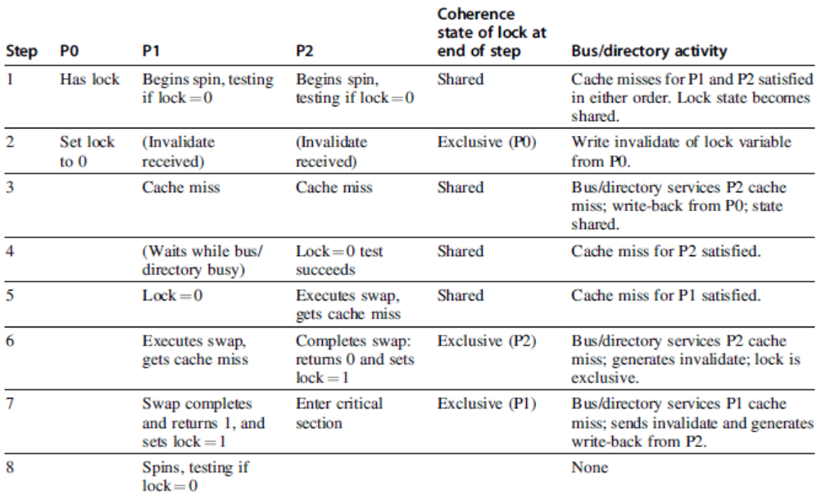
Implementing Locks
Synchronization
Advantage of this scheme: reduces memory traffic

Slide 42
Models of Memory Consistency
Processor 1:
A=0
…
A=1
if (B==0) …
Processor 2:
B=0
…
B=1
if (A==0) …
Should be impossible for both if-statements to be evaluated as true
Delayed write invalidate?
Sequential consistency:
Result of execution should be the same as long as:
Accesses on each processor were kept in order
Accesses on different processors were arbitrarily interleaved
Models of Memory Consistency: An Introduction

Slide 43
Implementing Locks
To implement, delay completion of all memory accesses until all invalidations caused by the access are completed
Reduces performance!
Alternatives:
Program-enforced synchronization to force write on processor to occur before read on the other processor
Requires synchronization object for A and another for B
“Unlock” after write
“Lock” after read
Models of Memory Consistency: An Introduction

Slide 44
Figure 5.23 The orderings imposed by various consistency models are shown for both ordinary accesses and synchronization accesses. The models grow from most restrictive (sequential consistency) to least restrictive (release consistency), allowing increased flexibility in the implementation. The weaker models rely on fences created by synchronization operations, as opposed to an implicit fence at every memory operation. S_{A} and S_{R} stand for acquire and release operations, respectively, and are needed to define release consistency. If we were to use the notation S_{A} and S_{R} for each S consistently, each ordering with one S would become two orderings (e.g., S → W becomes S_{A} → W, S_{R} → W), and each S → S would become the four orderings shown in the last line of the bottom-right table entry.

Slide 45
Relaxed Consistency Models
Rules:
X → Y
Operation X must complete before operation Y is done
Sequential consistency requires:
R → W, R → R, W → R, W → W
Relax W → R
“Total store ordering”
Relax W → W
“Partial store order”
Relax R → W and R → R
“Weak ordering” and “release consistency”
Models of Memory Consistency: An Introduction

Slide 46
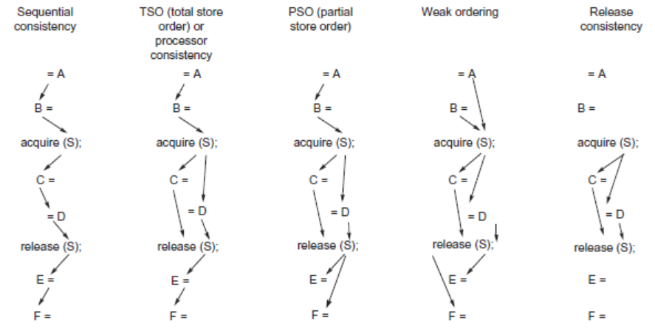
Relaxed Consistency Models
Models of Memory Consistency: An Introduction

Slide 47
Relaxed Consistency Models
Consistency model is multiprocessor specific
Programmers will often implement explicit synchronization
Speculation gives much of the performance advantage of relaxed models with sequential consistency
Basic idea: if an invalidation arrives for a result that has not been committed, use speculation recovery
Models of Memory Consistency: An Introduction

Slide 48
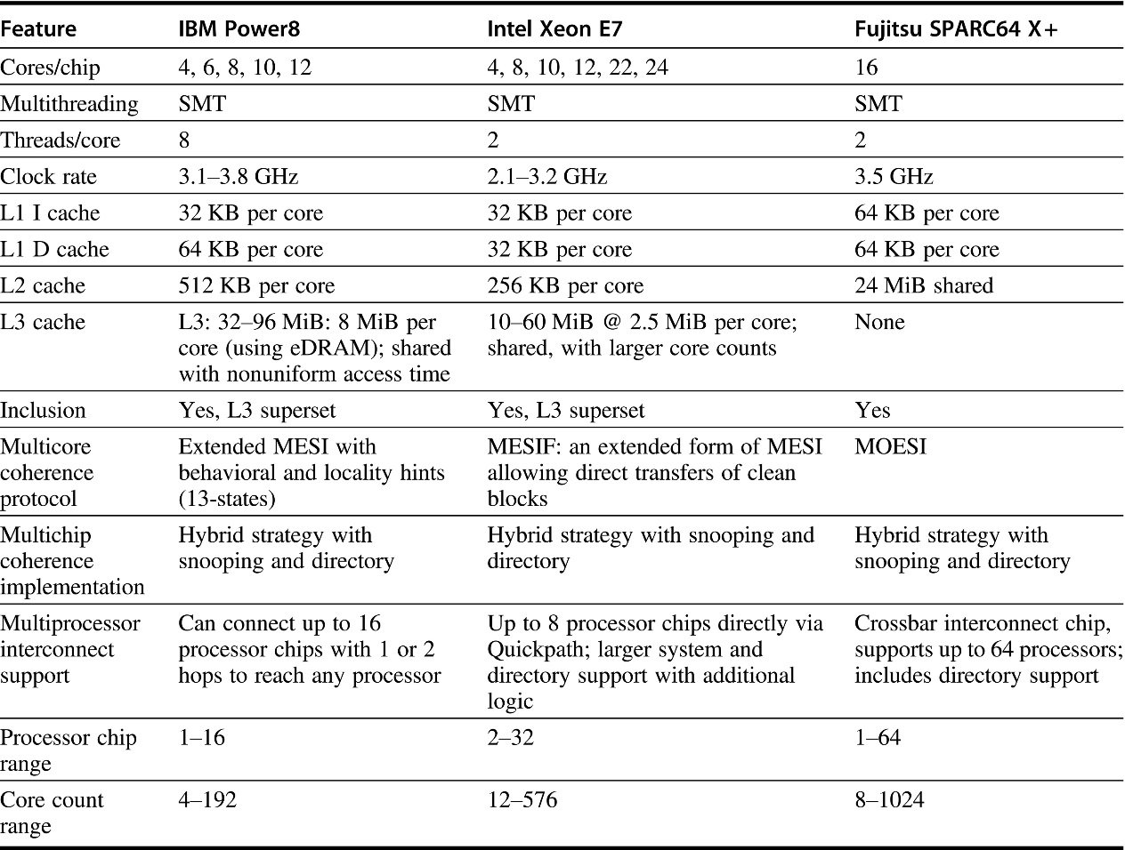
Figure 5.26 Summary of the characteristics of three recent high-end multicore processors (2015–2017 releases) designed for servers. The table shows the range of processor counts, clock rates, and cache sizes within each processor family. The Power8 L3 is a NUCA (Nonuniform Cache Access) design, and it also supports off-chip L4 of up to 128 MiB using EDRAM. A 32-core Xeon has recently been announced, but no system shipments have occurred. The Fujitsu SPARC64 is also available as an 8-core design, which is normally configured as a single processor system. The last row shows the range of configured systems with published performance data (such as SPECintRate) with both processor chip counts and total core counts. The Xeon systems include multiprocessors that extend the basic interconnect with additional logic; for example, using the standard Quickpath interconnect limits the processor count to 8 and the largest system to 8 × 24 = 192 cores, but SGI extends the interconnect (and coherence mechanisms) with extra logic to offer a 32 processor system using 18-core processor chips for a total size of 576 cores. Newer releases of these processors increased clock rates (significantly in the Power8 case, less so in others) and core counts (significantly in the case of Xeon).

Slide 49
Fallacies and Pitfalls
Fallacies and Pitfalls
Measuring performance of multiprocessors by linear speedup versus execution time
Amdahl’s Law doesn’t apply to parallel computers
Linear speedups are needed to make multiprocessors cost-effective
Doesn’t consider cost of other system components
Not developing the software to take advantage of, or optimize for, a multiprocessor architecture

