Slide 1
Computer Architecture
A Quantitative Approach, Sixth Edition
Chapter 4
Data-Level Parallelism in Vector, SIMD, and GPU Architectures

Slide 2
Introduction
Introduction
SIMD architectures can exploit significant data-level parallelism for:
Matrix-oriented scientific computing
Media-oriented image and sound processors
SIMD is more energy efficient than MIMD
Only needs to fetch one instruction per data operation
Makes SIMD attractive for personal mobile devices
SIMD allows programmer to continue to think sequentially

Slide 3
SIMD Parallelism
Introduction
Vector architectures
SIMD extensions
Graphics Processor Units (GPUs)
For x86 processors:
Expect two additional cores per chip per year
Intel & AMD seem to follow different paths on this
SIMD width to double every four years
Potential speedup from SIMD to be twice that from MIMD!

Slide 4
Vector Architectures
Vector Architectures
Basic idea:
Read sets of data elements into “vector registers”
Operate on those registers
Disperse the results back into memory
Registers are controlled by compiler
Used to hide memory latency
Leverage memory bandwidth

Slide 5
VMIPS
Vector Architectures
Example architecture: RV64V RISC-V 64-bit Vector
Loosely based on Cray-1
32 62-bit vector registers
Register file has 16 read ports and 8 write ports
Vector functional units
Fully pipelined
Data and control hazards are detected
Vector load-store unit
Fully pipelined
One word per clock cycle after initial latency
Scalar registers
31 general-purpose registers
32 floating-point registers

Slide 6
VMIPS Instructions
.vv: two vector operands
.vs and .sv: vector and scalar operands
LV/SV: vector load and vector store from address
Example: DAXPY: Y = a*X + Y. From BLAS (Basic Linear Algebra Subprograms)
vsetdcfg 4*FP64 # Enable 4 DP FP vregs
fld f0,a # Load scalar a
vld v0,x5 # Load vector X
vmul v1,v0,f0 # Vector-scalar mult
vld v2,x6 # Load vector Y
vadd v3,v1,v2 # Vector-vector add
vst v3,x6 # Store the sum
vdisable # Disable vector regs
8 instructions for RV64V vs 258 instructions for RV64G (scalar code)
Reason: vector operations work on 32 elements. See HP19.
Vector Architectures

Slide 7
Vector Execution Time
Vector Architectures
Execution time depends on three factors:
Length of operand vectors
Structural hazards
Data dependencies
RV64V functional units consume one element per clock cycle
Execution time is approximately the vector length
Conveoy
Set of vector instructions that could potentially execute together

Slide 8
Chimes
Vector Architectures
Sequences with read-after-write dependency hazards placed in same conveoy via chaining
Chaining
Allows a vector operation to start as soon as the individual elements of its vector source operand become available
Chime
Unit of time to execute one conveoy
m conveoys executes in m chimes for vector length n
For vector length of n, requires m x n clock cycles

Slide 9
Example
Vector Architectures
vld v0,x5 # Load vector X
vmul v1,v0,f0 # Vector-scalar multiply
vld v2,x6 # Load vector Y
vadd v3,v1,v2 # Vector-vector add
vst v3,x6 # Store the sum
Convoys:
1 vld vmul
2 vld vadd
3 vst
3 chimes, 2 FP ops per result, cycles per FLOP = 1.5
For 64 element vectors, requires 32 x 3 = 96 clock cycles

Slide 10
Challenges
Vector Architectures
Start up time
Latency of vector functional unit
Assume the same as Cray-1
Floating-point add => 6 clock cycles
Floating-point multiply => 7 clock cycles
Floating-point divide => 20 clock cycles
Vector load => 12 clock cycles
Improvements:
> 1 element per clock cycle
Non-64 wide vectors
IF statements in vector code
Memory system optimizations to support vector processors
Multiple dimensional matrices
Sparse matrices
Programming a vector computer

Slide 11
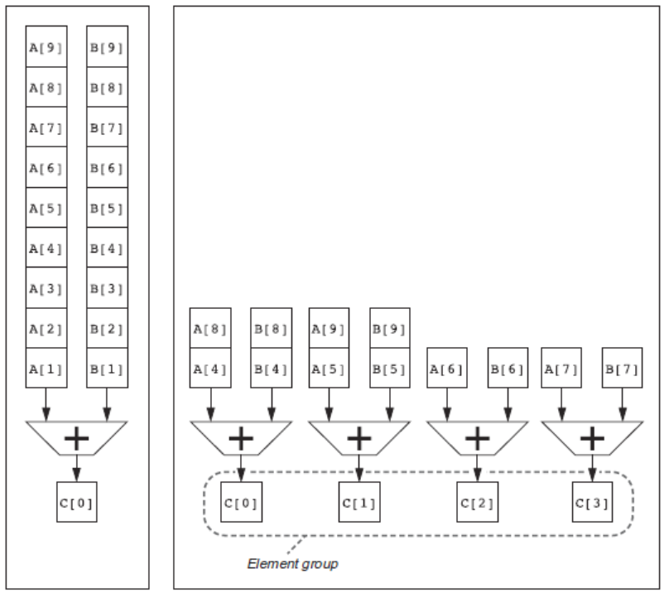
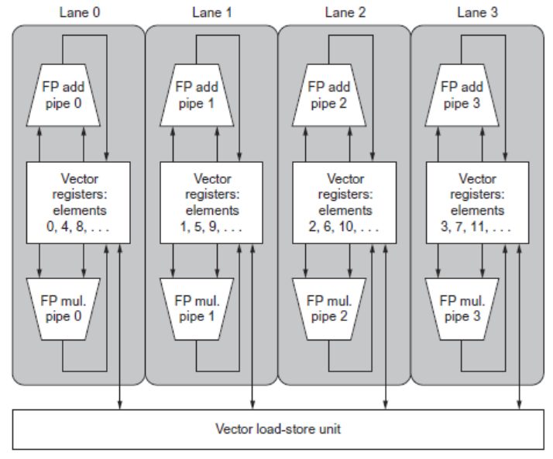
Multiple Lanes
Vector Architectures
Element n of vector register A is “hardwired” to element n of vector register B
Allows for multiple hardware lanes

Slide 12
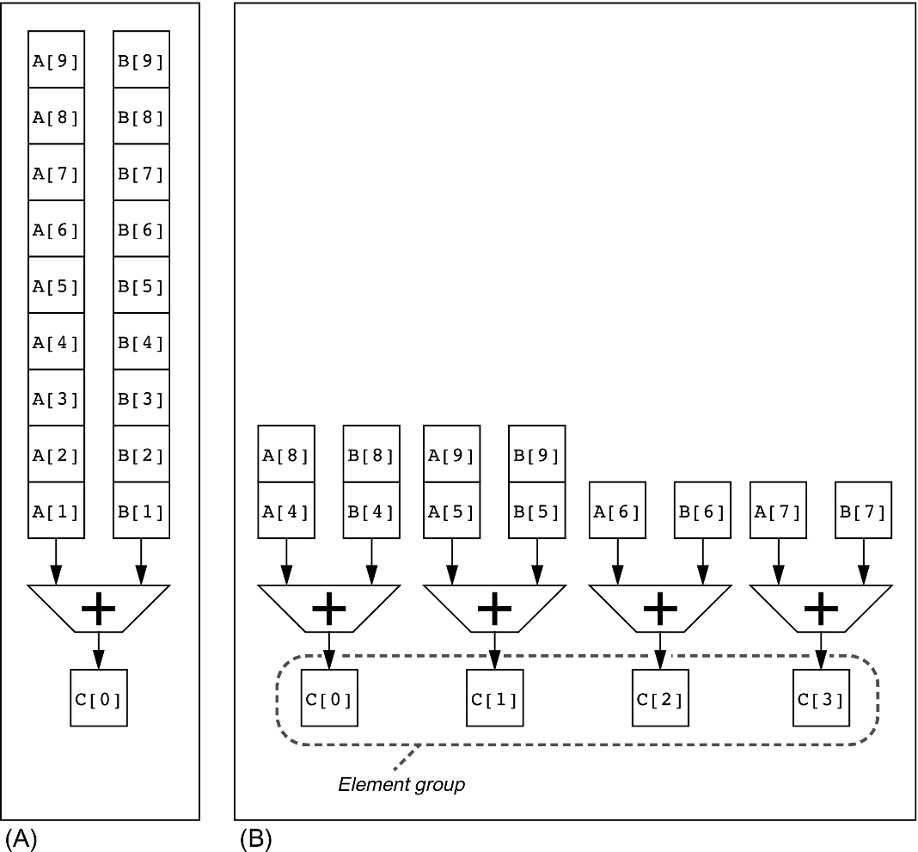
Figure 4.4 Using multiple functional units to improve the performance of a single vector add instruction, C = A + B. The vector processor (A) on the left has a single add pipeline and can complete one addition per clock cycle. The vector processor (B) on the right has four add pipelines and can complete four additions per clock cycle. The elements within a single vector add instruction are interleaved across the four pipelines. The set of elements that move through the pipelines together is termed an element group. Reproduced with permission from Asanovic, K., 1998. Vector Microprocessors (Ph.D. thesis). Computer Science Division, University of California, Berkeley.

Slide 13
Vector Length Register
Vector Architectures
for (i=0; i <n; i=i+1) Y[i] = a * X[i] + Y[i];
vsetdcfg 2 DP FP # Enable 2 64b Fl.Pt. registers
fld f0,a # Load scalar a
loop: setvl t0,a0 # vl = t0 = min(mvl,n)
vld v0,x5 # Load vector X
slli t1,t0,3 # t1 = vl * 8 (in bytes)
add x5,x5,t1 # Increment pointer to X by vl*8
vmul v0,v0,f0 # Vector-scalar mult
vld v1,x6 # Load vector Y
vadd v1,v0,v1 # Vector-vector add
sub a0,a0,t0 # n -= vl (t0)
vst v1,x6 # Store the sum into Y
add x6,x6,t1 # Increment pointer to Y by vl*8
bnez a0,loop # Repeat if n != 0
vdisable # Disable vector regs}

Slide 14
Vector Mask Registers
Consider:
for (i = 0; i < 64; i=i+1)
if (X[i] != 0)
X[i] = X[i] – Y[i];
If inner loop could be run for iterations where X[i]!=0, this subtraction could be vectorized
Use predicate register to “disable” elements:
vsetdcfg 2*FP64 # Enable 2 64b FP vector regs
vsetpcfgi 1 # Enable 1 predicate register
vld v0,x5 # Load vector X into v0
vld v1,x6 # Load vector Y into v1
fmv.d.x f0,x0 # Put (FP) zero into f0
vpne p0,v0,f0 # Set p0(i) to 1 if v0(i)!=f0
vsub v0,v0,v1 # Subtract under vector mask
vst v0,x5 # Store the result in X
vdisable # Disable vector registers
vpdisable # Disable predicate registers
Vector Architectures

Slide 15
Memory Banks
Vector Architectures
Memory system must be designed to support high bandwidth for vector loads and stores
Spread accesses across multiple banks
Control bank addresses independently
Load or store non sequential words (need independent bank addressing)
Support multiple vector processors sharing the same memory
Example:
32 processors, each generating 4 loads and 2 stores/cycle
Processor cycle time is 2.167 ns, SRAM cycle time is 15 ns
How many memory banks needed?
32x(4+2)x15/2.167 = ~1330 banks

Slide 16
Stride
Vector Architectures
Consider:
for (i = 0; i < 100; i=i+1)
for (j = 0; j < 100; j=j+1) {
A[i][j] = 0.0;
for (k = 0; k < 100; k=k+1)
A[i][j] = A[i][j] + B[i][k] * D[k][j];
}
Must vectorize multiplication of rows of B with columns of D
Use non-unit stride
Bank conflict (stall) occurs when the same bank is hit faster than bank busy time:
#banks / LCM(stride,#banks) < bank busy time

Slide 17
Scatter-Gather
Vector Architectures
Consider:
for (i = 0; i < n; i=i+1)
A[K[i]] = A[K[i]] + C[M[i]];
Use index vector:
vsetdcfg 4*FP64 # 4 64b FP vector registers
vld v0, x7 # Load K[]
vldx v1, x5, v0 # Load A[K[]]
vld v2, x28 # Load M[]
vldi v3, x6, v2 # Load C[M[]]
vadd v1, v1, v3 # Add them
vstx v1, x5, v0 # Store A[K[]]
vdisable # Disable vector registers

Slide 18
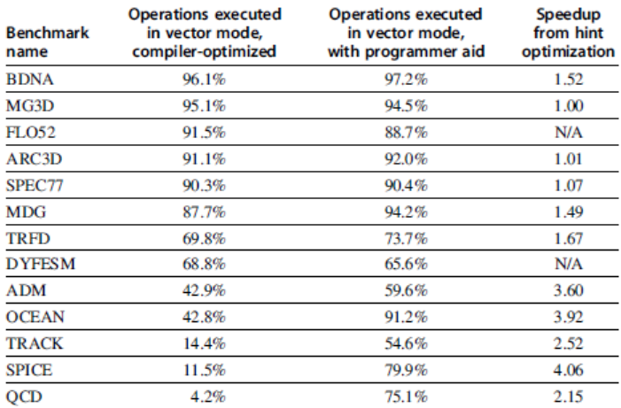
Programming Vec. Architectures
Vector Architectures
Compilers can provide feedback to programmers
Programmers can provide hints to compiler

Slide 19
SIMD Extensions
Media applications operate on data types narrower than the native word size
Example: disconnect carry chains to “partition” adder
Limitations, compared to vector instructions:
Number of data operands encoded into op code
No sophisticated addressing modes (strided, scatter-gather)
No mask registers
SIMD Instruction Set Extensions for Multimedia

Slide 20
SIMD Implementations
Implementations:
Intel MMX (1996)
Eight 8-bit integer ops or four 16-bit integer ops
Streaming SIMD Extensions (SSE) (1999)
Eight 16-bit integer ops
Four 32-bit integer/fp ops or two 64-bit integer/fp ops
Advanced Vector Extensions (2010)
Four 64-bit integer/fp ops
AVX-512 (2017)
Eight 64-bit integer/fp ops
Operands must be consecutive and aligned memory locations
SIMD Instruction Set Extensions for Multimedia

Slide 21
Example SIMD Code
Example DAXPY:
fld f0,a # Load scalar a
splat.4D f0,f0 # Make 4 copies of a
addi x28,x5,#256 # Last address to load
Loop: fld.4D f1,0(x5) # Load X[i] ... X[i+3]
fmul.4D f1,f1,f0 # a x X[i] ... a x X[i+3]
fld.4D f2,0(x6) # Load Y[i] ... Y[i+3]
fadd.4D f2,f2,f1 # a x X[i]+Y[i]...
# a x X[i+3]+Y[i+3]
fsd.4D f2,0(x6) # Store Y[i]... Y[i+3]
addi x5,x5,#32 # Increment index to X
addi x6,x6,#32 # Increment index to Y
bne x28,x5,Loop # Check if done
SIMD Instruction Set Extensions for Multimedia

Slide 22
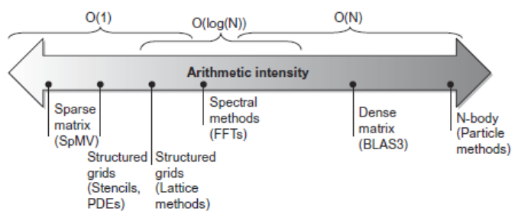
Roofline Performance Model
Basic idea:
Plot peak floating-point throughput as a function of arithmetic intensity
Ties together floating-point performance and memory performance for a target machine
Arithmetic intensity
Floating-point operations per byte read
SIMD Instruction Set Extensions for Multimedia

Slide 23
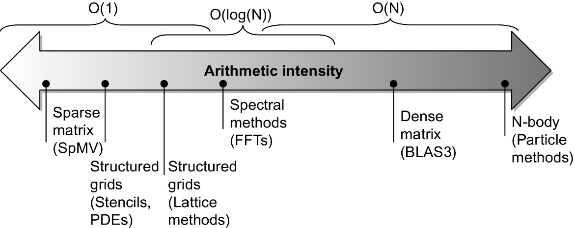
Figure 4.10 Arithmetic intensity, specified as the number of floating-point operations to run the program divided by the number of bytes accessed in main memory (Williams et al., 2009). Some kernels have an arithmetic intensity that scales with problem size, such as a dense matrix, but there are many kernels with arithmetic intensities independent of problem size.

Slide 24
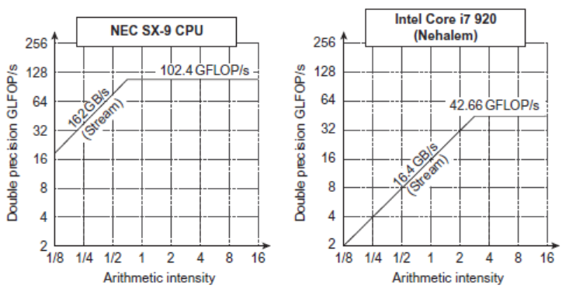
Examples
Attainable GFLOPs/sec = (Peak Memory BW × Arithmetic Intensity, Peak Floating Point Perf.)
SIMD Instruction Set Extensions for Multimedia

Slide 25
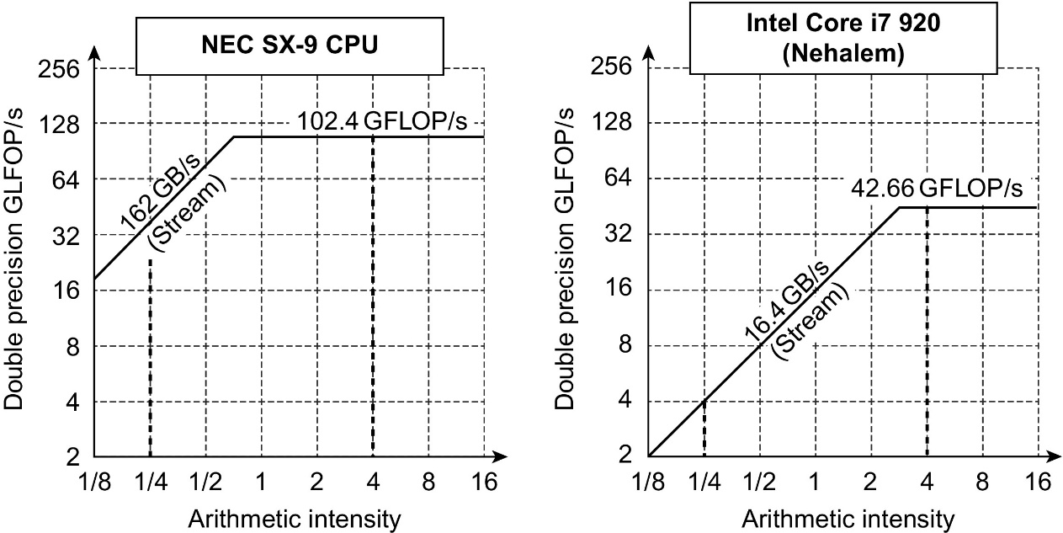
Figure 4.11 Roofline model for one NEC SX-9 vector processor on the left and the Intel Core i7 920 multicore computer with SIMD extensions on the right (Williams et al., 2009). This Roofline is for unit-stride memory accesses and double-precision floating-point performance. NEC SX-9 is a vector supercomputer announced in 2008 that cost millions of dollars. It has a peak DP FP performance of 102.4 GFLOP/s and a peak memory bandwidth of 162 GB/s from the Stream benchmark. The Core i7 920 has a peak DP FP performance of 42.66 GFLOP/s and a peak memory bandwidth of 16.4 GB/s. The dashed vertical lines at an arithmetic intensity of 4 FLOP/byte show that both processors operate at peak performance. In this case, the SX-9 at 102.4 FLOP/s is 2.4 × faster than the Core i7 at 42.66 GFLOP/s. At an arithmetic intensity of 0.25 FLOP/byte, the SX-9 is 10 × faster at 40.5 GFLOP/s versus 4.1 GFLOP/s for the Core i7.

Slide 26
Graphical Processing Units
Basic idea:
Heterogeneous execution model
CPU is the host, GPU is the device
Develop a C-like programming language for GPU
Unify all forms of GPU parallelism as CUDA thread
Programming model is “Single Instruction Multiple Thread” SIMT
Graphical Processing Units

Slide 27
Threads and Blocks
A thread is associated with each data element
Threads are organized into blocks
Blocks are organized into a grid
GPU hardware handles thread management, not applications or OS
Graphical Processing Units

Slide 28
GPU Programming
Performance programmers should keep the GPU hardware in mind when writing in CUDA. Means write in MIMD, but …think SIMD. Somewhat exceeds scope for this class
Hurts programmer productivity, but unavoidable since most programmers use GPUs instead of CPUs for performance
Need to:
Keep groups of 32 threads together in control flow for best performance from multithreaded SIMD processors, and
Create many more thread per multithreaded SIMD performance to hide latency to DRAM
Also need to keep data addresses localized (one or few memory blocks) to get the expected memory performance

Slide 29
NVIDIA GPU Architecture
Similarities to vector machines:
Works well with data-level parallel problems
Scatter-gather transfers
Mask registers
Large register files (…shared starting the 2010s)
Differences:
No scalar processor
Uses multithreading to hide memory latency
Has many functional units, as opposed to a few deeply pipelined units like a vector processor
Graphical Processing Units

Slide 30
Example
Code that works over all elements is the grid
Thread blocks break this down into manageable sizes
512 threads per block
SIMD instruction executes 32 elements at a time
Thus grid size = 16 blocks
Block is analogous to a strip-mined vector loop with vector length of 32
Block is assigned to a multithreaded SIMD processor by the thread block scheduler
Current-generation GPUs have 7-15 multithreaded SIMD processors
Graphical Processing Units

Slide 31
Terminology
Each thread is limited to 64 registers
Groups of 32 threads combined into a SIMD thread or “warp”
Mapped to 16 physical lanes
Up to 32 warps are scheduled on a single SIMD processor
Each warp has its own PC
Thread scheduler uses scoreboard (see App. C) to dispatch warps
By definition, no data dependencies between warps
Dispatch warps into pipeline, hide memory latency
Thread block scheduler schedules blocks to SIMD processors
Within each SIMD processor:
32 SIMD lanes
Wide and shallow compared to vector processors
Graphical Processing Units

Slide 32
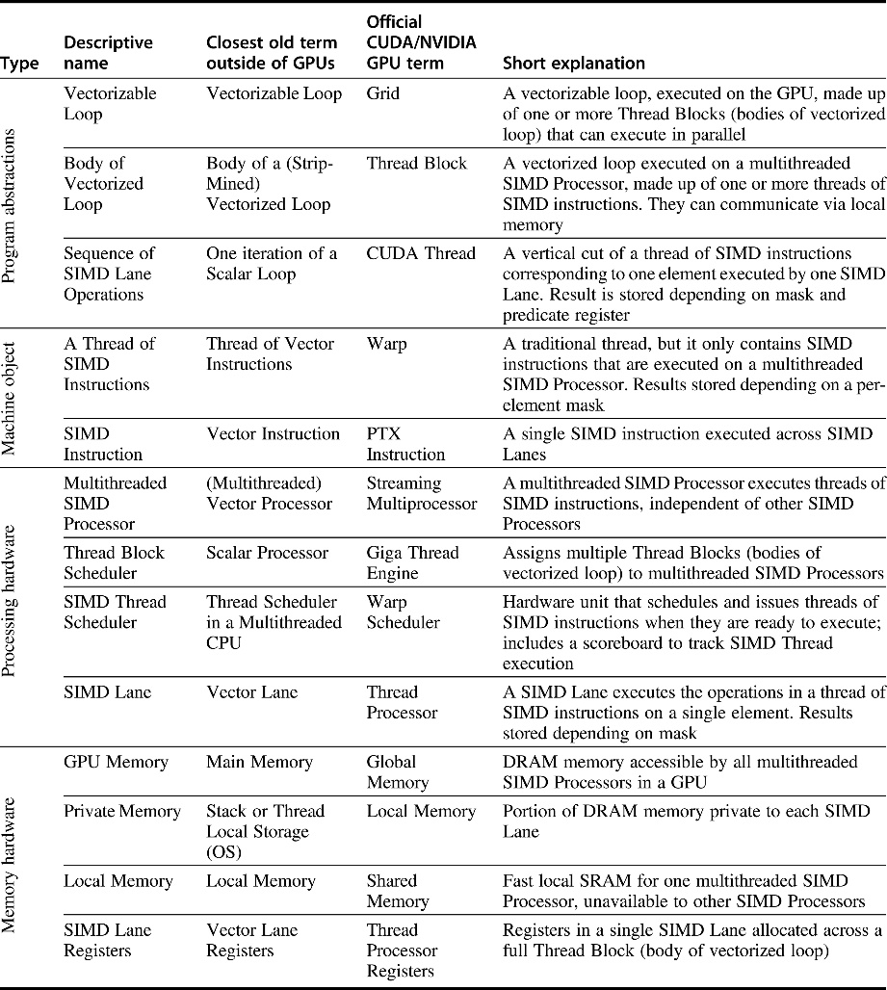
Work horse
CUDA: “shared memory” is local…
Figure 4.12 Quick guide to GPU terms used in this chapter. We use the first column for hardware terms. Four groups cluster these 11 terms. From top to bottom: program abstractions, machine objects, processing hardware, and memory hardware. Figure 4.21 on page 312 associates vector terms with the closest terms here, and Figure 4.24 on page 317 and Figure 4.25 on page 318 reveal the official CUDA/NVIDIA and AMD terms and definitions along with the terms used by OpenCL.

Slide 33
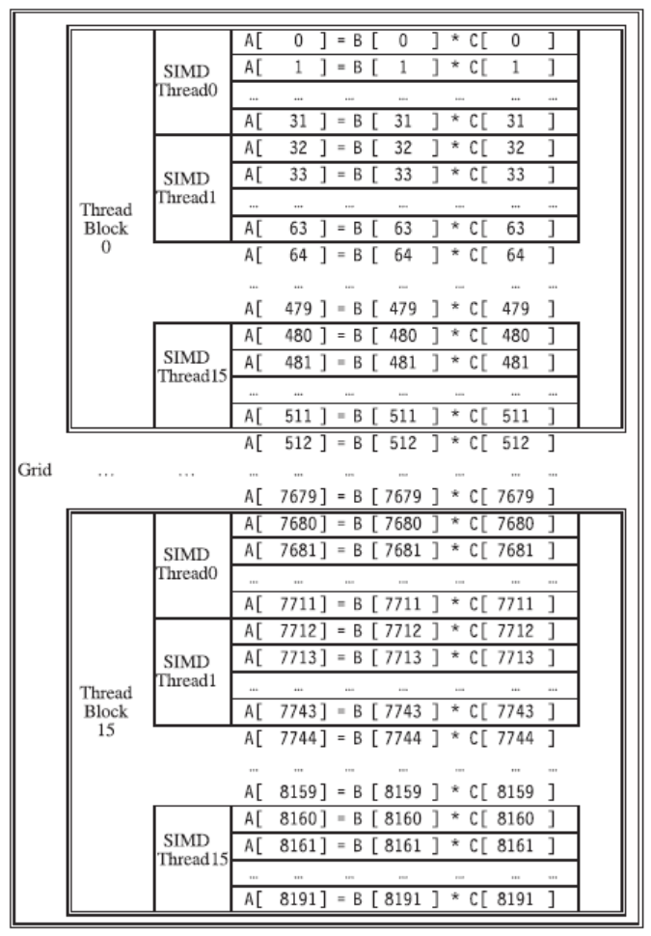
Example
Graphical Processing Units

Slide 34
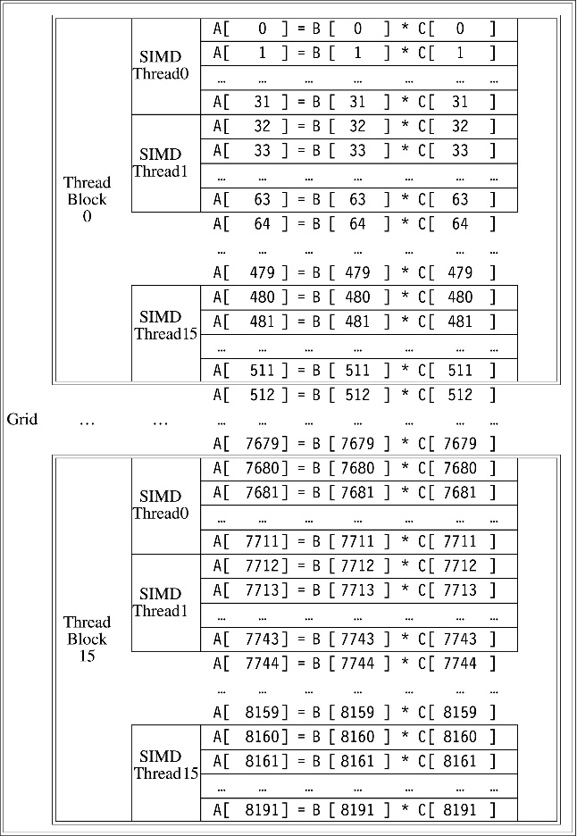
Quite hierarchical
Figure 4.13 The mapping of a Grid (vectorizable loop), Thread Blocks (SIMD basic blocks), and threads of SIMD instructions to a vector-vector multiply, with each vector being 8192 elements long. Each thread of SIMD instructions calculates 32 elements per instruction, and in this example, each Thread Block contains 16 threads of SIMD instructions and the Grid contains 16 Thread Blocks. The hardware Thread Block Scheduler assigns Thread Blocks to multithreaded SIMD Processors, and the hardware Thread Scheduler picks which thread of SIMD instructions to run each clock cycle within a SIMD Processor. Only SIMD Threads in the same Thread Block can communicate via local memory. (The maximum number of SIMD Threads that can execute simultaneously per Thread Block is 32 for Pascal GPUs.)

Slide 35
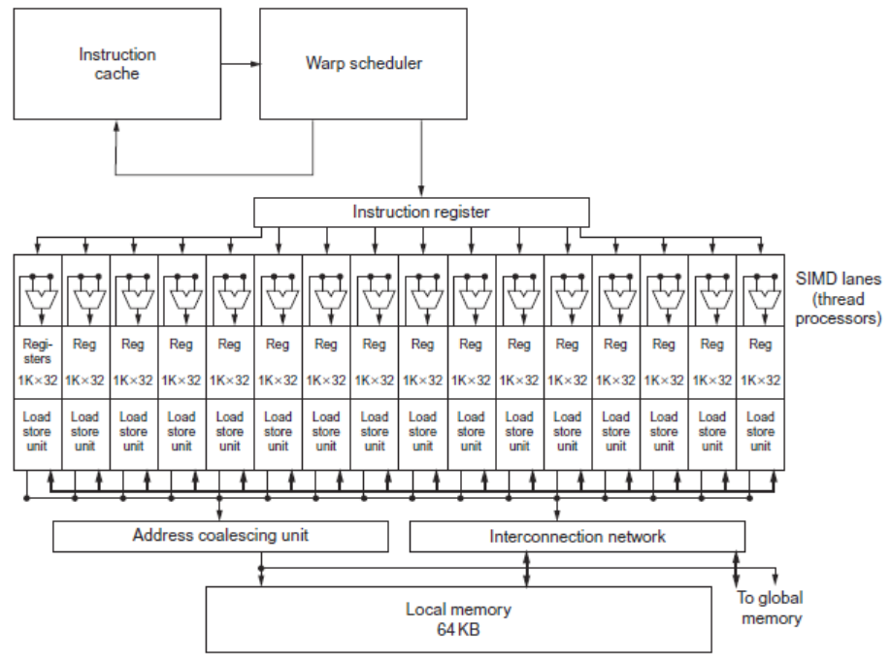
GPU Organization
Graphical Processing Units

Slide 36
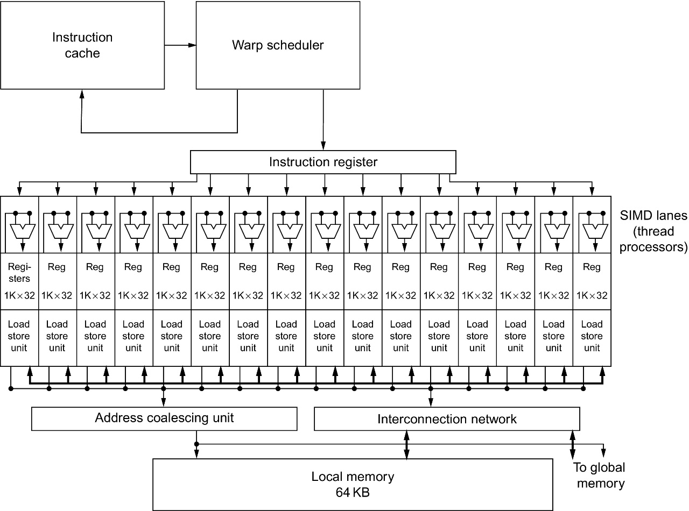
Figure 4.14 Simplified block diagram of a multithreaded SIMD Processor. It has 16 SIMD Lanes. The SIMD Thread Scheduler has, say, 64 independent threads of SIMD instructions that it schedules with a table of 64 program counters (PCs). Note that each lane has 1024 32-bit registers.

Slide 37
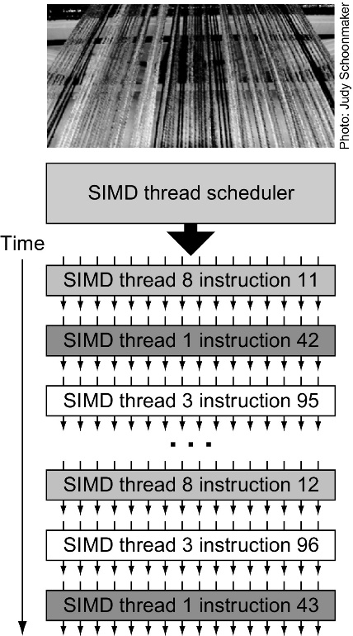
Figure 4.16 Scheduling of threads of SIMD instructions. The scheduler selects a ready thread of SIMD instructions and issues an instruction synchronously to all the SIMD Lanes executing the SIMD Thread. Because threads of SIMD instructions are independent, the scheduler may select a different SIMD Thread each time.
Why GPUs need: 1. an enormous number of registers, and 2. share them.
Big assumption: much/enough parallelism from app!
Big issue: Weak vs strong scaling.

Slide 38
From NVIDIA TESLA V100 GPU ARCHITECTURE*
Similar to Pascal GP100, the GV100 SM incorporates 64 FP32 cores and 32 FP64 cores per SM. However, the GV100 SM uses a new partitioning method to improve SM utilization and overall performance. Note that the GP100 SM is partitioned into two processing blocks, each with 32 FP32 Cores, 16 FP64 Cores, an instruction buffer, one warp scheduler, two dispatch units, and a 128 KB Register File.
The GV100 SM is partitioned into four processing blocks, each with 16 FP32 Cores, 8 FP64 Cores, 16 INT32 Cores, two of the new mixed-precision Tensor Cores for deep learning matrix arithmetic, a new L0 instruction cache, one warp scheduler, one dispatch unit, and a 64 KB Register File. Note that the new L0 instruction cache is now used in each partition to provide higher efficiency than the instruction buffers used in prior NVIDIA GPUs. (See the Volta SM in Figure 5).
* https://images.nvidia.com/content/volta-architecture/pdf/volta-architecture-whitepaper.pdf

Slide 39
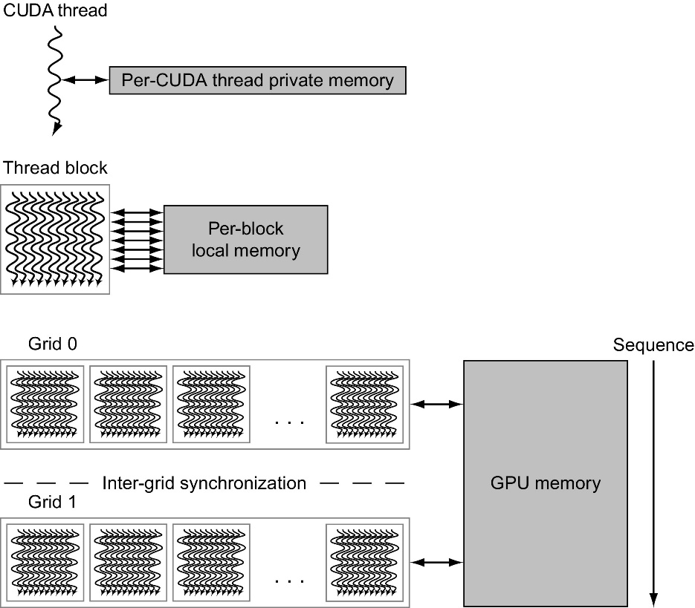
My understanding is that during the 2010s the role of private memory decreased and local memory increased
Figure 4.18 GPU memory structures. GPU memory is shared by all Grids (vectorized loops), local memory is shared by all threads of SIMD instructions within a Thread Block (body of a vectorized loop), and private memory is private to a single CUDA Thread. Pascal allows preemption of a Grid, which requires that all local and private memory be able to be saved in and restored from global memory. For completeness sake, the GPU can also access CPU memory via the PCIe bus. This path is commonly used for a final result when its address is in host memory. This option eliminates a final copy from the GPU memory to the host memory.

Slide 40
NVIDIA Instruction Set Arch.
ISA is an abstraction of the hardware instruction set
“Parallel Thread Execution (PTX)”
opcode.type d,a,b,c;
Uses virtual registers (since shared)
Translation to machine code is performed in software
Example:
shl.s32 R8, blockIdx, 9 ; Thread Block ID * Block size (512 or 29)
add.s32 R8, R8, threadIdx ; R8 = i = my CUDA thread ID
ld.global.f64 RD0, [X+R8] ; RD0 = X[i]
ld.global.f64 RD2, [Y+R8] ; RD2 = Y[i]
mul.f64 R0D, RD0, RD4 ; Product in RD0 = RD0 * RD4 (scalar a)
add.f64 R0D, RD0, RD2 ; Sum in RD0 = RD0 + RD2 (Y[i])
st.global.f64 [Y+R8], RD0 ; Y[i] = sum (X[i]*a + Y[i])
Graphical Processing Units

Slide 41
Conditional Branching
Like vector architectures, GPU branch hardware uses internal masks
Also uses
Branch synchronization stack
Entries consist of masks for each SIMD lane
I.e. which threads commit their results (all threads execute)
Instruction markers to manage when a branch diverges into multiple execution paths
Push on divergent branch
…and when paths converge
Act as barriers
Pops stack
Per-thread-lane 1-bit predicate register, specified by programmer
Graphical Processing Units

Slide 42
Example
if (X[i] != 0)
X[i] = X[i] – Y[i];
else X[i] = Z[i];
ld.global.f64 RD0, [X+R8] ; RD0 = X[i]
setp.neq.s32 P1, RD0, #0 ; P1 is predicate register 1
@!P1, bra ELSE1, *Push ; Push old mask, set new mask bits
; if P1 false, go to ELSE1
ld.global.f64 RD2, [Y+R8] ; RD2 = Y[i]
sub.f64 RD0, RD0, RD2 ; Difference in RD0
st.global.f64 [X+R8], RD0 ; X[i] = RD0
@P1, bra ENDIF1, *Comp ; complement mask bits
; if P1 true, go to ENDIF1
ELSE1: ld.global.f64 RD0, [Z+R8] ; RD0 = Z[i]
st.global.f64 [X+R8], RD0 ; X[i] = RD0
ENDIF1: <next instruction>, *Pop ; pop to restore old mask
Graphical Processing Units

Slide 43
NVIDIA GPU Memory Structures
Each SIMD Lane has private section of off-chip DRAM
“Private memory”
Contains stack frame, spilling registers, and private variables
Each multithreaded SIMD processor also has local memory
Shared by SIMD lanes / threads within a block
My understanding is that registered are shared across each multithreaded SIMD processor
Memory shared by SIMD processors is GPU Memory
Host can read and write GPU memory
Graphical Processing Units

Slide 44
Pascal Architecture Innovations
Each SIMD processor has
Two or four SIMD thread schedulers, two instruction dispatch units
16 SIMD lanes (SIMD width=32, chime=2 cycles), 16 load-store units, 4 special function units
Two threads of SIMD instructions are scheduled every two clock cycles
Fast single-, double-, and half-precision
High Bandwith Memory 2 (HBM2) at 732 GB/s
NVLink between multiple GPUs (20 GB/s in each direction)
On March 12, 2019 NVIDIA acquired Mellanox (Infiniband computer network switching technology) for 6.9B USD. Interest in data centers?
Unified virtual memory and paging support
Graphical Processing Units

Slide 45
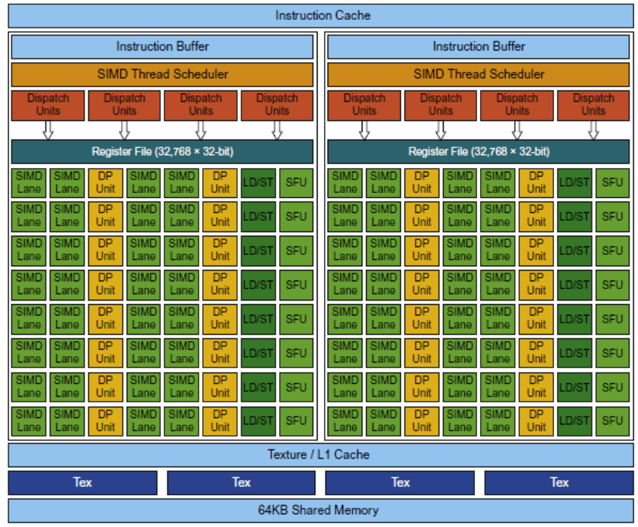
Pascal Multithreaded SIMD Proc.
Graphical Processing Units

Slide 46
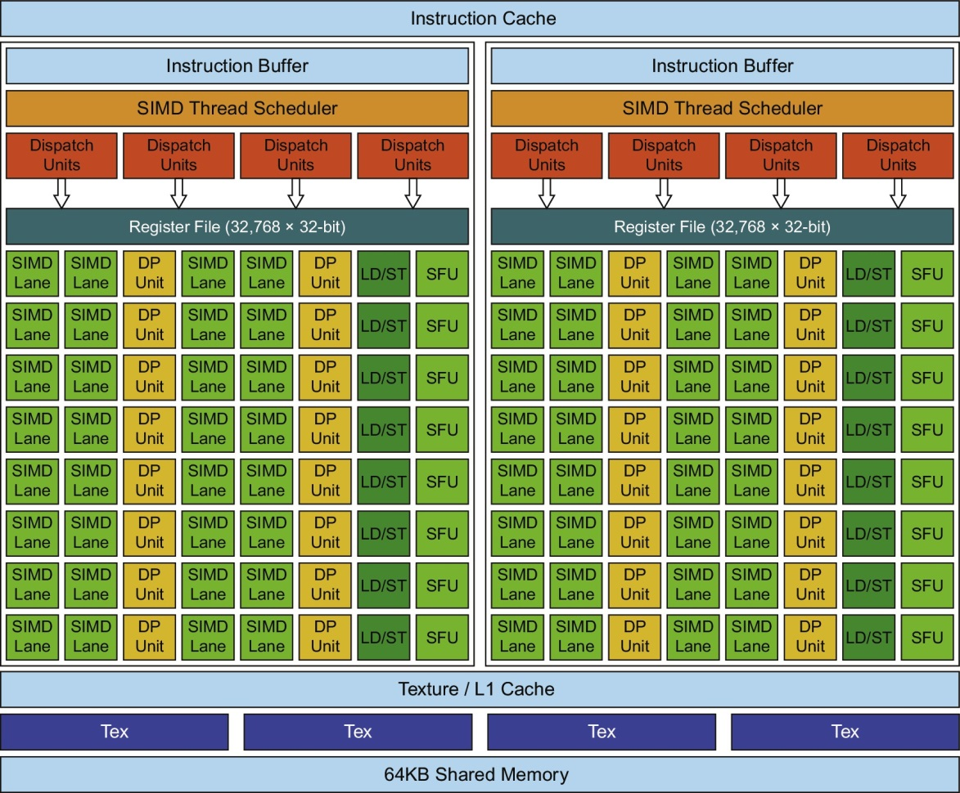
Figure 4.20 Block diagram of the multithreaded SIMD Processor of a Pascal GPU. Each of the 64 SIMD Lanes (cores) has a pipelined floating-point unit, a pipelined integer unit, some logic for dispatching instructions and operands to these units, and a queue for holding results. The 64 SIMD Lanes interact with 32 double-precision ALUs (DP units) that perform 64-bit floating-point arithmetic, 16 load-store units (LD/STs), and 16 special function units (SFUs) that calculate functions such as square roots, reciprocals, sines, and cosines.

Slide 47
Vector Architectures vs GPUs
SIMD processor analogous to vector processor, both have MIMD
Registers
RV64V register file holds entire vectors
GPU distributes vectors across the registers of SIMD lanes
RV64 has 32 vector registers of 32 elements (1024)
GPU has 256 registers with 32 elements each (8K)
RV64 has 2 to 8 lanes with vector length of 32, chime is 4 to 16 cycles
SIMD processor chime is 2 to 4 cycles
GPU vectorized loop is grid
All GPU loads are gather instructions and all GPU stores are scatter instructions
Graphical Processing Units

Slide 48
SIMD Architectures vs GPUs
GPUs have more SIMD lanes
GPUs have hardware support for more threads
Both have 2:1 ratio between double- and single-precision performance
Both have 64-bit addresses, but GPUs have smaller memory
SIMD architectures have no scatter-gather support
Graphical Processing Units

Slide 49
Loop-Level Parallelism
Focuses on determining whether data accesses in later iterations are dependent on data values produced in earlier iterations
Loop-carried dependence
Example 1:
for (i=999; i>=0; i=i-1)
x[i] = x[i] + s;
No loop-carried dependence
Detecting and Enhancing Loop-Level Parallelism

Slide 50
Loop-Level Parallelism
Example 2:
for (i=0; i<100; i=i+1) {
A[i+1] = A[i] + C[i]; /* S1 */
B[i+1] = B[i] + A[i+1]; /* S2 */
}
S1 and S2 use values computed by S1 in previous iteration
S2 uses value computed by S1 in same iteration
Detecting and Enhancing Loop-Level Parallelism

Slide 51
Loop-Level Parallelism
Example 3: loop carried dependence that does not prevent parallelism
for (i=0; i<100; i=i+1) {
A[i] = A[i] + B[i]; /* S1 */
B[i+1] = C[i] + D[i]; /* S2 */
}
S1 uses value computed by S2 in previous iteration but dependence is not circular so loop is parallel
Transform to:
A[0] = A[0] + B[0];
for (i=0; i<99; i=i+1) {
B[i+1] = C[i] + D[i];
A[i+1] = A[i+1] + B[i+1];
}
B[100] = C[99] + D[99];
Detecting and Enhancing Loop-Level Parallelism

Slide 52
Loop-Level Parallelism
Example 4:
for (i=0;i<100;i=i+1) {
A[i] = B[i] + C[i];
D[i] = A[i] * E[i];
}
Example 5: Not noted in textbook here, but see “reductions” later: this is a prefix-sum recursion. Assume Y[0]=0, Y[i] will include original Y[1] + … Y[i]. Assuming associativity, it can be transformed to balanced binary tree, or other reduction structures.
for (i=1;i<100;i=i+1) {
Y[i] = Y[i-1] + Y[i];
}
Detecting and Enhancing Loop-Level Parallelism

Slide 53
Finding dependencies
Assume indices are affine:
a x i + b (i is loop index)
Assume:
Store to a x i + b, then
Load from c x i + d
i runs from m to n
Dependence exists if:
Given j, k such that m ≤ j ≤ n, m ≤ k ≤ n
Store to a x j + b, load from a x k + d, and a x j + b = c x k + d
Detecting and Enhancing Loop-Level Parallelism

Slide 54
Finding dependencies
Generally cannot determine at compile time
Test for absence of a dependence:
GCD test:
If a dependency exists, GCD(c,a) must evenly divide (d-b)
Example:
for (i=0; i<100; i=i+1) {
X[2*i+3] = X[2*i] * 5.0;
}
Detecting and Enhancing Loop-Level Parallelism

Slide 55
Finding dependencies
Example 2:
for (i=0; i<100; i=i+1) {
Y[i] = X[i] / c; /* S1 */
X[i] = X[i] + c; /* S2 */
Z[i] = Y[i] + c; /* S3 */
Y[i] = c - Y[i]; /* S4 */
}
Watch for antidependencies and output dependencies
Detecting and Enhancing Loop-Level Parallelism

Slide 56
Finding dependencies
Example 2:
for (i=0; i<100; i=i+1) {
Y[i] = X[i] / c; /* S1 */
X[i] = X[i] + c; /* S2 */
Z[i] = Y[i] + c; /* S3 */
Y[i] = c - Y[i]; /* S4 */
}
Watch for antidependencies and output dependencies
Detecting and Enhancing Loop-Level Parallelism

Slide 57
Reductions
Reduction Operation:
for (i=9999; i>=0; i=i-1)
sum = sum + x[i] * y[i];
Transform to…
for (i=9999; i>=0; i=i-1)
sum [i] = x[i] * y[i];
for (i=9999; i>=0; i=i-1)
finalsum = finalsum + sum[i];
Do in parallel on p processors, where p below ranges over 0,1…9
for (i=999; i>=0; i=i-1)
finalsum[p] = finalsum[p] + sum[i+1000*p];
Then add finalsum[0], finalsum[1] … finalsum[9]
Note: assumes associativity!
Detecting and Enhancing Loop-Level Parallelism

Slide 58
Fallacies and Pitfalls
Fallacies and Pitfalls
GPUs suffer from being coprocessors (HP19 agrees that being a coprocessor has disadvantages but regards this a fallacy)
GPUs have flexibility to change ISA
Pitfall Concentrating on peak performance in vector architectures and ignoring start-up overhead
Overheads require long vector lengths to achieve speedup
Pitfall Increasing vector performance without comparable increases in scalar performance
Fallacy You can get good vector performance without providing memory bandwidth
Fallacy On GPUs, just add more threads if you don’t have enough memory performance

