Slide 1
Computer Architecture
A Quantitative Approach, Sixth Edition
Chapter 3
Instruction-Level Parallelism and Its Exploitation

Slide 2
Introduction
Introduction
Pipelining become universal technique in 1985
Overlaps execution of instructions
Exploits “Instruction Level Parallelism”
Beyond this, there are two main approaches:
Hardware-based dynamic approaches
Used in server and desktop processors
Not used as extensively in PMP processors
Compiler-based static approaches
Not as successful outside of scientific applications

Slide 3
Introduction
Introduction
Pipelining become universal technique in 1985
Overlaps execution of instructions
Exploits “Instruction Level Parallelism”
Beyond this, there are two main approaches:
Hardware-based dynamic approaches
Used in server and desktop processors
Not used as extensively in PMP processors
However, per http://www.arm.com/products/processors/cortex-a/cortex-a15.php, The Cortex-A15 processor has an out-of-order superscalar pipeline with a tightly-coupled low-latency level-2 cache which can be up to 4MB in size. Additional improvements in floating point and NEON™ media performance result in devices that deliver the next-generation user experience for consumers as well as high-performance computation for web infrastructure applications.
It is expected that mobile configurations of the Cortex-A15 MPCore processor will deliver over five times the performance of today’s advanced smartphones. In advanced infrastructure applications, the Cortex-A15 running at up to 2.5GHz will enable highly scalable solutions within constantly shrinking energy, thermal and cost budgets.
Compiler-based static approaches
Not as successful outside of scientific applications

Slide 4
5 Steps of MIPS Datapath Read Appendix C!!!
Instruction
Fetch
Instr. Decode
Reg. Fetch
Execute
Addr. Calc
Memory
Access
Write
Back
Next PC
IF/ID
ID/EX
EX/MEM
MUX
MEM/WB
Next SEQ PC
Next SEQ PC
Adder
4
Zero?
RS1
Reg File
Address
MUX
Memory
RS2
ALU
Data
Memory
MUX
MUX
Sign
Extend
Imm
WB Data
RD
RD
RD

Slide 5
Backup slide: Visualizing Pipelining
Time (clock cycles)
Cycle 1
Cycle 2
Cycle 3
Cycle 4
Cycle 5
Cycle 6
Cycle 7
I
n
s
t
r.
O
r
d
e
r
Ifetch
Reg
ALU
DMem
Reg
Ifetch
Reg
ALU
DMem
Reg
Ifetch
Reg
ALU
DMem
Reg
Ifetch
Reg
ALU
DMem
Reg

Slide 6
Most important: Pipelining is not quite that easy!
Limits to pipelining: Hazards prevent next instruction from executing during its designated clock cycle
Structural hazards: HW cannot support this combination of instructions (single person to fold and put clothes away)
Data hazards: Instruction depends on result of prior instruction still in the pipeline (missing sock)
Control hazards: Caused by delay between the fetching of instructions and decisions about changes in control flow (branches and jumps or decide what to wear before knowing whether you go to the office or the beach).

Slide 7
One Memory Port/Structural Hazards
Time (clock cycles)
Cycle 1
Cycle 2
Cycle 3
Cycle 4
Cycle 5
Cycle 6
Cycle 7
I
n
s
t
r.
O
r
d
e
r
Load
Ifetch
Reg
ALU
DMem
Reg
Instr 1
Ifetch
Reg
ALU
DMem
Reg
Instr 2
Ifetch
Reg
ALU
DMem
Reg
Instr 3
Ifetch
Reg
ALU
DMem
Reg
Instr 4
Ifetch
Reg
ALU
DMem
Reg

Slide 8
One Memory Port/Structural Hazards
Time (clock cycles)
Cycle 1
Cycle 2
Cycle 3
Cycle 4
Cycle 5
Cycle 6
Cycle 7
I
n
s
t
r.
O
r
d
e
r
Load
Ifetch
Reg
ALU
DMem
Reg
Instr 1
Ifetch
Reg
ALU
DMem
Reg
Instr 2
Ifetch
Reg
ALU
DMem
Reg
Stall
Bubble
Bubble
Bubble
Bubble
Bubble
Instr 3
Ifetch
Reg
ALU
DMem
Reg
How do you “bubble” the pipe?

Slide 9
Speed Up Equations for Pipelining
Speedup from pipelining = (average instruction time pipelined) /(average instruction time unpipelined)
Pipelining with stalls
Only above formula for ENEE446
For simple RISC pipeline, Ideal CPI = 1:

Slide 10
Data Hazard on R1
Time (clock cycles)
IF
ID/RF
EX
MEM
WB
I
n
s
t
r.
O
r
d
e
r
add r1,r2,r3
Reg
Ifetch
Reg
ALU
DMem
sub r4,r1,r3
Ifetch
Reg
ALU
DMem
Reg
and r6,r1,r7
Ifetch
Reg
ALU
DMem
Reg
or r8,r1,r9
Ifetch
Reg
ALU
DMem
Reg
xor r10,r1,r11
Ifetch
Reg
ALU
DMem
Reg

Slide 11
Three Generic Data Hazards
Read After Write (RAW) Instr_{J} tries to read operand before Instr_{I} writes it
Caused by a “Dependence” (in compiler nomenclature). This hazard results from an actual need for communication.
I: add r1,r2,r3
J: sub r4,r1,r3

Slide 12
Three Generic Data Hazards
Write After Read (WAR) Instr_{J} writes operand before Instr_{I} reads it
Called an “anti-dependence” by compiler writers. This results from reuse of the name “r1”.
Can’t happen in MIPS 5 stage pipeline because:
All instructions take 5 stages, and
Reads are always in stage 2, and
Writes are always in stage 5
I: sub r4,r1,r3
J: add r1,r2,r3
K: mul r6,r1,r7

Slide 13
Three Generic Data Hazards
Write After Write (WAW) Instr_{J} writes operand before Instr_{I} writes it.
Called an “output dependence” by compiler writers This also results from the reuse of name “r1”.
Can’t happen in MIPS 5 stage pipeline because:
All instructions take 5 stages, and
Writes are always in stage 5
Will see WAR and WAW in more complicated pipes
I: sub r1,r4,r3
J: add r1,r2,r3
K: mul r6,r1,r7

Slide 14
Forwarding to Avoid Data Hazard
Time (clock cycles)
I
n
s
t
r.
O
r
d
e
r
add r1,r2,r3
Ifetch
Reg
ALU
DMem
Reg
sub r4,r1,r3
Ifetch
Reg
ALU
DMem
Reg
and r6,r1,r7
Ifetch
Reg
ALU
DMem
Reg
or r8,r1,r9
Ifetch
Reg
ALU
DMem
Reg
xor r10,r1,r11
Ifetch
Reg
ALU
DMem
Reg

Slide 15
Forwarding to Avoid LW-SW Data Hazard
Time (clock cycles)
I
n
s
t
r.
O
r
d
e
r
add r1,r2,r3
Ifetch
Reg
ALU
DMem
Reg
lw r4, 0(r1)
Ifetch
Reg
ALU
DMem
Reg
sw r4,12(r1)
Ifetch
Reg
ALU
DMem
Reg
or r8,r6,r9
Ifetch
Reg
ALU
DMem
Reg
xor r10,r9,r11
Ifetch
Reg
ALU
DMem
Reg

Slide 16
Data Hazard Even with Forwarding
Time (clock cycles)
I
n
s
t
r.
O
r
d
e
r
lw r1, 0(r2)
Ifetch
Reg
ALU
DMem
Reg
sub r4,r1,r6
Ifetch
Reg
ALU
DMem
Reg
and r6,r1,r7
Ifetch
Reg
ALU
DMem
Reg
or r8,r1,r9
Ifetch
Reg
ALU
DMem
Reg
Notes:
MIPS actutally didn’t interlecok: MPU without Interlocked Pipelined Stages

Slide 17
Data Hazard Even with Forwarding
Time (clock cycles)
I
n
s
t
r.
O
r
d
e
r
lw r1, 0(r2)
Ifetch
Reg
ALU
DMem
Reg
Bubble
sub r4,r1,r6
Ifetch
Reg
ALU
DMem
Reg
Bubble
and r6,r1,r7
Ifetch
Reg
ALU
DMem
Reg
Bubble
or r8,r1,r9
Ifetch
Reg
ALU
DMem

Slide 18
Control Hazard on Branches Three Stage Stall
10: beq r1,r3,36
Ifetch
Reg
ALU
DMem
Reg
14: and r2,r3,r5
Ifetch
Reg
ALU
DMem
Reg
18: or r6,r1,r7
Ifetch
Reg
ALU
DMem
Reg
22: add r8,r1,r9
Ifetch
Reg
ALU
DMem
Reg
36: xor r10,r1,r11
Ifetch
Reg
ALU
DMem
Reg
What do you do with the 3 instructions in between?
How do you do it?
Where is the “commit”?

Slide 19
Branch Stall Impact
If CPI = 1, 30% branch, Stall 3 cycles => new CPI = 1.9!
Two part solution:
Determine branch taken or not sooner, AND
Compute taken branch address earlier

Slide 20
Four Branch Hazard Alternatives
#1: Stall until branch direction is clear
#2: Predict Branch Not Taken
Execute successor instructions in sequence
“Squash” instructions in pipeline if branch actually taken
Advantage of late pipeline state update
47% MIPS branches not taken on average
PC+4 already calculated, so use it to get next instruction
#3: Predict Branch Taken
53% MIPS branches taken on average
But haven’t calculated branch target address in MIPS
MIPS still incurs 1 cycle branch penalty
Other machines: branch target known before outcome

Slide 21
Four Branch Hazard Alternatives
#4: Delayed Branch Example in next slide
Define branch to take place AFTER a following instruction
branch instruction sequential successor₁ sequential successor₂ ........ sequential successor_{n}
branch target if taken
1 slot delay allows proper decision and branch target address in 5 stage pipeline
Branch delay of length n

Slide 22
Scheduling Branch Delay Slots
A. From before branch
B. From branch target
C. From fall through
add $1,$2,$3
if $2=0 then
sub $4,$5,$6
add $1,$2,$3
if $1=0 then
delay slot
delay slot
add $1,$2,$3
if $1=0 then
delay slot
sub $4,$5,$6
becomes
becomes
becomes
if $2=0 then
add $1,$2,$3
if $1=0 then
add $1,$2,$3
sub $4,$5,$6
add $1,$2,$3
if $1=0 then
sub $4,$5,$6
A is the best choice, fills delay slot & reduces instruction count (IC)
In B, the sub instruction may need to be copied, increasing IC
In B and C, must be okay to execute sub when branch fails ‘must be okay’ means that the work is wasted, but the program will still execute correctly
Notes:
Limitations on delayed-branch scheduling come from 1) restrictions on the instructions that can be moved/copied into the delay slot and 2) limited ability to predict at compile time whether a branch is likely to be taken or not.
In B and C, the use of $1 prevents the add instruction from being moved to the delay slot
In B the sub may need to be copied because it could be reached by another path. B is preferred when the branch is taken with high probability (such as loop branches

Slide 23
Instruction-Level Parallelism
Introduction
When exploiting instruction-level parallelism, goal is to minimize CPI
Pipeline CPI =
Ideal pipeline CPI +
Structural stalls +
Data hazard stalls +
Control stalls
Parallelism within basic block is limited
Typical size of basic block = 3-6 instructions
Must optimize across branches

Slide 24
Data Dependence
Introduction
Loop-Level Parallelism
Unroll loop statically or dynamically
Use SIMD (vector processors and GPUs)
Challenges:
Data dependency
Instruction j is data dependent on instruction i if
Instruction i produces a result that may be used by instruction j
Instruction j is data dependent on instruction k and instruction k is data dependent on instruction i
Dependent instructions cannot be executed simultaneously

Slide 25
Data Dependence
Introduction
Dependencies are a property of programs
Pipeline organization determines if how dependence is detected and if it causes a stall
Data dependence conveys:
Possibility of a hazard
Order in which results must be calculated
Upper bound on exploitable instruction level parallelism
Dependencies that flow through memory locations are difficult to detect

Slide 26
Name Dependence
Introduction
Two instructions use the same name but no flow of information
Not a true data dependence, but is a problem when reordering instructions
Antidependence: instruction j writes a register or memory location that instruction i reads
Initial ordering (i before j) must be preserved
Output dependence: instruction i and instruction j write the same register or memory location
Ordering must be preserved
To resolve, use register renaming techniques

Slide 27
Other Factors
Introduction
Data Hazards
Read after write (RAW)
Write after write (WAW)
Write after read (WAR)
Control Dependence
Ordering of instruction i with respect to a branch instruction
Instruction control dependent on a branch cannot be moved before the branch so that its execution is no longer controlled by the branch
An instruction not control dependent on a branch cannot be moved after the branch so that its execution is controlled by the branch

Slide 28
Examples [RISC-V commands: R1➔x1, etc]
Introduction
Example 1:
add x1,x2,x3
beq x4,x0,L
sub x1,x1,x6
L: …
or x7,x1,x8
Example 2:
add x1,x2,x3
beq x12,x0,skip
sub x4,x5,x6
add x5,x4,x9
skip:
or x7,x8,x9
or instruction dependent on add and sub
Assume x4 isn’t used after skip
Possible to move sub before the branch

Slide 29
Compiler Techniques for Exposing ILP
Compiler Techniques
Pipeline scheduling
Separate dependent instruction from the source instruction by the pipeline latency of the source instruction
Example:
for (i=999; i>=0; i=i-1)
x[i] = x[i] + s;

Slide 30
Pipeline Stalls
Compiler Techniques
Loop: fld f0,0(x1)
stall
fadd.d f4,f0,f2
stall
stall
fsd f4,0(x1)
addi x1,x1,-8
bne x1,x2,Loop
Loop: fld f0,0(x1)
addi x1,x1,-8
fadd.d f4,f0,f2
stall
stall
fsd f4,08(x1) bne x1,x2,Loop
8 clock cycles 7 clock cycles

Slide 31
Loop Unrolling
Compiler Techniques
Loop unrolling
Unroll by a factor of 4 (assume # elements is divisible by 4)
Eliminate unnecessary instructions
Loop: fld f0,0(x1)
fadd.d f4,f0,f2
fsd f4,0(x1) //drop addi & bne
fld f6,-8(x1)
fadd.d f8,f6,f2
fsd f8,-8(x1) //drop addi & bne
fld f10,-16(x1)
fadd.d f12,f10,f2
fsd f12,-16(x1) //drop addi & bne
fld f14,-24(x1)
fadd.d f16,f14,f2
fsd f16,-24(x1)
addi x1,x1,-32
bne x1,x2,Loop
6X4 + 2 ➔ 26/4
clock cycles/loop
note: number of live registers vs. original loop

Slide 32
Loop Unrolling/Pipeline Scheduling
Compiler Techniques
Pipeline schedule the unrolled loop:
Loop: fld f0,0(x1)
fld f6,-8(x1)
fld f108,-16(x1)
fld f14,-24(x1)
fadd.d f4,f0,f2
fadd.d f8,f6,f2
fadd.d f12,f10,f2
fadd.d f16,f14,f2
fsd f4,0(x1)
fsd f8,-8(x1)
fsd f12,-16(x1)
fsd f16,-24(x1)
addi x1,x1,-32
bne x1,x2,Loop
3X4 + 2 = 14 cycles
14/4 = 3.5 cycles per element

Slide 33
5 Loop Unrolling Decisions
Requires understanding how one instruction depends on another and how the instructions can be changed or reordered given the dependences:
Determine loop unrolling useful by finding that loop iterations were independent (except for maintenance code)
Use different registers to avoid unnecessary constraints forced by using same registers for different computations
Eliminate the extra test and branch instructions and adjust the loop termination and iteration code
Determine that loads and stores in unrolled loop can be interchanged by observing that loads and stores from different iterations are independent
Transformation requires analyzing memory addresses and finding that they do not refer to the same address
Schedule the code, preserving any dependences needed to yield the same result as the original code

Slide 34
Dependence graph reasoning
In the above example, each iteration had 3 “core instructions” A, B and C
Denote the instructions of iteration i: iA, iB and iC. Let us suppress for now control instructions.
Each instruction is a node in the dependence graph.
Each dependence is a directed edge
A common theme in the current chapter is seeking (towards execution) serial numbering of the instructions that obeys the directed edges
Such numbering is know as topological sort

Slide 35
3 Limits to Loop Unrolling
Decrease in amount of overhead amortized with each extra unrolling
Amdahl’s Law
Growth in code size
For larger loops, concern it increases the instruction cache miss rate
Register pressure: potential shortfall in registers created by aggressive unrolling and scheduling
If not possible to allocate all live values to registers, may lose some or all of its advantage
Loop unrolling reduces impact of branches on pipeline; another way is branch prediction

Slide 36
Strip Mining
Compiler Techniques
Unknown (at compile time) number of loop iterations?
Number of iterations = n
Goal: make k copies of the loop body
Generate pair of loops:
First executes n mod k times
Second executes n / k times
“Strip mining”

Slide 37
Branch Prediction
Branch Prediction
Basic 2-bit predictor:
For each branch:
Predict taken or not taken
If the prediction is wrong two consecutive times, change prediction
Correlating predictor:
Multiple 2-bit predictors for each branch
One for each possible combination of outcomes of preceding n branches
(m,n) predictor: behavior from last m branches to choose from 2^{m} n-bit predictors
Tournament predictor:
Combine correlating predictor with local predictor

Slide 38
Dynamic Branch Prediction
Solution: 2-bit scheme where change prediction only if get misprediction twice
Blue: stop, not taken
Grey: go, taken
Adds hysteresis (slowing effect) to decision making process
T
NT
Predict Taken
Predict Taken
T
T
NT
NT
Predict Not
Taken
Predict Not
Taken
T
NT

Slide 39
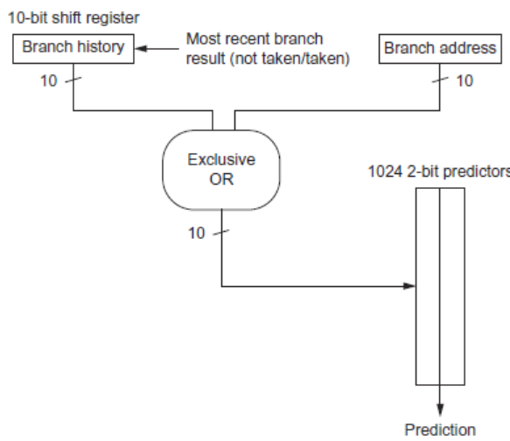
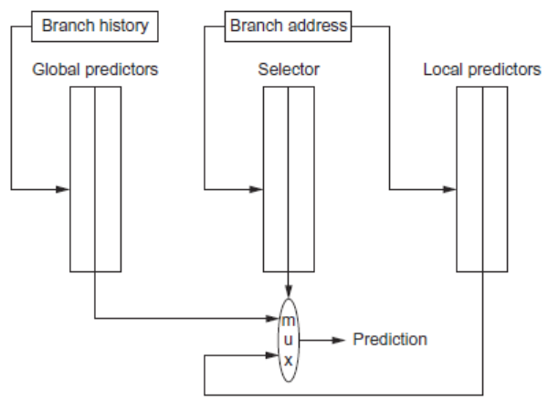
Branch Prediction
Branch Prediction
gshare
tournament

Slide 40
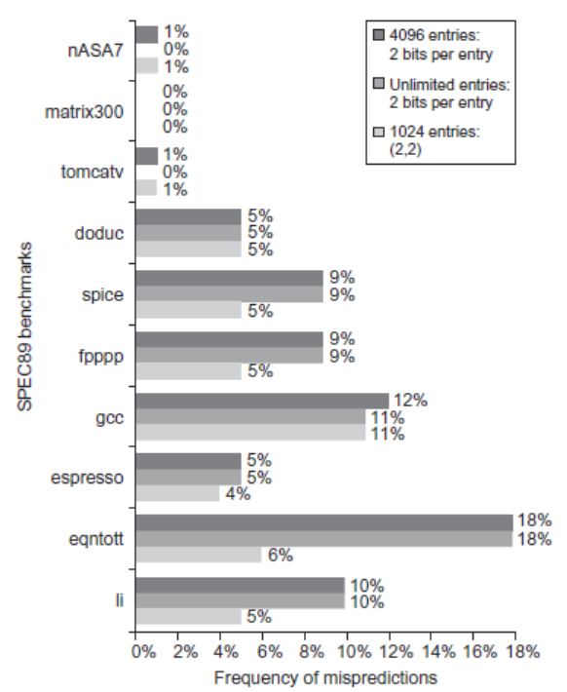
Branch Prediction Performance
Branch Prediction

Slide 41
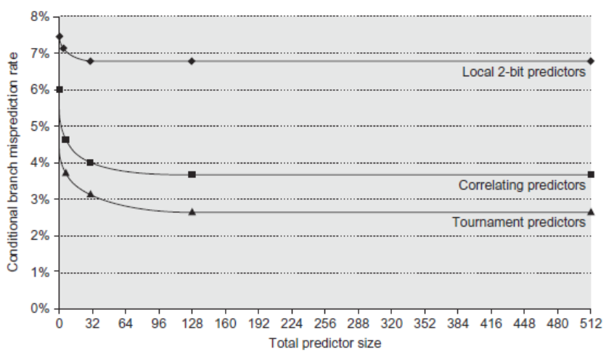
Branch Prediction Performance
Branch Prediction

Slide 42
Tagged Hybrid Predictors
Branch Prediction
Need to have predictor for each branch and history
Problem: this implies huge tables
Solution:
Use hash tables, whose hash value is based on branch address and branch history
Longer histories may lead to increased chance of hash collision, so use multiple tables with increasingly shorter histories

Slide 43
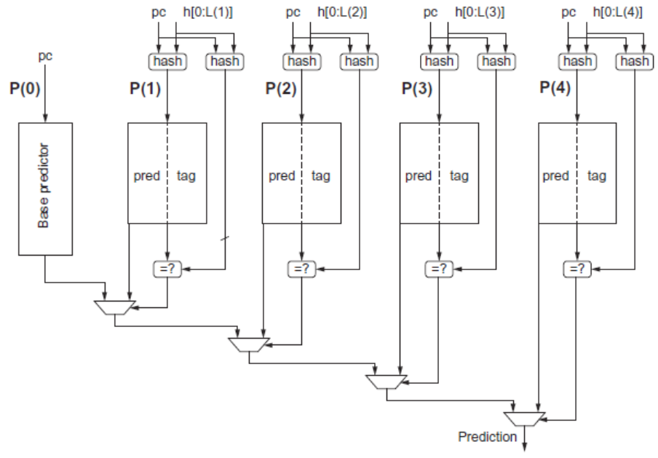
Tagged Hybrid Predictors
Branch Prediction

Slide 44
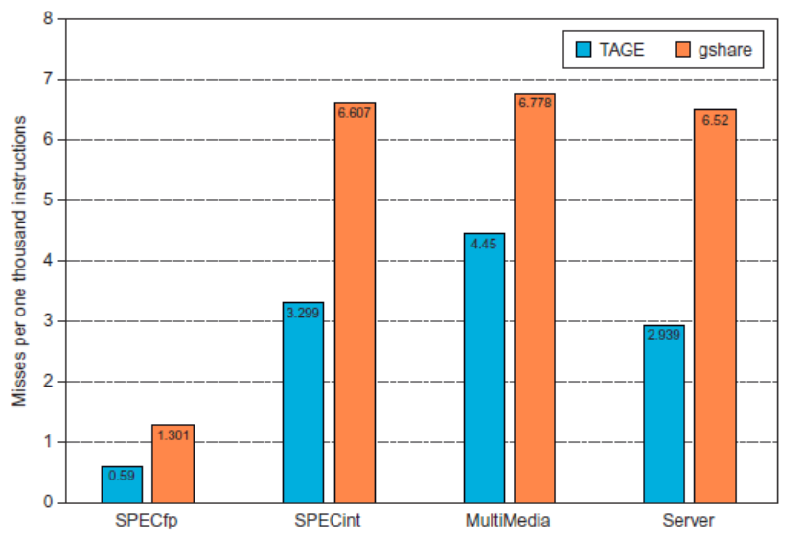
Tagged Hybrid Predictors
Branch Prediction

Slide 45
Dynamic Scheduling
Dynamic Scheduling
Rearrange order of instructions to reduce stalls while maintaining data flow
Advantages:
Compiler doesn’t need to have knowledge of microarchitecture
Handles cases where dependencies are unknown at compile time
Disadvantage:
Substantial increase in hardware complexity
Complicates exceptions

Slide 46
Dynamic Scheduling
Dynamic Scheduling
Dynamic scheduling implies:
Out-of-order execution
Out-of-order completion
Example 1:
fdiv.d f0,f2,f4
fadd.d f10,f0,f8
fsub.d f12,f8,f14
fsub.d is not dependent, issue before fadd.d

Slide 47
Dynamic Scheduling
Dynamic Scheduling
Example 2:
fdiv.d f0,f2,f4
fmul.d f6,f0,f8
fadd.d f0,f10,f14
fadd.d is not dependent, but the antidependence makes it impossible to issue earlier without register renaming

Slide 48
Register Renaming
Dynamic Scheduling
Example 3:
fdiv.d f0,f2,f4
fadd.d f6,f0,f8
fsd f6,0(x1)
fsub.d f8,f10,f14
fmul.d f6,f10,f8
name dependence with f6
antidependence
antidependence

Slide 49
Register Renaming
Dynamic Scheduling
Example 3:
fdiv.d f0,f2,f4
fadd.d S,f0,f8
fsd S,0(x1)
fsub.d T,f10,f14
fmul.d f6,f10,T
Now only RAW hazards remain, which can be strictly ordered

Slide 50
Register Renaming
Dynamic Scheduling
Tomasulo’s Approach
Tracks when operands are available
Introduces register renaming in hardware
Minimizes WAW and WAR hazards
Register renaming is provided by reservation stations (RS)
Contains:
The instruction
Buffered operand values (when available)
Reservation station number of instruction providing the operand values

Slide 51
Register Renaming
Dynamic Scheduling
RS fetches and buffers an operand as soon as it becomes available (not necessarily involving register file)
Pending instructions designate the RS to which they will send their output
Result values broadcast on a result bus, called the common data bus (CDB)
Only the last output updates the register file
As instructions are issued, the register specifiers are renamed with the reservation station
May be more reservation stations than registers
Load and store buffers
Contain data and addresses, act like reservation stations

Slide 52
A Dynamic Algorithm: Tomasulo’s
For IBM 360/91 (before caches!)
⇒ Long memory latency
Goal: High Performance without special compilers
Small number of floating point registers (4 in 360) prevented interesting compiler scheduling of operations
This led Tomasulo to try to figure out how to get more effective registers — renaming in hardware!
Why Study 1966 Computer?
The descendants of this have flourished!
Alpha 21264, Pentium 4, AMD Opteron, Power 5, …

Slide 53
Tomasulo Algorithm
Control & buffers distributed with Function Units (FU)
FU buffers called “reservation stations”; have pending operands
Registers in instructions replaced by values or pointers to reservation stations(RS); called register renaming ;
Renaming avoids WAR, WAW hazards
More reservation stations than registers, so can do optimizations compilers can’t
Results to FU from RS, not through registers, over Common Data Bus that broadcasts results to all FUs
Avoids RAW hazards by executing an instruction only when its operands are available
Load and Stores treated as FUs with RSs as well
Integer instructions can go past branches (predict taken), allowing FP ops beyond basic block in FP queue

Slide 54
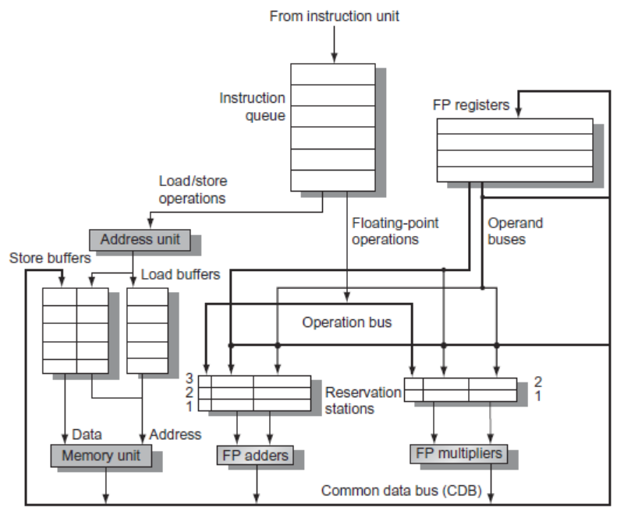
Tomasulo’s Algorithm
Dynamic Scheduling

Slide 55
Tomasulo’s Algorithm
Dynamic Scheduling
Three Steps:
Issue
Get next instruction from FIFO queue
If available RS, issue the instruction to the RS with operand values if available
If operand values not available, stall the instruction
Execute
When operand becomes available, store it in any reservation stations waiting for it
When all operands are ready, issue the instruction
Loads and store maintained in program order through effective address
No instruction allowed to initiate execution until all branches that proeceede it in program order have completed
Write result
Write result on CDB into reservation stations and store buffers
(Stores must wait until address and value are received)

Slide 56
Reservation Station Components
Op: Operation to perform in the unit (e.g., + or –)
Vj, Vk: Value of Source operands
Store buffers has V field, result to be stored
Qj, Qk: Reservation stations producing source registers (value to be written)
Note: Qj,Qk=0 => ready
Store buffers only have Qi for RS producing result
Busy: Indicates reservation station or FU is busy
Register result status—Indicates which functional unit will write each register, if one exists. Blank when no pending instructions that will write that register.
Notes:
What you might have thought
1. 4 stages of instruction executino
2.Status of FU: Normal things to keep track of (RAW & structura for busyl):
Fi from instruction format of the mahine (Fi is dest)
Add unit can Add or Sub
Rj, Rk - status of registers (Yes means ready)
Qj,Qk - If a no in Rj, Rk, means waiting for a FU to write result; Qj, Qk means wihch FU waiting for it
3.Status of register result (WAW &WAR)s:
which FU is going to write into registers
Scoreboard on 6600 = size of FU
6.7, 6.8, 6.9, 6.12, 6.13, 6.16, 6.17
FU latencies: Add 2, Mult 10, Div 40 clocks

Slide 57
Three Stages of Tomasulo Algorithm & Example
1. Issue—get instruction from FP Op Queue
If reservation station free (no structural hazard), control issues instr & sends operands (renames registers).
2. Execute—operate on operands (EX)
When both operands ready then execute; if not ready, watch Common Data Bus for result
3. Write result—finish execution (WB)
Write on Common Data Bus to all awaiting units; mark reservation station available
Normal data bus: data + destination (“go to” bus)
Common data bus: data + source (“come from” bus)
64 bits of data + 4 bits of Functional Unit source address
Write if matches expected Functional Unit (produces result)
Does the broadcast
Example speed: 3 clocks for Fl .pt. +,-; 10 for * ; 40 clks for /

Slide 58
Tomasulo Example
Instruction stream
3 Load/Buffers
FU count
down
3 FP Adder R.S.
2 FP Mult R.S.
Clock cycle counter

Slide 59
Dependence Graph
‘Data Flow’ Perspective
Draw a node for each instruction
Draw and incoming edge for each data-dependence (including anti dependence)

Slide 60
The dependence graph. 6 nodes shown. Add directed edge for RAW: result register = operand Note: F6 is WAR (or WAW)
LD F6 MULTD F0 F2 F4
DIVD F10 F0 F6
LD F2 SUBD F8 F6 F2
ADDD F6 F8 F2

Slide 61
Tomasulo Example Cycle 1

Slide 62
Tomasulo Example Cycle 2
Note: Can have multiple loads outstanding

Slide 63
Tomasulo Example Cycle 3
Note: registers names are removed (“renamed”) in Reservation Stations; MULT issued
Load1 completing; what is waiting for Load1?

Slide 64
Tomasulo Example Cycle 4
Load2 completing; what is waiting for Load2?

Slide 65
Tomasulo Example Cycle 5
Timer starts down for Add1, Mult1. Unclear: Add starts at 2. Not 3.
Note: DIVD already has the value of F6 ➔ No WAR hazard for ADDD

Slide 66
Tomasulo Example Cycle 6
Repeating: Issue ADDD here despite name dependency on F6?

Slide 67
Tomasulo Example Cycle 7
Add1 (SUBD) completing; what is waiting for it?

Slide 68
Tomasulo Example Cycle 8

Slide 69
Tomasulo Example Cycle 9

Slide 70
Tomasulo Example Cycle 10
Add2 (ADDD) completing; what is waiting for it?

Slide 71
Tomasulo Example Cycle 11
Write result of ADDD here?
All quick instructions complete in this cycle!

Slide 72
Tomasulo Example Cycle 12

Slide 73
Tomasulo Example Cycle 13

Slide 74
Tomasulo Example Cycle 14

Slide 75
Tomasulo Example Cycle 15
Mult1 (MULTD) completing; what is waiting for it?

Slide 76
Tomasulo Example Cycle 16
Just waiting for Mult2 (DIVD) to complete

Slide 77
Faster than light computation (skip a couple of cycles)

Slide 78
Tomasulo Example Cycle 55

Slide 79
Tomasulo Example Cycle 56
Mult2 (DIVD) is completing; what is waiting for it?

Slide 80
Tomasulo Example Cycle 57
Once again: In-order issue, out-of-order execution and out-of-order completion.

Slide 81
Why can Tomasulo overlap iterations of loops?
Register renaming
Multiple iterations use different physical destinations for registers (dynamic loop unrolling).
Reservation stations
Permit instruction issue to advance past integer control flow operations
Also buffer old values of registers - totally avoiding the WAR stall
Other perspective: Tomasulo building data flow dependency graph on the fly

Slide 82
Tomasulo’s scheme offers 2 major advantages
Distribution of the hazard detection logic
distributed reservation stations and the CDB
If multiple instructions waiting on single result, & each instruction has other operand, then instructions can be released simultaneously by broadcast on CDB
If a centralized register file were used, the units would have to read their results from the registers when register buses are available
Elimination of stalls for WAW and WAR hazards

Slide 83
Tomasulo Drawbacks
Complexity
delays of 360/91, MIPS 10000, Alpha 21264, IBM PPC 620 in CA:AQA 2/e, but not in silicon!
Many associative stores (CDB) at high speed
Performance limited by Common Data Bus
Each CDB must go to multiple functional units ⇒high capacitance, high wiring density
Number of functional units that can complete per cycle limited to one!
Multiple CDBs ⇒ more FU logic for parallel assoc stores
Non-precise interrupts!
We will address this later

Slide 84
And In Conclusion … #1
Leverage Implicit Parallelism for Performance: Instruction Level Parallelism
Loop unrolling by compiler to increase ILP
Branch prediction to increase ILP
Dynamic HW exploiting ILP
Works when can’t know dependence at compile time
Can hide L1 cache misses
Code for one machine runs well on another

Slide 85
And In Conclusion … #2
Reservations stations: renaming to larger set of registers + buffering source operands
Prevents registers as bottleneck
Avoids WAR, WAW hazards
Allows loop unrolling in HW
Not limited to basic blocks (integer units gets ahead, beyond branches) with speculation
Helps cache misses as well
Lasting Contributions
Dynamic scheduling
Register renaming
Load/store disambiguation
360/91 descendants are Intel Pentium 4, IBM Power 5, AMD Athlon/Opteron, …

Slide 86
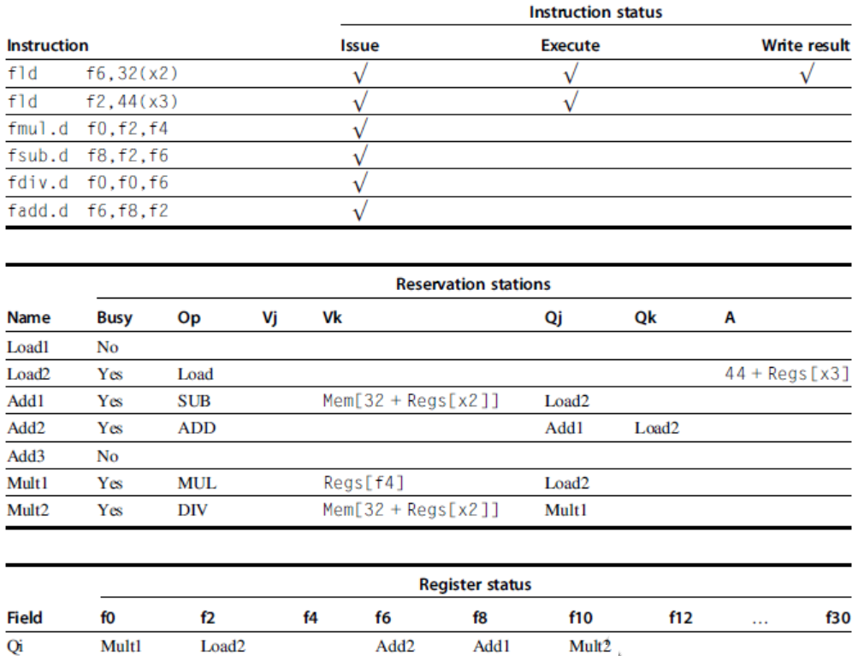
Example
Dynamic Scheduling

Slide 87
Tomasulo’s Algorithm
Dynamic Scheduling
Example loop:
Loop: fld f0,0(x1)
fmul.d f4,f0,f2
fsd f4,0(x1)
addi x1,x1,8
bne x1,x2,Loop // branches if x16 != x2

Slide 88
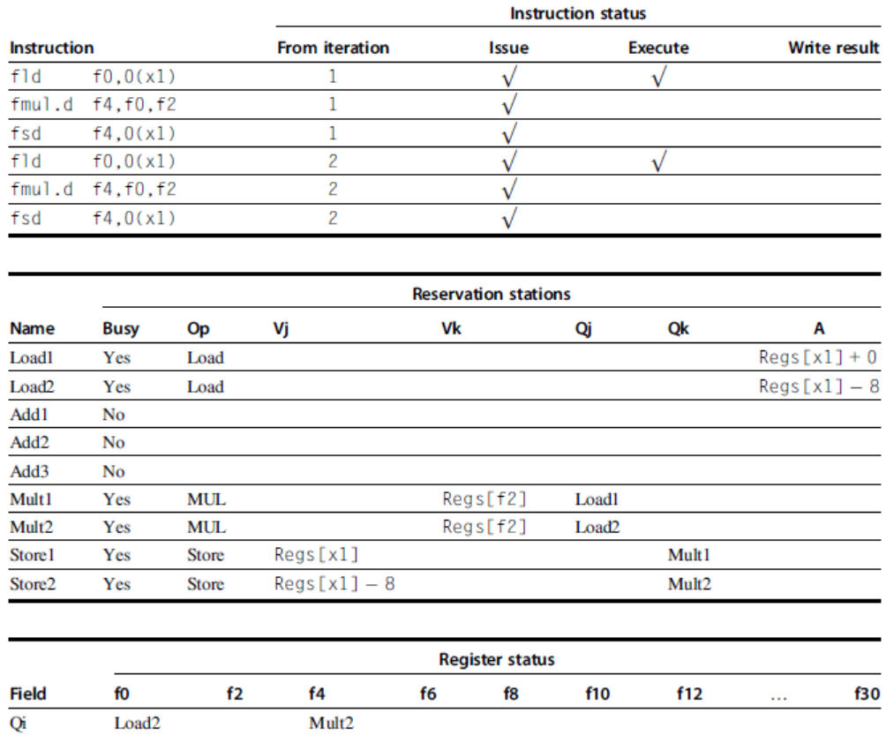
Tomasulo’s Algorithm
Dynamic Scheduling

Slide 89
Hardware-Based Speculation
Execute instructions along predicted execution paths but only commit the results if prediction was correct
Instruction commit: allowing an instruction to update the register file when instruction is no longer speculative
Need an additional piece of hardware to prevent any irrevocable action until an instruction commits
I.e. updating state or taking an execution
Hardware-Based Speculation

Slide 90
Reorder Buffer
Reorder buffer – holds the result of instructions between completion and commit
Four fields:
Instruction type: branch/store/register
Destination field: register number
Value field: output value
Ready field: completed execution?
Modify reservation stations:
Operand source is now reorder buffer instead of functional unit
Hardware-Based Speculation

Slide 91
Reorder Buffer
Issue:
Allocate RS and ROB, read available operands
Execute:
Begin execution when operand values are available
Write result:
Write result and ROB tag on CDB
Commit:
When ROB reaches head of ROB, update register
When a mispredicted branch reaches head of ROB, discard all entries
Hardware-Based Speculation

Slide 92
Reorder Buffer
Register values and memory values are not written until an instruction commits
On misprediction:
Speculated entries in ROB are cleared
Exceptions:
Not recognized until it is ready to commit
Hardware-Based Speculation

Slide 93
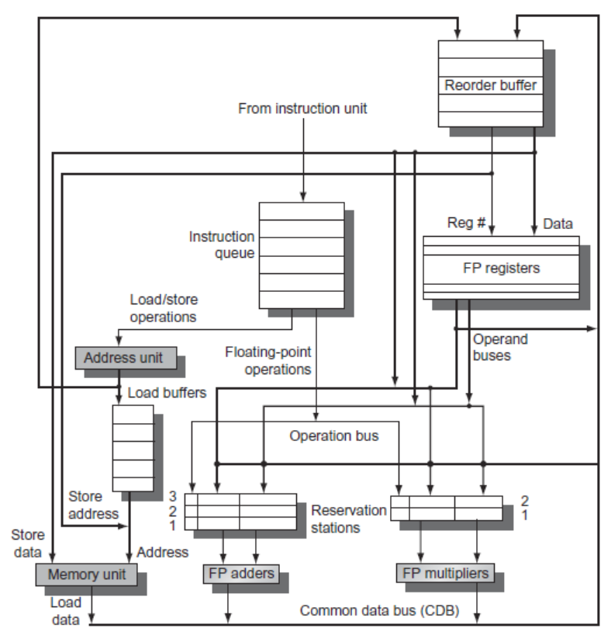
Reorder Buffer
Hardware-Based Speculation

Slide 94
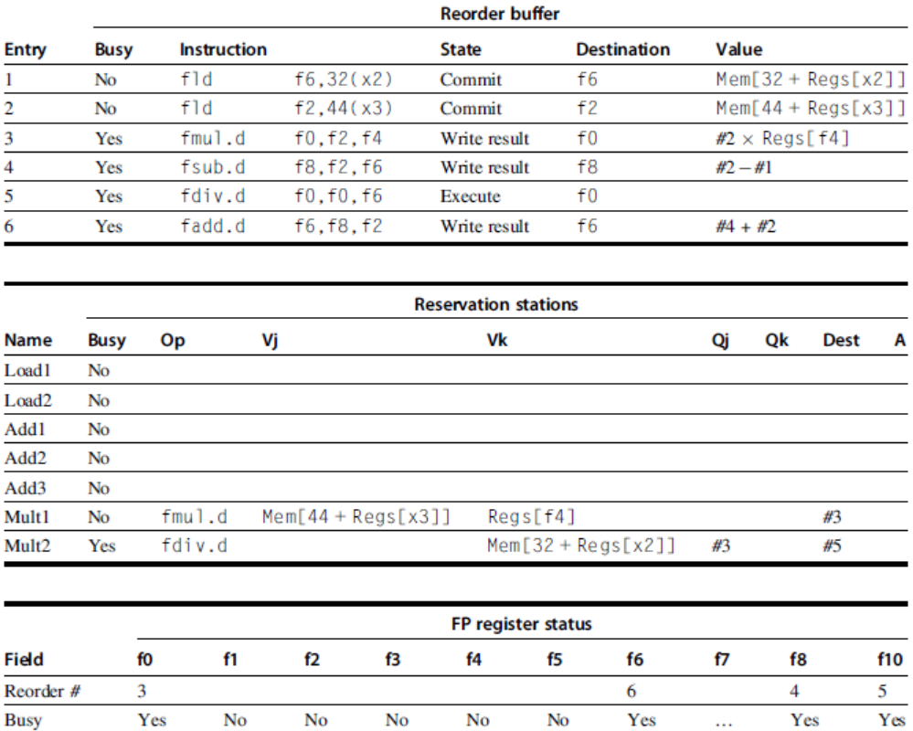
Reorder Buffer
Hardware-Based Speculation

Slide 95
Multiple Issue and Static Scheduling
To achieve CPI < 1, need to complete multiple instructions per clock
Solutions:
Statically scheduled superscalar processors
VLIW (very long instruction word) processors
Dynamically scheduled superscalar processors
Multiple Issue and Static Scheduling

Slide 96
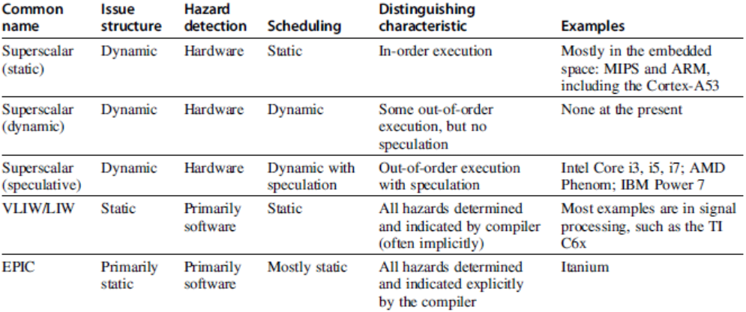
Multiple Issue
Multiple Issue and Static Scheduling

Slide 97
VLIW Processors
Package multiple operations into one instruction
Example VLIW processor:
One integer instruction (or branch)
Two independent floating-point operations
Two independent memory references
Must be enough parallelism in code to fill the available slots
Multiple Issue and Static Scheduling

Slide 98
Loop Unrolling/Pipeline Scheduling
Compiler Techniques
Pipeline schedule the unrolled loop:
Loop: fld f0,0(x1)
fld f6,-8(x1)
fld f8,-16(x1)
fld f14,-24(x1)
fadd.d f4,f0,f2
fadd.d f8,f6,f2
fadd.d f12,f0,f2
fadd.d f16,f14,f2
fsd f4,0(x1)
fsd f8,-8(x1)
fsd f12,-16(x1)
fsd f16,-24(x1)
addi x1,x1,-32
bne x1,x2,Loop
3X4 + 2 = 14 cycles
14/4 = 3.5 cycles per element

Slide 99
Recall Loop Unrolling/Pipeline Scheduling
Compiler Techniques
Pipeline schedule the unrolled loop:
Loop: fld f0,0(x1)
fld f6,-8(x1)
fld f8,-16(x1)
fld f14,-24(x1)
fadd.d f4,f0,f2
fadd.d f8,f6,f2
fadd.d f12,f0,f2
fadd.d f16,f14,f2
fsd f4,0(x1)
fsd f8,-8(x1)
fsd f12,-16(x1)
fsd f16,-24(x1)
addi x1,x1,-32
bne x1,x2,Loop
3X4 + 2 = 14 cycles
14/4 = 3.5 cycles per element

Slide 100
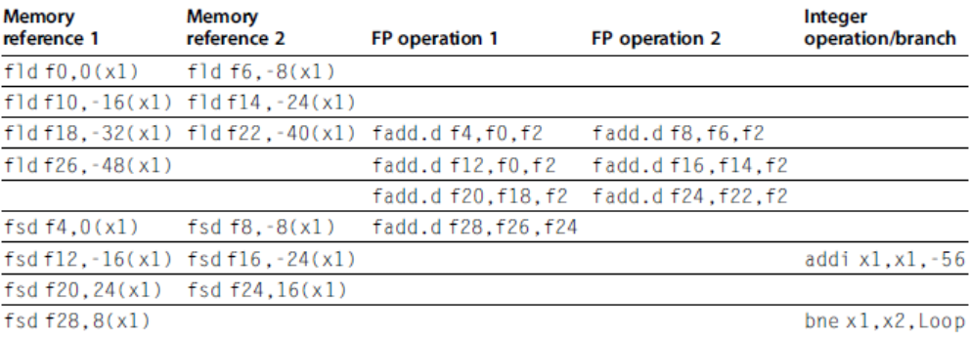
VLIW Processors
Multiple Issue and Static Scheduling
Disadvantages:
Statically finding parallelism
Code size
No hazard detection hardware
Binary code compatibility
Unrolled 7 times to avoid delays. 7 results in 9 clocks, or 1.3 clocks per iteration (1.8X). Average: 2.5 ops per clock, 50% efficiency. Note: Need more registers in VLIW (15 vs. 6 in SS)

Slide 101
Problems with 1st Generation VLIW
Increase in code size
generating enough operations in a straight-line code fragment requires ambitiously unrolling loops
whenever VLIW instructions are not full, unused functional units translate to wasted bits in instruction encoding
Operated in lock-step; no hazard detection HW
a stall in any functional unit pipeline caused entire processor to stall, since all functional units must be kept synchronized
Compiler might predict function units, but caches hard to predict
Binary code compatibility
Pure VLIW => different numbers of functional units and unit latencies require different versions of the code

Slide 102
Intel/HP IA-64 “Explicitly Parallel Instruction Computer (EPIC)”
IA-64: instruction set architecture
128 64-bit integer regs + 128 82-bit floating point regs
Not separate register files per functional unit as in old VLIW
Hardware checks dependencies (interlocks => binary compatibility over time)
Predicated execution (select 1 out of 64 1-bit flags) => 40% fewer mispredictions?
Itanium™ was first implementation (2001)
Highly parallel and deeply pipelined hardware at 800Mhz
6-wide, 10-stage pipeline at 800Mhz on 0.18 µ process
Itanium 2™ is name of 2nd implementation (2005)
6-wide, 8-stage pipeline at 1666Mhz on 0.13 µ process
Caches: 32 KB I, 32 KB D, 128 KB L2I, 128 KB L2D, 9216 KB L3

Slide 103
Dynamic Scheduling, Multiple Issue, and Speculation
Modern microarchitectures:
Dynamic scheduling + multiple issue + speculation
Two approaches:
Assign reservation stations and update pipeline control table in half clock cycles
Only supports 2 instructions/clock
Design logic to handle any possible dependencies between the instructions
Issue logic is the bottleneck in dynamically scheduled superscalars
Dynamic Scheduling, Multiple Issue, and Speculation

Slide 104
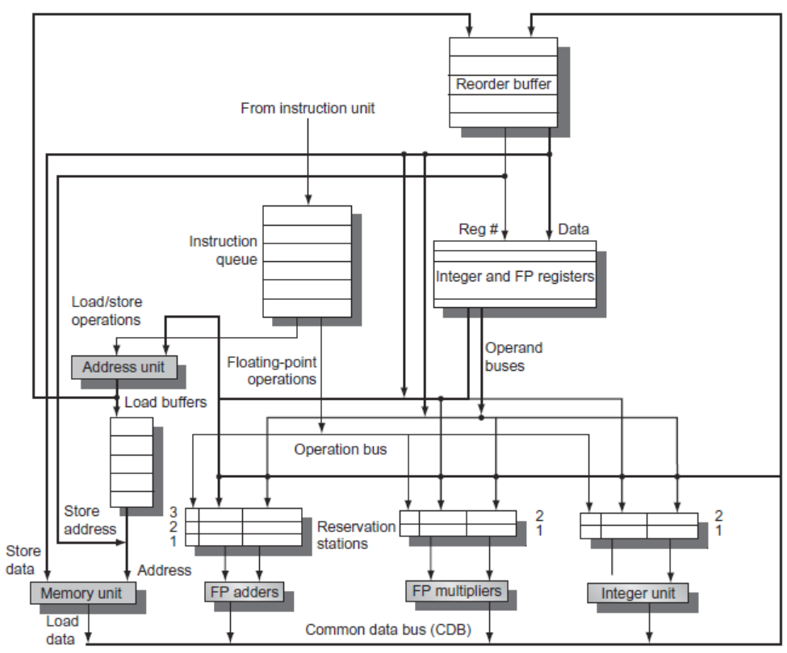
Overview of Design. Problem with figure: the main info is … in the caption. See next slide
Dynamic Scheduling, Multiple Issue, and Speculation

Slide 105
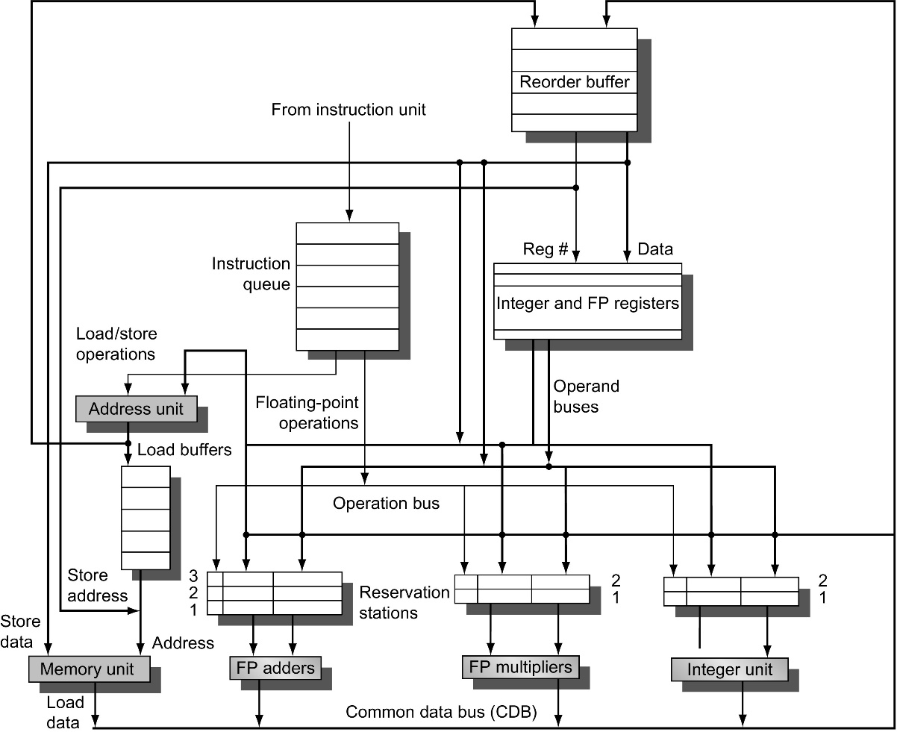
Figure 3.21 The basic organization of a multiple issue processor with speculation. In this case, the organization could allow a FP multiply, FP add, integer, and load/store to all issues simultaneously (assuming one issue per clock per functional unit). Note that several datapaths must be widened to support multiple issues: the CDB, the operand buses, and, critically, the instruction issue logic, which is not shown in this figure. The last is a difficult problem, as we discuss in the text.

Slide 106
Multiple Issue
Examine all the dependencies among the instructions in the bundle
If dependencies exist in bundle, encode them in reservation stations
Also need multiple completion/commit
To simplify RS allocation:
Limit the number of instructions of a given class that can be issued in a “bundle”, i.e. on FP, one integer, one load, one store
Dynamic Scheduling, Multiple Issue, and Speculation

Slide 107
Multithreading
Crosscutting topic relevant to pipelining & superscalar (Ch. 3), GPUs (Ch. 4) and multiporcessors (Ch. 5)
Thread: like a process that has state and program counter
But, threads typically share the address space of other threads, with easy access to their data within the same process.
(Underlined two non-identical use of the word “process”.)

Slide 108
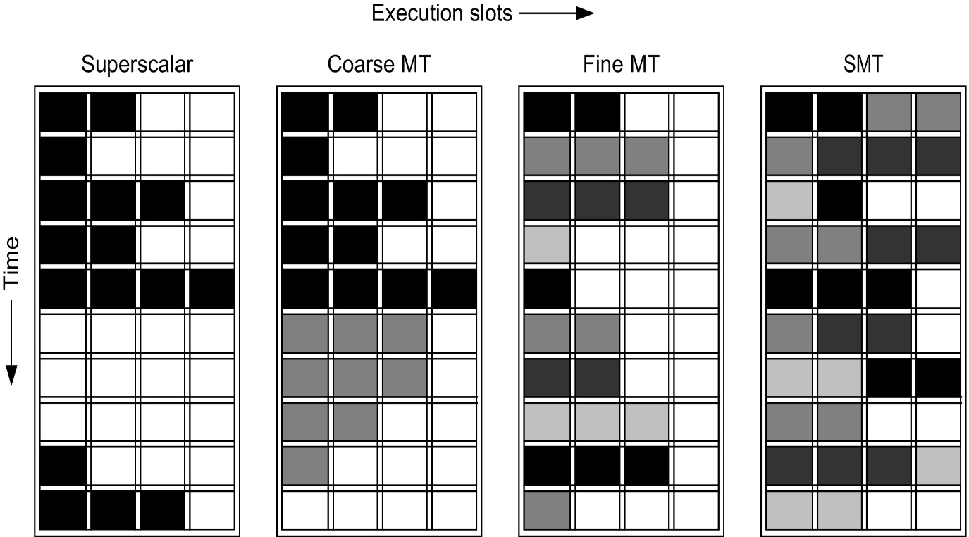
Simultaneous MultiThreading (SMT)
Figure 3.31 How four different approaches use the functional unit execution slots of a superscalar processor. The horizontal dimension represents the instruction execution capability in each clock cycle. The vertical dimension represents a sequence of clock cycles. An empty (white) box indicates that the corresponding execution slot is unused in that clock cycle. The shades of gray and black correspond to four different threads in the multithreading processors. Black is also used to indicate the occupied issue slots in the case of the superscalar without multithreading support. The Sun T1 and T2 (aka Niagara) processors are fine-grained, multithreaded processors, while the Intel Core i7 and IBM Power7 processors use SMT. The T2 has 8 threads, the Power7 has 4, and the Intel i7 has 2. In all existing SMTs, instructions issue from only one thread at a time. The difference in SMT is that the subsequent decision to execute an instruction is decoupled and could execute the operations coming from several different instructions in the same clock cycle.

Slide 109
Example
Loop: ld x2,0(x1) //x2=array element
addi x2,x2,1 //increment x2
sd x2,0(x1) //store result
addi x1,x1,8 //increment pointer
bne x2,x3,Loop //branch if not last
Dynamic Scheduling, Multiple Issue, and Speculation
Consider the execution of this loop, on a two-issue processor.
Once without speculation.
Once with speculation

Slide 110
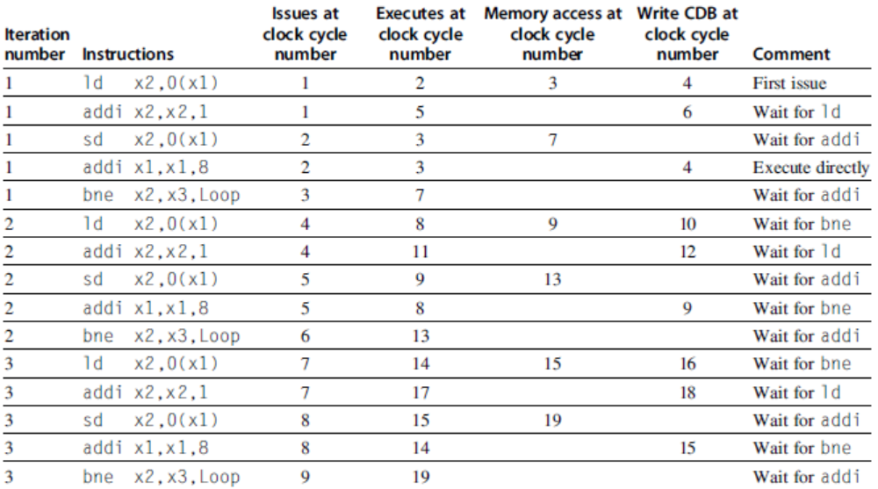
Example (No Speculation)
Dynamic Scheduling, Multiple Issue, and Speculation

Slide 111
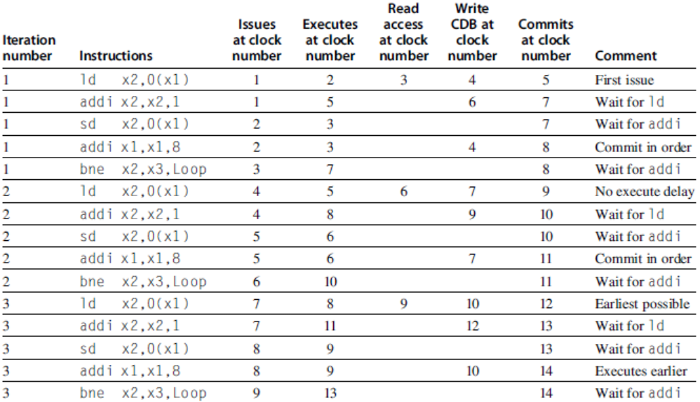
Example (Mutiple Issue with Speculation)
Dynamic Scheduling, Multiple Issue, and Speculation

Slide 112
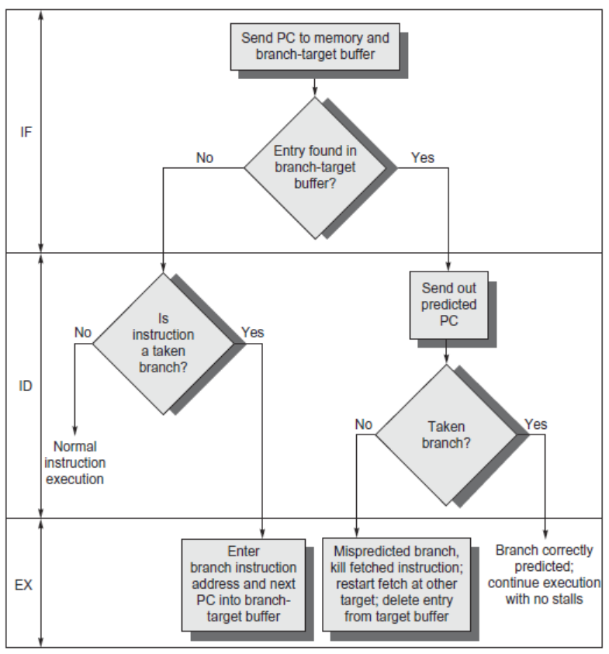
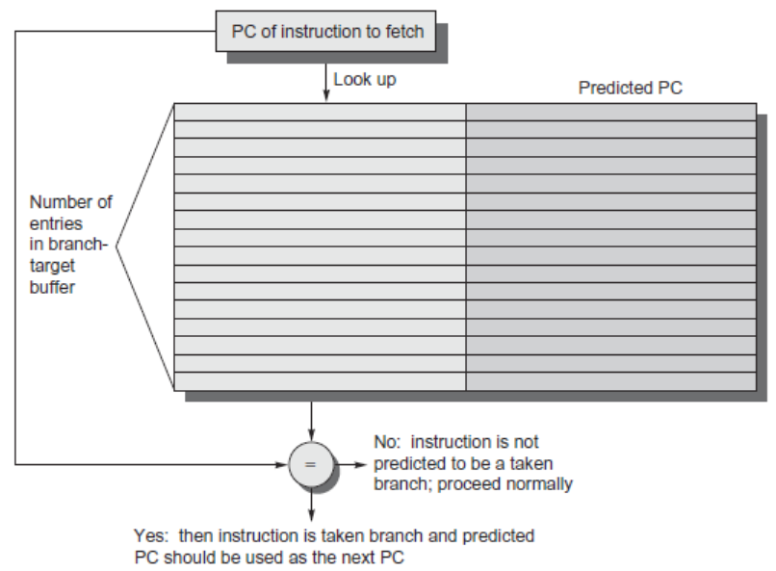
Branch-Target Buffer
Need high instruction bandwidth
Branch-Target buffers
Next PC prediction buffer, indexed by current PC
Adv. Techniques for Instruction Delivery and Speculation

Slide 113
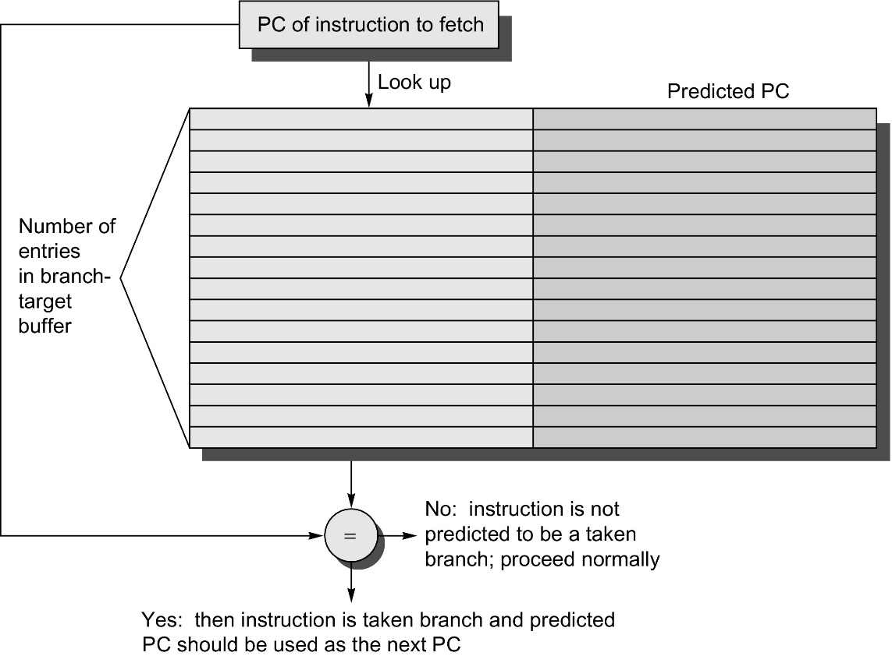
Branch-Target Buffer
Figure 3.25 A branch-target buffer. The PC of the instruction being fetched is matched against a set of instruction addresses stored in the first column; these represent the addresses of known branches. If the PC matches one of these entries, then the instruction being fetched is a taken branch, and the second field, predicted PC, contains the prediction for the next PC after the branch. Fetching begins immediately at that address. The third field, which is optional, may be used for extra prediction state bits.

Slide 114
Branch Folding
Optimization:
Larger branch-target buffer
Add target instruction into buffer to deal with longer decoding time required by larger buffer
“Branch folding”
Adv. Techniques for Instruction Delivery and Speculation

Slide 115
Return Address Predictor
Most unconditional branches come from function returns
The same procedure can be called from multiple sites
Causes the buffer to potentially forget about the return address from previous calls
Create return address buffer organized as a stack
Adv. Techniques for Instruction Delivery and Speculation

Slide 116
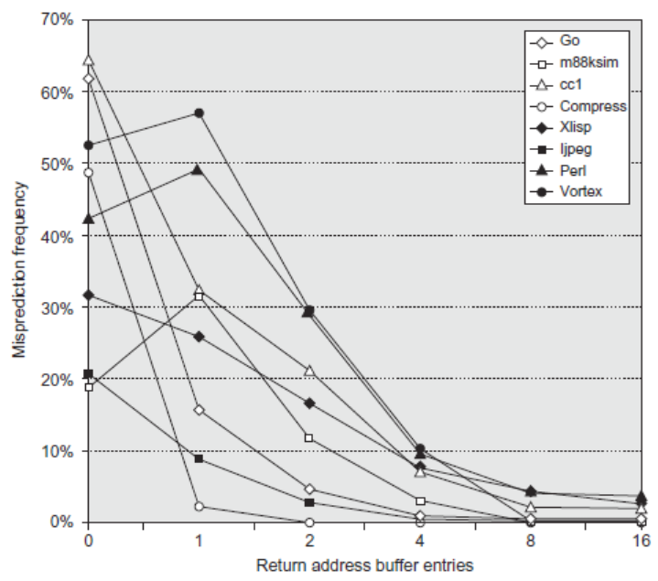
Return Address Predictor
Adv. Techniques for Instruction Delivery and Speculation

Slide 117
Integrated Instruction Fetch Unit
Design monolithic unit that performs:
Branch prediction
Instruction prefetch
Fetch ahead
Instruction memory access and buffering
Deal with crossing cache lines
Adv. Techniques for Instruction Delivery and Speculation

Slide 118
Register Renaming
Register renaming vs. reorder buffers
Instead of virtual registers from reservation stations and reorder buffer, create a single register pool
Contains visible registers and virtual registers
Conceptually extends Tomasulo’s register renaming to…registers
Use hardware-based map to rename registers during issue
WAW and WAR hazards are avoided
Speculation recovery occurs by copying during commit
Still need a ROB-like queue to update table in order
Simplifies commit:
Record that mapping between architectural register and physical register is no longer speculative
Free up physical register used to hold older value
In other words: SWAP physical registers on commit
Physical register de-allocation is more difficult
Simple approach: deallocate virtual register when next instruction writes to its mapped architecturally-visibly register
Adv. Techniques for Instruction Delivery and Speculation

Slide 119
Integrated Issue and Renaming
Combining instruction issue with register renaming:
Issue logic pre-reserves enough physical registers for the bundle
Issue logic finds dependencies within bundle, maps registers as necessary
Issue logic finds dependencies between current bundle and already in-flight bundles, maps registers as necessary
Adv. Techniques for Instruction Delivery and Speculation

Slide 120
How Much?
How much to speculate
Mis-speculation degrades performance and power relative to no speculation
May cause additional misses (cache, TLB)
Prevent speculative code from causing higher costing misses (e.g. L2)
Speculating through multiple branches
Complicates speculation recovery
Speculation and energy efficiency
Note: speculation is only energy efficient when it significantly improves performance
Adv. Techniques for Instruction Delivery and Speculation

Slide 121
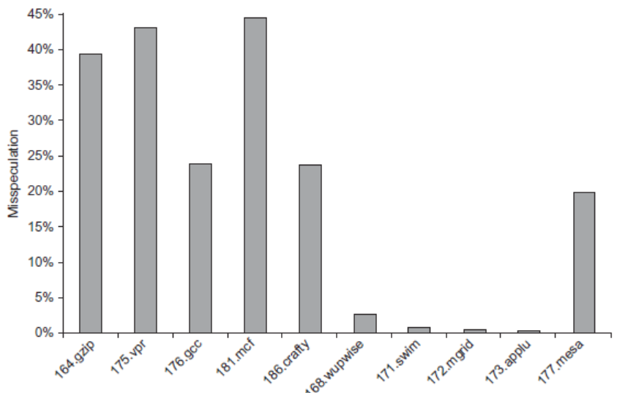
How Much?
integer
Adv. Techniques for Instruction Delivery and Speculation

Slide 122
Energy Efficiency
Value prediction
Uses:
Loads that load from a constant pool
Instruction that produces a value from a small set of values
Not incorporated into modern processors
Similar idea--address aliasing prediction--is used on some processors to determine if two stores or a load and a store reference the same address to allow for reordering
Adv. Techniques for Instruction Delivery and Speculation

Slide 123
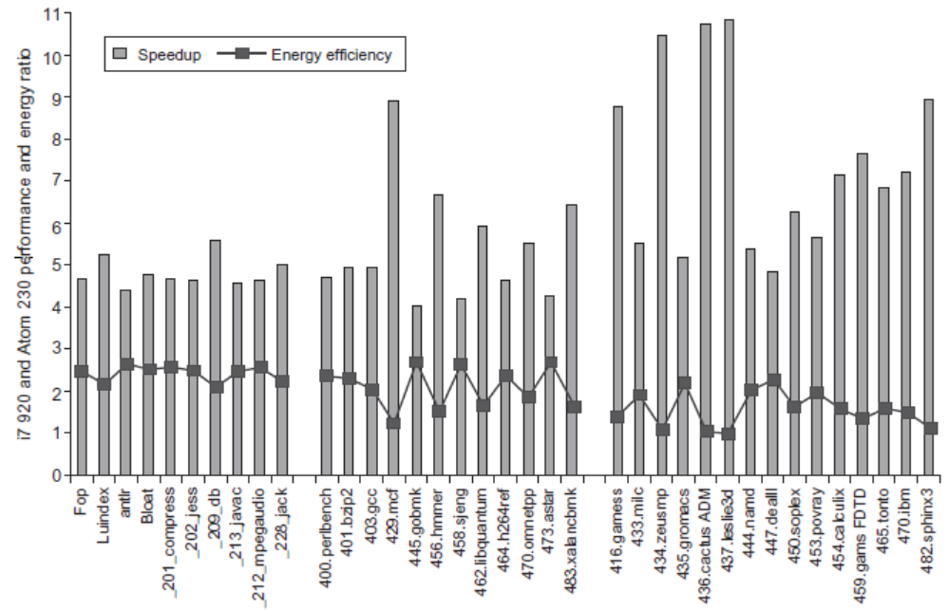
Fallacies and Pitfalls
Fallacies and Pitfalls
It is easy to predict the performance/energy efficiency of two different versions of the same ISA if we hold the technology constant

Slide 124
Fallacies and Pitfalls
Fallacies and Pitfalls
Processors with lower CPIs / faster clock rates will also be faster
Pentium 4 had higher clock, lower CPI
Itanium had same CPI, lower clock

Slide 125
Fallacies and Pitfalls
Fallacies and Pitfalls
Sometimes bigger and dumber is better
Pentium 4 and Itanium were advanced designs, but could not achieve their peak instruction throughput because of relatively small caches as compared to i7
And sometimes smarter is better than bigger and dumber
TAGE branch predictor outperforms gshare with less stored predictions

Slide 126
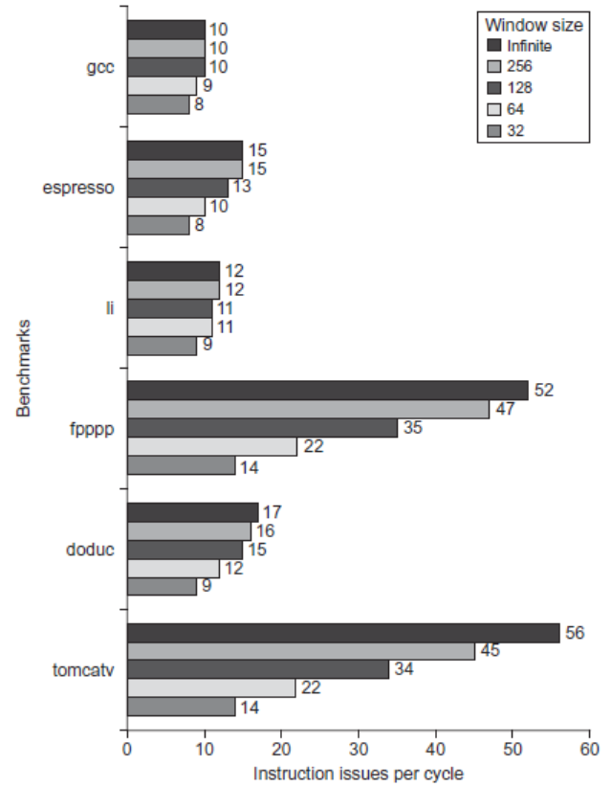
Fallacies and Pitfalls
Fallacies and Pitfalls
Believing that there are large amounts of ILP available, if only we had the right techniques

