Slide 1
Computer Architecture
A Quantitative Approach, Sixth Edition
Chapter 2
Memory Hierarchy Design

Slide 2
Introduction
Introduction
Programmers want unlimited amounts of memory with low latency
Fast memory technology is more expensive per bit than slower memory
Solution: organize memory system into a hierarchy
Entire addressable memory space available in largest, slowest memory
Incrementally smaller and faster memories, each containing a subset of the memory below it, proceed in steps up toward the processor
Temporal and spatial locality insures that nearly all references can be found in smaller memories
Gives the allusion of a large, fast memory being presented to the processor

Slide 3
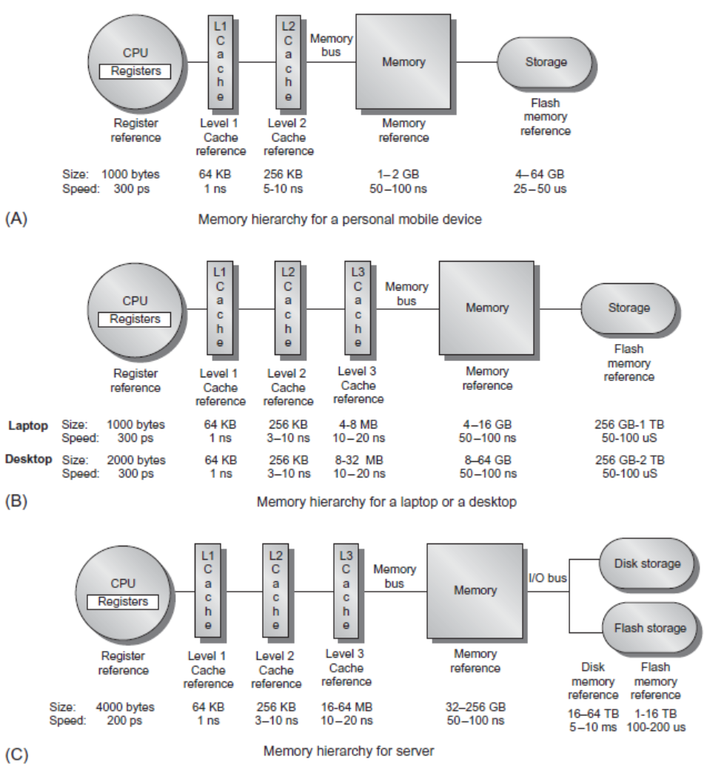
Memory Hierarchy
Introduction

Slide 4
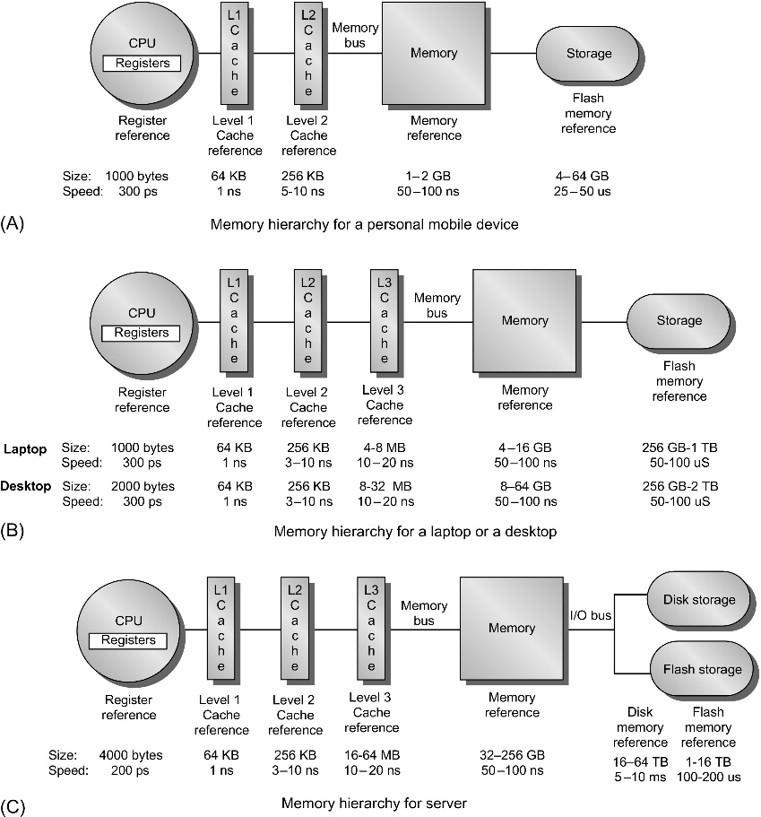
Figure 2.1 The levels in a typical memory hierarchy in a personal mobile device (PMD), such as a cell phone or tablet (A), in a laptop or desktop computer (B), and in a server (C). As we move farther away from the processor, the memory in the level below becomes slower and larger. Note that the time units change by a factor of 10⁹ from picoseconds to milliseconds in the case of magnetic disks and that the size units change by a factor of 10¹⁰ from thousands of bytes to tens of terabytes. If we were to add warehouse-sized computers, as opposed to just servers, the capacity scale would increase by three to six orders of magnitude. Solid-state drives (SSDs) composed of Flash are used exclusively in PMDs, and heavily in both laptops and desktops. In many desktops, the primary storage system is SSD, and expansion disks are primarily hard disk drives (HDDs). Likewise, many servers mix SSDs and HDDs.

Slide 5
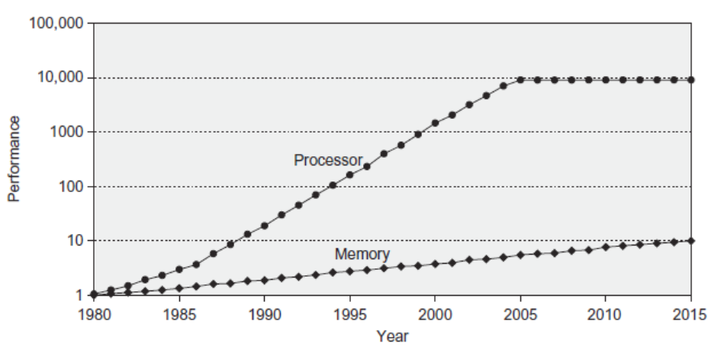
Memory Performance Gap
Introduction

Slide 6
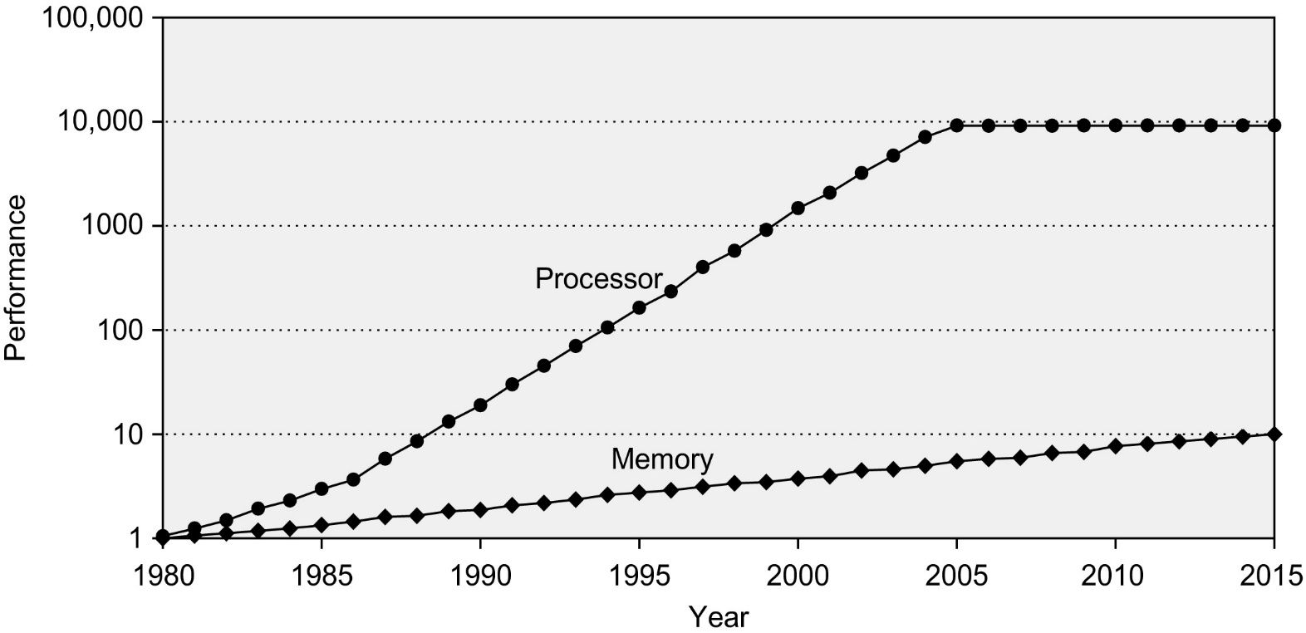
Figure 2.2 Starting with 1980 performance as a baseline, the gap in performance, measured as the difference in the time between processor memory requests (for a single processor or core) and the latency of a DRAM access, is plotted over time. In mid-2017, AMD, Intel and Nvidia all announced chip sets using versions of HBM technology. Note that the vertical axis must be on a logarithmic scale to record the size of the processor-DRAM performance gap. The memory baseline is 64 KiB DRAM in 1980, with a 1.07 per year performance improvement in latency (see Figure 2.4 on page 88). The processor line assumes a 1.25 improvement per year until 1986, a 1.52 improvement until 2000, a 1.20 improvement between 2000 and 2005, and only small improvements in processor performance (on a per-core basis) between 2005 and 2015. As you can see, until 2010 memory access times in DRAM improved slowly but consistently; since 2010 the improvement in access time has reduced, as compared with the earlier periods, although there have been continued improvements in bandwidth. See Figure 1.1 in Chapter 1 for more information.

Slide 7
Memory Hierarchy Design
Introduction
Memory hierarchy design becomes more crucial with recent multi-core processors:
Aggregate peak bandwidth grows with # cores:
Intel Core i7 can generate two references per core per clock
Four cores and 3.2 GHz clock
25.6 billion 64-bit data references/second +
12.8 billion 128-bit instruction references/second
= 409.6 GB/s!
DRAM bandwidth is only 8% of this (34.1 GB/s)
Requires:
Multi-port, pipelined caches
Two levels of cache per core
Shared third-level cache on chip

Slide 8
Performance and Power
Introduction
High-end microprocessors have >10 MB on-chip cache
Consumes large amount of area and power budget

Slide 9
Memory Hierarchy Basics
Introduction
When a word is not found in the cache, a miss occurs:
Fetch word from lower level in hierarchy, requiring a higher latency reference
Lower level may be another cache or the main memory
Also fetch the other words contained within the block
Takes advantage of spatial locality
Place block into cache in any location within its set, determined by address
block address MOD number of sets in cache

Slide 10
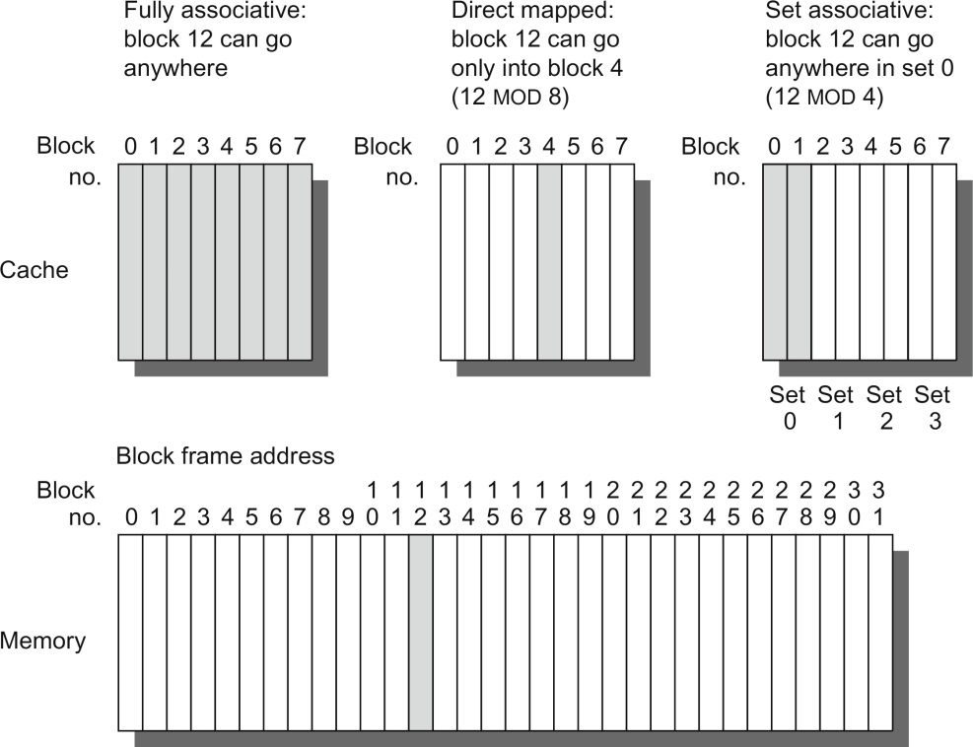
Figure B.2 This example cache has eight block frames and memory has 32 blocks. The three options for caches are shown left to right. In fully associative, block 12 from the lower level can go into any of the eight block frames of the cache. With direct mapped, block 12 can only be placed into block frame 4 (12 modulo 8). Set associative, which has some of both features, allows the block to be placed anywhere in set 0 (12 modulo 4). With two blocks per set, this means block 12 can be placed either in block 0 or in block 1 of the cache. Real caches contain thousands of block frames, and real memories contain millions of blocks. The set associative organization has four sets with two blocks per set, called two-way set associative. Assume that there is nothing in the cache and that the block address in question identifies lower-level block 12.

Slide 11
Memory Hierarchy Basics
Introduction
n sets => n-way set associative [unclear what this line means]
Direct-mapped cache => one block per set
Fully associative => one set
Writing to cache: two strategies
Write-through
Immediately update lower levels of hierarchy
Write-back
Only update lower levels of hierarchy when an updated block is replaced
Both strategies use write buffer to make writes asynchronous

Slide 12
Memory Hierarchy Basics
Introduction
Miss rate
Fraction of cache access that result in a miss
Causes of misses
Compulsory
First reference to a block
Capacity
Blocks discarded and later retrieved. Do they mean misses that even a fully associative cache could not avoid? If so, how to determine for individual reference?
Conflict
Program makes repeated references to multiple addresses from different blocks that map to the same location in the cache
“The 3C’s model is conceptual; although its insights usually hold, it is not a definitive model for explaining cache behavior of individual references” p.82.
Notes:
Capacity—misses even for fully associative cache
Conflict—misses for set associative (or direct mapped) cache that could have been avoided for fully associative cache

Slide 13
Memory Hierarchy Basics
Introduction
Speculative and multithreaded processors may execute other instructions during a miss
Reduces performance impact of misses

Slide 14
Memory Hierarchy Basics
Introduction
Six basic cache optimizations:
Larger block size
Reduces compulsory misses
Increases capacity and conflict misses, increases miss penalty
Larger total cache capacity to reduce miss rate
Increases hit time, increases power consumption
Higher associativity
Reduces conflict misses
Increases hit time, increases power consumption
Higher number of cache levels
Reduces overall memory access time
Giving priority to read misses over writes
Reduces miss penalty
Avoiding address translation in cache indexing
Reduces hit time

Slide 15
Memory Technology and Optimizations
Performance metrics
Latency is concern of cache
Bandwidth is concern of multiprocessors and I/O
Access time
Time between read request and when desired word arrives
Cycle time
Minimum time between unrelated requests to memory
SRAM memory has low latency, use for cache
Organize DRAM chips into many banks for high bandwidth, use for main memory
Memory Technology and Optimizations

Slide 16
Memory Technology
SRAM
Requires low power to retain bit
Requires 6 transistors/bit
DRAM
Must be re-written after being read
Must also be periodically refreshed
Every ~ 8 ms (roughly 5% of time)
Each row can be refreshed simultaneously
One transistor/bit
Address lines are multiplexed:
Upper half of address: row access strobe (RAS)
Lower half of address: column access strobe (CAS)
Memory Technology and Optimizations

Slide 17
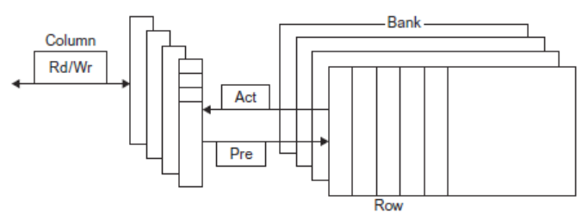
Internal Organization of DRAM
Memory Technology and Optimizations

Slide 18
Memory Technology
Amdahl:
Memory capacity should grow linearly with processor speed
Unfortunately, memory capacity and speed has not kept pace with processors
Some optimizations:
Multiple accesses to same row
Synchronous DRAM
Added clock to DRAM interface
Burst mode with critical word first
Wider interfaces
Double data rate (DDR)
Multiple banks on each DRAM device
Memory Technology and Optimizations

Slide 19
Memory Optimizations
Memory Technology and Optimizations

Slide 20
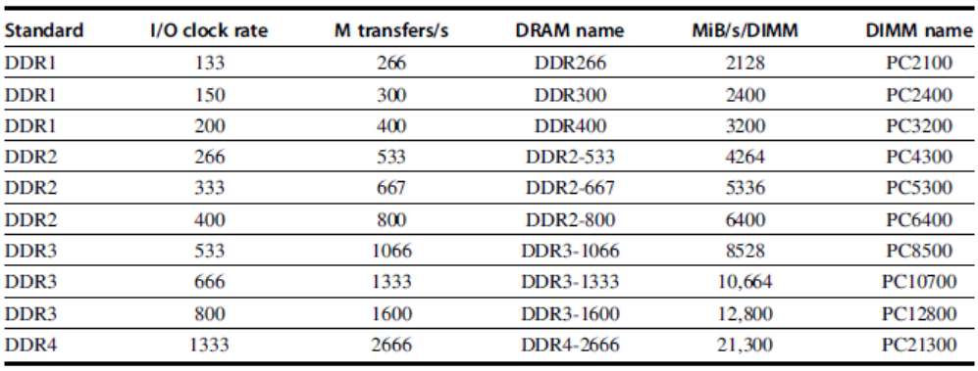
Memory Optimizations
Memory Technology and Optimizations

Slide 21
Memory Optimizations
DDR: [transfers data on both the rising and falling edges of the clock signal]
DDR2
Lower power (2.5 V -> 1.8 V)
Higher clock rates (266 MHz, 333 MHz, 400 MHz)
DDR3
1.5 V
800 MHz
DDR4
1-1.2 V
1333 MHz
GDDR5 is graphics memory based on DDR3
Memory Technology and Optimizations

Slide 22
Memory Optimizations
Reducing power in SDRAMs:
Lower voltage
Low power mode (ignores clock, continues to refresh)
Graphics memory:
Achieve 2-5 X bandwidth per DRAM vs. DDR3
Wider interfaces (32 vs. 16 bit)
Higher clock rate
Possible because they are attached via soldering instead of socketed DIMM modules
… Soldering led to HBM (successor to GDDR5?)
Memory Technology and Optimizations

Slide 23
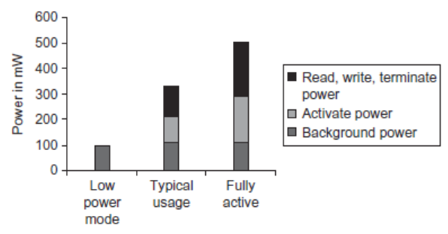
Memory Power Consumption
Memory Technology and Optimizations

Slide 24
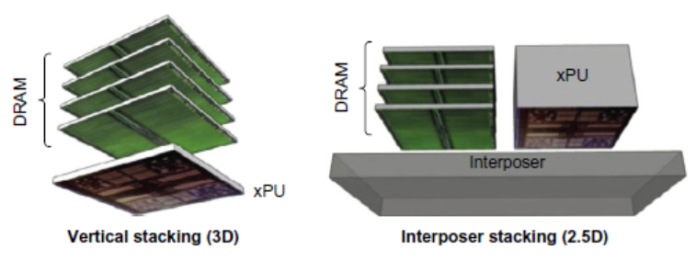
Stacked/Embedded DRAMs
Stacked DRAMs in same package as processor [shorter distance/latency, more connections/bandwidth]
High Bandwidth Memory (HBM)
Memory Technology and Optimizations

Slide 25
Flash Memory
Type of EEPROM [Electrically Erasable Programmable Read-Only Memory and is a type of non-volatile memory]
Types: NAND (denser) and NOR (faster)
NAND Flash:
Reads are sequential, reads entire page (.5 to 4 KiB)
25 us for first byte, 40 MiB/s for subsequent bytes
SDRAM: 40 ns for first byte, 4.8 GB/s for subsequent bytes
2 KiB transfer: 75 uS vs 500 ns for SDRAM, 150X slower
300 to 500X faster than magnetic disk
Memory Technology and Optimizations

Slide 26
NAND Flash Memory
Must be erased (in blocks) before being overwritten
Nonvolatile, can use as little as zero power
Limited number of write cycles (~100,000)
$2/GiB, compared to $20-40/GiB for SDRAM and $0.09 GiB for magnetic disk
[GiB=2³² Bytes. GB=10⁹ Bytes]
Phase-Change/Memrister Memory
Possibly 10X improvement in write performance and 2X improvement in read performance
Memory Technology and Optimizations

Slide 27
Memory Dependability
Memory is susceptible to cosmic rays
Soft errors: dynamic errors
Detected and fixed by error correcting codes (ECC)
Hard errors: permanent errors
Use spare rows to replace defective rows
Chipkill: a RAID-like error recovery technique
RAID- Redundant Array of Independent Disks
Memory Technology and Optimizations

Slide 28
Advanced Optimizations
Reduce hit time
Small and simple first-level caches
Way prediction
Increase bandwidth
Pipelined caches, multibanked caches, non-blocking caches
Reduce miss penalty
Critical word first, merging write buffers
Reduce miss rate
Compiler optimizations
Reduce miss penalty or miss rate via parallelization
Hardware or compiler prefetching
Advanced Optimizations

Slide 29
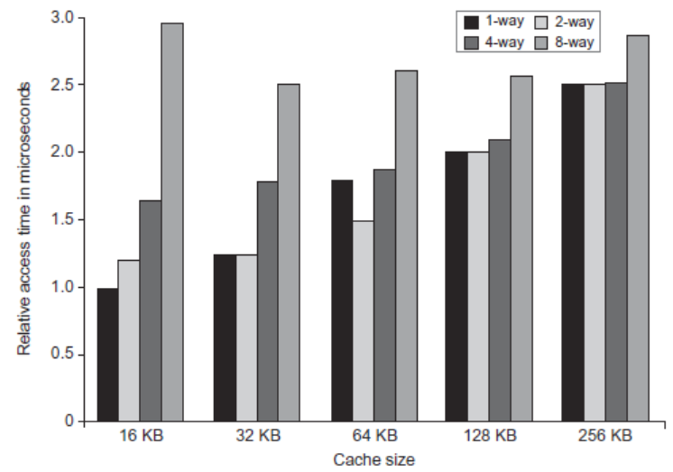
L1 Size and Associativity
Advanced Optimizations
Access time vs. size and associativity

Slide 30
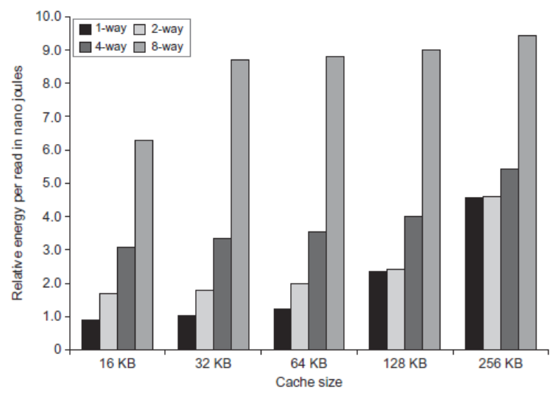
L1 Size and Associativity
Advanced Optimizations
Energy per read vs. size and associativity

Slide 31
Way Prediction
To improve hit time, predict the way to pre-set mux (using extra bit(s) )
Mis-prediction gives longer hit time
Prediction accuracy
> 90% for two-way
> 80% for four-way
I-cache has better accuracy than D-cache
First used on MIPS R10000 in mid-90s
Used on ARM Cortex-A8
Extend to predict block as well
“Way selection”
Increases mis-prediction penalty
Example: 4-way set-associative. Predicts which of the 4 blocks in a set to read next
Advanced Optimizations

Slide 32
Pipelined Caches
Pipeline cache access to improve bandwidth
Examples:
Pentium: 1 cycle
Pentium Pro – Pentium III: 2 cycles
Pentium 4 – Core i7: 4 cycles
Increases branch mis-prediction penalty
Makes it easier to increase associativity
Advanced Optimizations

Slide 33
Multibanked Caches
Organize cache as independent banks to support simultaneous access
ARM Cortex-A8 supports 1-4 banks for L2
Intel i7 supports 4 banks for L1 and 8 banks for L2
Interleave banks according to block address
Advanced Optimizations

Slide 34
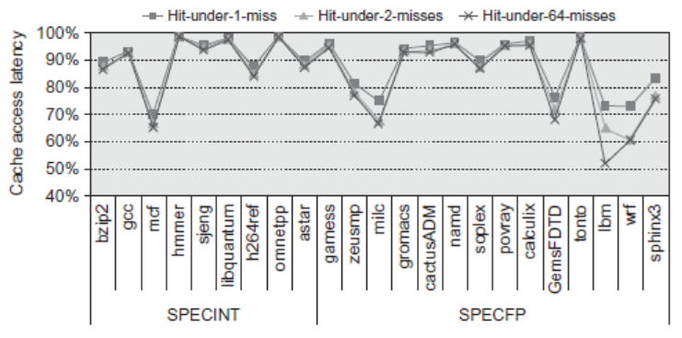
Nonblocking Caches
Allow hits before previous misses complete
“Hit under miss”
“Hit under multiple miss”
L2 must support this
In general, processors can hide L1 miss penalty but not L2 miss penalty
Advanced Optimizations

Slide 35
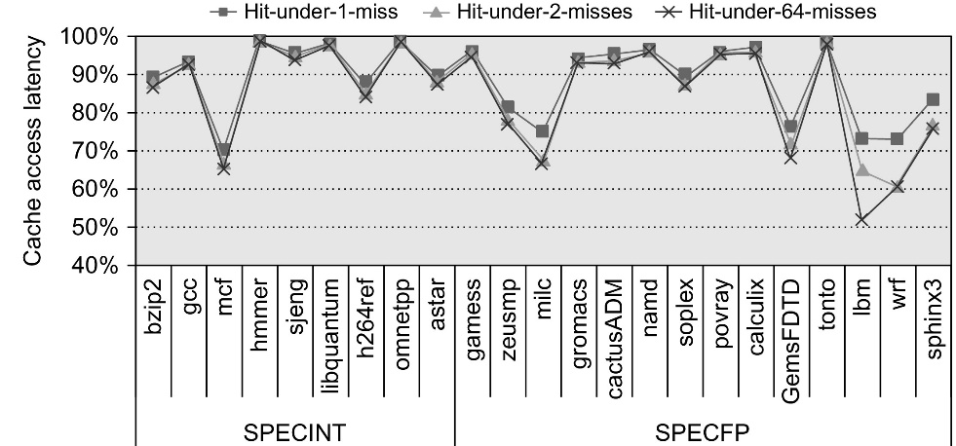
Figure 2.11 The effectiveness of a nonblocking cache is evaluated by allowing 1, 2, or 64 hits under a cache miss with 9 SPECINT (on the left) and 9 SPECFP (on the right) benchmarks. The data memory system modeled after the Intel i7 consists of a 32 KiB L1 cache with a four-cycle access latency. The L2 cache (shared with instructions) is 256 KiB with a 10-clock cycle access latency. The L3 is 2 MiB and a 36-cycle access latency. All the caches are eight-way set associative and have a 64-byte block size. Allowing one hit under miss reduces the miss penalty by 9% for the integer benchmarks and 12.5% for the floating point. Allowing a second hit improves these results to 10% and 16%, and allowing 64 results in little additional improvement.

Slide 36
Critical Word First, Early Restart
Critical word first
Request missed word from memory first
Send it to the processor as soon as it arrives
Early restart
Request words in normal order
Send missed work to the processor as soon as it arrives
Beneficial if block are large
Effectiveness of these strategies depends on block size and likelihood of another access to the portion of the block that has not yet been fetched
Advanced Optimizations

Slide 37
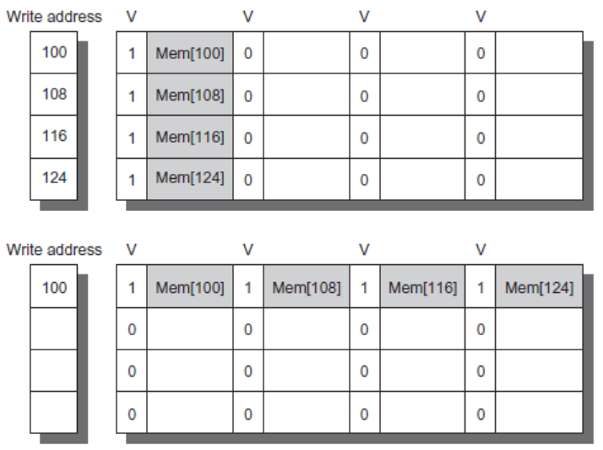
Merging Write Buffer
When storing to a block that is already pending in the write buffer, update write buffer
Reduces stalls due to full write buffer
Do not apply to I/O addresses
Advanced Optimizations
No write buffering
Write buffering

Slide 38
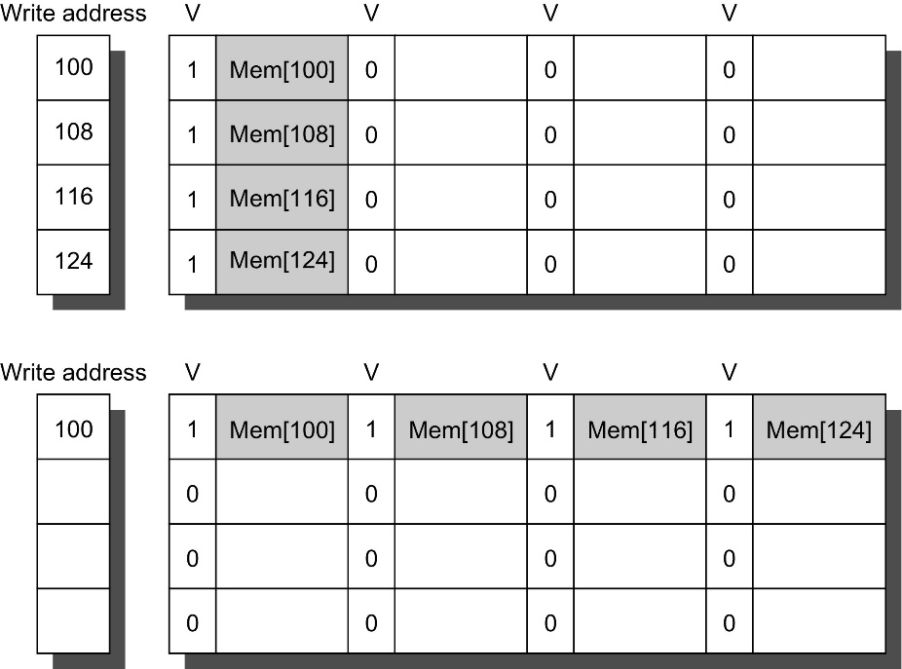
Figure 2.12 In this illustration of write merging, the write buffer on top does not use write merging while the write buffer on the bottom does. The four writes are merged into a single buffer entry with write merging; without it, the buffer is full even though three-fourths of each entry is wasted. The buffer has four entries, and each entry holds four 64-bit words. The address for each entry is on the left, with a valid bit (V) indicating whether the next sequential 8 bytes in this entry are occupied. (Without write merging, the words to the right in the upper part of the figure would be used only for instructions that wrote multiple words at the same time.)

Slide 39
Compiler Optimizations
Loop Interchange
Swap nested loops to access memory in sequential order Example: if a matrix is stored in row order and loop accesses it in column order switch to row order
Blocking
Instead of accessing entire rows or columns, subdivide matrices into blocks
Requires more memory accesses but improves locality of accesses
If cache can store B² memory words but not an entire matrix…
Advanced Optimizations

Slide 40
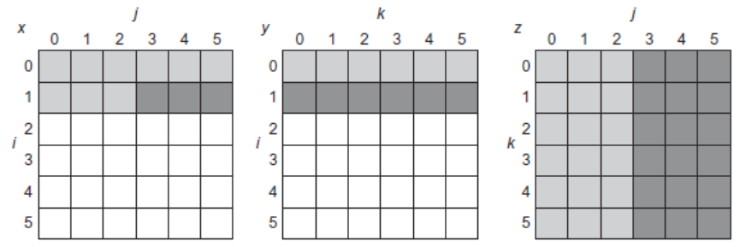
Blocking
for (i = 0; i < N; i = i + 1)
for (j = 0; j < N; j = j + 1)
{
r = 0;
for (k = 0; k < N; k = k + 1)
r = r + y[i][k]*z[k][j];
x[i][j] = r;
};

Slide 41
Figure 2.13 A snapshot of the three arrays x, y, and z when N = 6 and i = 1. The age of accesses to the array elements is indicated by shade: white means not yet touched, light means older accesses, and dark means newer accesses. The elements of y and z are read repeatedly to calculate new elements of x. The variables i, j, and k are shown along the rows or columns used to access the arrays.

Slide 42
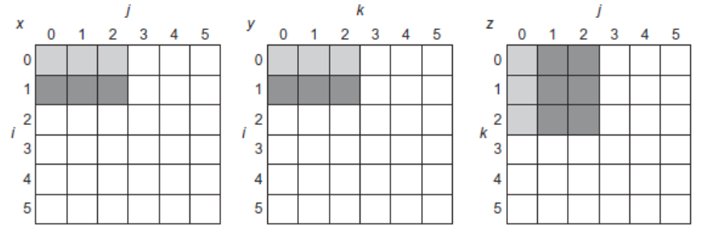
Blocking
for (jj = 0; jj < N; jj = jj + B)
for (kk = 0; kk < N; kk = kk + B)
for (i = 0; i < N; i = i + 1)
for (j = jj; j < min(jj + B,N); j = j + 1)
{
r = 0;
for (k = kk; k < min(kk + B,N); k = k + 1)
r = r + y[i][k]*z[k][j];
x[i][j] = x[i][j] + r;
};
The range of j (and k) is B

Slide 43
Figure 2.14 The age of accesses to the arrays x, y, and z when B = 3. Note that, in contrast to Figure 2.13, a smaller number of elements is accessed.

Slide 44
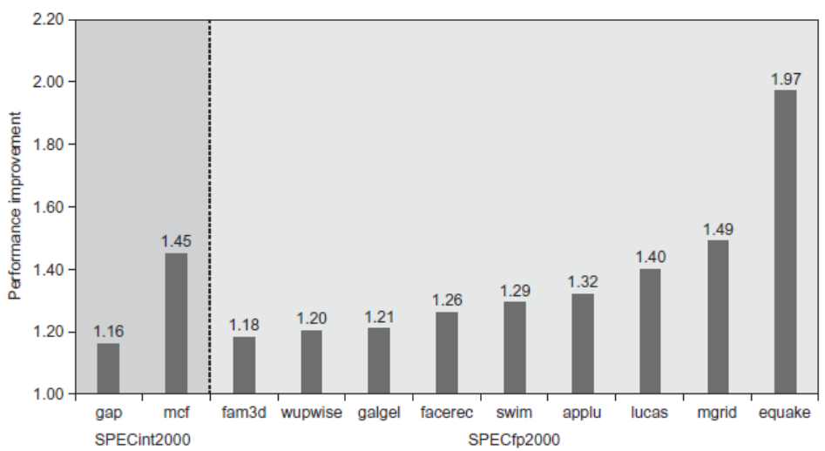
Hardware Prefetching
Fetch two blocks on miss (include next sequential block)
Advanced Optimizations
Pentium 4 Pre-fetching

Slide 45
Compiler Prefetching
Insert prefetch instructions before data is needed
Non-faulting: prefetch doesn’t cause exceptions for virtual address faults and protection violations
Register prefetch
Loads data into register
Cache prefetch
Loads data into cache
Combine with loop unrolling and software pipelining
Advanced Optimizations

Slide 46
Use HBM to Extend Hierarchy
128 MiB to 1 GiB
Smaller blocks require substantial tag storage
Larger blocks are potentially inefficient
One approach (L-H):
Each SDRAM row is a block index
Each row contains set of tags and 29 data segments
29-set associative
Hit requires a CAS
Advanced Optimizations

Slide 47
Use HBM to Extend Hierarchy
Another approach (Alloy cache):
Mold tag and data together
Use direct mapped
Both schemes require two DRAM accesses for misses
Two solutions:
Use map to keep track of blocks
Predict likely misses
Advanced Optimizations

Slide 48
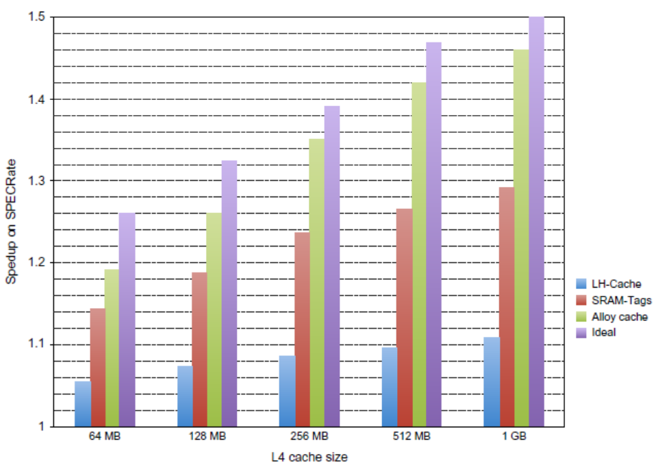
Use HBM to Extend Hierarchy
Advanced Optimizations

Slide 49
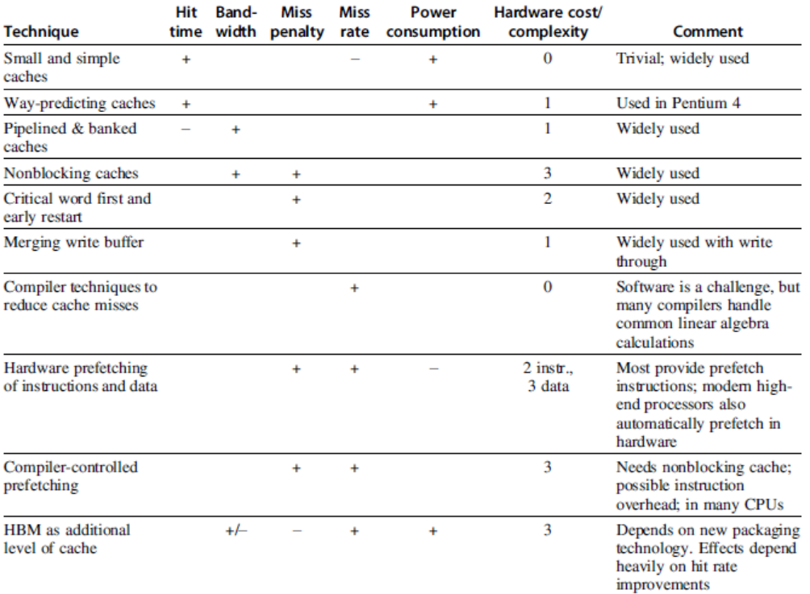
Summary
Advanced Optimizations

Slide 50
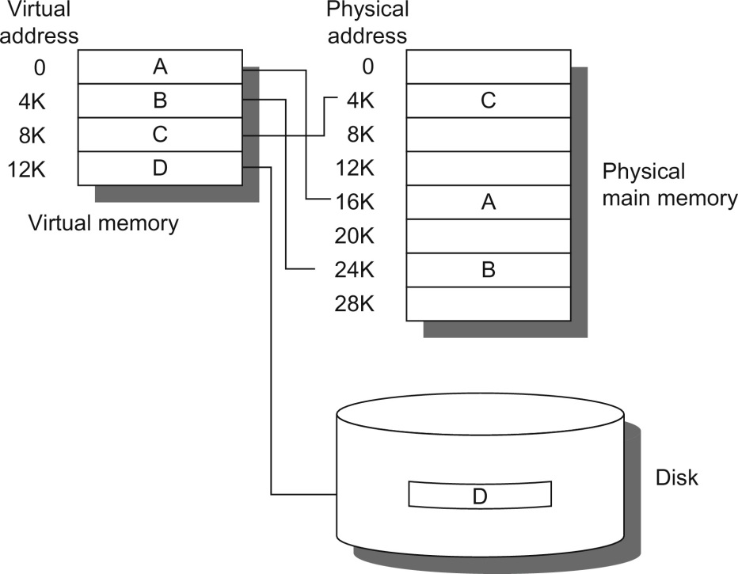
Virtual memory, Section B4
Initially meant to remove the burden of the programmers from having to deal with
physical memory
Figure B.19 The logical program in its contiguous virtual address space is shown on the left. It consists of four pages, A, B, C, and D. The actual location of three of the blocks is in physical main memory and the other is located on the disk.

Slide 51
Protection Segue: HP-2012 slides for self-contained presentation
Virtual memory
Virtual machines

Slide 52
The Limits of Physical Addressing
“Physical addresses” of memory locations
A0-A31
A0-A31
CPU
Memory
D0-D31
D0-D31
Data
All programs share one address space:
The physical address space
Machine language programs must be
aware of the machine organization
No way to prevent a program from accessing any machine resource

Slide 53
Solution: Add a Layer of Indirection
“Virtual Addresses”
“Physical Addresses”
A0-A31
Virtual
Physical
A0-A31
CPU
Address
Translation
Memory
D0-D31
D0-D31
Data
User programs run in an standardized
virtual address space
Address Translation hardware
managed by the operating system (OS)
maps virtual address to physical memory
Hardware supports “modern” OS features:
Protection, Translation, Sharing

Slide 54
Three Advantages of Virtual Memory
Translation:
Program can be given consistent view of memory, even though physical memory is scrambled
Makes multithreading reasonable (now used a lot!)
Only the most important part of program (“Working Set”) must be in physical memory.
Contiguous structures (like stacks) use only as much physical memory as necessary yet still grow later.
Protection:
Different threads (or processes) protected from each other.
Different pages can be given special behavior
(Read Only, Invisible to user programs, etc).
Kernel data protected from User programs
Very important for protection from malicious programs
Sharing:
Can map same physical page to multiple users (“Shared memory”)

Slide 55
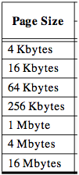
Page tables encode virtual address spaces
Page Table
Physical
Memory Space
A virtual address space
is divided into blocks
of memory called pages
frame
frame
frame
frame
A machine usually supports
pages of a few sizes
(MIPS R4000):
virtual address
OS manages the page table for each ASID (thread)
A page table is indexed by a
virtual address
A valid page table entry codes physical memory “frame” address for the page

Slide 56
TLB Design Concepts
(Translation Look-Aside Buffer)
Anecdote TLB preceded caches, since address delays preceded data & instruction delays. Still what is better known: TLBs or caches?

Slide 57
MIPS Address Translation: How does it work?
“Virtual Addresses”
“Physical Addresses”
A0-A31
Virtual
Physical
A0-A31
Translation
Look-Aside
Buffer
(TLB)
CPU
Memory
D0-D31
D0-D31
Data
What is the table of
mappings that it caches?
Translation Look-Aside Buffer (TLB)
A small fully-associative cache of
mappings from virtual to physical addresses
TLB also contains
protection bits for virtual address
Fast common case: Virtual address is in TLB,
process has permission to read/write it.

Slide 58
Summary: TLB, Virtual Memory
Page tables map virtual address to physical address
TLBs are important for fast translation
TLB misses are significant in processor performance
funny times, as most systems can’t access all of 2nd level cache without TLB misses!
Caches, TLBs, Virtual Memory all understood by examining how they deal with 4 questions: 1) Where can block be placed? 2) How is block found? 3) What block is replaced on miss? 4) How are writes handled?
Today VM allows many processes to share single memory without having to swap all processes to disk; today VM protection is more important than memory hierarchy benefits, but computers insecure
Notes:
Let’s do a short review of what you learned last time.
Virtual memory was originally invented as another level of memory hierarchy such that programmers, faced with main memory much smaller than their programs, do not have to manage the loading and unloading portions of their program in and out of memory.
It was a controversial proposal at that time because very few programmers believed software can manage the limited amount of memory resource as well as human.
This all changed as DRAM size grows exponentially in the last few decades.
Nowadays, the main function of virtual memory is to allow multiple processes to share the same main memory so we don’t have to swap all the non-active processes to disk.
Consequently, the most important function of virtual memory these days is to provide memory protection.
The most common technique, but we like to emphasis not the only technique, to translate virtual memory address to physical memory address is to use a page table.
TLB, or translation lookaside buffer, is one of the most popular hardware techniques to reduce address translation time.
Since TLB is so effective in reducing the address translation time, what this means is that TLB misses will have a significant negative impact on processor performance.
+3 = 3 min. (X:43)

Slide 59
Introduction to Virtual Machines
VMs developed in late 1960s
Remained important in mainframe computing over the years
Largely ignored in single user computers of 1980s and 1990s
Recently regained popularity due to
increasing importance of isolation and security in modern systems,
failures in security and reliability of standard operating systems,
sharing of a single computer among many unrelated users,
and the dramatic increases in raw speed of processors, which makes the overhead of VMs more acceptable

Slide 60
What is a Virtual Machine (VM)?
Broadest definition includes all emulation methods that provide a standard software interface, such as the Java VM
“(Operating) System Virtual Machines” provide a complete system level environment at binary ISA
Here assume ISAs always match the native hardware ISA
E.g., IBM VM/370, VMware ESX Server, and Xen
Present illusion that VM users have entire computer to themselves, including a copy of OS
Single computer runs multiple VMs, and can support a multiple, different OSes
On conventional platform, single OS “owns” all HW resources
With a VM, multiple OSes all share HW resources
Underlying HW platform is called the host, and its resources are shared among the guest VMs

Slide 61
Virtual Machine Monitors (VMMs)
Virtual machine monitor (VMM) or hypervisor is software that supports VMs
VMM determines how to map virtual resources to physical resources
Physical resource may be time-shared, partitioned, or emulated in software
VMM is much smaller than a traditional OS;
isolation portion of a VMM is ≈ 10,000 lines of code

Slide 62
VMM Overhead?
Depends on the workload
User-level processor-bound programs (e.g., SPEC) have zero-virtualization overhead
Runs at native speeds since OS rarely invoked
I/O-intensive workloads ⇒ OS-intensive ⇒ execute many system calls and privileged instructions ⇒ can result in high virtualization overhead
For System VMs, goal of architecture and VMM is to run almost all instructions directly on native hardware
If I/O-intensive workload is also I/O-bound (I/O is the bottleneck?) ⇒ low processor utilization since waiting for I/O ⇒ processor virtualization can be hidden ⇒ low virtualization overhead

Slide 63
Other Uses of VMs
Focus here on protection
2 Other commercially important uses of VMs
Managing Software
VMs provide an abstraction that can run the complete SW stack, even including old OSes like DOS
Typical deployment: some VMs running legacy OSes, many running current stable OS release, few testing next OS release
Managing Hardware
VMs allow separate SW stacks to run independently yet share HW, thereby consolidating number of servers
Some run each application with compatible version of OS on separate computers, as separation helps dependability
Migrate running VM to a different computer
Either to balance load or to evacuate from failing HW
Basic idea Make everything replaceable: i.e., HW, OS

Slide 64
Requirements of a Virtual Machine Monitor
A VM Monitor (or hypervisor)
Presents a SW interface to guest software,
Isolates state of guests from each other, and
Protects itself from guest software (including guest OSes)
Guest software should behave on a VM exactly as if running on the native HW
Except for performance-related behavior or limitations of fixed resources shared by multiple VMs
Guest software should not be able to change allocation of real system resources directly
Hence, VMM must control ≈ everything even though guest VM and OS currently running is temporarily using them
Access to privileged state, Address translation, I/O, Exceptions and Interrupts, …

Slide 65
Requirements of a Virtual Machine Monitor
VMM must be at higher privilege level than guest VM, which generally run in user mode
Execution of privileged instructions handled by VMM
E.g., Timer interrupt: VMM suspends currently running guest VM, saves its state, handles interrupt, determine which guest VM to run next, and then load its state
Guest VMs that rely on timer interrupt provided with virtual timer and an emulated timer interrupt by VMM
Requirements of system virtual machines are ≈ same as paged-virtual memory:
At least 2 processor modes, system and user
Privileged subset of instructions available only in system mode, trap if executed in user mode
All system resources controllable only via these instructions

Slide 66
ISA Support for Virtual Machines
If VMs are planned for during design of ISA, easy to reduce instructions that must be executed by a VMM and how long it takes to emulate them
Since VMs have been considered for desktop/PC server apps only recently, most ISAs were created without virtualization in mind, including 80x86 and most RISC architectures
VMM must ensure that guest system only interacts with virtual resources ⇒ conventional guest OS runs as user mode program on top of VMM
If guest OS attempts to access or modify information related to HW resources via a privileged instruction--for example, reading or writing the page table pointer--it will trap to the VMM
If not, VMM must intercept instruction and support a virtual version of the sensitive information as the guest OS expects (examples soon)

Slide 67
Impact of VMs on Virtual Memory
Virtualization of virtual memory if each guest OS in every VM manages its own set of page tables?
VMM separates real and physical memory
Makes real memory a separate, intermediate level between virtual memory and physical memory
Some use the terms virtual memory, physical/”real” memory, and machine memory to name the 3 levels
Guest OS maps virtual memory to real memory via its page tables, and VMM page tables map real memory to physical memory
VMM maintains a shadow page table that maps directly from the guest virtual address space to the physical address space of HW
Rather than pay extra level of indirection on every memory access
VMM must trap any attempt by guest OS to change its page table or to access the page table pointer

Slide 68
ISA Support for VMs & Virtual Memory
IBM 370 architecture added additional level of indirection that is managed by the VMM
Guest OS keeps its page tables as before, so the shadow pages are unnecessary
To virtualize software TLB, VMM manages the real TLB and has a copy of the contents of the TLB of each guest VM
Any instruction that accesses the TLB must trap
TLBs with Process ID tags support a mix of entries from different VMs and the VMM, thereby avoiding flushing of the TLB on a VM switch

Slide 69
Impact of I/O on Virtual Memory
Most difficult part of virtualization
Increasing number of I/O devices attached to the computer
Increasing diversity of I/O device types
Sharing of a real device among multiple VMs,
Supporting the myriad of device drivers that are required, especially if different guest OSes are supported on the same VM system
Give each VM generic versions of each type of I/O device driver, and let VMM to handle real I/O
Method for mapping virtual to physical I/O device depends on the type of device:
Disks partitioned by VMM to create virtual disks for guest VMs
Network interfaces shared between VMs in short time slices, and VMM tracks messages for virtual network addresses to ensure that guest VMs only receive their messages

Slide 70
Back to HP-2017 Virtual Memory and Virtual Machines
Protection via virtual memory
Keeps processes in their own memory space
Role of architecture
Provide user mode and supervisor mode
Protect certain aspects of CPU state
Provide mechanisms for switching between user mode and supervisor mode
Provide mechanisms to limit memory accesses
Provide TLB to translate addresses
Virtual Memory and Virtual Machines

Slide 71
Virtual Machines
Supports isolation and security
Sharing a computer among many unrelated users
Enabled by raw speed of processors, making the overhead more acceptable
Allows different ISAs and operating systems to be presented to user programs
“System Virtual Machines”
SVM software is called “virtual machine monitor” or “hypervisor”
Individual virtual machines run under the monitor are called “guest VMs”
Virtual Memory and Virtual Machines

Slide 72
Requirements of VMM
Guest software should:
Behave on as if running on native hardware
Not be able to change allocation of real system resources
VMM should be able to “context switch” guests
Hardware must allow:
System and use processor modes
Privileged subset of instructions for allocating system resources
Virtual Memory and Virtual Machines

Slide 73
Impact of VMs on Virtual Memory
Each guest OS maintains its own set of page tables
VMM adds a level of memory between physical and virtual memory called “real memory”
VMM maintains shadow page table that maps guest virtual addresses to physical addresses
Requires VMM to detect guest’s changes to its own page table
Occurs naturally if accessing the page table pointer is a privileged operation
Virtual Memory and Virtual Machines

Slide 74
Extending the ISA for Virtualization
Objectives:
Avoid flushing TLB
Use nested page tables instead of shadow page tables
Allow devices to use DMA to move data
Allow guest OS’s to handle device interrupts
For security: allow programs to manage encrypted portions of code and data
Virtual Memory and Virtual Machines

Slide 75
Fallacies and Pitfalls
Predicting cache performance of one program from another
Simulating enough instructions to get accurate performance measures of the memory hierarchy. Actually 3 pitfalls:
Seek to predict performance of a large cache using a small trace
Program’s locality behavior is not constant over an entire program
Program’s locality may vary depending on the input
Not delivering high memory bandwidth in a cache-based system

