Slide 1
Computer Architecture
A Quantitative Approach, Sixth Edition
Chapter 1
Fundamentals of Quantitative Design and Analysis

Slide 2
Computer Technology
Introduction
Performance improvements:
  Improvements in semiconductor technology
    Feature size, clock speed
  Improvements in computer architectures
    Enabled by HLL compilers, UNIX
    Lead to RISC architectures but X86 is CISC
  Together have enabled:
    Lightweight computers
    Productivity-based managed/interpreted programming languages

Slide 3
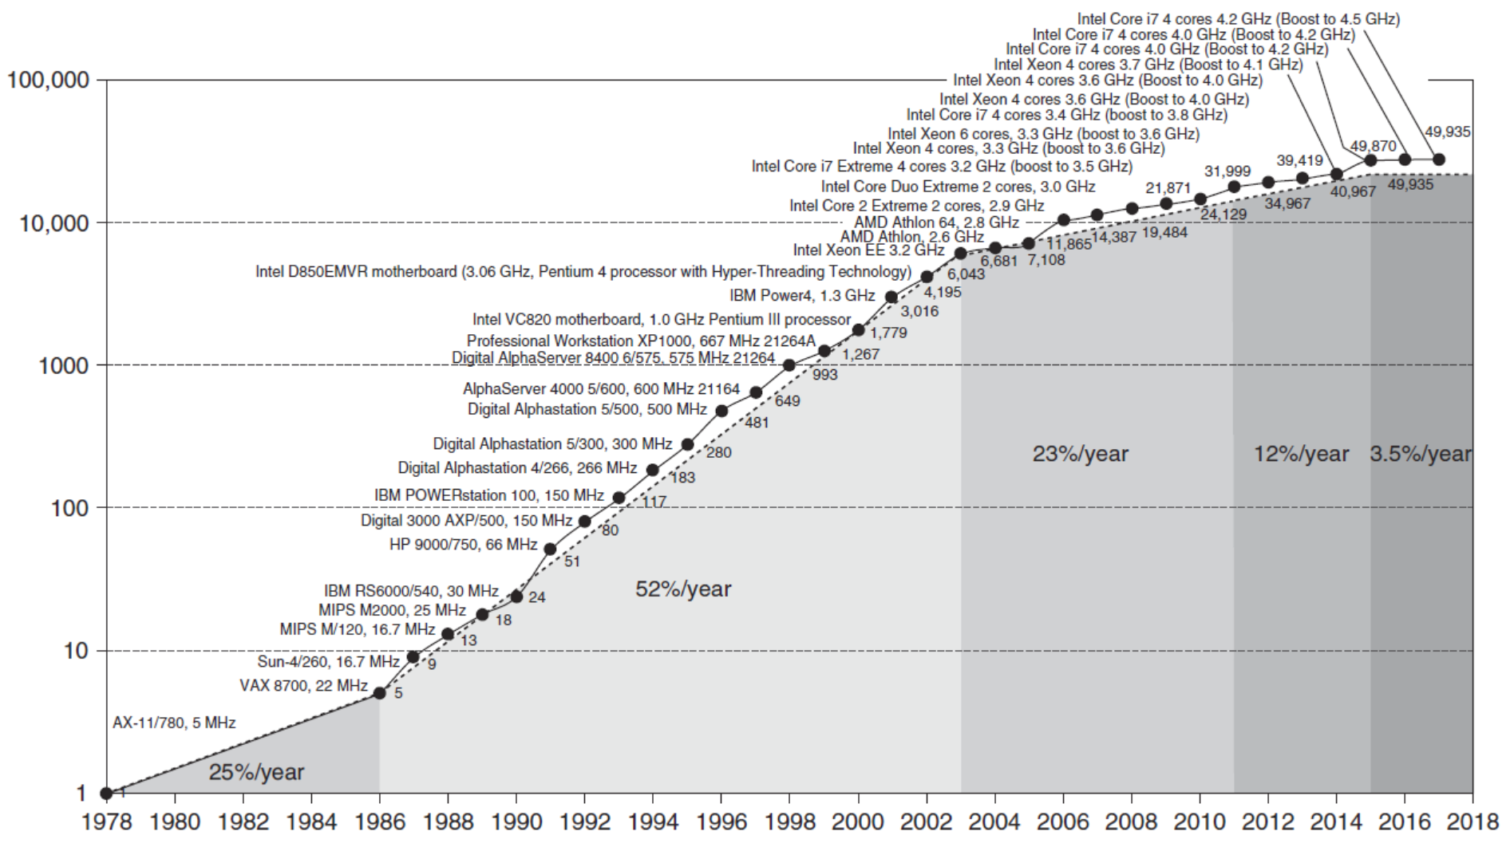
Single Processor Performance
Introduction
Over Vax 11/780 using SPEC Int benchmark

Slide 4
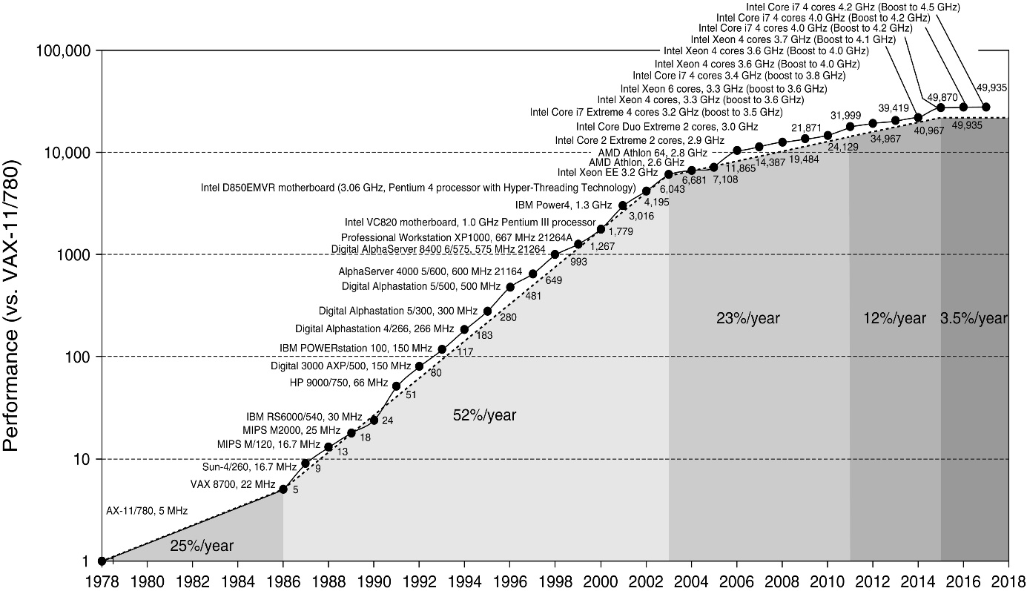
Figure 1.1 Growth in processor performance over 40 years. This chart plots program performance relative to the VAX 11/780 as measured by the SPEC integer benchmarks (see Section 1.8). Prior to the mid-1980s, growth in processor performance was largely technology-driven and averaged about 22% per year, or doubling performance every 3.5 years. The increase in growth to about 52% starting in 1986, or doubling every 2 years, is attributable to more advanced architectural and organizational ideas typified in RISC architectures. By 2003 this growth led to a difference in performance of an approximate factor of 25 versus the performance that would have occurred if it had continued at the 22% rate. In 2003 the limits of power due to the end of Dennard scaling and the available instruction-level parallelism slowed uniprocessor performance to 23% per year until 2011, or doubling every 3.5 years. (The fastest SPECintbase performance since 2007 has had automatic parallelization turned on, so uniprocessor speed is harder to gauge. These results are limited to single-chip systems with usually four cores per chip.) From 2011 to 2015, the annual improvement was less than 12%, or doubling every 8 years in part due to the limits of parallelism of Amdahl’s Law. Since 2015, with the end of Moore’s Law, improvement has been just 3.5% per year, or doubling every 20 years! Performance for floating-point-oriented calculations follows the same trends, but typically has 1% to 2% higher annual growth in each shaded region. Figure 1.11 on page 27 shows the improvement in clock rates for these same eras. Because SPEC has changed over the years, performance of newer machines is estimated by a scaling factor that relates the performance for different versions of SPEC: SPEC89, SPEC92, SPEC95, SPEC2000, and SPEC2006. There are too few results for SPEC2017 to plot yet.

Slide 5
Current Trends in Architecture
Introduction
Cannot continue to leverage Instruction-Level parallelism (ILP) (assuming serial code)
  Single processor performance improvement ~ended in 2003
    Dennard scaling (constant power density). Stopped by threshold voltage
New models for performance:
  Data-level parallelism (DLP) Operate on multiple data items at the same time
  Thread-level parallelism (TLP) Concurrent threads of control
  Request-level parallelism (RLP) Decoupled tasks
These require explicit restructuring of the application

Slide 6
My dilemma as instructor. Example
Intel’s flagship many-integrated core (MIC):
Larrabbee (2006) then Xeon Phi nick-named:
Knights Ferry | 45 nm | offered as PCIe card; derived from Larrabee project
Knights Corner | 22 nm | derived from P54C; vector processing unit; first device to be announced as Xeon Phi
Knights Landing | 14 nm | Abbr.: KNL;^{[6]} derived from Silvermont/Airmont (Intel Atom);^{[7]} AVX-512
Knights Hill | 10 nm | cancelled
Knights Mill | 14 nm | nearly identical to Knights Landing but optimized for deep learning

Slide 7
My dilemma as instructor, cont’d
Not going so well. Intel announced Xeon Phi product discontinuance during Summer 2018 https://qdms.intel.com/dm/i.aspx/9C54A9A7-BF37-4496-B268-BD2746EA54D3/PCN116378-00.pdf
After HP-2019 (…actually 2017). Compounded with many other changes since HP-2012 (…2011).
Teach Spring’15 class, as is, or current 2019 version with its many unknowns and authoritative suboptimally organized text?
Meaning for you More reading & self-study

Slide 8
Classes of Computers
Personal Mobile Device (PMD) Standard: ARM
  e.g. start phones, tablet computers
  Emphasis on energy efficiency and real-time
Desktop Computing Standard: X86
  Emphasis on price-performance
Servers
  Emphasis on availability, scalability, throughput
Clusters / Warehouse Scale Computers
  Used for “Software as a Service (SaaS)” e.g., search, video view/share, social networks, online shopping, multiplayer games
  Emphasis on availability and price-performance
  Sub-class: Supercomputers, emphasis: floating-point performance and fast internal networks
Internet of Things/Embedded Computers home, car
  Emphasis: price
Classes of Computers

Slide 9
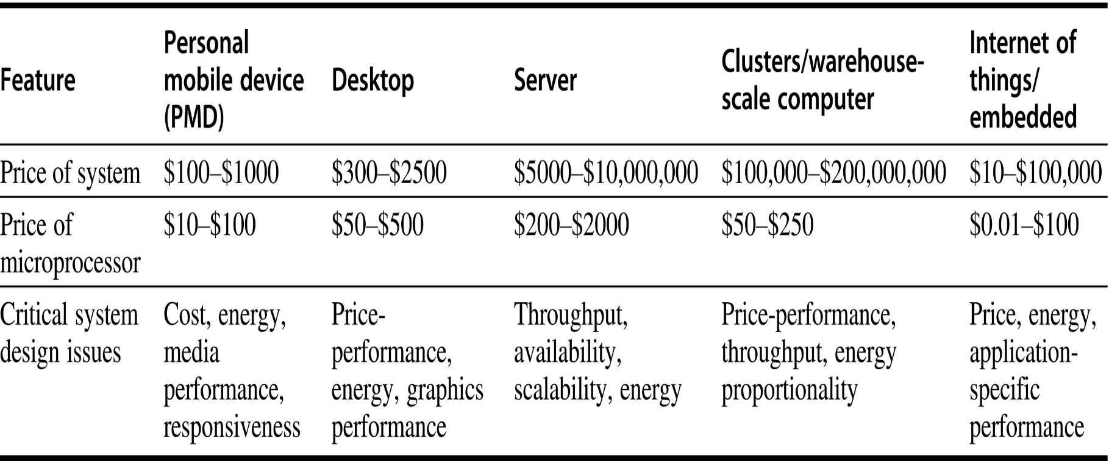
Figure 1.2 A summary of the five mainstream computing classes and their system characteristics. Sales in 2015 included about 1.6 billion PMDs (90% cell phones), 275 million desktop PCs, and 15 million servers. The total number of embedded processors sold was nearly 19 billion. In total, 14.8 billion ARM-technology-based chips were shipped in 2015. Note the wide range in system price for servers and embedded systems, which go from USB keys to network routers. For servers, this range arises from the need for very large-scale multiprocessor systems for high-end transaction processing.

Slide 10
Parallelism
Classes of parallelism in applications:
  Data-Level Parallelism (DLP)
  Task-Level Parallelism (TLP)
Classes of architectural parallelism:
  Instruction-Level Parallelism (ILP)
  Vector architectures/Graphic Processor Units (GPUs)
  Thread-Level Parallelism
  Request-Level Parallelism
Classes of Computers

Slide 11
Flynn’s Taxonomy
Single instruction stream, single data stream (SISD)
Single instruction stream, multiple data streams (SIMD)
  Vector architectures
  Multimedia extensions
  Graphics processor units
  NVIDIA-SIMT. MIMD/SIMD hybrid executed in thread blocks
Multiple instruction streams, single data stream (MISD)
  No commercial implementation
Multiple instruction streams, multiple data streams (MIMD)
  Tightly-coupled MIMD
  Loosely-coupled MIMD
Classes of Computers

Slide 12
Defining Computer Architecture
“Old” view of computer architecture:
  Instruction Set Architecture (ISA) design
  i.e. decisions regarding:
    registers, memory addressing, addressing modes, instruction operands, available operations, control flow instructions, instruction encoding
“Real” computer architecture:
  Specific requirements of the target machine
  Design to maximize performance within constraints: cost, power, and availability
  Includes ISA, microarchitecture, hardware
Defining Computer Architecture

Slide 13
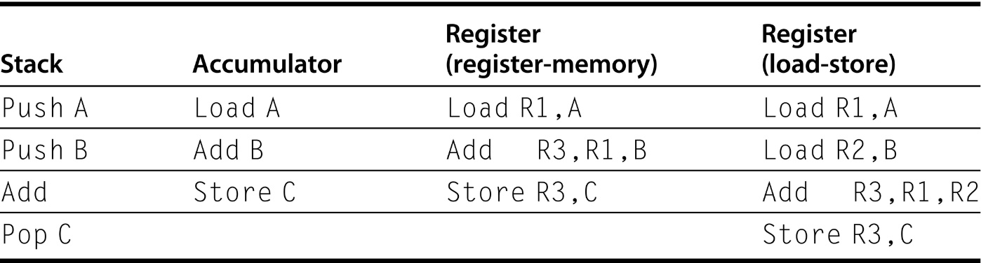
From Appendix 1
The main high-level distinction of RISC
The rest is (lots of) ENEE350-type detail
Figure A.2 The code sequence for C = A + B for four classes of instruction sets. Note that the Add instruction has implicit operands for stack and accumulator architectures and explicit operands for register architectures. It is assumed that A, B, and C all belong in memory and that the values of A and B cannot be destroyed. Figure A.1 shows the Add operation for each class of architecture.

Slide 14
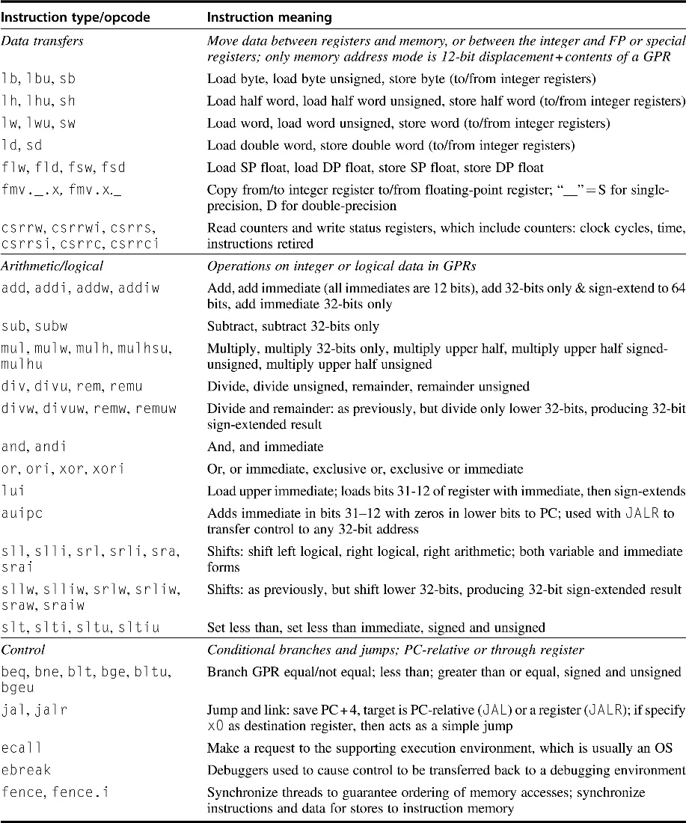
One self study example
Figure 1.5 Subset of the instructions in RISC-V. RISC-V has a base set of instructions (R64I) and offers optional extensions: multiply-divide (RVM), single-precision floating point (RVF), double-precision floating point (RVD). This figure includes RVM and the next one shows RVF and RVD. Appendix A gives much more detail on RISC-V.

Slide 15
Instruction Set Architecture
Class of ISA
  General-purpose registers
  Register-memory vs load-store
RISC-V registers
  32 g.p., 32 f.p.
Defining Computer Architecture
Register | Name | Use | Saver
x9 | s1 | saved | callee
x10-x17 | a0-a7 | arguments | caller
x18-x27 | s2-s11 | saved | callee
x28-x31 | t3-t6 | temporaries | caller
f0-f7 | ft0-ft7 | FP temps | caller
f8-f9 | fs0-fs1 | FP saved | callee
f10-f17 | fa0-fa7 | FP arguments | callee
f18-f27 | fs2-fs21 | FP saved | callee
f28-f31 | ft8-ft11 | FP temps | caller
Register | Name | Use | Saver
x0 | zero | constant 0 | n/a
x1 | ra | return addr | caller
x2 | sp | stack ptr | callee
x3 | gp | gbl ptr
x4 | tp | thread ptr
x5-x7 | t0-t2 | temporaries | caller
x8 | s0/fp | saved/ frame ptr | callee

Slide 16
Instruction Set Architecture
Memory addressing
  RISC-V: byte addressed, aligned accesses faster
Addressing modes
  RISC-V: Register, immediate, displacement (base+offset)
  Other examples: autoincrement, indexed, PC-relative
Types and size of operands
  RISC-V: 8-bit, 32-bit, 64-bit
Defining Computer Architecture

Slide 17
Instruction Set Architecture
Operations
  RISC-V: data transfer, arithmetic, logical, control, floating point
  See Fig. 1.5 in text
Control flow instructions
  Use content of registers (RISC-V) vs. status bits (x86, ARMv7, ARMv8)
  Return address in register (RISC-V, ARMv7, ARMv8) vs. on stack (x86)
Encoding
  Fixed (RISC-V, ARMv7/v8 except compact instruction set) vs. variable length (x86)
Defining Computer Architecture

Slide 18
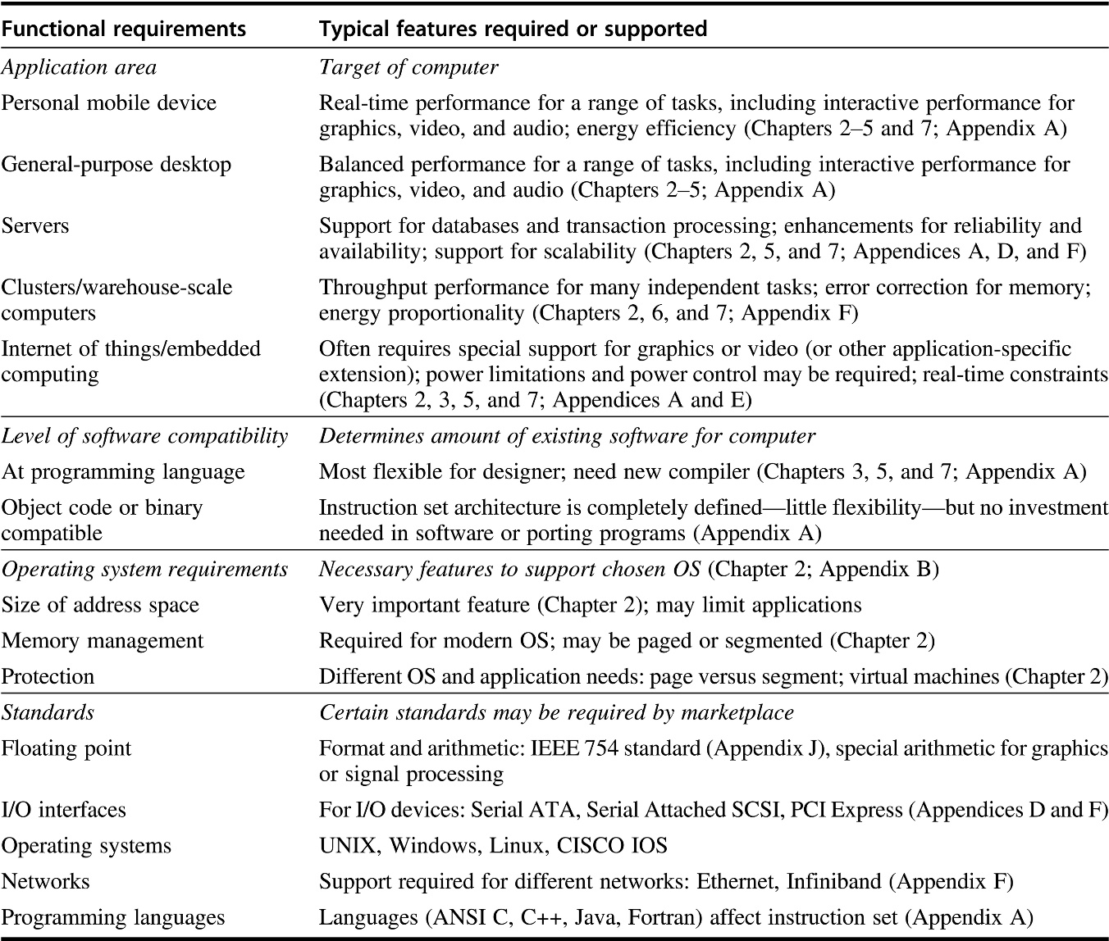
Some “real” computer architecture
Figure 1.8 Summary of some of the most important functional requirements an architect faces. The left-hand column describes the class of requirement, while the right-hand column gives specific examples. The right-hand column also contains references to chapters and appendices that deal with the specific issues.

Slide 19
Trends in Technology
Integrated circuit technology (Moore’s Law)
  Transistor density: 35%/year
  Die size: 10-20%/year
  Integration overall: 40-55%/year
DRAM capacity: 25-40%/year (slowing)
  8 Gb (2014), 16 Gb (2019), possibly no 32 Gb
Flash capacity: 50-60%/year
  8-10X cheaper/bit than DRAM
Magnetic disk capacity: recently slowed to 5%/year
  Density increases may no longer be possible, maybe increase from 7 to 9 platters
  8-10X cheaper/bit then Flash
  200-300X cheaper/bit than DRAM
Trends in Technology

Slide 20
Bandwidth and Latency
Bandwidth or throughput
  Total work done in a given time
  32,000-40,000X improvement for processors
  300-1200X improvement for memory and disks
Latency or response time
  Time between start and completion of an event
  50-90X improvement for processors
  6-8X improvement for memory and disks
Trends in Technology

Slide 21
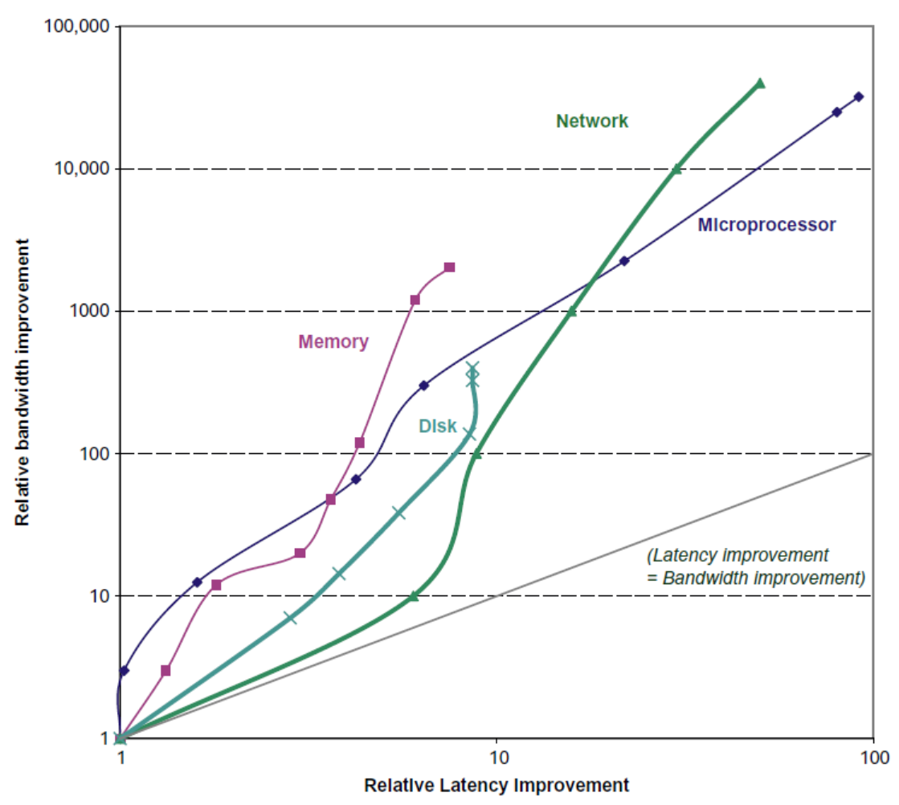
Bandwidth and Latency
Trends in Technology
Over ~35
years
Log-log plot of bandwidth and latency milestones

Slide 22
Transistors and Wires
Feature size
  Minimum size of transistor or wire in x or y dimension
  10 microns in 1971 to .011 microns in 2017
  Transistor performance scales linearly
    Wire delay does not improve with feature size!
  Integration density scales quadratically. Namely, 10nm will mean 1M larger density since 1971. Increase in chip size is extra….
Trends in Technology

Slide 23
Power and Energy
Problem: Get power in, get power out
Thermal Design Power (TDP)
  Characterizes sustained power consumption
  Used as target for power supply and cooling system
  Lower than peak power (1.5X higher), higher than average power consumption
Clock rate can be reduced dynamically to limit power consumption
Energy per task is often a better measurement
Trends in Power and Energy

Slide 24
Dynamic Energy and Power
Dynamic energy
  Transistor switch from 0 -> 1 or 1 -> 0
  ½ x Capacitive load x Voltage²
Dynamic power
  ½ x Capacitive load x Voltage² x Frequency switched
Reducing clock rate reduces power, not energy
Trends in Power and Energy

Slide 25
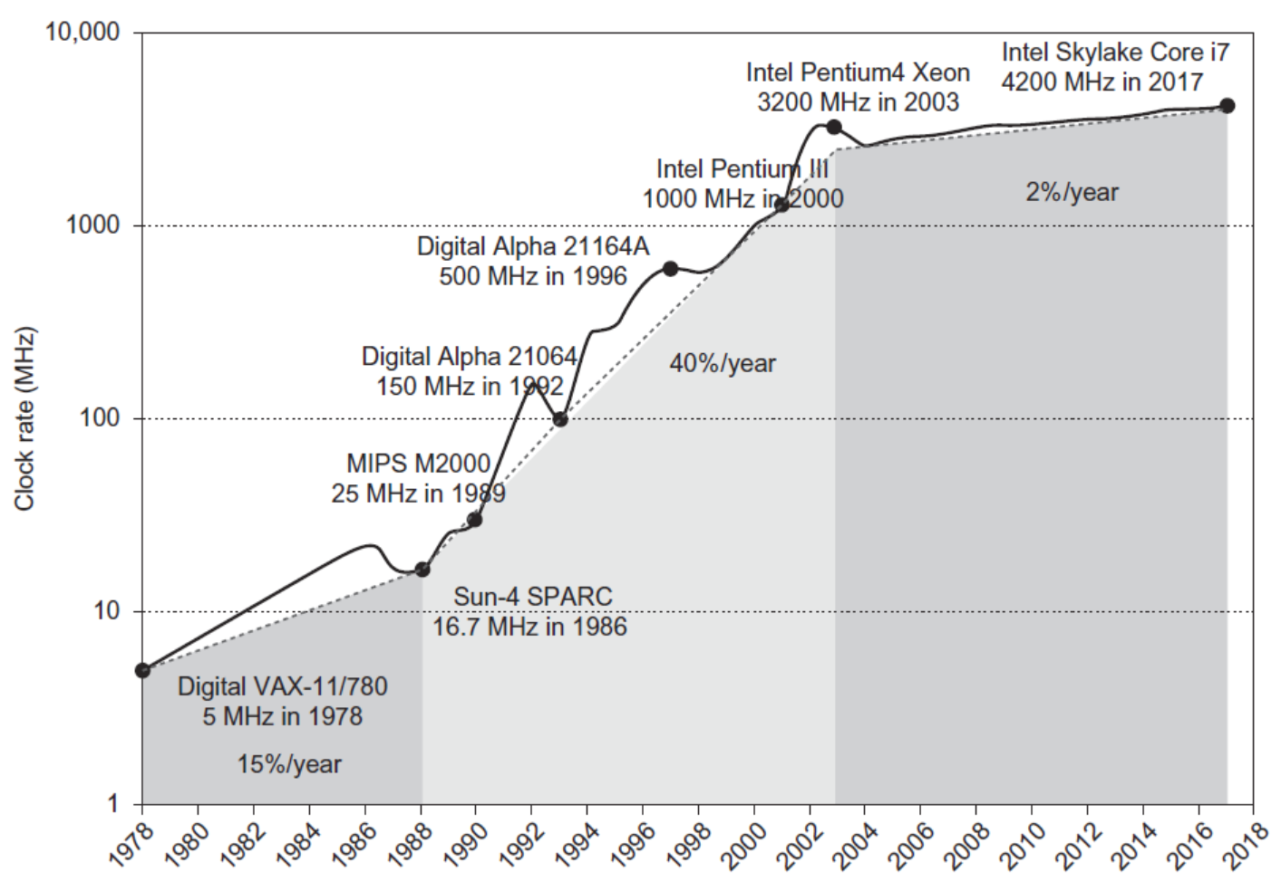
Power
Intel 80386 consumed ~ 2 W
3.3 GHz Intel Core i7 consumes 130 W
Heat must be dissipated from 1.5 x 1.5 cm chip
This is the limit of what can be cooled by air
Trends in Power and Energy

Slide 26
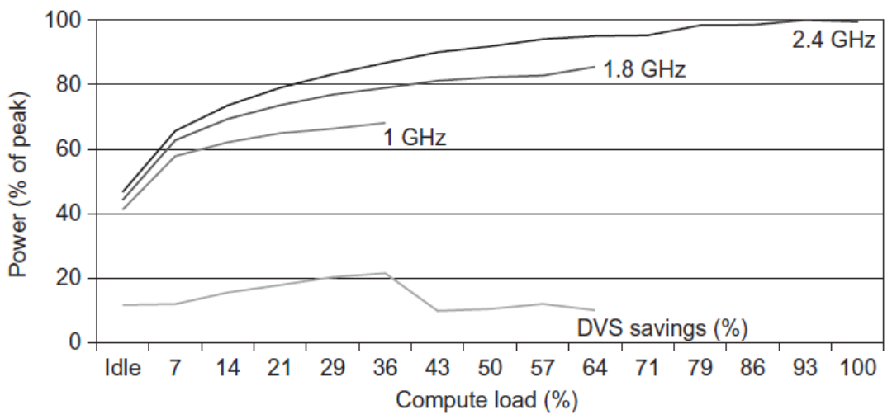
Reducing Power
Techniques for reducing power:
  Do nothing well
  Dynamic Voltage-Frequency Scaling
  Low power state for DRAM, disks
  Overclocking, turning off cores
Trends in Power and Energy

Slide 27
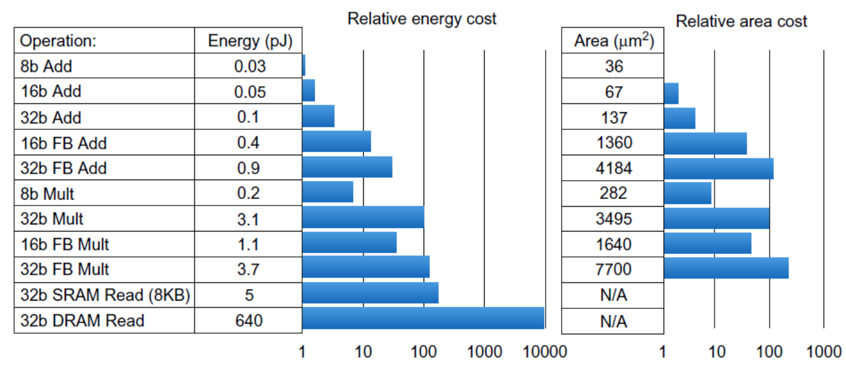
Static Power
Static power consumption
  25-50% of total power
  Current_{static} x Voltage
  Scales with number of transistors
  To reduce: power gating
Trends in Power and Energy

Slide 28
Trends in Cost
Trends in Cost
Cost driven down by learning curve
  Yield
DRAM: price closely tracks cost
Microprocessors: price depends on volume
  10% less for each doubling of volume

Slide 29

Integrated Circuit Cost
Trends in Cost
Integrated circuit
Bose-Einstein formula:
Defects per unit area = 0.016-0.057 defects per square cm (2010)
N = process-complexity factor = 11.5-15.5 (40 nm, 2010)

Slide 30
Dependability
Dependability
Module reliability
  Mean time to failure (MTTF)
  Mean time to repair (MTTR)
  Mean time between failures (MTBF) = MTTF + MTTR
  Availability = MTTF / MTBF

Slide 31
Measuring Performance
Typical performance metrics:
  Response time
  Throughput
Speedup of X relative to Y
  Execution time_{Y} / Execution time_{X}
Execution time
  Wall clock time: includes all system overheads
  CPU time: only computation time
Benchmarks
  Kernels (e.g. matrix multiply)
  Toy programs (e.g. sorting)
  Synthetic benchmarks (e.g. Dhrystone)
  Benchmark suites (e.g. SPEC06fp, TPC-C)
Measuring Performance

Slide 32

Principles of Computer Design
Principles
Take Advantage of Parallelism
  e.g. multiple processors, disks, memory banks, pipelining, multiple functional units
Principle of Locality
  Reuse of data and instructions
  Temporal Locality (Locality in Time): If an item is referenced, it will tend to be referenced again soon (e.g., loops, reuse)
  Spatial Locality (Locality in Space): If an item is referenced, items whose addresses are close by tend to be referenced soon (e.g., straight-line code, array access)
Focus on the Common Case
  Amdahl’s Law

Slide 33


Principles of Computer Design
Principles
The Processor Performance Equation

Slide 34


Principles of Computer Design
Principles
Different instruction types having different CPIs

Slide 35
Principles of Computer Design
Principles
Different instruction types having different CPIs

Slide 36
Fallacies and Pitfalls
All exponential laws must come to an end
  Dennard scaling (constant power density)
    Stopped by threshold voltage
  Disk capacity
    30-100% per year to 5% per year
  Moore’s Law
    Most visible with DRAM capacity
    ITRS disbanded next slide
    Only four foundries left producing state-of-the-art logic chips
    11 nm, 3 nm might be the limit

Slide 37
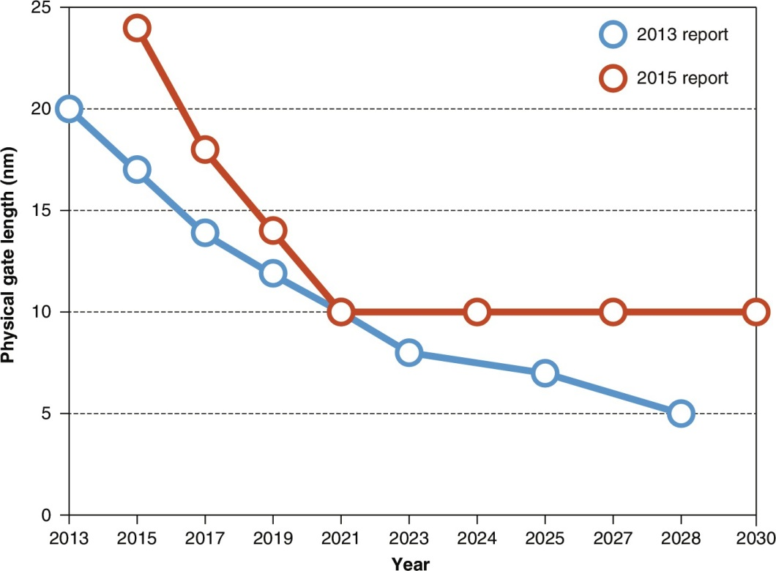
International Technology Roadmap for Semiconductors (ITRS)
Figure 1.22 Predictions of logic transistor dimensions from two editions of the ITRS report. These reports started in 2001, but 2015 will be the last edition, as the group has disbanded because of waning interest. The only companies that can produce state-of-the-art logic chips today are GlobalFoundaries, Intel, Samsung, and TSMC, whereas there were 19 when the first ITRS report was released. With only four companies left, sharing of plans was too hard to sustain. From IEEE Spectrum, July 2016, “Transistors will stop shrinking in 2021, Moore’s Law Roadmap Predicts,” by Rachel Courtland.

Slide 38
Fallacies and Pitfalls
Microprocessors are a silver bullet
  With multi-processors: Performance is now a programmer’s burden
Falling prey to Amdahl’s Law
A single point of failure add redundancy: no single component can fail the whole system
Hardware enhancements that increase performance also improve energy efficiency, or are at worst energy neutral often worsen energy
Benchmarks remain valid indefinitely
  Compiler optimizations target benchmarks

Slide 39
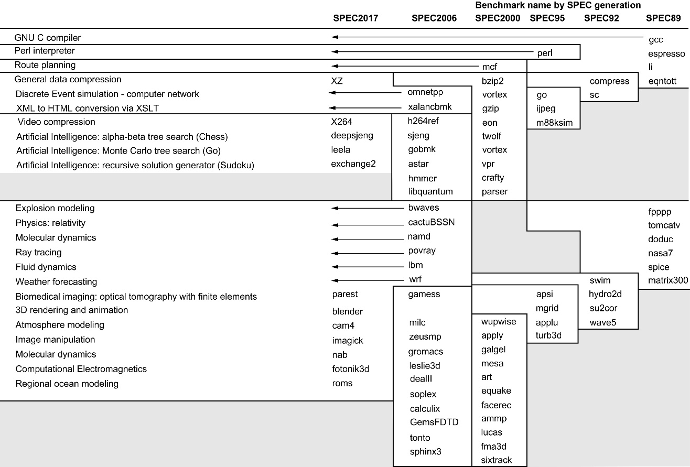
Figure 1.17 SPEC2017 programs and the evolution of the SPEC benchmarks over time, with integer programs above the line and floating-point programs below the line. Of the 10 SPEC2017 integer programs, 5 are written in C, 4 in C++., and 1 in Fortran. For the floating-point programs, the split is 3 in Fortran, 2 in C++, 2 in C, and 6 in mixed C, C++, and Fortran. The figure shows all 82 of the programs in the 1989, 1992, 1995, 2000, 2006, and 2017 releases. Gcc is the senior citizen of the group. Only 3 integer programs and 3 floating-point programs survived three or more generations. Although a few are carried over from generation to generation, the version of the program changes and either the input or the size of the benchmark is often expanded to increase its running time and to avoid perturbation in measurement or domination of the execution time by some factor other than CPU time. The benchmark descriptions on the left are for SPEC2017 only and do not apply to earlier versions. Programs in the same row from different generations of SPEC are generally not related; for example, fpppp is not a CFD code like bwaves.

Slide 40
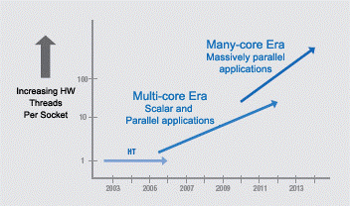
Commodity computer systems from talks ~2015
Chapter 1 1946➔2003: Serial. 5KHz➔4GHz.
Chapter 2 2004--: Parallel.
Projection, Intel 2005:
#”cores”: ~d^{y-2003}, d>1
Reality
Not really a many-core “era”
IMO: systems not good enough 2019: Still in the Multi-core phase
Clock frequency growth: ~flat
If you want your program to run significantly faster … you’re going to have to parallelize it ➔ Parallelism: only game in town
Since 1980:
#Transistors/chip 29K➔~10sB!
Bandwidth/Latency ~400X [HP17]
Programmer’s IQ? Flat..
Fallacy: Intel Platform 2015, March05
Notes:
40
Yet, today’s hot research: Power is important; indeed! Conclusion: build slightly more power efficient machines that are even more difficult to program, and for this reason typical programs will end up being suboptimal possibly requiring more power. Also, few program will be developed, saving even more power..

Slide 41
Pitfall: Power above all
Today’s hot research. I am not questioning that power is important. However, a pitfall since implies
building slightly more power efficient machines that are even more difficult to program; hence,
typical programs will end up being suboptimal possibly requiring more power, and
fewer program will be developed… saving even more power… and, disconnecting computers from power would be optimal…just kidding.
The Industrial Revolution meant more electricity for better human productivity. Isn’t this about arguing the opposite?

Slide 42
Fallacies and Pitfalls
The marketing rated mean time to failure of disks is 1,200,000 hours or almost 140 years, so disks practically never fail
  Still: MTTF value from manufacturers assume regular replacement
Peak performance tracks observed performance Namely, 4x processors do not mean 4X speed.
  More significant: “at present it seems unlikely that some form of simple multicore scaling will provide a cost-effective path to growing performance”, p. 445.
Fault detection can lower availability
  Not all operations are needed for correct execution ignore errors not critical for what you need

Slide 43
Last question
How come that HP-17 does not mention the Intel iGPU?
Surprisingly little attention in academic papers prior to 2018. Not much even now

Slide 44
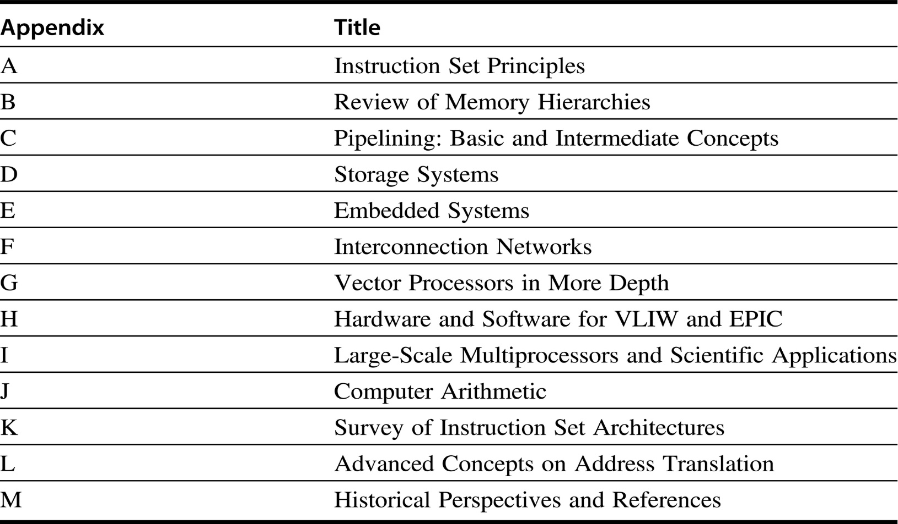
Reading assignments by:
Feb 3
Feb 17
March 3
Figure 1.25 List of appendices.

