Slide 1


Single-Threaded Parallel Programming
Parallel algorithms/programming dominated by Math induction, like serial a/p for Multi-Threaded Many-Core Design scalable parallel systems
Uzi Vishkin
Notes:
Or, why an old colleague said: you can retire now

Slide 2
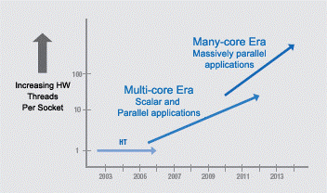
Commodity computer systems
Chapter 1 1946➔2003: Serial. 5KHz➔4GHz.
Chapter 2 2004--: Parallel.
Projection, Intel 2005: #”cores”: ~d^{y-2003}, d>1. Expected a different design to take over somewhere in the range of 16-32 cores.
Not exactly…
Intel Platform 2015, March05
Notes:
2

Slide 3
Commodity computer systems
[Hennessy Patterson-19]:
- Clock frequency growth: ~flat. If you want your program to run significantly faster … you’re going to have to parallelize it ➔ Parallelism: only game in town
- Since 1980:
#Transistors/chip 29K➔~10sB!
Bandwidth/Latency +300X
Great but… Programmer’s IQ? Flat..
Glass half full or half empty?
Products
Market success of:
  dedicated GPUs (e.g., NVIDIA)
  integrated GPUs (Intel)
  Deprecated:
      2005–2018 ☹ Many-Integrated-Core (Intel, Xeon Phi Knights Landing)
Notes:
3
Yet, today’s hot research: Power is important; indeed! Conclusion: build slightly more power efficient machines that are even more difficult to program, and for this reason typical programs will end up being suboptimal possibly requiring more power. Also, few program will be developed, saving even more power..

Slide 4
Comments on operations/programming
(of commodity computers)
Parallel programming: Programmer-generated concurrent threads. Some issues: locality, race conditions, no thread too long relative to others. Too hard
Vendors change designs often➔map & tune performance programs for each generation. Sisyphean
Forced shift to heterogeneous platforms: “it seems unlikely that some form of simple multicore scaling will provide a cost-effective path to growing performance”, HP19.
First comment on this quote:
  Babel-Tower ➔ Hard: Sisyphean & Babel-Tower
Qualifier The glass is only half empty
Salient math primitive supported by GPUs: matrix multiplication (MM)
Deep learning (DL) exuberance: MM➔SGD➔Back propagration➔DL
Explanation (HP19): for dense MM, arithmetic intensity [#FLOPs per <bytes read from main memory>] increases with input size ➔ GPUs
Notes:
For opinion on the limitations of such programming: Is Multi-Core Hardware for General-Purpose Parallel Processing Broken? V-CACM-14

Slide 5
Recall: “unlikely that simple multicore scaling will provide cost-effective path to growing performance”
XMT@UMD: simple multicore scaling and cost-effective path to growing performance
Validated with extensive prototyping: algorithms, compilers, architecture and commitment to silicon
Contradicts the above quote (&common wisdom)

Slide 6
Lead insight: Every Serial Algorithm is a Parallel One
(Semester-long course on theory of parallel algorithms in 30s)
Serial abstraction: a single instruction ready for execution in a serial program executes immediately – ”Immediate Serial Execution (ISE)”
Abstraction for making parallel computing simple: indefinitely many instructions ready for concurrent execution execute immediately - Immediate Concurrent Execution (ICE): ‘parallel algorithmic thinking’
Note: Math induction drives both ISE and ICE. Compare, e,g., with MM.
If more parallelism is desired, algorithm design effort may be needed
New: Programmer’s job is done with ICE algorithm specification
Cilk, etc.: Limited overlap; e.g., some work-depth reasoning.
Serial Execution, Based on Serial Abstraction
What could I do in parallel at each step assuming unlimited hardware
➔
Concurrent writes? Arbitrary…
Parallel Execution, Based on Parallel Abstraction
#
ops
.
.
#
ops
.
.
.
.
..
..
..
..
time
time
Time = Work
Work = total #ops
Time (“depth”) << Work
Notes:
Serial--Abstracts away: different execution time for operation (memory hierarchy). Made serial programming simple. Programmers: conceptualize. HW and compilers: implement. Program: instruction to execute next (inductively)
Parallel--Step-by-step (inductive) explication of the instructions available next for concurrent execution. # processors not even mentioned. Falls back on the serial abstraction if 1 instruction/step

Slide 7
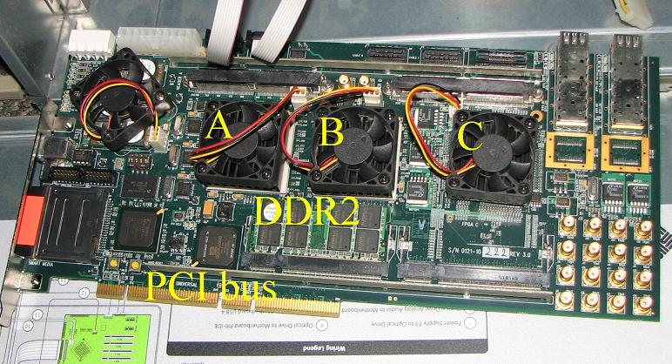
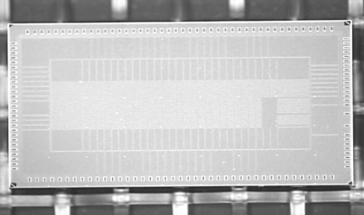
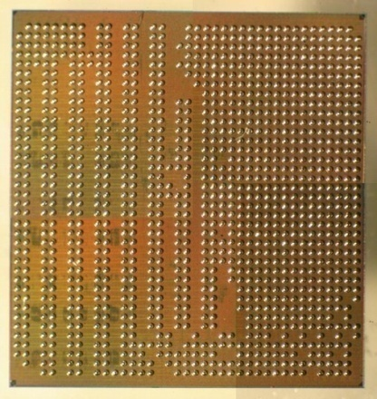
Not just talking
Algorithms&Software
PRAM-On-Chip HW Prototypes
2018: ICE
WorkDepth/PAT/PRAM
Creativity ends here
Programming & workflow
Pre 2018: explicit multi threading
Still: No ‘parallel programming’ course beyond freshmen
Stable compiler
64-core, 75MHz FPGA of XMT
(Explicit Multi-Threaded) architecture
128-core intercon. network IBM 90nm: 9mmX5mm, 400 MHz
FPGA design➔ASIC
IBM 90nm: 10mmX10mm
Architecture scales to 1000+ (100K+?) cores on-chip (off-chip?)
Notes:
Creativity--By nature, algorithms require some level of creativity. Ideally, programming does not.
Current ideas for 100K+ cores require going off-chip

Slide 8
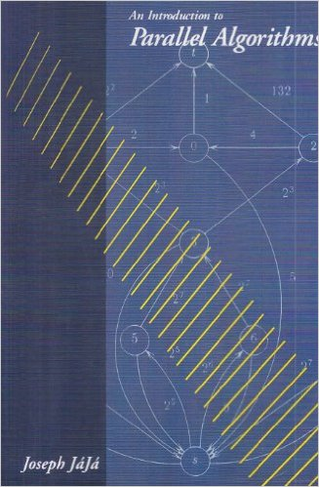

PRAM: main theory of parallel algorithms
Also: surveys, class notes and chapters in algorithms textbooks.
First my focus. Then my compass. since 1979

Slide 9
Immediate Concurrent Execution (ICE) Programming
[Easy PRAM-based high-performance parallel programming with ICE, Ghanim, V,B, IEEE TPDC 2018]
PRAM algorithm and its ICE program
PRAM: main model for theory of parallel algorithm
  Strong speedups for irregular parallel algorithms
ICE: Follows the lock-step execution model
  Parallelism as-is from PRAM algorithms textbook:
  An extension of the C language
    New keyword ‘pardo’ (Parallel Do)
New work: Translate ICE programs into XMTC (& run on XMT)
  Lock-step model → Threaded Model
Motivation: Ease-of-programming of parallel algorithms
Question: but at what performance slowdown?
Perhaps surprising answer: Comparable runtime to XMTC
  average 0.7% speedup(!) on eleven-benchmarks suite
pardo (unsigned i = 0; n – 1; 1) {
 | while (S[i] != S[S[i]]) {
 |  | W[i] = W[i] + W[S[i]];
 |  | S[i] = S[S[i]];
 | }
}
Anecdote Older colleague commented “you can retire now”
 | Integer Sort | Sample Sort | Merge Sort | Graph Connectivity | Breadth First Search | Maximum Finding | Tree Contraction | Tree Rooting | Jacobi | LU Factorization | Cholesky Factorization
Normalized to XMTC | 100.00% | 98.54% | 102.07% | 98.55% | 108.42% | 104.78% | 100.61% | 97.42% | 100.99% | 98.39% | 98.66%
ICE slowdown | 0.002% | 1.457% | -2.070% | 1.453% | -8.424% | -4.780% | -0.610% | 2.584% | -0.985% | 1.605% | 1.338%
Notes:
Proof-of-concept
While XMTC compiler has been stable for human programming, some issues regarding code which is (ICE) compiler output

Slide 10
The appliance that took over the world
Critical feature of serial computing
Math (mankind?) invented (only?) one way for rigorous reasoning:
Mathematical induction (MI) ➔ Serial von-Neumann:
Intuition: An MI appliance?
MI-Enabled for programming, machinery and reasoning.
(Alleged) Aspiration: enabling efficient MI-based algorithms; i.e., constructive step-by-step descriptions
(Beyond scope: “best” model & architecture. Elaborate literature 1940s to 1970; e.g., [AHU74])
To bypass debate: MIA-appliance (MI Aspiring)
In retrospect: engineering for serendipity. An appliance that roared.
The CS miracle: apps unimagined by originators …taken for granted

Slide 11
Parallel computing
Concurrent threads ➔ mandated whole new: 1. algorithms, 2. programming and 3. reasoning. Alas, no 100s yrs of Math to lean on
HW vendor design origins: “build-first figure-out-how-to-program-later” ➔ “threw the programmers under the bus” ☹. Yet: Nice MM appliance ☺
Our aspiration: MI-based parallel algorithms first: Lock-step parallelism for algorithms & programming ➔
Parallel MIA appliance!
Pun intended, since… missing in action
Henceforth: MI-appliance
Contrast with: multi-threaded programming, SIMT (Nvidia), multi-threaded algorithms [CLRS,3rd edition], MIT/Intel Cilk, Intel TBB.

Slide 12
Where we should go from here
Future: CPU +
  GPU
  Other excelerators
Algorithms is a technology. For some this is hard to recognize, since … abstract
Parallel algorithms technology is critical for (at least) the CPU ➔ lead HW/SW specifications, subject to understanding of:
  technology constraints, and
  applications
Contrast with the industry mode of “build-first-figure-out-how-to-program-later”. A related mistake in a leading company:
  1st rate HW and system software people
  No technical representation of parallel algorithmicists
My quest: reproduce for parallelism the biggest (?) technology success story of the 20th century: von-Neumann’s general-purpose serial computer

Slide 13
Takes home: 1 result & 2 questions
Main result A parallel MI appliance is: Desirable, effective and feasible for properly designed many-core systems
  Validated by extensive prototyping
Question 1. Is MI a hidden pull for computing platforms seeking ubiquity? (Example of a hidden pull: Gravity)
  Will compare MI-driven designs choices with afterthought (?) choices in some vendor products
Deep Learning➔stochastic gradient descent➔MM➔ killer app for GPUs … serendipity
Question 2. Find a killer app for many-core parallelism You are unlikely to appreciate the challenge till you try
(Yes to Q2 ➔ likely a killer app for an MI-based one)

Slide 14
Example serial & parallel(!) algorithm: Breadth-First-Search (BFS)

Slide 17
(i) “Concurrent&writes”. Only changes to serial algorithm; involves implementation… natural BFS
(ii) Defies “decomposition”/”partition”
Parallel complexity
W = ~(|V| + |E|)
T = ~d, the number of layers
Average parallelism = ~W/T
Mental effort
1. Sometimes easier than serial
2. Within common denominator of other parallel approaches. In fact, much easier

Slide 18
Prior Case Studies Limited speedups of multi-core CPUs & GPUs vs. “same-size” UMD XMT
 | XMT | GPU/CPU | factor
Graph Biconnectivity | 33X | 4X random graphs Muuuch parallelism | >>8
Graph Triconnectivity | 129X | Only serial result | 129
Max Flow | 108X | 2.5X | 43
Burrows Wheeler Compression Transform - bzip2 Decompression | 25X 13X | X/2.8 … on GPU 1.1 | 70 11
- On XMT the connectivity and max-flow algorithms did not require algorithmic creativity. But, on other platforms, biconnectivity and max-flow required significant creativity
- BWT is 1st “truly parallel” speedup for lossless data compression. Beats Google Snappy (message passing within warehouse scale computers)
Validated PRAM theory Above most advanced problem. Many more results.
Horizons of computer architecture cannot be studied by only using elementary algorithms [Performance, efficiency and effectiveness of a car not tested only in low gear or limited road conditions]
Stress test for important architecture capabilities not often discussed:
Strong scaling : Increase #processors, not problem size
Speedups even with little amounts of algorithm parallelism & not falling behind on serial
Notes:
Quote from Abstract of the Game over report:
The only foreseeable way to continue advancing performance is to match parallel hardware with parallel software and ensure that the new software is portable across generations of parallel hardware. There has been genuine progress on the software front in specific fields, such as some scientific applications and commercial searching and transactional applications. Heroic programmers can exploit vast amounts of parallelism, domain-specific languages flourish, and powerful abstractions hide complexity. However, none of those developments comes close to the ubiquitous support for programming parallel hardware that is required to ensure that IT’s effect on society over the next two decades will be as stunning as it has been over the last half-century.
Teaching experiment favoring Intel SMP in a joint UIUC/UMD class with 42 students. Codes breadth-first-search (BFS) on graphs using OpenMP on an Intel SMP machine and XMTC. While same effort, no student got any speedups on the SMP machine, while range of XMT speedups was 7X to 25X.
Teaching experiment. Application: MATVEC, by DARPA-HPCS funded Hochstein-Basili. UCSB: MPI. UMD: XMTC. Finding (in journal paper): XMTC needed 50% development time of MPI.

Slide 19
Structure of PRAM algorithms for tree and graph problems
advanced planarity testing
advanced triconnectivity
planarity testing
triconnectivity
st-numbering
k-edge/vertex
connectivity
minimum
spanning forest
Euler
tours
ear decompo-
sition search
bicon-
nectivity
strong
orientation
centroid
decomposition
tree
contraction
lowest common
ancestors
graph
connectivity
tree Euler tour
Root of OoM speedups on tree and graph algorithms
Speedup on various input sizes
on much simpler problems; e.g., list ranking
list ranking
2-ruling set
prefix-sums
deterministic coin tossing

Slide 20
From now on:
2018 publications

Slide 21
Machine Learning App: XGBoost
XGBoost = Efficient implementation of gradient boosted decision trees
  Optimized for serial and parallel CPUs
  Recently extended to GPUs
  For market-place apps
  (i) Top-10 winners of KDDCup 2015;
  (ii) Many top winners on Kaggle
  (ML competition website, acquired by Google, 2017)
Important to reduce XGBoost train time:
  Published speedups: GPUs
  Target of Intel Data Analytics Acceleration Library (DAAL)

Slide 22
XGBoost (cont’d)
Conjecture: much greater speedups are possible
  GPUs tuned for regular computation (e.g., deep learning). However,
  XGBoost is highly irregular: sorting, compaction, prefix-sums with indirect addressing
  GPU improves irregular algorithms support; still far behind regular algs support
New speedups
3.3X over NVIDIA's Volta - most powerful GPU to date [Edwards-V 2018]

Slide 23
XMT Architecture
For memory architectures: tightly coupling serial and parallel computation But, tension:
  Serial code: more sensitive to memory latency. Less to bandwidth. Parallel code: can issue multiple requests in parallel to hide latency; often requires sharing data among processors
The hybrid memory architecture underlying the XMT framework features:
  “Heavy” master CPU with a traditional cache (“serial mode”)
  “Light” CPUs with shared caches (“parallel mode”); no local write-caches
  Low-overhead (~10s cycles) transition between the two
  High-bandwidth, on-chip, all-to-all interconnection network
➔ Competitive up- and down- scalable performance
GRF
prefix-sum unit
MTCU
spawn-join
cluster 0
cluster 1
cluster 63
•••
cache
interconnection network
cache 0
•••
cache 7
cache 56
•••
cache 63
•••
MC 0
MC 7

Slide 24
XMT Architecture (cont’d)
How come?
1. Many programs consist of both serial sections of code and parallel sections, potentially with varying degrees of parallelism. Need: Strong serial support
2. Many programs with fine-grained threaded parallelism need to “rethread”. Switch to serial mode and back to parallel mode can be effective
But, what are the prospects that architecture insights and, in particular, memory architecture ones reach commercial implementation?

Slide 25
Preview
While their original principles guided them in the opposite direction, new evidence that:
  both multi-core and GPU design have been getting much closer to this hybrid memory architecture, and
  reasoning that their current quest for more effective support of fine-grained irregular parallelism drew them closer to such memory architecture

Slide 26
Goal for architecture
Fastest implementation from whatever parallelism programmer/application provide
Point of next slides
Much to be desired for limited parallelism
Conditions where CPU doing better than GPU
Can CPU/GPU do better if they get closer to XMT?

Slide 27
GPU memory architectures: something changed…
Compared run-times cycle-accurate simulations of programs on FusionSim (based on GPGPU-Sim) versus recent NVIDIA GPU:
  1. Matched NVIDIA GTX 480 GPU (Fermi architecture). Then,
  2. Sought to develop a cycle-accurate simulation of the Tesla M40 GPU (Maxwell architecture, 2 generations later) for further research
Ran a list ranking (highly irregular parallel pointer jumping) benchmark of three NVIDIA GPUs as well as FusionSim
However, we had to abandon our plans since we could not get FusionSim to match the actual performance of modern GPUs
Anecdotal conclusion: something must have changed

Slide 28
GPU memory architectures: something changed (cont.)
1. For small input sizes (< 8000 elements), FusionSim underestimates benchmark run time relative to all three GPUs.
  Suggests: some kernel launch overheads are not reflected in FusionSim
2. The more recent Tesla K20 and M40 GPUs exhibit a steeper increase in runtime at around 250,000 elements than at any other point, but FusionSim does not reflect this
  FusionSim more closely follows the older GTX 260 in this respect
  This observation led us to suspect that NVIDIA made some improvements between the release of the GTX 260 in 2008 and the Tesla K20 in 2012

Slide 29
Finally a clue…
We could not make sense of this improvement based on published papers. Unexpected given keynote talk [Dally’09] and its well-cited claim: “locality equals efficiency”: How can parallel architectures equating locality with efficiency (and minimizing reliance on non-local memories) provide such strong support for massive data movement?
So, we dug further.
Biggest surprise: unnoticed(?) patent [Dally’15] filed in 2010 which seems near opposite of [D’09]: much better support for shared memory at the expense of local memories for GPUs
Indeed, information on the streaming multiprocessor in the NVIDIA P100 Volta revealed that even the register file is shared
Interestingly…
1. [D’15] claims improved energy consumption. Similar motivation to …[D’09]
2. However, we have not been able to find direct support in the literature for improved energy consumption as a result of trading local memories for shared ones…Our XMT work appears closest: articulating the appeal of shared memory over local memories for both performance and energy
3. In fact, much of the architecture literature seems to continue being influenced by [’09] and its call for limiting data movement
Next: 1. Why XMT-type support for low-overhead transition between serial and parallel execution may be a good idea for GPUs. 2. Some growth in this direction.

Slide 30
Evaluation: Sensitivity to serial-parallel transition overhead
Here, we examine the effect of spawn latency (= hardware portion of transition overhead) on the XGBoost speedup
  Original value = 23 cycles (leftmost point)
Performance falls off when latency exceeds 1,000 cycles
  Typical GPU kernel launch latency ≈ 10,000 cycles.
If the overhead for serial-to-parallel transition on XMT were as high as it is for the GPU, then XMT would perform no better than the GPU.
  Shows the importance of low-overhead transition from serial to parallel in a complete application

Slide 31
Evaluation: Serial-parallel transition overhead (OpenGL)
For ≤ 2048 pixels, the Intel i5 processor with HD Graphics 4600 is faster than the discrete NVIDIA GTX 1060 GPU
(Support for OpenGL both on Nvidia and Intel GPUs. No access to OpenGL in later NVidia GPUs. Other apps did not optimize down-scaling on Intel. See also paper)
This may be because the Intel GPU uses a unified memory architecture
  “Zero-copy” sharing of data between serial and parallel code
  Support for memory coherency and consistency for fine-grained “pointer-based” sharing between CPU cores and GPU
Combined with physical proximity of GPU on the same chip, this may enable tighter coupling of GPU control with the CPU
Does this suggest that CPUs are moving in the direction of XMT?

Slide 32
Buildable, effective and scalable
Buildable: Explicit multi-threading (XMT) architecture
Lock-step➔XMTC➔Tuned threaded code➔HW
For underlined: V-CACM-2011 (~19K download), best introduction; plus updates
Lock-step➔ (threaded) XMTC: IEEE-TPDC-2018
Effective: Unmatched latent algorithm knowledge base; speedups; ease of programming and learning
Scalable: CMOS compatible [will not reach today]

Slide 33
A personal angle
1980 Premise Parallel algorithms technology (yet to be developed in 1980) would be crucial for any effective approach to high end computing systems
  Programmer’s mental model vs build-first figure-out-to-program-later
ACM Fellow’96 citation One of the pioneers of parallel algorithms research, Dr. Vishkin's seminal contributions played a leading role in forming and shaping what thinking in parallel has come to mean in the fundamental theory of Computer Science
2007 Commitment to silicon Explicit multi-threading (XMT) stack
  Overcame notable architects’ claim (1993 LogP paper): parallel algorithms technology too theoretical to ever be implemented in practice
  Last decade
  Rest of the stack; e.g., loop: manual optimizations ➔ teaching the compiler
  2018: ICE threading-free, lock-step programming. Same performance
  2 OoM speedups on non-trivial apps. 2018: 3.3X for XGBoost.
  Successes in programmer’s productivity: Comparison: DARPA HPCS UCSB/UMD, UIUC/UMD. 700 TJ-HS students (75 in Spring2019). >250 grads/undergrads solve otherwise research problems in 6X 2-week class projects
  Scaling
XMT alone: over 60 papers…this talk & prior stuff
Notes:
OoM – orders of magnitude

Slide 34
Summary
Takes home: 1 result & 2 questions
Main result A parallel MI appliance is: Desirable, effective and feasible for properly designed many-core systems
  Validated by extensive prototyping
Question 1. Is MI a hidden pull for computing platforms seeking ubiquity? (Example of a hidden pull: Gravity)
  Compared MI-driven designs choices with afterthought (?) choices in some vendor products
Deep Learning/MM ➔ serendipity killer app for GPUs
Question 2. Find killer app for many-core parallelism.
(Yes to Q2 ➔ likely a killer app for an MI-based one)

