Slide 1
Computer Architecture
A Quantitative Approach, Fifth Edition
Chapter 4
Data-Level Parallelism in Vector, SIMD, and GPU Architectures

Slide 2
Introduction
Introduction
SIMD architectures can exploit significant data-level parallelism for:
matrix-oriented scientific computing
media-oriented image and sound processors
SIMD is more energy efficient than MIMD
Only needs to fetch one instruction per data operation
Makes SIMD attractive for personal mobile devices
SIMD allows programmer to continue to think sequentially
Notes:
XMT is MIMD, but still no need to do multiple fetches. Only broadcast to multiple processors.
XMT allow programmers to continue to think in a mathematically inductive way

Slide 3
SIMD Parallelism
Introduction
Vector architectures
SIMD extensions
Graphics Processor Units (GPUs)
For x86 processors:
Expect two additional cores per chip per year
SIMD width to double every four years
Potential speedup from SIMD to be twice that from MIMD! Qualifier: X86 processors
Notes:
XMT allows much more than 2 more TCUs (or cores) per year

Slide 4
Vector Architectures
Vector Architectures
Basic idea:
Read sets of data elements into “vector registers”
Operate on those registers
Disperse the results back into memory
Registers are controlled by compiler
Used to hide memory latency
Leverage memory bandwidth

Slide 5
VMIPS
Vector Architectures
Example architecture: VMIPS
Loosely based on Cray-1
Vector registers
Each register holds a 64-element, 64 bits/element vector
Register file has 16 read ports and 8 write ports
Vector functional units
Fully pipelined
Data and control hazards are detected
Vector load-store unit
Fully pipelined
One word per clock cycle after initial latency
Scalar registers
32 general-purpose registers
32 floating-point registers

Slide 6
VMIPS Instructions
ADDVV.D: add two vectors
ADDVS.D: add vector to a scalar
LV/SV: vector load and vector store from address
Example aX+Y,DAXPY Double-precision real Alpha X Plus Y
L.D F0,a ; load scalar a
LV V1,Rx ; load vector X
MULVS.D V2,V1,F0 ; vector-scalar multiply
LV V3,Ry ; load vector Y
ADDVV V4,V2,V3 ; add
SV Ry,V4 ; store the result
Requires 6 instructions vs. almost 600 for MIPS
Vector Architectures

Slide 7
Vector Execution Time
Execution time depends on three factors:
Length of operand vectors
Structural hazards
Data dependencies
VMIPS functional units consume one element per clock cycle
For simplicity One pipeline lane, and initiation rate (rate in which vector unit consumes new operands and produce new results) is one element per clock for individual operations Execution time is approximately the vector length
Convoy
Set of vector instructions that could potentially execute together without structural hazard. Property of code+HW
Can estimate performance by # of convoys
Vector Architectures

Slide 8
Chimes
Vector Architectures
Sequences with read-after-write dependency hazards can be in the same convoy via chaining
Chaining
Allows a vector operation to start as soon as the individual elements of its vector source operand become available ’enhanced forwarding’
Chime
Unit of time to execute one convoy
m convoys executes in m chimes
For vector length of n, requires m x n clock cycles

Slide 9
Example
Vector Architectures
LV V1,Rx ;load vector X
MULVS.D V2,V1,F0 ;vector-scalar multiply
LV V3,Ry ;load vector Y
ADDVV.D V4,V2,V3 ;add two vectors
SV Ry,V4 ;store the sum
Convoys:
1 LV MULVS.D chaining
2 LV ADDVV.D separate convoy since structural hazard among LV instructions
3 SV
Since 3 chimes and 2 FP ops per result, the cycles per FLOP = 1.5
For 64 element vectors, requires 64 x 3 = 192 clock cycles

Slide 10
Challenges
Vector Architectures
Start up time
Latency of vector functional unit ignored by the chime model
Assume the same as Cray-1
Floating-point add => 6 clock cycles
Floating-point multiply => 7 clock cycles
Floating-point divide => 20 clock cycles
Vector load => 12 clock cycles
Improvements: follow in the slides ahead
> 1 element per clock cycle
Non-64 wide vectors
IF statements in vector code
Memory system optimizations to support vector processors
Multiple dimensional matrices
Sparse matrices
Programming a vector computer

Slide 11
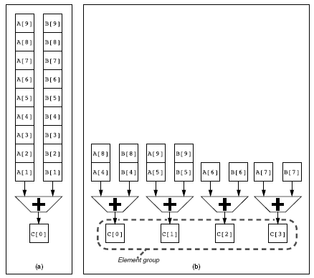
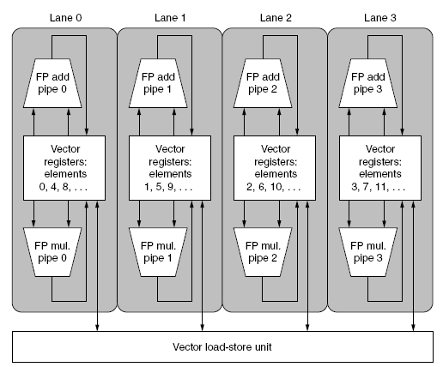
Multiple Lanes
Element n of vector register A is “hardwired” to element n of vector register B
Allows for multiple hardware lanes
Vector Architectures

Slide 12
Vector Length Register
Vector length not known at compile time?
Use Vector Length Register (VLR)
Use strip mining for vectors over the maximum vector length (MVL):
low = 0;
VL = (n % MVL); /*find odd-size piece using modulo op % */
for (j = 0; j <= (n/MVL); j=j+1) { /*outer loop*/
for (i = low; i < (low+VL); i=i+1) /*runs for length VL*/
Y[i] = a * X[i] + Y[i] ; /*main operation*/
low = low + VL; /*start of next vector*/
VL = MVL; /*reset the length to maximum vector length*/
}
Vector Architectures
First odd size, then MVL

Slide 13
Vector Mask Registers
Vector Architectures
Consider:
for (i = 0; i < 64; i=i+1)
if (X[i] != 0)
X[i] = X[i] – Y[i];
Use vector mask register to “disable” elements:
LV V1,Rx ;load vector X into V1
LV V2,Ry ;load vector Y
L.D F0,#0 ;load FP zero into F0
SNEVS.D V1,F0 ;sets VM(i) to 1 if V1(i)!=F0
SUBVV.D V1,V1,V2 ;subtract under vector mask
SV Rx,V1 ;store the result in X
GFLOPS rate decreases!

Slide 14
Memory Banks
Memory system must be designed to support high bandwidth for vector loads and stores
Spread accesses across multiple banks
Control bank addresses independently
Load or store non sequential words
Support multiple vector processors sharing the same memory
Example:
32 processors, each generating 4 loads and 2 stores/cycle
Processor cycle time is 2.167 ns, SRAM cycle time is 15 ns
How many memory banks needed?
192 – max # of memory references 32 X (4+2)
Each SRAM bank need 15/2.167 < 7 cycles/reference
➔ 192 X 7 = 1,344 memory banks! (Largest configuration of Cray T90: 1024 memory banks (➔ required pipelined synchronous SRAM)
Vector Architectures

Slide 15
Stride
Consider:
for (i = 0; i < 100; i=i+1)
for (j = 0; j < 100; j=j+1) {
A[i][j] = 0.0;
for (k = 0; k < 100; k=k+1)
A[i][j] = A[i][j] + B[i][k] * D[k][j];
}
Must vectorize multiplication of rows of B with columns of D
Use non-unit stride [the distance separating elements to be gathered into a single (vector) register is called the stride]
And Bank conflict (stall) occurs when the same bank is hit faster than bank busy time: LCM – least common multiple
#banks / LCM(stride,#banks) < bank busy time
Example 8 memory banks. Bank busy time – 6 clocks. Total memory latency – 12 clocks. How long to complete 64-element vector load with stride of 1? With stride of 32?
Answer Stride of 1. Since 8, #banks, is larger than 6, bank busy time, the load will take 12+64=72 clocks ➔ 1.2 clocks/element
Stride of 32. Worst case for strides when multiple of #banks (.e.g. 32 and 8). Every access needs to wait for previous access 6 clocks. Load will take 12+1+6X63=391 ➔ 6.1 clocks/element
Vector Architectures

Slide 16
Scatter-Gather handling sparse matrices in vector architectures
Consider:
for (i = 0; i < n; i=i+1)
A[K[i]] = A[K[i]] + C[M[i]];
Use index vector:
LV Vk, Rk ;load K
LVI Va, (Ra+Vk) ;load A[K[]] gather
LV Vm, Rm ;load M
LVI Vc, (Rc+Vm) ;load C[M[]] gather
ADDVV.D Va, Va, Vc ;add them
SVI (Ra+Vk), Va ;store A[K[]] scatter
Loads (gather) and stores (scatter) can be pipelined, BUT are much slower than non-indexed loads and stores. Why? Memory banks unknown at start of instruction ➔ Cannot be handled in groups. Also conflicts at memory banks➔ each access incurs significat latency
Vector Architectures
scatter gather gather

Slide 17
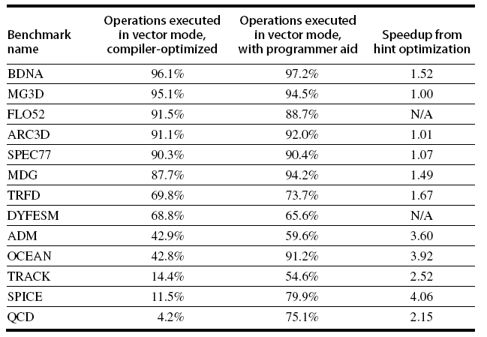
Programming Vec. Architectures
Compilers can provide feedback/hints to programmers
Will code vectorize? if not, what are problems? Helps experts to vectorize or provide hints to the compiler.
Programmers can provide hints to compiler
Dialog simplifies programming. Main factor The algorithm: dependence among loops
Level of vectorization in scientific programs Perfect Club benchmark
Vector Architectures

Slide 18
SIMD Extensions for multimedia
Media applications operate on data types narrower than the native word size (e.g., many graphics systems use 8 bit for each of the 3 primary colors plus 8 bits for transparency)
Example: disconnect carry chains to “partition” adder
Limitations, compared to vector instructions:
Number of data operands encoded into op code
No sophisticated addressing modes (strided, scatter-gather)
No mask registers
SIMD Instruction Set Extensions for Multimedia

Slide 19
SIMD Implementations
Implementations:
Intel MMX (1996)
Eight 8-bit integer ops or four 16-bit integer ops
Streaming SIMD Extensions (SSE) (1999)
Eight 16-bit integer ops
Four 32-bit integer/fp ops or two 64-bit integer/fp ops
Advanced Vector Extensions (2010)
Four 64-bit integer/fp ops
Operands must be consecutive and aligned memory locations
SIMD Instruction Set Extensions for Multimedia

Slide 20
Example SIMD Code suffix 4D: instruction operating on 4 double precision operands at once
Example DAXPY:
L.D F0,a ;load scalar a
MOV F1, F0 ;copy a into F1 for SIMD MUL unclear point:
MOV F2, F0 ;copy a into F2 for SIMD MUL broadcast in real SIMD
MOV F3, F0 ;copy a into F3 for SIMD MUL instead of copy
DADDIU R4,Rx,#512 ;last address to load
Loop: L.4D F4,0[Rx] ;load X[i], X[i+1], X[i+2], X[i+3]
MUL.4D F4,F4,F0 ;a×X[i],a×X[i+1],a×X[i+2],a×X[i+3]
L.4D F8,0[Ry] ;load Y[i], Y[i+1], Y[i+2], Y[i+3]
ADD.4D F8,F8,F4 ;a×X[i]+Y[i], ..., a×X[i+3]+Y[i+3]
S.4D 0[Ry],F8 ;store into Y[i], Y[i+1], Y[i+2], Y[i+3]
DADDIU Rx,Rx,#32 ;increment index to X
DADDIU Ry,Ry,#32 ;increment index to Y
DSUBU R20,R4,Rx ;compute bound
BNEZ R20,Loop ;check if done
SIMD Instruction Set Extensions for Multimedia

Slide 21
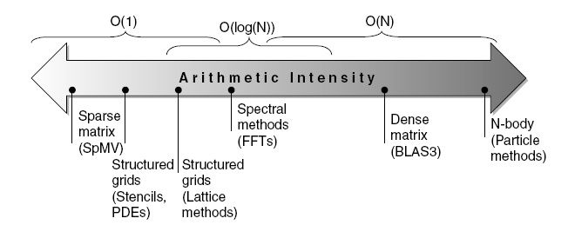
Roofline Performance Model
Basic idea:
Plot peak floating-point throughput as a function of arithmetic intensity
Ties together floating-point performance and memory performance for a target machine
Arithmetic intensity
Floating-point operations per byte read
SIMD Instruction Set Extensions for Multimedia

Slide 22
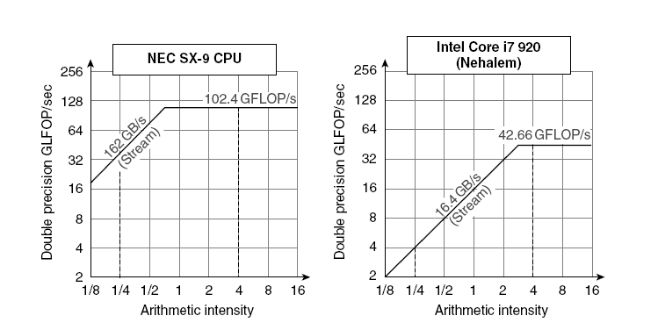
Examples
Y-axis Attainable GFLOPs/sec
Min(Peak Memory BW × Arithmetic Intensity up to a point limited by peak memory BW,
beyond that point by Peak Floating Point Perf.)
SIMD Instruction Set Extensions for Multimedia

Slide 23
Graphics Processing Units
Given the hardware invested to do graphics well, how can be supplement it to improve performance of a wider range of applications?
Basic idea:
Heterogeneous execution model
CPU is the host, GPU is the device
Develop a C-like programming language for GPU
Unify all forms of GPU parallelism as CUDA thread
Programming model is “Single Instruction Multiple Thread”
Graphical Processing Units

Slide 24
Threads and Blocks
A thread is associated with each data element
Threads are organized into blocks
Blocks are organized into a grid
GPU hardware handles thread management, not applications or OS
Graphical Processing Units

Slide 25
NVIDIA GPU Architecture
Similarities to vector machines:
Works well with data-level parallel problems
Scatter-gather transfers
Mask registers
Large register files
Differences:
No scalar processor
Uses multithreading to hide memory latency
Has many functional units, as opposed to a few deeply pipelined units like a vector processor
Graphical Processing Units

Slide 26
Example
Multiply two vectors of length 8192
Code that works over all elements is the grid
Thread blocks break this down into manageable sizes
512 threads per block
SIMD instruction executes 32 elements at a time
Thus grid size = 16 blocks (X512 = 8192)
Block is analogous to a strip-mined vector loop with vector length of 32 (X16 = 512)
Block is assigned to a multithreaded SIMD processor by the thread block scheduler
Current-generation GPUs (Fermi) have 7-15 multithreaded SIMD processors
Graphical Processing Units

Slide 27
Terminology
Threads of SIMD instructions
Each has its own PC
Thread scheduler uses scoreboard to dispatch
No data dependencies between threads!
Keeps track of up to 48 threads of SIMD instructions
Hides memory latency
Thread block scheduler schedules blocks to SIMD processors
Within each SIMD processor:
32 SIMD lanes
Wide and shallow compared to vector processors
Graphical Processing Units

Slide 28
Example
NVIDIA GPU has 32,768 registers
Divided into lanes
Each SIMD thread is limited to 64 registers
SIMD thread has up to:
64 vector registers of 32 32-bit elements
32 vector registers of 32 64-bit elements
Fermi has 16 physical SIMD lanes, each containing 2048 registers
Graphical Processing Units

Slide 29
NVIDIA Instruction Set Arch.
ISA is an abstraction of the hardware instruction set
“Parallel Thread Execution (PTX)” i.e., CUDA-like
Uses virtual registers
Translation to machine code is performed in software
Example one iteration of DAXPY loop:
shl.s32 R8, blockIdx, 9 ; Thread Block ID * Block size (512 or 2⁹) shift left
block id to each block
add.s32 R8, R8, threadIdx ; R8 = i = my CUDA thread ID
thread id to each thread (total 8192 threads)
shl.u32 R8, R8, 3 ; byte offset (per p. 300 in HP12)
First 3 PTX instructions calculate unique byte offset in R8, which is added to base of array
Following: load 2 double-precision FP operands, then multiply, add and store
ld.global.f64 RD0, [X+R8] ; RD0 = X[i]
ld.global.f64 RD2, [Y+R8] ; RD2 = Y[i]
mul.f64 R0D, RD0, RD4 ; Product in RD0 = RD0 * RD4 (scalar a)
add.f64 R0D, RD0, RD2 ; Sum in RD0 = RD0 + RD2 (Y[i])
st.global.f64 [Y+R8], RD0 ; Y[i] = sum (X[i]*a + Y[i])
Graphical Processing Units

Slide 30
Some comparison with vector architecture
Unlike vector architectures, GPUs don’t have separate instructions for sequential data transfers, strided data transfers, and gather-scatter data transfers. All data transfers are gather-scatter.
To regain efficiency, GPUs include special Coalescing hardware to recognize sequential addresses and notifies the Memory Interface Unit to request block transfers.
The GPU programmer must ensue that adjacent CUDA Threads access nearby addresses nearby addresses at the same time. (Done in above example.)

Slide 31
Conditional Branching
Like vector architectures, GPU branch hardware uses internal masks
Also uses
Branch synchronization stack
Entries consist of masks for each SIMD lane
I.e. which threads commit their results (all threads execute)
Instruction markers to manage when a branch diverges into multiple execution paths
Push on divergent branch
…and when paths converge
Act as barriers
Pops stack
Per-thread-lane 1-bit predicate register, specified by programmer
Graphical Processing Units

Slide 32
Example
if (X[i] != 0)
X[i] = X[i] – Y[i];
else X[i] = Z[i];
Assuming that R8 has already the scaled thread ID, the IF statement translates in PTX to
ld.global.f64 RD0, [X+R8] ; RD0 = X[i]
setp.neq.s32 P1, RD0, #0 ; P1 is predicate register 1
@!P1, bra ELSE1, *Push ; Push old mask, set new mask bits
; if P1 false, go to ELSE1 bra is branch
ld.global.f64 RD2, [Y+R8] ; RD2 = Y[i]
sub.f64 RD0, RD0, RD2 ; Difference in RD0
st.global.f64 [X+R8], RD0 ; X[i] = RD0
@P1, bra ENDIF1, *Comp ; complement mask bits
; if P1 true, go to ENDIF1
ELSE1: ld.global.f64 RD0, [Z+R8] ; RD0 = Z[i]
st.global.f64 [X+R8], RD0 ; X[i] = RD0
ENDIF1: <next instruction>, *Pop ; pop to restore old mask
Push old mask, complement current mask, restore old mask. Why? For nesting.
Illusion of each thread operating independently. In practice: no ops. Nesting: ½ speed/level
Graphical Processing Units

Slide 33
NVIDIA GPU Memory Structures
Each SIMD Lane has private section of off-chip DRAM
“Private memory”
Contains stack frame, spilling registers, and private variables
Each multithreaded SIMD processor also has local memory
Shared by SIMD lanes / threads within a block
Memory shared by SIMD processors is GPU Memory
Host can read and write GPU memory
Memory per: 1. Lane. 2. SIMD processor. 3. Block.
Graphical Processing Units

Slide 34
Fermi Architecture Innovations
Each SIMD processor has
Two SIMD thread schedulers, two instruction dispatch units
16 SIMD lanes (SIMD width=32, chime=2 cycles), 16 load-store units, 4 special function units
Thus, two threads of SIMD instructions are scheduled every two clock cycles
Fast double precision
Caches for GPU memory
64-bit addressing and unified address space
Error correcting codes
Faster context switching
Faster atomic instructions
Graphical Processing Units

Slide 35
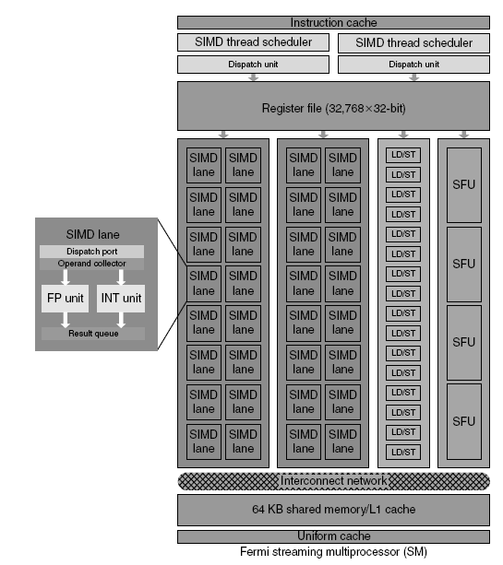
Fermi Multithreaded SIMD Proc.
Graphical Processing Units
Each SIMD lane has 2 pipelined units: FP and integer, logic for dispatching instruction to these units and queue for holding results. 4 Special Function Units (SFUs) calculate special functions (square roots, sines, etc)

Slide 36
Summary
GPU are really just multi-threaded SIMD processors. They do have more processors, more lanes per processor and more multithreaded hardware than do traditional multi-cores.
GPUs rely on extensive multithreading to hide the very high DRAM latency. The chip area used for caches in system processors is spent instead on computing resources and on the large number of registers to hold the state of many threads of SIMD instructions.
Hiding latencies (by hoping for huge amounts of parallelism form the application and its code) is the underlying philosophy. But the relatively recent Fermi added some shared cache. Smaller (.25MB to .75 MB for L1 and .75MB for L2) than registers (2MB). HP12: more for keeping shared variables across threads closer than classic cache role (bringing main memory closer).

Slide 37
Detecting and Enhancing Loop-Level Parallelism
Focuses on determining whether data accesses in later iterations are dependent on data values produced in earlier iterations
Loop-carried dependence
Example 1:
for (i=999; i>=0; i=i-1)
x[i] = x[i] + s;
No loop-carried dependence
Detecting and Enhancing Loop-Level Parallelism

Slide 38
Loop-Level Parallelism
Example 2:
for (i=0; i<100; i=i+1) {
A[i+1] = A[i] + C[i]; /* S1 */
B[i+1] = B[i] + A[i+1]; /* S2 */
}
S1 uses a value computed by S1 in previous iteration
S2 uses a value computed by S2 in previous iteration
S2 uses value computed by S1 in same iteration
Detecting and Enhancing Loop-Level Parallelism
S1,1 S1,2
S2,1 S2,2 draw dependencies
S3,1 S3,2
…

Slide 39
Loop-Level Parallelism
Example 3:
for (i=0; i<100; i=i+1) {
A[i] = A[i] + B[i]; /* S1 */
B[i+1] = C[i] + D[i]; /* S2 */
}
S1 uses value computed by S2 in previous iteration but dependence is not circular so loop is parallel
Transform to:
A[0] = A[0] + B[0];
for (i=0; i<99; i=i+1) {
B[i+1] = C[i] + D[i];
A[i+1] = A[i+1] + B[i+1];
}
B[100] = C[99] + D[99];
Detecting and Enhancing Loop-Level Parallelism

Slide 40
Loop-Level Parallelism
Example 4:
for (i=0;i<100;i=i+1) {
A[i] = B[i] + C[i];
D[i] = A[i] * E[i];
}
Example 5:
for (i=1;i<100;i=i+1) {
Y[i] = Y[i-1] + Y[i];
}
Wait.. The theory solutions: Can be computed in log n time. BUT, only with transformation
Practical solution: ‘reductions’ – last slide of Chapter 4
Detecting and Enhancing Loop-Level Parallelism

Slide 41
Finding dependencies
Assume indices are affine:
a x i + b (i is loop index)
Assume:
Store to a x i + b, then
Load from c x i + d
i runs from m to n
Dependence exists if:
Given j, k such that m ≤ j ≤ n, m ≤ k ≤ n
Store to a x j + b, load from a x k + d, and a x j + b = c x k + d
Detecting and Enhancing Loop-Level Parallelism

Slide 42
Finding dependencies
Generally cannot determine at compile time
Test for absence of a dependence:
GCD test:
If a dependency exists, GCD(c,a) must evenly divide (d-b)
Example:
for (i=0; i<100; i=i+1) {
X[2*i+3] = X[2*i] * 5.0;
}
Detecting and Enhancing Loop-Level Parallelism

Slide 43
Finding dependencies
Example 2:
for (i=0; i<100; i=i+1) {
Y[i] = X[i] / c; /* S1 */
X[i] = X[i] + c; /* S2 */
Z[i] = Y[i] + c; /* S3 */
Y[i] = c - Y[i]; /* S4 */ }
True dependences: S1 to S3 & S1 to S4
No loop carried dependence ➔ loop is parallel
Still S3 and S4 need to wait for S1 to complete
Anti-dependences: S1 to S2 (for X[i]) & S3 to S4 (for Y[i])
Output dependence: S1 to S4 for Y[i]
for (i=0; i<100; i=i+1) {
T[i] = X[i] / c; /* Y renamed T to remove output dependence
X1[i] = X[i] + c; /* X renamed X1 to remove anti dependence
Z[i] = T[i] + c; /* Y renamed T to remove anti dependence
Y[i] = c - T[i];
Detecting and Enhancing Loop-Level Parallelism

Slide 44
Reductions – Eliminating dependent computation
Reduction Operation:
for (i=9999; i>=0; i=i-1)
sum = sum + x[i] * y[i];
Transform to…
for (i=9999; i>=0; i=i-1)
sum [i] = x[i] * y[i];
for (i=9999; i>=0; i=i-1) These 2 commands are called ‘reduction’
finalsum = finalsum + sum[i];
Do on 10 processors: [processor 0 <= p <= 9, does the following]
for (i=999; i>=0; i=i-1)
finalsum[p] = finalsum[p] + sum[i+1000*p];
It remains to add up finalsum[0], finalsum[1] … finalsum[9]
Note: assumes associativity!
Detecting and Enhancing Loop-Level Parallelism

