Slide 1
Computer Architecture
A Quantitative Approach, Fifth Edition
Chapter 3
Instruction-Level Parallelism and Its Exploitation

Slide 2
Introduction
Introduction
Pipelining become universal technique in 1985
  Overlaps execution of instructions
  Exploits “Instruction Level Parallelism”
Beyond this, there are two main approaches:
  Hardware-based dynamic approaches
    Used in server and desktop processors
    Not used as extensively in PMP processors
  However, per http://www.arm.com/products/processors/cortex-a/cortex-a15.php, The Cortex-A15 processor has an out-of-order superscalar pipeline with a tightly-coupled low-latency level-2 cache which can be up to 4MB in size. Additional improvements in floating point and NEON™ media performance result in devices that deliver the next-generation user experience for consumers as well as high-performance computation for web infrastructure applications.
  It is expected that mobile configurations of the Cortex-A15 MPCore processor will deliver over five times the performance of today’s advanced smartphones. In advanced infrastructure applications, the Cortex-A15 running at up to 2.5GHz will enable highly scalable solutions within constantly shrinking energy, thermal and cost budgets.
  Compiler-based static approaches
    Not as successful outside of scientific applications

Slide 3
5 Steps of MIPS Datapath
Read Appendix C!!!
Instruction
Fetch
Instr. Decode
Reg. Fetch
Execute
Addr. Calc
Memory
Access
Write
Back
Next PC
IF/ID
ID/EX
EX/MEM
MUX
MEM/WB
Next SEQ PC
Next SEQ PC
Adder
4
Zero?
RS1
Reg File
Address
MUX
Memory
RS2
ALU
Data
Memory
MUX
MUX
Sign
Extend
Imm
WB Data
RD
RD
RD

Slide 4
Backup slide: Visualizing Pipelining
Time (clock cycles)
Cycle 1
Cycle 2
Cycle 3
Cycle 4
Cycle 5
Cycle 6
Cycle 7
I
n
s
t
r.
O
r
d
e
r
Ifetch
Reg
ALU
DMem
Reg
Ifetch
Reg
ALU
DMem
Reg
Ifetch
Reg
ALU
DMem
Reg
Ifetch
Reg
ALU
DMem
Reg

Slide 5
Most important:
Pipelining is not quite that easy!
Limits to pipelining: Hazards prevent next instruction from executing during its designated clock cycle
  Structural hazards: HW cannot support this combination of instructions (single person to fold and put clothes away)
  Data hazards: Instruction depends on result of prior instruction still in the pipeline (missing sock)
  Control hazards: Caused by delay between the fetching of instructions and decisions about changes in control flow (branches and jumps or decide what to wear before knowing whether you go to the office or the beach).

Slide 6
One Memory Port/Structural Hazards
Time (clock cycles)
Cycle 1
Cycle 2
Cycle 3
Cycle 4
Cycle 5
Cycle 6
Cycle 7
I
n
s
t
r.
O
r
d
e
r
Load
Ifetch
Reg
ALU
DMem
Reg
Instr 1
Ifetch
Reg
ALU
DMem
Reg
Instr 2
Ifetch
Reg
ALU
DMem
Reg
Instr 3
Ifetch
Reg
ALU
DMem
Reg
Instr 4
Ifetch
Reg
ALU
DMem
Reg

Slide 7
One Memory Port/Structural Hazards
Time (clock cycles)
Cycle 1
Cycle 2
Cycle 3
Cycle 4
Cycle 5
Cycle 6
Cycle 7
I
n
s
t
r.
O
r
d
e
r
Load
Ifetch
Reg
ALU
DMem
Reg
Instr 1
Ifetch
Reg
ALU
DMem
Reg
Instr 2
Ifetch
Reg
ALU
DMem
Reg
Stall
Bubble
Bubble
Bubble
Bubble
Bubble
Instr 3
Ifetch
Reg
ALU
DMem
Reg
How do you “bubble” the pipe?

Slide 8
Speed Up Equations for Pipelining
Speedup from pipelining = (average instruction time pipelined) /(average instruction time unpipelined)
Pipelining with stalls
Only above formula for ENEE446
For simple RISC pipeline, Ideal CPI = 1:

Slide 9
Data Hazard on R1
Time (clock cycles)
IF
ID/RF
EX
MEM
WB
I
n
s
t
r.
O
r
d
e
r
add r1,r2,r3
Reg
Ifetch
Reg
ALU
DMem
sub r4,r1,r3
Ifetch
Reg
ALU
DMem
Reg
and r6,r1,r7
Ifetch
Reg
ALU
DMem
Reg
or r8,r1,r9
Ifetch
Reg
ALU
DMem
Reg
xor r10,r1,r11
Ifetch
Reg
ALU
DMem
Reg

Slide 10
Three Generic Data Hazards
Read After Write (RAW)
Instr_{J} tries to read operand before Instr_{I} writes it
Caused by a “Dependence” (in compiler nomenclature). This hazard results from an actual need for communication.
I: add r1,r2,r3
J: sub r4,r1,r3

Slide 11
Three Generic Data Hazards
Write After Read (WAR)
Instr_{J} writes operand before Instr_{I} reads it
Called an “anti-dependence” by compiler writers.
This results from reuse of the name “r1”.
Can’t happen in MIPS 5 stage pipeline because:
  All instructions take 5 stages, and
  Reads are always in stage 2, and
  Writes are always in stage 5
I: sub r4,r1,r3
J: add r1,r2,r3
K: mul r6,r1,r7

Slide 12
Three Generic Data Hazards
Write After Write (WAW)
Instr_{J} writes operand before Instr_{I} writes it.
Called an “output dependence” by compiler writers
This also results from the reuse of name “r1”.
Can’t happen in MIPS 5 stage pipeline because:
  All instructions take 5 stages, and
  Writes are always in stage 5
Will see WAR and WAW in more complicated pipes
I: sub r1,r4,r3
J: add r1,r2,r3
K: mul r6,r1,r7

Slide 13
Forwarding to Avoid Data Hazard
Time (clock cycles)
I
n
s
t
r.
O
r
d
e
r
add r1,r2,r3
Ifetch
Reg
ALU
DMem
Reg
sub r4,r1,r3
Ifetch
Reg
ALU
DMem
Reg
and r6,r1,r7
Ifetch
Reg
ALU
DMem
Reg
or r8,r1,r9
Ifetch
Reg
ALU
DMem
Reg
xor r10,r1,r11
Ifetch
Reg
ALU
DMem
Reg

Slide 14
Forwarding to Avoid LW-SW Data Hazard
Time (clock cycles)
I
n
s
t
r.
O
r
d
e
r
add r1,r2,r3
Ifetch
Reg
ALU
DMem
Reg
lw r4, 0(r1)
Ifetch
Reg
ALU
DMem
Reg
sw r4,12(r1)
Ifetch
Reg
ALU
DMem
Reg
or r8,r6,r9
Ifetch
Reg
ALU
DMem
Reg
xor r10,r9,r11
Ifetch
Reg
ALU
DMem
Reg

Slide 15
Data Hazard Even with Forwarding
Time (clock cycles)
I
n
s
t
r.
O
r
d
e
r
lw r1, 0(r2)
Ifetch
Reg
ALU
DMem
Reg
sub r4,r1,r6
Ifetch
Reg
ALU
DMem
Reg
and r6,r1,r7
Ifetch
Reg
ALU
DMem
Reg
or r8,r1,r9
Ifetch
Reg
ALU
DMem
Reg
Notes:
MIPS actutally didn’t interlecok: MPU without Interlocked Pipelined Stages

Slide 16
Data Hazard Even with Forwarding
Time (clock cycles)
I
n
s
t
r.
O
r
d
e
r
lw r1, 0(r2)
Ifetch
Reg
ALU
DMem
Reg
Bubble
sub r4,r1,r6
Ifetch
Reg
ALU
DMem
Reg
Bubble
and r6,r1,r7
Ifetch
Reg
ALU
DMem
Reg
Bubble
or r8,r1,r9
Ifetch
Reg
ALU
DMem

Slide 17
Control Hazard on Branches
Three Stage Stall
10: beq r1,r3,36
Ifetch
Reg
ALU
DMem
Reg
14: and r2,r3,r5
Ifetch
Reg
ALU
DMem
Reg
18: or r6,r1,r7
Ifetch
Reg
ALU
DMem
Reg
22: add r8,r1,r9
Ifetch
Reg
ALU
DMem
Reg
36: xor r10,r1,r11
Ifetch
Reg
ALU
DMem
Reg
What do you do with the 3 instructions in between?
How do you do it?
Where is the “commit”?

Slide 18
Branch Stall Impact
If CPI = 1, 30% branch,
Stall 3 cycles => new CPI = 1.9!
Two part solution:
  Determine branch taken or not sooner, AND
  Compute taken branch address earlier

Slide 19
Four Branch Hazard Alternatives
#1: Stall until branch direction is clear
#2: Predict Branch Not Taken
  Execute successor instructions in sequence
  “Squash” instructions in pipeline if branch actually taken
  Advantage of late pipeline state update
  47% MIPS branches not taken on average
  PC+4 already calculated, so use it to get next instruction
#3: Predict Branch Taken
  53% MIPS branches taken on average
  But haven’t calculated branch target address in MIPS
    MIPS still incurs 1 cycle branch penalty
    Other machines: branch target known before outcome

Slide 20
Four Branch Hazard Alternatives
#4: Delayed Branch Example in next slide
  Define branch to take place AFTER a following instruction
  branch instruction
  sequential successor₁
  sequential successor₂
  ........
  sequential successor_{n}
  branch target if taken
  1 slot delay allows proper decision and branch target address in 5 stage pipeline
Branch delay of length n

Slide 21
Scheduling Branch Delay Slots
A. From before branch
B. From branch target
C. From fall through
add $1,$2,$3
if $2=0 then
sub $4,$5,$6
add $1,$2,$3
if $1=0 then
delay slot
delay slot
add $1,$2,$3
if $1=0 then
delay slot
sub $4,$5,$6
becomes
becomes
becomes
if $2=0 then
add $1,$2,$3
if $1=0 then
add $1,$2,$3
sub $4,$5,$6
add $1,$2,$3
if $1=0 then
sub $4,$5,$6
A is the best choice, fills delay slot & reduces instruction count (IC)
In B, the sub instruction may need to be copied, increasing IC
In B and C, must be okay to execute sub when branch fails ‘must be okay’ means that the work is wasted, but the program will still execute correctly
Notes:
Limitations on delayed-branch scheduling come from 1) restrictions on the instructions that can be moved/copied into the delay slot and 2) limited ability to predict at compile time whether a branch is likely to be taken or not.
In B and C, the use of $1 prevents the add instruction from being moved to the delay slot
In B the sub may need to be copied because it could be reached by another path. B is preferred when the branch is taken with high probability (such as loop branches

Slide 22
Instruction-Level Parallelism
Introduction
When exploiting instruction-level parallelism, goal is to maximize CPI
  Pipeline CPI =
    Ideal pipeline CPI +
    Structural stalls +
    Data hazard stalls +
    Control stalls
Parallelism within basic block is limited
  Typical size of basic block = 3-6 instructions
  Must optimize across branches

Slide 23
Data Dependence
Introduction
Loop-Level Parallelism
  Unroll loop statically or dynamically
  Use SIMD (vector processors and GPUs)
Challenges:
  Data dependency
    Instruction j is data dependent on instruction i if
      Instruction i produces a result that may be used by instruction j
      Instruction j is data dependent on instruction k and instruction k is data dependent on instruction i
Dependent instructions cannot be executed simultaneously

Slide 24
Data Dependence
Introduction
Dependencies are a property of programs
Pipeline organization determines if dependence is detected and if it causes a stall
Data dependence conveys:
  Possibility of a hazard
  Order in which results must be calculated
  Upper bound on exploitable instruction level parallelism
Dependencies that flow through memory locations are difficult to detect

Slide 25
Name Dependence
Introduction
Two instructions use the same name but no flow of information
  Not a true data dependence, but is a problem when reordering instructions
  Antidependence: instruction j writes a register or memory location that instruction i reads
    Initial ordering (i before j) must be preserved
  Output dependence: instruction i and instruction j write the same register or memory location
    Ordering must be preserved
To resolve, use renaming techniques

Slide 26
Other Factors
Introduction
Data Hazards
  Read after write (RAW)
  Write after write (WAW)
  Write after read (WAR)
Control Dependence
  Ordering of instruction i with respect to a branch instruction
    Instruction control dependent on a branch cannot be moved before the branch so that its execution is no longer controlled by the branch
    An instruction not control dependent on a branch cannot be moved after the branch so that its execution is controlled by the branch

Slide 27
Examples
Introduction
Example 1:
DADDU R1,R2,R3
BEQZ R4,L
DSUBU R1,R1,R6
L: …
OR R7,R1,R8
Example 2:
DADDU R1,R2,R3
BEQZ R12,skip
DSUBU R4,R5,R6
DADDU R5,R4,R9
skip:
OR R7,R8,R9
OR instruction dependent on DADDU and DSUBU
Assume R4 isn’t used after skip
  Possible to move DSUBU before the branch

Slide 28
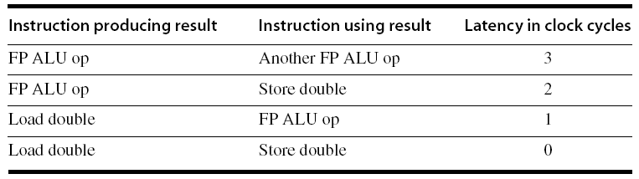
Compiler Techniques for Exposing ILP
Compiler Techniques
Pipeline scheduling
  Separate dependent instruction from the source instruction by the pipeline latency of the source instruction
Example:
  for (i=999; i>=0; i=i-1)
  x[i] = x[i] + s;

Slide 29
Pipeline Stalls
Loop: L.D F0,0(R1)
stall
ADD.D F4,F0,F2
stall
stall
S.D F4,0(R1)
DADDUI R1,R1,#-8
stall (assume integer load latency is 1)
BNE R1,R2,Loop
9 clock cycles/loop
Compiler Techniques

Slide 30
Pipeline Scheduling
Scheduled code:
Loop: L.D F0,0(R1)
DADDUI R1,R1,#-8
ADD.D F4,F0,F2
stall
stall
S.D F4,8(R1)
BNE R1,R2,Loop
7 clock cycles/loop
Compiler Techniques

Slide 31
Loop Unrolling
Loop unrolling
  Unroll by a factor of 4 (assume # elements is divisible by 4)
  Eliminate unnecessary instructions
Loop: L.D F0,0(R1)
ADD.D F4,F0,F2
S.D F4,0(R1) ;drop DADDUI & BNE
L.D F6,-8(R1)
ADD.D F8,F6,F2
S.D F8,-8(R1) ;drop DADDUI & BNE
L.D F10,-16(R1)
ADD.D F12,F10,F2
S.D F12,-16(R1) ;drop DADDUI & BNE
L.D F14,-24(R1)
ADD.D F16,F14,F2
S.D F16,-24(R1)
DADDUI R1,R1,#-32
BNE R1,R2,Loop
6X4 + 3 ➔ 27/4 clock cycles/loop
Compiler Techniques
note: number of live registers vs. original loop

Slide 32
Loop Unrolling/Pipeline Scheduling
Pipeline schedule the unrolled loop:
Loop: L.D F0,0(R1)
L.D F6,-8(R1)
L.D F10,-16(R1)
L.D F14,-24(R1)
ADD.D F4,F0,F2
ADD.D F8,F6,F2
ADD.D F12,F10,F2
ADD.D F16,F14,F2
S.D F4,0(R1)
S.D F8,-8(R1)
DADDUI R1,R1,#-32
S.D F12,16(R1)
S.D F16,8(R1)
BNE R1,R2,Loop
3X4 + 2 ➔ 14/4 clock cycles/loop
Compiler Techniques

Slide 33
5 Loop Unrolling Decisions
Requires understanding how one instruction depends on another and how the instructions can be changed or reordered given the dependences:
Determine loop unrolling useful by finding that loop iterations were independent (except for maintenance code)
Use different registers to avoid unnecessary constraints forced by using same registers for different computations
Eliminate the extra test and branch instructions and adjust the loop termination and iteration code
Determine that loads and stores in unrolled loop can be interchanged by observing that loads and stores from different iterations are independent
  Transformation requires analyzing memory addresses and finding that they do not refer to the same address
Schedule the code, preserving any dependences needed to yield the same result as the original code

Slide 34
3 Limits to Loop Unrolling
Decrease in amount of overhead amortized with each extra unrolling
  Amdahl’s Law
Growth in code size
  For larger loops, concern it increases the instruction cache miss rate
Register pressure: potential shortfall in registers created by aggressive unrolling and scheduling
  If not possible to allocate all live values to registers, may lose some or all of its advantage
Loop unrolling reduces impact of branches on pipeline; another way is branch prediction

Slide 35
Strip Mining
Compiler Techniques
Unknown (at compile time) number of loop iterations?
  Number of iterations = n
  Goal: make k copies of the loop body
  Generate pair of loops:
    First executes n mod k times
    Second executes n / k times
    “Strip mining”

Slide 36
Branch Prediction
Branch Prediction
Basic 2-bit predictor:
  For each branch:
    Predict taken or not taken
    If the prediction is wrong two consecutive times, change prediction
Correlating predictor:
  Multiple 2-bit predictors for each branch
  One for each possible combination of outcomes of preceding n branches
Local predictor:
  Multiple 2-bit predictors for each branch
  One for each possible combination of outcomes for the last n occurrences of this branch
Tournament predictor:
  Combine correlating predictor with local predictor

Slide 37
Dynamic Branch Prediction
Solution: 2-bit scheme where change prediction only if get misprediction twice
Blue: stop, not taken
Grey: go, taken
Adds hysteresis to decision making process
T
NT
Predict Taken
Predict Taken
T
T
NT
NT
Predict Not
Taken
Predict Not
Taken
T
NT

Slide 38
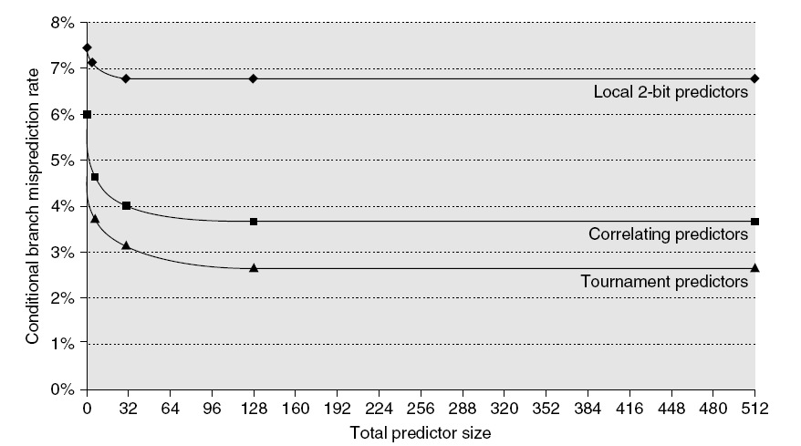
Branch Prediction Performance
Branch Prediction
Branch predictor performance

Slide 39
Dynamic Scheduling
Branch Prediction
Rearrange order of instructions to reduce stalls while maintaining data flow
Advantages:
  Compiler doesn’t need to have knowledge of microarchitecture
  Handles cases where dependencies are unknown at compile time
Disadvantage:
  Substantial increase in hardware complexity
  Complicates exceptions

Slide 40
Dynamic Scheduling
Branch Prediction
Dynamic scheduling implies:
  Out-of-order execution
  Out-of-order completion
Creates the possibility for WAR and WAW hazards
Tomasulo’s Approach
  Tracks when operands are available
  Introduces register renaming in hardware
    Minimizes WAW and WAR hazards

Slide 41
Register Renaming
Branch Prediction
Example:
DIV.D F0,F2,F4
ADD.D F6,F0,F8
S.D F6,0(R1)
SUB.D F8,F10,F14
MUL.D F6,F10,F8
+ name dependence with F6
antidependence
antidependence

Slide 42
Register Renaming
Branch Prediction
Example:
DIV.D F0,F2,F4
ADD.D S,F0,F8
S.D S,0(R1)
SUB.D T,F10,F14
MUL.D F6,F10,T
Now only RAW hazards remain, which can be strictly ordered

Slide 43
Register Renaming
Branch Prediction
Register renaming is provided by reservation stations (RS)
  Contains: Imagine: Place holder for 2 ingredients + cooking instruction
    The instruction Fry [Note: physical image may mislead, since: data broadcast]
    Buffered operand values (when available) [Boiled egg,Steamed carrot]
    Each may not be available when instruction reaches RS. Need to wait for them.
    Reservation station keeps instructions providing the operand values
  RS fetches and buffers an operand boiled egg is ready as soon as it becomes available (not necessarily involving register file)
  Pending instructions designate the RS to which they will send their output egg boiling RS designated frying RS
    Result values broadcast on a result bus, called the common data bus (CDB)
  Only the last output updates the register file in fact, execution engine apparatus
  As instructions are issued, the register specifyiers are renamed with the reservation station
  May be more reservation stations than registers

Slide 44
A Dynamic Algorithm: Tomasulo’s
For IBM 360/91 (before caches!)
  ⇒ Long memory latency
Goal: High Performance without special compilers
Small number of floating point registers (4 in 360) prevented interesting compiler scheduling of operations
  This led Tomasulo to try to figure out how to get more effective registers — renaming in hardware!
Why Study 1966 Computer?
The descendants of this have flourished!
  Alpha 21264, Pentium 4, AMD Opteron, Power 5, …

Slide 45
Tomasulo Algorithm
Control & buffers distributed with Function Units (FU)
  FU buffers called “reservation stations”; have pending operands
Registers in instructions replaced by values or pointers to reservation stations(RS); called register renaming ;
  Renaming avoids WAR, WAW hazards
  More reservation stations than registers, so can do optimizations compilers can’t
Results to FU from RS, not through registers, over Common Data Bus that broadcasts results to all FUs
  Avoids RAW hazards by executing an instruction only when its operands are available
Load and Stores treated as FUs with RSs as well
Integer instructions can go past branches (predict taken), allowing FP ops beyond basic block in FP queue

Slide 46
Tomasulo Organization
From Mem
FP Op
Queue
FP Registers
Load Buffers
Load1
Load2
Load3
Load4
Load5
Load6
Store
Buffers
Add1
Add2
Add3
Mult1
Mult2
Reservation
Stations
To Mem
FP adders
FP multipliers
Common Data Bus (CDB)
Notes:
Resolve RAW memory conflict? (address in memory buffers)
Integer unit executes in parallel

Slide 47
Reservation Station Components
Op: Operation to perform in the unit (e.g., + or –)
Vj, Vk: Value of Source operands
  Store buffers has V field, result to be stored
Qj, Qk: Reservation stations producing source registers (value to be written)
  Note: Qj,Qk=0 => ready
  Store buffers only have Qi for RS producing result
Busy: Indicates reservation station or FU is busy
Register result status—Indicates which functional unit will write each register, if one exists. Blank when no pending instructions that will write that register.
Notes:
What you might have thought
1. 4 stages of instruction executino
2.Status of FU: Normal things to keep track of (RAW & structura for busyl):
Fi from instruction format of the mahine (Fi is dest)
Add unit can Add or Sub
Rj, Rk - status of registers (Yes means ready)
Qj,Qk - If a no in Rj, Rk, means waiting for a FU to write result; Qj, Qk means wihch FU waiting for it
3.Status of register result (WAW &WAR)s:
which FU is going to write into registers
Scoreboard on 6600 = size of FU
6.7, 6.8, 6.9, 6.12, 6.13, 6.16, 6.17
FU latencies: Add 2, Mult 10, Div 40 clocks

Slide 48
Three Stages of Tomasulo Algorithm
1. Issue—get instruction from FP Op Queue
  If reservation station free (no structural hazard),
  control issues instr & sends operands (renames registers).
2. Execute—operate on operands (EX)
  When both operands ready then execute;
  if not ready, watch Common Data Bus for result
3. Write result—finish execution (WB)
  Write on Common Data Bus to all awaiting units;
  mark reservation station available
Normal data bus: data + destination (“go to” bus)
Common data bus: data + source (“come from” bus)
  64 bits of data + 4 bits of Functional Unit source address
  Write if matches expected Functional Unit (produces result)
  Does the broadcast
Example speed:
3 clocks for Fl .pt. +,-; 10 for * ; 40 clks for /

Slide 49
Tomasulo Example
Instruction stream
3 Load/Buffers
FU count
down
3 FP Adder R.S.
2 FP Mult R.S.
Clock cycle
counter

Slide 50
Dependence Graph
‘Data Flow’ Perspective
Draw a node for each instruction
Draw and incoming edge for each data-dependence (including anti dependence)

Slide 51
The dependence graph.
6 nodes shown.
Add directed edge for RAW: result register = operand
Note: F6 is WAR (or WAW)
LD F6 MULTD F0 F2 F4
DIVD F10 F0 F6
LD F2 SUBD F8 F6 F2
ADDD F6 F8 F2

Slide 52
Tomasulo Example Cycle 1

Slide 53
Tomasulo Example Cycle 2
Note: Can have multiple loads outstanding

Slide 54
Tomasulo Example Cycle 3
Note: registers names are removed (“renamed”) in Reservation Stations; MULT issued
Load1 completing; what is waiting for Load1?

Slide 55
Tomasulo Example Cycle 4
Load2 completing; what is waiting for Load2?

Slide 56
Tomasulo Example Cycle 5
Timer starts down for Add1, Mult1. Unclear: Add starts at 2. Not 3.
Note: DIVD already has the value of F6 ➔ No WAR hazard for ADDD

Slide 57
Tomasulo Example Cycle 6
Repeating: Issue ADDD here despite name dependency on F6?

Slide 58
Tomasulo Example Cycle 7
Add1 (SUBD) completing; what is waiting for it?

Slide 59
Tomasulo Example Cycle 8

Slide 60
Tomasulo Example Cycle 9

Slide 61
Tomasulo Example Cycle 10
Add2 (ADDD) completing; what is waiting for it?

Slide 62
Tomasulo Example Cycle 11
Write result of ADDD here?
All quick instructions complete in this cycle!

Slide 63
Tomasulo Example Cycle 12

Slide 64
Tomasulo Example Cycle 13

Slide 65
Tomasulo Example Cycle 14

Slide 66
Tomasulo Example Cycle 15
Mult1 (MULTD) completing; what is waiting for it?

Slide 67
Tomasulo Example Cycle 16
Just waiting for Mult2 (DIVD) to complete

Slide 68
Faster than light computation
(skip a couple of cycles)

Slide 69
Tomasulo Example Cycle 55

Slide 70
Tomasulo Example Cycle 56
Mult2 (DIVD) is completing; what is waiting for it?

Slide 71
Tomasulo Example Cycle 57
Once again: In-order issue, out-of-order execution and out-of-order completion.

Slide 72
Why can Tomasulo overlap iterations of loops?
Register renaming
  Multiple iterations use different physical destinations for registers (dynamic loop unrolling).
Reservation stations
  Permit instruction issue to advance past integer control flow operations
  Also buffer old values of registers - totally avoiding the WAR stall
Other perspective: Tomasulo building data flow dependency graph on the fly

Slide 73
Tomasulo’s scheme offers 2 major advantages
Distribution of the hazard detection logic
  distributed reservation stations and the CDB
  If multiple instructions waiting on single result, & each instruction has other operand, then instructions can be released simultaneously by broadcast on CDB
  If a centralized register file were used, the units would have to read their results from the registers when register buses are available
Elimination of stalls for WAW and WAR hazards

Slide 74
Tomasulo Drawbacks
Complexity
  delays of 360/91, MIPS 10000, Alpha 21264,
  IBM PPC 620 in CA:AQA 2/e, but not in silicon!
Many associative stores (CDB) at high speed
Performance limited by Common Data Bus
  Each CDB must go to multiple functional units
  ⇒high capacitance, high wiring density
  Number of functional units that can complete per cycle limited to one!
    Multiple CDBs ⇒ more FU logic for parallel assoc stores
Non-precise interrupts!
  We will address this later

Slide 75
And In Conclusion … #1
Leverage Implicit Parallelism for Performance: Instruction Level Parallelism
Loop unrolling by compiler to increase ILP
Branch prediction to increase ILP
Dynamic HW exploiting ILP
  Works when can’t know dependence at compile time
  Can hide L1 cache misses
  Code for one machine runs well on another

Slide 76
And In Conclusion … #2
Reservations stations: renaming to larger set of registers + buffering source operands
  Prevents registers as bottleneck
  Avoids WAR, WAW hazards
  Allows loop unrolling in HW
Not limited to basic blocks
(integer units gets ahead, beyond branches) with speculation
Helps cache misses as well
Lasting Contributions
  Dynamic scheduling
  Register renaming
  Load/store disambiguation
360/91 descendants are Intel Pentium 4, IBM Power 5, AMD Athlon/Opteron, …

Slide 77
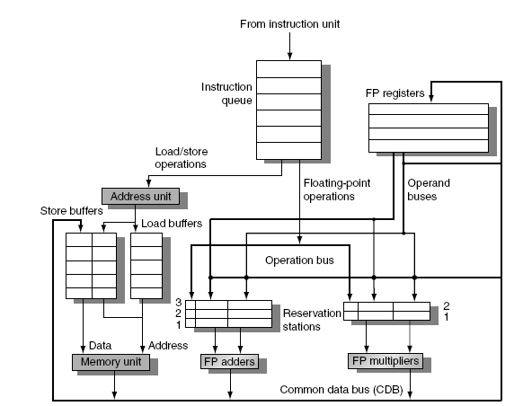
Tomasulo’s Algorithm
Branch Prediction
Load and store buffers
  Contain data and addresses, act like reservation stations
Top-level design:

Slide 78
Tomasulo’s Algorithm
Three Steps:
  Issue
    Get next instruction from FIFO queue
    If available RS, issue the instruction to the RS with operand values if available
    If operand values not available, stall the instruction
  Execute
    When operand becomes available, store it in any of the reservation stations waiting for it
    When all operands are ready, issue the instruction
    Loads and store maintained in program order through effective address
    No instruction allowed to initiate execution until all branches that proceed it in program order have completed
  Write result
    Write result on CDB into reservation stations and store buffers
      (Stores must wait until address and value are received)
Branch Prediction

Slide 79
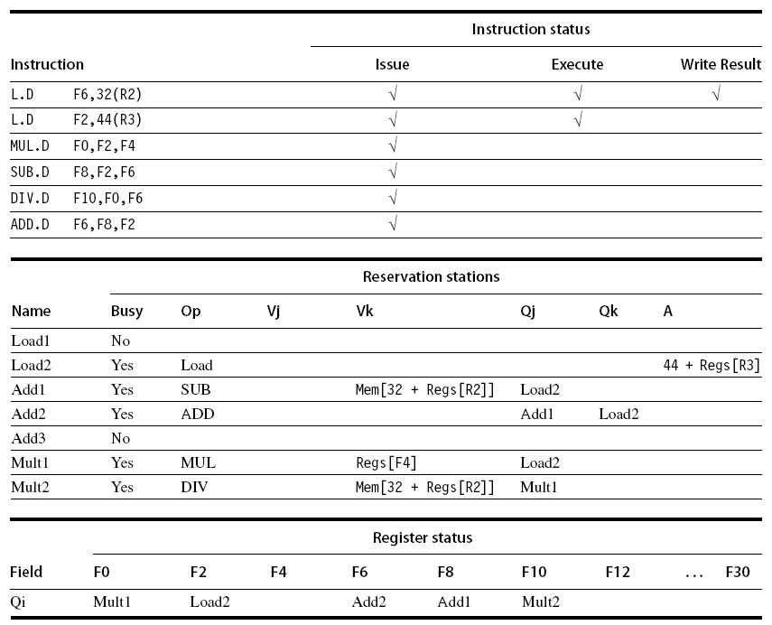
Example
Branch Prediction

Slide 80
Hardware-Based Speculation
Branch Prediction
Execute instructions along predicted execution paths but only commit the results if prediction was correct
Instruction commit: allowing an instruction to update the register file when instruction is no longer speculative
Need an additional piece of hardware to prevent any irrevocable action until an instruction commits
  I.e. updating state or taking an execution

Slide 81
Reorder Buffer
Branch Prediction
Reorder buffer – holds the result of instruction between completion and commit
Four fields:
  Instruction type: branch/store/register
  Destination field: register number
  Value field: output value
  Ready field: completed execution?
Modify reservation stations:
  Operand source is now reorder buffer instead of functional unit

Slide 82
Reorder Buffer
Branch Prediction
Register values and memory values are not written until an instruction commits
On misprediction:
  Speculated entries in ROB are cleared
Exceptions:
  Not recognized until it is ready to commit

Slide 83
Multiple Issue and Static Scheduling
To achieve CPI < 1, need to complete multiple instructions per clock
Solutions:
  Statically scheduled superscalar processors
  VLIW (very long instruction word) processors
  dynamically scheduled superscalar processors
Multiple Issue and Static Scheduling

Slide 84
Getting CPI below 1
CPI ≥ 1 if issue only 1 instruction every clock cycle
Multiple-issue processors come in 3 flavors:
  statically-scheduled superscalar processors,
  dynamically-scheduled superscalar processors, and
  VLIW (very long instruction word) processors
2 types of superscalar processors issue varying numbers of instructions per clock
  use in-order execution if they are statically scheduled, or
  out-of-order execution if they are dynamically scheduled
VLIW processors, in contrast, issue a fixed number of instructions formatted either as one large instruction or as a fixed instruction packet with the parallelism among instructions explicitly indicated by the instruction (Intel/HP Itanium)

Slide 85
VLIW: Very Large Instruction Word
Each “instruction” has explicit coding for multiple operations
  In IA-64, grouping called a “packet”
Tradeoff instruction space for simple decoding
  The long instruction word has room for many operations
  By definition, all the operations the compiler puts in the long instruction word are independent => execute in parallel
  E.g., 2 integer operations, 2 FP ops, 2 Memory refs, 1 branch
    16 to 24 bits per field => 7*16 or 112 bits to 7*24 or 168 bits wide
  Need compiling technique that schedules across several branches

Slide 86
Recall: Unrolled Loop that Minimizes Stalls for Scalar
1 Loop: L.D F0,0(R1)
2 L.D F6,-8(R1)
3 L.D F10,-16(R1)
4 L.D F14,-24(R1)
5 ADD.D F4,F0,F2
6 ADD.D F8,F6,F2
7 ADD.D F12,F10,F2
8 ADD.D F16,F14,F2
9 S.D 0(R1),F4
10 S.D -8(R1),F8
11 S.D -16(R1),F12
12 DSUBUI R1,R1,#32
13 BNEZ R1,LOOP
14 S.D 8(R1),F16 ; 8-32 = -24
14 clock cycles, or 3.5 per iteration
L.D to ADD.D: 1 Cycle
ADD.D to S.D: 2 Cycles

Slide 87
Loop Unrolling in VLIW
Memory Memory FP FP Int. op/ Clock
reference 1 reference 2 operation 1 op. 2 branch
L.D F0,0(R1) L.D F6,-8(R1) 1
L.D F10,-16(R1) L.D F14,-24(R1) 2
L.D F18,-32(R1) L.D F22,-40(R1) ADD.D F4,F0,F2 ADD.D F8,F6,F2 3
L.D F26,-48(R1) ADD.D F12,F10,F2 ADD.D F16,F14,F2 4
ADD.D F20,F18,F2 ADD.D F24,F22,F2 5
S.D 0(R1),F4 S.D -8(R1),F8 ADD.D F28,F26,F2 6
S.D -16(R1),F12 S.D -24(R1),F16 7
S.D -32(R1),F20 S.D -40(R1),F24 DSUBUI R1,R1,#48 8
S.D -0(R1),F28 BNEZ R1,LOOP 9
Unrolled 7 times to avoid delays. 7 results in 9 clocks, or 1.3 clocks per iteration (1.8X)
Average: 2.5 ops per clock, 50% efficiency. Note: Need more registers in VLIW (15 vs. 6 in SS)

Slide 88
Problems with 1st Generation VLIW
Increase in code size
  generating enough operations in a straight-line code fragment requires ambitiously unrolling loops
  whenever VLIW instructions are not full, unused functional units translate to wasted bits in instruction encoding
Operated in lock-step; no hazard detection HW
  a stall in any functional unit pipeline caused entire processor to stall, since all functional units must be kept synchronized
  Compiler might predict function units, but caches hard to predict
Binary code compatibility
  Pure VLIW => different numbers of functional units and unit latencies require different versions of the code

Slide 89
Intel/HP IA-64 “Explicitly Parallel Instruction Computer (EPIC)”
IA-64: instruction set architecture
128 64-bit integer regs + 128 82-bit floating point regs
  Not separate register files per functional unit as in old VLIW
Hardware checks dependencies
(interlocks => binary compatibility over time)
Predicated execution (select 1 out of 64 1-bit flags)
=> 40% fewer mispredictions?
Itanium™ was first implementation (2001)
  Highly parallel and deeply pipelined hardware at 800Mhz
  6-wide, 10-stage pipeline at 800Mhz on 0.18 µ process
Itanium 2™ is name of 2nd implementation (2005)
  6-wide, 8-stage pipeline at 1666Mhz on 0.13 µ process
  Caches: 32 KB I, 32 KB D, 128 KB L2I, 128 KB L2D, 9216 KB L3

Slide 90
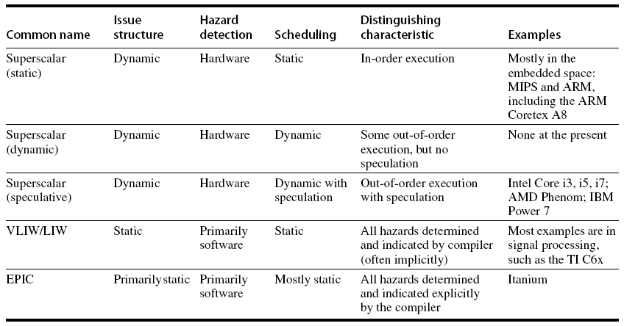
Multiple Issue
Multiple Issue and Static Scheduling
ARM Cortex A15 already OOO with speculation

Slide 91
VLIW Processors
Package multiple operations into one instruction
Example VLIW processor:
  One integer instruction (or branch)
  Two independent floating-point operations
  Two independent memory references
Must be enough parallelism in code to fill the available slots
Multiple Issue and Static Scheduling

Slide 92
VLIW Processors
Disadvantages:
  Statically finding parallelism
  Code size
  No hazard detection hardware
  Binary code compatibility
Multiple Issue and Static Scheduling

Slide 93
Dynamic Scheduling, Multiple Issue, and Speculation
Modern microarchitectures:
  Dynamic scheduling + multiple issue + speculation
Two approaches:
  Assign reservation stations and update pipeline control table in half clock cycles
    Only supports 2 instructions/clock
  Design logic to handle any possible dependencies between the instructions
  Hybrid approaches
Issue logic can become bottleneck
Dynamic Scheduling, Multiple Issue, and Speculation

Slide 94
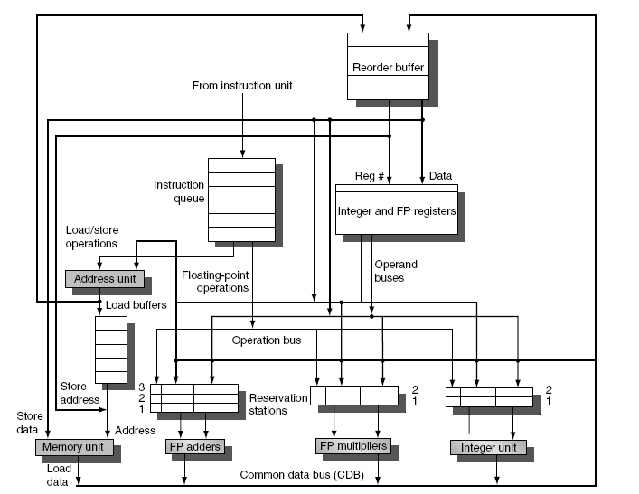
Overview of Design
Dynamic Scheduling, Multiple Issue, and Speculation

Slide 95
Multiple Issue
Limit the number of instructions of a given class that can be issued in a “bundle”
  I.e. on FP, one integer, one load, one store
Examine all the dependencies among the instructions in the bundle
If dependencies exist in bundle, encode them in reservation stations
Also need multiple completion/commit
Dynamic Scheduling, Multiple Issue, and Speculation

Slide 96
Limits to ILP
Conflicting studies of amount
  Benchmarks (vectorized Fortran FP vs. integer C programs)
  Hardware sophistication
  Compiler sophistication
How much ILP is available using existing mechanisms with increasing HW budgets?
Do we need to invent new HW/SW mechanisms to keep on processor performance curve?
  Intel MMX, SSE (Streaming SIMD Extensions): 64 bit ints
  Intel SSE2: 128 bit, including 2 64-bit Fl. Pt. per clock
  Motorola AltaVec: 128 bit ints and FPs
  Supersparc Multimedia ops, etc.

Slide 97
Overcoming Limits
Advances in compiler technology + significantly new and different hardware techniques may be able to overcome limitations assumed in studies
However, unlikely such advances when coupled with realistic hardware will overcome these limits in near future

Slide 98
Limits to ILP Discuss: does it provide an upper bound?
Initial HW Model here; MIPS compilers.
Assumptions for ideal/perfect machine to start:
1. Register renaming – infinite virtual registers
=> all register WAW & WAR hazards are avoided
2. Branch prediction – perfect; no mispredictions
3. Jump prediction – all jumps perfectly predicted (returns, case statements)
2 & 3 ⇒ no control dependencies; perfect speculation & an unbounded buffer of instructions available
4. Memory-address alias analysis – addresses known & a load can be moved before a store provided addresses not equal; 1&4 eliminates all but RAW
Also: perfect caches; 1 cycle latency for all instructions (FP *,/); unlimited instructions issued/clock cycle;

Slide 99
Limits to ILP HW Model comparison
 | Model | Power 5
Instructions Issued per clock | Infinite | 4
Instruction Window Size | Infinite | 200
Renaming Registers | Infinite | 48 integer + 40 Fl. Pt.
Branch Prediction | Perfect | 2% to 6% misprediction (Tournament Branch Predictor)
Cache | Perfect | 64KI, 32KD, 1.92MB L2, 36 MB L3
Memory Alias Analysis | Perfect | ??

Slide 100
Upper Limit to ILP: Ideal Machine
FP: 75 - 150
Integer: 18 - 60
Instructions Per Clock

Slide 101
Pages 214-215
A set of programs was compiled & optimized with standard MIPs optimizing compilers
The programs were instrumented and executed to produce a trace of the instructions and data references
Every instruction in the trace was scheduled as early as possible, limited only by data dependences
Since a trace is used, perfect branch prediction and perfect alias analysis are easy to do
These mechanisms allow scheduling instructions much earlier they would otherwise, moving across large number of instructions on which they are not data dependent including branches, since branches are perfectly predicted

Slide 102
Limits to ILP HW Model comparison
 | New Model | Model | Power 5
Instructions Issued per clock | Infinite | Infinite | 4
Instruction Window Size | Infinite, 2K, 512, 128, 32 | Infinite | 200
Renaming Registers | Infinite | Infinite | 48 integer + 40 Fl. Pt.
Branch Prediction | Perfect | Perfect | 2% to 6% misprediction (Tournament Branch Predictor)
Cache | Perfect | Perfect | 64KI, 32KD, 1.92MB L2, 36 MB L3
Memory Alias | Perfect | Perfect | ??

Slide 103
More Realistic HW: Window Impact
Change from Infinite window 2048, 512, 128, 32
FP: 9 - 150
Integer: 8 - 63
IPC

Slide 104
Limits to ILP HW Model comparison
 | New Model | Model | Power 5
Instructions Issued per clock | 64 | Infinite | 4
Instruction Window Size | 2048 | Infinite | 200
Renaming Registers | Infinite | Infinite | 48 integer + 40 Fl. Pt.
Branch Prediction | Perfect vs. 8K Tournament vs. 512 2-bit vs. profile vs. none | Perfect | 2% to 6% misprediction (Tournament Branch Predictor)
Cache | Perfect | Perfect | 64KI, 32KD, 1.92MB L2, 36 MB L3
Memory Alias | Perfect | Perfect | ??

Slide 105
More Realistic HW: Branch Impact
Change from Infinite window to examine to 2048 and maximum issue of 64 instructions per clock cycle
FP: 15 - 45
Integer: 6 - 12
IPC
Perfect
Tournament
BHT (512)
Profile
No prediction

Slide 106
Misprediction Rates

Slide 107
Limits to ILP HW Model comparison
 | New Model | Model | Power 5
Instructions Issued per clock | 64 | Infinite | 4
Instruction Window Size | 2048 | Infinite | 200
Renaming Registers | Infinite v. 256, 128, 64, 32, none | Infinite | 48 integer + 40 Fl. Pt.
Branch Prediction | 8K 2-bit | Perfect | Tournament Branch Predictor
Cache | Perfect | Perfect | 64KI, 32KD, 1.92MB L2, 36 MB L3
Memory Alias | Perfect | Perfect | Perfect

Slide 108
More Realistic HW: Renaming Register Impact (N int + N fp)
Change 2048 instr window, 64 instr issue, 8K 2 level Prediction
FP: 11 - 45
Integer: 5 - 15
IPC
Infinite
256
128
64
32
None

Slide 109
Limits to ILP HW Model comparison
 | New Model | Model | Power 5
Instructions Issued per clock | 64 | Infinite | 4
Instruction Window Size | 2048 | Infinite | 200
Renaming Registers | 256 Int + 256 FP | Infinite | 48 integer + 40 Fl. Pt.
Branch Prediction | 8K 2-bit | Perfect | Tournament
Cache | Perfect | Perfect | 64KI, 32KD, 1.92MB L2, 36 MB L3
Memory Alias | Perfect v. Stack v. Inspect v. none | Perfect | Perfect

Slide 110
More Realistic HW: Memory Address Alias Impact
Change 2048 instr window, 64 instr issue, 8K 2 level Prediction, 256 renaming registers
FP: 4 - 45
(Fortran,
no heap)
Integer: 4 - 9
IPC
Perfect
Global/Stack perf;
heap conflicts
Inspec.
Assem.
None

Slide 111
Limits to ILP HW Model comparison
 | New Model | Model | Power 5
Instructions Issued per clock | 64 (no restrictions) | Infinite | 4
Instruction Window Size | Infinite vs. 256, 128, 64, 32 | Infinite | 200
Renaming Registers | 64 Int + 64 FP | Infinite | 48 integer + 40 Fl. Pt.
Branch Prediction | 1K 2-bit | Perfect | Tournament
Cache | Perfect | Perfect | 64KI, 32KD, 1.92MB L2, 36 MB L3
Memory Alias | HW disambiguation | Perfect | Perfect

Slide 112
Realistic HW: Window Impact
Perfect disambiguation (HW), 1K Selective Prediction, 16 entry return, 64 registers, issue as many as window
FP: 8 - 45
IPC
Integer: 6 - 12
Infinite
256
128
64
32
16
8
4

Slide 113
Limits to ILP Discuss: does it provide an upper bound?
What else could we do?
Theoretical answer Transform code to a different code that does the same thing.
Example Arithmetic expression (== Binary tree).
Even when serial (height is ~n with n terms)
ax+b(x+c(x+d(x+e(x+ …))))
can be transformed to height ~log n. [Take ENEE651, S16]
Take home be careful.
  - Wrong to say that the most optimistic bounds above cannot be improved
  - Wrong to say that these (optimistic) bounds can be achieved

Slide 114
Back-up from here to end

Slide 115
Example
Loop: LD R2,0(R1) ;R2=array element
DADDIU R2,R2,#1 ;increment R2
SD R2,0(R1) ;store result
DADDIU R1,R1,#8 ;increment pointer
BNE R2,R3,LOOP ;branch if not last element
Dynamic Scheduling, Multiple Issue, and Speculation

Slide 116
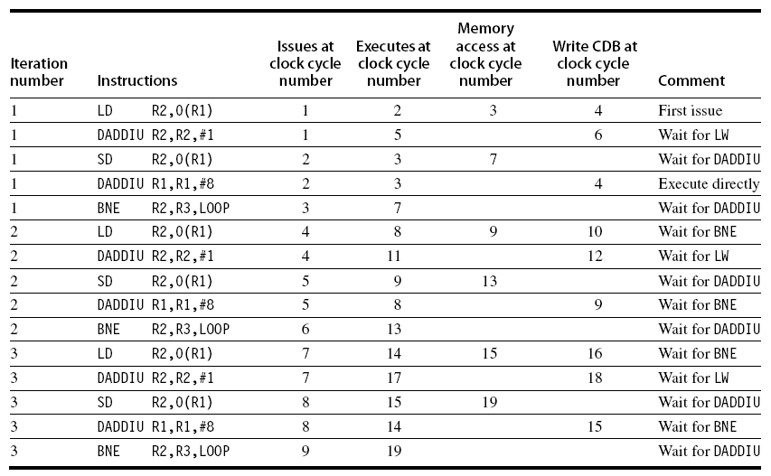
Example (No Speculation)
Dynamic Scheduling, Multiple Issue, and Speculation

Slide 117
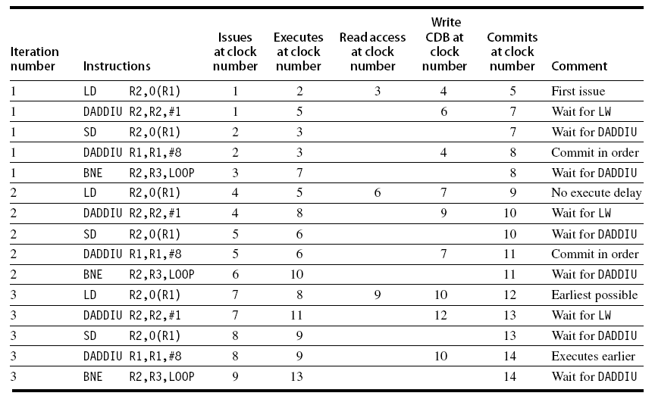
Example
Dynamic Scheduling, Multiple Issue, and Speculation

Slide 118
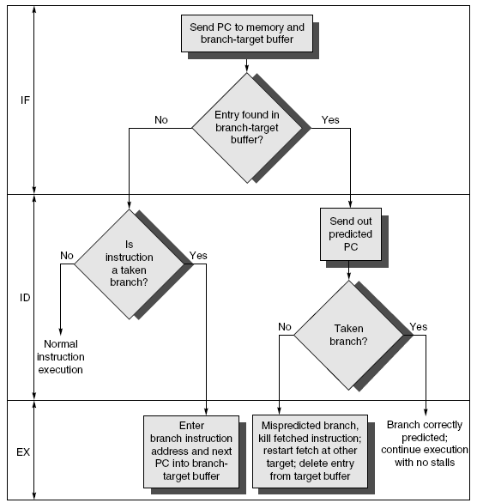
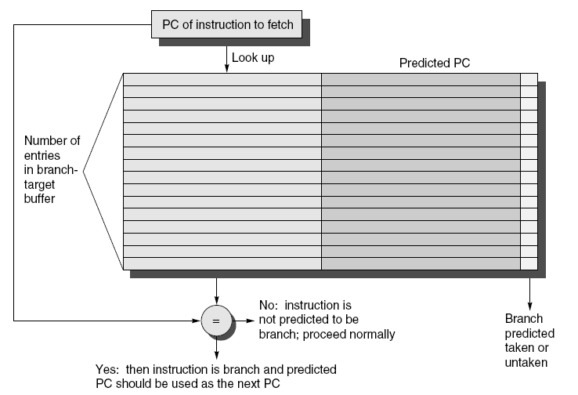
Branch-Target Buffer
Need high instruction bandwidth!
  Branch-Target buffers
    Next PC prediction buffer, indexed by current PC
Adv. Techniques for Instruction Delivery and Speculation

Slide 119
Branch Folding
Optimization:
  Larger branch-target buffer
  Add target instruction into buffer to deal with longer decoding time required by larger buffer
  “Branch folding”
Adv. Techniques for Instruction Delivery and Speculation

Slide 120
Return Address Predictor
Most unconditional branches come from function returns
The same procedure can be called from multiple sites
  Causes the buffer to potentially forget about the return address from previous calls
Create return address buffer organized as a stack
Adv. Techniques for Instruction Delivery and Speculation

Slide 121
Integrated Instruction Fetch Unit
Design monolithic unit that performs:
  Branch prediction
  Instruction prefetch
    Fetch ahead
  Instruction memory access and buffering
    Deal with crossing cache lines
Adv. Techniques for Instruction Delivery and Speculation

Slide 122
Register Renaming
Register renaming vs. reorder buffers
  Instead of virtual registers from reservation stations and reorder buffer, create a single register pool
    Contains visible registers and virtual registers
  Use hardware-based map to rename registers during issue
  WAW and WAR hazards are avoided
  Speculation recovery occurs by copying during commit
  Still need a ROB-like queue to update table in order
  Simplifies commit:
    Record that mapping between architectural register and physical register is no longer speculative
    Free up physical register used to hold older value
    In other words: SWAP physical registers on commit
  Physical register de-allocation is more difficult
Adv. Techniques for Instruction Delivery and Speculation

Slide 123
Integrated Issue and Renaming
Combining instruction issue with register renaming:
  Issue logic pre-reserves enough physical registers for the bundle (fixed number?)
  Issue logic finds dependencies within bundle, maps registers as necessary
  Issue logic finds dependencies between current bundle and already in-flight bundles, maps registers as necessary
Adv. Techniques for Instruction Delivery and Speculation

Slide 124
How Much?
How much to speculate
  Mis-speculation degrades performance and power relative to no speculation
    May cause additional misses (cache, TLB)
  Prevent speculative code from causing higher costing misses (e.g. L2)
Speculating through multiple branches
  Complicates speculation recovery
  No processor can resolve multiple branches per cycle
Adv. Techniques for Instruction Delivery and Speculation

Slide 125
Energy Efficiency
Speculation and energy efficiency
  Note: speculation is only energy efficient when it significantly improves performance
Value prediction
  Uses:
    Loads that load from a constant pool
    Instruction that produces a value from a small set of values
  Not been incorporated into modern processors
  Similar idea--address aliasing prediction--is used on some processors
Adv. Techniques for Instruction Delivery and Speculation

