Slide 1
Computer Architecture
A Quantitative Approach, Fifth Edition
Chapter 2
Memory Hierarchy Design

Slide 2
Introduction
Introduction
Programmers want unlimited amounts of memory with low latency
Fast memory technology is more expensive per bit than slower memory
Solution: organize memory system into a hierarchy
Entire addressable memory space available in largest, slowest memory
Incrementally smaller and faster memories, each containing a subset of the memory below it, proceed in steps up toward the processor
Temporal and spatial locality insures that nearly all references can be found in smaller memories
Gives the allusion of a large, fast memory being presented to the processor

Slide 3
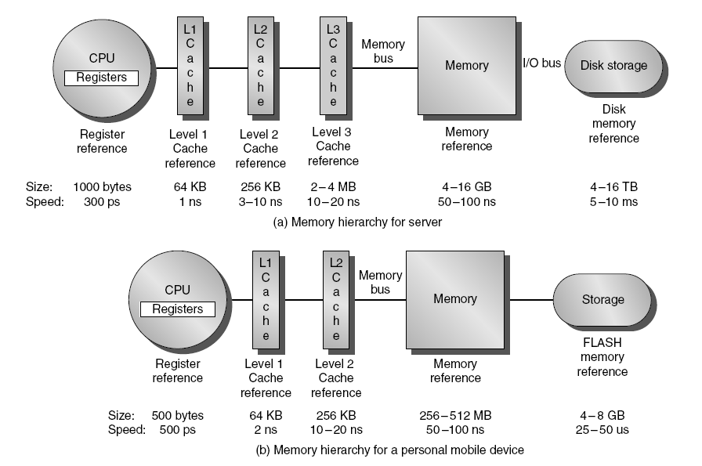
Memory Hierarchy
Introduction

Slide 4
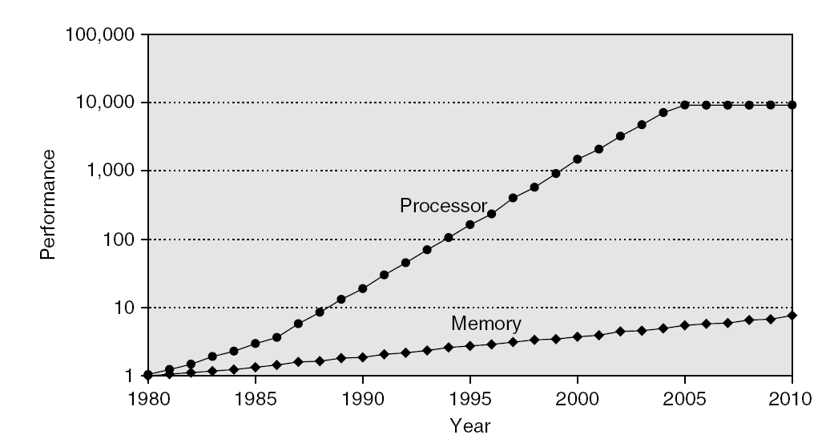
Memory Performance Gap
Introduction

Slide 5
Memory Hierarchy Design
Introduction
Memory hierarchy design becomes more crucial with recent multi-core processors:
Aggregate peak bandwidth grows with # cores:
Intel Core i7 can generate two references per core per clock
Four cores and 3.2 GHz clock (4X2X3.2=25.6)
25.6 billion 64-bit data references/second +
12.8 billion 128-bit instruction references
= 409.6 GB/s!
DRAM bandwidth is only 6% of this (25 GB/s)
Requires:
Multi-port, pipelined caches
Two levels of cache per core
Shared third-level cache on chip

Slide 6
Performance and Power
Introduction
High-end microprocessors have >10 MB on-chip cache
Consumes large amount of area and power budget

Slide 7
Memory Hierarchy Basics
Introduction
First: Read Appendix B!
When a word is not found in the cache, a miss occurs:
Fetch word from lower level in hierarchy, requiring a higher latency reference
Lower level may be another cache or the main memory
Also fetch the other words contained within the block
Takes advantage of spatial locality
Place block into cache in any location within its set, determined by address
block address MOD number of sets

Slide 8
4 Questions for Memory Hierarchy
Q1: Where can a block be placed in the upper level? (Block placement)
Q2: How is a block found if it is in the upper level? (Block identification)
Q3: Which block should be replaced on a miss? (Block replacement)
Q4: What happens on a write? (Write strategy)

Slide 9
Q1: Where can a block be placed in the upper level?
Block 12 placed in 8 block cache:
Fully associative, direct mapped, 2-way set associative
S.A. Mapping = Block Number Modulo Number Sets
Direct Mapped
(12 mod 8) = 4
2-Way Assoc
(12 mod 4) = 0
Full Mapped
01234567
01234567
01234567
Cache
1111111111222222222233
01234567890123456789012345678901
Memory

Slide 10
Q2: How is a block found if it is in the upper level?
Tag on each block
No need to check index or block offset
Tag is used to check all block in the set, the index is used to select the set. The block offset is the address of the desired data within the block. Fully-associative caches have no index field.
Increasing associativity shrinks index, expands tag
Block Address
Block
Offset
Tag
Index

Slide 11
Q3: Which block should be replaced on a miss?
Easy for Direct Mapped
Set Associative or Fully Associative:
Random
LRU (Least Recently Used)
Assoc: 2-way 4-way 8-way
Size LRU Ran LRU Ran LRU Ran
16 KB 5.2% 5.7% 4.7% 5.3% 4.4% 5.0%
64 KB 1.9% 2.0% 1.5% 1.7% 1.4% 1.5%
256 KB 1.15% 1.17% 1.13% 1.13% 1.12% 1.12%

Slide 12
Q3: After a cache read miss, if there are no empty cache blocks, which block should be removed from the cache?
The Least Recently Used (LRU) block? Appealing,
but hard to implement for high associativity
A randomly chosen block?
Easy to implement, how
well does it work?
Miss Rate for 2-way Set Associative Cache
Size | Random | LRU
16 KB | 5.7% | 5.2%
64 KB | 2.0% | 1.9%
256 KB | 1.17% | 1.15%
Also,
try
other
LRU
approx.

Slide 13
Q4: What happens on a write?
 | Write-Through | Write-Back
Policy | Data written to cache block also written to lower-level memory | Write data only to the cache Update lower level when a block falls out of the cache
Debug | Easy | Hard
Do read misses produce writes? | No | Yes
Do repeated writes make it to lower level? | Yes | No
Additional option -- let writes to an un-cached address allocate a new cache line (“write-allocate”).

Slide 14
Write Buffers for Write-Through Caches
Cache
Lower Level Memory
Processor
Write Buffer
Holds data awaiting write-through to
lower level memory
Q. Why a write buffer ?
A. So CPU doesn’t stall
Q. Why a buffer, why not just one register ?
A. Bursts of writes are
common.
Q. Are Read After Write (RAW) hazards an issue for write buffer?
A. Yes! Drain buffer before next read, or send read 1st after check write buffers.

Slide 15
Memory Hierarchy Basics
Introduction
n sets => n-way set associative
Direct-mapped cache => one block per set
Fully associative => one set
Writing to cache: two strategies
Write-through
Immediately update lower levels of hierarchy
Write-back
Only update lower levels of hierarchy when an updated block is replaced
Both strategies use write buffer to make writes asynchronous

Slide 16
Memory Hierarchy Basics
Introduction
Miss rate
Fraction of cache access that result in a miss
Causes of misses
Compulsory
First reference to a block
Capacity
Blocks discarded and later retrieved since cache cannot contain all blocks needed during execution.
Conflict
In set associative or direct mapped cache, if program makes repeated references to multiple addresses from different blocks that map to the same set/location in the cache (due to going from fully associative to set associative)

Slide 17
Memory Hierarchy Basics
Introduction
Note that speculative and multithreaded processors may execute other instructions during a miss
Reduces performance impact of misses

Slide 18
Memory Hierarchy Basics
Introduction
Six basic cache optimizations (or “knobs” since impact mixed):
Larger block size
Reduces compulsory misses
Increases capacity and conflict misses, increases miss penalty
Larger total cache capacity to reduce miss rate
Increases hit time, increases power consumption
Higher associativity
Reduces conflict misses
Increases hit time, increases power consumption
Higher number of cache levels
Reduces overall memory access time
Giving priority to read misses over writes
Reduces miss penalty
Avoiding address translation in cache indexing
Reduces hit time

Slide 19
Ten Advanced Optimizations (ch. 2)
Small and simple first level caches
Critical timing path:
addressing tag memory, then
comparing tags, then
selecting correct set
Direct-mapped caches can overlap tag compare and transmission of data (pre-set mux ; speculative?)
Lower associativity reduces power because fewer cache lines are accessed
Advanced Optimizations

Slide 20
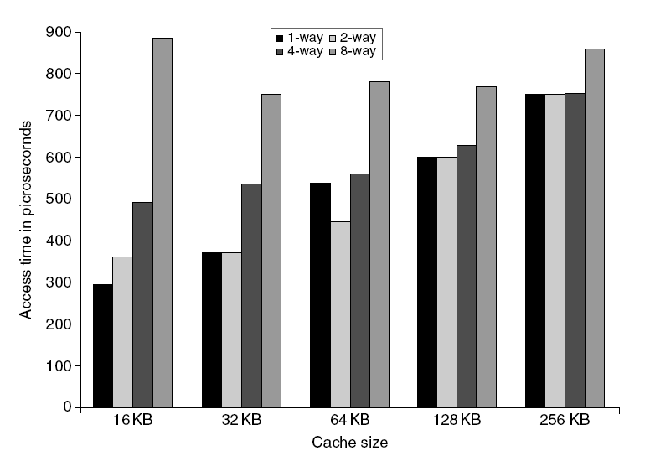
L1 Size and Associativity
Advanced Optimizations
Book only says: results are surprising; perhaps due to some non monotonicity.
Depend on
technology & design assumptions
Access time vs. size and associativity

Slide 21
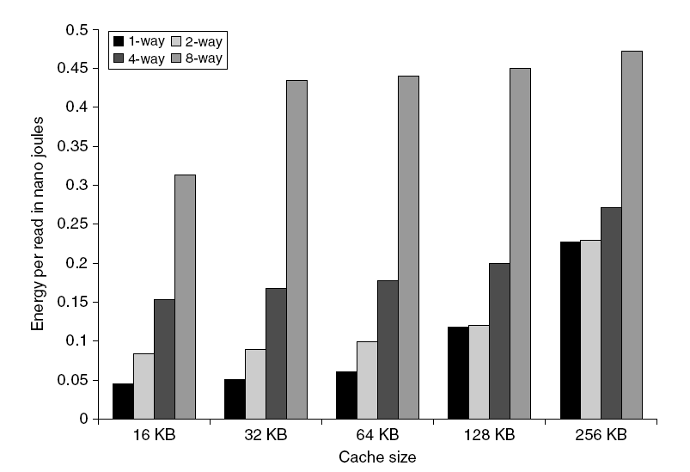
L1 Size and Associativity
Advanced Optimizations
Energy per read vs. size and associativity

Slide 22
Way Prediction 1990s ENEE446: “predict as much as you can”
To improve hit time, predict the way to pre-set mux extra bits in cache to predict the or block for next cache access. To reduce conflict misses for (say) direct mapped cache: extra bits to predict miss and possibly missed block
Mis-prediction gives longer hit time
Prediction accuracy
> 90% for two-way
> 80% for four-way
I-cache has better accuracy than D-cache
First used on MIPS R10000 in mid-90s
Used on ARM Cortex-A8
Extend to predict block as well
“Way selection” use way prediction bits to decide which cache block to access
Increases mis-prediction penalty
What matter in this part: know the ideas even when names get confusing
Advanced Optimizations

Slide 23
2nd explanation. Fast Hit times via Way Prediction
How to combine fast hit time of Direct Mapped and have the lower conflict misses of 2-way SA cache?
Way prediction: keep extra bits in cache to predict the “way,” or block within the set, of next cache access.
Multiplexer is set early to select desired block, only 1 tag comparison performed that clock cycle in parallel with reading the cache data
Miss ⇒ 1st check other blocks for matches in next clock cycle

Slide 24
Pipelining Cache
Pipeline cache access to improve bandwidth
Examples:
Pentium: 1 cycle
Pentium Pro – Pentium III: 2 cycles
Pentium 4 – Core i7: 4 cycles (note: increased hit time)
Increases branch mis-prediction (ch 3) penalty
Makes it easier to increase associativity
Advanced Optimizations

Slide 25
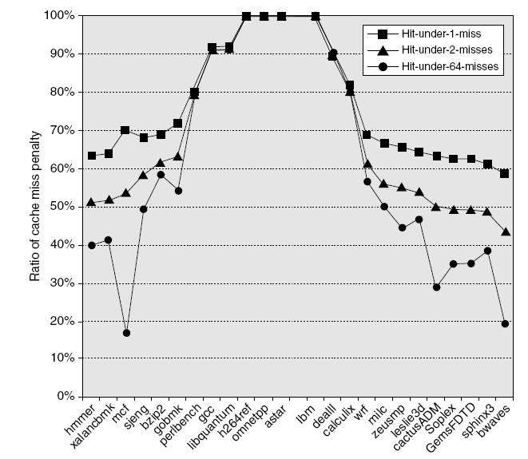
Nonblocking Caches
For pipelined computer that allow out of order execution (Ch. 3…): The processor need not stall on data cache miss.
Allow hits before previous misses complete
“Hit under miss”
“Hit under multiple miss”
L2 must support this
In general, processors can hide L1 miss penalty but not L2 miss penalty
Advanced Optimizations
In text:
Cache
access
Latency..
SPECINT SPECFP

Slide 26
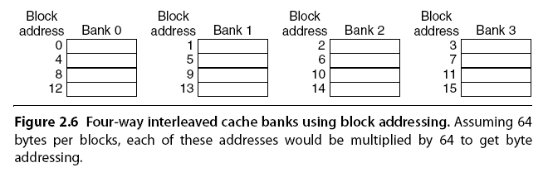
Multibanked Caches
Organize cache as independent banks to support simultaneous access
ARM Cortex-A8 supports 1-4 banks for L2
Intel i7 supports 4 banks for L1 and 8 banks for L2
Interleave banks according to block address
Works best when accesses naturally spread themselves across banks
What if not?
Advanced Optimizations

Slide 27
Critical Word First, Early Restart
Critical word first
Request missed word from memory first
Send it to the processor as soon as it arrives
Early restart
Request words in normal order
Send missed work to the processor as soon as it arrives
Effectiveness of these strategies depends on block size and likelihood of another access to the portion of the block that has not yet been fetched
Advanced Optimizations

Slide 28
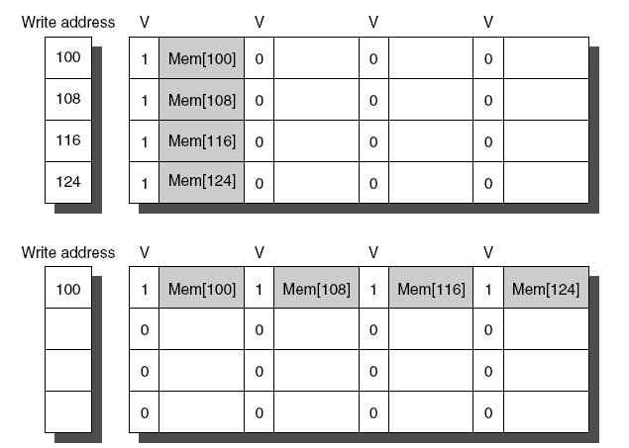
Merging Write Buffer
When storing to a block that is already pending in the write buffer, update write buffer if buffer contains modifed block check for match & merge if yes
Reduces stalls due to full write buffer
Do not apply to I/O addresses “since I/O device registers are often mapped to physical address space”
Advanced Optimizations
No write buffering
Write buffering

Slide 29
Compiler Optimizations
Loop Interchange
Swap nested loops to access memory in sequential order
Example: replace column after column matrix access by row after row
Blocking
Instead of accessing entire rows or columns, subdivide matrices into blocks
Requires more memory accesses but improves locality of accesses
Advanced Optimizations

Slide 30
Loop Interchange Example
/* Before */
for (k = 0; k < 100; k = k+1)
for (j = 0; j < 100; j = j+1)
for (i = 0; i < 5000; i = i+1)
x[i][j] = 2 * x[i][j];
/* After */
for (k = 0; k < 100; k = k+1)
for (i = 0; i < 5000; i = i+1)
for (j = 0; j < 100; j = j+1)
x[i][j] = 2 * x[i][j];
Sequential accesses instead of striding through memory every 100 words; improved spatial locality

Slide 31
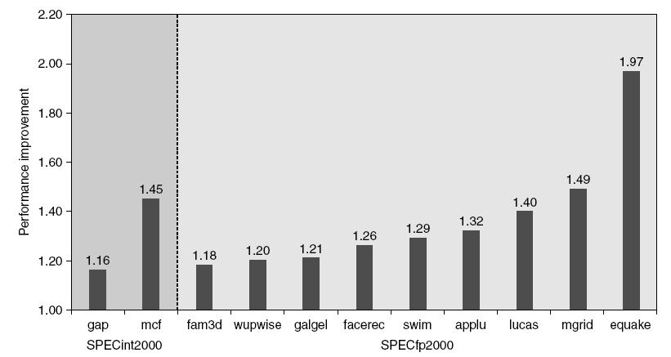
Hardware Prefetching yet another prediction
Fetch two blocks on miss (include next sequential block)
Advanced Optimizations
Pentium 4 Pre-fetching
Text: “Only the programs that benefit most are shown”

Slide 32
Compiler Prefetching
Insert prefetch instructions before data is needed
Non-faulting: prefetch doesn’t cause exceptions
Register prefetch
Loads data into register
Cache prefetch
Loads data into cache
Combine with loop unrolling and software pipelining
Advanced Optimizations

Slide 33
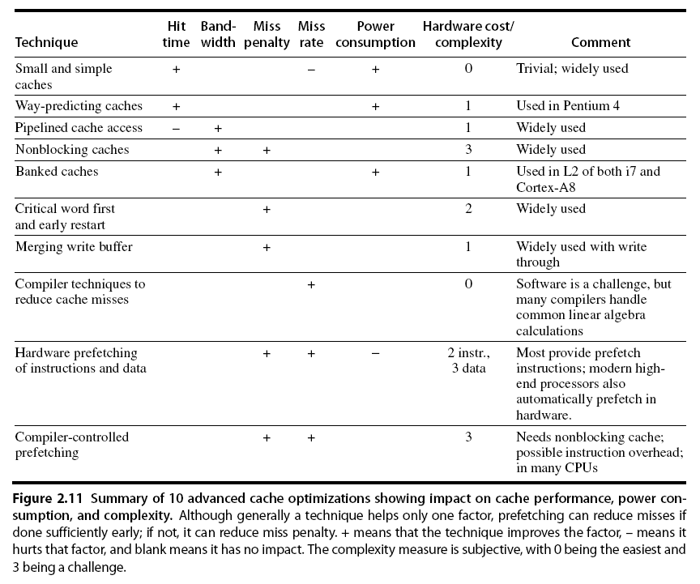
Summary
Advanced Optimizations

Slide 34
Memory Technology
Memory Technology
Performance metrics
Latency is concern of cache
Bandwidth is concern of multiprocessors and I/O
Access time
Time between read request and when desired word arrives
Cycle time
Minimum time between unrelated requests to memory
DRAM used for main memory, SRAM used for cache

Slide 35
Memory Technology
Memory Technology
SRAM
Requires low power to retain bit
Requires 6 transistors/bit
DRAM
Must be re-written after being read
Must also be periodically refeshed
Every ~ 8 ms
Each row can be refreshed simultaneously
One transistor/bit
Address lines are multiplexed:
Upper half of address: row access strobe (RAS)
Lower half of address: column access strobe (CAS)

Slide 36
Memory Technology
Memory Technology
Amdahl:
Memory capacity should grow linearly with processor speed
Unfortunately, memory capacity and speed has not kept pace with processors (speed & number of cores)
Some optimizations:
Multiple accesses to same row
Synchronous DRAM
Added clock to DRAM interface
Burst mode with critical word first
Wider interfaces
Double data rate (DDR)
Multiple banks on each DRAM device

Slide 37
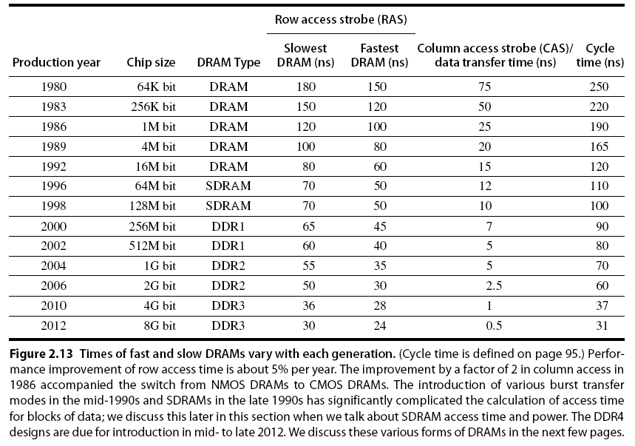
Memory Optimizations
Memory Technology

Slide 38
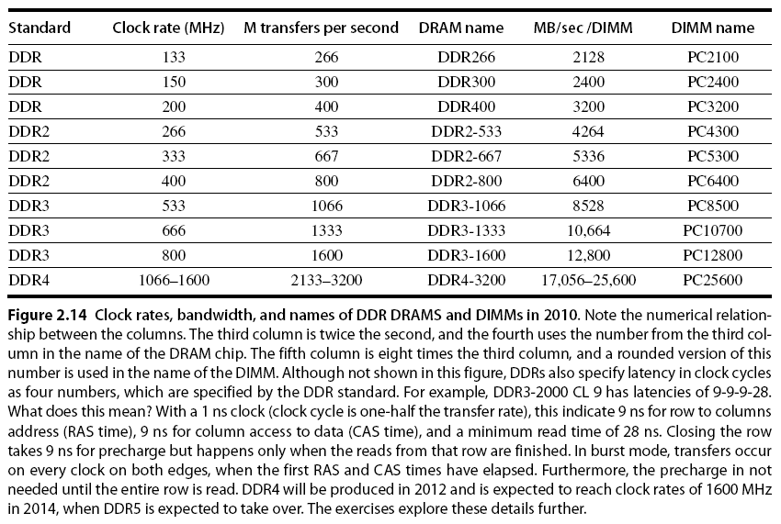
Memory Optimizations
Memory Technology

Slide 39
Quest for DRAM Performance
Fast Page mode
Add timing signals that allow repeated accesses to row buffer without another row access time
Such a buffer comes naturally, as each array will buffer 1024 to 2048 bits for each access
Synchronous DRAM (SDRAM)
Add a clock signal to DRAM interface, so that the repeated transfers would not bear overhead to synchronize with DRAM controller
Double Data Rate (DDR SDRAM)
Transfer data on both the rising edge and falling edge of the DRAM clock signal ⇒ doubling the peak data rate
DDR2 lowers power by dropping the voltage from 2.5 to 1.8 volts + offers higher clock rates: up to 400 MHz
DDR3 drops to 1.5 volts + higher clock rates: up to 800 MHz
Improved Bandwidth, not Latency

Slide 40
Memory Optimizations
Memory Technology
DDR:
DDR2
Lower power (2.5 V -> 1.8 V)
Higher clock rates (266 MHz, 333 MHz, 400 MHz)
DDR3
1.5 V
800 MHz
DDR4
1-1.2 V
1600 MHz
GDDR5 is graphics memory based on DDR3

Slide 41
Memory Optimizations
Memory Technology
Graphics memory:
Achieve 2-5 X bandwidth per DRAM vs. DDR3
Wider interfaces (32 vs. 16 bit)
Higher clock rate
Possible because they are attached via soldering instead of socketted DIMM (Dual Inline memory modules). DRAM are commonly sold on boards called DIMMs contaning 4-16 DRAMs
Reducing power in SDRAMs:
Lower voltage
Low power mode (ignores clock, continues to refresh)

Slide 42
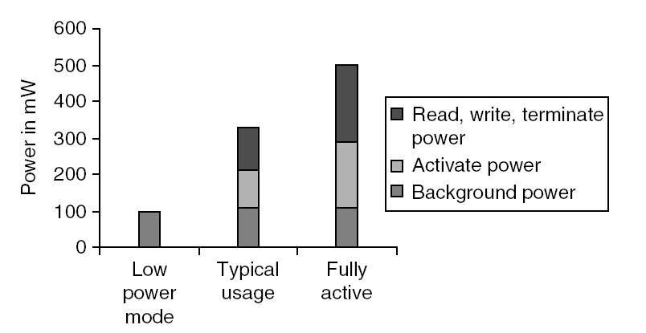
Memory Power Consumption
Memory Technology

Slide 43
Flash Memory
Memory Technology
Type of EEPROM
Must be erased (in blocks) before being overwritten
Non volatile
Limited number of write cycles
Cheaper than SDRAM, more expensive than disk
Slower than SRAM, faster than disk

Slide 44
Memory Dependability
Memory Technology
Memory is susceptible to cosmic rays very high energy particles, mainly originating in outer space, outside the solar system
Soft errors: dynamic errors
Detected and fixed by error correcting codes (ECC)
Hard errors: permanent errors
Use sparse rows to replace defective rows
Chipkill: a RAID-like error recovery technique

Slide 45
Protection
Virtual memory
Virtual machines

Slide 46
The Limits of Physical Addressing
“Physical addresses” of memory locations
A0-A31
A0-A31
CPU
Memory
D0-D31
D0-D31
Data
All programs share one address space:
The physical address space
Machine language programs must be
aware of the machine organization
No way to prevent a program from accessing any machine resource

Slide 47
Solution: Add a Layer of Indirection
“Virtual Addresses”
“Physical Addresses”
A0-A31
Virtual
Physical
A0-A31
CPU
Address
Translation
Memory
D0-D31
D0-D31
Data
User programs run in an standardized
virtual address space
Address Translation hardware
managed by the operating system (OS)
maps virtual address to physical memory
Hardware supports “modern” OS features:
Protection, Translation, Sharing

Slide 48
Three Advantages of Virtual Memory
Translation:
Program can be given consistent view of memory, even though physical memory is scrambled
Makes multithreading reasonable (now used a lot!)
Only the most important part of program (“Working Set”) must be in physical memory.
Contiguous structures (like stacks) use only as much physical memory as necessary yet still grow later.
Protection:
Different threads (or processes) protected from each other.
Different pages can be given special behavior
(Read Only, Invisible to user programs, etc).
Kernel data protected from User programs
Very important for protection from malicious programs
Sharing:
Can map same physical page to multiple users (“Shared memory”)

Slide 49
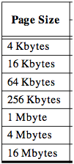
Page tables encode virtual address spaces
Page Table
Physical
Memory Space
A virtual address space
is divided into blocks
of memory called pages
frame
frame
frame
frame
A machine usually supports
pages of a few sizes
(MIPS R4000):
virtual address
OS manages the page table for each ASID
A page table is indexed by a
virtual address
A valid page table entry codes physical memory “frame” address for the page

Slide 50
Details of Page Table
Page Table
Physical
Memory Space
Virtual Address
frame
12
frame
V page no.
offset
frame
frame
Page Table
Page Table
Base Reg
V
Access
Rights
PA
index
into
page
table
virtual address
table located
in physical
memory
P page no.
offset
12
Physical Address
Page table maps virtual page numbers to physical frames (“PTE” = Page Table Entry)
Virtual memory => treat memory ≈ cache for disk

Slide 51
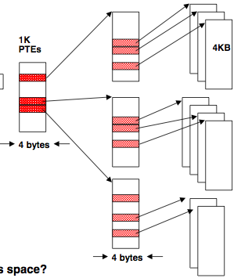
Page tables may not fit in memory!
A table for 4KB pages for a 32-bit address space has 1M entries
Each process needs its own address space!
Two-level Page Tables
32 bit virtual address
31
22
21
12
11
0
P1 index
P2 index
Page Offset
Top-level table wired in main memory
Subset of 1024 second-level tables in main memory; rest are on disk or unallocated

Slide 52
VM and Disk: Page replacement policy
Page Table
Dirty bit: page written.
Used bit: set to
1 on any reference
dirty
used
1 0
...
1 0
0 1
1 1
0 0
Set of all pages
in Memory
Tail pointer:
Clear the used
bit in the
page table
Head pointer
Place pages on free list if used bit
is still clear.
Schedule pages with dirty bit set to
be written to disk.
Freelist
Architect’s role: support setting dirty and used bits
Free Pages

Slide 53
TLB Design Concepts
(Translation Look-Aside Buffer)
Anecdote TLB preceded caches, since address delays preceded data & instruction delays. Still what is better known: TLBs or caches?

Slide 54
MIPS Address Translation: How does it work?
“Virtual Addresses”
“Physical Addresses”
A0-A31
Virtual
Physical
A0-A31
Translation
Look-Aside
Buffer
(TLB)
CPU
Memory
D0-D31
D0-D31
Data
What is the table of
mappings that it caches?
Translation Look-Aside Buffer (TLB)
A small fully-associative cache of
mappings from virtual to physical addresses
TLB also contains
protection bits for virtual address
Fast common case: Virtual address is in TLB,
process has permission to read/write it.

Slide 55
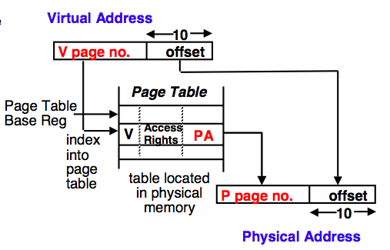
Backup The TLB caches page table entries
Physical and virtual pages must be the same size!
TLB caches page table entries.
Physical
frame
address
virtual address
off
for ASID
page
Page Table
2
0
1
3
V=0 pages either reside on disk or have not yet been allocated.
OS handles V=0
“Page fault”
physical address
TLB
page
off
frame
page
2
2
MIPS handles TLB misses in software (random replacement). Other machines use hardware.
0
5

Slide 56
Summary: TLB, Virtual Memory
Page tables map virtual address to physical address
TLBs are important for fast translation
TLB misses are significant in processor performance
funny times, as most systems can’t access all of 2nd level cache without TLB misses!
Caches, TLBs, Virtual Memory all understood by examining how they deal with 4 questions: 1) Where can block be placed? 2) How is block found? 3) What block is replaced on miss? 4) How are writes handled?
Today VM allows many processes to share single memory without having to swap all processes to disk; today VM protection is more important than memory hierarchy benefits, but computers insecure
Notes:
Let’s do a short review of what you learned last time.
Virtual memory was originally invented as another level of memory hierarchy such that programers, faced with main memory much smaller than their programs, do not have to manage the loading and unloading portions of their program in and out of memory.
It was a controversial proposal at that time because very few programers believed software can manage the limited amount of memory resource as well as human.
This all changed as DRAM size grows exponentially in the last few decades.
Nowadays, the main function of virtual memory is to allow multiple processes to share the same main memory so we don’t have to swap all the non-active processes to disk.
Consequently, the most important function of virtual memory these days is to provide memory protection.
The most common technique, but we like to emphasis not the only technique, to translate virtual memory address to physical memory address is to use a page table.
TLB, or translation lookaside buffer, is one of the most popular hardware techniques to reduce address translation time.
Since TLB is so effective in reducing the address translation time, what this means is that TLB misses will have a significant negative impact on processor performance.
+3 = 3 min. (X:43)

Slide 57
Introduction to Virtual Machines
VMs developed in late 1960s
Remained important in mainframe computing over the years
Largely ignored in single user computers of 1980s and 1990s
Recently regained popularity due to
increasing importance of isolation and security in modern systems,
failures in security and reliability of standard operating systems,
sharing of a single computer among many unrelated users,
and the dramatic increases in raw speed of processors, which makes the overhead of VMs more acceptable

Slide 58
What is a Virtual Machine (VM)?
Broadest definition includes all emulation methods that provide a standard software interface, such as the Java VM
“(Operating) System Virtual Machines” provide a complete system level environment at binary ISA
Here assume ISAs always match the native hardware ISA
E.g., IBM VM/370, VMware ESX Server, and Xen
Present illusion that VM users have entire computer to themselves, including a copy of OS
Single computer runs multiple VMs, and can support a multiple, different OSes
On conventional platform, single OS “owns” all HW resources
With a VM, multiple OSes all share HW resources
Underlying HW platform is called the host, and its resources are shared among the guest VMs

Slide 59
Virtual Machine Monitors (VMMs)
Virtual machine monitor (VMM) or hypervisor is software that supports VMs
VMM determines how to map virtual resources to physical resources
Physical resource may be time-shared, partitioned, or emulated in software
VMM is much smaller than a traditional OS;
isolation portion of a VMM is ≈ 10,000 lines of code

Slide 60
VMM Overhead?
Depends on the workload
User-level processor-bound programs (e.g., SPEC) have zero-virtualization overhead
Runs at native speeds since OS rarely invoked
I/O-intensive workloads ⇒ OS-intensive ⇒ execute many system calls and privileged instructions ⇒ can result in high virtualization overhead
For System VMs, goal of architecture and VMM is to run almost all instructions directly on native hardware
If I/O-intensive workload is also I/O-bound (I/O is the bottleneck?) ⇒ low processor utilization since waiting for I/O ⇒ processor virtualization can be hidden ⇒ low virtualization overhead

Slide 61
Other Uses of VMs
Focus here on protection
2 Other commercially important uses of VMs
Managing Software
VMs provide an abstraction that can run the complete SW stack, even including old OSes like DOS
Typical deployment: some VMs running legacy OSes, many running current stable OS release, few testing next OS release
Managing Hardware
VMs allow separate SW stacks to run independently yet share HW, thereby consolidating number of servers
Some run each application with compatible version of OS on separate computers, as separation helps dependability
Migrate running VM to a different computer
Either to balance load or to evacuate from failing HW
Basic idea Make everything replaceable: i.e., HW, OS

Slide 62
Requirements of a Virtual Machine Monitor
A VM Monitor (or hypervisor)
Presents a SW interface to guest software,
Isolates state of guests from each other, and
Protects itself from guest software (including guest OSes)
Guest software should behave on a VM exactly as if running on the native HW
Except for performance-related behavior or limitations of fixed resources shared by multiple VMs
Guest software should not be able to change allocation of real system resources directly
Hence, VMM must control ≈ everything even though guest VM and OS currently running is temporarily using them
Access to privileged state, Address translation, I/O, Exceptions and Interrupts, …

Slide 63
Requirements of a Virtual Machine Monitor
VMM must be at higher privilege level than guest VM, which generally run in user mode
Execution of privileged instructions handled by VMM
E.g., Timer interrupt: VMM suspends currently running guest VM, saves its state, handles interrupt, determine which guest VM to run next, and then load its state
Guest VMs that rely on timer interrupt provided with virtual timer and an emulated timer interrupt by VMM
Requirements of system virtual machines are ≈ same as paged-virtual memory:
At least 2 processor modes, system and user
Privileged subset of instructions available only in system mode, trap if executed in user mode
All system resources controllable only via these instructions

Slide 64
ISA Support for Virtual Machines
If VMs are planned for during design of ISA, easy to reduce instructions that must be executed by a VMM and how long it takes to emulate them
Since VMs have been considered for desktop/PC server apps only recently, most ISAs were created without virtualization in mind, including 80x86 and most RISC architectures
VMM must ensure that guest system only interacts with virtual resources ⇒ conventional guest OS runs as user mode program on top of VMM
If guest OS attempts to access or modify information related to HW resources via a privileged instruction--for example, reading or writing the page table pointer--it will trap to the VMM
If not, VMM must intercept instruction and support a virtual version of the sensitive information as the guest OS expects (examples soon)

Slide 65
Impact of VMs on Virtual Memory
Virtualization of virtual memory if each guest OS in every VM manages its own set of page tables?
VMM separates real and physical memory
Makes real memory a separate, intermediate level between virtual memory and physical memory
Some use the terms virtual memory, physical/”real” memory, and machine memory to name the 3 levels
Guest OS maps virtual memory to real memory via its page tables, and VMM page tables map real memory to physical memory
VMM maintains a shadow page table that maps directly from the guest virtual address space to the physical address space of HW
Rather than pay extra level of indirection on every memory access
VMM must trap any attempt by guest OS to change its page table or to access the page table pointer

Slide 66
ISA Support for VMs & Virtual Memory
IBM 370 architecture added additional level of indirection that is managed by the VMM
Guest OS keeps its page tables as before, so the shadow pages are unnecessary
To virtualize software TLB, VMM manages the real TLB and has a copy of the contents of the TLB of each guest VM
Any instruction that accesses the TLB must trap
TLBs with Process ID tags support a mix of entries from different VMs and the VMM, thereby avoiding flushing of the TLB on a VM switch

Slide 67
Impact of I/O on Virtual Memory
Most difficult part of virtualization
Increasing number of I/O devices attached to the computer
Increasing diversity of I/O device types
Sharing of a real device among multiple VMs,
Supporting the myriad of device drivers that are required, especially if different guest OSes are supported on the same VM system
Give each VM generic versions of each type of I/O device driver, and let VMM to handle real I/O
Method for mapping virtual to physical I/O device depends on the type of device:
Disks partitioned by VMM to create virtual disks for guest VMs
Network interfaces shared between VMs in short time slices, and VMM tracks messages for virtual network addresses to ensure that guest VMs only receive their messages

Slide 68
Comments on Quiz 1
Eye opener: need to study more seriously. Read ahead of class. Read after class.
Not to worry: Small fraction of grade.
Other comments
Would have been easier for me to use prior years notes, all the way to … the 1st edition. But, Computer/Electrical engineers should know how today’s computers are built.
The textbook language is a bit vague, and … so will be your boss. Namely, you will need to get used to cope with it.

