Slide 1
Computer Architecture
A Quantitative Approach, Fifth Edition
Chapter 1
Fundamentals of Quantitative Design and Analysis

Slide 2
Computer Technology
Introduction
Performance improvements:
Improvements in semiconductor technology
Feature size, clock speed
Improvements in computer architectures
Enabled by HLL compilers, UNIX new arch➔no new OS
Lead to RISC architectures but X86 is CISC?
Together have enabled:
Lightweight computers
Productivity-based managed/interpreted programming languages

Slide 3
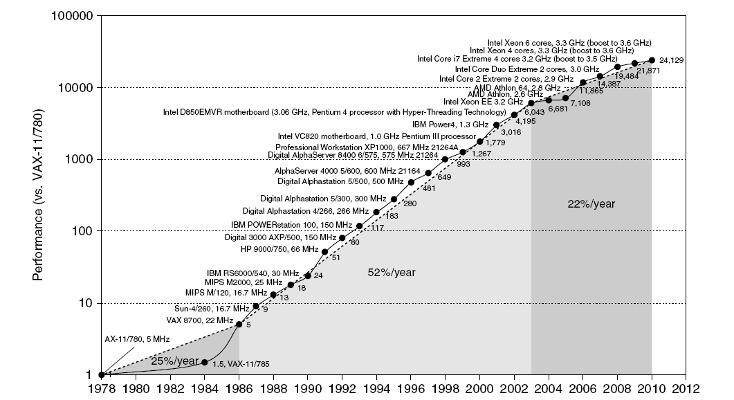
Single Processor Performance
Introduction
Move to multi-processor
RISC
X86 was good enough, till PMD

Slide 4
Current Trends in Architecture
Introduction
Cannot continue to leverage Instruction-Level parallelism (ILP) (basically, assuming serial code)
Single processor performance improvement ended in 2003
New models for performance:
Data-level parallelism (DLP) Operate on many data items at the same time
Thread-level parallelism (TLP) Tasks of work, operate independently and hopefully in parallel
These require explicit restructuring of the application
Don’t blame yourself if you find this confusing. See comments on SIMT in Fig 4.25, p. 314.

Slide 5
Classes of Computers
Personal Mobile Device (PMD) $10 - $100s Standard ARM
e.g. smart phones, tablet computers
Emphasis on energy efficiency and real-time
Desktop Computing $300 – $2,500 Standard X86
Emphasis on price-performance
Servers $5,000 - $10M
Emphasis on availability, scalability, throughput
Clusters / Warehouse Scale Computers $100K - $200M
Used for “Software as a Service (SaaS)”
Emphasis on availability and price-performance
Sub-class: Supercomputers, emphasis: floating-point performance and fast internal networks
Embedded Computers $10 - $100K
Emphasis: price & application specific
Classes of Computers

Slide 6
Parallelism
Classes of parallelism in applications:
Data-Level Parallelism (DLP)
Task-Level Parallelism (TLP)
Request-Level Parallelism (RLP) – Many requests per second (Google queries); mostly independent
Classes of Computers

Slide 7
Parallelism
Classes of architectural parallelism:
Instruction-Level Parallelism (ILP) Exploits DLP at modest level. Compiler help. Pipelining. Speculative execution. ‘Out-of-order’ execution of serial code.
Vector architectures/Graphic Processor Units (GPUs) Exploits DLP by applying a single instruction to a collection of data in parallel
Thread-Level Parallelism Exploits either DLP or TLP. Tightly coupled HW model. Allows interaction among threads
What if DLP defies single instruction and long enough threads?
Request-Level Parallelism Exploits parallelism among largely decoupled tasks. Source: programmer or OS.
Classes of Computers

Slide 8
Flynn’s Taxonomy
Single instruction stream, single data stream (SISD)
Single instruction stream, multiple data streams (SIMD)
Vector architectures
Multimedia extensions
Graphics processor units
Multiple instruction streams, single data stream (MISD)
No commercial implementation
Multiple instruction streams, multiple data streams (MIMD)
Tightly-coupled MIMD
Loosely-coupled MIMD
Classes of Computers

Slide 9
Defining Computer Architecture
“Old” view of computer architecture:
Instruction Set Architecture (ISA) design
i.e. decisions regarding:
registers, memory addressing, addressing modes, instruction operands, available operations, control flow instructions, instruction encoding
“Real” computer architecture:
Design to meet specific requirements of the target machine
Design to maximize performance within constraints: cost, power, and availability
Includes ISA, microarchitecture, hardware
Defining Computer Architecture

Slide 10
Trends in Technology
Integrated circuit technology
Transistor density: 35%/year
Die size: 10-20%/year
Integration overall: 40-55%/year
DRAM capacity: 25-40%/year (slowing)
Flash (electrically erasable programmable read-only memory; standard storage device for PMD; nonvolatile) capacity: 50-60%/year
15-20X cheaper/bit than DRAM
Magnetic disk technology: 40%/year
15-25X cheaper/bit than Flash
300-500X cheaper/bit than DRAM
Trends in Technology

Slide 11
Bandwidth and Latency
Bandwidth or throughput
Total work done in a given time (e.g., MBs/sec)
10,000-25,000X improvement for processors
300-1200X improvement for memory and disks
Latency or response time
Time between start and completion of an event
30-80X improvement for processors
6-8X improvement for memory and disks
Trends in Technology

Slide 12
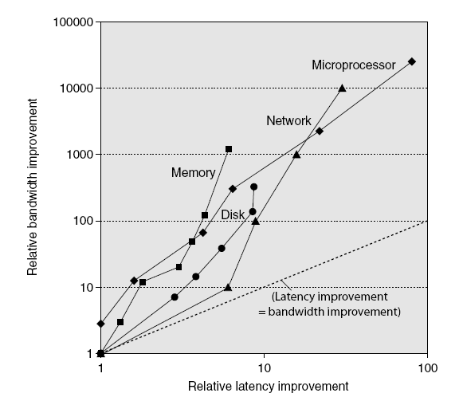
Bandwidth and Latency
Trends in Technology
Log-log plot of bandwidth and latency milestones

Slide 13
Transistors and Wires
Feature size
Minimum size of transistor or wire in x or y dimension
10 microns in 1971 to .032 microns in 2011 and .014 microns (14nm) in 2014
Transistor performance scales linearly
Wire delay does not improve with feature size!
Integration density scales quadratically. Namely, the projected 10nm in 2016 means 1M larger density since 1971. Increase in die size is extra…
Trends in Technology

Slide 14
Power and Energy
Problem: Get power in, get power out
Thermal Design Power (TDP)
Characterizes sustained power consumption
Used as target for power supply and cooling system
Lower than peak power, higher than average power consumption
Clock rate can be reduced dynamically to limit power consumption
Energy per task is often a better measurement
Trends in Power and Energy

Slide 15
Dynamic Energy and Power
Dynamic energy
Transistor switch from 0 -> 1 or 1 -> 0
½ x Capacitive load x Voltage²
Dynamic power
½ x Capacitive load x Voltage² x Frequency switched
Reducing clock rate reduces power, not energy
Trends in Power and Energy

Slide 16
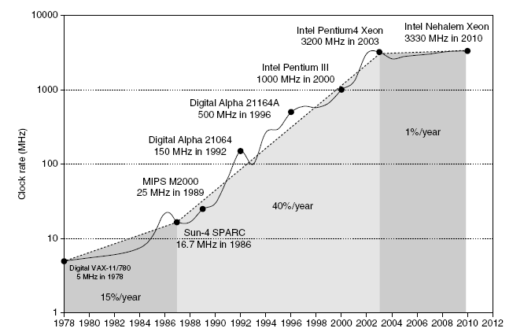
Power
Intel 80386 consumed ~ 2 W
3.3 GHz Intel Core i7 consumes 130 W
Heat must be dissipated from 1.5 x 1.5 cm chip
This is the limit of what can be cooled by air
Trends in Power and Energy

Slide 17
Reducing Power
Techniques for reducing power:
Do nothing well Turn off clock of inactive modules
Dynamic Voltage-Frequency Scaling Multiple clock frequencies and voltages. Switch among them
Low power state for DRAM, disks
Overclocking, turning off cores If safe run one core faster. Turn off others
Trends in Power and Energy

Slide 18
Static Power
Static power consumption
Current_{static} x Voltage
Scales with number of transistors
To reduce: power gating (turn off)
Trends in Power and Energy

Slide 19
Trends in Cost
Trends in Cost
Cost driven down by learning curve
Yield
DRAM: price closely tracks cost
Microprocessors: price depends on volume
10% less for each doubling of volume

Slide 20
Integrated Circuit Cost
Trends in Cost
Integrated circuit
Bose-Einstein formula:
Defects per unit area = 0.016-0.057 defects per square cm (2010)
N = process-complexity factor = 11.5-15.5 (40 nm, 2010)

Slide 21
Dependability
Dependability
Module reliability
Mean time to failure (MTTF)
Mean time to repair (MTTR)
Mean time between failures (MTBF) = MTTF + MTTR
Availability = MTTF / MTBF

Slide 22
Measuring Performance
Typical performance metrics:
Response time
Throughput Total amount of work done in a given time
Speedup of X relative to Y
Execution time_{Y} / Execution time_{X}
Execution time
Wall clock time: includes all system overheads
CPU time: only computation time
Benchmarks
Kernels (e.g. matrix multiply)
Toy programs (e.g. sorting)
Synthetic benchmarks (e.g. Dhrystone)
Benchmark suites (e.g. SPEC06fp, TPC-C). Very impressive (well rounded) representation of applications. Even they must keep changing. Why?
Problems (not in text): Vendor representatives set them.
The next generation of computers: optimized for code that was
optimized for current (or older) computers ➔ inertia
Measuring Performance

Slide 23
Principles of Computer Design
Principles
Take Advantage of Parallelism
e.g. multiple processors, disks, memory banks, pipelining, multiple functional units
Principle of Locality
Reuse of data and instructions
(Evidence for serial code. But, what about parallel?)
Temporal Locality (Locality in Time): If an item is referenced, it will tend to be referenced again soon (e.g., loops, reuse)
Spatial Locality (Locality in Space): If an item is referenced, items whose addresses are close by tend to be referenced soon (e.g., straight-line code, array access)

Slide 24
Principles of Computer Design cnt’d
Principles
Focus on the Common Case
If overflow is rare in addition, optimize for simpler case
Amdahl’s Law Drive 2hrs@30MPH. With 1hr@30MPH speedup is <= 2

Slide 25
Principles of Computer Design
Principles
The Processor Performance Equation
For a given
program
ISA &
Compiler
Technology
HW technology
& organization
Organization
& ISA

Slide 26
Pitfall: Mutiprocessors are a silver bullet
Switch to multiple processors ~2005, not due to insight on parallel programming or architecture breakthrough
Rather: power walls and ILP walls
Performance is now the programmer’s burden – not in the processor performance equation…
Popular version of “Moore’s law” – increasing performance with each generation – is now up to the programmer

Slide 27
Principles of Computer Design
Principles
Different instruction types having different CPIs

