Slide 1
Web Search
Week 6
LBSC 796/INFM 718R
March 9, 2011

Slide 2
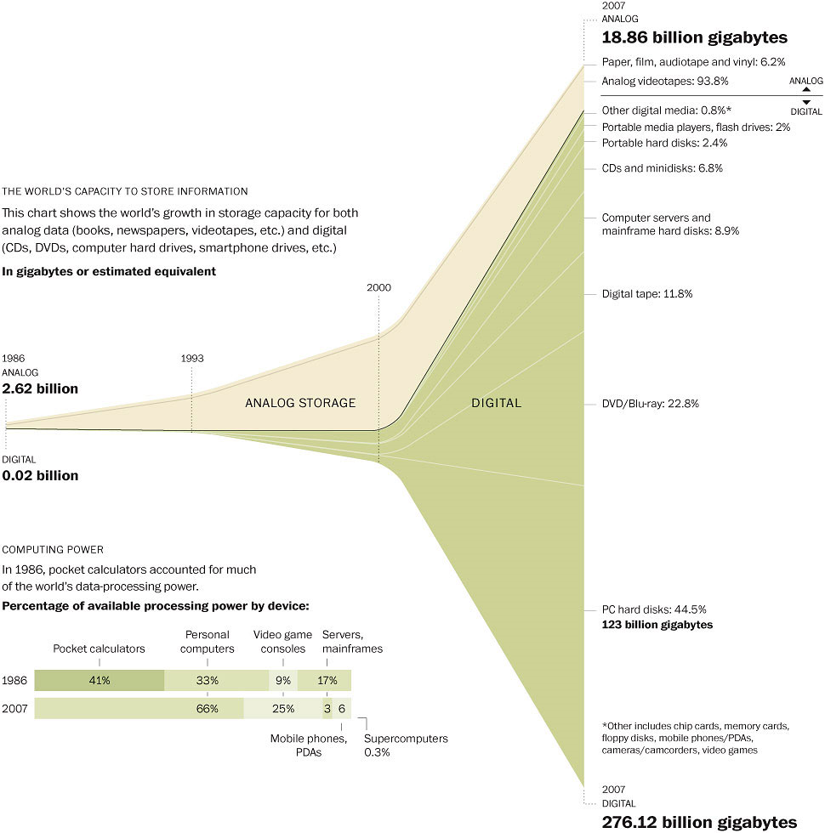
Washington Post, February 10, 2011

Slide 3
What “Caused” the Web?
Affordable storage
300,000 words/$ by 1995
Adequate backbone capacity
25,000 simultaneous transfers by 1995
Adequate “last mile” bandwidth
1 second/screen (of text) by 1995
Display capability
10% of US population could see images by 1995
Effective search capabilities
Lycos and Yahoo! achieved useful scale in 1994-1995

Slide 4
Defining the Web
HTTP, HTML, or URL?
Static, dynamic or streaming?
Public, protected, or internal?

Slide 5
Number of Web Sites

Slide 6
What’s a Web “Site”?
Any server at port 80?
Misses many servers at other ports
Some servers host unrelated content
Geocities
Some content requires specialized servers
rtsp

Slide 7
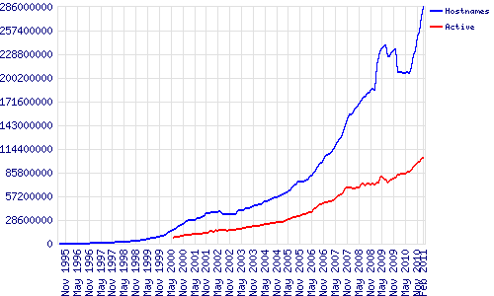
Web Servers

Slide 8
Web Pages (2005)
Gulli and Signorini, 2005

Slide 9
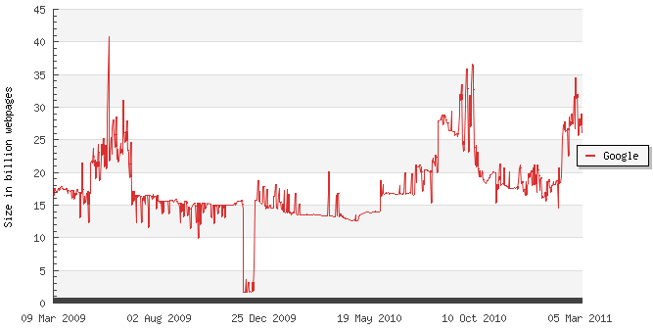
The Indexed Web in 2011

Slide 10
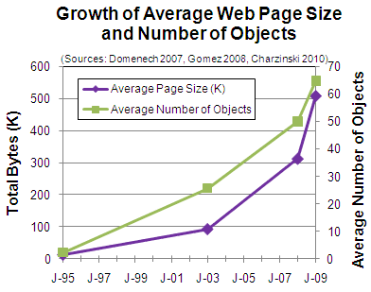

Slide 11
Crawling the Web

Slide 12
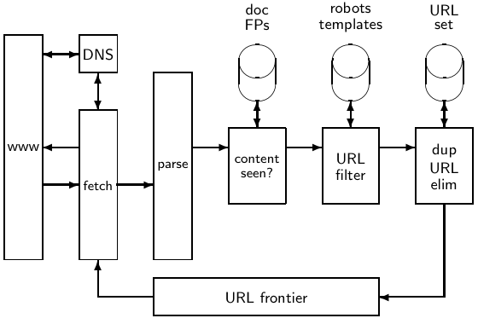
Basic crawl architecture
12

Slide 13
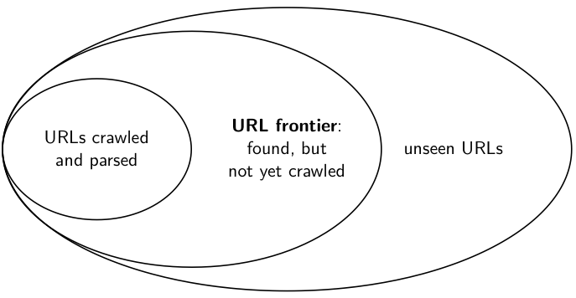
URL frontier
13

Slide 14
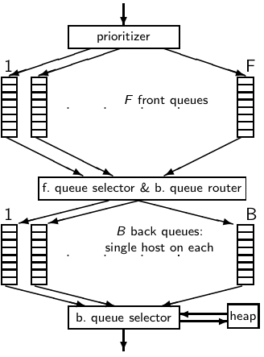
Mercator URL frontier
URLs flow in from the top into the frontier.
Front queues manage prioritization.
Back queues enforce politeness.
Each queue is FIFO.
14

Slide 15
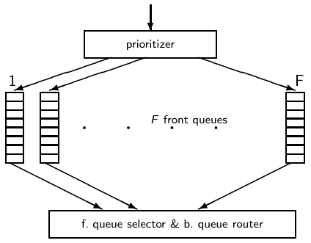
Mercator URL frontier: Front queues
Selection from front queues is initiated by back queues
Pick a front queue from which to select next URL: Round robin, randomly, or more sophisticated variant
But with a bias in favor of high-priority front queues
15

Slide 16
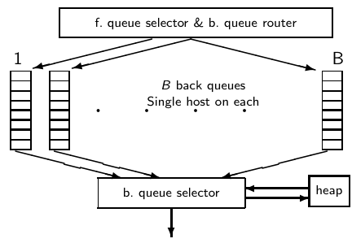
Mercator URL frontier: Back queues
When we have emptied a back queue q:
Repeat (i) pull URLs u from front queues and (ii) add u to its corresponding back queue . . .
. . . until we get a u whose host does not have a back queue.
Then put u in q and create heap entry for it.
16

Slide 17
Web Crawling Algorithm
Put a set of known sites on a queue
Repeat the until the queue is empty:
Take the first page off of the queue
Check to see if this page has been processed
If this page has not yet been processed:
Add this page to the index
Add each link on the current page to the queue
Record that this page has been processed

Slide 18
Link Structure of the Web

Slide 19
Web Crawl Challenges
Politeness
Discovering “islands” and “peninsulas”
Duplicate and near-duplicate content
30-40% of total content
Server and network loads
Dynamic content generation
Link rot
Changes at ~1% per week
Temporary server interruptions
Spider traps

Slide 20
Duplicate Detection
Structural
Identical directory structure (e.g., mirrors, aliases)
Syntactic
Identical bytes
Identical markup (HTML, XML, …)
Semantic
Identical content
Similar content (e.g., with a different banner ad)
Related content (e.g., translated)

Slide 21
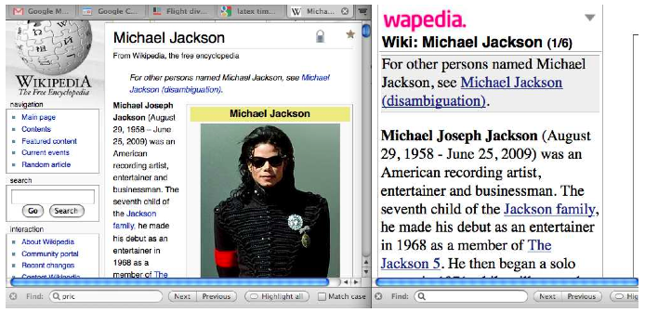
Near-duplicates: Example

Slide 22
Detecting near-duplicates
Compute similarity with an edit-distance measure
We want “syntactic” (as opposed to semantic) similarity.
True semantic similarity (similarity in content) is too difficult to compute.
We do not consider documents near-duplicates if they have the same content, but express it with different words.
Use similarity threshold θ to make the call “is/isn’t a near-duplicate”.
E.g., two documents are near-duplicates if similarity
> θ = 80%.

Slide 23
Represent each document as set of shingles
A shingle is simply a word n-gram.
Shingles are used as features to measure syntactic similarity of documents.
For example, for n = 3, “a rose is a rose is a rose” would be represented as this set of shingles:
{ a-rose-is, rose-is-a, is-a-rose }
We can map shingles to 1..2^{m} (e.g., m = 64) by fingerprinting.
From now on: s_{k} refers to the shingle’s fingerprint in 1..2^{m}.
We define the similarity of two documents as the Jaccard coefficient of their shingle sets.

Slide 24
Shingling: Summary
Input: N documents
Choose n-gram size for shingling, e.g., n = 5
Pick 200 random permutations, represented as hash functions
Compute N sketches: 200 × N matrix shown on previous slide, one row per permutation, one column per document
Compute pairwise similarities
Transitive closure of documents with similarity > θ
Index only one document from each equivalence class

Slide 25
Robots Exclusion Protocol
Depends on voluntary compliance by crawlers
Exclusion by site
Create a robots.txt file at the server’s top level
Indicate which directories not to crawl
Exclusion by document (in HTML head)
Not implemented by all crawlers
<meta name="robots“ content="noindex,nofollow">

Slide 26
Hands on: The Internet Archive
Web crawls since 1997
http://archive.org
Check out the iSchool’s Web site in 1997
Check out the history of your favorite site

Slide 27
Indexing Anchor Text
A type of “document expansion”
Terms near links describe content of the target
Works even when you can’t index content
Image retrieval, uncrawled links, …

Slide 28
Estimating Authority from Links
Hub
Authority
Authority

Slide 29
Simplified PageRank Algorithm
R(u): PageRank score of page u
B_{u}: the set of pages that link to u
R(v): PageRank score of page v
N_{V}: number of links from page v
c: normalization factor

Slide 30
PageRank Algorithm Example
1/2
A
B
1/2
1
1/2
1/2
1
C
D

Slide 31
R2(A) = ½ x 2 + 1 x 2 + 1 x 2 = 5
R2(B)’ = ½ x 2 = 1
R1(A) = 2
1/2
R1(B) = 2
A
B
1/2
1
1/2
1/2
1
C
D
R2(C) = 2
R2(D) = 2
R1(C)’ = ½ x 2 = 1
R1(D)’ = ½ x 2 = 1

Slide 32
R3(A) = ½ x 1 + 1 x 1 + 1 x 1 = 2.5
R3(B) = ½ x 5 = 2.5
R2(A) = 5
1/2
R2(B) = 1
A
B
1/2
1
1/2
1/2
1
C
D
R2(C) = 1
R2(D) = 1
R3(C) = ½ x 5 = 2.5
R3(D) = ½ x 1 = 0.5

Slide 33
Convergence
R(A)’ = ½ x 2 + 1 x 2 + 1 x 1 = 4
R(B)’ = ½ x 4 = 2
R(A) = 4
1/2
R(B) = 2
A
B
1/2
1
1/2
1/2
1
C
D
R(C) = 2
R(D) = 1
R(C)’ = ½ x 4 = 2
R(D)’ = ½ x 2 = 1

Slide 34
Index Spam
Goal: Manipulate rankings of an IR system
Multiple strategies:
Create bogus user-assigned metadata
Add invisible text (font in background color, …)
Alter your text to include desired query terms
“Link exchanges” create links to your page
Cloaking

Slide 35
Spamming with Link Farms
1
R(C) = 1
C
A
B
1
R(A) = 1
1
R(B) = 1
2
1
2
2
3
2
3
3
…
…

Slide 36
Adversarial IR
Search is user-controlled suppression
Everything is known to the search system
Goal: avoid showing things the user doesn’t want
Other stakeholders have different goals
Authors risk little by wasting your time
Marketers hope for serendipitous interest

Slide 37
“Safe Search”
Text
Whitelists and blacklists
Link structure
Image analysis

Slide 38
Computational Advertizing
Variant of a search problem
Jointly optimize relevance and revenue
Triangulating features
Queries
Clicks
Page visits
Auction markers

Slide 39
Internet Users
http://www.internetworldstats.com/

Slide 40
Global Internet Users
Web Pages

Slide 41
Global Internet Users
Native speakers, Global Reach projection for 2004 (as of Sept, 2003)
Notes:
Until the year 2000, more than half of all users of the Internet spoke English as their native language. Although the total number of English speakers on the Internet continues to increase, the number of Internet users that speak a first language other than English is rising far more rapidly. The consulting firm Global Reach estimates that more that two-thirds of all Internet users presently speak a first language other than English.

Slide 42
Global Internet Users
Web Pages
Native speakers, Global Reach projection for 2004 (as of Sept, 2003)
Notes:
However, English still dominates the information space. As the inner ring illustrates, more than two-thirds of all Web pages are still written in English. The same is true in our libraries; English is the principal language of international publishing. In business, English is the language of commerce. For these reasons, many people around the world have a working knowledge of English as a second language. But many others do not. If we aspire to universal access, we must build systems that help all of our citizens to access the full storehouse of the world’s information. In my talk this morning, I will review what we presently know how to do. I’ll then close with a few remarks about how we might employ these capabilities.

Slide 43
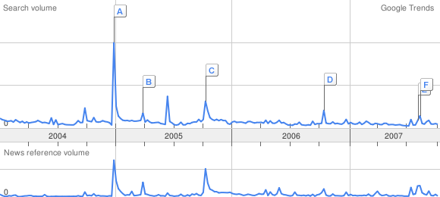
Search Engine Query Logs
A: Southeast Asia (Dec 27, 2004)
B: Indonesia (Mar 29, 2005)
C; Pakistan (Oct 10, 2005)
D; Hawaii (Oct 16, 2006)
E: Indonesia (Aug 8, 2007) F: Peru (Aug 16, 2007)

Slide 44
Query Statistics
Pass, et al., “A Picture of Search,” 2007

Slide 45
Pass, et al., “A Picture of Search,” 2007

Slide 46
Temporal Variation
Pass, et al., “A Picture of Search,” 2007

Slide 47
Pass, et al., “A Picture of Search,” 2007

Slide 48
28% of Queries are Reformulations
Pass, et al., “A Picture of Search,” 2007

Slide 49
The Tracking Ecosystem
http://wsj.com/wtk

Slide 50
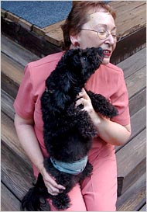
AOL User 4417749

Slide 51
Blogs
Doubling
18.9 Million Weblogs Tracked
Doubling in size approx. every 5 months
Consistent doubling over the last 36 months
Doubling
Doubling
Doubling

Slide 52
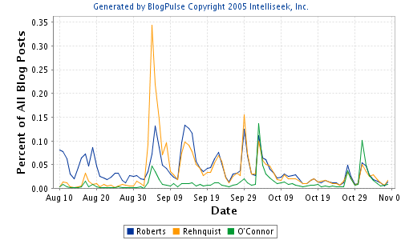

Slide 53
Daily Posting Volume
1.2 Million legitimate Posts/Day
Spam posts marked in red
On average, additional 5.8% are spam posts
Some spam spikes as high as 18%
London Bombings
Katrina
Justice O’Connor
Live 8 Concerts
Deepthroat Revealed
Kryptonite
Lock Controversy
Newsweek Koran
US Election Day
Schiavo Dies
Superbowl
Indian Ocean Tsunami

Slide 54
The “Deep Web”
Dynamic pages, generated from databases
Not easily discovered using crawling
Perhaps 400-500 times larger than surface Web
Fastest growing source of new information

Slide 55
Deep Web
60 Deep Sites Exceed Surface Web by 40 Times
Name
Type
URL
Web Size (GBs)
National Climatic Data Center (NOAA)
Public
http://www.ncdc.noaa.gov/ol/satellite/satelliteresources.html
366,000
NASA EOSDIS
Public
http://harp.gsfc.nasa.gov/~imswww/pub/imswelcome/plain.html
219,600
National Oceanographic (combined with Geophysical) Data Center (NOAA)
Public/Fee
http://www.nodc.noaa.gov/, http://www.ngdc.noaa.gov/
32,940
Alexa
Public (partial)
http://www.alexa.com/
15,860
Right-to-Know Network (RTK Net)
Public
http://www.rtk.net/
14,640
MP3.com
Public
http://www.mp3.com/

Slide 56
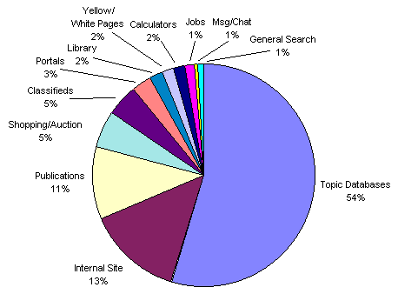
Content of the Deep Web

Slide 57
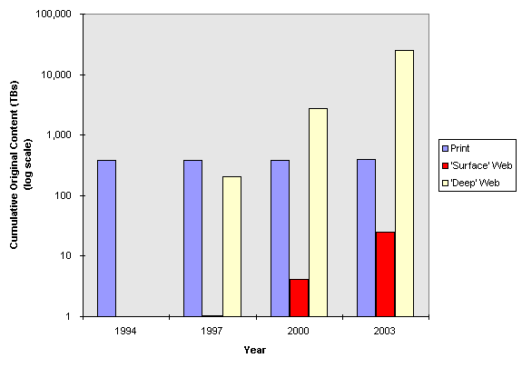

Slide 58
Semantic Web
RDF provides the schema for interchange
Ontologies support automated inference
Similar to thesauri supporting human reasoning
Ontology mapping permits distributed creation
This is where the magic happens ☺

