Slide 1
Evidence from Metadata
INST 734
Doug Oard
Module 8
Notes:
1

Slide 2
Agenda
Metadata
Intentional description
Incidental description
Linked data
Notes:
2
Start 1:00

Slide 3
Named Entity Recognition
Machine learning techniques can find:
Location in the text of a reference to an entity
Extent of that reference (i.e., which characters)
Type of the entity (person, location, ...)
Two types of features are useful
Orthography (e.g., paired capitalization)
Trigger words (e.g., Mr., Professor, said, …)

Slide 4
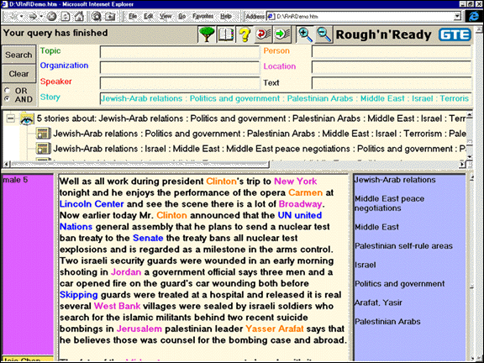

Slide 5
Reference Chaining
Variant forms of person names
Nicknames, common forms of reference
Variant forms of other references
Acronyms, abbreviations
Within-document co-reference resolution
Named, nominal, pronominal

Slide 6
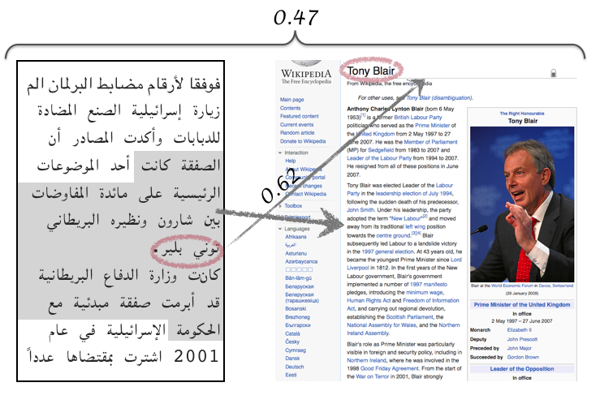
Cross-Document Entity Linking

Slide 7
Example: Bibliographic References

Slide 8
Microformats
microformat
URL
<div class="h-card">
<p><img class="u-photo" href="/me.png" alt="" /></p>
<p class="p-name"> <a href="u-url"
href="http://waterpigs.co.uk">Barnaby Walters</a> </p>
</div>
plain-text
http://microformats.org/

Slide 10
Semantic Search

Slide 11
Web Ontology Language (OWL)
<owl:Class rdf:about="http://dbpedia.org/ontology/Astronaut">
<rdfs:label xml:lang="en">astronaut</rdfs:label>
<rdfs:label xml:lang="de">Astronaut</rdfs:label>
<rdfs:label xml:lang="fr">astronaute</rdfs:label>
<rdfs:subClassOf
rdf:resource="http://dbpedia.org/ontology/Person">
</rdfs:subClassOf>
</owl:Class>

Slide 12
Knowledge-Base Population
When Lisa's mother Marge Simpson went to a weekend getaway at Rancho Relaxo, …
After two years in the academic quagmire of Springfield Elementary, Lisa finally has a teacher that she connects with. But she soon learns that the problem with being middle-class is that …
Springfield
Bottomless Pete, Nature’s
Cruelest Mistake
per:cities_of_residence
per:alternate_names
Marge Simpson
Homer Simpson
per:spouse
Springfield Elementary
per:children
per:children
per:schools_attended
Lisa Simpson
Bart Simpson
Paul McNamee et al, HLTCOE Participation at TAC 2012: Entity Linking and Cold Start Knowledge Base Construction
http://www.nist.gov/tac/publications/2012/papers.html

Slide 13
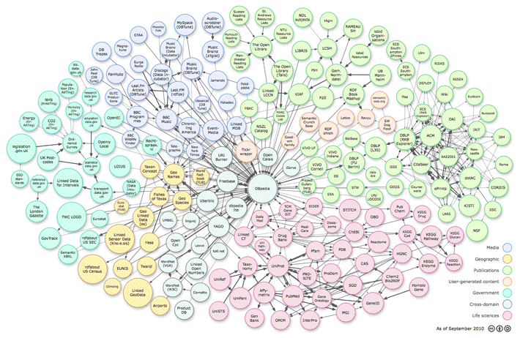
Linked Open Data

Slide 15
Integrating Multiple Types of Evidence
 | Free Text | Behavior | Metadata
Topicality
Quality
Reliability
Cost
Flexibility

