Slide 1
Cross-Language Retrieval
INST 734
Module 11
Doug Oard
Notes:
1

Slide 2
Agenda
CLIR
Dictionary-Based CLIR
Corpus-Based CLIR
Interactive CLIR

Slide 3
Cross-Language “Retrieval”
Query
Query
Translation
Translated Query
Search
Ranked List
Notes:
The answer can be given by looking at interactions within the search process monolingual or multilingual.
Besides interested in nominate, interactive ir also interested in the three yellow boxes in predict and choose

Slide 4
Interactive CLIR
If you can’t understand the documents…
Source
Selection
How do you formulate a query?
Resource
How do you know something is worth looking at?
Query
Formulation
Query
How can you understand the retrieved documents?
Search
Ranked List
Selection
Documents
System discovery
Vocabulary discovery
Concept discovery
Document discovery
Examination
Documents
source reselection
Delivery

Slide 5
The Search Process
Monolingual
Searcher
Cross-Language
Searcher
Author
Choose
Document-Language
Terms
Choose
Document-Language
Terms
Choose
Query-Language
Terms
Infer
Concepts
Select
Document-Language
Terms
Query-Document
Matching
Document
Query

Slide 6
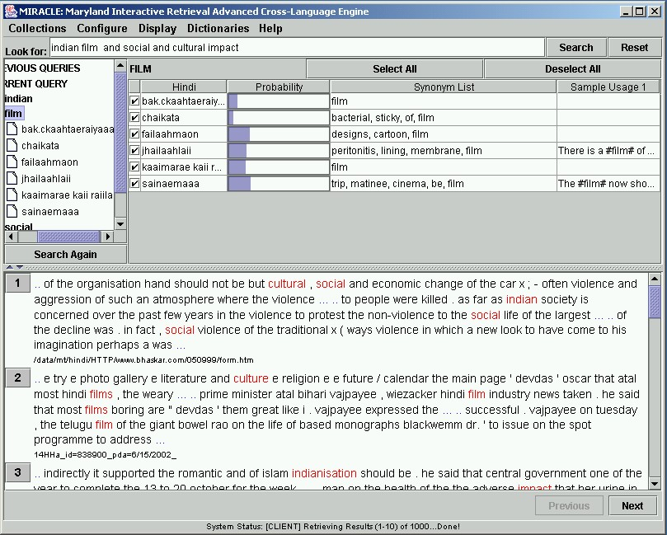
Notes:
Here is one approach that we have been experimenting with. At the top of the screen, you can see a query that was entered by the searcher: “Indian film and social and cultural impact.” Our system knows six Hindi translations for “film”, which are shown on the six lines of the table in the upper right. In the column labeled “Hindi” we show a locally developed transliteration that is similar to ITRANS. English speakers sometimes find this provides useful cues to meaning, as is the case in the bottom line with “sainaemaaa,” which sounds like the English word “cinema.” In other cases, automaticaly detected synonyms are useful, as in the case in the fourth line where “membrane” indicates a different meaning for “film.” The searcher can deselect undesired translations and then search again. The remainder of the system works like any Web search engine, although we clearly have a ways to go before our interface is as elegant as Google. ☺ As with the translation system, we adapted this system to Hindi in a month.

Slide 7
Translation for Assessment
Indonesian City of Bali in October last year in the bomb blast in the case of imam accused India of the sea on Monday began to be averted. The attack on getting and its plan to make the charges and decide if it were found guilty, he death sentence of May. Indonesia of the police said that the imam sea bomb blasts in his hand claim to be accepted. A night Club and time in the bomb blast in more than 200 people were killed and several injured were in which most foreign nationals. …
Notes:
Here is a translation from the best Hindi-to-English machine translation system in the previous slide. The translation is certainly not good enough to read for understanding, but there is probably enough there to allow a searcher to decide whether it would be worth paying someone to make a fluent translation. From the highlighted words, we can see that there was an attack using a bomb in a Bali night club and that many people were killed. Pulling that information out of an imperfect translation such as this takes some time, of course. But imagine how much longer it would take if you were looking at a Hindi document and did not know Hindi. Thirty days before this translation was produced, we were not able to find a single translation system anywhere in the world to translate Hindi into English. Perhaps even more impressively, the person that did the majority of the work to build this system spoke no Hindi at all! It used to take ten years and an army of linguists to build a mediocre machine translation system. We can now build systems that are just as good in a few months, and this technology has a clear potential for further improvement.

Slide 8
Information
Access
Information
Use
Cross-Language
Search
Cross-Language
Browsing
Translation
Select
Examine
Query
Document

Slide 9
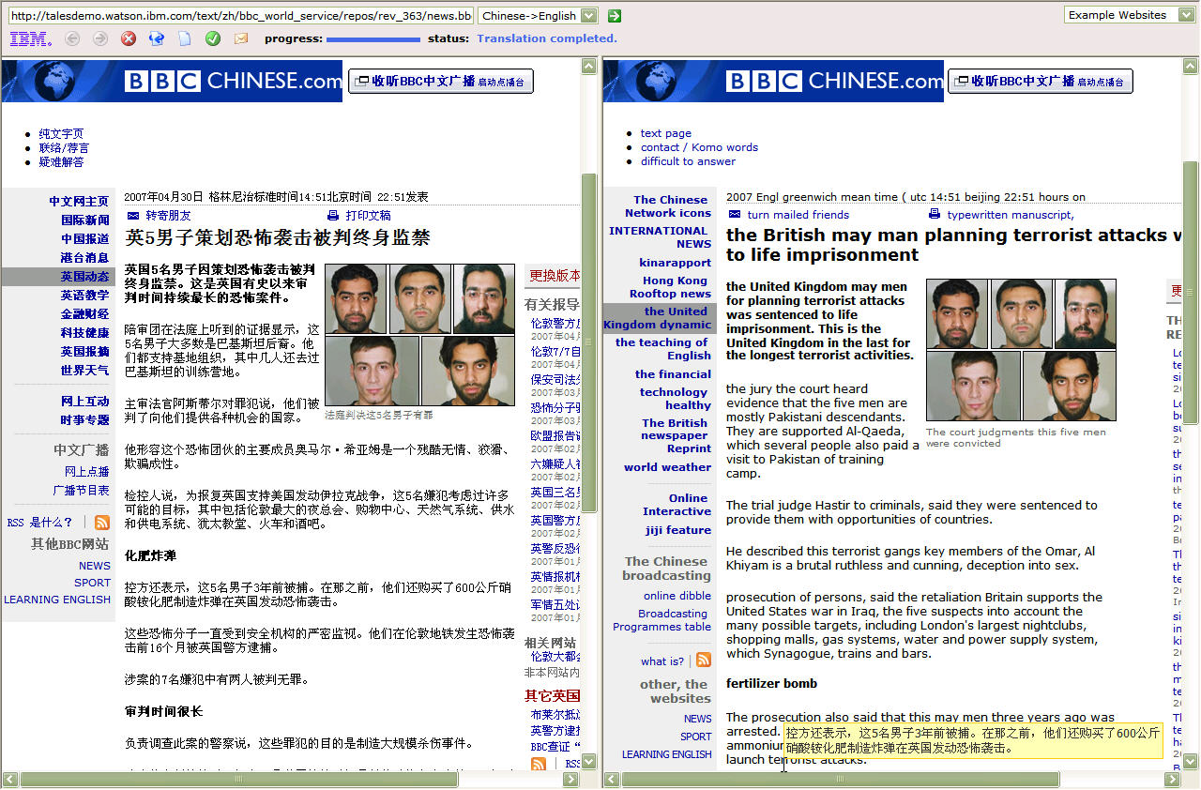
Side-by-side Translation
9
Notes:
9

Slide 10
Interactive Question Answering

Slide 11
Questions, Grouped by Difficulty
8 Who is the managing director of the International Monetary Fund?
11 Who is the president of Burundi?
13 Of what team is Bobby Robson coach?
4 Who committed the terrorist attack in the Tokyo underground?
16 Who won the Nobel Prize for Literature in 1994?
6 When did Latvia gain independence?
14 When did the attack at the Saint-Michel underground station in Paris occur?
7 How many people were declared missing in the Philippines after the
typhoon “Angela”?
2 How many human genes are there?
10 How many people died of asphyxia in the Baku underground?
15 How many people live in Bombay?
12 What is Charles Millon's political party?
1 What year was Thomas Mann awarded the Nobel Prize?
3 Who is the German Minister for Economic Affairs?
9 When did Lenin die?
5 How much did the Channel Tunnel cost?

Slide 12
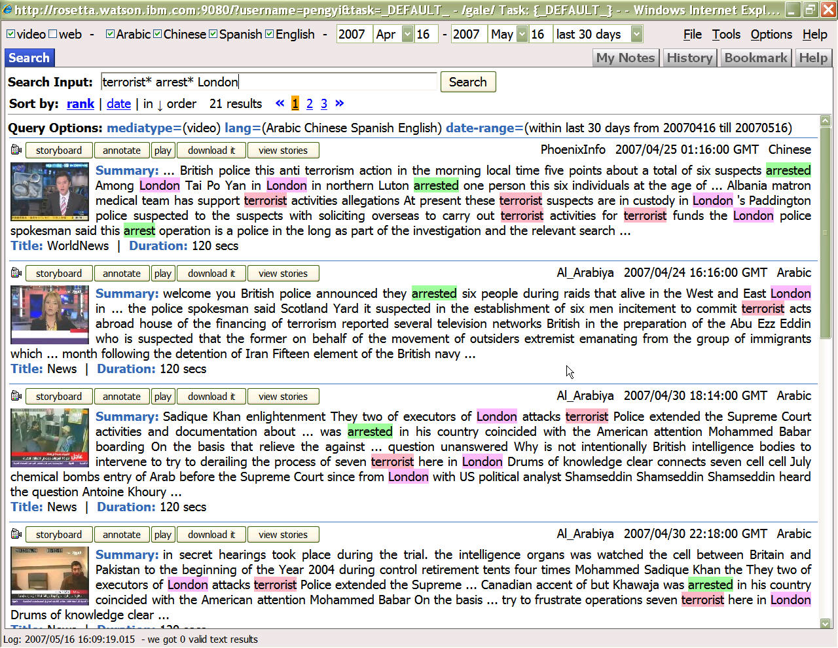
12
Notes:
12

Slide 13
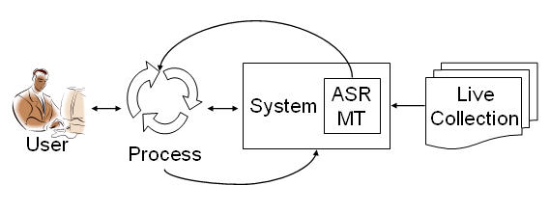
User
Process
Notes:
Problems of this kind are defined by two constraints: by what the user must accomplish, and by the information sources that are available. Given those constraints, a co-design problem emerges in which designers must iteratively refine (1) the capabilities of the system and (2) the process by which that system is used.
(comes from the JCDL paper)

Slide 14
The Problem Space
Retrospective search
  Web search
  Specialized services (medicine, law, patents)
  Help desks
Real-time filtering
  Email spam
  Web parental control
  News personalization
Real-time interaction
  Instant messaging
  Chat rooms
  Teleconferences
Key Capabilities
Map across languages
  For human understanding
  For automated processing

