Slide 1
Filtering and Recommendation
INST 734
Module 9
Doug Oard
Notes:
1

Slide 2
Agenda
Filtering
Recommender systems
Classification

Slide 3
Rating-Based Recommendation
Use ratings to describe objects
Personal recommendations, peer review, …
Beyond topicality:
Accuracy, coherence, depth, novelty, style, …
Has been applied to many modalities
Books, movies, music, jokes, people, …
Notes:
27

Slide 4
Using Positive Information
Source: Jon Herlocker, SIGIR 1999

Slide 5
Using Negative Information
Source: Jon Herlocker, SIGIR 1999

Slide 6
Recommending w/Implicit Feedback
User
Observations
Estimate
Rating
User Ratings
User
Model
Predicted
Ratings
User
Ratings
Community
Ratings
Ratings Server
Predicted
Observations
User
Observations
User
Model
Estimate
Ratings
Predicted
Ratings
Community
Observations
Observations Server

Slide 7
Hybrid Systems
Start with a query
Stereotypes or content-based query
Obtain some “ratings”
Implicit feedback, explicit feedback
Leverage the ratings to find other content
User-user(-item)
(User)-item-item

Slide 8
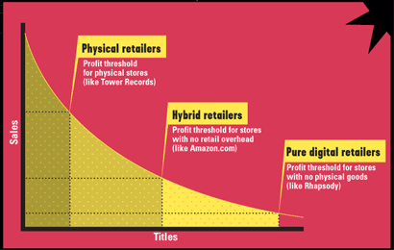
Need for Inventory Recommendation
Chris Andersen, “The Long Tail,” Wired, October 2004

Slide 9
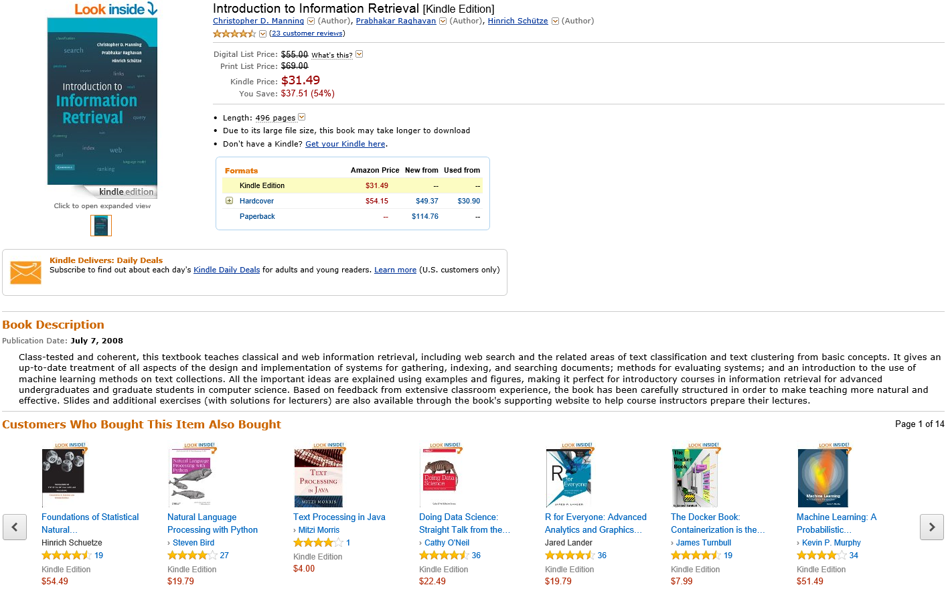
Item-Item Recommendation

Slide 10
Agenda
Filtering
Recommender systems
Classification

