Slide 1
Evidence from Metadata
INST 734
Doug Oard
Module 8
Notes:
1

Slide 2
Agenda
Metadata
Intentional description
Incidental description
Linked data
Notes:
2
Start 1:00

Slide 3
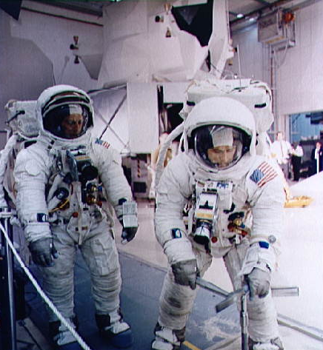
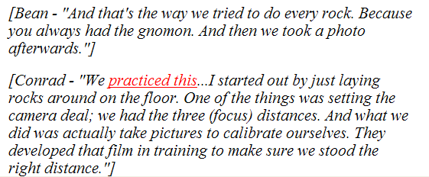
Anchor Text
[Conrad - &quot;We
<a href="a12.s69_55362.jpg" title="image" target="new">practiced this</a>... I started out by just laying rocks around on the floor. One of the things was setting the camera deal; we had the three (focus) distances. And what we did was actually take pictures to calibrate ourselves. They developed that film in training to make sure we stood the right distance.&quot;]

Slide 4
Community Metadata:
Games With a Purpose
van Ahn and Dabbish, CHI 2004

Slide 5
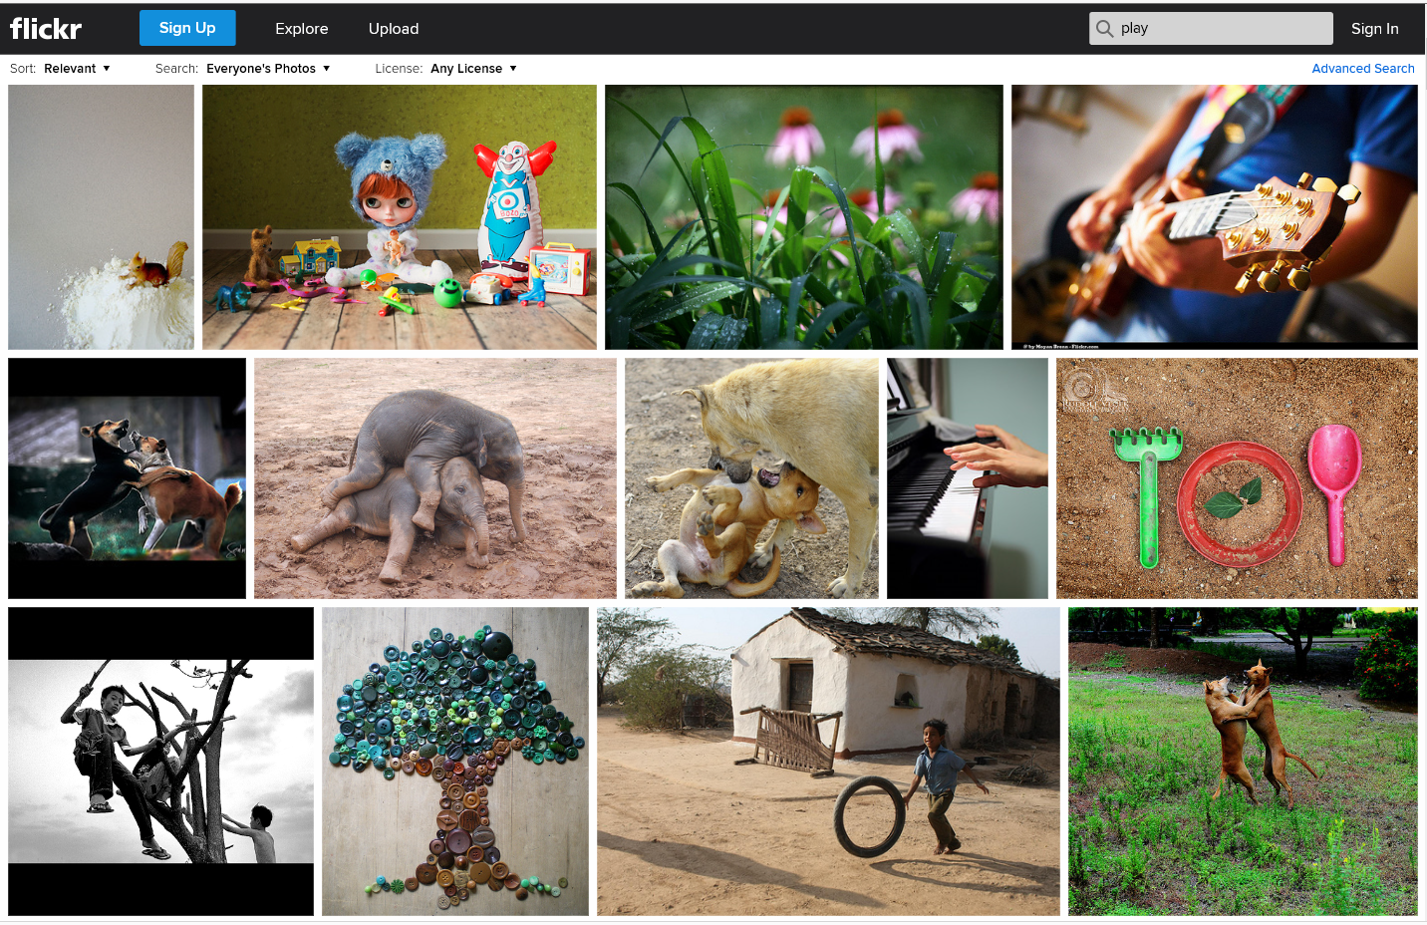
Community Metadata: “Folksonomy”

Slide 6
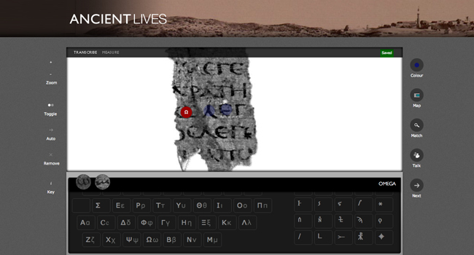
Community Metadata: Crowdsourcing

Slide 7
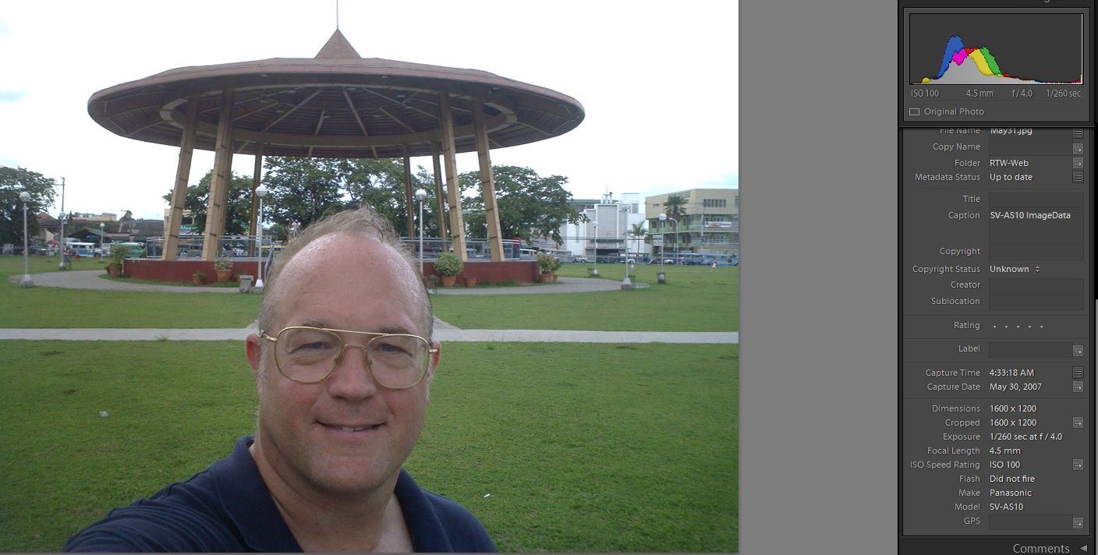
Exchangeable Image Format (EXIF)
http://www.umiacs.umd.edu/~oard/rtw/

Slide 8
Microsoft Word Metadata
Descriptive metadata
  Author
  Title
  Date created
  Version history (with tracked changes)
Behavioral metadata
  Word: Date and time last opened, changed, printed
  NTFS: Date and time last copied, renamed

Slide 9
Email Metadata
Descriptive metadata
  Subject line
  Folder name
  Time sent
Behavioral metadata
  Time received, time resent
  Reply chain
  Route

Slide 10
Agenda
Metadata
Intentional description
Incidental description
Linked data
Notes:
2
Start 1:00

