Slide 1
Evidence from Metadata
INST 734
Doug Oard
Module 8
Notes:
1

Slide 2
Agenda
Metadata
Intentional description
Incidental description
Linked data
Notes:
2
Start 1:00

Slide 3
Some Types of “Metadata”
Adapted from
Introduction to Metadata,
Getty Information Institute (2000)
Descriptive
  Content, creation process, relationships
Technical
  Format, system requirements
Administrative
  Acquisition, authentication, access rights
Preservation
  Media migration
Behavior (Usage)
  Display, derivative works

Slide 4




Aspects of Metadata
Framework
  Functional Requirements for Bibliographic Records (FRBR)
Schema (“Data Fields and Structure”)
  Dublin Core
Guidelines (“Data Content and Values”)
  Resource Description and Access (RDA)
  Library of Congress Subject Headings (LCSH)
Representation (abstract “Data Format”)
  Resource Description Framework (RDF)
Serialization (“Data Format”)
  RDF in eXtensible Markup Language (RDF/XML)
Adapted from Elings and Waibel, First Monday, (12)3, 2007

Slide 5
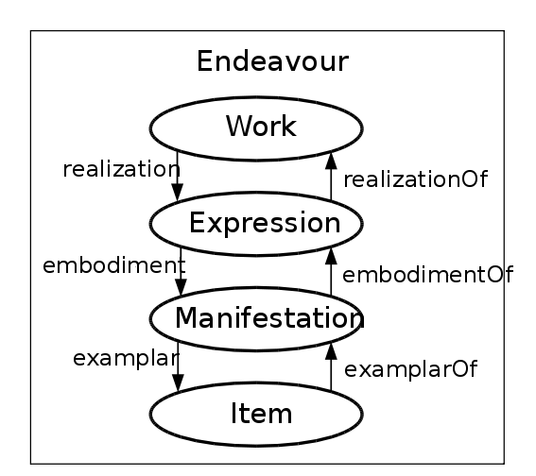
A Framework: FRBR
Functional Requirements for Bibliographic Records
The Organization
of Information
Third Edition
Paperback
(ISBN 978-1-59…)
Copy 2
(barcode 102343…)

Slide 6
FRBR (and FRAD) Entity Types
Product Entities
  Works, Expressions, Manifestations, Items
Responsibility (or subject) Entities
  Persons
  “Corporate” bodies (~any kind of organization)
  Families
Subject entities
  (any kind of) Places
  (tangible) Objects
  Events
  (abstract) Concepts

Slide 7
A Schema: Dublin Core
Content
Title
Subject [LCSH, MeSH, …]
Description
Type
Coverage [spatial, temporal, …]
Related resource
Rights
Instantiation (~Manifestations)
Date [Created, Modified, Copyright, …]
Format
Language
Identifier [URI, Citation, …]
Responsibility
Creator
Contributor
Source
Publisher
Dublin Core Version 1.1

Slide 8
A Serialized Representation:
Dublin Core in RDF XML
<rdf:RDF
xmlns:rdf="http://www.w3.org/1999/02/22-rdf-syntax-ns#"
xmlns:dc="http://purl.org/dc/elements/1.1/">
<rdf:Description
rdf:about="http://media.example.com/audio/guide.ra">
<dc:creator>Rose Bush</dc:creator>
<dc:title>A Guide to Growing Roses</dc:title>
<dc:description>Describes process for planting and nurturing
different kinds of rose bushes.</dc:description>
<dc:date>2001-01-20</dc:date>
</rdf:Description>
</rdf:RDF>

Slide 9
Aspects of Metadata
Framework
  Functional Requirements for Bibliographic Records (FRBR)
Schema (“Data Fields and Structure”)
  Dublin Core
Guidelines (“Data Content and Values”)
  Resource Description and Access (RDA)
  Library of Congress Subject Headings (LCSH)
Representation (abstract “Data Format”)
  Resource Description Framework (RDF)
Serialization (“Data Format”)
  RDF in eXtensible Markup Language (RDF/XML)
Adapted from Elings and Waibel, First Monday, (12)3, 2007

Slide 10
Metadata Encoding and Transmission Standard (METS)
Descriptive metadata (e.g., subject, author)
Administrative metadata (e.g., rights, provenance)
Technical metadata
  Which program can render this?
  Resolution, color space, …
Structural map (e.g., page order)
  Structural links (e.g., Web site navigation links)
Files (the raw data)
Root (meta-metadata)

Slide 11
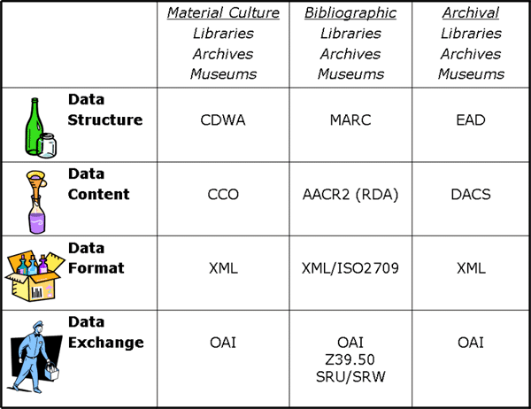
Different Content: Different Standards
Adapted from Elings and Waibel, First Monday, (12)3, 2007

Slide 12
Agenda
Metadata
Intentional description
Incidental description
Linked data
Notes:
2
Start 1:00

