Slide 1
Evidence from Metadata
INST 734
Doug Oard
Module 8
Notes:
1

Slide 2
Agenda
Metadata
Intentional description
Incidental description
Linked data
Notes:
2
Start 1:00

Slide 3
HTML Meta Tags
<HEAD>
<TITLE>INST 734: Information Retrieval Systems</TITLE>
<META NAME="DESCRIPTION"
CONTENT=“Make Money Fast">
<META NAME="KEYWORDS"
CONTENT=“easy,money,part-time,home">
</HEAD>

Slide 4
Metadata Uses
Have it
  Preservation (e.g., PREMIS)
  Validation
  Disposition
Find it
  Search/Recognize/Choose
  Browse (“Navigation”)
Serve it
  Persistent location
  Structure
  Surrogates
Use it
  Context
  Rights management
  User behavior capture
  Reasoning (“Semantic Web”)

Slide 5
Problems with “Free Text” Search
Homonymy
  Terms may have many unrelated meanings
  Polysemy (related meanings) is less of a problem
Synonymy
  Many ways of saying (nearly) the same thing
Anaphora
  Alternate ways of referring to the same thing

Slide 6
Controlled Vocabulary
Develop a concept inventory
  Uniquely identify concepts using “descriptors”
  Concept labels form a “controlled vocabulary”
  Organize concepts using a “thesaurus”
Assign concept descriptors to documents
  Also known as “indexing”
Craft queries using the controlled vocabulary
Notes:
18
Start 2:40

Slide 7
Two Ways of Searching
Controlled
Vocabulary
Searcher
Free-Text
Searcher
Author
Indexer
Construct query from
terms that may
appear in documents
Write the document
using terms to
convey meaning
Choose appropriate
concept descriptors
Construct query from
available concept
descriptors
Content-Based
Query-Document
Matching
Metadata-Based
Query-Document
Matching
Query Terms
Document Terms
Document Descriptors
Query Descriptors
Retrieval Status Value

Slide 8
Controlled Vocabulary Applications
When implied concepts must be captured
  Political action, volunteerism, …
When searchers can’t guess what was written
  Searching foreign language materials
When no words are present
  Photos w/o captions, videos w/o transcripts, …
When user needs are easily anticipated
  Weather reports, yellow pages, …
Notes:
23
Start 3:00

Slide 9
Controlled Vocabulary Challenges
Changing concept inventories
  Literary warrant and user needs are hard to predict
Accurate concept indexing is expensive
  Machines are inaccurate, humans are inconsistent
Users and indexers may think differently
  Diverse user populations add to the complexity
Using thesauri effectively requires training
  Meta-knowledge and thesaurus-specific expertise
Notes:
22
Start 2:55
Dialog searching on the homework should illustrate the last point

Slide 10
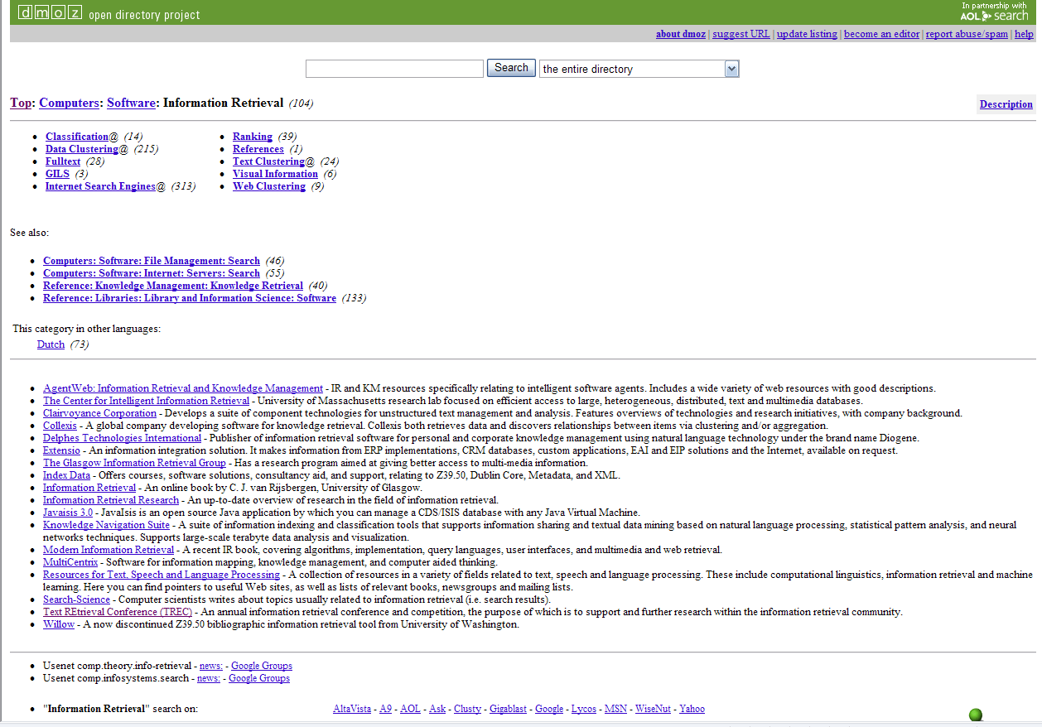
Notes:
24
Start 3:05

Slide 11
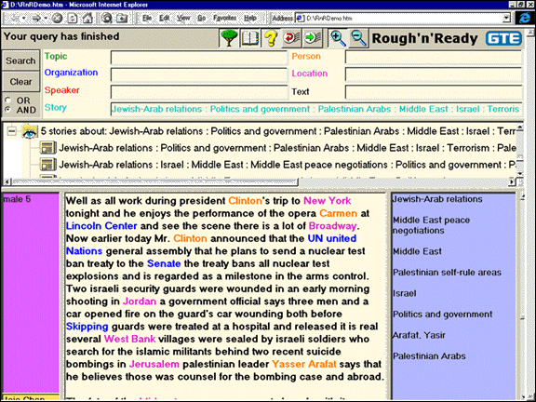

Slide 12
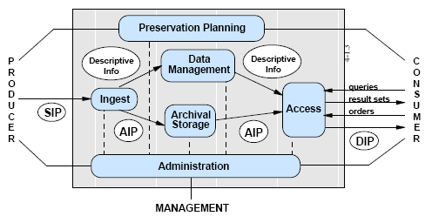
Open Archival Information System
(OAIS) Reference Model

Slide 13
Metadata Sources
Manual
  Professional
  Community
  Personal
Automated
  Capture
  Extraction
  Classification

Slide 14
Machine-Assisted Indexing
Access Innovations system:
//TEXT: science
IF (all caps)
USE research policy
USE community program
ENDIF
IF (near “Technology” AND with “Development”)
USE community development
USE development aid
ENDIF
near: within 250 words
with: in the same sentence
Notes:
26
Start 3:15

Slide 15
Metadata Design Issues
Balance cost and benefit
  Complement (don’t repeat) content and behavior
Accommodate dynamic factors
  Changing concepts, content, URL’s, …
Limit adversarial behavior
  Social authority, transparency, …
Consider the future
  Interpretability, automated reasoning, …

Slide 16
Agenda
Metadata
Intentional description
Incidental description
Linked data
Notes:
2
Start 1:00

