Slide 1
Evidence from Behavior
INST 734
Doug Oard
Module 7
Notes:
1

Slide 2
Agenda
Explicit feedback
Implicit Feedback
Link analysis
Clickstreams

Slide 3
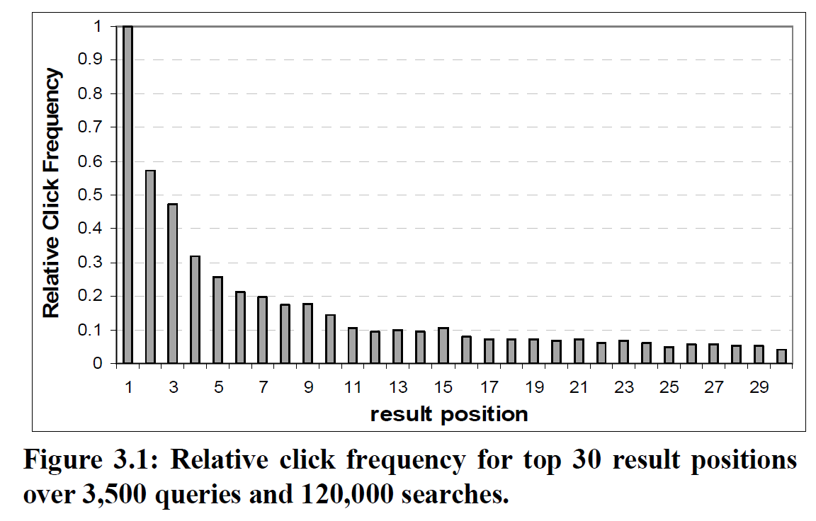
Click Probability
Eugene Agichtein, et al., Learning User Interaction Models for Predicting Web Search Result Preferences, in SIGIR 2006.

Slide 4
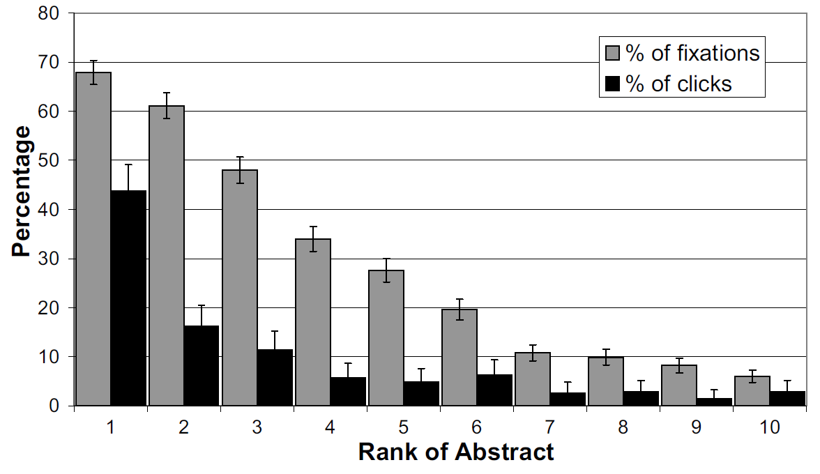
Click Probability
Thorsten Joachims et al., Evaluating the Accuracy of Implicit Feedback from Clicks and Query Reformulations in Web Search, ACM TOIS, 25(2), 2007.

Slide 5
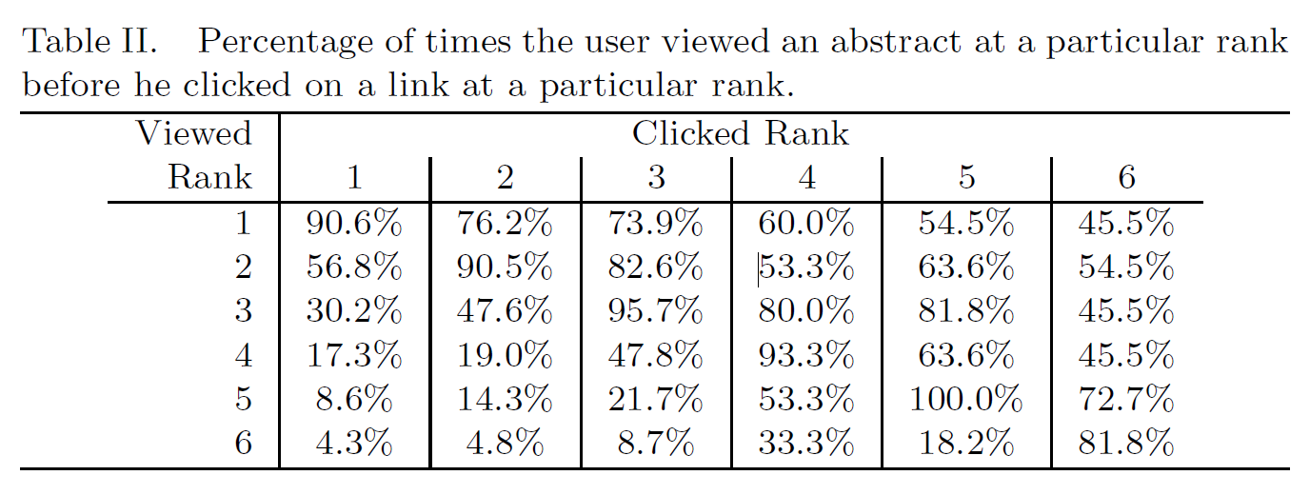
Detecting Unclicked Links
Thorsten Joachims et al., Evaluating the Accuracy of Implicit Feedback from Clicks and Query Reformulations in Web Search, ACM TOIS, 25(2), 2007.

Slide 6
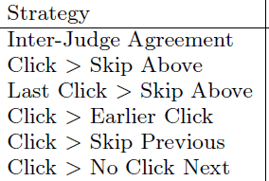
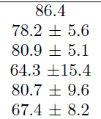
Inferring Preferences from Clicks
Thorsten Joachims et al., Accurately Interpreting Clickthrough Data as Implicit Feedback, SIGIR 2005.

Slide 7
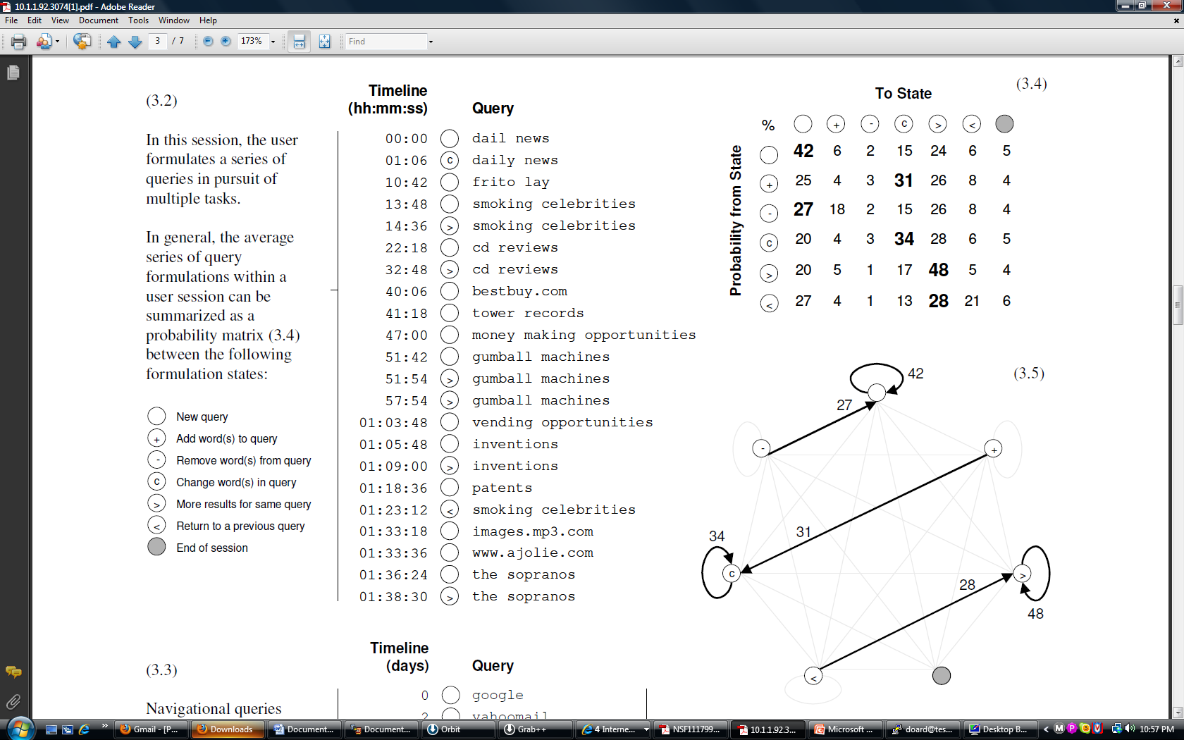
Session Analysis
Pass, et al., “A Picture of Search,” InfoScale 2007

Slide 8
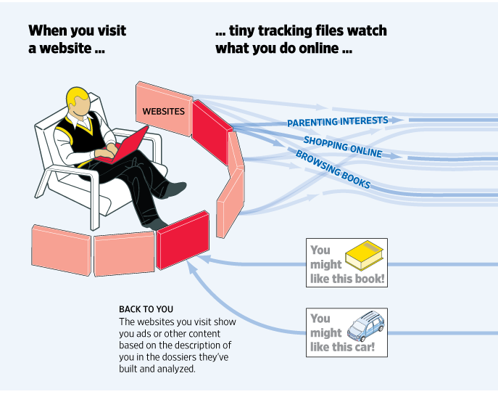
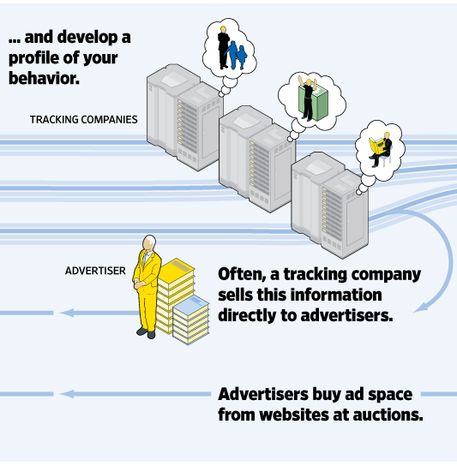
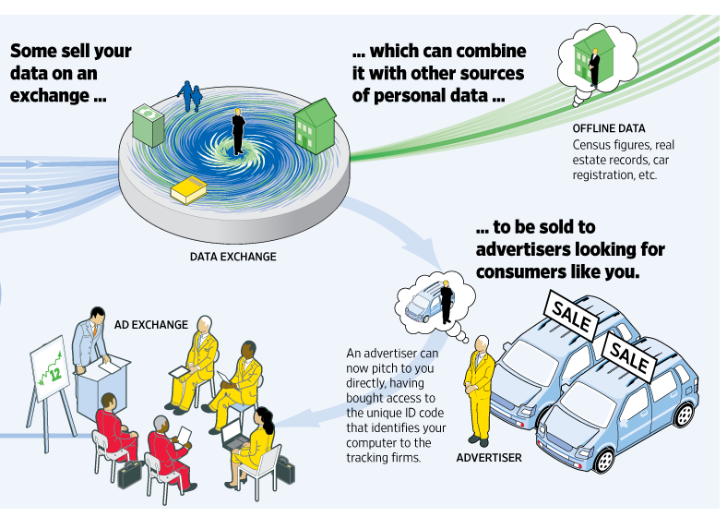
The Tracking Ecosystem
http://wsj.com/wtk

Slide 9
Summary
Explicit feedback is useful, but rare
Behavioral evidence is plentiful, but problematic
  Noisy
  Contextualized
  Sensitive

