Slide 1
Web Search
Module 6
INST 734
Doug Oard

Slide 2
Agenda
The Web
Crawling
Web search

Slide 3
Query Statistics
Pass, et al., “A Picture of Search,” 2007

Slide 4
Periodic Daily Variation
Pass, et al., “A Picture of Search,” 2007

Slide 5
Pass, et al., “A Picture of Search,” 2007

Slide 6
Pass, et al., “A Picture of Search,” 2007

Slide 7
Burstiness Query: Earthquake
http://www.google.com/trends/

Slide 8
28% of Queries are Reformulations
Pass, et al., “A Picture of Search,” 2007

Slide 9
Indexing Anchor Text
A type of “document expansion”
Terms near links describe content of the target
Works even when you can’t index content
Image retrieval, uncrawled links, …

Slide 10
Estimating Authority from Links
Hub
Authority
Authority

Slide 11
Aggregated Search

Slide 12
Computational Advertizing
Variant of a search problem
Jointly optimize relevance and revenue
Triangulating evidence
Queries
Clicks
Page visits
Obtaining evidence
Advertising networks
Online auctions

Slide 13
Adversarial IR
Search is user-controlled suppression
Everything is known to the search system
Goal: avoid showing things the user doesn’t want
Other stakeholders have different goals
Authors risk little by wasting your time
Marketers may hope for serendipitous interest

Slide 14
Influencing the Ranking
Search Engine Optimization (SEO)
Alter your content to better match user queries
Create partnerships to drive traffic (and links)
Index Spam
Create bogus user-assigned metadata
Add invisible text (font in background color, …)
Cloaking
Link exchange

Slide 15
Result Filtering (“Safe Search”)
Source analysis
Whitelists, blacklists
Content analysis
Text, image analysis, …
Contextual analysis
Links, user activity, …

Slide 16
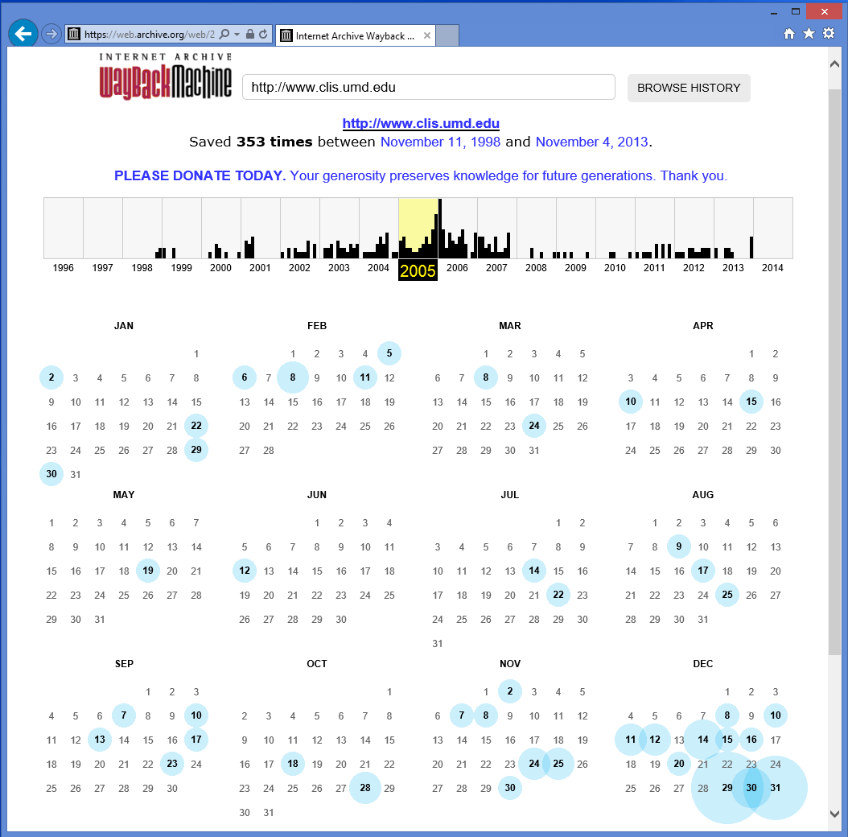
Internet Archive

Slide 17
Web Search Summary
Different content
Links
User-generated
Crawling
Different searches
Different goals (transactions, advertising, …)
Temporal variations and burstiness
Different interaction designs

