Slide 1

Web Search
Module 6
INST 734
Doug Oard

Slide 2
Agenda
The Web
Crawling
Web search

Slide 3
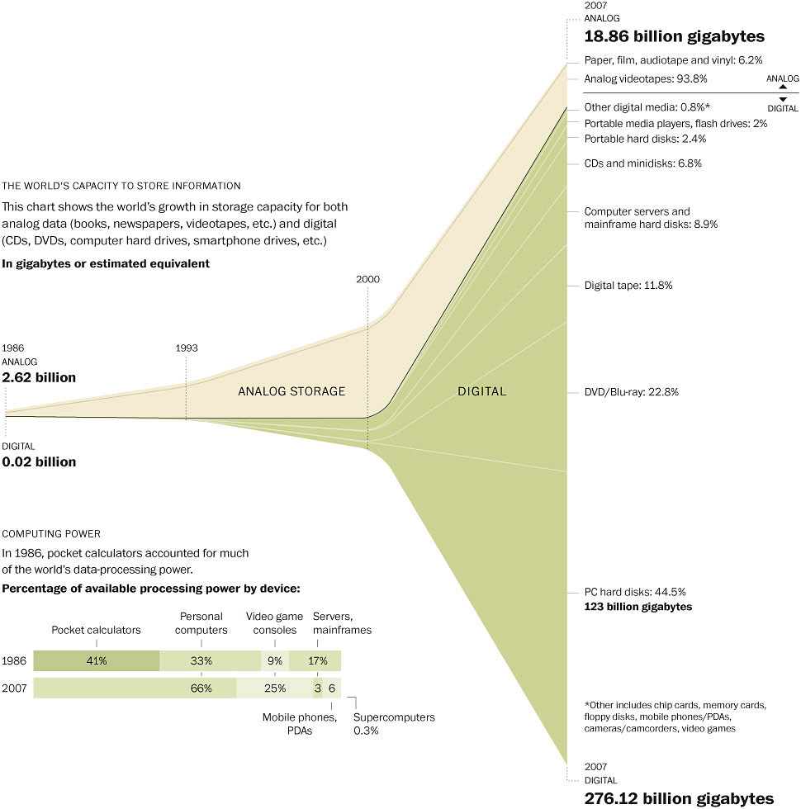
Washington Post, February 10, 2011

Slide 4
“The Web”
HTML
HTTP
Email
FTP
RTSP
URL
URL
(e.g.,http://www.foo.org/snarf.html)
Web
Server
File System
Internet
communication
protocols
HTML
(data/display)
HTTP
(transfer)

Slide 5
Internet ≠ Web
Internet: collection of global networks
Web: way of managing information exchange
There are many other uses for the Internet
  File transfer (FTP)
  Email (SMTP, POP, IMAP)

Slide 6
What “Caused” the Web?
Affordable storage
  300,000 (typed) words/$ by 1995
Adequate network capacity
  25,000 simultaneous transfers by 1995
  1 second/screen (of text) by 1995
Display capability
  10% of US population could see images by 1995
Effective search capabilities
  Lycos and Yahoo! achieved useful scale in 1994-1995

Slide 7
Internet Hosts

Slide 8
Internet Users
http://www.internetworldstats.com/

Slide 9
Global Internet Users
Web Pages

Slide 10
Billions of Queries per Month
December, 2012

Slide 11
An Adoption Curve: Blogs
Doubling
18.9 Million Weblogs Tracked
Doubling in size approx. every 5 months
Consistent doubling over the last 36 months
Doubling
Doubling
Doubling

Slide 12
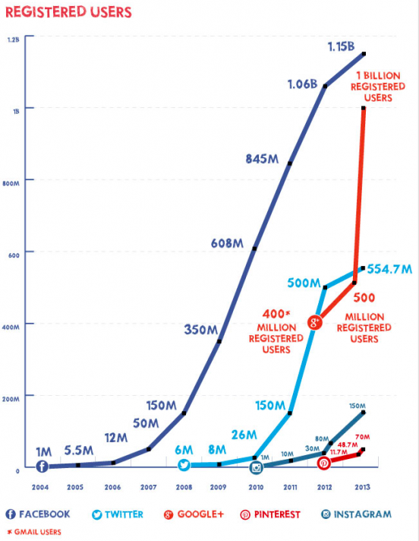
November 2013
http://www.searchenginejournal.com/growth-social-media-2-0-infographic/77055/

Slide 13
Agenda
The Web
Crawling
Web search

