Slide 1
Evaluation
INST 734
Module 5
Doug Oard

Slide 2
Agenda
Evaluation fundamentals
Test collections: evaluating sets
Test collections: evaluating rankings
Interleaving
User studies

Slide 3
Batch Evaluation
Query
Search
Ranked List

Slide 4
Interleaved Evaluation
Query
Search
Ranked List
Selection
Document

Slide 5
User Studies
Query
Formulation
Query
Search
Ranked List
Selection
Query Reformulation
and
Relevance Feedback
Document
Examination
Document

Slide 6
Interleaving
Combine two result sets
  Balanced or Team-Draft
  Avoid near-duplicates
Assign credit as people click
  Averaging by session or by query
Prefer the system that generates more clicks

Slide 7
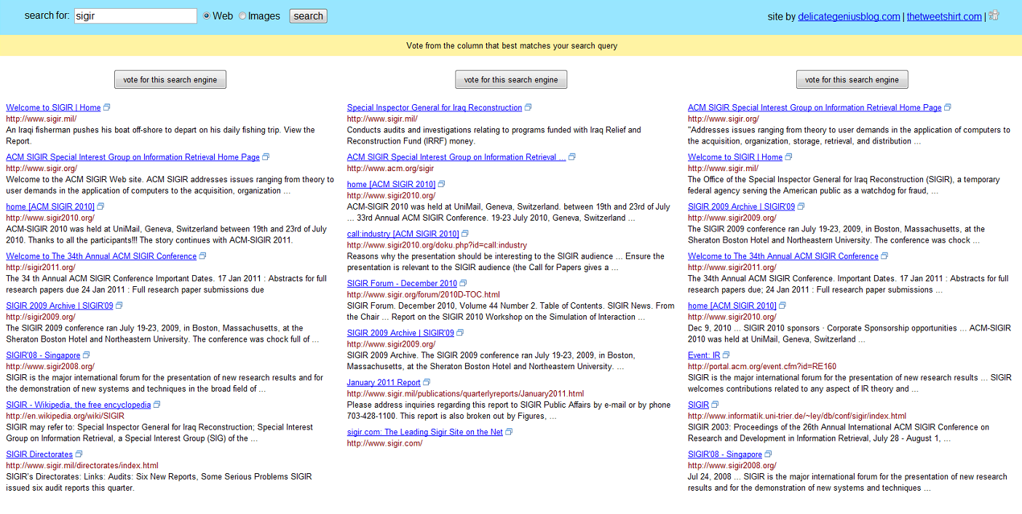
Motivation: A “Taste Test”
Credit: Filip Radlinsky and Katja Hofmann, Practical Online Retrieval Evaluation, 2013

Slide 8
Balanced Interleaving
Ranking A
Napa Valley – The authority for lodging...
www.napavalley.com
Napa Valley Wineries - Plan your wine...
www.napavalley.com/wineries
Napa Valley College
www.napavalley.edu/homex.asp
4. Been There | Tips | Napa Valley
www.ivebeenthere.co.uk/tips/16681
5. Napa Valley Wineries and Wine
www.napavintners.com
6. Napa Country, California – Wikipedia
en.wikipedia.org/wiki/Napa_Valley
Ranking B
1. Napa Country, California – Wikipedia
en.wikipedia.org/wiki/Napa_Valley
2. Napa Valley – The authority for lodging...
www.napavalley.com
3. Napa: The Story of an American Eden...
books.google.co.uk/books?isbn=...
4. Napa Valley Hotels – Bed and Breakfast...
www.napalinks.com
5. NapaValley.org
www.napavalley.org
6. The Napa Valley Marathon
www.napavalleymarathon.org
Presented Ranking
Napa Valley – The authority for lodging...
www.napavalley.com
2. Napa Country, California – Wikipedia
en.wikipedia.org/wiki/Napa_Valley
Napa Valley Wineries – Plan your wine...
www.napavalley.com/wineries
Napa Valley College
www.napavalley.edu/homex.asp
Napa: The Story of an American Eden...
books.google.co.uk/books?isbn=...
Been There | Tips | Napa Valley
www.ivebeenthere.co.uk/tips/16681
Napa Valley Hotels – Bed and Breakfast...
www.napalinks.com
Credit: Filip Radlinsky and
Katja Hofmann, Practical Online
Retrieval Evaluation, 2013
[Joachims ‘02]

Slide 9
Balanced Interleaving
Winner!
Ranking A
Napa Valley – The authority for lodging...
www.napavalley.com
Napa Valley Wineries - Plan your wine...
www.napavalley.com/wineries
Napa Valley College
www.napavalley.edu/homex.asp
4. Been There | Tips | Napa Valley
www.ivebeenthere.co.uk/tips/16681
5. Napa Valley Wineries and Wine
www.napavintners.com
6. Napa Country, California – Wikipedia
en.wikipedia.org/wiki/Napa_Valley
Ranking B
1. Napa Country, California – Wikipedia
en.wikipedia.org/wiki/Napa_Valley
2. Napa Valley – The authority for lodging...
www.napavalley.com
3. Napa: The Story of an American Eden...
books.google.co.uk/books?isbn=...
4. Napa Valley Hotels – Bed and Breakfast...
www.napalinks.com
5. NapaValley.org
www.napavalley.org
6. The Napa Valley Marathon
www.napavalleymarathon.org
[
Presented Ranking
Napa Valley – The authority for lodging...
www.napavalley.com
2. Napa Country, California – Wikipedia
en.wikipedia.org/wiki/Napa_Valley
Napa Valley Wineries – Plan your wine...
www.napavalley.com/wineries
Napa Valley College
www.napavalley.edu/homex.asp
Napa: The Story of an American Eden...
books.google.co.uk/books?isbn=...
Been There | Tips | Napa Valley
www.ivebeenthere.co.uk/tips/16681
Napa Valley Hotels – Bed and Breakfast...
www.napalinks.com
Click
Click
Credit: Filip Radlinsky and
Katja Hofmann, Practical Online
Retrieval Evaluation, 2013
[Joachims ‘02]

Slide 10
Team Draft Interleaving
Ranking A
Napa Valley – The authority for lodging...
www.napavalley.com
Napa Valley Wineries - Plan your wine...
www.napavalley.com/wineries
Napa Valley College
www.napavalley.edu/homex.asp
4. Been There | Tips | Napa Valley
www.ivebeenthere.co.uk/tips/16681
5. Napa Valley Wineries and Wine
www.napavintners.com
6. Napa Country, California – Wikipedia
en.wikipedia.org/wiki/Napa_Valley
Ranking B
1. Napa Country, California – Wikipedia
en.wikipedia.org/wiki/Napa_Valley
2. Napa Valley – The authority for lodging...
www.napavalley.com
3. Napa: The Story of an American Eden...
books.google.co.uk/books?isbn=...
4. Napa Valley Hotels – Bed and Breakfast...
www.napalinks.com
5. NapaValley.org
www.napavalley.org
6. The Napa Valley Marathon
www.napavalleymarathon.org
Presented Ranking
Napa Valley – The authority for lodging...
www.napavalley.com
2. Napa Country, California – Wikipedia
en.wikipedia.org/wiki/Napa_Valley
3. Napa: The Story of an American Eden...
books.google.co.uk/books?isbn=...
Napa Valley Wineries – Plan your wine...
www.napavalley.com/wineries
5. Napa Valley Hotels – Bed and Breakfast...
www.napalinks.com
Napa Valley College
www.napavalley.edu/homex.asp
7 NapaValley.org
www.napavalley.org
A
B
Credit: Filip Radlinsky and
Katja Hofmann, Practical Online
Retrieval Evaluation, 2013
  [Radlinski et al. 2008]

Slide 11
Team Draft Interleaving
Ranking A
Napa Valley – The authority for lodging...
www.napavalley.com
Napa Valley Wineries - Plan your wine...
www.napavalley.com/wineries
Napa Valley College
www.napavalley.edu/homex.asp
4. Been There | Tips | Napa Valley
www.ivebeenthere.co.uk/tips/16681
5. Napa Valley Wineries and Wine
www.napavintners.com
6. Napa Country, California – Wikipedia
en.wikipedia.org/wiki/Napa_Valley
Ranking B
1. Napa Country, California – Wikipedia
en.wikipedia.org/wiki/Napa_Valley
2. Napa Valley – The authority for lodging...
www.napavalley.com
3. Napa: The Story of an American Eden...
books.google.co.uk/books?isbn=...
4. Napa Valley Hotels – Bed and Breakfast...
www.napalinks.com
5. NapaValley.org
www.napavalley.org
6. The Napa Valley Marathon
www.napavalleymarathon.org
Presented Ranking
Napa Valley – The authority for lodging...
www.napavalley.com
2. Napa Country, California – Wikipedia
en.wikipedia.org/wiki/Napa_Valley
3. Napa: The Story of an American Eden...
books.google.co.uk/books?isbn=...
Napa Valley Wineries – Plan your wine...
www.napavalley.com/wineries
5. Napa Valley Hotels – Bed and Breakfast...
www.napalinks.com
Napa Balley College
www.napavalley.edu/homex.asp
7 NapaValley.org
www.napavalley.org
Click
Tie!
Click
Credit: Filip Radlinsky and
Katja Hofmann, Practical Online
Retrieval Evaluation, 2013
  [Radlinski et al. 2008]

Slide 12
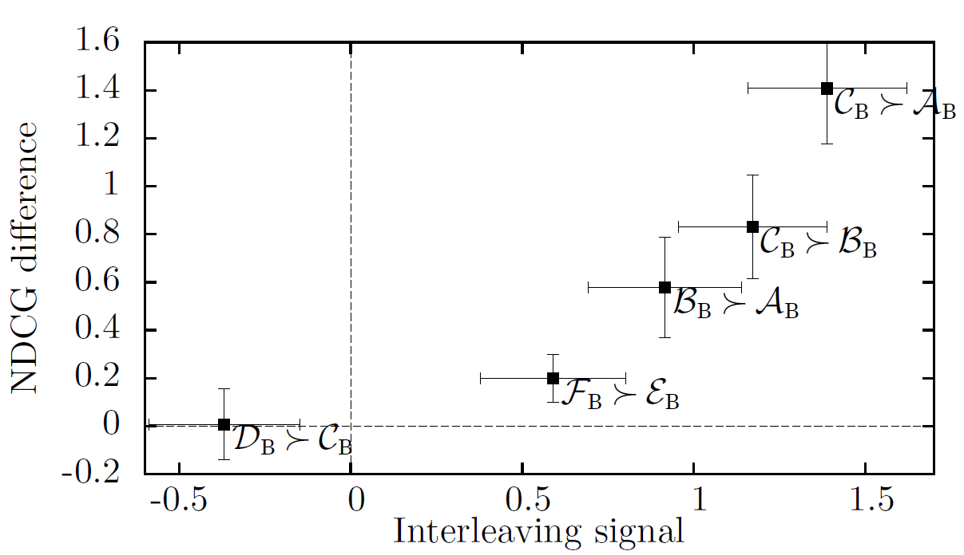
Comparison with “Expert” Judgments
  [Radlinski & Craswell 2010; Chapelle et al. 2012]
Credit: Filip Radlinsky and Katja Hofmann, Practical Online Retrieval Evaluation, 2013

Slide 13
Getting Clicks
Build your own search engine for some special collection
  Direct access to index, generate any rankings
Build on top of a public search API
  Fetch results from a search API, build your own results page
Use a Web proxy or browser toolbar
  Intercept and modify the page the browser gets
Credit: Filip Radlinsky and Katja Hofmann, Practical Online Retrieval Evaluation, 2013

Slide 14
Practicalities
Method | Easy to get users | Easy on/off? | Easy to observe | Robust | Runs on … | Amount of work | Changes are easy
Proxy | ✓ |  | All web traffic |  | server | ✶ | ✓
Toolbar | ✓ | ✓ | Everything |  | client | 
Search API |  | ✓ | Queries & clicks | ✓ | server |  | ✓
Search engine |  | ✓ | Queries & clicks | ✓ | server |  | ✓
Credit: Filip Radlinsky and Katja Hofmann, Practical Online Retrieval Evaluation, 2013

Slide 15
Agenda
Evaluation fundamentals
Test collections: evaluating sets
Test collections: evaluating rankings
Interleaving
User studies

