Slide 1
Interaction
LBSC 734
Module 4
Doug Oard
Notes:
1

Slide 2
Agenda
Where interaction fits
Query formulation
Selection part 1: Snippets
Selection part 2: Result sets
Examination
Notes:
2

Slide 3
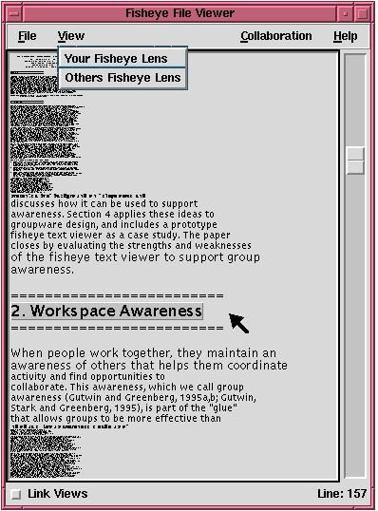
Fisheye Document Viewer

Slide 4
TileBars
Topic: reliability of DBMS (database systems)
Query terms: DBMS, reliability
DBMS
Mainly about both DBMS and reliability
reliability
DBMS
Mainly about DBMS, discusses reliability
reliability
DBMS
Mainly about, say, banking, with a subtopic discussion on DBMS/Reliability
reliability
DBMS
Mainly about high-tech layoffs
reliability

Slide 5
U Mass: Scrollbar-Tilebar

Slide 6
Some Good Advice
Human-Computer Interaction
Interactive IR
User in control
Anticipatable outcomes
Explainable results
Browsable content
Informative feedback
Easy reversal
Limit working memory load
Show query context
Support for learning
Novice and expert alternatives
Scaffolding
Support human reasoning
Show actual content
Depict uncertainty
Be fast
Use familiar metaphors
Timelines, ranked lists, maps, …
Some system initiative
Loosely guide the process
Expose structure of knowledge
Co-design w/search strategies
Credit: Ben Shneiderman

Slide 7
Four Simple Ideas
Show the query in the selection interface
It provides context for the display
Suggest options to the user
Query refinements, for example
Explain what the system has done
Highlight query terms in the results, for example
Complement what the system has done
Users add value by doing things the system can’t
Expose the information users need to judge utility
Notes:
28

