Slide 1
Interaction
LBSC 734
Module 4
Doug Oard
Notes:
1

Slide 2
Agenda
Where interaction fits
Query formulation
Selection part 1: Snippets
Selection part 2: Result sets
Examination
Notes:
2

Slide 3
The Cluster Hypothesis
“Closely associated documents tend to be
relevant to the same requests.”
van Rijsbergen 1979

Slide 4
  Single Link: Group two most similar members
  Complete Link: Group two least similar members
  Group Average: Group two most similar centroids
Centroids

Slide 5
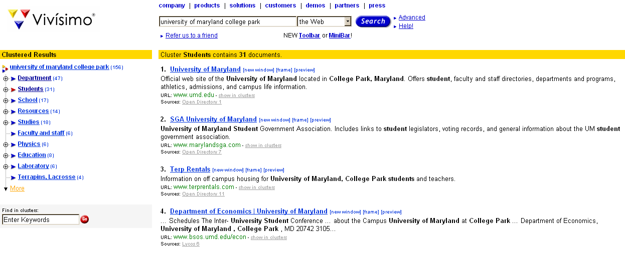
Clustered Results
http://www.clusty.com

Slide 6
Diversity Ranking
Query ambiguity
  UPS: United Parcel Service
  UPS: Uninteruptable power supply
  UPS: University of Puget Sound
Query aspects
  United Parcel Service: store locations
  United Parcel Service: delivery tracking
  United Parcel Service: stock price

Slide 7
Scatter/Gather
System clusters documents into “themes”
  Displays clusters by showing:
    Topical terms
    Typical titles
User chooses a subset of the clusters
System re-clusters documents in selected cluster
  New clusters have different, more refined, “themes”
Marti A. Hearst and Jan O. Pedersen. (1996) Reexaming the Cluster Hypothesis: Scatter/Gather on Retrieval Results. Proceedings of SIGIR 1996.

Slide 8
Scatter/Gather Example
Query = “star”
sports 14 docs
film, tv 47 docs
music 7 docs
symbols 8 docs
film, tv 68 docs
astrophysics 97 docs
astronomy 67 docs
flora/fauna 10 docs
stellar phenomena 12 docs
galaxies, stars 49 docs
constellations 29 docs
miscellaneous 7 docs

Slide 9
Hierarchical Agglomerative Clustering
Start with each document in its own cluster
Until there is only one cluster:
  Determine the two most similar clusters c_{i} and c_{j}
  Replace c_{i} and c_{j} with a single cluster c_{i} ∪ c_{j}

Slide 10
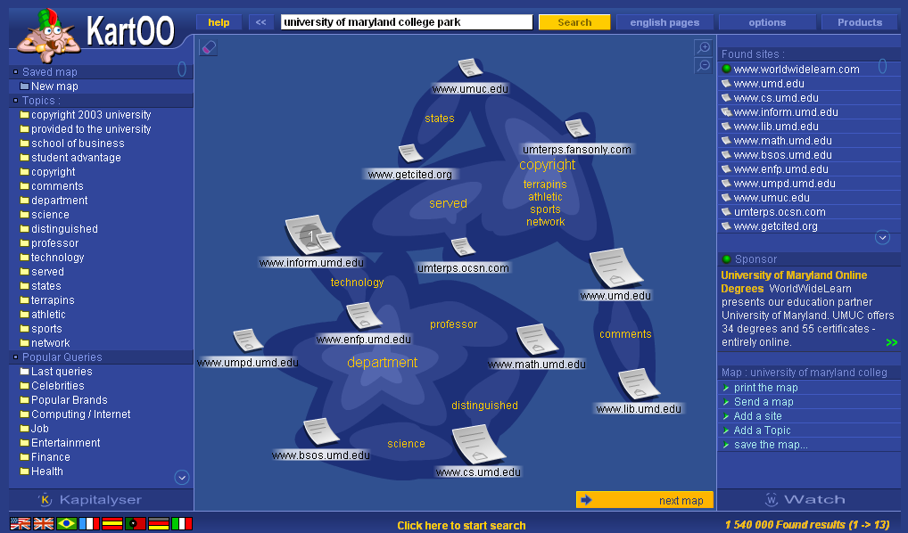
Kartoo’s Cluster Visualization
http://www.kartoo.com/

Slide 11
Summary: Clustering
Advantages:
  Provides an overview of main themes in search results
  Makes it easier to skip over similar documents
Disadvantages:
  Not always easy to understand the theme of a cluster
  Documents can be clustered in many ways
  Correct level of granularity can be hard to guess
  Computationally costly

Slide 12
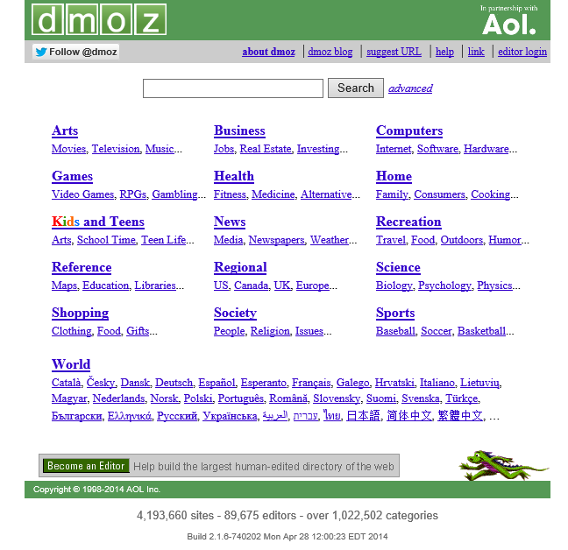
Open Directory Project
http://www.dmoz.org

Slide 13
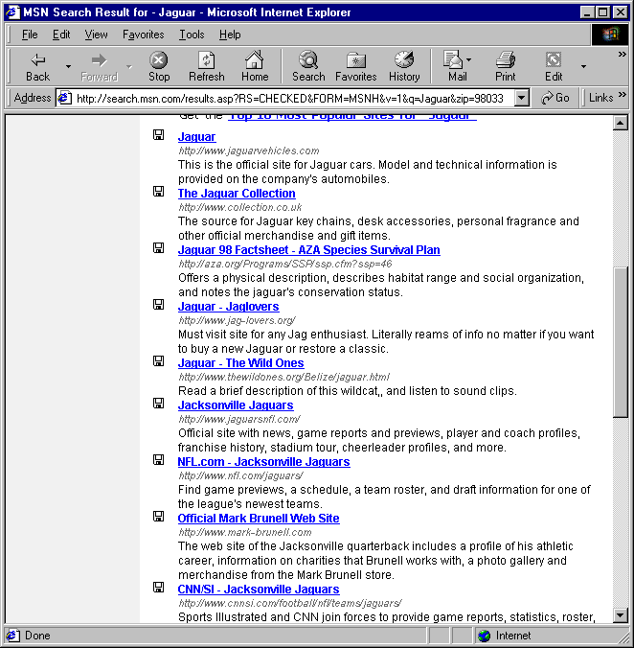
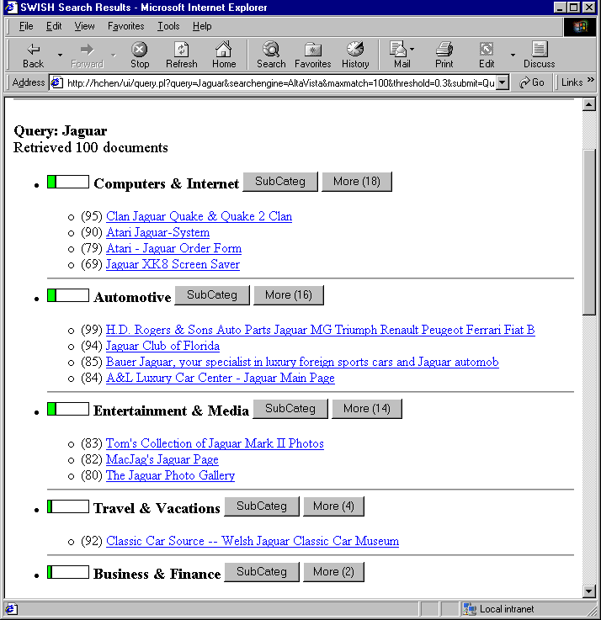
SWISH: Faceted Browsing
Query: jaguar
List Display
Category Display
Chen and Dumais, Bringing Order to the Web: Automatically Categorizing Search Results, CHI 2000

Slide 14
Text Classification
Obtain a training set with ground truth labels
Use “supervised learning” to train a classifier
  This is equivalent to learning a query
  Many techniques: kNN, SVM, decision tree, …
Apply classifier to new documents
  Assigns labels according to patterns learned in training
Notes:
27
Start 3:20

Slide 15
Example: k Nearest Neighbor (kNN)
Select k most similar labeled documents
Have them “vote” on the best label:
  Each document gets one vote, or
  More similar documents get a larger vote

Slide 16
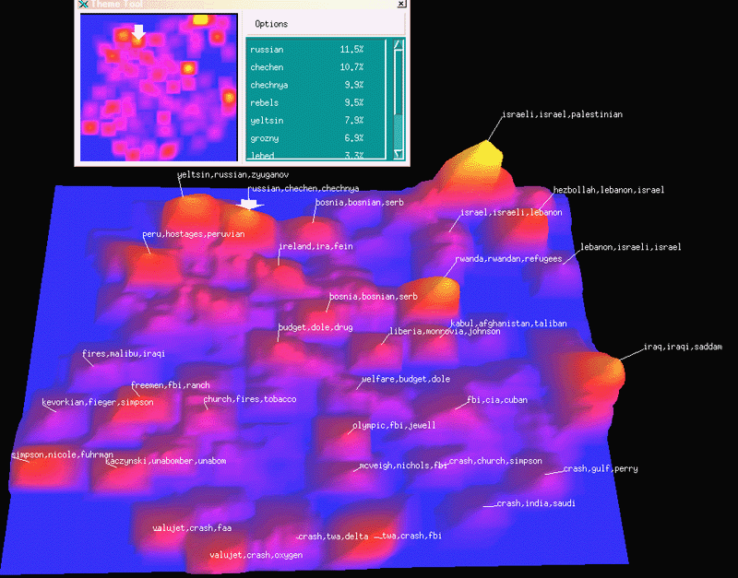
Visualization: ThemeView
Pacific Northwest National Laboratory

Slide 17
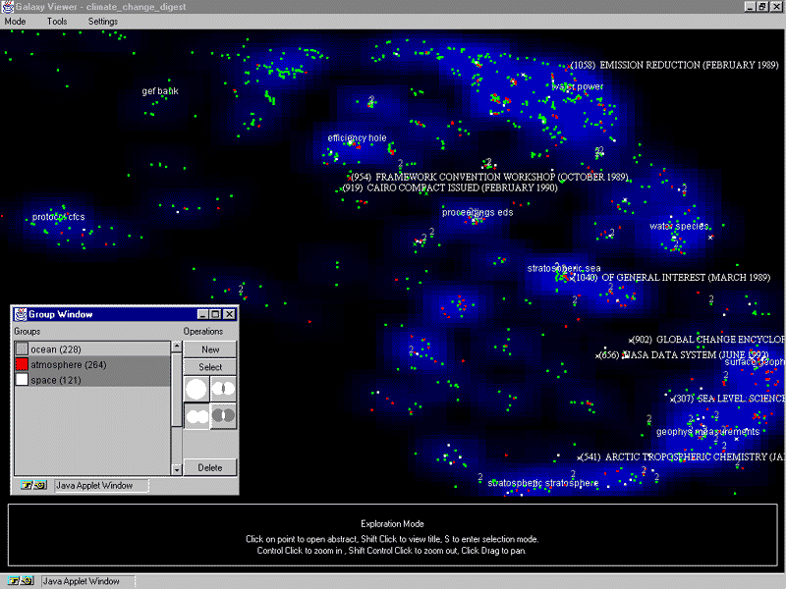
WebTheme

Slide 18
An Interface Taxonomy
List (one-dimensional)
  Navigation: Pagination, continuous scrolling, …
  Content: Title, source, date, summary, ratings, ...
  Order: “Relevance,” date, alphabetic, ...
Screen (two-dimensional)
  Construction: Clustering, classification, scatterplot, …
  Navigation: Jump, pan, zoom
Virtual reality (three-dimensional)
  Navigation: “Fishtank” VR, immersive VR
Notes:
18

Slide 19
Selection Recap
Summarization
  Query-biased snippets work well
Clustering
  Basis for “diversity ranking”
Classification
  Basis for “faceted browsing”
Visualization
  Useful for exploratory search

Slide 20
Agenda
Where interaction fits
Query formulation
Selection part 1: Snippets
Selection part 2: Result sets
Examination
Notes:
2

