Slide 1
Interaction
LBSC 734
Module 4
Doug Oard
Notes:
1

Slide 2
Agenda
Where interaction fits
Query formulation
Selection part 1: Snippets
Selection part 2: Result sets
Examination
Notes:
2

Slide 3
A Traditional Concordance

Slide 4
Web Search Engine Snippets: “KeyWord In Context” (KWIC)
Query: University of Maryland College Park
Notes:
20

Slide 5
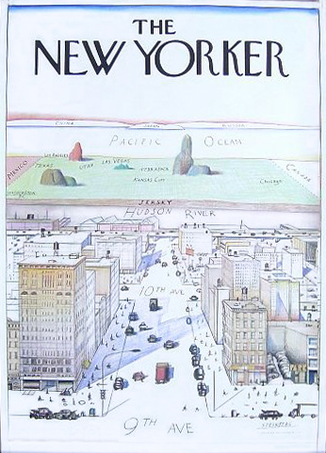
Summarization

Slide 6
Indicative vs. Informative
Indicative abstracts support selection
They describe the contents of a document
Informative abstracts support understanding
They summarize the contents of a document
Applies to any information presentation
Presented for indicative or informative purposes
Notes:
15

Slide 7
Selection/Examination Tasks
“Indicative” tasks
Recognizing what you are looking for
Determining that no answer exists in a source
Probing to refine mental models of system operation
“Informative” tasks
Vocabulary acquisition
Concept learning
Information use

Slide 8
Extraction-Based Summarization
Robust technique for making disfluent summaries
Four broad types:
Query-biased vs. generic
Term-oriented vs. sentence-oriented
Combine evidence for selection:
Salience: similarity to the query
Specificity: IDF or chi-squared, …
Emphasis: title, first sentence, …
Jimmy Lin, et al.. INTERACT 2003.
Notes:
27

Slide 9
Agenda
Where interaction fits
Query formulation
Selection part 1: Snippets
Selection part 2: Result sets
Examination
Notes:
2

