Slide 1
Interaction
LBSC 734
Module 4
Doug Oard
Notes:
1

Slide 2
Agenda
Where interaction fits
Query formulation
Selection part 1: Snippets
Selection part 2: Result sets
Examination
Notes:
2

Slide 3
Query Formulation
“Command” language
Form fill-in and menu selection
Direct manipulation
Natural language
Ben Shneiderman, 1997

Slide 4
WESTLAW® Query Language
What is the statute of limitations in cases involving the federal tort claims act?
LIMIT! /3 STATUTE ACTION /S FEDERAL /2 TORT /3 CLAIM
Are there any cases which discuss negligent maintenance or failure to maintain aids to navigation such as lights, buoys, or channel markers?
NOT NEGLECT! FAIL! NEGLIG! /5 MAINT! REPAIR! /P NAVIGAT! /5 AID EQUIP! LIGHT BUOY “CHANNEL MARKER”
What cases have discussed the concept of excusable delay in the application of statutes of limitations or the doctrine of laches involving actions in admiralty or under the “Jones Act” or the “Death on the High Seas Act”?
EXCUS! /3 DELAY /P (LIMIT! /3 STATUTE ACTION) LACHES /P “JONES ACT” “DEATH ON THE HIGH SEAS ACT” (46 +3 761)

Slide 5
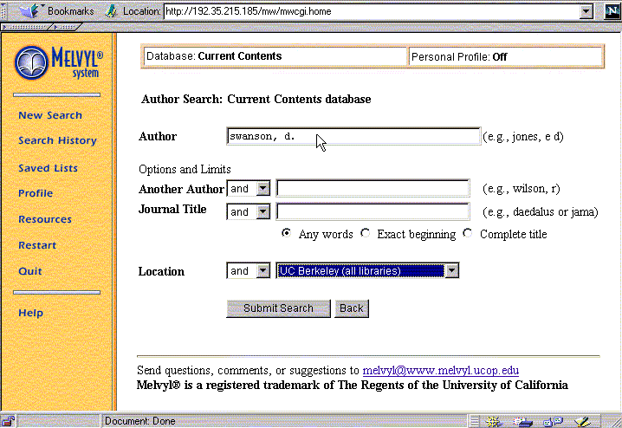
Form-Based Query Specification
Credit: Marti Hearst

Slide 6
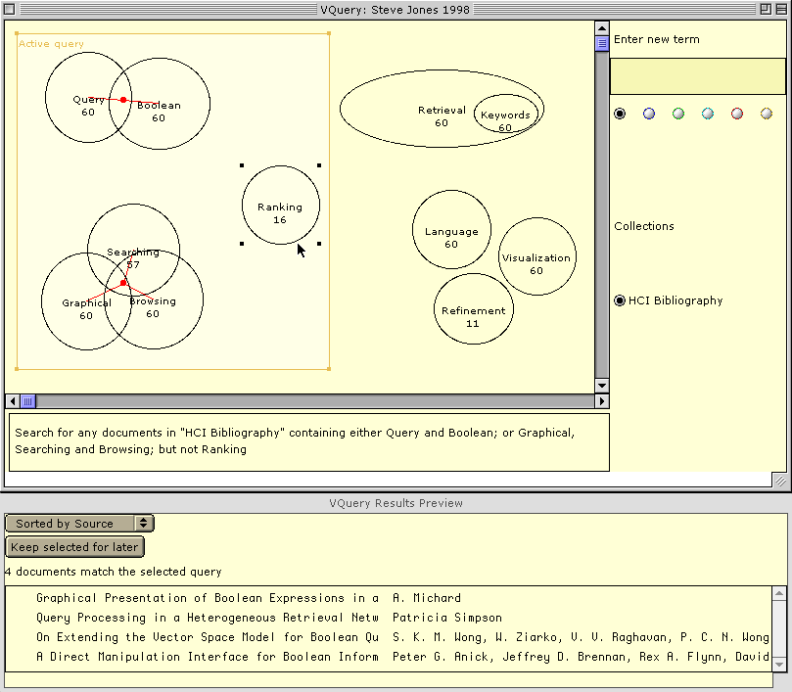
Direct Manipulation: VQUERY
Steve Jones, A Graphical User Interface for Boolean Query Specification, IJDL, 2(2-3), 1999

Slide 7
Natural Language Queries
Typed
Well formed questions (“QA”) or “keywords”
Hard to use on wearable devices
Spoken
Useful for telephone and hands-free applications
Reasonably accurate with limited vocabulary
Handwritten / gestural
Reasonably accurate if a “shorthand” is used
Notes:
13

Slide 8
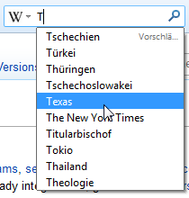
Query Suggestion
Predict what the user might type next
Learned from behavior of many users
Can be customized to a user or group
Helps w/typos, limited vocabulary, …
Provides a basis for auto-completion
Particularly useful in difficult input settings

Slide 9
Agenda
Query formulation
Selection part 1: Snippets
Selection part 2: Result sets
Examination
Notes:
2

