Slide 1
Evidence from Content
INST 734
Module 2
Doug Oard
Notes:
1

Slide 2
Agenda
Character sets
Terms as units of meaning
Boolean retrieval
Building an index
Notes:
2

Slide 3
An “Inverted Index”
Term Index
Term
Doc 1
Doc 3
Postings
Doc 2
Doc 4
Doc 5
Doc 6
Doc 7
Doc 8
AI
aid
0
0
0
1
0
0
0
1
4, 8
A
AL
all
0
1
0
1
0
1
0
0
2, 4, 6
BA
back
1
0
1
0
0
0
1
0
1, 3, 7
B
BR
brown
1
0
1
0
1
0
1
0
1, 3, 5, 7
C
come
0
1
0
1
0
1
0
1
2, 4, 6, 8
D
dog
0
0
1
0
1
0
0
0
3, 5
F
fox
0
0
1
0
1
0
1
0
3, 5, 7
G
good
0
1
0
1
0
1
0
1
2, 4, 6, 8
J
jump
0
0
1
0
0
0
0
0
3
L
lazy
1
0
1
0
1
0
1
0
1, 3, 5, 7
M
men
0
1
0
1
0
0
0
1
2, 4, 8
N
now
0
1
0
0
0
1
0
1
2, 6, 8
O
over
1
0
1
0
1
0
1
1
1, 3, 5, 7, 8
P
party
0
0
0
0
0
1
0
1
6, 8
Q
quick
1
0
1
0
0
0
0
0
1, 3
TH
their
1
0
0
0
1
0
1
0
1, 5, 7
T
TI
time
0
1
0
1
0
1
0
0
2, 4, 6
Notes:
15

Slide 4
Deconstructing the Inverted Index
The term Index
Postings File
aid
4, 8
all
2, 4, 6
back
1, 3, 7
brown
1, 3, 5, 7
come
2, 4, 6, 8
dog
3, 5
fox
3, 5, 7
good
2, 4, 6, 8
jump
3
lazy
1, 3, 5, 7
men
2, 4, 8
now
2, 6, 8
over
1, 3, 5, 7, 8
party
6, 8
quick
1, 3
their
1, 5, 7
time
2, 4, 6
Notes:
15

Slide 5
Computational Complexity
Time complexity: how long will it take:
  At index-creation time?
  At query time?
Space complexity: how much memory is needed:
  In RAM?
  On disk?

Slide 6
Linear Dictionary Lookup
Suppose we want to find the word “complex”
relaxation
astronomical
zebra
belligerent
subterfuge
daffodil
cadence
wingman
loiter
peace
arcade
respondent
complex
tax
kingdom
jambalaya
Worst-case time: proportional to number of dictionary entries
This algorithm is O(n)
(a “linear time” algorithm)
Found it!

Slide 7
With a Sorted Dictionary
Let’s try again, except this time with a sorted dictionary: find “complex”
arcade
astronomical
belligerent
cadence
complex
daffodil
jambalaya
kingdom
loiter
peace
relaxation
respondent
subterfuge
tax
wingman
zebra
Worst-case time: proportional to number of halvings (1, 2, 4, 8, … 1024, 2048, 4096, …)
We call this Binary “search”
  an “O(log n) time” algorithm
Found it!

Slide 8
“Asymptotic” Complexity

Slide 9
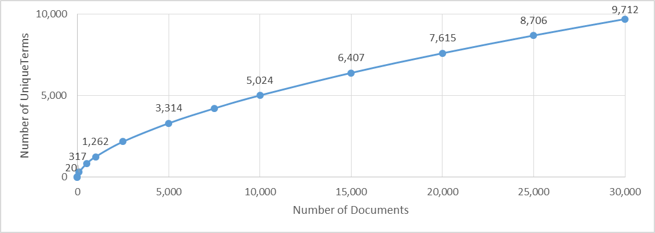
Term Index Size
Heap’s Law predicts vocabulary size
Term index will usually fits in RAM
  For any size collection
V is vocabulary size
n is number of documents)
K and β are constants
Notes:
22

Slide 10
Building a Term Index
Simplest solution is a single sorted array
  Fast lookup using binary search
  But sorting is expensive [it’s O(n * log n)]
    And adding one document means starting over
Tree structures allow easy insertion
  But the worst case lookup time is O(n)
Balanced trees provide the best of both
  Fast lookup [O (log n) and easy insertion [O(log n)]
  But they require 45% more disk space
Notes:
19

Slide 11
Postings File Size
Fairly compact for Boolean retrieval
  About 10% of the size of the documents
Not much larger for ranked retrieval
  Perhaps 20%
Enormous for proximity operators
  Sometimes larger than the documents!
Most postings must be stored on disk
Notes:
18

Slide 12
Large Postings Cause Slow Queries
Disks are 200,000 times slower than RAM!
  Typical RAM: Size: 2 GB, Access speed: 50 ns
  Typical Disk: Size: 1 TB, access speed: 10 ms
Smaller postings require fewer disk reads
Two strategies for reducing postings size:
  Stopword removal
  Index compression

Slide 13
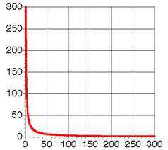
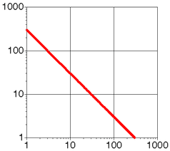
Zipf’s “Long Tail” Law
For many distributions, the nth most frequent element is related to its frequency by:
Only few words occur very frequently
  Very frequent words are rarely useful query terms
  Stopword removal yields faster query processing
or
f = frequency
r = rank
c = constant

Slide 14
Word Frequency in English
Frequency of 50 most common words in English
(sample of 19 million words)

Slide 15
Demonstrating Zipf’s Law
The following shows r*(f/n)*1000
r is the rank of word w in the sample
f is the frequency of word w in the sample
n is the total number of word occurrences in the sample

Slide 16
Index Compression
CPU’s are much faster than disks
  A disk can transfer 1,000 bytes in ~20 ms
  The CPU can do ~10 million instructions in that time
Compressing the postings file is a big win
  Trade decompression time for fewer disk reads
Key idea: reduce redundancy
  Trick 1: store relative offsets (some will be the same)
  Trick 2: use a near-optimal coding scheme
Notes:
23

Slide 17
Compression Example
Raw postings: 7 one-byte Doc-IDs (56 bits)
  37, 42, 43, 48, 97, 98, 243
Difference encoding (e.g., 42-37=5)
  37, 5, 1, 5, 49, 1, 145
Variable length binary Huffman code
  0:1, 10:5, 110:37, 1110:49, 1111: 145
Compressed postings (17 bits; 30% of raw)
  11010010111001111

Slide 18
Summary
Slow indexing yields fast query processing
  Key fact: most terms don’t appear in most documents
We use extra disk space to save query time
  Index space is in addition to document space
  Time and space complexity must be balanced
Disk reads are the critical resource
  This makes index compression a big win
Notes:
25

