Slide 1
The Future of IR
INST 734
Module 14
Doug Oard
Notes:
1

Slide 2
Agenda
Search among secrets
Preparing for the final exam

Slide 3
Sensitive Content
Privacy-sensitive personal interactions
  Phone, email, SMS, …
Legally protected information
  Doctor-Patient, Attorney-Client, Trade secret, …
National security

Slide 4
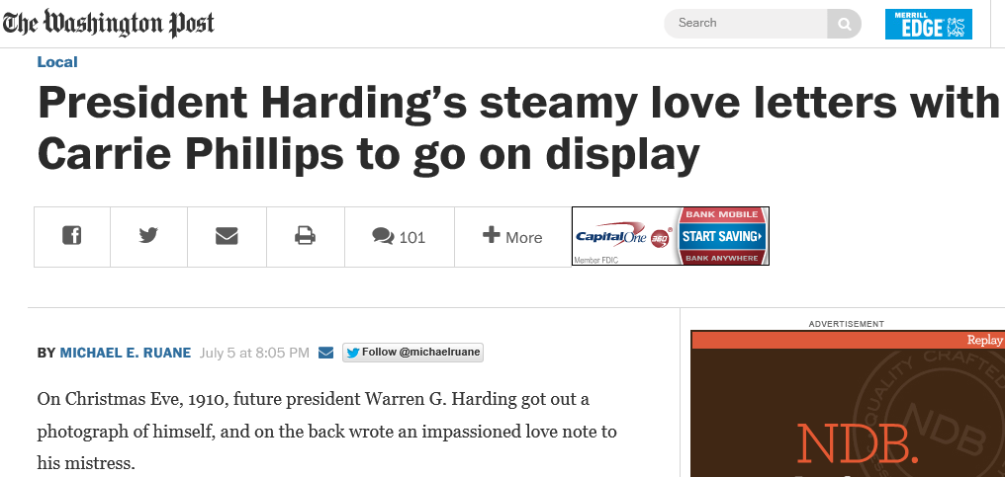
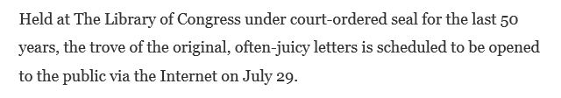
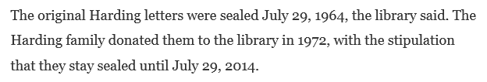

Slide 5
Open Government
“Information maintained by the Federal Government is a national asset. My Administration will take appropriate action, consistent with law and policy, to disclose information rapidly in forms that the public can readily find and use.”
Presidential Memorandum, January 21, 2009

Slide 6
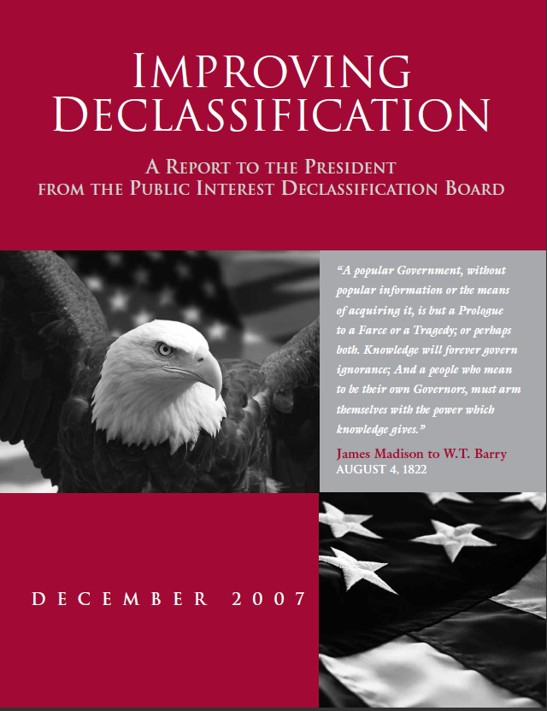
ISSUE NO. 2:
Prioritizing the Declassification Review of Historically Significant Information.
There is no satisfactory means at present of identifying historically significant information within the vast body of information that is being reviewed and declassified. Accordingly, no priority is given to the declassification and release to the public of such information.

Slide 7
Value Estimation
Evidence for scholarly interest
  Scholar-specified criteria
  Scholarly literature
  FOIA and Mandatory Declassification requests
    Both the requests and the requested materials
Evidence for gaps in the scholarly record
  Passage-level novelty
  Contradiction

Slide 8
Releasability Estimation
Declassification guidance
  Content
  Classification markings
Evidence from relationships
  Decisions on other versions of the same document
  Decisions on quoted content
  Decisions on similar documents

Slide 9
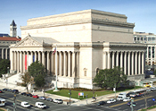
E-Discovery
Clinton
White House
search request
Tobacco Policy
32 million emails
~~~~~~~~~~~~~~~~~~~~~~~~~~~~~~~~~~~~~~~~
~~~~~~~~~~~~~~~~~~~~~~~~~~~~~~~~~~~~~~~~
80,000
National Archives
hired 25 persons
for 6 months …
~~~~~~~~~~~~~~~~~~~~~~~~~~~~~~~~~~~~~~~~
200,000
Notes:
9

Slide 10
TREC Legal Track Batch Privilege Review

Slide 11
Different Errors Have Different Costs
Incorrect withholding results in foregone value
Incorrect disclosure can be the greater disaster
Result: we withhold collections because we lack sufficient confidence that we can prevent:
  Potentially harmful disclosure of items, or of specific types of elements in those items
  Potentially harmful inferences at the collection, item, or element level

Slide 12
FOIA Guidance
“[identify the subject(s) or record(s) as clearly and specifically as possible -- for example, all previously released National Intelligence Estimates (NIEs) on the former Soviet Union's space program].”
http://www.foia.cia.gov/sample_request_letter.asp

Slide 13
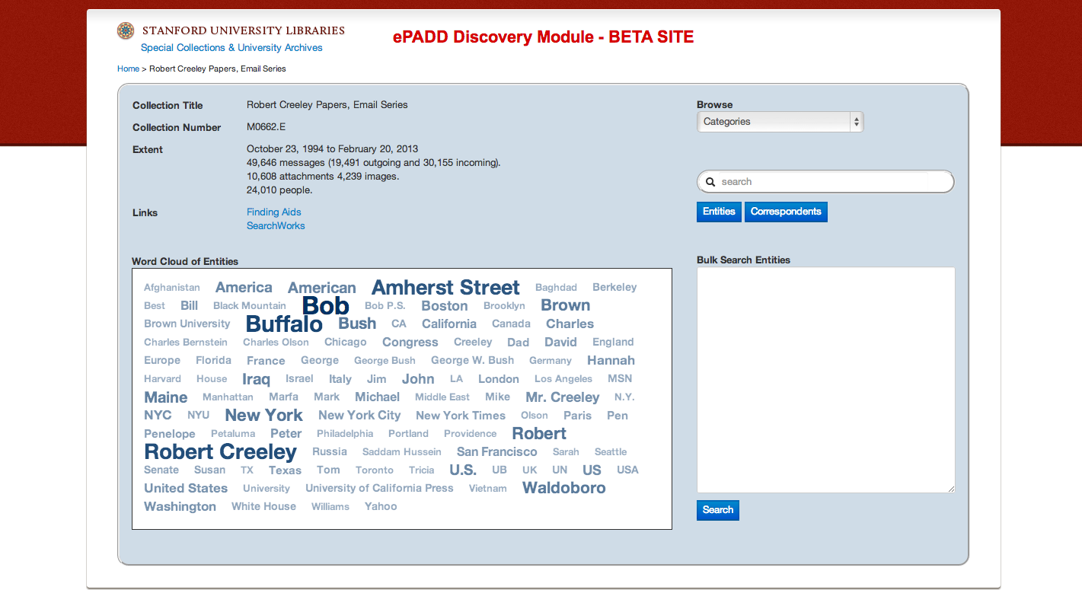
ePADD Collection Overview
Sudheendra Hangal, Providing Access to Historical Email Archives for Historical Research,
Personal Digital Archiving, 2013

Slide 14
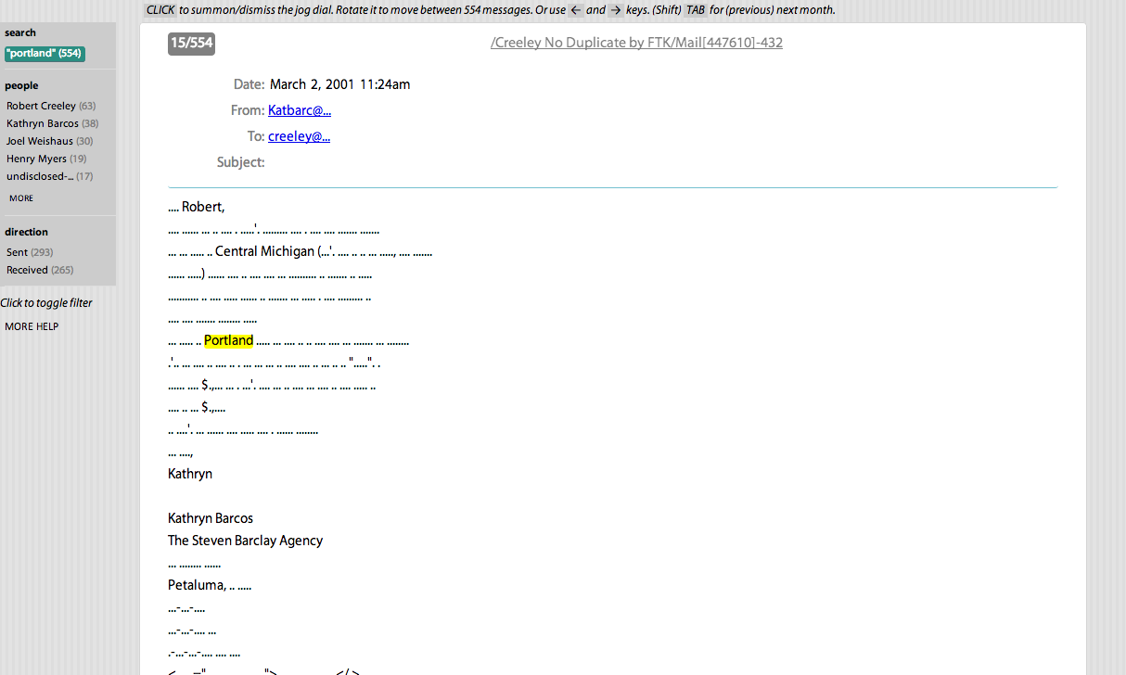
ePADD Partial Message View

Slide 15
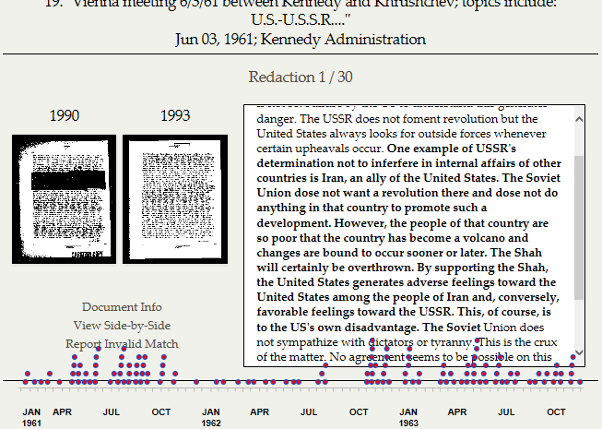
Rush, The Redaction Archive, 2013 http://declassification-engine.org/redactions/#/

Slide 16
What Needs to be Withheld?
Some specific items
  e.g., privileged documents in e-discovery
Some specific types of elements
  e.g., PII in medical records
Some types of inference
  e.g., in declassification
The location of the last copy
  If your goal is to prevent authorized destruction

Slide 17
Agenda
Search among secrets
Preparing for the final exam

