Slide 1
Image and Video Retrieval
INST 734
Doug Oard
Module 13
Notes:
1

Slide 2
Agenda
Image retrieval
Video retrieval
Multimedia retrieval
Notes:
2

Slide 3
Multimedia
A set of time-synchronized modalities
Video
Images, object motion, camera motion, scenes
Audio
Speech, music, other sounds
Text
Closed captioning, on-screen captions, signs, …
Notes:
5

Slide 4
Multimedia Genres
Television programs
News, sports, documentary, talk show, …
Movies
Drama, comedy, mystery, …
Meeting records
Conference, video teleconference, …
Others
Lifelogging, surveillance cameras, …
Notes:
6

Slide 5
Story Segmentation
Video often lacks easily detected boundaries
Between programs, news stories, etc.
Accurate segmentation improves utility
Too large hurts effectiveness, to small is unnatural
Multiple segmentation cues are available
Genre shift in shot-to-shot structure
Vocabulary shift in closed captions
Intrusive on-screen text
Musical segues
Notes:
13

Slide 6
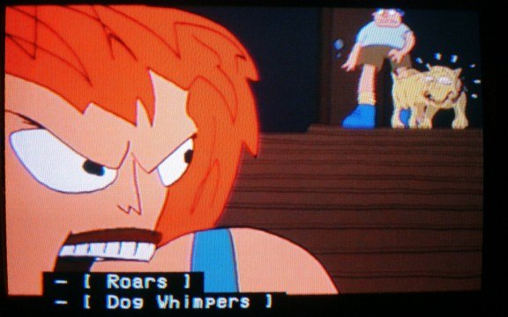
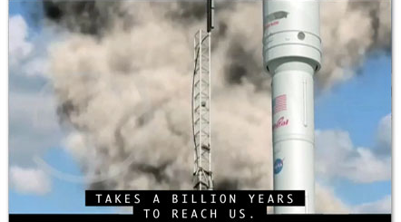
Closed Captions
Designed for hearing-impaired viewers
Pre-processed, live stenography, automatic
Speech content, speaker id, non-speech audio
Complementary to speech recognition
Each contains different types of errors
Each provides unique information
Weakly synchronized with the video
Notes:
14

Slide 8
On-Screen Captions
Useful
Speaker names, event names, program titles, …
Challenging
Low resolution, variable background
Possible
Absolutely stable over multiple frames
Standard locations and orientations
Notes:
16

Slide 9
Identity-Based Retrieval
Face recognition and speaker identification
Both exploit information that is usually present
On-screen captions provide useful cues
Confounded by OCR errors and varied spelling
Closed captions and speech retrieval help too
Announcers often introduce speakers before cuts
Notes:
19

Slide 10
Summary
Multimedia retrieval builds on all we know
Controlled vocabulary retrieval & social filtering
Text, image, speech and music retrieval
New sources of evidence are added
Video structure, closed & on-screen captions
Cross-modal alignment adds new possibilities
One modality can make another more informative
One modality can make another more precise
Notes:
20

