Slide 1
Image and Video Retrieval
INST 734
Doug Oard
Module 13
Notes:
1

Slide 2
Agenda
Image retrieval
Video retrieval
Multimedia retrieval
Notes:
2

Slide 3
Video Structures
Image structure
  Absolute positioning, relative positioning
Object motion
  Translation, rotation
Camera motion
  Pan, zoom, perspective change
Shot transitions
  Cut, fade, dissolve, …
Notes:
7

Slide 4
Shot Boundary Detection
Create a color histogram for each image
Segment at discontinuities (cuts)
  Cuts are easy, other transitions are also detectable
Cluster representative histograms for each shot
  Identifies cuts back to a prior shot
Build a time-labeled transition graph
Notes:
10

Slide 5
Shot Classification
Shot-to-shot structure correlates with genre
  Reflects accepted editorial conventions
Some substructures are informative
  Frequent cuts to and from announcers
  Periodic cuts between talk show participants
  Wide-narrow cuts in sports programming
Simple image features can reinforce this
  Head-and-shoulders, object size, …
Notes:
11

Slide 6
Object Motion Detection
Hypothesize objects as in image retrieval
  Segment based on color and texture
Examine frame-to-frame pixel changes
Classify motion
  Translation
    Linear transforms model unaccelerated motion
  Rotation
    Creation & destruction, elongation & compression
  Merge or split
Notes:
8

Slide 7
Camera Motion Detection
Do global frame-to-frame pixel analysis
Classify the resulting patterns
  Central tendency -> zoom out
  Balanced exterior destruction -> zoom in
  Selective exterior destruction -> pan
  Coupled rotation and translation -> perspective
Notes:
9

Slide 8
Some Concept Detectors
Outdoor
  Road->Cul-de-Sac
Vehicle
  Airplane->Airplane Flying->Airplane Landing
Person
  Politicians->Tony Blair
  Person_Using_ATM
Election_Campaign
  Election_Campaign_Greeting
Animal
  Arthropod->Crustacean->Lobster
http://www-nlpir.nist.gov/projects/tv2014/tv2014.html

Slide 9
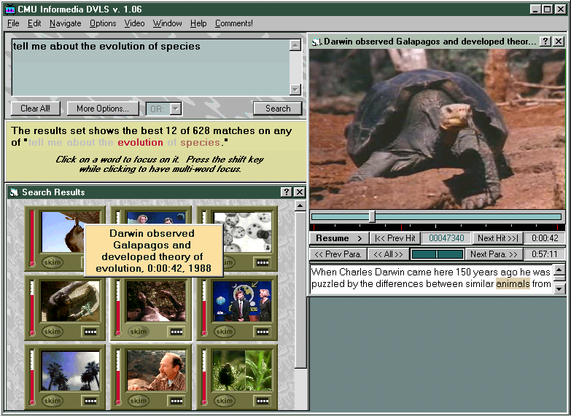

Slide 10
Key Frame Extraction
First frame of a shot is easy to select
  But it may not be the best choice
Genre-specific cues may be helpful
  Minimum optical flow for director’s emphasis
  Face detection for interviews
  Presence of on-screen captions
This may produce too many frames
  Color histogram clusters can reveal duplicates
Notes:
22

Slide 11
Full Motion Extracts
Extracted shots, joined by cuts
  The technique used in movie advertisements
Conveys more information using motion
  Optionally aligned with extracted sound as well
Hard to build a coherent extract
  Movie ads are constructed by hand
Notes:
27

Slide 12
“Salient Stills” Abstractive Summary
Notes:
24

Slide 13
Agenda
Image retrieval
Video retrieval
Multimedia retrieval
Notes:
2

