Slide 1
Image and Video Retrieval
INST 734
Doug Oard
Module 13
Notes:
1

Slide 2
Agenda
Image retrieval
Video retrieval
Multimedia retrieval
Notes:
2

Slide 3
Image Retrieval Applications
Retrospective retrieval applications
  Manage stock photo archives
  Index images on the Web
  Organize materials for art history courses
Information filtering applications
  Earth resources satellite image triage
  News bureau wirephoto routing
  Law enforcement at immigration facilities

Slide 4
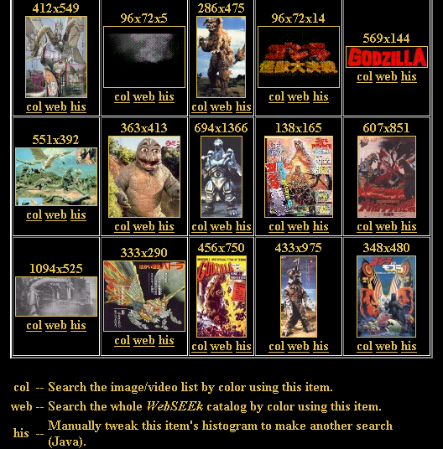
http://www.ee.columbia.edu/ln/dvmm/researchProjects/MultimediaIndexing/WebSEEK/WebSEEK.htm

Slide 5
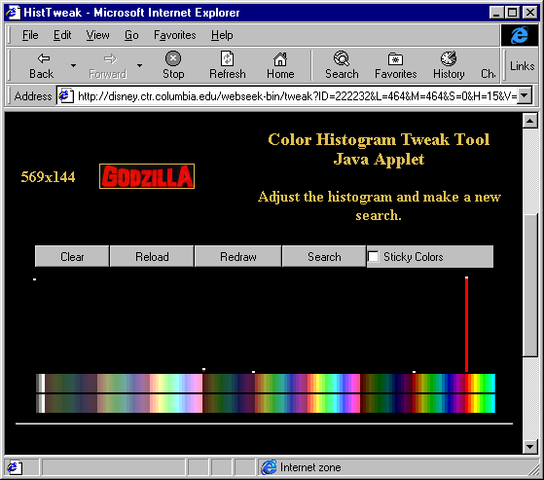
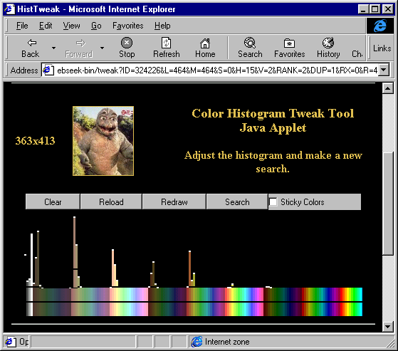
Color Histogram Example

Slide 6
Color Histogram Matching
Represent image as a rectangular pixel raster
  e.g., 1024 columns and 768 rows
Represent each pixel as a quantized color
  e.g., 256 colors ranging from red through violet
Count the number of pixels in each color bin
  Produces vector representations
Compute vector similarity
  e.g., normalized inner product

Slide 7
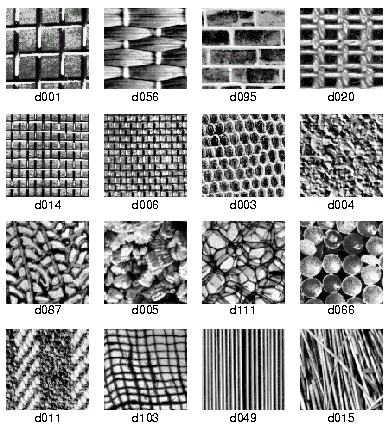
Texture Test Patterns

Slide 8
Texture Matching
Texture characterizes small-scale regularity
  Color describes pixels, texture describes regions
Described by several types of features
  e.g., smoothness, periodicity, directionality
Match region size with image characteristics
  Computed using filter banks, Gabor wavelets, …
Perform weighted vector space matching
  Usually in combination with a color histogram

Slide 9
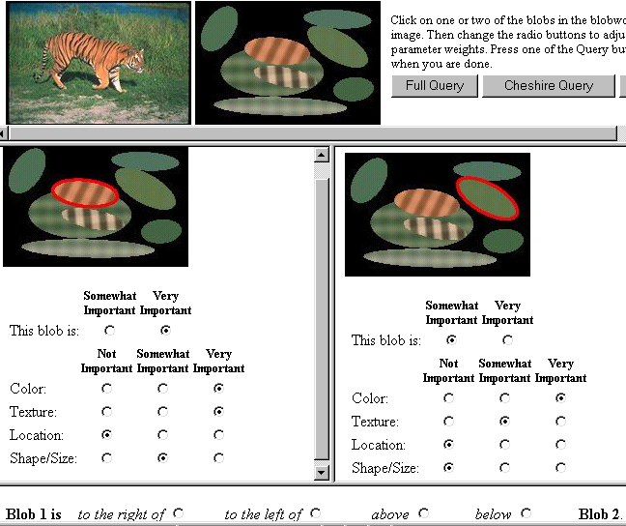
Berkeley Blobworld

Slide 10
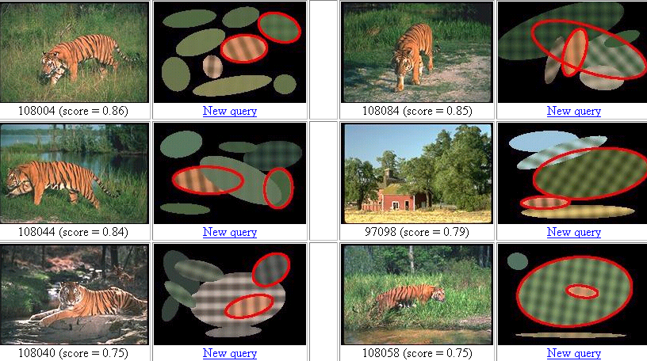
Berkeley Blobworld

Slide 11
Image Segmentation
Global techniques alone yield low precision
  Color & texture characterize objects, not images
Segment at color and texture discontinuities
  Like “flood fill” in Photoshop
Represent size shape & orientation of objects
  e.g., Berkeley’s “Blobworld” uses ellipses
Represent relative positions of objects
  e.g., angles between lines joining the centers
Perform rotation- and scale-invariant matching

Slide 12
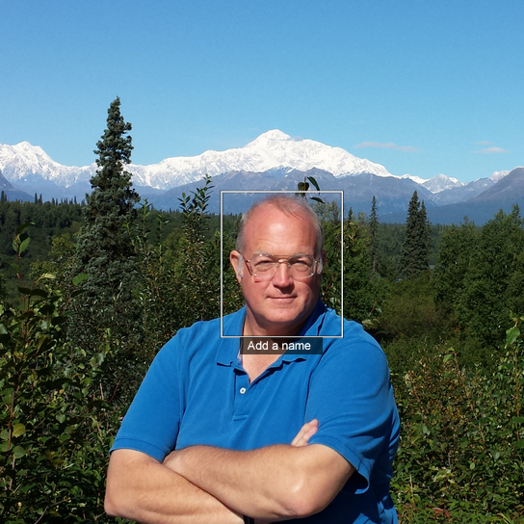
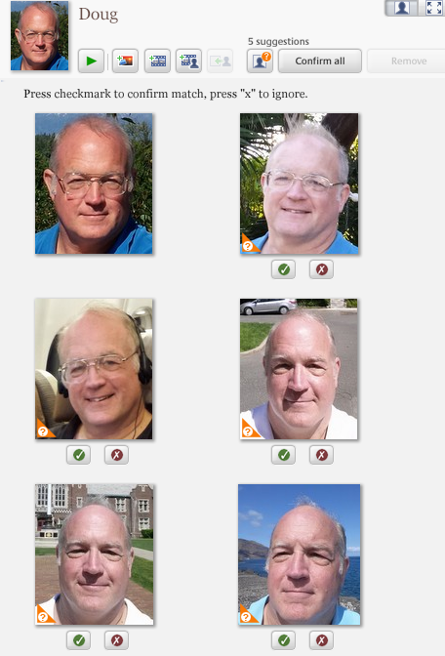
Picasa Face Recognition

Slide 13
Face Recognition
Segment from images based on shape
  Head, shoulders, and hair provide strong cues
Select the most directly frontal view
  If video, select best frame (e.g., based on eyes+cheeks)
Construct feature vectors
  “Eigenface” produces 16-element vectors
Perform similarity matching
Notes:
18

Slide 14
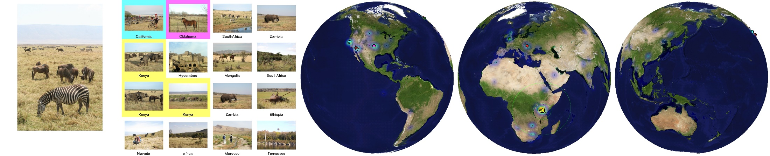
Image Georeferencing
http://graphics.cs.cmu.edu/projects/im2gps/

Slide 15
Image Retrieval Summary
Query
  Keywords, example, sketch
Matching
  Caption text
  Segmentation
  Similarity (color, texture, shape)
  Spatial arrangement (orientation, position)
  Specialized techniques (e.g., face recognition)
Selection
  Thumbnails

Slide 16
Agenda
Image retrieval
Video retrieval
Multimedia retrieval
Notes:
2

