Slide 1
Speech and Music Retrieval
INST 734
Doug Oard
Module 12

Slide 2
Agenda
Music retrieval
Speech retrieval
Interactive speech retrieval

Slide 3
Comparison with Text Retrieval
Detection is harder
  Speech recognition errors
Selection is harder
  Date and time alone are not very informative
Examination is harder
  Linear medium is hard to browse
  Arbitrary segments produce unnatural breaks

Slide 4
Competing Demands on the Interface
Query must result in a manageable set
  But users prefer simple query interfaces
Selection interface must show several segments
  Representations must be compact, but informative
Rapid examination should be possible
  But complete access to the recordings is desirable

Slide 5
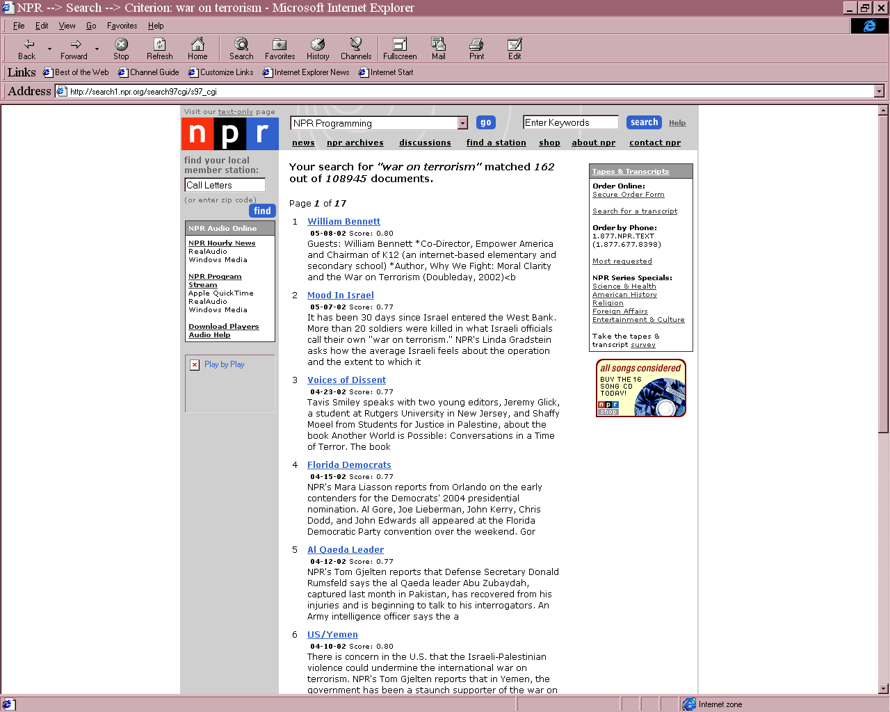
NPR Online

Slide 6
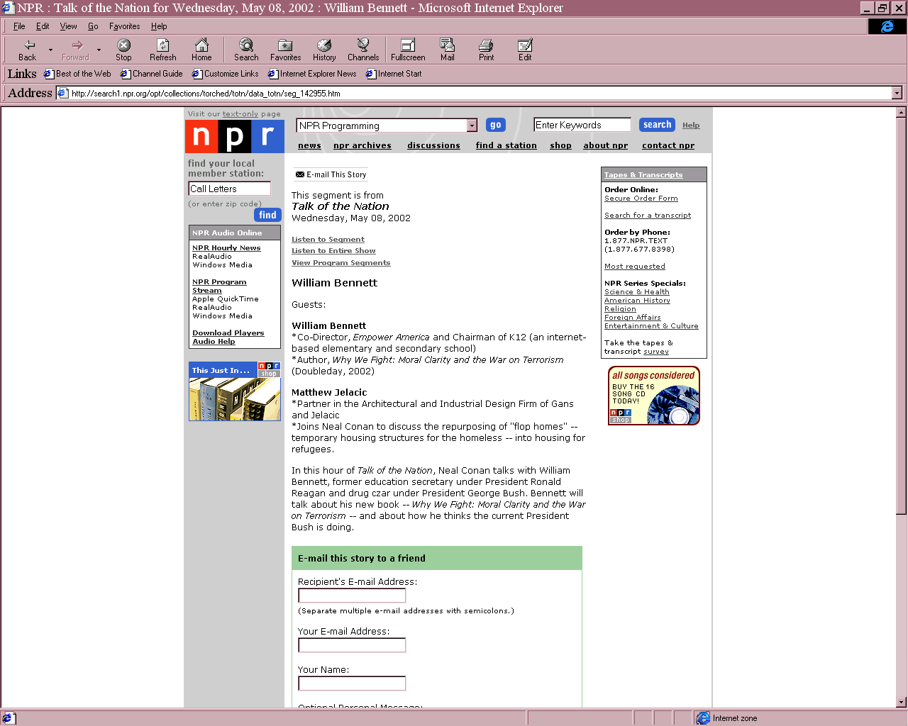

Slide 7
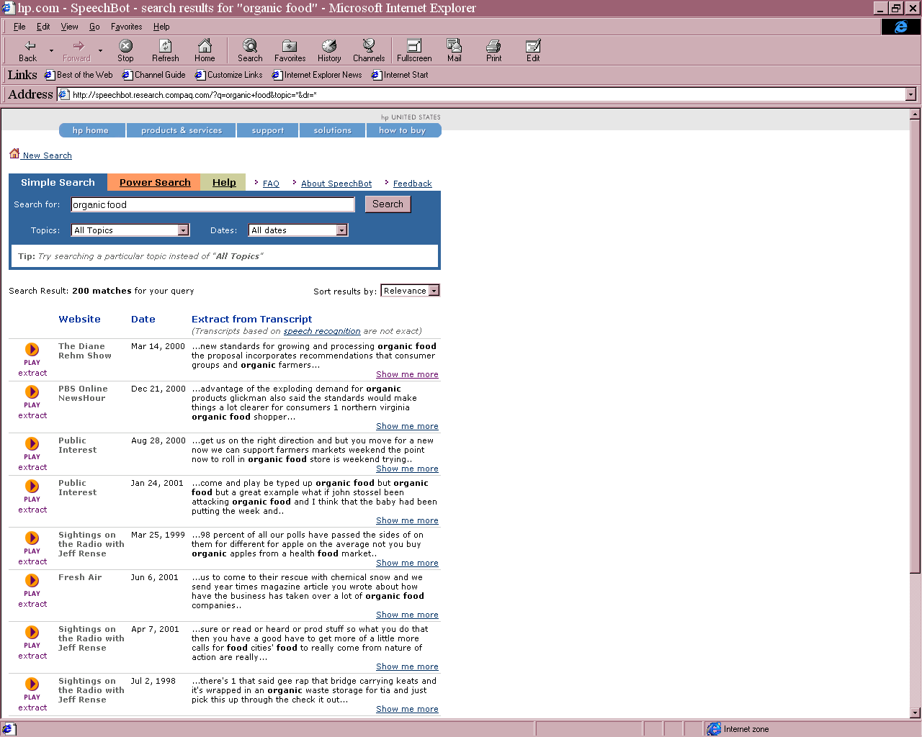
SpeechBot

Slide 8
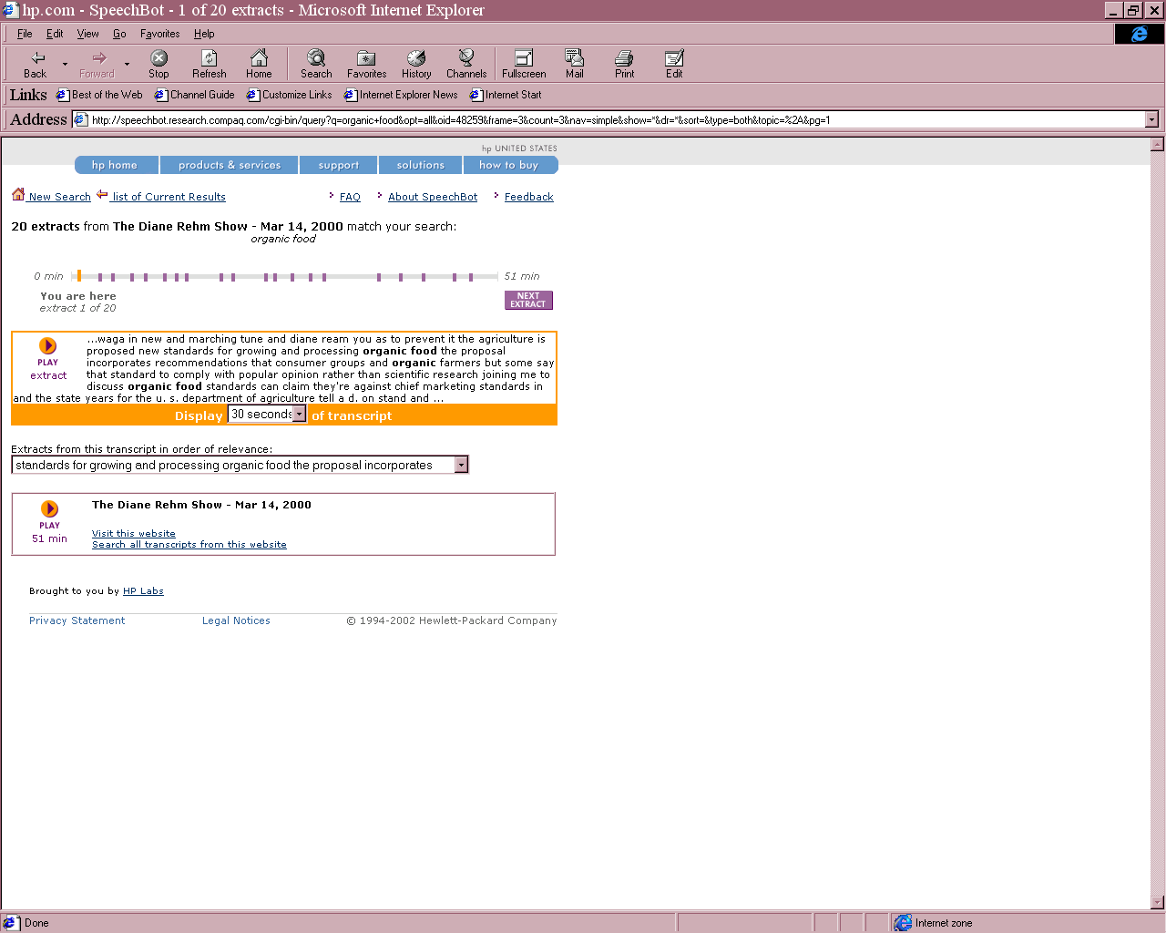

Slide 9
Criterion-Attribute Framework
Relevance Criteria | Associated Attributes
 | NPR Online | SpeechBot
Topicality Story Type Authority | Story title Brief summary Audio Detailed summary Speaker name Audio Detailed summary Short summary Story title Program title Speaker name Speaker’s affiliation | Detailed summary Brief summary Audio Highlighted terms Audio Program title
Notes:
Date is often associated with query formulation. That is searchers often wanted to limit their search by date.
Program title – Users who were familiar with some program names were often able to tell the ‘type’ of a story by looking at the program title.

Slide 10
Detectable Speech Features
Content
  Phonemes, one-best word recognition, lattice
Identity
  Speaker identification, speaker segmentation
Language
  Language, dialect, accent
Other measurable parameters
  Time, duration, channel, environment

Slide 11
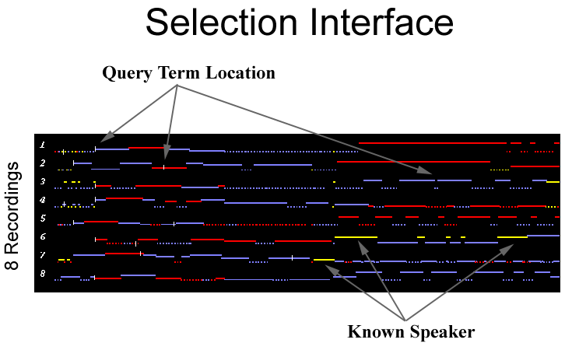
Visualizing Turn-Taking

Slide 12
Human History
Oral Tradition
Writing
Human Future
Writing and Speech

