Slide 1
Speech and Music Retrieval
INST 734
Doug Oard
Module 12

Slide 2
Agenda
Music retrieval
Speech retrieval
Interactive speech retrieval

Slide 3
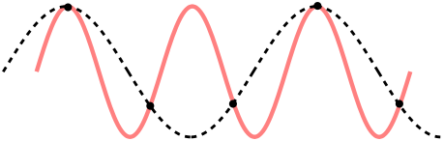
Digitizing Speech
Sampling rate
Sample accuracy

Slide 4
Basic Audio Coding
Sample at twice the highest frequency
  8 bits or 16 bits per sample
Speech (0-4 kHz) requires 8 kB/s
  Standard telephone channel (1-byte samples)
Music (0-22 kHz) requires 172 kB/s
  Standard for CD-quality audio (2-byte samples)
Sampler

Slide 5
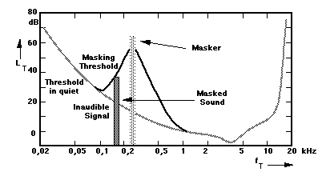
Music Compression
Opportunity:
  The human ear cannot hear all frequencies at once
Approach:
  Don’t represent “masked” frequencies
Standard: MPEG-1 Layer 3 (.mp3)

Slide 6
Cover Song Retrieval Example
“Three Blind Mice” is indexed as:
  *DDUDDUDRDUDRD
    * represents the first note
    D represents a descending pitch (U is ascending)
    R represents a repetition (detectable split, same pitch)
My singing produces:
  *DDUDDUDRRUDRR
Approximate string match finds 2 substitutions

Slide 7
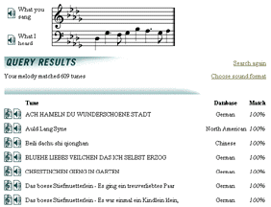
New Zealand Melody Index

Slide 8
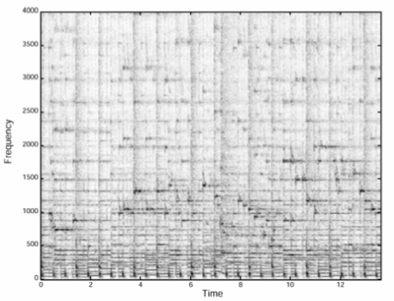
Shazam
Spectrogram
  Time vs. frequency plot of intensity
Peak filter
  Local maxima of intensity
Difference coding
  Rate of frequency change over time
Convolution
  Sliding-window match

Slide 9
Agenda
Music retrieval
Speech retrieval
Interactive speech retrieval

