Slide 1
Cross-Language Retrieval
INST 734
Module 11
Doug Oard
Notes:
1

Slide 2
Agenda
CLIR
Dictionary-Based CLIR
Corpus-Based CLIR
Interactive CLIR

Slide 3
Sources of Translation Knowledge
Lexicons
Phrase books, bilingual dictionaries, …
Similarity
Similar pronunciation
Large text collections (“corpora”)
Translations (“parallel”)
Similar topics (“comparable”)
People
Notes:
Fundamentally, there are four sources of knowledge that we can rely on when teaching a machine to translate. Perhaps the simplest is some form of dictionary. Dictionaries are very useful, but it is hard for machines to learn to select the right translation using a dictionary alone because the machine has no real sense of context. Large collections of text can provide that context, however, and in recent years they have proven to be very useful as a basis for building “machine translation” systems. The best results have been obtained using very large collections of translated documents, which we call a “parallel text collection”. The next two slides illustrate how that is done.

Slide 4
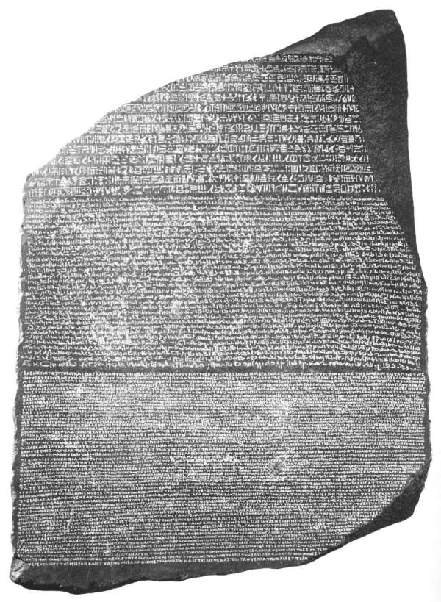
Hieroglyphic
Egyptian Demotic
Greek

Slide 5
Some Modern Rosetta Stones
News
Hong Kong News (Chinese-English)
Government
Canadian Hansards (French-English)
Europarl (21 EU languages)
UN Treaties (Russian, English, Arabic, …)
Religion
Bible, Koran, Book of Mormon

Slide 6
Word-Level Alignment
English
Diverging opinions about planned tax reform
Unterschiedliche Meinungen zur geplanten Steuerreform
German
English
Madam President , I had asked the administration …
Señora Presidenta, había pedido a la administración del Parlamento …
Spanish

Slide 7
Statistical Translation Model
Induce translation model
From word-aligned bilingual text
Count the alignments, and smooth
Example:
where,
p(探测|survey) = 0.4
p(试探|survey) = 0.3
p(测量|survey) = 0.25
p(样品|survey) = 0.05

Slide 8
Using Multiple Translations
Probabilistic Structured Queries (PSQ)
Multiple translations
Each with an esimates translation probability
TF and DF of query term e are computed using TF and DF of its translations:

Slide 9
Retrieval Effectiveness
CLEF French
Wang & Oard, Matching Meaning for Cross-Language Information Retrieval, IP&M, 2012

Slide 10
Exploiting Comparable Corpora
Blind relevance feedback
Any CLIR technique + unlinked comparable corpus
Lexicon enrichment
Any lexicon + unlinked comparable corpus
“Dual-space” techniques
Document-linked comparable corpus

Slide 11
Lexicon Enrichment with Comparable Corpora
… Cross-Language Evaluation Forum …
?
… Solto Extunifoc Tanixul Knadu …

Slide 12
Lexicon Enrichment
Use a bilingual lexicon to align “context regions”
Regions with high coincidence of known translations
Pair unknown terms with unmatched terms
Unknown: language A, not in the lexicon
Unmatched: language B, not covered by translation
Treat the most surprising pairs as new translations
Notes:
42

Slide 13
“Interlingual” Retrieval
Chinese
Query
Terms
Query
Translation
English
Document
Terms
Document
Translation
Interlingual
Retrieval
3: 0.91
4: 0.57
5: 0.36

Slide 14
Dual Space Techniques:
Learning From Document Pairs
English Terms
Spanish Terms
E1 E2 E3 E4 E5 S1 S2 S3 S4
Doc 1
4
2
2
1
Doc 2
8
4
4
2
Doc 3
2
2
2
1
Doc 4
2
1
2
1
Doc 5
4
1
2
1
Notes:
34

Slide 15
Generalized Vector Space Model
“Term space” of each language is different
Document links define a common “document space”
Describe documents based on the corpus
Vector of similarities to each corpus document
Compute cosine similarity in document space
Very effective in a within-domain evaluation
Notes:
36

Slide 16
Latent Semantic Indexing
Term-based similarity captures noise with signal
Term choice variation, word sense ambiguity
Signal-preserving dimensionality reduction
Conflates terms with similar usage patterns
Reduces term choice effect, even across languages
Computationally expensive

Slide 17
Agenda
CLIR
Dictionary-Based CLIR
Corpus-Based CLIR
Interactive CLIR

