Slide 1
Cross-Language Retrieval
INST 734
Module 11
Doug Oard
Notes:
1

Slide 2
Agenda
CLIR
Dictionary-Based CLIR
Corpus-Based CLIR
Interactive CLIR

Slide 3
oil
petroleum
probe
survey
take samples
No
translation!
Which
translation?
probe
survey
take samples
cymbidium
goeringii
Wrong
segmentation
oil
petroleum
restrain

Slide 4
Key Questions
What to translate?
Phrases, words, stems, character n-grams, …
Where to get translation knowledge?
Dictionary or corpus
How to use it?

Slide 5
Translation Resources
Bilingual term list
Pairs of translation-equivalent terms
Lexicon
Rich word list, for use by machines
Dictionary
Rich word list, for use by people
Thesaurus
Organized list of descriptors, for use by people
Ontology
Organization of knowledge, for use by machines
Notes:
22

Slide 6
BM-25
term frequency
document frequency
document length

Slide 7
Structured Queries
Unbalanced:
Overweights query terms that have many translations
Structured:
Deemphasizes query terms with any common translation
Implemented by the #syn operator in Indri

Slide 8
Query-Language Indexing Time

Slide 9
Four-Stage Backoff Translation
Document Stemming
Dictionary Stemming
Index Stemming
No No
Yes No
No Yes
Yes Yes
mangez
mangez
- eat
mangez
mange
mange
- eats
eat
mange
mangez
mange
- eat
mangez
mange
mangent
mange
- eat

Slide 10
Bilingual Query Expansion
query
Query
Language
Expansion
Query
Translation
Document
Language
Expansion
results
expanded
query-language
query
expanded
document-language
terms
source language
collection
target language
collection
Pre-translation expansion
Post-translation expansion

Slide 11
Query Expansion Effect
McNamee & Mayfield, Comparing Cross-Language Query Expansion Techniques by Degrading Translation Resources, SIGIR 2002

Slide 12
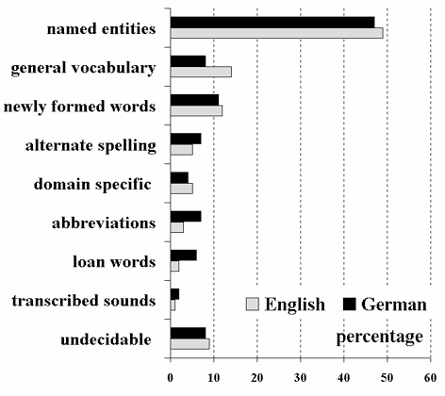
Out-of-Vocabulary (OOV) Terms

Slide 13
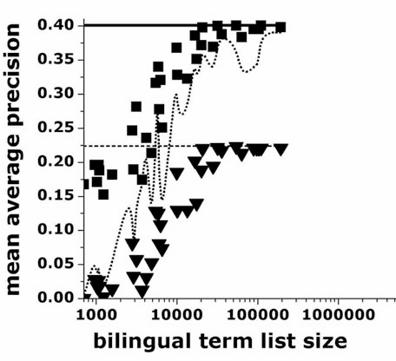
Named Entity Effect
Full Query
Named entities added
Named entities from term list
Named entities removed
English side of 35 bilingual term lists
33 CLEF 2000 TD queries
113K LA Times news stories
Demner-Fushman & Oard, The Effect of Bilingual Term List Size on Dictionary-Based Cross-Language Information Retrieval, HICSS 2003

Slide 14
Matching OOV Terms
Similarity
String
Comparison
English
Written
Form
Written
Form
French
Alphabetic
Transliteration

Slide 15
Matching OOV Terms
Similarity
Phonetic
Comparison
Spoken
Form
Spoken
Form
Phonetic
Transliteration
Pronunciation
Pronunciation
English
Written
Form
Written
Form
Chinese

Slide 16
Agenda
CLIR
Dictionary-Based CLIR
Corpus-Based CLIR
Interactive CLIR

