Slide 1
Cross-Language Retrieval
INST 734
Module 11
Doug Oard
Notes:
1

Slide 2
Agenda
CLIR
Dictionary-Based CLIR
Corpus-Based CLIR
Interactive CLIR

Slide 3
Source: Ethnologue (1999)
Source: International Monetary Fund (2014)
Internet Users
Web
Pages

Slide 4
Multilingual Information Access
Multilingual document
  Document containing more than one language
Multilingual collection
  Collection of documents in different languages
Multilingual IR system
  Can retrieve from a multilingual collection
Cross-language IR (CLIR) system
  Query in one language finds document in another
Notes:
5

Slide 5
Who needs Cross-Language IR?
Polyglots: users who can read >1 language
  Convenience: build a good query just once
  Capability: query in most fluent language
Monolingual users
  If translations can be provided
  If text is used to search for images, music, …
  If it suffices to know that a document exists
Notes:
3
2

Slide 6
One Approach:
Multilingual Thesaurus
Build a cross-cultural knowledge structure
  Build it from scratch
  Translate an existing thesaurus
  Merge monolingual thesauri
Assign descriptors to each content item
  By design, descriptors are “interlingual”
Create “lead-in vocabulary” in each language

Slide 7
Another Approach: Free-Text CLIR
Chinese
Term
Selection
Monolingual
Chinese
Retrieval
1: 0.72
2: 0.48
Language
Identification
Chinese
Query
Chinese
Term
Selection
English
Term
Selection
Cross-
Language
Retrieval
3: 0.91
4: 0.57
5: 0.36

Slide 8
Evidence for Language Identification
Metadata
  Included in HTTP and HTML
Word-scale features
  Which stopword list gets the most hits?
Subword features
  Character n-gram statistics
Notes:
24

Slide 9
Merging Ranked Lists
1 EN3145 .22
2 EN3052 .21
3 EN4091 .17
…
1000 DE4221 .04
1 DE4062 .52
2 DE2156 .37
3 DE3112 .31
…
1000 DE2159 .02
Types of Evidence
  Rank
  Score
Evidence Combination
  Weighted round robin
  Score combination
Parameter tuning
  Condition-based
  Query-based
1 DE4062
2 EN3145
3 DE2156
…
1000 EN4201

Slide 10
Query-Language CLIR
Chinese Document
Collection
Translation
System
Results
select
examine
Retrieval
Engine
English
queries
English Document
Collection

Slide 11
Example
(Modular) Document Translation
Select a single query language
Translate every document into that language
Perform monolingual retrieval

Slide 12
Document-Language CLIR
Chinese Document
Collection
Chinese
documents
Retrieval
Engine
Results
Translation System
Chinese
queries
select
examine
English
queries

Slide 13
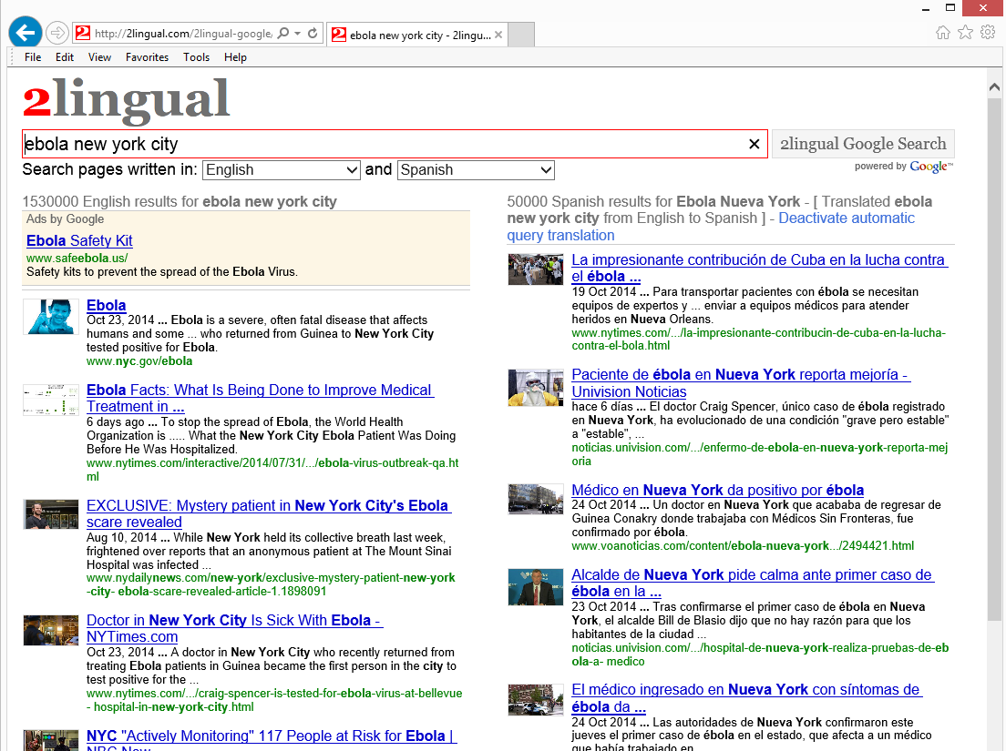

Slide 14
Which Approach to Use?
“Document translation” (query-language CLIR)
  Good choice when all queries are in one language
  Cached translations can support user interaction
“Query translation” (document-language CLIR)
  Good choice when all documents are in one language
  Commonly used for CLIR experiments
Notes:
23

Slide 15
Agenda
CLIR
Dictionary-Based CLIR
Corpus-Based CLIR
Interactive CLIR

